Slide 2
Unit
9
FESTIVALS AROUND THE WORLD
LESSON 6: SKILLS 2

Slide 3
OBJECTIVES
By the end of the lesson, students will be able to:
- listen for special information about a festival
- write an email to describe a festival

Slide 4
LESSON 6: SKILLS 2
WARM-UP
Bingo
Task 1: Look at the animal. Discuss the questions.
Task 2: Listen to Mark talking about how his family celebrates a festival. Check your answers.
Task 3: Listen again and decide if the statements are true or false.
LISTENING
Task 4: Think about a festival that your family usually celebrates. Fill in the blanks with your answers.
Task 5: Write an email of about 70 words to tell Mark about the festival.
WRITING
POST-LISTENING & WRITING
Task 6: Class gallery
CONSOLIDATION
Wrap-up
Home work

Slide 5
LESSON 6: SKILLS 2
WARM-UP
Bingo
Aims of the stage:
To waken up students’ interest
Notes:
- Each student gets a piece of paper, draws a table with 3 rows and 3 columns, then fills in the table with names of some festivals randomly.
- Teacher calls out the names of some festivals. Each time the teacher calls out a word, the students search for the right square on their paper and mark.
- The student who has 3 words highlighted in a row yells “Bingo” and wins.

Slide 6
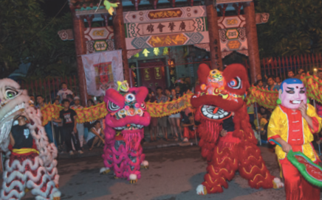
WARM-UP

Slide 7
LESSON 6: SKILLS 2
WARM-UP
Bingo
Task 1: Look at the animal. Discuss the questions.
Task 2: Listen to Mark talking about how his family celebrates a festival. Check your answers.
Task 3: Listen again and decide if the statements are true or false.
LISTENING

Slide 8
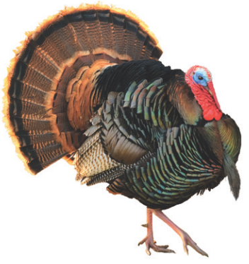
LISTENING
1
Look at the animal below. Discuss the following questions with a partner.
1. What is it?
2. What festival is it a part of?

Slide 9
LISTENING
2
Listen to Mark talking about how his family celebrates a festival. Check your answers.
1. What is it?
2. What festival is it a part of?
A turkey.
Thanksgiving.

Slide 10
LISTENING
3
Listen again and decide if the statements are true or false.
 | True | False
1. Only people from the USA celebrate Thanksgiving.
2. People celebrate it on the third Thursday of November.
3. Family members and friends usually gather to have a feast.
4. In his family, only adults prepare the feast.
5. Cornbread is one of the traditional dishes.
6. After the feast, they play board games.
✓
✓
✓
✓
✓
✓

Slide 11
LESSON 6: SKILLS 2
WARM-UP
Bingo
Task 1: Look at the animal. Discuss the questions.
Task 2: Listen to Mark talking about how his family celebrates a festival. Check your answers.
Task 3: Listen again and decide if the statements are true or false.
LISTENING
Task 4: Think about a festival that your family usually celebrates. Fill in the blanks with your answers.
Task 5: Write an email of about 70 words to tell Mark about the festival.
WRITING

Slide 12
WRITING
4
Think about a festival that your family usually celebrates. Fill in the blanks with your answers.
When do you celebrate it?
__________
What food does your family eat? __________
What festival is it?
__________
What activities does your family do?
__________
Do you like the festival? Why or why not?
__________

Slide 13
WRITING
5
Now write an email of about 70 words to tell Mark about the festival. Use the notes in 4.

Slide 14
POST-WRITING
CLASS GALLERY
Students can:
go and see other’s work
give comments to each other

Slide 15
CONSOLIDATION
1
WRAP-UP
In this lesson, we have learnt to:
- listen for special information about a festival
- write an email to describe a festival

Slide 16
CONSOLIDATION
2
HOMEWORK
Prepare for the next lesson: Looking back & Project
Rewrite the emails on your notebook.

Slide 17
Website: hoclieu.vn
Fanpage: facebook.com/www.tienganhglobalsuccess.vn/

