Slide 2
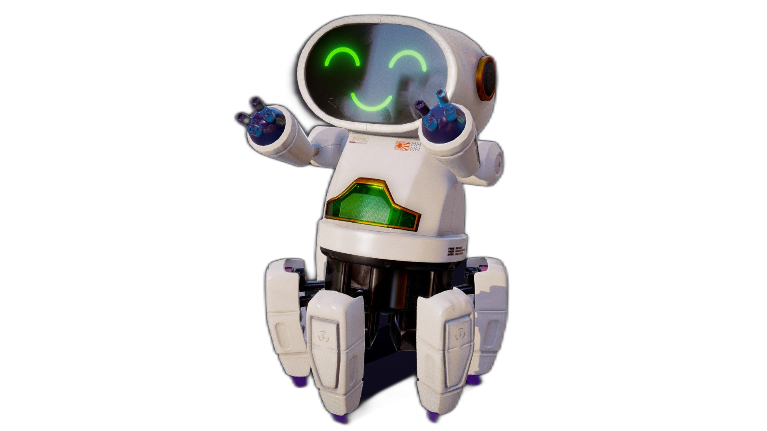
Unit
12
ROBOTS
LESSON 6: SKILLS 2

Slide 3
LESSON 5: SKILLS 1
LESSON 1: GETTING STARTED
WARM-UP
Brainstorming
Task 1: Listen and tick the phrases.
Task 2: True or False.
LISTENING
Task 3: Imagine and make notes.
Task 4: Write a paragraph.
WRITING
Wrap-up
Homework
CONSOLIDATION

Slide 4
WARM-UP
BRAINSTORMING

Slide 5
WARM-UP
Work in groups
Brainstorm all abilities that the robot can have.
The group having the most suitable answers is the winner.

Slide 6
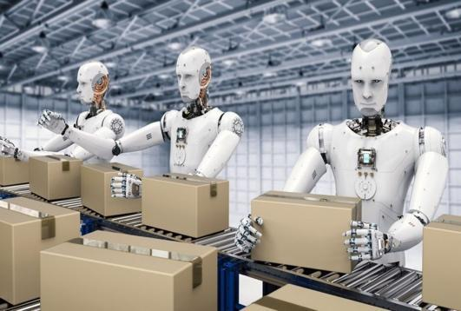
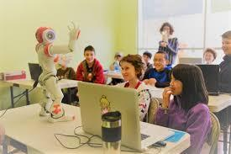
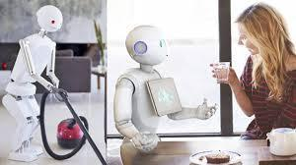
WARM-UP

Slide 7
WARM-UP

Slide 8
WARM-UP

Slide 9
LISTENING
Listen to the conversation between Khang and Dr Adams and tick () the phrases you hear.
- look after sick people

- understand what we say

- build the very high buildings

- teach many subjects

- move heavy things

Slide 10
LISTENING
Listen and tick True or False
 | T | F
1. Robots can’t do many things today.
2. Worker robots can build the very high buildings.
3. Teacher robots can teach on the internet.
4. Robots can talk to humans.
5. Robots can do everything like humans.






Slide 11
WRITING
Imagine a robot you would like to have. Make notes about it.
1. Name of your robot | ________________
2. Type of robot | ________________
3. Where it can work | ________________
4. What it can do for you | ________________
- Make notes on a robot you want to design
- Don’t have to write full sentences

Slide 12
WRITING
Now write a paragraph of 50-60 words about the robot you would like to have. Use the information in 3 to help you.
My robot’s name is ____________________.
It is a ________________________________. _____________________________________ _____________________________________ _____________________________________ _____________________________________

Slide 13
CONSOLIDATION
1
Wrap-up
What have we learnt in this lesson?
Listen for specific information about what a robot can do
Write a paragraph about the robot they want to have

Slide 14
CONSOLIDATION
2
Homework
- Rewrite the paragraph in the notebooks.
- Do exercises in the workbook.

Slide 15
Website: hoclieu.vn
Fanpage: facebook.com/www.tienganhglobalsuccess.vn/

