Slide 2
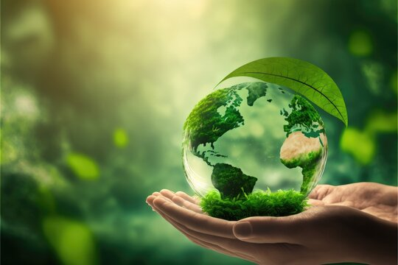
Unit
11
OUR GREENER WORLD
LESSON 7: LOOKING BACK AND PROJECT
1

Slide 3
LESSON 7: LOOKING BACK AND PROJECT
LESSON 1: GETTING STARTED
WARM-UP
Vocabulary brainstorming
VOCABULARY
Task 1: Add more words/ phrases to the word webs.
Task 2: Write “a/ an” or “the”.
Task 3: Write the correct form of the verb.
Task 4: Combine the sentences.
GRAMMAR
PROJECT
Creative ideas about reusing old things
CONSOLIDATION
Wrap-up
Homework

Slide 4
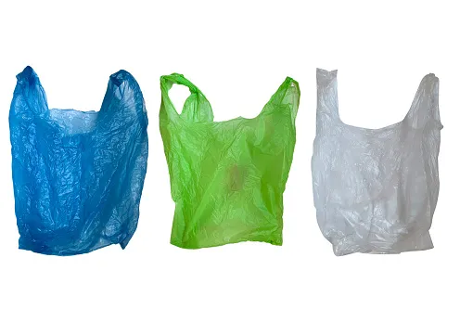
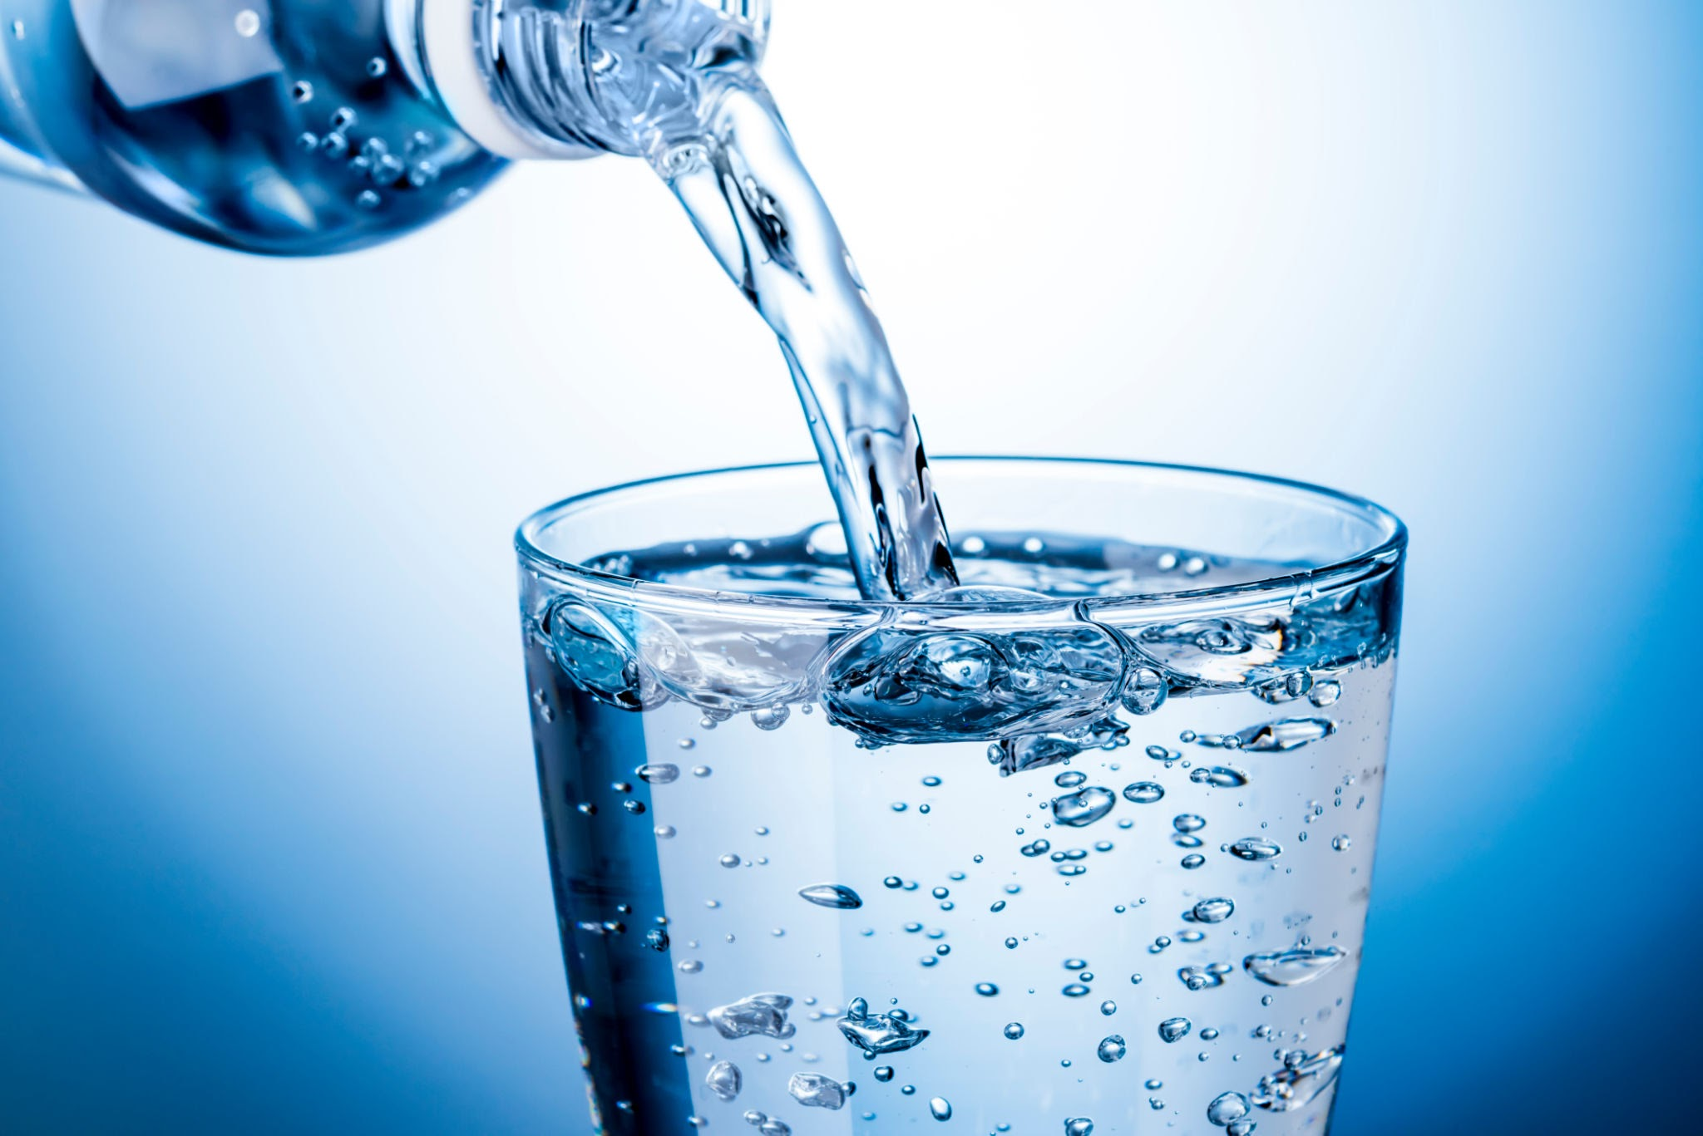
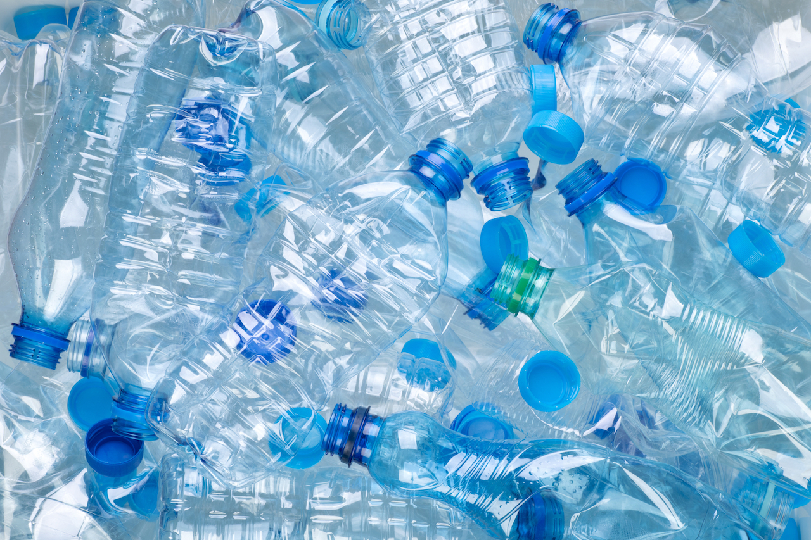
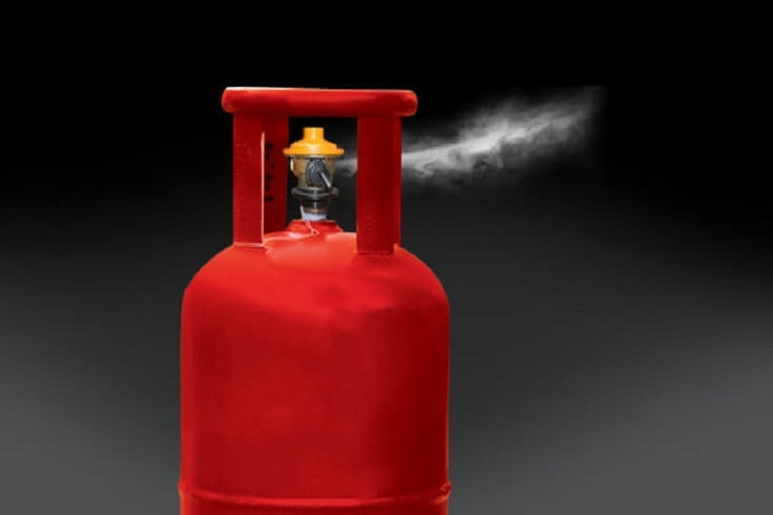
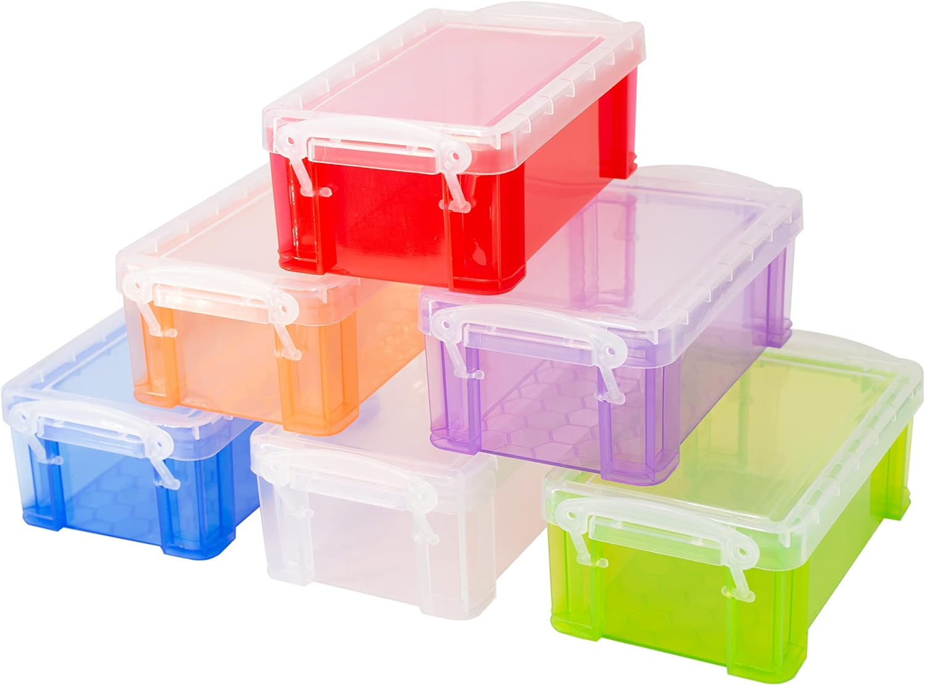
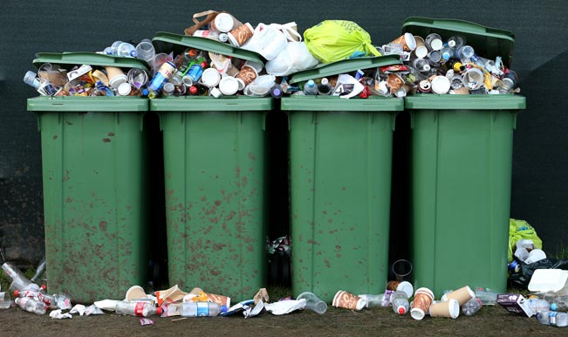
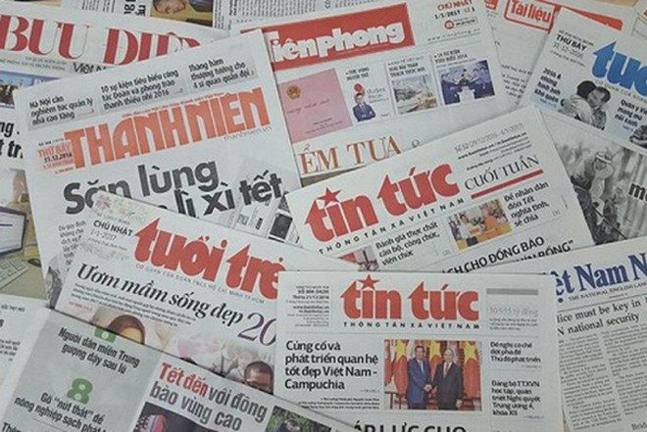
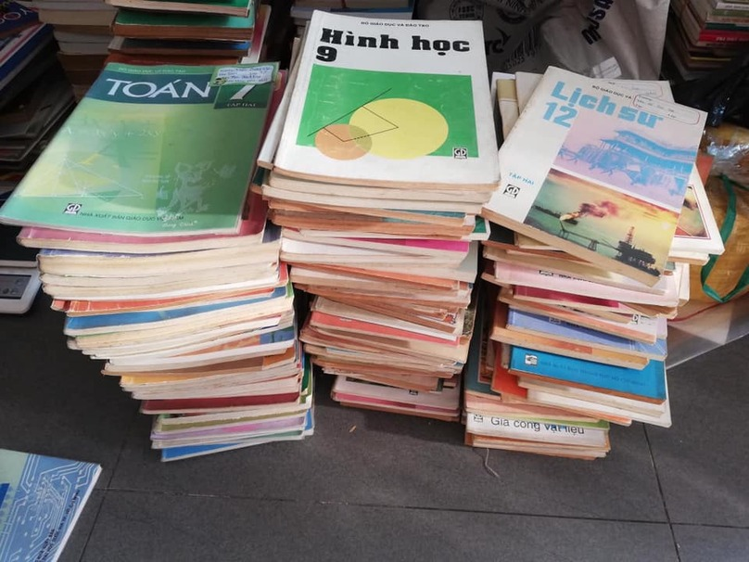
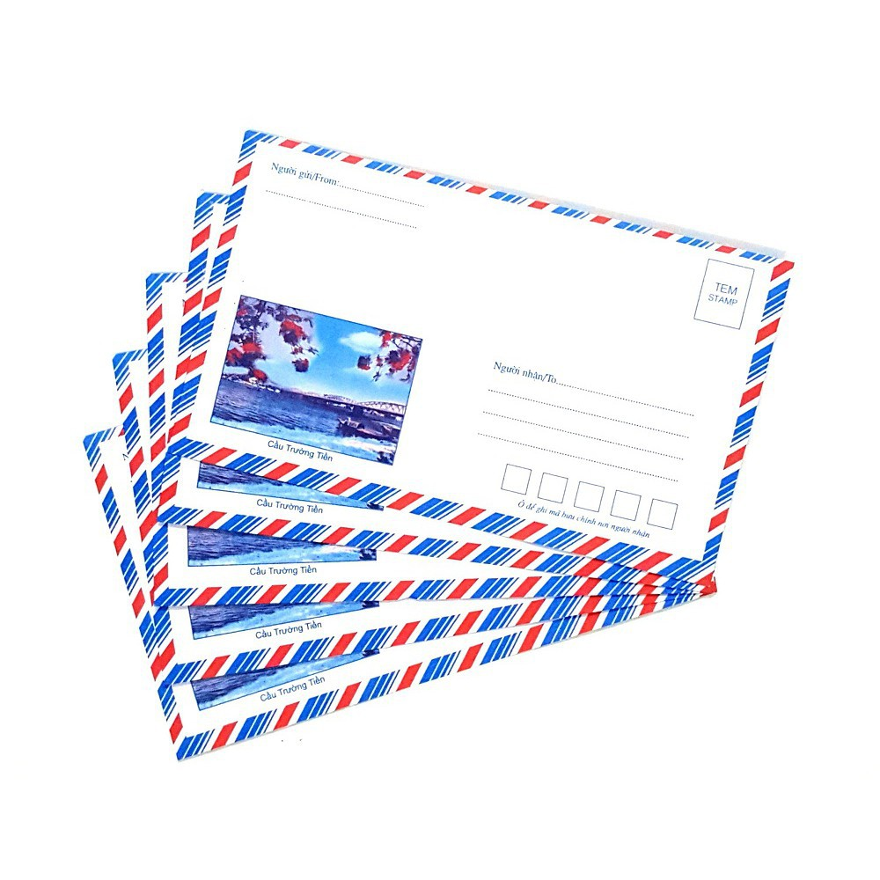
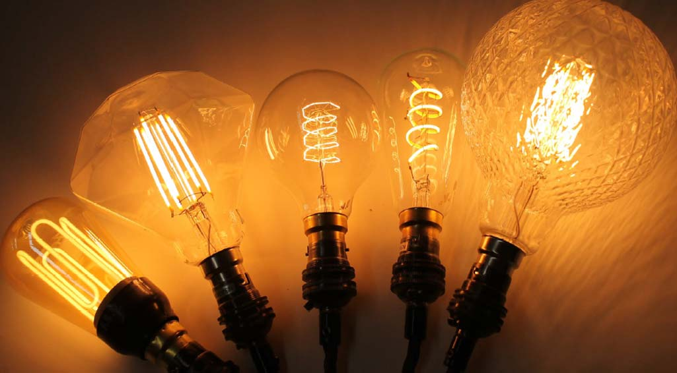
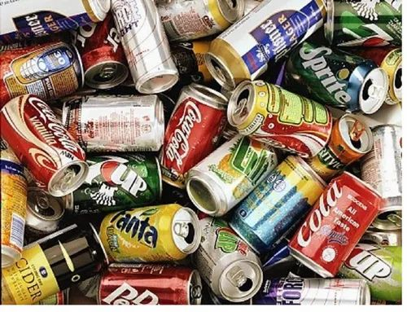
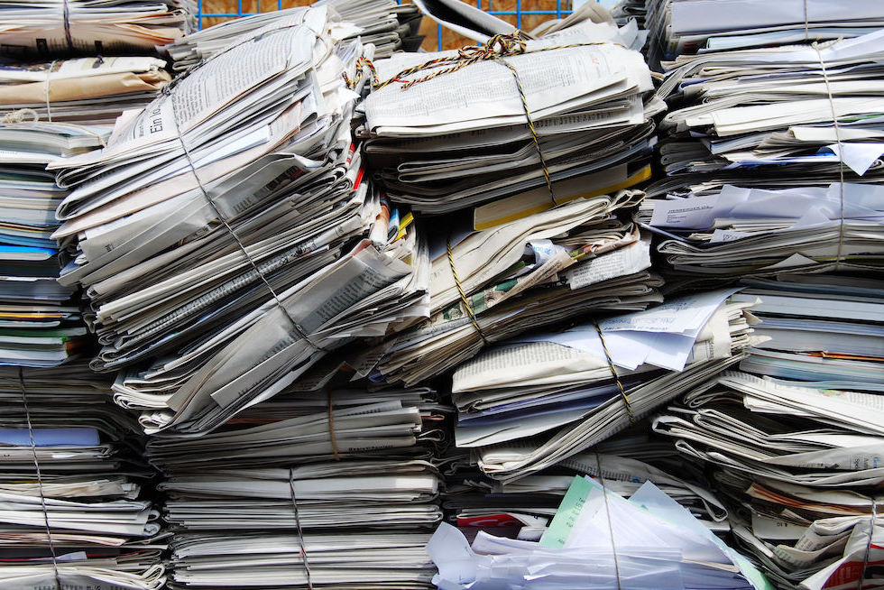
WARM-UP
GAME: KIM’S GAME

Slide 5
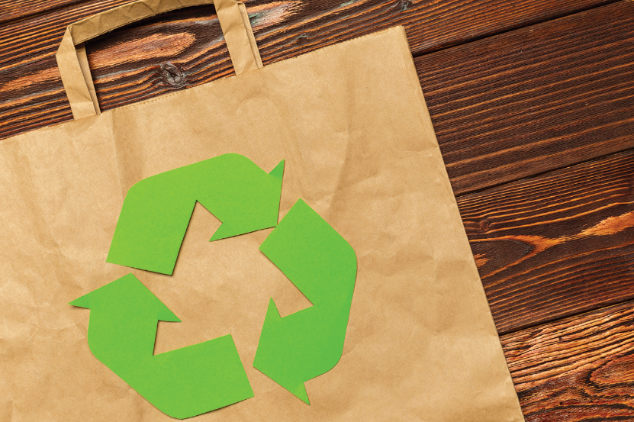
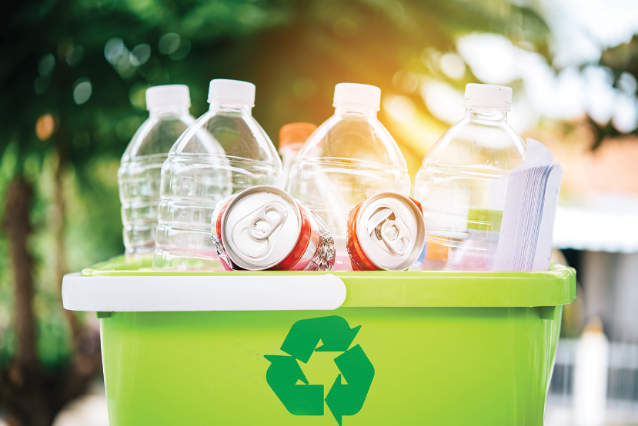
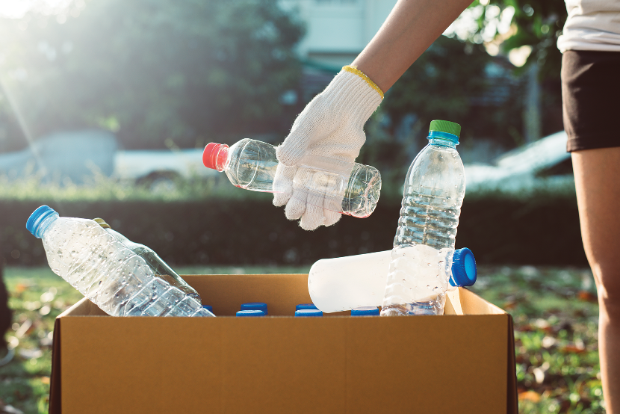
VOCABULARY
Add more words to the word webs below.

Slide 6
VOCABULARY
Add more words to the word webs below.
electricity
water
gas
Reduce
plastic bags
rubbish
paper

Slide 7
VOCABULARY
Add more words to the word webs below.
bottles
envelopes
cans
Reuse
plastic bottles
light bulbs
plastic bags

Slide 8
VOCABULARY
Add more words to the word webs below.
plastic
boxes
plastic
bags
books
Recycle
glass
newspapers
cans

Slide 9
GRAMMAR
Write a / an or the.
a
1. If I see _______ dog, I will run away.
2. Does your town have _______ art gallery?
3. _______ Moon is bright tonight.
4. There is a big temple in the town.
_______ temple is very old.
5. – Is your mother _______ teacher?
– No, she isn’t. She’s _______ artist.
an
The
The
a
an

Slide 10
GRAMMAR
Write the correct form of each verb in brackets.
build
will be
1. If they (build) _______ an airport here, it (be) _______ very noisy.
2. People (save) ________ the environment if they (reuse) _______ old items.
3. If we (grow) _______ trees, our school (be) _______ greener.
4. If we (not have) ___________ enough food, we (be) _______ hungry.
5. If we (be) _______ hungry, we (be) _______ tired.
will save
reuse
grow
will be
don’t have
will be
are
will be

Slide 11
GRAMMAR
Combine each pair of sentences below to make a first conditional sentence.
1.
We walk or cycle. We are healthy.
If we walk or cycle, we will be healthy.
2.
We use the car all the time. We make the air dirty.
If we use the car all the time, we will make the air dirty.
3.
You reuse paper. You save trees.
If you reuse paper, you will save trees.
4.
You make noise. Your sister doesn’t sleep.
If you make noise, your sister will not / won’t sleep.
5.
I see a used bottle on the road. I put it in the bin.
If I see a used bottle on the road, I will put it in the bin.

Slide 12
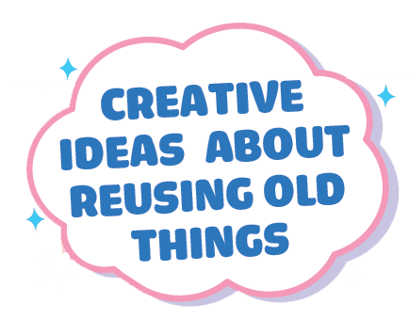
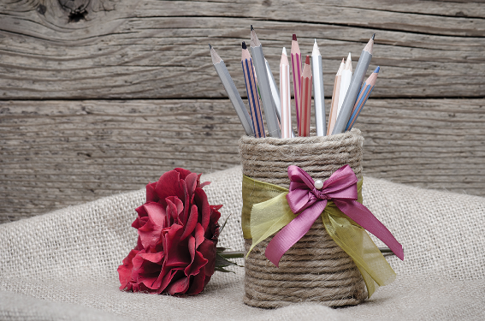
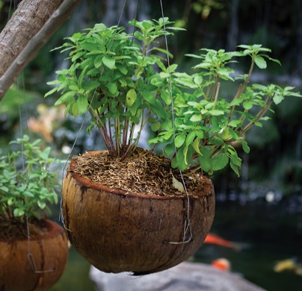
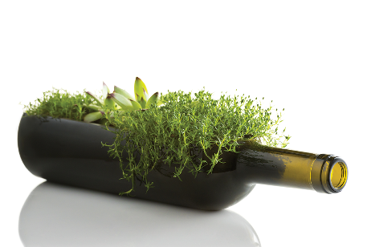
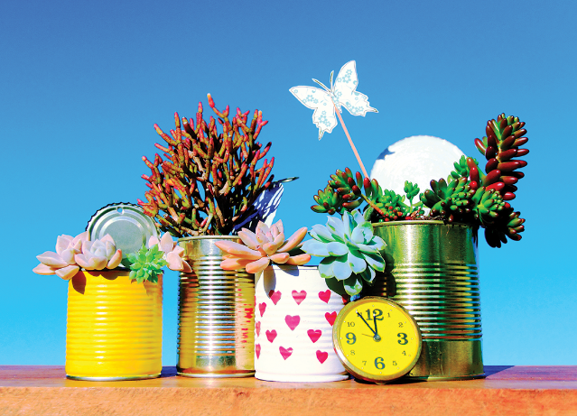
PROJECT
What can you see in each picture? What did people use to make the things in the pictures?

Slide 13
PROJECT
Work in pairs or in groups to complete the project.
Choose a used object (a bottle, a sheet of paper, etc.).
Make something new from it and decorate it.
Bring it to class.
Do a “show and tell” about it.

Slide 14
PROJECT
Listen to other presentations and decide which is the best.

Slide 15
CONSOLIDATION
1
Wrap-up
What have we learnt in this lesson?
Vocabulary: the words for things that can be reduced, reused and recycled
Grammar: - Articles
- The 1st conditional sentences
Project: Creative ideas about reusing old things

Slide 16
CONSOLIDATION
2
Homework
- Do exercise in the workbook.
- Prepare for the next unit.

Slide 17
Website: hoclieu.vn
Fanpage: facebook.com/www.tienganhglobalsuccess.vn/

