Slide 2
Unit
10
HOUSES IN THE FUTURE
LESSON 6: SKILLS 2
1

Slide 3
LESSON 6: SKILLS 2
LESSON 1: GETTING STARTED
WARM-UP
Jumbled words
Task 1: Listen and write.
Task 2: Listen again and tick.
Task 3: Listen again and answer the question.
LISTENING
WRITING
Task 4: Discussion.
Task 5: Write a paragraph about your dream house.
CONSOLIDATION
Wrap-up
Homework

Slide 4
WARM-UP
REARRANGE THE JUMBLED WORDS
JUMBLED WORDS

Slide 5
WARM-UP
IYCT
→ CITY

Slide 6
WARM-UP
MATTSVR
→ SMART TV

Slide 7
WARM-UP
AGRNED
→ GARDEN

Slide 8
WARM-UP
LFTA
→ FLAT

Slide 9
WARM-UP
ILVLA
→ VILLA

Slide 10
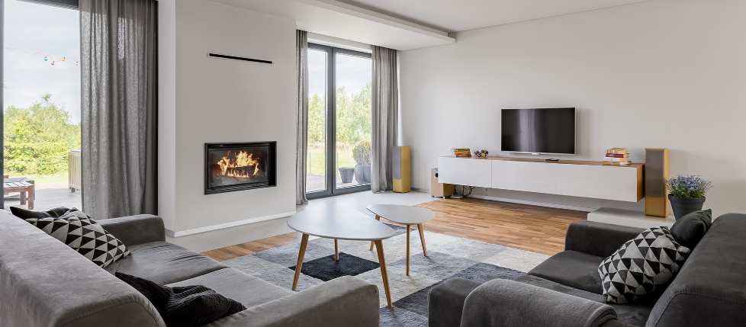
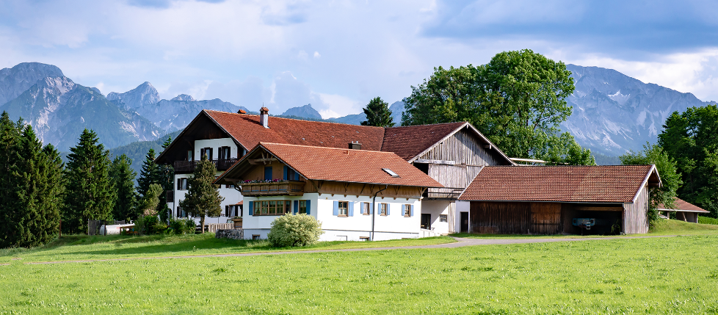
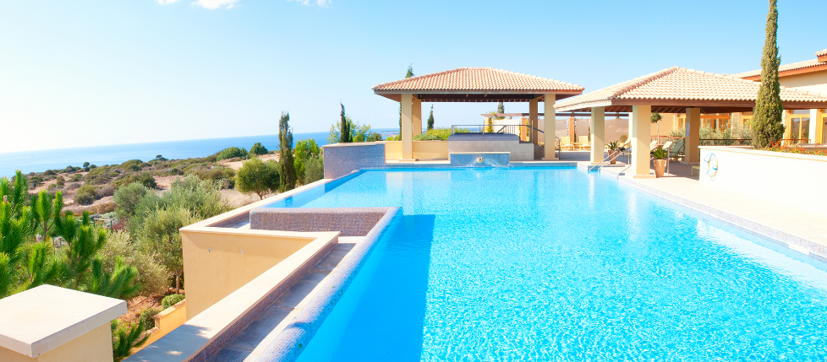
LISTENING
Can you describe these houses?
a
b
c

Slide 11
LISTENING
1
Listen to Nick and Linda talking about their dream houses. Which one would each prefer?
a
b
Nick
(a flat in the city)
c
Linda
(a villa by the sea, with a swimming pool and a garden)

Slide 12
LISTENING
2
What is important to Nick? What is important to Linda?
Listen and tick.
 | Linda | Nick
1. park view
2. city view
3. sea view
4. swimming pool
5. garden
Linda: Well, it's a big villa by the sea. It has a view of the sea. It has a swimming pool and a garden.



Nick: It's a beautiful flat in the city. It has a park view in front and a city view at the back.


T

Slide 13
LISTENING
3
Listen again and answer the questions about their dream houses.
1. What type of house does Linda have?
2. Where is her house?
3. What is around her house?
4. What type of house does Nick have?
5. Where is it?
→ She has a big villa.
→ He has a flat.
→ Her house / It is by the sea.
→ It’s in the city.
→ There’s a swimming pool and a garden around her house.

Slide 14
WRITING
4
Discuss your dream house, and fill the table.
What type of dream house is it?
Type of house: | palace
Location: | in the mountains
Number of rooms:
Appliances in the house:
It's a palace.
Where is it?
It's in the mountains.

Slide 15
WRITING
5
Use the information in Task 4 to write a paragraph of about 50 words about your dream house.
1. What type of dream house is it?
My dream house is a big palace. It is in the mountains. It is surrounded by lots of trees. It has seven rooms: three bedrooms, two bathrooms, one kitchen and one living room. There is a large swimming pool in front of it. I have some robots in the palace. They help me to clean the floor, cook meals, water flowers... I'm happy to live in my palace.
2. Where is it?
3. What does it look like?
4. How many rooms are there?
5. What appliances are there and what will they help you to do?

Slide 16
Peer check
WRITING
4
No. | Question?
1 | Are the verbs in the correct form?
2 | Are the nouns in the correct form?
3 | Is the spelling correct?
4 | Has the paragraph answered all questions?

Slide 17
CONSOLIDATION
1
Wrap-up
What have we learnt in this lesson?
Listen for specific information about dream houses
Write a paragraph about your dream house

Slide 18
CONSOLIDATION
2
Homework
Rewrite the paragraph in your notebook.

Slide 19
Website: hoclieu.vn
Fanpage: facebook.com/www.tienganhglobalsuccess.vn/

