Slide 2



Unit
10
HOUSES IN THE FUTURE
LESSON 5: SKILLS 1
1

Slide 3
LESSON 5: SKILLS 1
LESSON 1: GETTING STARTED
WARM-UP
Game: True or False
Task 1: Look and discuss.
Vocabulary
Task 2: Read and match.
Task 3: Read and choose the correct answer.
READING
Task 4: ﻿Ask and answer.
Task 5: Discussion.
SPEAKING
Wrap-up
Homework
CONSOLIDATION

Slide 4
WARM-UP
Look at the picture
TRUE OR FALSE
Work in pairs
Decide whether these statements are true or false

Slide 5
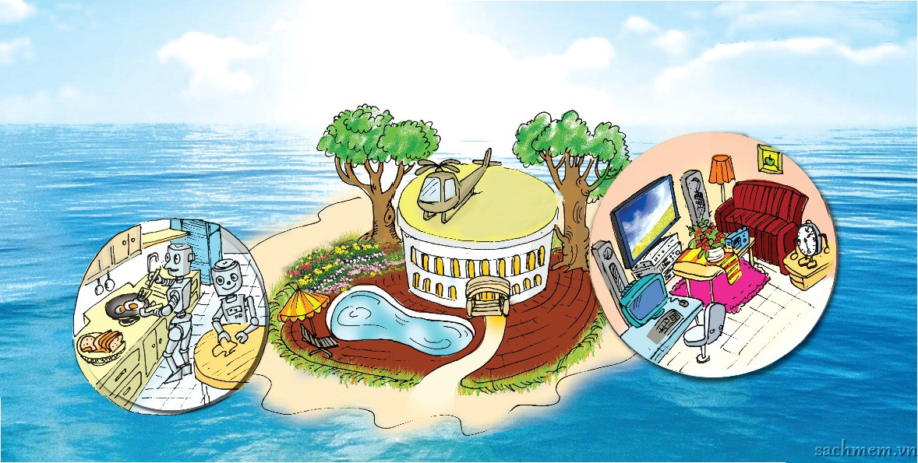
WARM-UP
TRUE OR FALSE
1. The house will be surrounded by a jungle.
2. Robots will help to do the housework.
3. There will be an UFO on the roof.
4. There will be a swimming pool in the house.
F
T
F
T

Slide 6
READING
1
Look at the picture and answer.
1. What type of house do you think it is?
It’s a villa.
2. Where do you think the house is?
It’s on an island.
3. What can you see around the house?
A helicopter, trees, a garden, a swimming pool, blue sea.
4. What can you see in the house?
Robots in the kitchen, a TV, a computer,… in the living room.

Slide 7


VOCABULARY
surround (v)
/ səˈraʊnd/
bao quanh

Slide 8

VOCABULARY
helicopter (n)
/ ˈhelɪˌkɒptə(r)/
máy bay trực thăng

Slide 9

VOCABULARY
feed (v)
/fiːd/
cho ăn

Slide 10
VOCABULARY
New words | Pronunciation | Meaning
1. surround (v) | / səˈraʊnd/ | bao quanh
2. helicopter (n) | / ˈhelɪˌkɒptə(r)/ | máy bay trực thăng
3. feed (v) | /fiːd/ | cho ăn

Slide 11
2
Read the text and match the phrases in A with the correct ones in B.
My future house will be on an island. It will be surrounded by tall trees and the blue sea. There will be a swimming pool in front of the house. There will be a helicopter on the roof. I can fly to school in it.
There will be some robots in the house. They will help me to clean the floors, cook meals, wash clothes and water the flowers. They will also help me to feed the dogs and cats.
There will be a super smart TV. It will help me to send and receive emails, and contact my friends on other planets. It will also help me to buy food from the supermarket.
a. clean the floors. f. send and receive emails.
b. contact my friends. g. feed the dogs and cats.
c. wash clothes. h. water the flowers.
d. buy food from the supermarket.
e. cook meals.
A | B
1. The house will have robots to
2. The house will have a super smart TV to
a. clean the floors.
c. wash clothes.
e. cook meals.
h. water the flowers.
g. feed the dogs and cats.
f. send and receive emails.
b. contact my friends.
d. buy food from the supermarket.

Slide 12

Read the text again and circle the option (A, B, or C) to complete the sentences.
My future house will be on an island. It will be surrounded by tall tees and the blue sea. There will be a swimming pool in front of the house. There will be a helicopter on the roof. I can fly to school in it.
There will be some robots in the house. They will help me to clean the floors, cook meals, wash clothes and water the flowers. They will also help me to feed the dogs and cats.
There will be a super smart TV. It will help me to send and receive emails, and contact my friends on other planets. It will also help me to buy food from the supermarket.
3
1. The house will be _____
A. in the mountains
B. on an island
C. on the Moon
2. There will be a _____ in front of the house.
A. garden
B. pond
C. swimming pool
3. The house will have _____ robots.
A. many
B. some
C. a lot of
4. The _____ will help me to feed the dogs and cats.
A. helicopter
B. robot
C. super smart TV

Slide 13


SPEAKING
4
In pairs. Ask about future house.
What type of future house do you think it will be?
1. What type of future house do you think it will be?
2. Where will it be?
3. What will it look like?
4. How many rooms will it have?
5. What appliances will it have and what will they help you to do?
It'll be a palace.

Slide 14
SPEAKING
FUTURE HOUSE
5
Students to work in groups and “build” their ideal future house.
Groups of 6.
Take turns and share about your future house
The others DRAW the house you describe.

Slide 15

CONSOLIDATION
1
Wrap-up
What have we learnt in this lesson?
Read for general information and specific information
Talk about different houses in the future

Slide 16

CONSOLIDATION
2
Homework
- Do exercises in the workbook
- Write some sentences to describe your future house, at least 3 classmates.

Slide 17






Website: hoclieu.vn
Fanpage: facebook.com/www.tienganhglobalsuccess.vn/

