Slide 2


Unit
9
CITIES OF THE WORLD
LESSON 6: SKILLS 2
Listening
Writing
1
1

Slide 3
LESSON 6: SKILLS 2
LESSON 1: GETTING STARTED
Game: Relay-race to capital cities of ASEAN countries
WARM-UP
Task 1: Work in groups. Discuss and answer the questions.
Task 2: Listen and tick T (True) or F (False).
Task 3: Listen again and fill in each gap with ONE word/ number.
LISTENING
Task 4: ﻿Work in groups. Talk about a city in your country, using the questions below as a guide.
Task 5: Write a postcard of about 50 words about your holiday in a city. Use the information in 4.
WRITING
CONSOLIDATION
Wrap-up
Homework

Slide 4
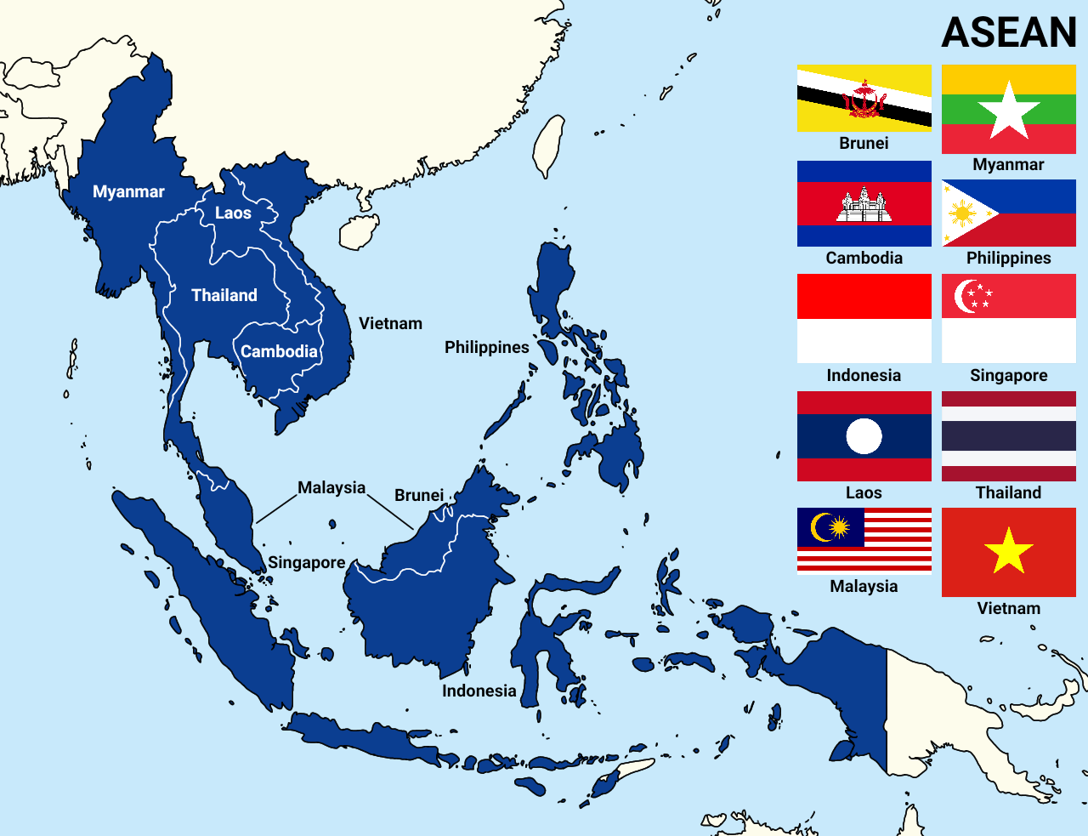
WARM-UP
Ha Noi
Bandar Seri Begawan
Phnom Penh
Jakarta
Vientiane
Manila
Singapore
Bangkok
Kuala Lumpur
Naypyidaw

Slide 5

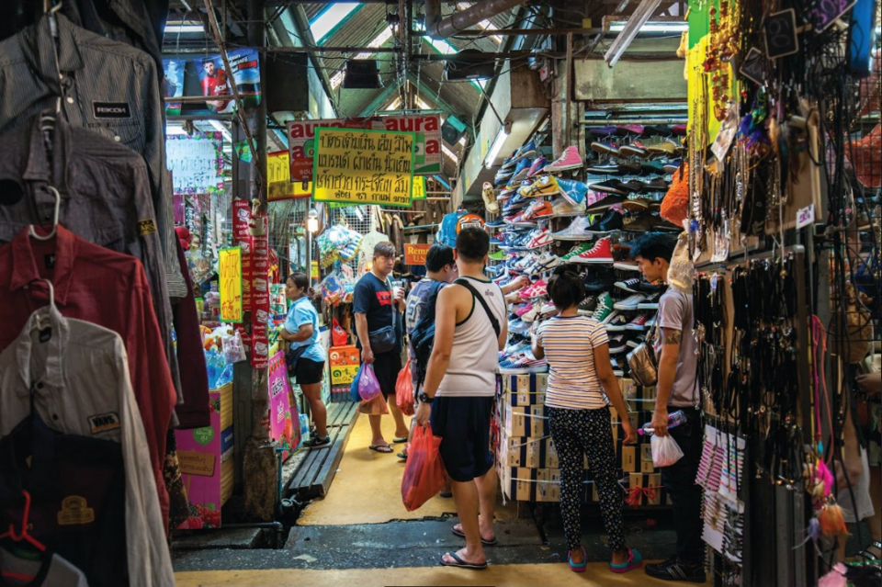
LISTENING
1
Work in groups. Discuss and answer the questions.
1.
Where is Bangkok?
2.
What is Bangkok famous for?

Slide 6

LISTENING
2
Listen and tick T (True) or F (False).
 |  | T | F
1. | Bangkok is famous for palace.
2. | Things at Chatuchak market are expensive.
3. | The floating market is on the sea.
4. | You can find food stalls all around Bangkok.
✓
✓
✓
✓

Slide 7
LISTENING
3
Listen again and fill each gap with ONE word / number.
1.
Chatuchak market has over stalls.
15,000
2.
5
Chatuchak market is about minutes’ walk from the station.
3.
life
You can see part of Thai people’s at a market.
4.
Street food in Bangkok is .
delicious

Slide 8
WRITING
4
Work in groups. Talk about a city in your country, using the questions below as a guide.
What city is it?
What is it like? (the weather, the people, the food)
What can you see and do there?

Slide 9

WRITING
5
Write a postcard of about 50 words about your holiday in a city.
Use the information in 4.
Dear Mum and Dad,
To:
Love,
Trang

Slide 10

CONSOLIDATION
1
Wrap-up
What have we learnt in this lesson?
Listen for specific information about Thailand
Write a postcard about your holiday

Slide 11

CONSOLIDATION
2
Homework
- Rewrite the postcard in the notebook.
- Do exercises in the workbook.

Slide 12






Website: hoclieu.vn
Fanpage: facebook.com/www.tienganhglobalsuccess.vn/

