Slide 2
Unit
9
CITIES OF THE WORLD
LESSON 4: COMMUNICATION
1
EVERYDAY ENGLISH
1
Expressing exclamations with What

Slide 3
LESSON 4: COMMUNICATION
LESSON 1: GETTING STARTED
WARM-UP
Pictures describing
Expressing exclamations with What
Task 1: Look at the picture. Listen and read the exclamations.
Task 2: Work in pair. Look at the picture below and say what you think by using exclamations with What.
EVERYDAY ENGLISH
Task 3: Work in pairs. Write the names of the landmarks under the correct pictures.
Task 4: Write the names of the landmarks in 3 for the descriptions.
Task 5: Quiz.
CITY LANDMARKS
CONSOLIDATION
Wrap-up
Homework

Slide 4
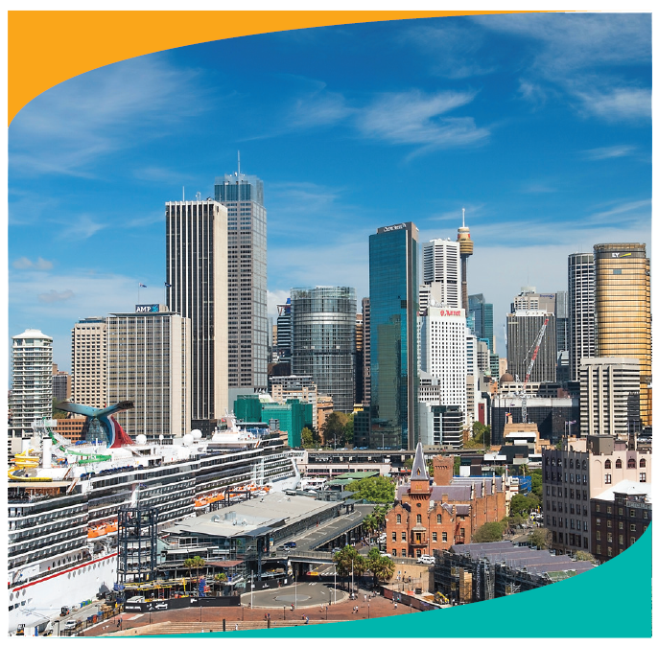
EVERYDAY ENGLISH
1
Look at the picture. Listen and read the exclamations.
1.
What a nice city!
2.
What a clear sky!
3.
What tall buildings!

Slide 5
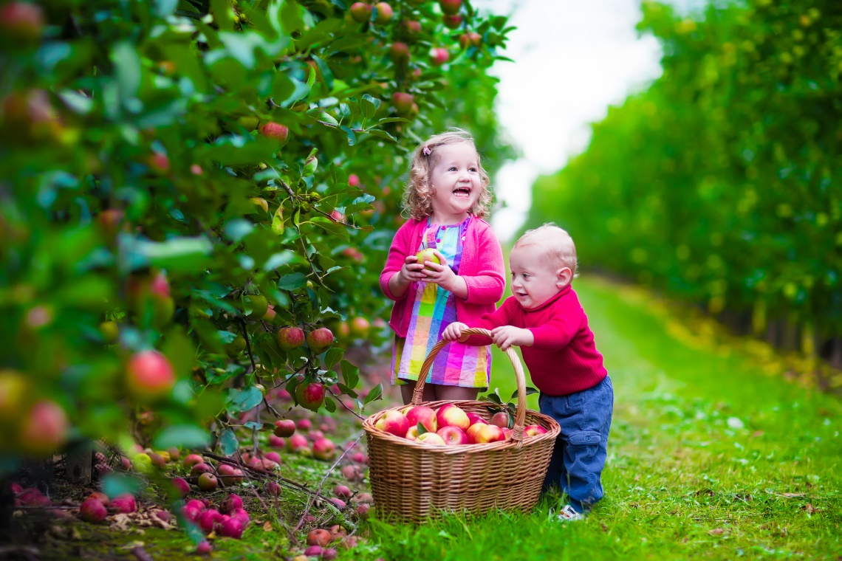
EVERYDAY ENGLISH
2
Work in pair. Look at the picture below and say what you think by using exclamations with What. You may use the suggestions below.
- happy / beautiful children
- colourful / nice picture
- sunny / beautiful weather
- small / cute boy
- beautiful / colourful apple trees

Slide 6
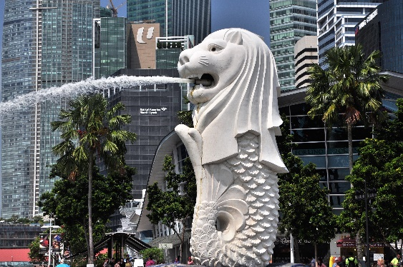
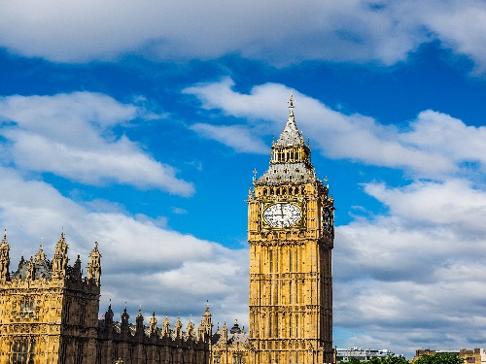
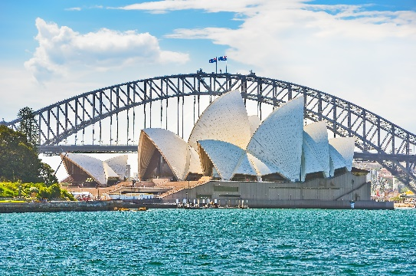
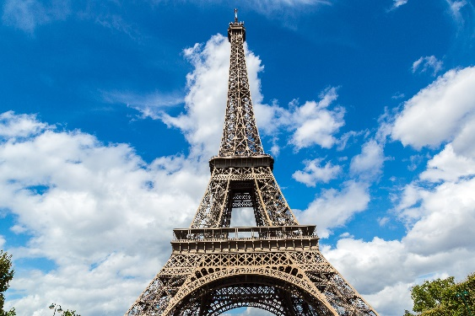
CITY LANDMARKS
3
Work in pairs. Write the names of the landmarks under the correct pictures.
Eiffel Tower
Sydney Opera House
1.
Merlion
2.
Big Ben
Big Ben
Merlion
3.
Sydney Opera House
4.
Eiffel Tower

Slide 7
CITY LANDMARKS
4
Write the names of the landmarks in 3 for the descriptions.
1.
Big Ben
3.
Eiffel Tower
This tower is on the bank of the River Thames in London. In the tower, there’s a big clock and a bell.
This famous tower is in Paris. Every year, millions of visitors climb to its top to see the whole view of Paris.
2.
Sydney Opera House
4.
Merlion
It’s a theatre on Sydney Harbour. Its roofs are white and look like shells. Visitors from all over the world come to see it.
It has the head of a lion and the body of a fish. It’s a famous landmark in Singapore.

Slide 8
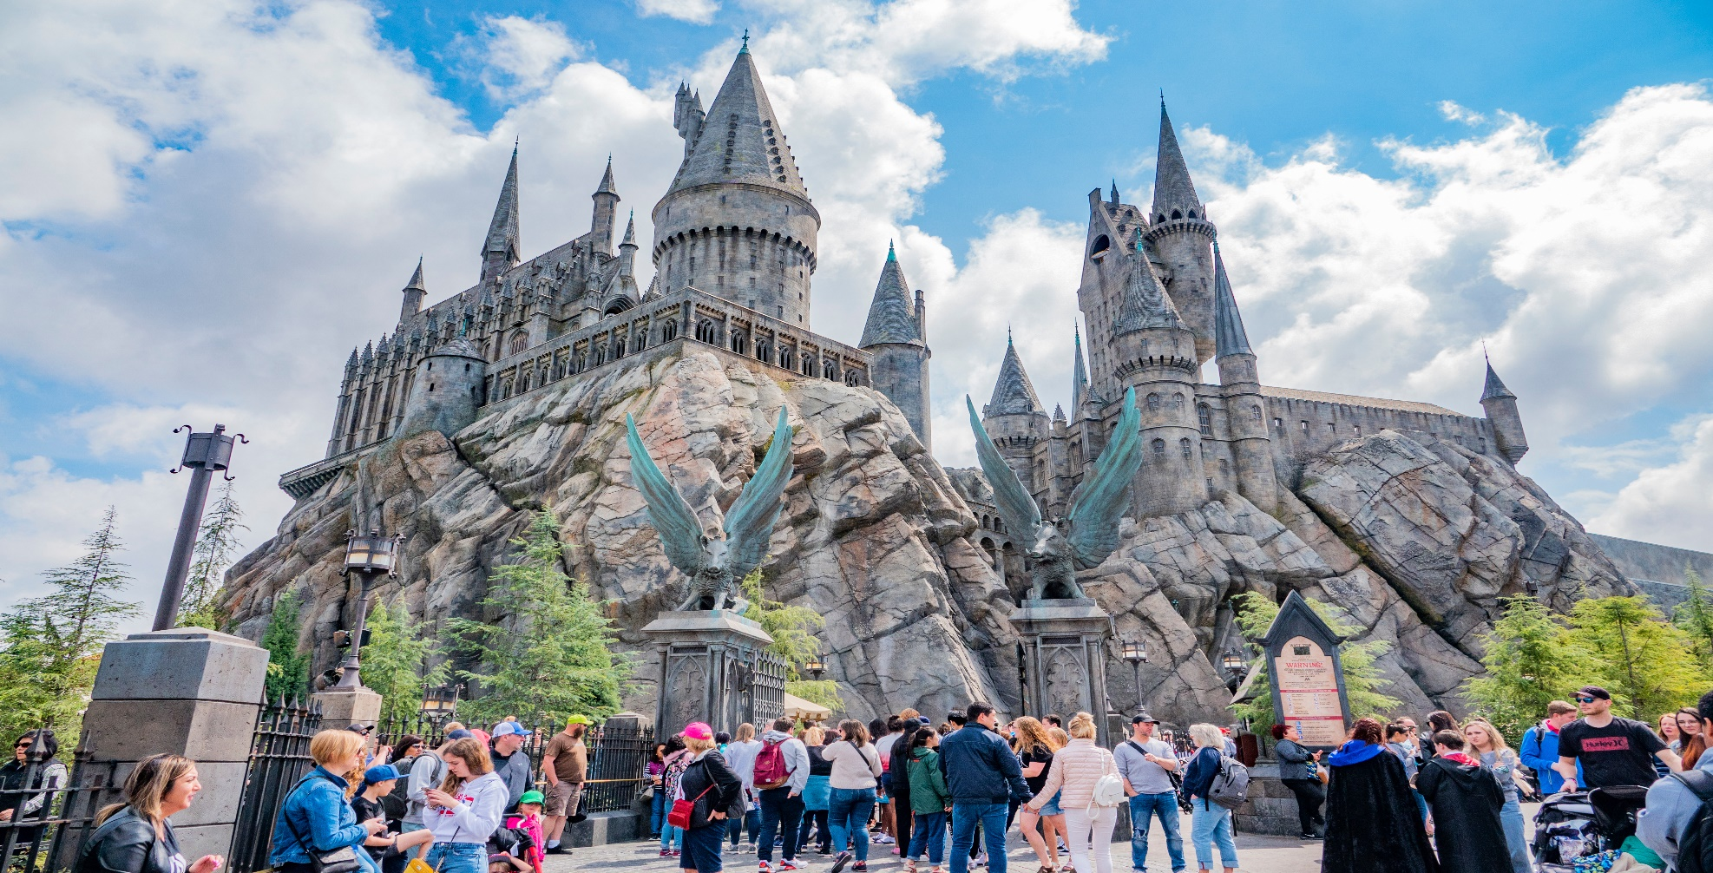
CITY LANDMARKS
5
Work in pairs. Read the questions and circle the correct answers.

Slide 9
CITY LANDMARKS
1.
Which city is nearer to Ha Noi than the others?
A.
Berlin
B.
Bangkok
C.
Tokyo
2.
The people of Quang Nam are proud of their ancient town, ____.
A.
Hoi An
B.
Sa Pa
C.
Bach Ma
3.
Phnom Penh is the capital city of ______.
A.
Indonesia
B.
The Philippines
C.
Cambodia
4.
For children, California is famous for its ______ .
A.
Disneyland Park
B.
Golden Gate Bridge
C.
national parks

Slide 10
CONSOLIDATION
1
Wrap-up
What have we learnt in this lesson?
Expressing exclamations with What
Practice to talk about city’s landmarks

Slide 11
CONSOLIDATION
2
Homework
- Choose a city and find out the information about that city
- Do exercises in the workbook.
- Prepare for the next lesson: Skills 1

Slide 12
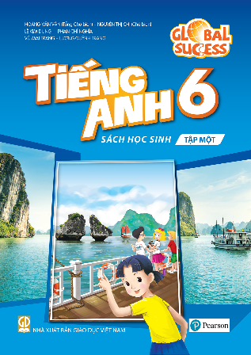
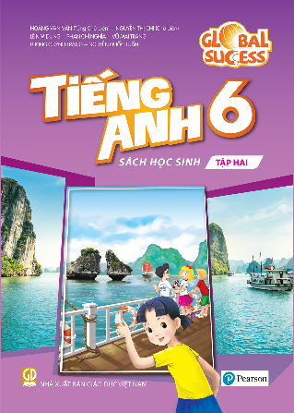
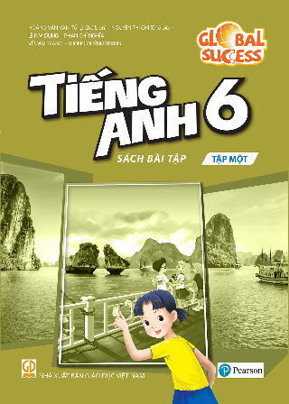
Website: hoclieu.vn
Fanpage: facebook.com/www.tienganhglobalsuccess.vn/

