Slide 2
Unit
9
CITIES OF THE WORLD
LESSON 3: A CLOSER LOOK 2
Possessive adjectives and Possessive pronouns
1

Slide 3
LESSON 3: A CLOSER LOOK 2
LESSON 1: GETTING STARTED
WARM-UP
Game: Sentence puzzling
Task 1: Match the sentences with the pictures, paying attention to the underlined part in each sentence.
Task 2: Complete the sentences with the correct possessive adjectives.
POSSESSIVE ADJECTIVES
Task 3: Complete the sentences with the correct possessive pronouns.
Task 4: Underline the correct word in brackets to complete each sentence.
Task 5: Choose the correct word to complete each sentence.
POSSESSIVE PRONOUNS
CONSOLIDATION
Wrap-up
Homework

Slide 4
WARM-UP
Sentence puzzling
1. very / is / city / beautiful / my / .
2. big / is / house / very / his / .
3. school / garden / has / our / a / big / .
4. smaller / your / mine / than / is / school / .
5. are bigger / hers / my / than / shoes / .
1
→ My city is very beautiful.
→ His house is very big.
→ Our school has a big garden.
→ Your school is smaller than mine.
→ My shoes are bigger than hers.

Slide 5
POSSESSIVE ADJECTIVES
Grammar
Possessive adjectives
A possessive adjective is used only when there’s a noun following it.
Example:
I have a pen.
This is my pen.

Slide 6
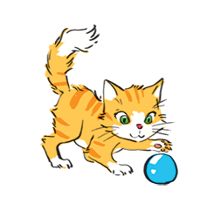
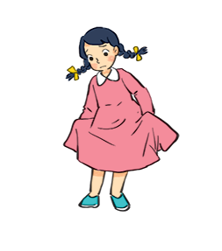
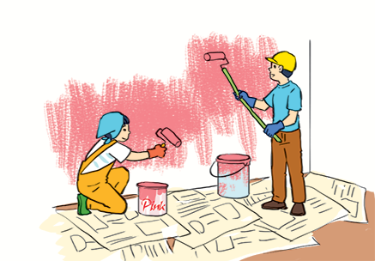
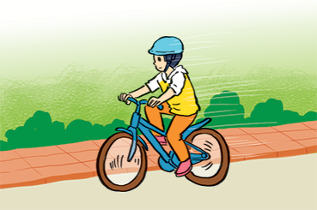
POSSESSIVE ADJECTIVES
1
Match the sentences with the pictures, paying attention to the underlined part in each sentence.
a
b
1.
Sue doesn’t like her new dress.
→ d
2.
Billy is riding his bicycle.
→ e
d
3.
The cat is playing with its ball.
→ b
c
4.
→ a
We love our school.
5.
They are painting their room pink.
→ c
e

Slide 7
POSSESSIVE ADJECTIVES
2
Complete the sentences with the correct possessive adjectives.
1.
I love cartoons.
My
_____ favourite cartoon is Dragon Balls.
your
2.
This book has your name on it. Is it
_______ book?
____ cubs are playing under a big tree.
3.
The lion has three cubs.
Its
____ house is close to the park.
4.
Do you know my friend Anna?
Her
Our
5.
We are from Switzerland.
____ country is famous for chocolate.

Slide 8
POSSESSIVE PRONOUNS
Grammar
Possessive pronouns
A possessive pronoun is used alone, without a noun following it.
Example:
This book is my book, not your book.
This book is mine, not yours.

Slide 9
POSSESSIVE PRONOUNS
3
Complete the sentences with the correct possessive pronouns.
1.
I have a new bike. The bike is .
mine
2.
These are Mai’s and Lan’s maps. These maps are .
theirs
yours
3.
This is a present for you. It’s .
My father has new shoes. They’re .
4.
his
5.
This is our new house. The house is .
ours

Slide 10
POSSESSIVE PRONOUNS
4
Underline the correct word in brackets to complete each sentence.
1.
Australia is a strange country. All of (it’s / its) big cities are along the coast.
2.
Our city is very crowded. How about (your / yours)?
3.
I love my football club. Does phong like (his / him)?
4.
(Our / Ours) street is short and narrow.
5.
They cannot find (their / theirs) city map anywhere.

Slide 11
POSSESSIVE PRONOUNS
5
Choose the correct word to complete the sentences.
1.
The book is (my / mine / yours), but you are welcome to read it.
2.
( Your / Yours / You) bike is dirty, and I can’t tell what colour it is.
3.
Your country is much bigger than (our / ours / their).
4.
(They / Their / Theirs) dog is so friendly. It never barks.
5.
(It / It’s / Its) not easy to find your way in a strange city.

Slide 12
CONSOLIDATION
1
Wrap-up
What have we learnt in this lesson?
Use the Possessive adjectives and Possessive pronouns

Slide 13
CONSOLIDATION
2
Homework
Do exercises in the workbook.

Slide 14
Website: hoclieu.vn
Fanpage: facebook.com/www.tienganhglobalsuccess.vn/

