Slide 2
Unit
8
SPORTS AND GAMES
LESSON 7: LOOKING BACK & PROJECT
Looking back
Project
1

Slide 3
LESSON 6: SKILLS 2
LESSON 1: GETTING STARTED
WARM-UP
Mind map
Task 1: Find one odd word/ phrase in each question.
Task 2: Put the correct form of the verbs play, do, or go in the blanks.
Task 3: Put the verbs in brackets in the correct form.
Task 4: What do you say in these situations?
Task 5: Fill each blank with one word to complete the passage
LOOKING BACK
PROJECT
Present about a sports/ games.
CONSOLIDATION
Wrap-up
Homework

Slide 4
Game: Mind map
WARM-UP

Slide 5
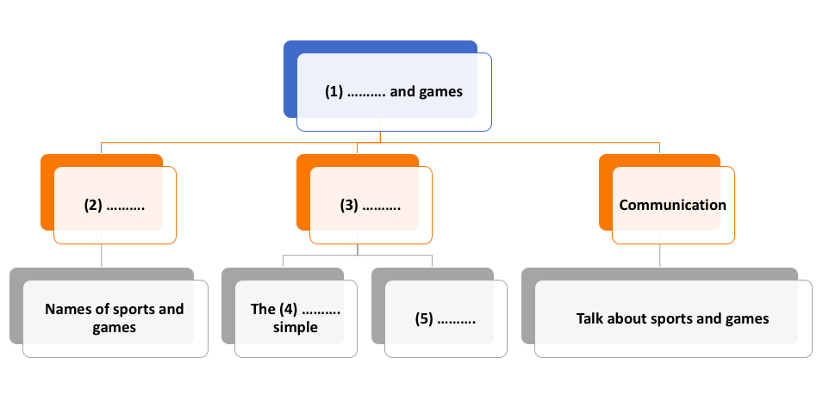
WARM-UP
Mind map
(1) Sports
(2) Vocabulary
(3) Grammar
(4) past
(5) Imparatives

Slide 6
I. VOCABULARY
LOOKING BACK

Slide 7
LOOKING BACK
1
Find one odd word / phrase in each question.
1. | A. volleyball | B. badminton | C. bicycle
2. | A. playground | B. ball | C. racket
3. | A. running | B. cycling | C. driving
4. | A. sports shoes | B. winter sports | C. goggles
5. | A. sporty | B. intelligent | C. fit

Slide 8
LOOKING BACK
2
Put the correct form of the verbs play, do or go in the blanks.
1. Duong can __________ karate.
2. Duy isn't reading now. He __________ table tennis with his friend.
3. Michael ______swimming nearly every day.
4. Phong didn't play football yesterday. He _______fishing.
5. Khang ________volleyball last Saturday.
6. The girls __________ aerobics in the playground now.
do
is playing
goes
went
played
are doing

Slide 9
II. GRAMMAR
LOOKING BACK

Slide 10
LOOKING BACK
3
Put the verbs in brackets in the correct form.
1. The first Olympic Games (take) _______ place in Greece in 776 BC.
2. People (start) _______ to use computers about 50 years ago.
3. My brother (not like) ___________to play games when he was small.
4. - What _____ you (do) _____ last weekend?
- I (cycle) ________ round the lake with my friends. Then I (watch) _________ TV in the afternoon.
took
stated
didn’t like
did
do
cycled
watched

Slide 11
LOOKING BACK
4
What do you say in these situations?
1. Your friends are making a lot of noise.
→ Please, stop _________________.
2. The boy is watching TV for too long.
→__________to play with your friends.
3. Some children are feeding the animals at the zoo, but it is not allowed.
→________________the animals.
4. The teacher wants the boys to stand in line.
→___________________
5. Your mother tells you not to touch the dog.
→_____________________
making noise
Go out
Don't feed
Stand in line, boys!
Don’t touch the dog.
Notes:
llhjhjgdfgfgltkrolskflkobvvkshfjkhfgrhdfjnvvmvn

Slide 12
LOOKING BACK
5
Fill each blank with ONE word to complete the passage.
Sports and games are very important in our lives. We all can (1) _______ a sport, or a game, or watch sports events on TV or at the stadium. When you listen to the radio every day, you can always (2) _______ sports news. When you open a newspaper, you will always find an article about your (3) __________ kind of game. Television programmes about (4) _______ are also very popular, and you can watch something interesting every day. Stories about (5) ________ sports stars are often very interesting.
play
hear
favourite
sports
famous
Notes:
llhjhjgdfgfgltkrolskflkobvvkshfjkhfgrhdfjnvvmvn

Slide 13
PROJECT
PROJECT

Slide 14
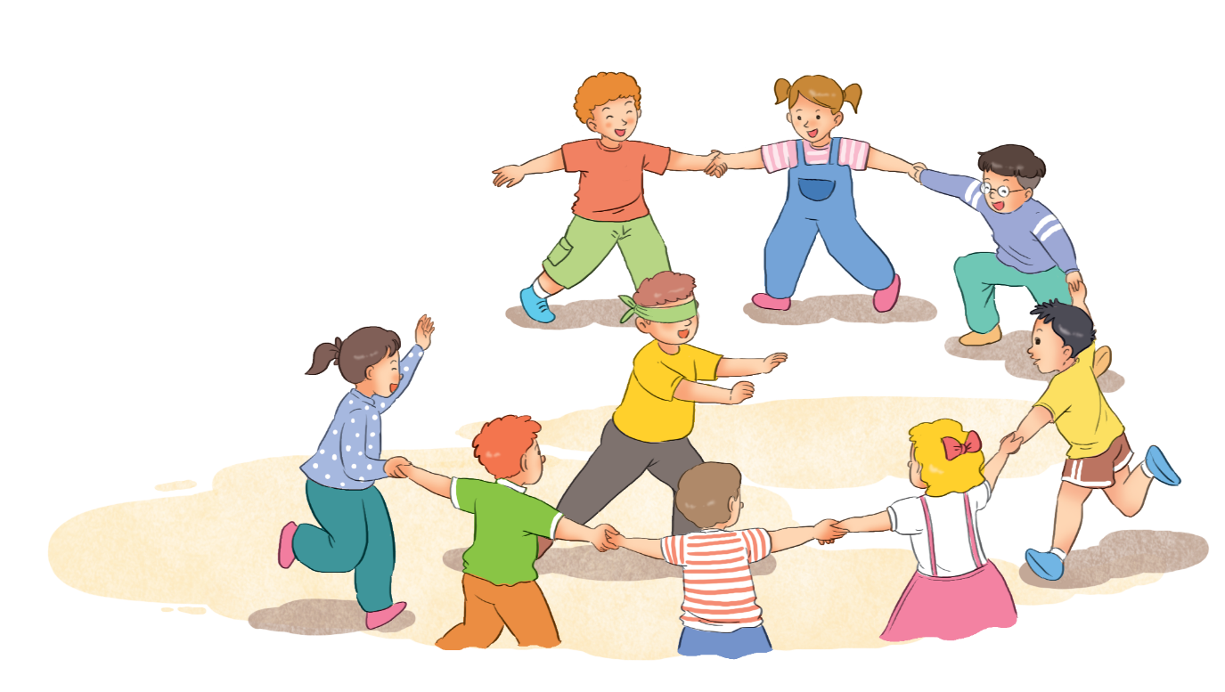
PROJECT
Present about a traditional game

Slide 15
CONSOLIDATION
2
Homework
Prepare for the next lesson:
Unit 9 – Getting started

Slide 16
Website: hoclieu.vn
Fanpage: facebook.com/www.tienganhglobalsuccess.vn/

