Slide 1

WELCOME TO OUR CLASS!
Presented by: ……..

Slide 2

WARM UP
Work in groups
Watch a video
Write down the housework in the video
The group has more correct answers will win.

Slide 3

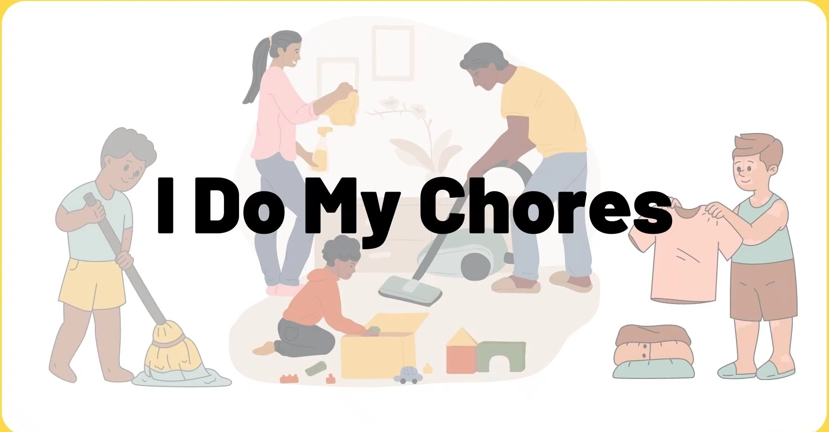

Who is FASTER?

Slide 4
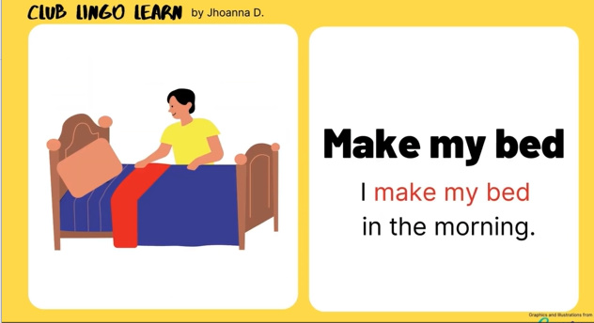
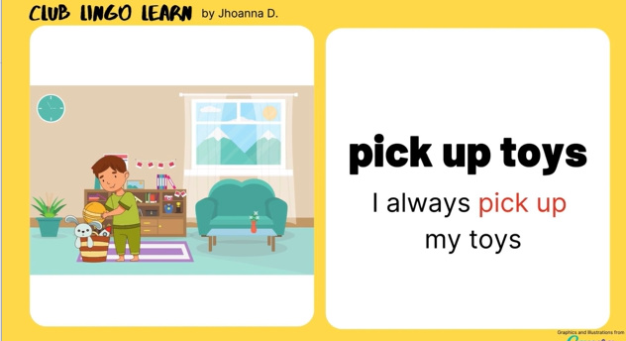
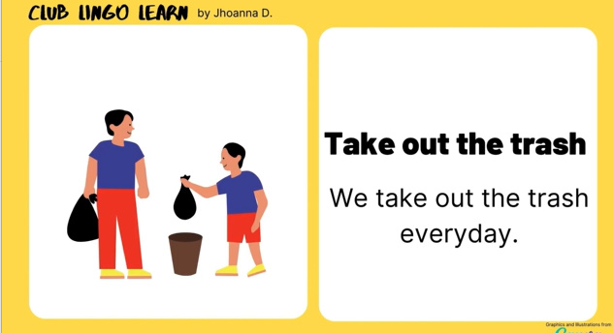
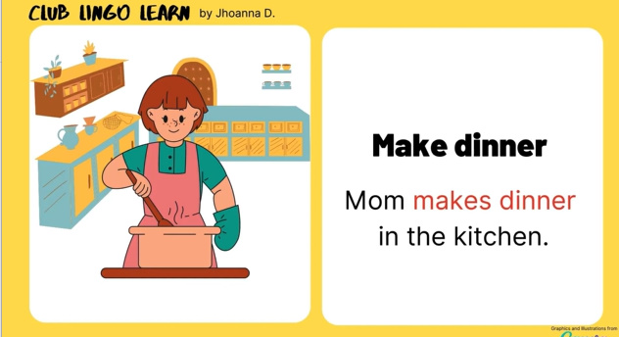
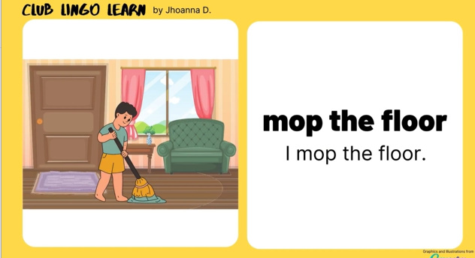
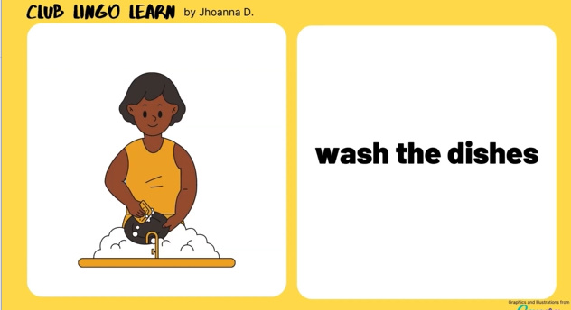
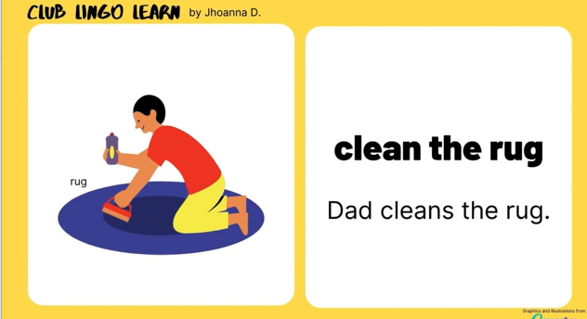
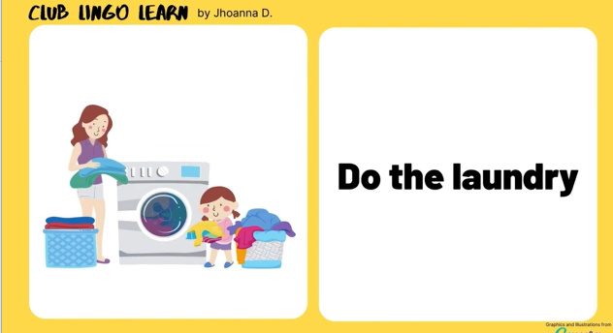
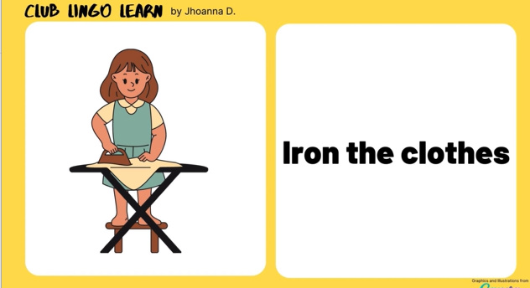


Slide 5
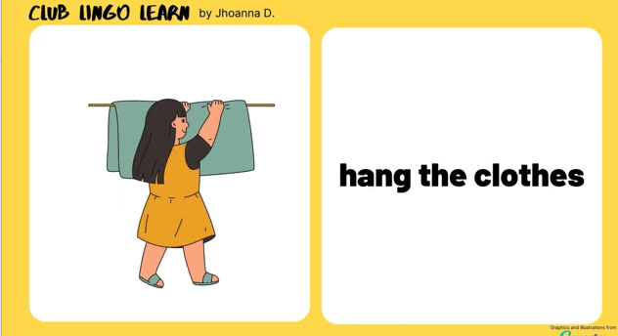
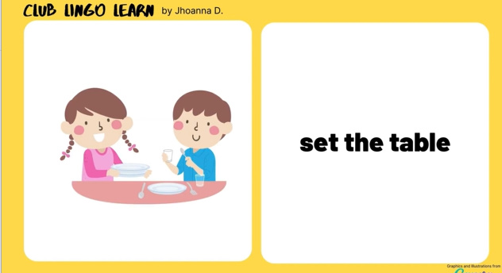
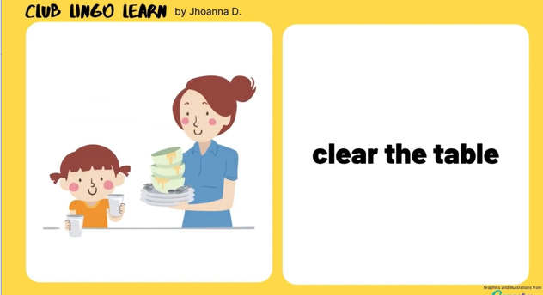
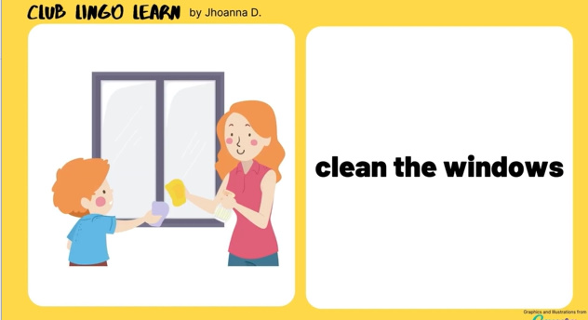
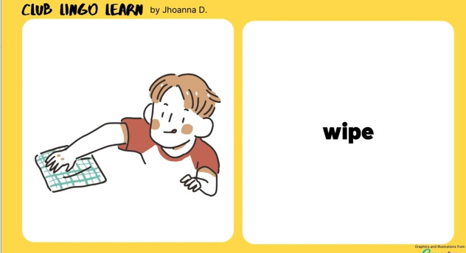
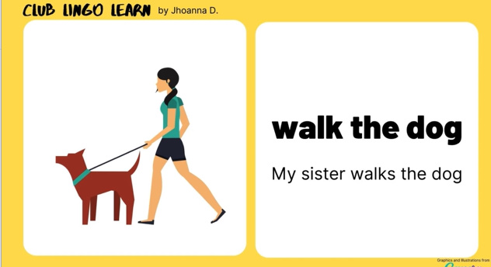
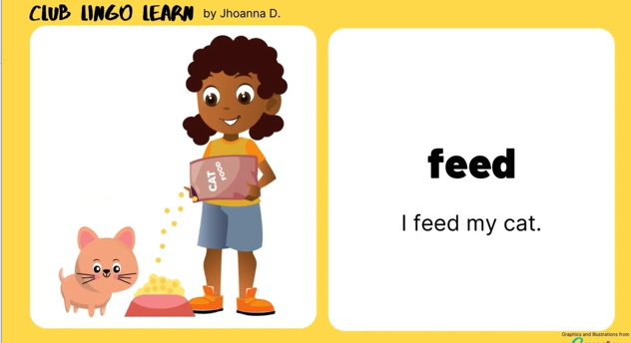
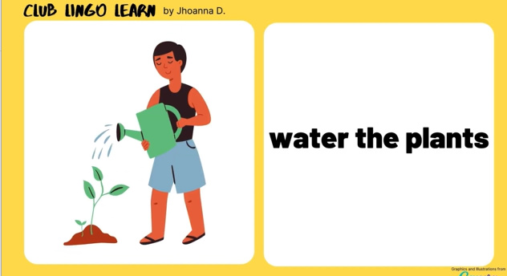
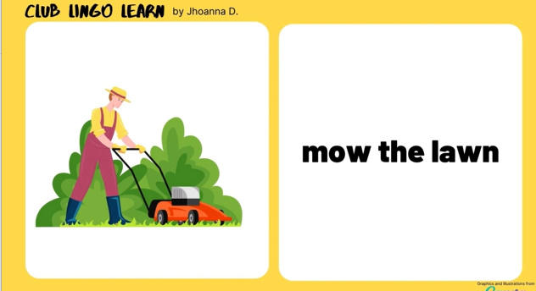

Slide 6
……, November …., 202…
Unit 4:
Ethnic groups of viet nam
Lesson 6: Skills 2

Slide 7
VOCABULARY

Slide 8
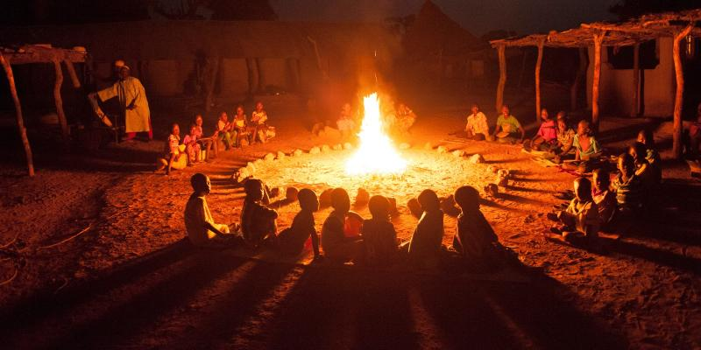

VOCABULARY
gather (v)
/ˈɡæðər/
tụ họp

Slide 9
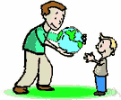
VOCABULARY
pass on (v)
/pɑːs ɒn/
để lại

Slide 10
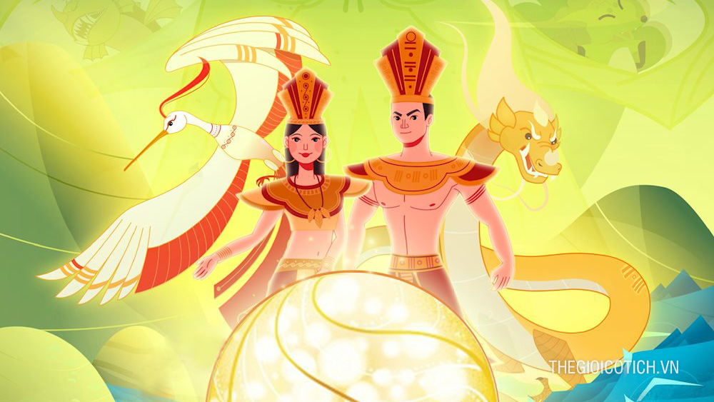

VOCABULARY
legend (n)
/ˈledʒənd/
truyền thuyết

Slide 11
VOCABULARY
- gather (v) | /ˈɡæðər/ | tụ họp
- pass on (v) | /pɑːs ɒn/ | để lại
- legend (n) | /ˈledʒənd/ | truyền thuyết

Slide 12
listening

Slide 13

1. Match the phrases with the correct pictures.
1. catching fish
2. weaving clothing
3. growing crops
_______________
_______________
_______________

Slide 14
catching fish

Slide 15
weaving clothing

Slide 16
growing crops

Slide 17
Look at the answers again
2. weaving clothing
3. growing crops
1. catching fish
_______________
_______________
_______________

Slide 18


2. Listen and tick ( ) the activities that minority children do to help their families.
1. look after the house
2. weave clothing
3. prepare food
4. build houses
5. grow crops
6. raise livestock

Slide 19
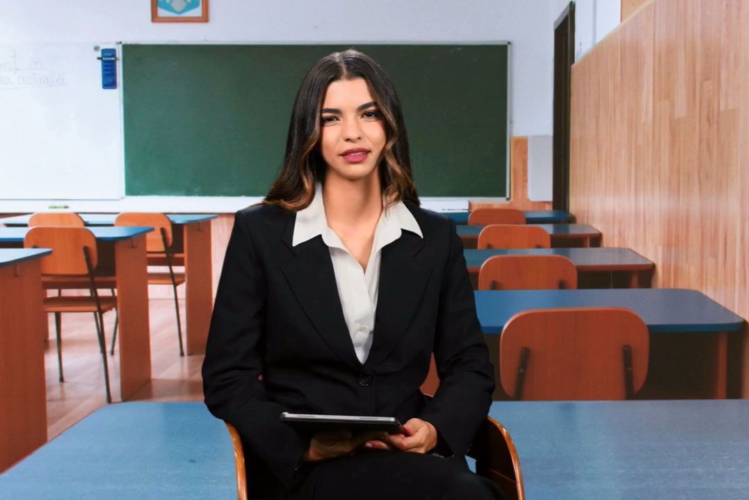

Slide 20
2. Listen and tick ( ) the activities that minority children do to help their families.
1. look after the house
2. weave clothing
3. prepare food
4. build houses
5. grow crops
6. raise livestock

Slide 21
3. Listen again and circle the correct answer A, B, or C.
1. Minority children usually learn to work at ______.
A. twelve B. ten C. six
2. Girls ______.
A. weave clothing B. do the gardening C. catch fish
3. Boys ______.
A. prepare food B. raise livestock C. do housework
4. Children learn traditions through _____
A. work B. music C. stories
5. The number of minority children going to school is ______.
A. going up B. going down C. staying the same

Slide 22





LUCKY WHEEL
30
20
1
2
3
40
10
50
80
4
5
6
60
70
PLAY
Notes:
CLICK PLAY ĐỂ QUAY, CLICK VÒNG QUAY ĐỂ DỪNG QUAY.
CLICK TRÁI TIM VÀNG ĐỂ CHUYỂN SLIDE XEM CÂU TL.

Slide 23

Check your answers
1. Minority children usually learn to work at ______.
twelve
ten
six
They learn to work from an early age, usually at six.

Slide 24
Check your answers
2. Girls ______.
A. weave clothing
B. do the gardening
C. catch fish
Girls help look after the house, care for smaller children, weave clothing and prepare food.

Slide 25
Check your answers
3. Boys ______.
A. prepare food
B. raise livestock
C. do housework
Boys learn to do what their fathers do. They grow crops, raise the family's livestock and catch fish.

Slide 26
Check your answers
4. Children learn traditions through _____.
work
music
stories
Children listen to stories or legends of heroes from their grandparents. They also listen to adults talk about their work. This is how the elders pass on traditions and knowledge to their children.

Slide 27
Check your answers
5. The number of minority children going to school is ______.
A. going up
B. going down
C. staying the same
Nowadays, more and more minority children are going to school.

Slide 28


Slide 29
Look at the answers again
1. Minority children usually learn to work at ______.
A. twelve B. ten C. six
2. Girls ______.
A. weave clothing B. do the gardening C. catch fish
3. Boys ______.
A. prepare food B. raise livestock C. do housework
4. Children learn traditions through _____
A. work B. music C. stories
5. The number of minority children going to school is ______.
A. going up B. going down C. staying the same

Slide 30
writing

Slide 31
4. Note five things you do to help your family.
Example: - cook meals
- Tidy up the bed
- Prepare breakfast / dinner
- Clean the room
- Plant vegetables / flowers
- Repair the bike

Slide 32
5. Write a paragraph (80 - 100 words) about the things you do to help your family. Use the ideas in 4.

Slide 33
Suggested answer:
I learnt to share housework with other members of the family when I was seven or eight. I always start the day by tidying up my bed. Then I prepare breakfast for me and my brother. I usually help prepare dinner or do the washing afterwards. At the weekend, I usually spend an hour cleaning and tidying up my room and collecting dirty clothes of the whole family for washing. I sometimes do other work like planting vegetables or flowers on the top open floor of our house with my mother, repairing our bikes with my father, or repainting the gate. I think doing housework together connects our family’s members.

Slide 34
WRAP - UP
learnt new words related the topic of the listening text.
understood more about ethnic children through listening tasks.
written a paragraph about the things you do to help your family.

Slide 35
HOMEWORK
Learn by heart vocabulary
Prepare for the next lesson

Slide 36
THANK YOU

