Slide 2
Unit
5
OUR EXPERIENCES
LESSON 6: SKILLS 2
1

Slide 3
LESSON 6: SKILLS 2
LESSON 1: GETTING STARTED
WARM-UP
Asking questions
Task 1: Which of the following is a bad experience.
Task 2: Listen to the conversation between Minh and his dad and tick T (True) or F (False).
Task 3: Listen again and choose the correct answer A, B, or C.
LISTENING
Task 4: Work in pairs. Put the phrases from the box in the correct column.
Task 5: Write a paragraph (100 – 120 words) about the most pleasant OR unpleasant experience you have had at school.
WRITING
CONSOLIDATION
Wrap-up
Homework

Slide 4
WARM-UP
Who is faster?
1. Play in 2 teams.
2. Each team has a set of phrases on slips of paper about the experiences of Duong and Aikiko.
3. Distinguish between Duong’s activities and Akiko’s.
4. The fastest and most correct one wins.
EXPERIENCES

Slide 5
LET’S CHECK
WARM-UP
Duong:
1. Join a performance
2. Read books
3. Join team activities
4. Call his / her parents once a day
5. Received letters from our parents
6. Travelled without his / her parents
7. Wake up at 5 a.m.
EXPERIENCES

Slide 6
WARM-UP
LET’S CHECK.
Akiko:
1. Attend English classes
2. Join team activities
3. Communicate in English
4. Played board games
5. Play billiards
6. Go hiking
7. Enjoy the city view at the mountain top
8. Travelled without his / her parents
EXPERIENCES

Slide 7
LISTENING
1
Which of the following is a bad experience?
1. failing an exam
2. being bullied
3. winning a competition
4. lacking confidence

Slide 8
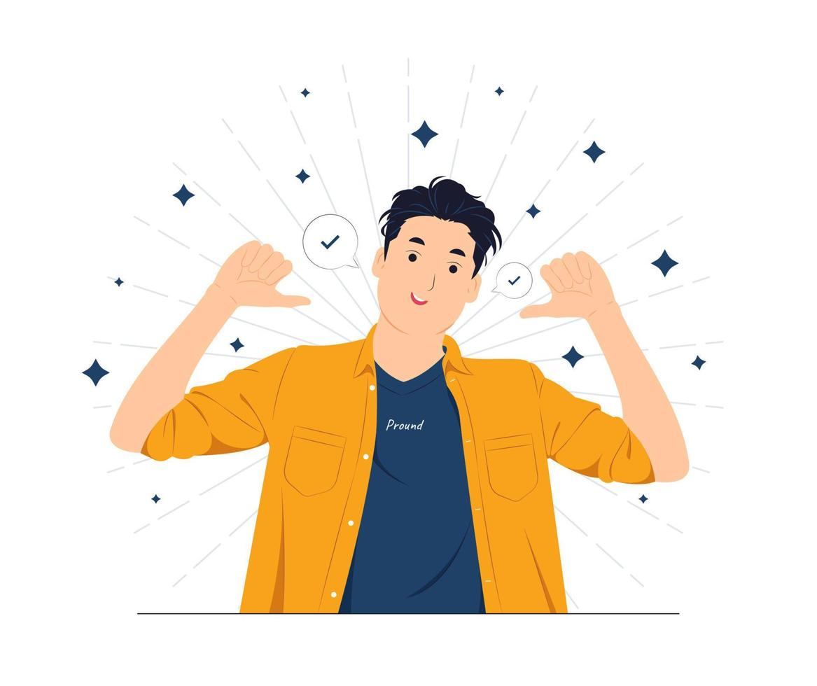
PRESENTATION
confidence (n)
/ˈkɒnfɪdəns/
niềm tin, sự tin tưởng, sự tự tin

Slide 9
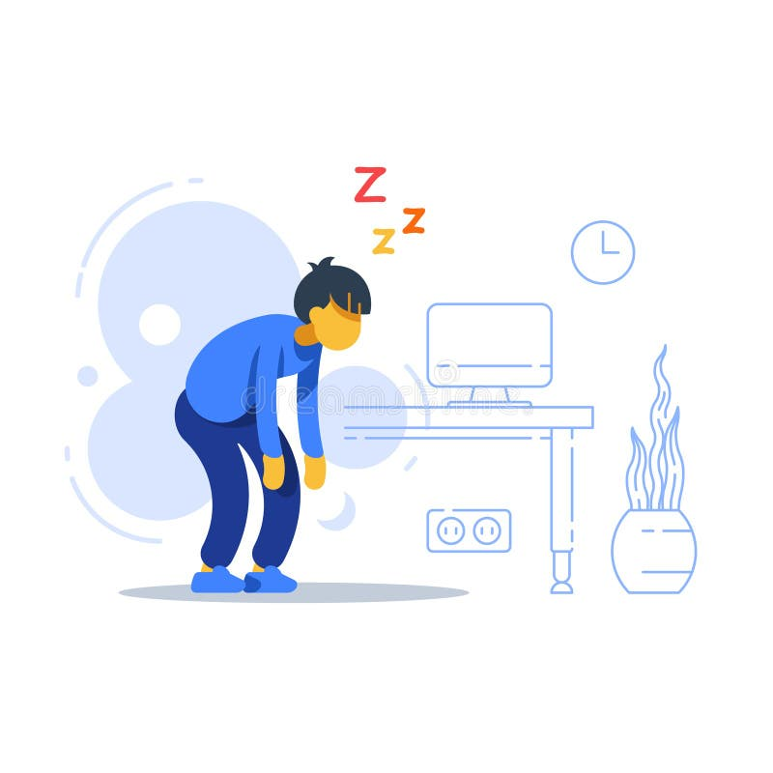
PRESENTATION
lack (v)
/læk/
thiếu

Slide 10
PRESENTATION
New words | Pronunciation | Meaning
1. confidence (n) | /ˈkɒnfɪdəns/ | niềm tin, sự tin tưởng, sự tự tin
2. lack (v) | /læk/ | thiếu

Slide 11
LISTENING
2
Listen to the conversation between Minh and his dad and tick T (True) or F (False).
1. Minh’s peers bullied him. ______
2. Dad could always get things back. ______
3. Dad’s peers got his money. ______
4. Minh had an embarrassing experience. ______
5. Minh understood the lesson well. ______
F
F
T
T
F

Slide 12
PRACTICE
3
Listen again and choose the correct answer A, B, or C.
1. Dad and Minh are talking about ______.
A. dad’s experiences
B. Minh’s experiences
C. experiences of Minh and his dad
2. Dad’s classmates often ______ him.
A. bullied B. helped C. argued with

Slide 13
PRACTICE
3
Listen again and choose the correct answer A, B, or C.
3. Minh’s dad ______ the bullies.
A. ran away from B. shouted at C. fought
4. Minh got a low mark because he ______.
A. reviewed the lesson
B. learnt the lesson by rote
C. learnt the lesson by heart

Slide 14
WRITING
4
Work in pairs. Put the phrases from the box in the correct column.
a. taking wrong things ______________ b. doing community service ______________
c. not revising lessons ______________ d. winning a competition ______________ e. arguing with a friend ______________ f. coming to school late ______________
unpleasant
pleasant
unpleasant
pleasant
unpleasant
unpleasant

Slide 15
WRITING
5
Write a paragraph (100 – 120 words) about the most pleasant OR unpleasant experience you have had at school.
SAMPLE:
I had very pleasant experiences at my school. The first lovely experience I had was when I did community service last year. I joined the school English club, and tutored some primary school students for a semester. Their English became better, and they were much more confident in English lessons. The second memorable experience I had was going on a camping trip with my classmates. We went to a village about 20 km from our school. Here, we put up tent, decorated it and we also won the competition of tent decoration. We sang and danced and took a lot of photos. I also remember winning the first prize in the school chess competition that year. The school then presented me with a chess set. All these pleasant experiences will go with me forever.

Slide 16
CONSOLIDATION
1
Wrap-up
What have we learnt in this lesson?
Listen about experiences of Minh and his dad;
Write about the most pleasant or unpleasant experience you have had at school.

Slide 17
CONSOLIDATION
2
Homework
Do exercises in the workbook;
Rewrite the paragraph in the notebooks.

Slide 18
Website: hoclieu.vn
Fanpage: facebook.com/tienganhglobalsuccess.vn/

