Slide 2
Unit
5
OUR EXPERIENCES
LESSON 5: SKILLS 1
1

Slide 3
LESSON 5: SKILLS 1
LESSON 1: GETTING STARTED
WARM-UP
Chain game
Task 1: Tick the experiences you have had.
Task 2: Complete each sentence with an adjective in the box. Read the texts again and tick Duong or Akiko.
READING
Task 4: Match the questions in A with the answers in B. Share your answers with a classmate.
Task 5: Work in pairs. Ask and answer about a course you have experienced. Use the questions in 4 as cues. Then report your partner’s answers to the class.
SPEAKING
CONSOLIDATION
Wrap-up
Homework

Slide 4
CHAIN GAME!!
WARM-UP
1. Play in 2 teams
2. Each team play rock paper scissors to decide who will go first.
3. The winner say a sentence about their past experience then choose the second one in the other team. The second repeats and say their past experience and so on.
EXPERIENCES

Slide 5
CHAIN GAME!!
WARM-UP
4. The team can’t repeat the prior players’ answers in 10 seconds will lose the game.
EXPERIENCES

Slide 6
WARM-UP
CHAIN GAME!!
EXAMPLE
Student 1 from Team 1:
I had an unpleasant experience of a sports competition at school.
Student 2 from Team 2:
She had an unpleasant experience of a sports competition at school and I accidentally fell while leaning to skate.
Student 3 from Team 1:
She had an unpleasant experience of a sports competition at school. He accidentally fell while leaning to skate and I had a very good experience in the last summer camp …
EXPERIENCES

Slide 7
READING
1
Tick (√) the experiences you have had.
1. Joining a performance
2. Attending an army course
3. Travelling to a new place without parents

Slide 8
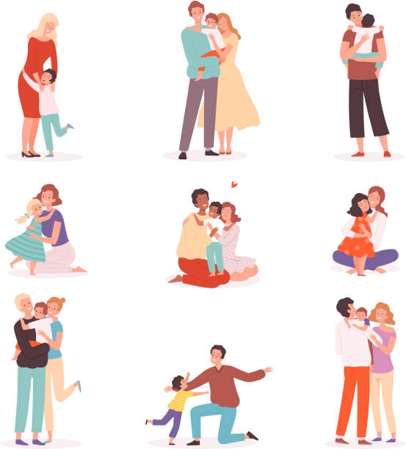
READING
touching (adj)
/ˈtʌtʃɪŋ/
gây xúc động,
tạo cảm giác đồng cảm

Slide 9
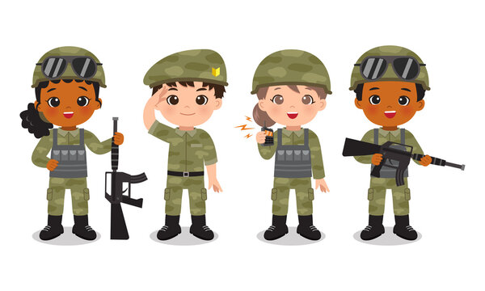
READING
soldier (n)
/ˈsəʊldʒər/
người lính

Slide 10
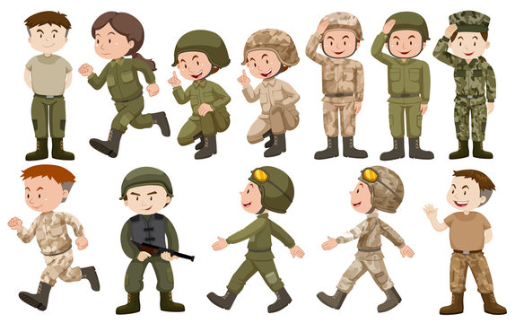
READING
army-like (adj)
/ɑːmi laɪk/
như trong quân đội

Slide 11
READING
strict (adj)
/strɪkt/
nghiêm khắc

Slide 12
READING
theme (n)
/θiːm/
chủ đề, đề tài

Slide 13
READING
New words | Pronunciation | Meaning
1. touching (adj) | /ˈtʌtʃɪŋ/ | gây xúc động, tạo cảm giác đồng cảm
2. soldier (n) | /ˈsəʊldʒə(r)/ | người lính
3. army-like (adj) | /ɑːmi laɪk/ | như trong quân đội
4. strict (adj) | /strɪkt/ | nghiêm khắc
5. theme (n) | /θiːm/ | chủ đề

Slide 14
READING
2
Read the texts and choose the correct answer A, B, C, or D.
Duong: I had a hard 10-day course in an army camp in Son Tay last summer. Everything was different from my life at home. We had to wake up at 5 a.m. and attended classes which were like training courses for soldiers. In the evening, we read books or worked in teams. The team leaders walked us through many exciting activities. We also joined a performance that had the theme: environment protection. We could only call our parents once a day.
We also had touching moments when we received letters from our parents. I have never attended such a strict but exciting course like this.

Slide 15
READING
2
Read the texts and choose the correct answer A, B, C, or D.
Akiko: I have been on an unforgettable summer course in America.
I stayed in Thornwood campus on the outskirts of New York City for three weeks. We had an enjoyable campus tour, attended English classes, and joined team activities. We all tried to communicate in English. In the evening, we played board games and billiards. The most special experience was my visit to the top of Rockefeller Centre. From there, I could view the whole city below.
That was the first time I travelled without my parents, so I felt like
I grew up a lot after the trip.

Slide 16
READING
2
Read the texts and choose the correct answer A, B, C, or D.
1. Duong and Akiko talked about ______.
A. their English summer courses B. experiences at summer courses C. activities in summer D. their army training
2. What didn’t Duong do during his course?
A. Get up early. B. Work as a leader. C. Receive letters from home. D. Work in teams.

Slide 17
READING
2
Read the texts and choose the correct answer A, B, C, or D.
3. The word “theme” means ______.
A. performance B. environment C. activity D. topic
4. The experience at Rockefeller Centre was ______ for Akiko.
A. unforgettable B. enjoyable C. special D. touching
5. The word “that” refers to ______.
A. travelling to America B. touring the Thornwood campus
C. visiting Rockefeller Centre D. viewing the city below

Slide 18
READING
3
Read the texts again and tick Duong or Akiko.
Experiences | Duong | Akiko
1. attending an English course
2. attending an army-like course
3. joining a performance
4. touring a campus
5. receiving letters from home

Slide 19
SPEAKING
4
Match the questions in A with the answers in B. Share your answers with a classmate.
A |  | B
1. What course did you attend? |  | a. It was in June.
2. When was that? |  | b. I felt that I grew up a lot after that course.
3. What did you do? |  | c. I attended a course on soft skills with a group of young trainers.
4. What do you remember most about it? |  | d. We worked in groups on different projects. We also learned to solve problems. We had various experiences.
5. How did you feel? |  | e. I remember being so embarrassed at first. But the trainers and my peers were great and they helped me a lot.

Slide 20
SPEAKING
5
Work in pairs. Ask and answer about a course you have experienced. Use the questions in 4 as cues. Then report your partner’s answers to the class.
Minh attended a memorable summer course last year. It was a presentation skill course. He learnt how to organise the talk, and how to use visual aids. He also practised using gestures, and having eye contacts with the audience. He felt that the course was so impressive and memorable.
Example:

Slide 21
CONSOLIDATION
1
Wrap-up
What have we learnt in this lesson?
Read about Duong and Akiko’s experiences in their last summer;
Talk about a course you have experienced.

Slide 22
CONSOLIDATION
2
Homework
Do exercises in the workbook;
Write down your friend’s experiences in your notebooks.

Slide 23
Website: hoclieu.vn
Fanpage: facebook.com/tienganhglobalsuccess.vn/

