Slide 1

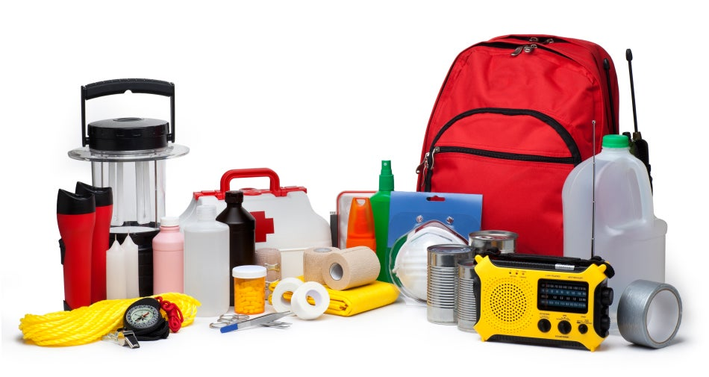
Unit
9
NATURAL DISASTERS
Unit
ETHNIC GROUPS OF VIET NAM
LESSON 3: A CLOSER LOOK 2
LESSON 6: SKILLS 2
Unit
HOBBIES

Slide 2
LESSON 6: SKILLS 2
WARM-UP
Chatting
* Vocabulary
Task 1: Work in pairs. Look at the picture and answer the questions.
Task 2: Listen to a broadcast. Put the activities in the correct column.
Task 3: Listen again and tick T (True) or F (False) for each sentence.
LISTENING
Task 4: Work in pairs. Discuss what you should do before, during, and after a flood. Write your ideas in the columns.
Task 5: Write instructions (80 - 100 words) about things to do before, during, and after a flood.
WRITING
CONSOLIDATION
Wrap-up
Homework

Slide 3
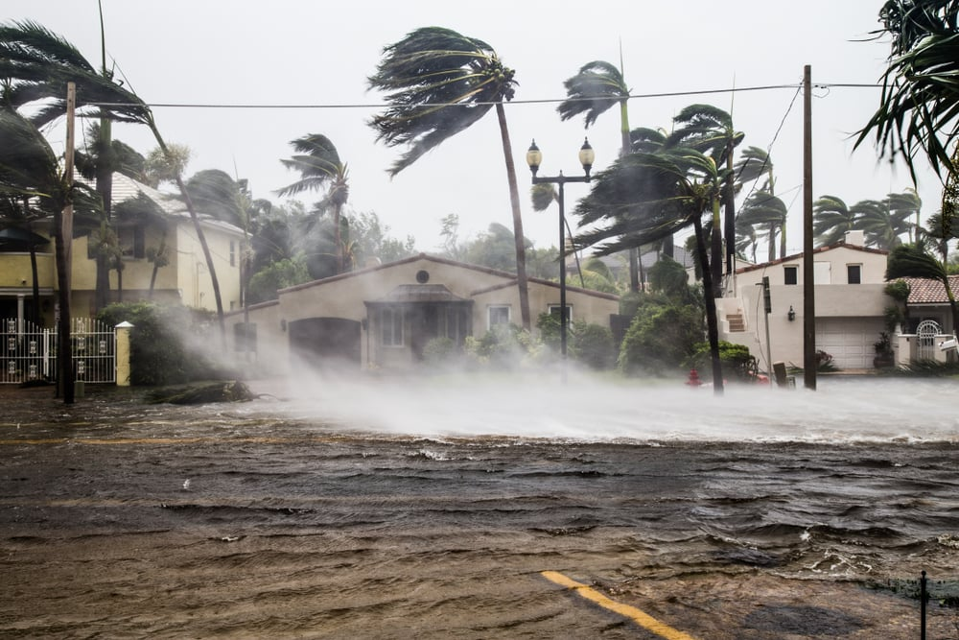
WARM-UP
What should people do before, during and after a storm?

Slide 4
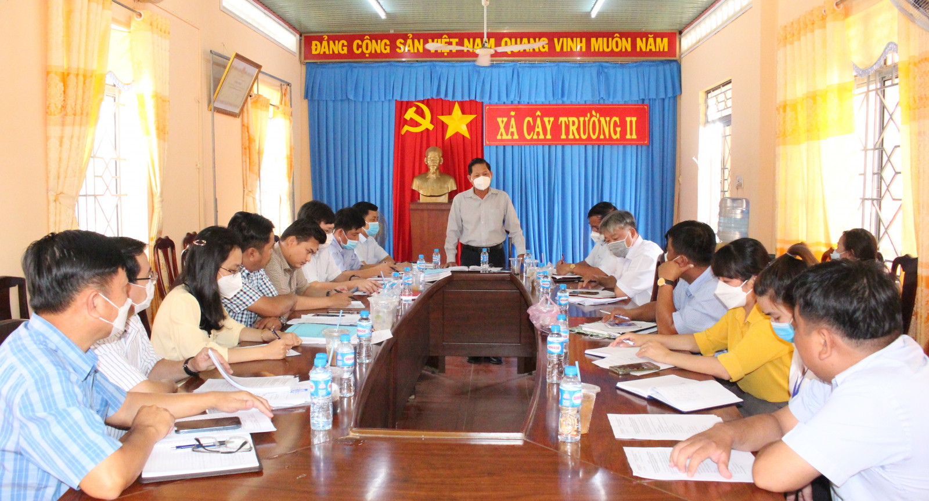

LISTENING
authority (n)
/ɔːˈθɒrəti/
chính quyền

Slide 5
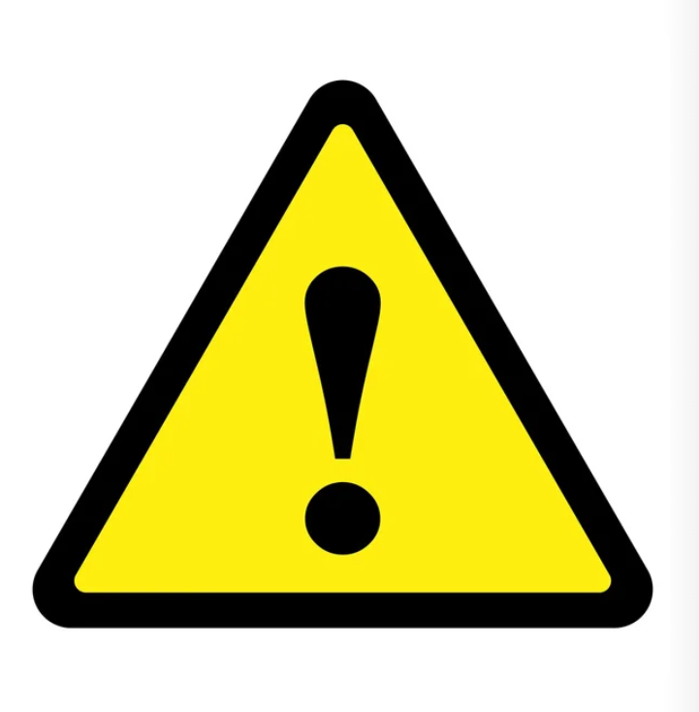
LISTENING
warn (v)
/wɔːn/
cảnh báo

Slide 6

LISTENING
avoid (v)
/əˈvɔɪd/
tránh, tránh xa

Slide 7
LISTENING
New words | Pronunciation | Meaning
1. authority (n) | /ɔːˈθɒrəti/ | chính quyền
2. warn (v) | /wɔːn/ | cảnh báo
3. avoid (v) | /əˈvɔɪd/ | tránh, tránh xa

Slide 8
LISTENING
New words |  | Meaning
1. authority (n)
2. warn (v)
3. avoid (v)
cảnh báo
tránh, tránh xa
chính quyền

Slide 9
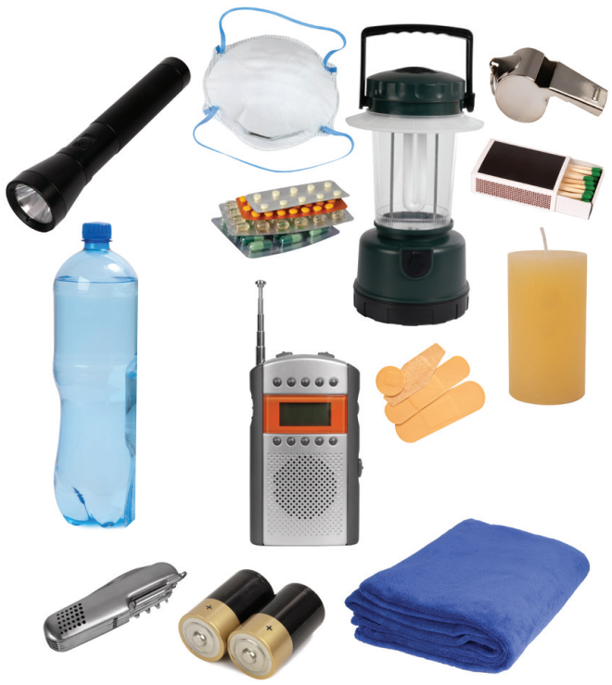
LISTENING
1
Work in pairs. Look at the picture and answer the questions.
What can you see in the picture?
2. When do we need these things?

Slide 10
LISTENING
2
Listen to a broadcast. Put the activities (1 – 6) in the correct column.
Before a storm | During a storm | After a storm
2,6
3,5
1,4
1. Listen to instructions from local authorities
2. Prepare an emergency kit
3. Stay inside the house
4. Keep away from dangerous areas
5. Avoid windows and glass doors
6. Strengthen houses

Slide 11

LISTENING
3
Listen again and tick T (True) or F (False) for each sentence.
 | T | F
1. The broadcast is on TV.
2. You should bring flowerpots and rubbish bins into the house.
3. Right after the storm, you can leave your home.
4. The local authority may warn you about dangerous places.

Slide 12
WRITING
4
Work in pairs. Discuss what you should do before, during, and after a flood. Write your ideas in the columns.
Before a storm | During a storm | After a storm
-Prepare an emergency
kit.
....
-Stay inside a safe and high place.
…
-Avoid moving water.
…

Slide 13
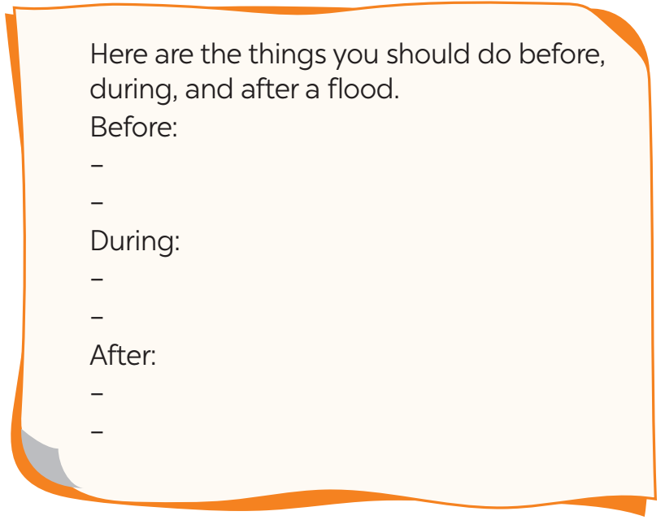
WRITING
5
Write instructions (80 - 100 words) about things to do before, during, and after a flood.

Slide 14
WRITING
5
Write instructions (80 - 100 words) about things to do before, during, and after a flood.
Suggested answer:
Here are the things you should do before, during, and after a ﬂood.
Before:
– Prepare an emergency kit with necessary things.
– Build barriers to stop ﬂoodwater from entering the house.
– Move to a higher place if necessary.
During:
– Listen to the radio or television for warnings and information.
– Be careful with ﬂash ﬂooding.
After:
– Avoid moving water.
– Stay away from damaged areas unless the local authority needs your help.
– Listen for local warnings of ﬂash ﬂoods.

Slide 15

CONSOLIDATION
1
Wrap-up
In this lesson, you have:
learnt new words related to natural disasters.
known more about things to do before, during, and after a storm.
written instructions about things to do before, during, and after a flood.

Slide 16

CONSOLIDATION
2
Homework
Learn by heart all the words.
Do exercises in the workbook.
Rewrite the instructions.
Prepare for Lesson 7

Slide 17

Website: hoclieu.vn
Fanpage: facebook.com/tienganhglobalsuccess.vn/

