Slide 1
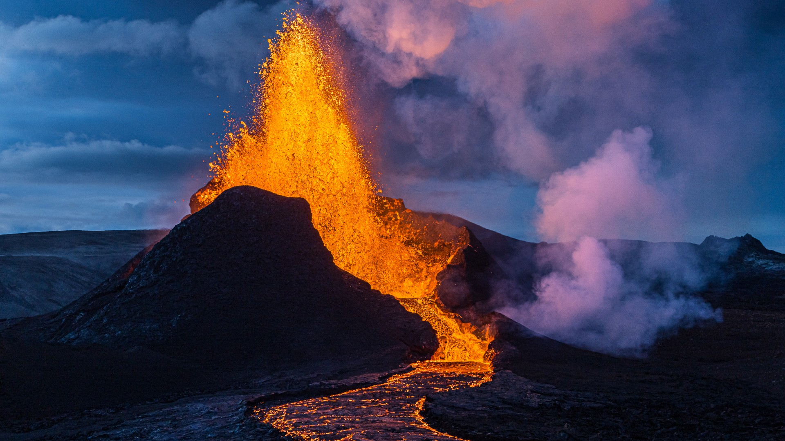
Unit
9
NATURAL DISASTERS
Unit
ETHNIC GROUPS OF VIET NAM
LESSON 5: SKILLS 1
LESSON 3: A CLOSER LOOK 2
Unit
HOBBIES

Slide 2
LESSON 5: SKILLS 1
WARM-UP
Who’s faster?
* Vocabulary
Task 1: Match the headlines with the natural disasters.
Task 2: Read the articles. Match the highlighted words with their meanings.
Task 3: Read the articles again and answer the questions.
READING
Task 4: Match the questions with the answers.
Task 5: Prepare a short piece of news about the natural disaster in 4 or one you know of. Report the news to the class.
SPEAKING
CONSOLIDATION
Wrap-up
Homework

Slide 3
WARM-UP
landslide
erupt
tornado
Natural disasters
warning
rescue worker
shake
victim
emergency kit

Slide 4
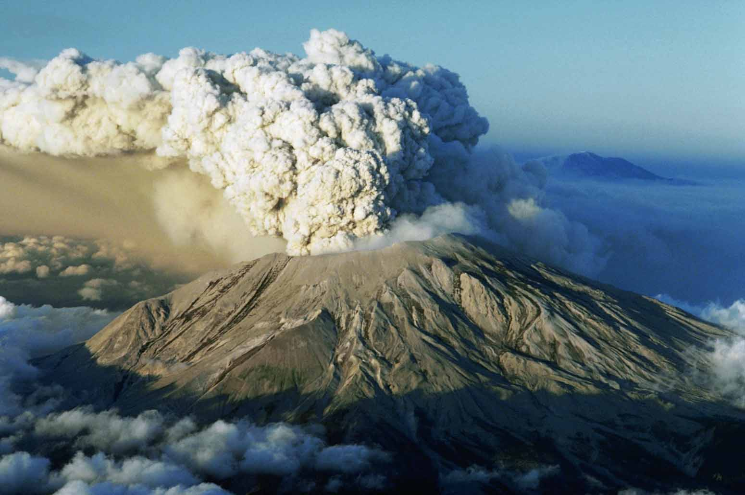
VOCABULARY
ash (n)
/æʃ/
tro

Slide 5
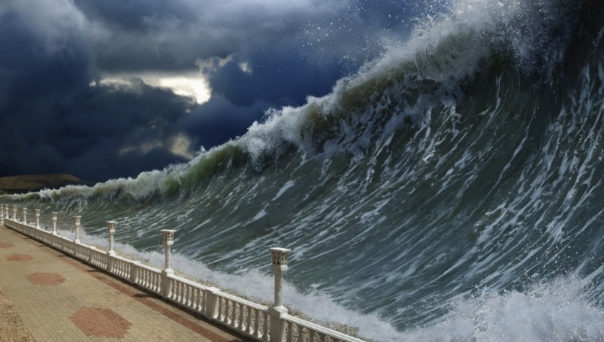
VOCABULARY
tsunami (n)
/tsuːˈnɑːmi/
trận sóng thần

Slide 6
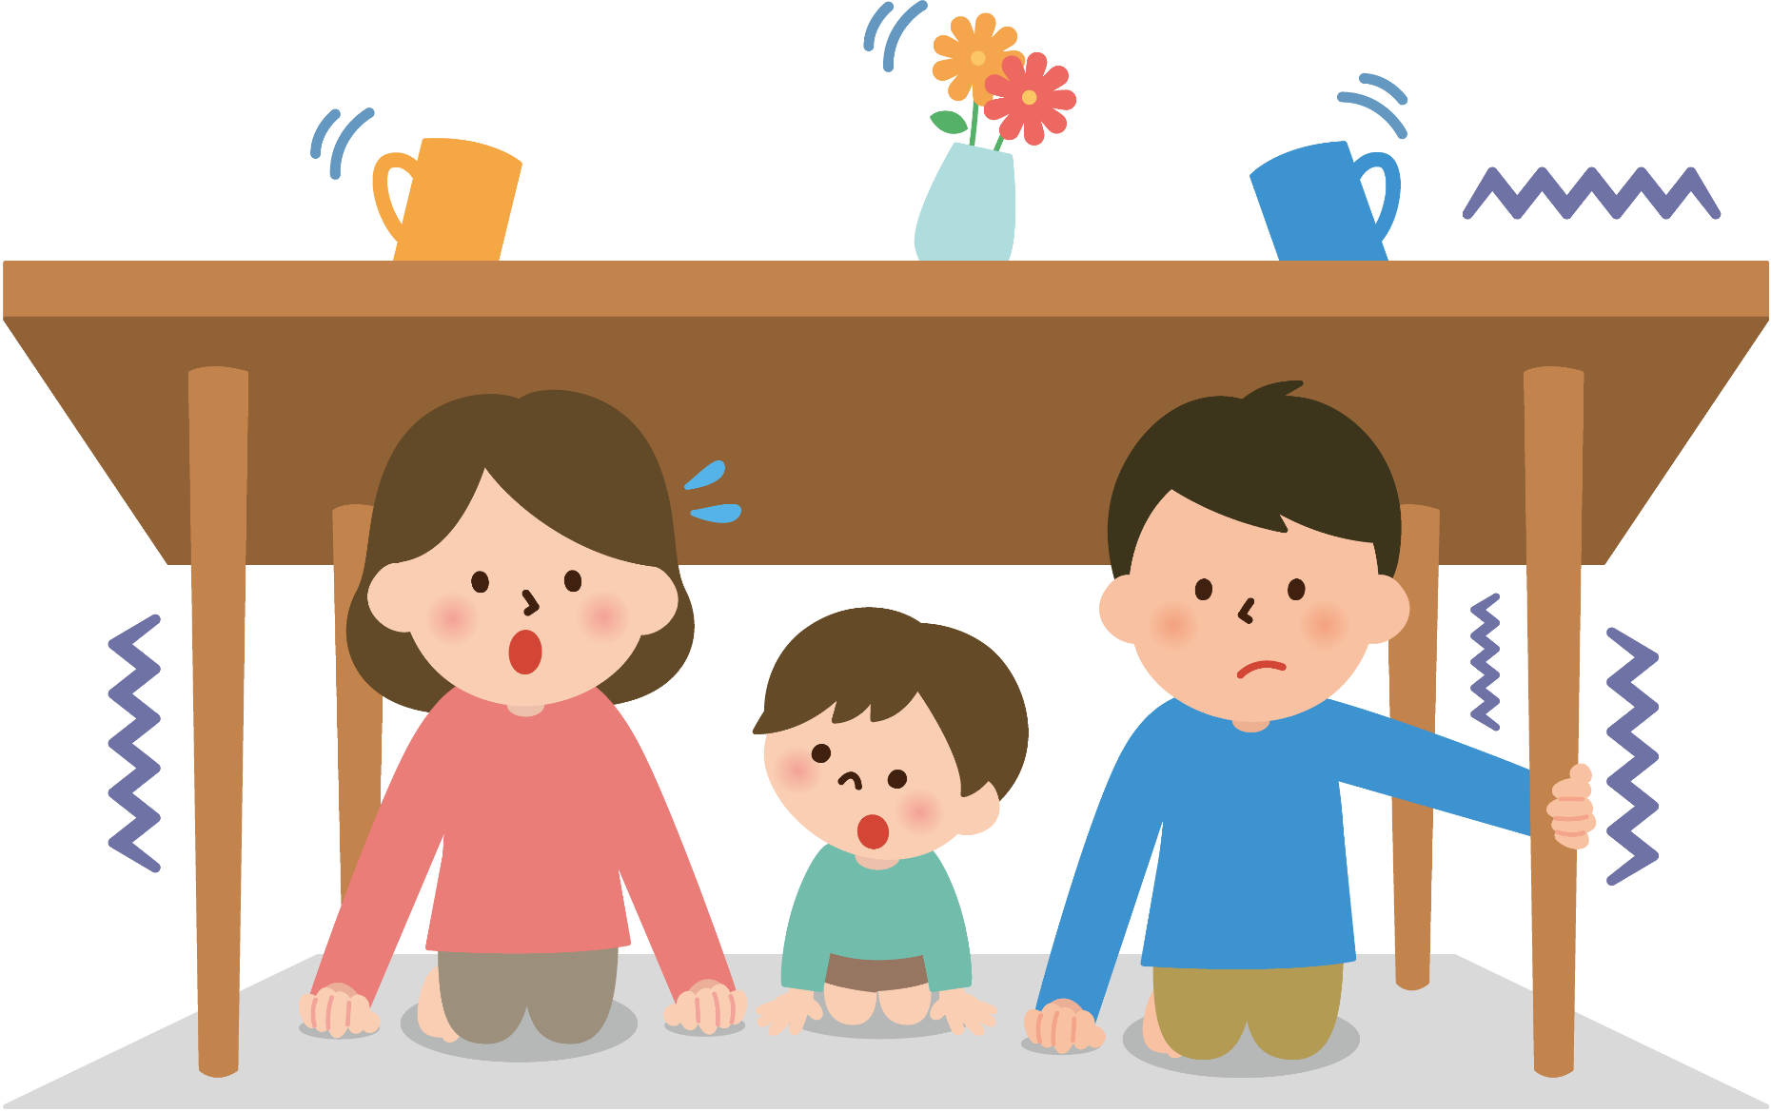
VOCABULARY
tremble (v)
/ˈtrembl/
rung lắc

Slide 7
VOCABULARY
New words | Pronunciation | Meaning
1. ash (n) | /æʃ/ | tro
2. tsunami (n) | /tsuːˈnɑːmi/ | trận sóng thần
3. tremble (v) | /ˈtrembl/ | rung lắc

Slide 8
VOCABULARY
New words |  | Meaning
1. ash (n)
2. tsunami (n)
3. tremble (v)
trận sóng thần
rung lắc
tro

Slide 9
READING
1
Match the headlines (1 – 2) with the natural disasters (A – B).
Headlines |  | Natural disasters
1. 30 seconds of a slight shaking in Ha Noi
2. A thick layer of ash covers Tonga
A. volcanic eruption
B. earthquake

Slide 10
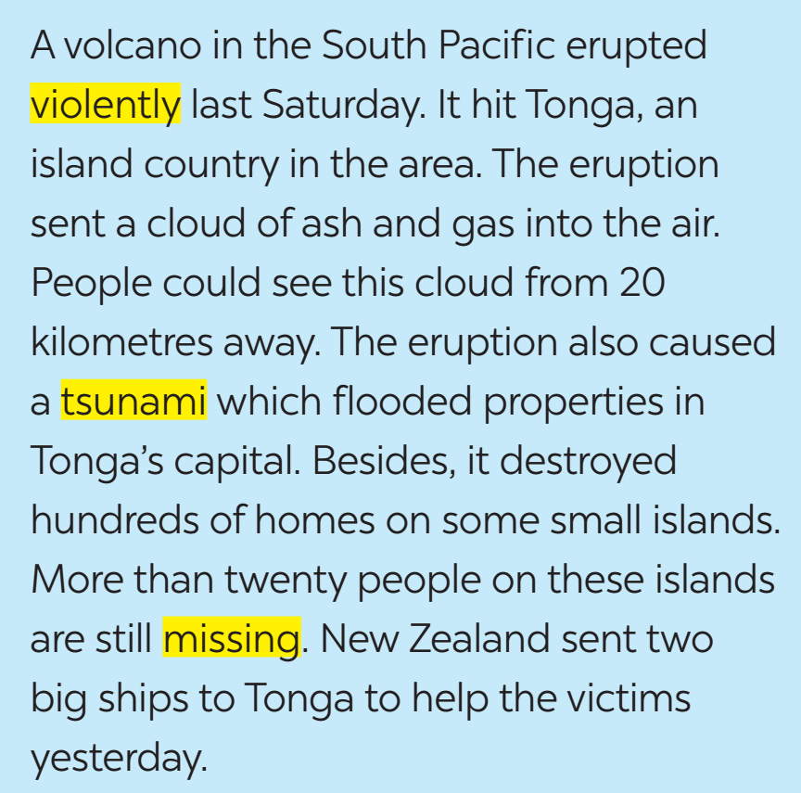
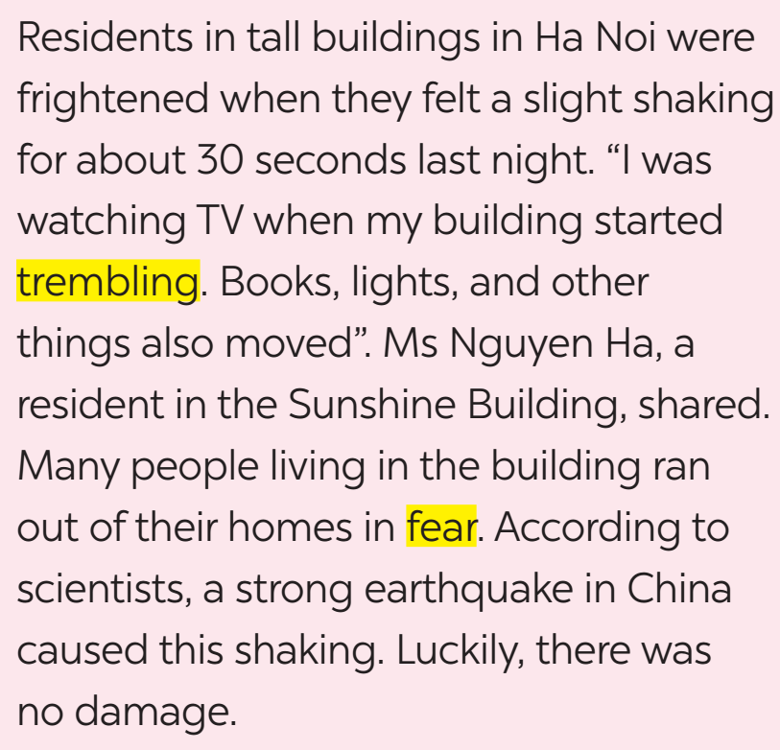
READING
2
Read the two news articles. Match the highlighted words with their meanings.

Slide 11
READING
2
Read the two news articles. Match the highlighted words with their meanings.
Highlighted words |  | Meanings
1. violently
2. tsunami
3. missing
4. trembling
5. fear
a. not yet found
b. slightly shaking
c. the bad feeling you have when you are frightened
d. very strongly
e. very large waves in the sea

Slide 12
READING
3
Read the articles again and answer the questions.
1. Where and when did the eruption happen?
=>
2. What did the eruption cause?
=>
3. What were the other effects of the eruption?
=>
In the South Pacific last Saturday.
A tsunami.
It destroyed hundreds of homes on some small islands, and more than twenty people on these islands are missing.

Slide 13
READING
3
Read the articles again and answer the questions.
4. How long did the buildings shake?
=>
5. What caused the shaking?
=>
For about 30 seconds.
A strong earthquake in China.

Slide 14
SPEAKING
4
Work in pairs. Match the questions with the answers.

Slide 15
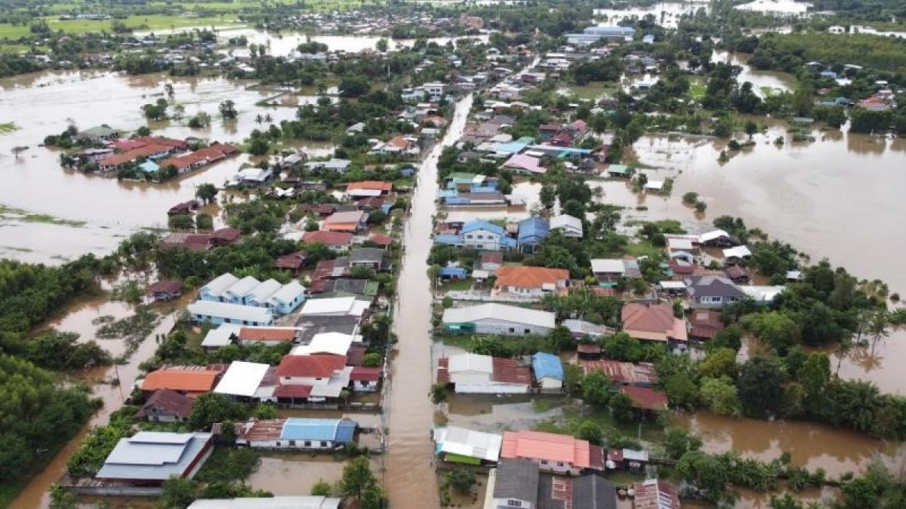
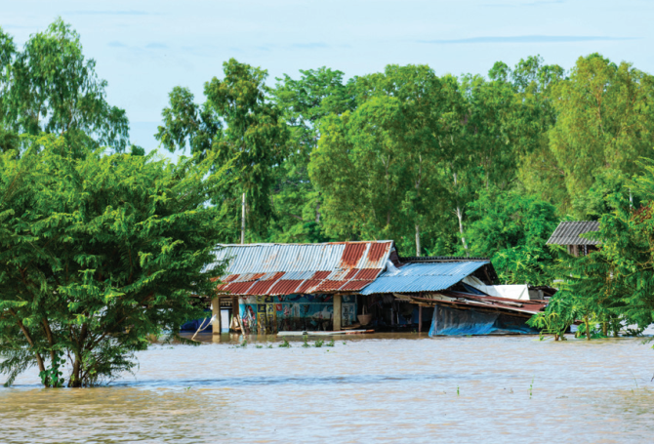
SPEAKING
5
Work in groups. Prepare a short piece of news about the natural disaster in 4 or one you know of. Report the news to the class.
Example:
Five days of heavy rain caused a serious flood in a village in Phu Yen. The flood happened last week. …

Slide 16
CONSOLIDATION
1
Wrap-up
In this lesson, you have:
learnt new words related to natural disasters.
read 2 passages about volcano and earthquake.
report a short piece of news about the natural disaster.

Slide 17
CONSOLIDATION
2
Homework
Learn the words by heart.
Do exercises in the workbook.
Prepare for Lesson 6 – Skills 2.

Slide 18
Website: hoclieu.vn
Fanpage: facebook.com/tienganhglobalsuccess.vn/

