Slide 1
Unit
7
ENVIRONMENTAL PROTECTION
LESSON 6: SKILLS 2
1

Slide 2
LESSON 6: SKILLS 2
WARM-UP
Task 1: Work in groups. Make a list of some activities that cause water pollution.
Task 2: Listen to the conversation and choose the correct word to complete each sentence.
Task 3: Listen again and give short answers to the following questions. Use no more than THREE words.
LISTENING
Task 4: Work in pairs. Read the notice and match the headings with the numbers.
Task 5: Write a notice for the Go Green Club leader to invite students to attend a lecture on water pollution.
WRITING
Wrap-up
Homework
CONSOLIDATION

Slide 3
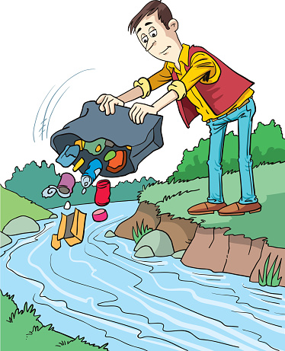
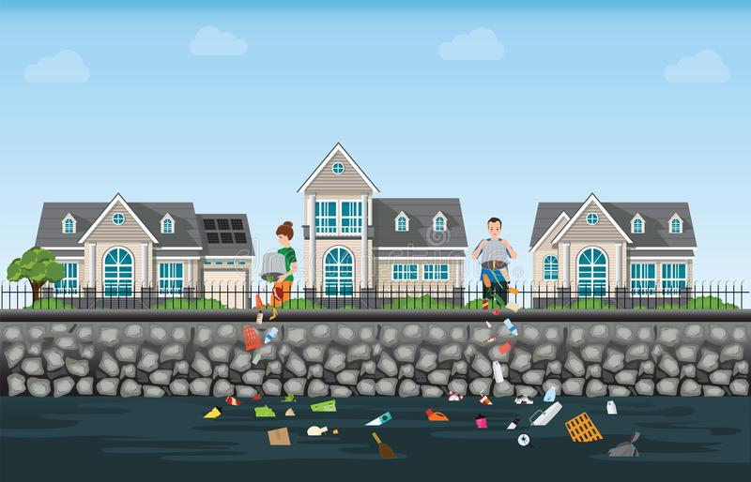
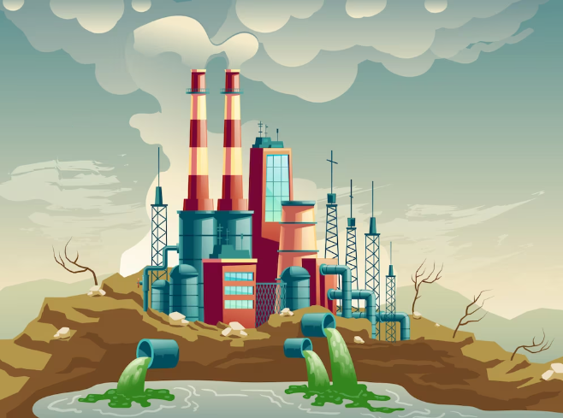
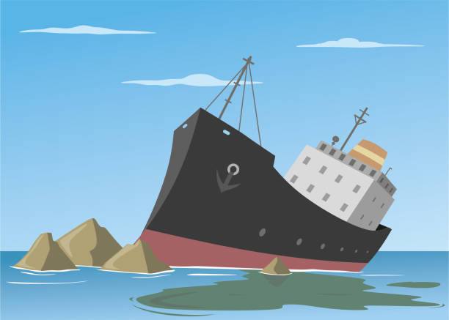
WARM-UP
1
Work in groups. Make a list of some activities that cause water pollution.
THROWING RUBBISH
DOMESTIC WASTE
INDUSTRIAL WASTE
SPILLING FUEL

Slide 4
LISTENING
2
Listen to a talk and choose the correct word to complete each sentence.
1. Polluted water is unsafe for drinking / cooking and for other uses.
2. Sometimes toxic substances ﬂow into rivers from factories / hospitals.
3. Water pollution has a dangerous / harmful eﬀect on our life.
4. We couldn’t / shouldn’t throw litter into rivers and lakes.

Slide 5
LISTENING
3
Listen again and give short answers to the following questions. Use no more than THREE words.
1. What is the listening text about?
2. How many sources of water pollution are there?
3. What are two common sources of drinking water?
4. What type of eﬀect does water pollution have on our life?
5. What products can we use to reduce water pollution?
Water pollution
Two
Rivers and lakes
A harmful effect
Green products

Slide 6
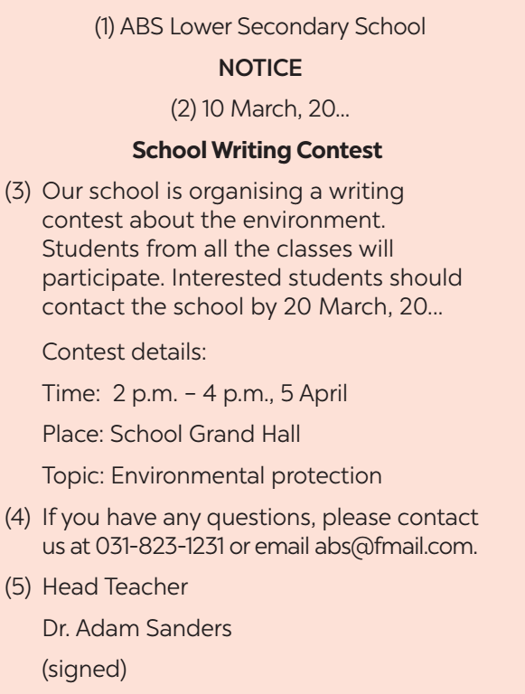
WRITING
4
Work in pairs. Read the notice and match the headings (a – e) below with the numbers (1 – 5).
a. Name of institution or organisation
(School, etc.)
c. Date of writing the notice
b. Body (date / time / duration / place, etc.)
e. Contact details
d. Author’s name and signature

Slide 7
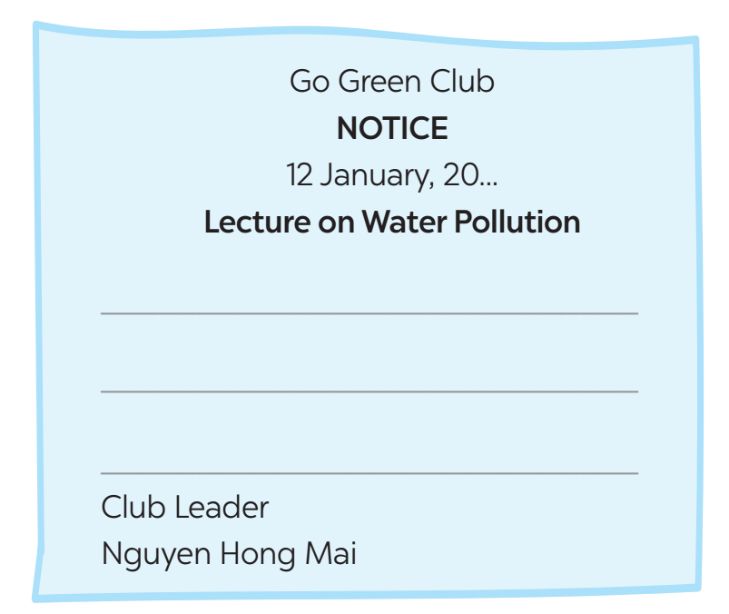
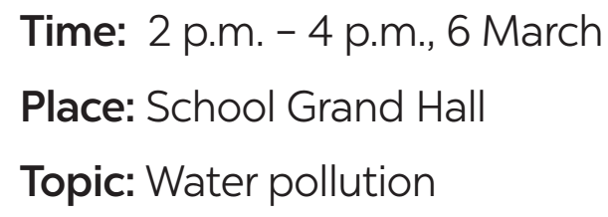
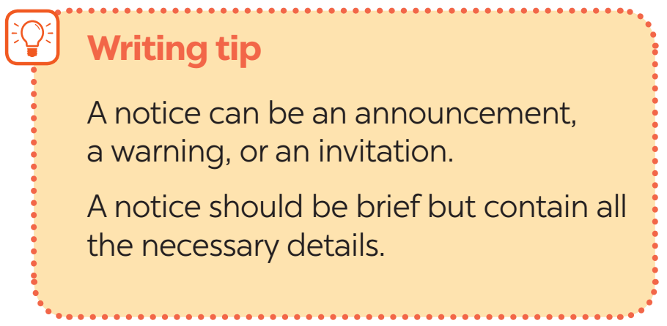
WRITING
5
Write a notice for the Go Green Club leader to invite students to attend a lecture on water pollution. Use the following details.

Slide 8
WRITING
Go Green Club
NOTICE
12 January, 2023
Lecture on Water Pollution
All students of our school are invited to attend a lecture on water pollution next week. Interested students should contact the club by 17 February, 2023.
Details:
Time: 2 p.m. – 4 p.m., 6 March
Place: School Grand Hall
Topic: Water pollution
If you have any questions, please contact us at 012-3476-789 or email gogreen@fmail.com.
Club Leader
Nguyen Hong Mai

Slide 9
CONSOLIDATION
1
Wrap-up
What have we learnt in this lesson?
Listening about water pollution
Writing a notice

Slide 10
CONSOLIDATION
2
Homework
- Do exercises in the workbook.

Slide 11
Website: hoclieu.vn
Fanpage: facebook.com/www.tienganhglobalsuccess.vn/

