Slide 2
WARM-UP
1. I always take a bath before I go to bed.
2. Will you wait here until I am ready?
3. I was not at home when he came to see me.
4. Do not disturb me when I am busy with my work.
5. As soon as she finished that project, she started working on the next.
6. After I have finished my work, I will accompany you to the park.
ADVERB CLAUSES OF TIME

Slide 3
PRESENTATION
Complex sentences with adverb clauses of time
– A complex sentence contains one independent clause and at least one dependent clause.
Example:
The roads were slippery when it rained.
independent clause dependent clause

Slide 4
PRESENTATION
Complex sentences with adverb clauses of time
– An adverb clause is a dependent clause.
– An adverb clause of time shows when something happens. It is usually introduced by time connectors: before, after, when, while, till / until, as soon as, …

Slide 5
PRESENTATION
1
Read the sentences and write I.C if the underlined clause is an independent clause or D.C if it is a dependent clause
I.C
1. I’ll wait for you here until you get back.
2. Make sure you lock the door when you go out.
3. You must get a permit before you build a campfire at a national park.
D.C
I.C

Slide 6
PRESENTATION
1
Read the sentences and write I.C if the underlined clause is an independent clause or D.C if it is a dependent clause
D.C
4. Don’t use too much water while you are having a shower.
5. As soon as my friends come, we will pick up rubbish on the beach.
D.C

Slide 7
PRACTICE
2
Choose A, B, or C to complete each sentence.
1. I was not at home ______ he came to see me yesterday. A. when B. until C. as soon as
2. We called the forest guard unit ______ we saw the bush fire. A. as soon as B. while C. until
3. I went straight to the gym ______ I left home. A. while B. before C. after

Slide 8
PRACTICE
2
Choose A, B, or C to complete each sentence.
4. You can stay with us ______ you find a suitable place to stay. A. as soon as B. before C. until
5. We cleaned up everything at the campsite ______ we left. A. until B. before C. while

Slide 9
PRACTICE
3
Match the clauses in the two columns to form complex sentences.

Slide 10
PRACTICE
4
Combine each pair of sentences, using the conjunction in brackets.
1. I arrive at the station. I will call you right after. (as soon as)
2. Many Vietnamese women wear conical hats. They work in the field. (when)
I will call you as soon as I arrive at the station.
As soon as I arrive at the station, I will call you.
Many Vietnamese women wear conical hats when they work in the field.

Slide 11
PRACTICE
4
Combine each pair of sentences, using the conjunction in brackets.
3. My father taught me how to use the computer. Then he bought one for me. (before)
My father taught me how to use the computer before he bought one for me.
Before my father bought me a computer, he taught me how to use it.

Slide 12
PRACTICE
4
Combine each pair of sentences, using the conjunction in brackets.
4. Nick is reading a novel. Jack is reading a cartoon. (while)
Nick is reading a novel while Jack is reading a cartoon.
While Nick is reading a novel, Jack is reading a cartoon.

Slide 13
PRACTICE
4
Combine each pair of sentences, using the conjunction in brackets.
5. The tornado hit. There were only a few houses left standing. (after)
After the tornado hit, there were only a few houses left standing.
There were only a few houses left standing after the tornado hit.

Slide 14
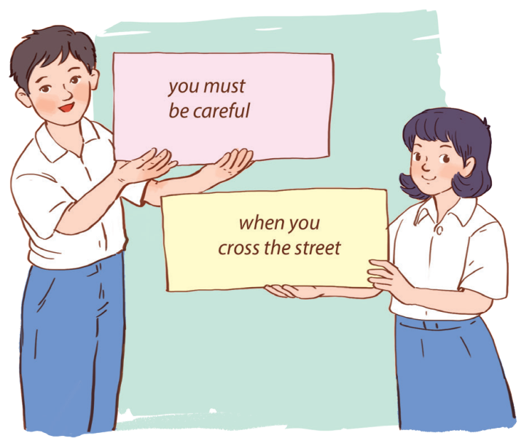
PRODUCTION
5
Matching game:
Work in two groups, A and B.
Group A: write main clauses
Group B: write adverb clauses of time

Slide 15
CONSOLIDATION
1
Wrap-up
What have we learnt in this lesson?
use the Complex sentences with adverb clauses of time;

Slide 16
CONSOLIDATION
2
Homework
Do exercises in the workbook.

Slide 17
Website: hoclieu.vn
Fanpage: facebook.com/www.tienganhglobalsuccess.vn/

