Slide 1

WARM-UP
1
Vocabulary
Environmental protection
Pronunciation
Sounds: /bl/ and /kl/
Skills
• Reading about Con Dao National Park
• Talking about Vu Quang National Park
• Listening about water pollution
• Writing a notice
Grammar
Complex sentences with
adverb clauses of time

Slide 2
VOCABULARY
1
Choose the correct answer A, B, or C to complete each sentence.
1. The panda’s natural ______ is the bamboo forest.
A. habitat B. ecosystem C. area
2. This forest provides a habitat for hundreds of ______ of plants
and animals.
A. styles B. classes C. species
3. ______ the environment must be the job of everyone in the community.
A. Caring B. Protecting C. Keeping

Slide 3
VOCABULARY
1
Choose the correct answer A, B, or C to complete each sentence
4. We should ______ the consumption of single-use products like plastic bottles and bags.
A. reduce B. encourage C. raise
5. ______ trees and burning forests destroy a lot of wildlife habitats.
A. Watering B. Cleaning up C. Cutting down

Slide 4
VOCABULARY
2
Complete each of the sentences with a word or phrase from the box.
carbon footprint littering picking up rubbish habitats endangered species
1. Do you know that _______ can cause pollution?
2. One eﬀective way to reduce your ______________ is to walk or cycle whenever you can.
3. By planting trees and ________________, we can improve our environment.
4. Humans are harming the _______ of bees throughout the world.
5. Animals such as saolas and dugongs are _________________.
littering
carbon footprint
picking up rubbish
habitats
endangered species

Slide 5
GRAMMAR
3
Complete the following sentences using a clause. Use your own ideas.
1. We should wait here until _____________________.
2. As soon as I arrived, ________________________________.
3. Remember to lock the door before __________________.
4. There were not many animals on the mountain after
_______________________.
5. When we finished our picnic, ______________________________.
the teacher comes back
all of my classmates had already there
you leave the house
they built the factory there
we need to clean up all the rubbish

Slide 6
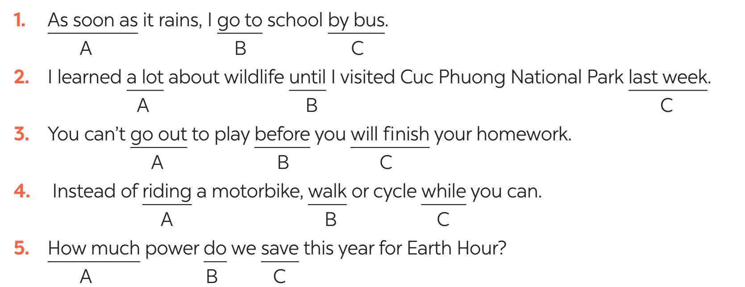
GRAMMAR
4
Circle A, B, or C to identify the underlined part that needs correction.

Slide 7

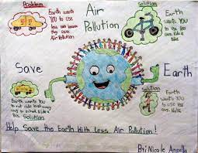
PROJECT
Choose a pollution problem and suggest the solutions.
Make a poster. Use pictures and illustration.
Present the poster to the class.
5

Slide 8

CONSOLIDATION
1
Wrap-up
What have we learnt in this lesson?
review the vocabulary and grammar of Unit 7
apply what they have learnt (vocabulary and grammar) into practice through a project

Slide 9

CONSOLIDATION
2
Homework
- Do exercises in the workbook.

Slide 10

Website: hoclieu.vn
Fanpage: facebook.com/www.tienganhglobalsuccess.vn/

