Slide 1
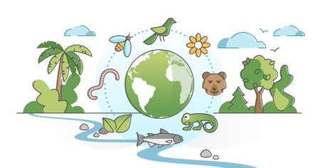
Unit
7
ENVIRONMENTAL PROTECTION
LESSON 2: A CLOSER LOOK 1
1

Slide 2
LESSON 2: A CLOSER LOOK 1
WARM-UP
Jumbled words
Vocabulary
Task 1: Label each picture with a phrase from the list.
Task 2: Match each word or phrase in column A with its meaning in column B.
Task 3: Complete the sentences with the words from the box.
VOCABULARY
Task 4: Listen and repeat the words. Pay attention to the sounds /bl/ and /kl/.
Task 5: Listen and practise the sentences. Underline the words with /bl/, and circle the words with /kl/.
PRONUNCIATION
CONSOLIDATION
Wrap-up
Homework

Slide 3
WARM-UP
AHTTABI
PLTINOOLU
XEOGYN
EEERLAS
BBSOAR
MECYSSOET
-> HABITAT
-> POLLUTION
-> OXYGEN
-> RELEASE
-> ABSORB
-> ECOSYSTEM
JUMBLED

Slide 4
VOCABULARY
ecosystem (n)
/ˈiːkəʊsɪstəm/
hệ sinh thái

Slide 5
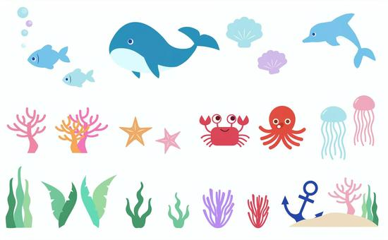
VOCABULARY
marine life (n)
/məˈriːn laɪf/
sinh vật biển

Slide 6
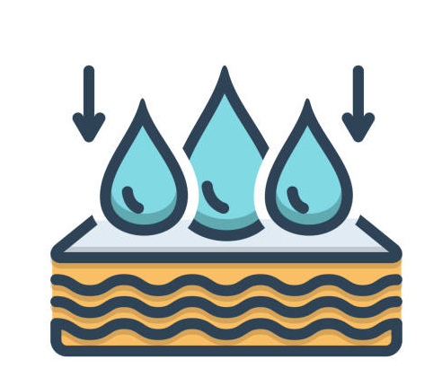
VOCABULARY
absorb (v)
/əbˈzɔːb/
thẩm thấu

Slide 7
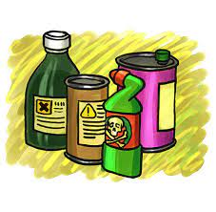
VOCABULARY
harmful substance (n)
/ˈhɑːmfl ˈsʌbstəns/
tác nhân gây hại

Slide 8
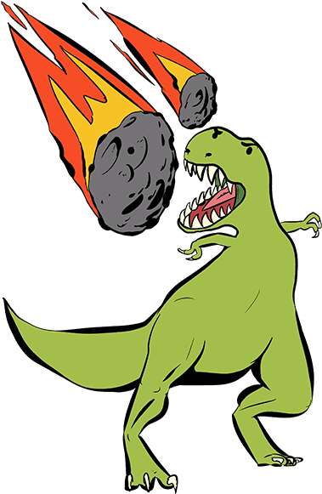
VOCABULARY
extinction (n)
/ ɪkˈstɪŋkʃn/
sự tuyệt chủng

Slide 9
VOCABULARY
New words | Pronunciation | Meaning
1. ecosystem (n) | /ˈiːkəʊsɪstəm/ | hệ sinh thái
2. marine life (n) | /məˈriːn laɪf/ | sinh vật biển
3. absorb (v) | /əbzɔːʳb/ | thẩm thấu
4. harmful substance (n) | /ˈhɑːmfl ˈsʌbstəns/ | tác nhân gây hại
5. extinction (n) | /ɪkˈstɪŋkʃn/ | sự tuyệt chủng

Slide 10
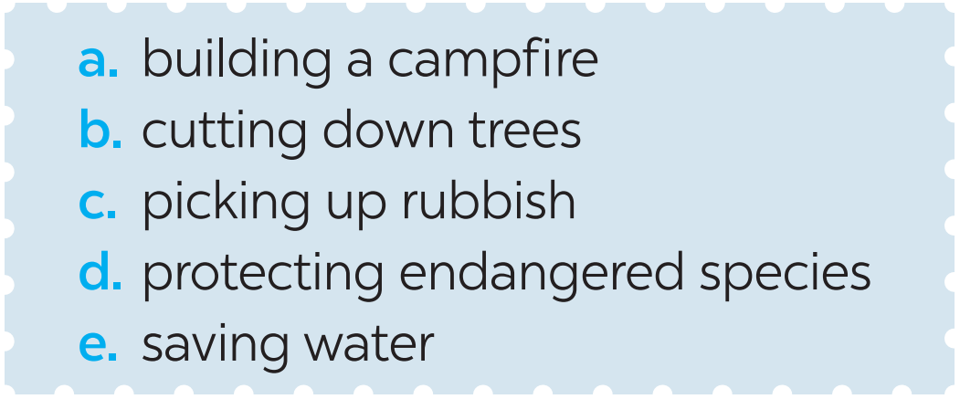
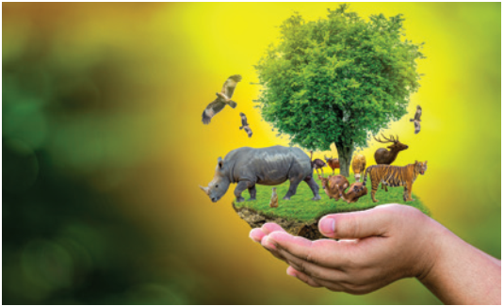
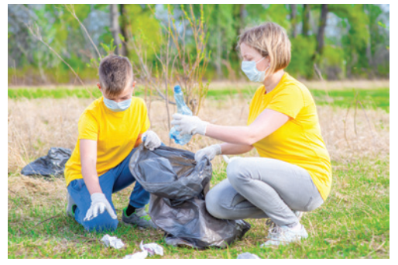
PRACTICE
1
Label each picture with a phrase from the list.
protecting
endangered species
picking up rubbish
1. ____________
2. ____________________

Slide 11
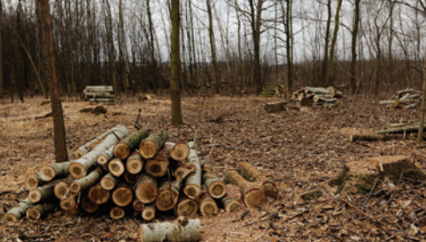
PRACTICE
1
Label each picture with a phrase from the list.
saving water
cutting down trees
4. ____________
3. ______________

Slide 12
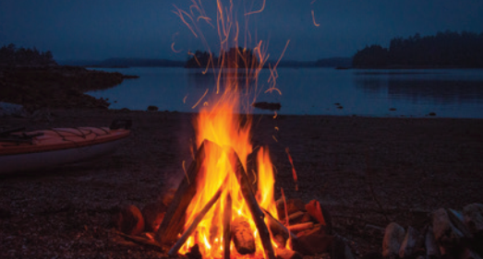
PRACTICE
1
Label each picture with a phrase from the list.
building a campfire
5. ________________

Slide 13
PRACTICE
1
Tick the actions above that protect the environment.

Slide 14
PRACTICE
2
Match each word or phrase in column A with its meaning in column B.

Slide 15
PRACTICE
3
Complete each sentence with a word or phrase from the box.
habitat cutting down trees ecosystem endangered species carbon dioxide
1. People in my neighbourhood are doing a lot to save _________________.
2. Con Dao National Park provides a rich ________ for marine life.
3. Forests help release oxygen and absorb _____________; they also provide homes for many species.
endangered species
habitat
carbon dioxide

Slide 16
PRACTICE
3
Complete each sentence with a word or phrase from the box.
habitat cutting down trees ecosystem endangered species carbon dioxide
Cutting down trees
4. ________________ is a serious environmental concern as it harms natural habitats.
5. An __________ may be a whole forest, or a small pond, and it can be of any size.
ecosystem

Slide 17
PRONUNCIATION
4
Listen and repeat the words. Pay attention to the sounds /bl/ and /kl/.
/bl/ | /kl/
block blast blanket black problem | clean clown club class clear

Slide 18
PRONUNCIATION
5
Listen and practise the sentences. Underline the words with /bl/, and circle the words with /kl/.
1. Look! There are black clouds all over!
2. A truck blocked the way to the club.
3. The students painted the classroom blue.
4. The wind blew the clock down.
5. We cleaned up the environment after the blast.

Slide 19
CONSOLIDATION
1
Wrap-up
What have we learnt in this lesson?
Vocabulary: The lexical items related to Environmental protection
Pronunciation: Words that contain the sounds: /bl/ and /kl/

Slide 20
CONSOLIDATION
2
Homework
Do exercises in the workbook.

Slide 21
Website: hoclieu.vn
Fanpage: facebook.com/www.tienganhglobalsuccess.vn/

