Slide 1
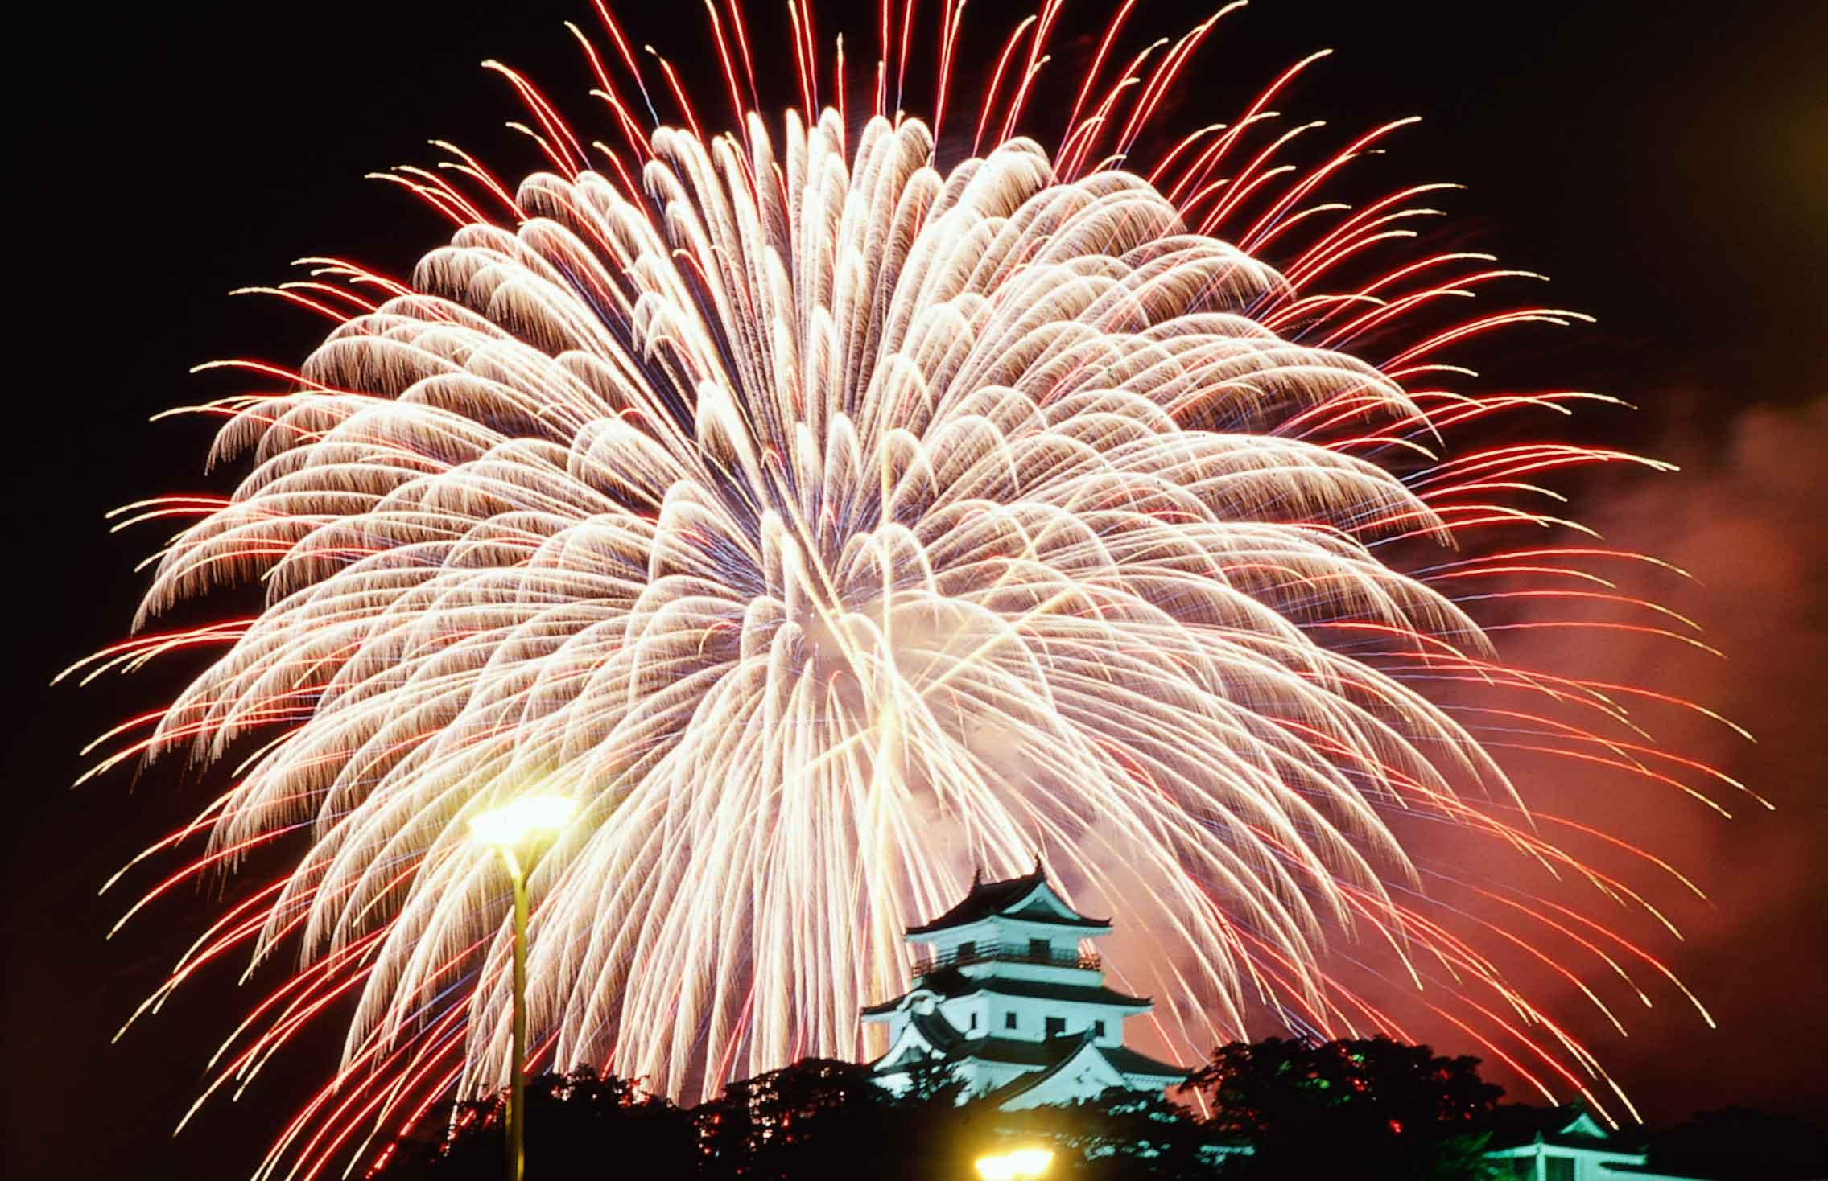
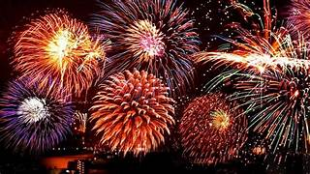
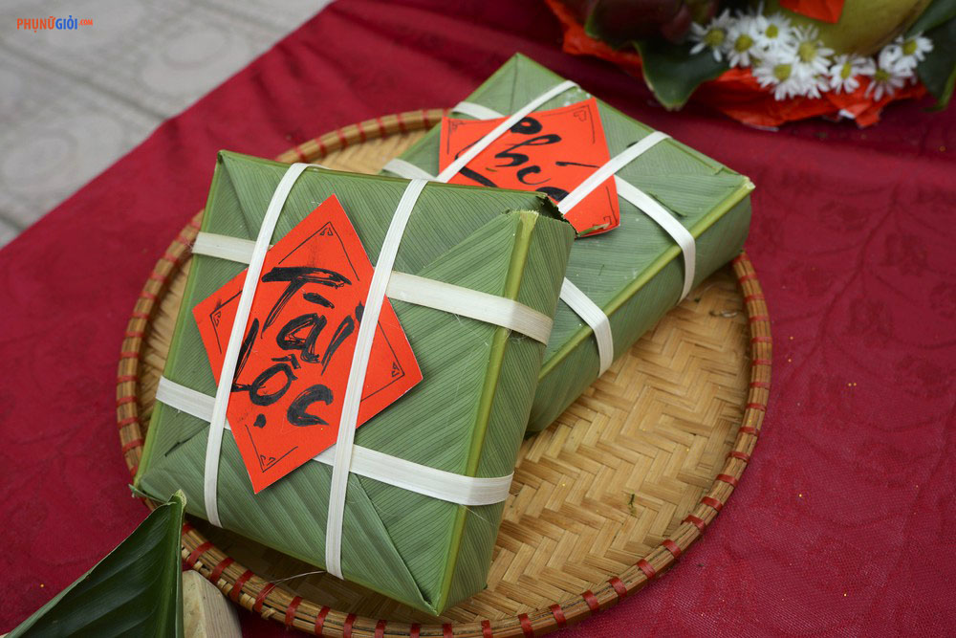
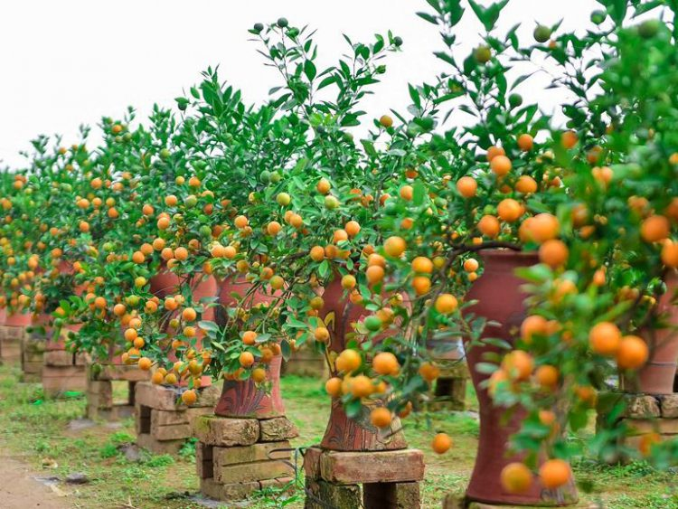
Well come to our class!

Slide 2
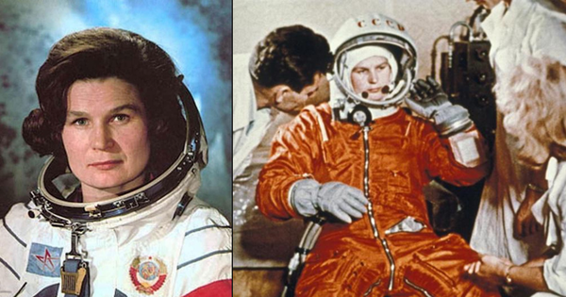
Do you think women are able to go into space?
Period 50: Unit 6: GENDER EQUALITY
Lesson 5: LISTENING
THE FIRST HUMAN IN SPACE

Slide 3
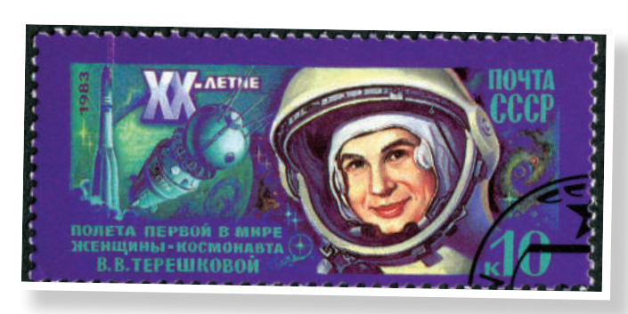
PRE-LISTENING
1
Work in pairs. Look at the picture and tell your partner what this woman’s job is.
She’s a cosmonaut.

Slide 4
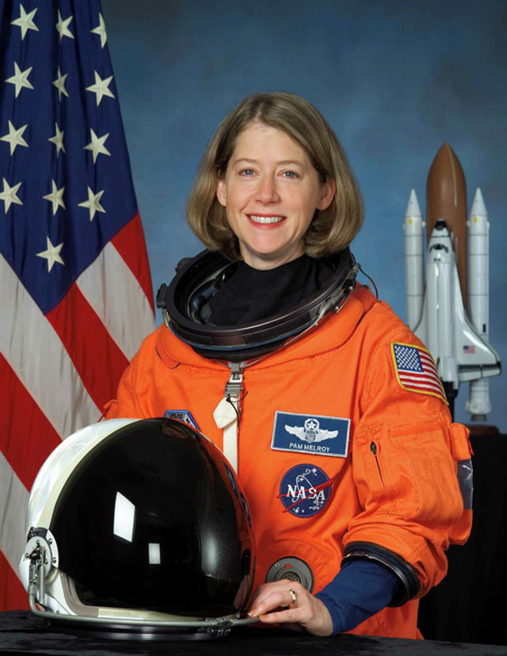
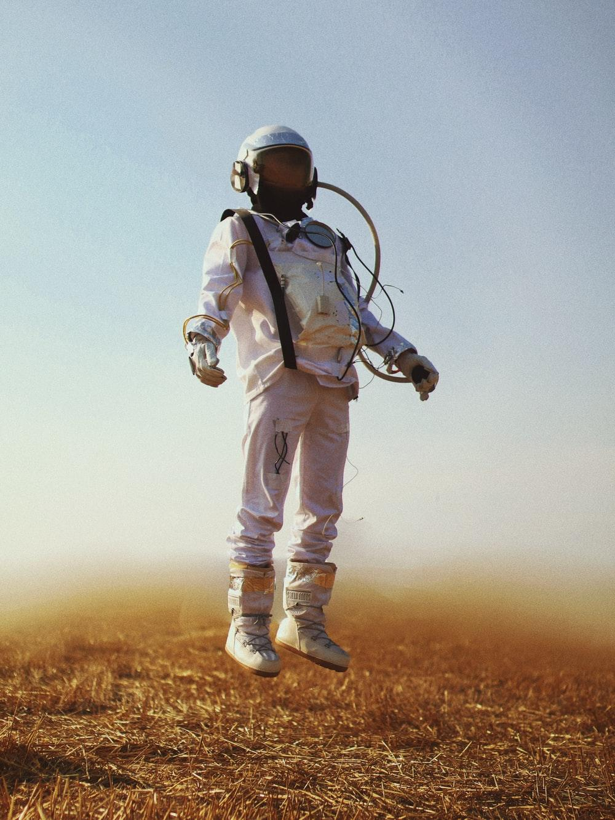
VOCABULARY
cosmonaut (n)
/ˈkɒzmənɔːt/
an astronaut from the former Soviet Union or Russia: nhà du hành vũ trụ

Slide 5
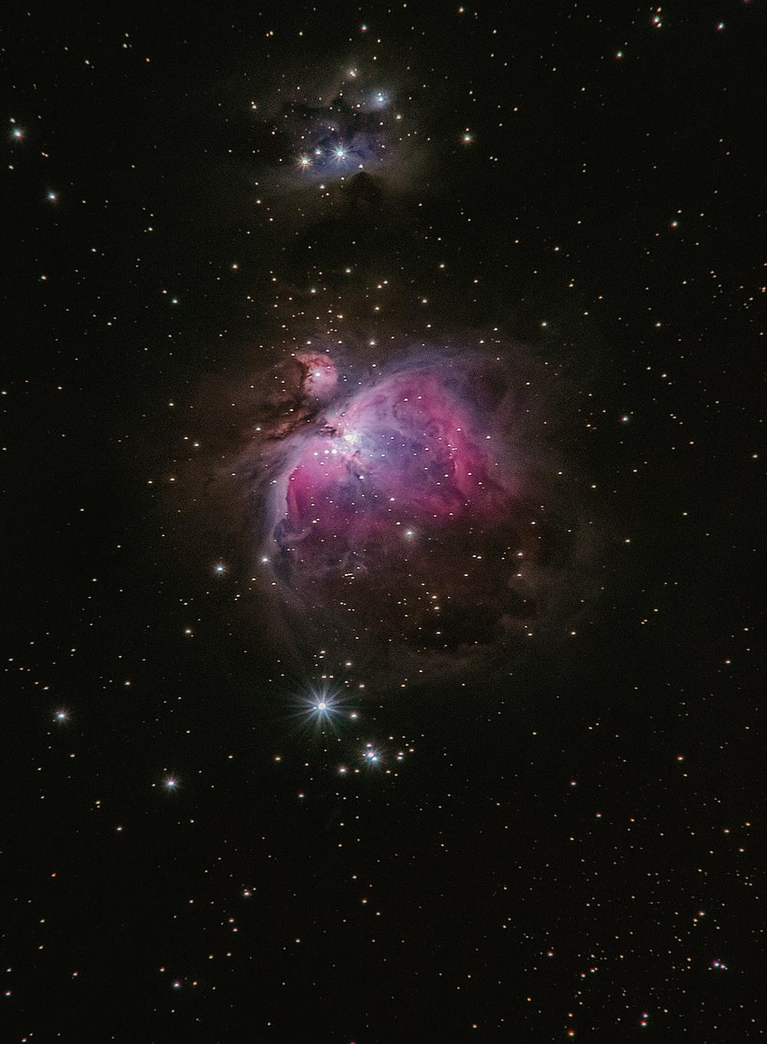
VOCABULARY
space (n)
/speɪs/
the area outside the earth’s atmosphere where all the other planets and stars are: không gian, vũ trụ

Slide 6
WHILE-LISTENING
2
Listen to a talk about Valentina Tereshkova. Choose the best answer to complete each sentence.
1. Valentina Tereshkova joined a local flying club and became a talented parachutist while she was ________________________.
2. Tereshkova and _______ other women were chosen for the Soviet space programme.
3. Tereshkova joined the Soviet Air Force and became _________________ after completing her training and passing an examination.
4. She travelled into space in Vostok 6 and successfully returned to earth on ______________.
5. After the flight, Tereshkova received many awards, and __________________________.
A. working as a factory worker
B. four
A. an Air Force officer
B. 19 June, 1963
B. completed her university degree

Slide 7
WHILE-LISTENING
3
Listen again and give short answers to the following questions.
1. When was Tereshkova born?
A. 1937 B. 1938 C. 1942 D. 1941
2. How old was she when she started working?
A. 17 B. 18 C. 16 D. 15
3. When did she join the Soviet space programme?
A. 1964 B. 1970 C. 1961 D. 1962
4. At what age did she travel into space?
A. 21 B. 26 C. 22 D. 23
5. How many days did she spend in space?
A. 3 days B. 4 days C. 1 day D. 2 days

Slide 8
POST-LISTENING
4
Work in groups. Discuss the following questions.
Do you want to be a cosmonaut? Why or why not?

Slide 9
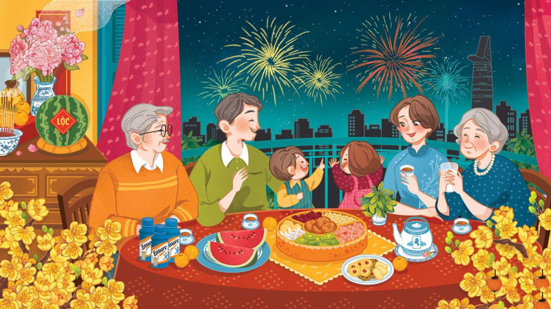
CONSOLIDATION
2
Homework
Do exercises in the workbook.
Prepare for the Project.

