Slide 1
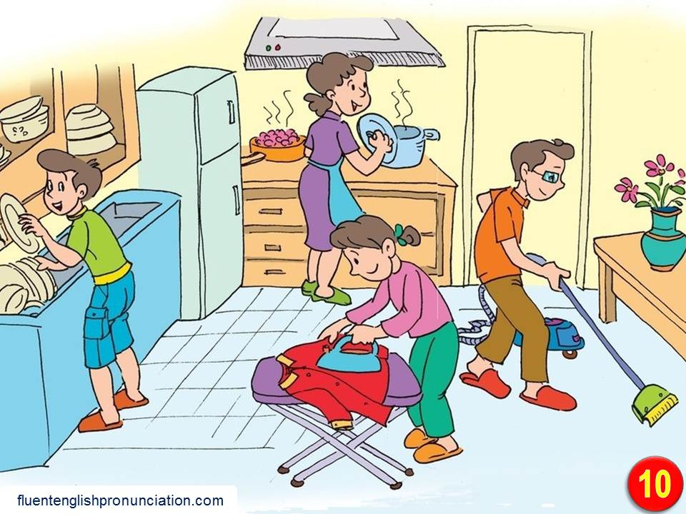
      UNIT 1: FAMILY LIFE
      LESSON 1: GETTING STARTED

Slide 2
Warm up
Do you often do housework?
What housework does each member of your family do?

Slide 3
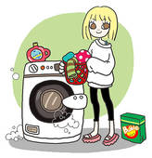



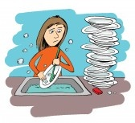

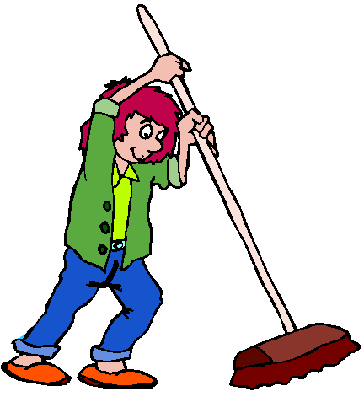
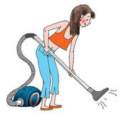
do the washing
make the bed
wash the car
do the shopping
Iron the clothes
do the washing up
clean the windows
sweep
cacuum

Slide 4
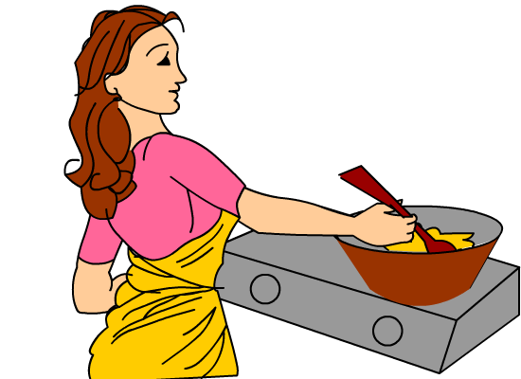
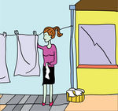
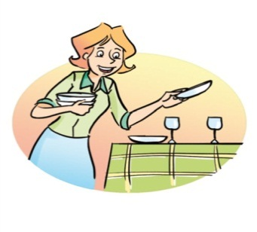
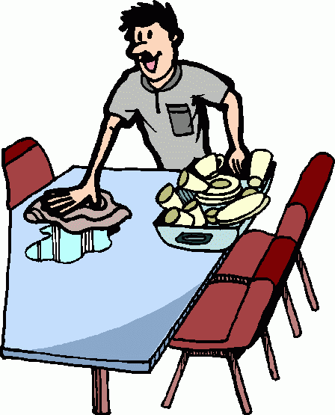
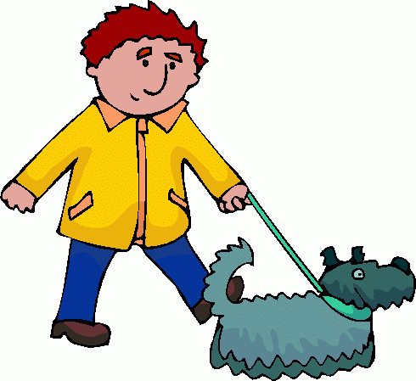
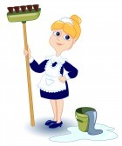

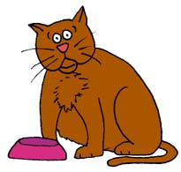
do the cooking
hang out the clothes
set/ lay the table
clear the table
tidy the house
walk the dog
mop the floor
water the plants
feed the cat

Slide 5
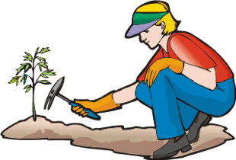
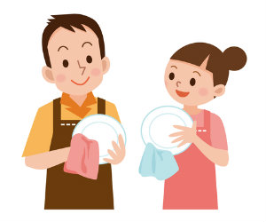
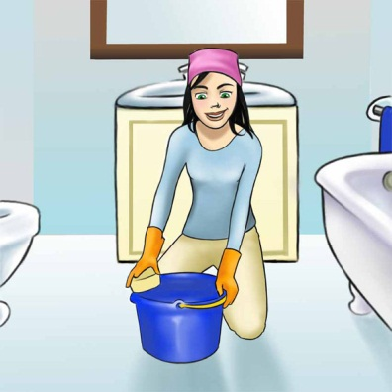
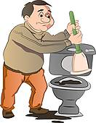
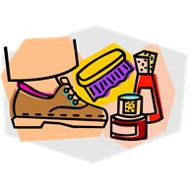
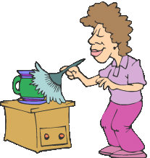
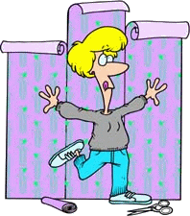
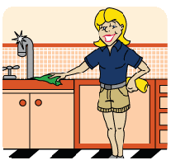

do the gardening
dry the dishes
clean the bathroom
clean the toilet
polish one’s shoes
dust the furniture
hang some wallpaper
clean the kitchen
mow the lawn

Slide 6

Vocabulary
ask sb out:
prepare sth (v) for sb
housework (n)
do housework
share sth with sb (phr)
household duties/chores
divide / split sth (v)
grocery (n)
do the washing-up
mời ai đi chơi
chuẩn bị gì cho ai
việc nhà
làm việc nhà
chia sẻ gì với ai
nhiệm vụ gia đình/ việc nhà
phân chia / chia gì
hàng tạp hóa
giặt giũ

Slide 7
Vocabulary
do heavy lifting
do the laundry
do the ironing
take out the garbage/ rubbish
handle (v)
be responsible for
finance (n)
breadwinner (n)
anyway (adv)
làm việc nặng nhọc
giặt giũ
là quần áo
lấy rác
xử lý
chịu trách nhiệm
tài chính
người trụ cột
dẫu sao

Slide 8
Activity 1. Listen and read HOUSEHOLD CHORES
Nam: Hello?
Mr Long: Hello, Nam? This is Uncle Long. Is your dad there? I’d like to ask him out for a game of tennis.
Nam: Well, I’m afraid he can’t go out with you now. He’s preparing dinner.
Mr Long: Is he? Where’s your mum? Doesn’t she cook?
Nam: Oh, yes. My mum usually does the cooking, but she’s working late today.
Mr Long: How about your sister and you? Do you help with the housework?
Nam: Yes, we do. In my family, everybody shares the household duties. Today my sister can’t help with the cooking. She’s studying for exams.

Slide 9
Mr Long: I see. So how do you divide household chores in your family?
Nam: Well, both my parents work, so we split the chores equally - my mother cooks and shops for groceries, my father cleans the house and does the heavy lifting, my sister does all the laundry, and I do the washing-up and take out the rubbish.
Mr Long: Really? It’s different in my family. My wife handles most of the chores around the house and I’m responsible for the household finances. She’s the homemaker and I’m the breadwinner. Anyway, I have to go now. Tell your dad I called. Bye.
Nam: Oh yes, I will. Bye, Uncle Long.

Slide 10
Activity 2. Work in pairs. Decide whether the following statements are true (T), false (F), or not given (NG) and tick the correct box.
 | T | F | NG
1. Nam’s father is going out to play tennis with Mr Long.
2. Nam’s mother is a busy woman.
3. Nam’s sister is cooking dinner.
4. Sometimes Nam’s father cooks.
5. Everybody in Nam’s family does some of the housework.
6. Mr Long never does any household chores.







Slide 11
Activity 3. Listen and repeat the words or phrases.
rubbish washing-up laundry
household finances groceries
household chores heavy lifting

Slide 12
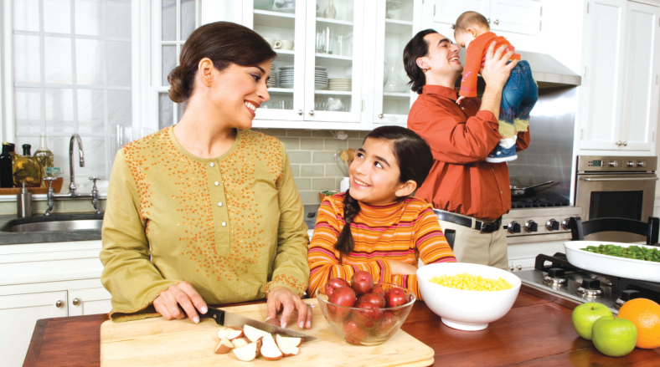
Activity 4. Write the verbs or verb phrases that are used with the words or phrases in the conversation
 | Verbs / verb phrases | Words / phrases
1 |  | (household) chores
2 |  | rubbish
3 |  | laundry
4 |  | groceries
5 |  | heavy lifting
6 |  | washing-up
7 |  | household finances
split, divide, handle
take out
do
shop for
do
do
be responsible for

Slide 13
Homework
  Learn vocabulary by heart.
  Redo exercises.
  Prepare the next lesson: Language

