Slide 1
UNIT 10: ECOTOURISM
LESSON 1: GETTING STARTED

Slide 2
WARM-UP
Where do you want to visit on summer vaction?
Look at the pictures and name the destinations.

Slide 3
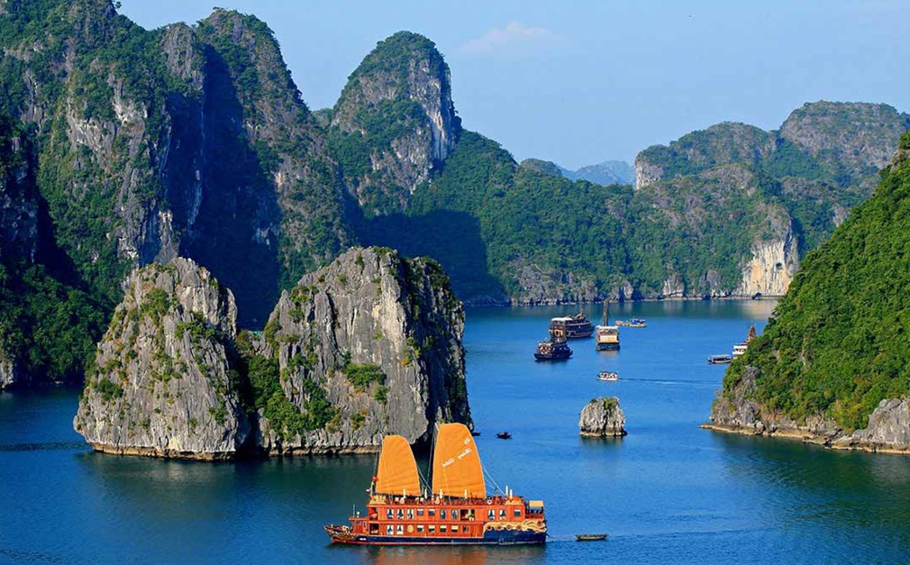
Ha Long Bay

Slide 4
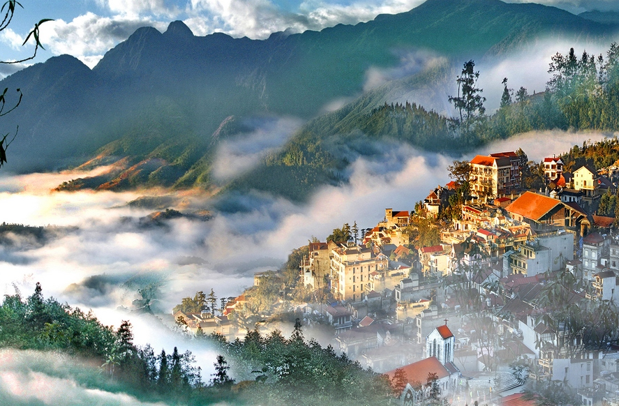
Sa Pa

Slide 5
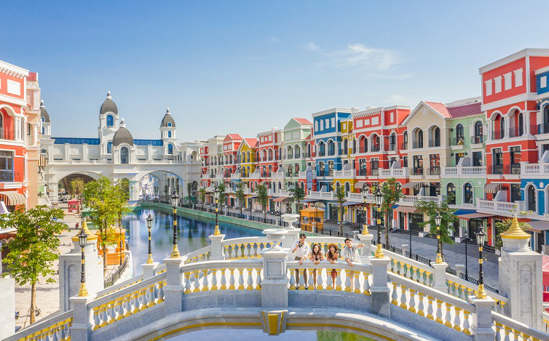
Phu Quoc Island

Slide 6
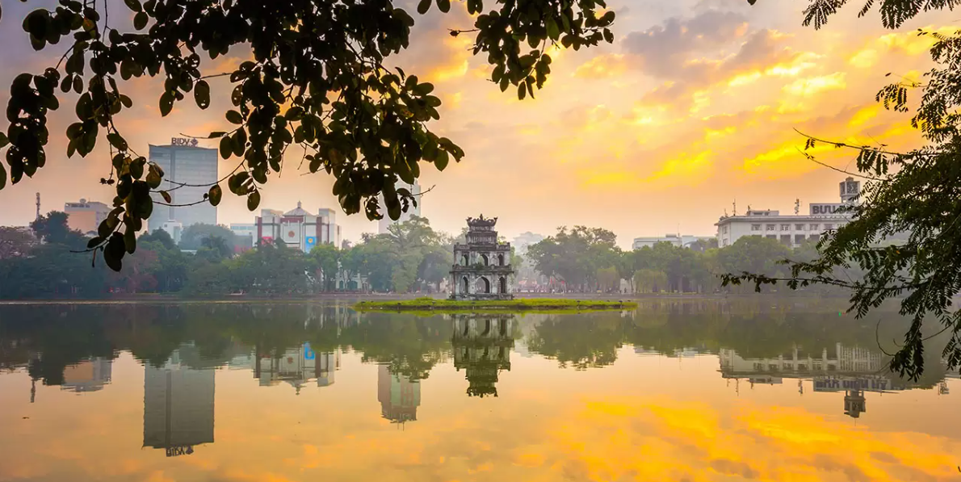
Hoan Kiem Lake

Slide 7
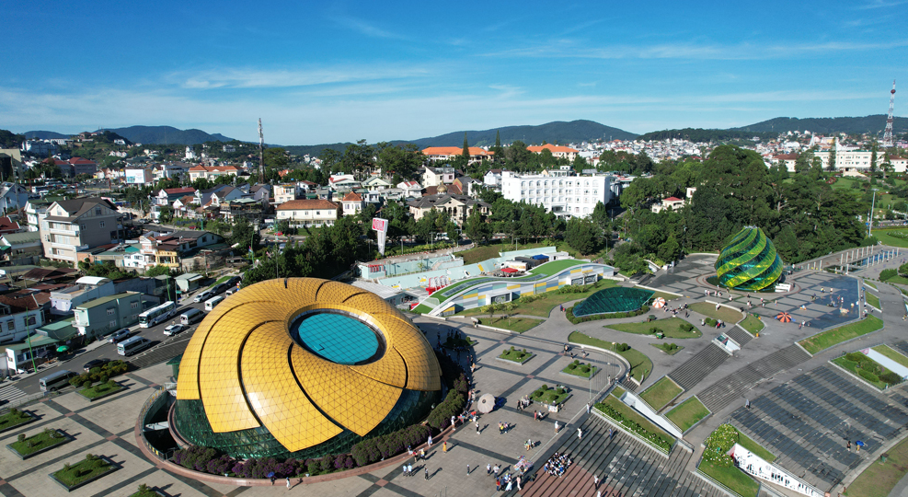
Da Lat

Slide 8
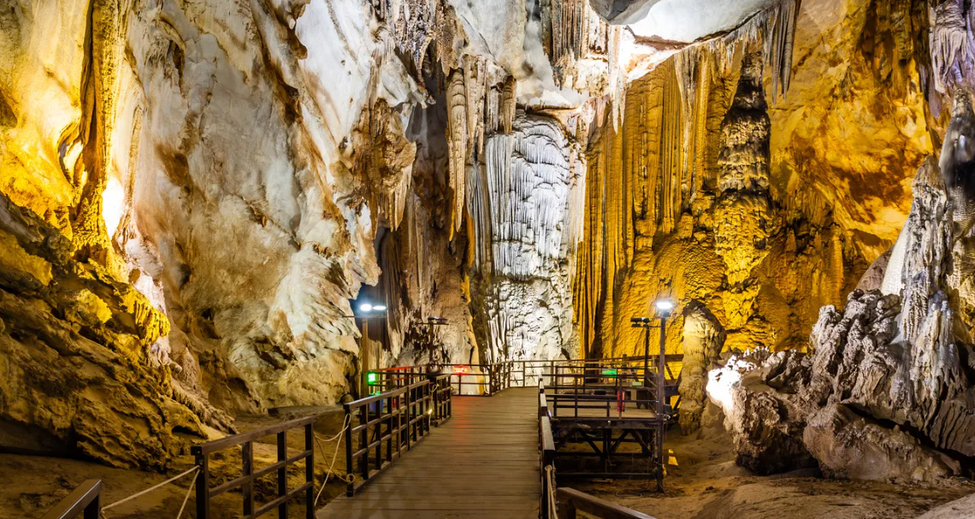
Phong Nha Cave

Slide 9
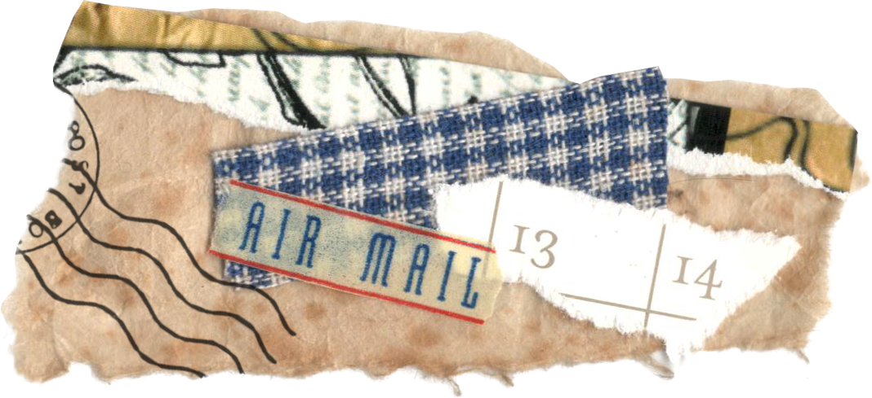
VOCABULARY

Slide 10
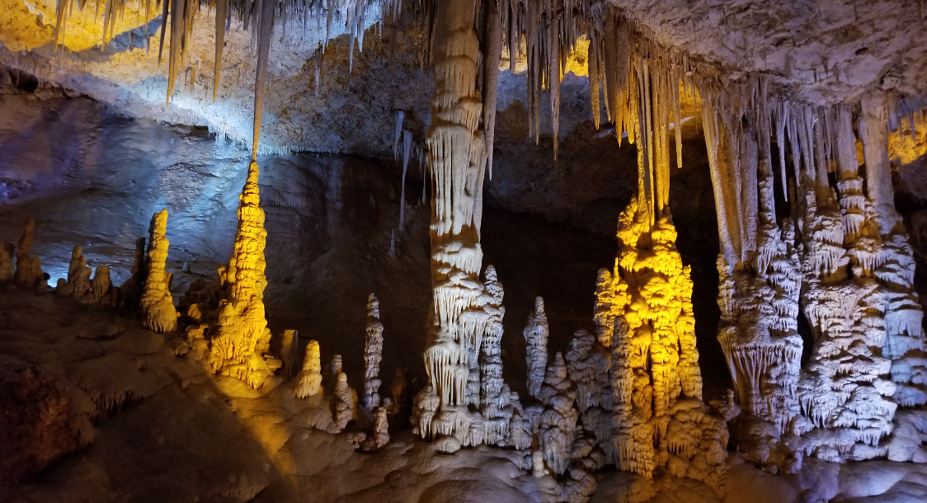
stalactite (n)
/ˈstæləktaɪt/
piece of rock hanging down from the roof of a cave

Slide 11
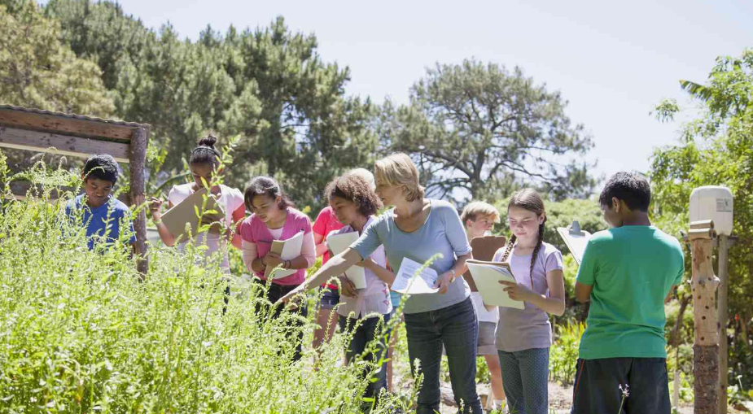
fieldtrip (n)
/ˈfiːldˌtrɪp/
a visit made by students to study something away from their school or college

Slide 12
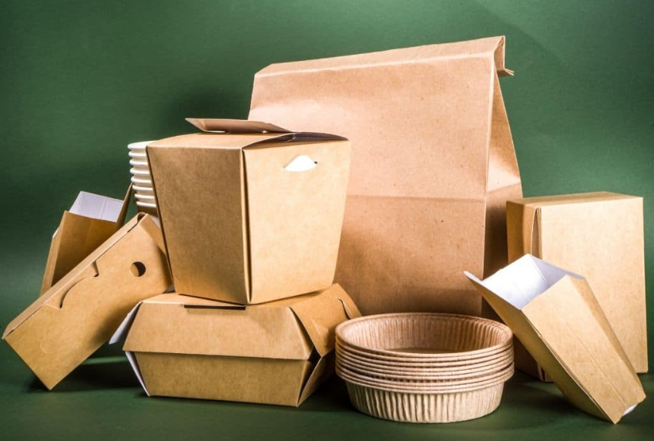
packaging (n)
/ˈpækɪdʒɪŋ/
the materials in which objects are wrapped before being sold

Slide 13
PRACTICE

Slide 14
Task 1. Listen and read
An eco-friendly fieldtrip to Phong Nha Cave
Ms Hoa: Listen, everyone! this year, we’re going on a fieldtrip to Phong Nha Cave, a tourist attraction in Quang Binh Province.
Class: Hooray!
Nam: I hope I can find some small pieces of stalactites. If I add some to my rock collection, it will be the best at school.
Mai: I’ll buy a lot of snacks to share. We'll have fun!
Ms Hoa: We will have fun, but in a different way. This time, the fieldtrip is going to be eco-friendly.
Nam: Ms Hoa, what’s an eco-friendly fieldtrip?
Ms Hoa: Going on an eco-friendly fieldtrip means we’ll enjoy, explore and learn about the place, but in a way that will not damage it. So, Nam, I’m afraid you can’t take any stalactites because it takes hundreds or sometimes thousands of years for them to form.
Nam: Wow! I didn’t know that. I won’t even touch them, I promise.
Mai: But can we bring snacks?
Ms Hoa: Yes, but if I were you, I wouldn’t bring too many snacks. We don’t want to leave litter behind and damage the environment.
Mai: I agree. I’ll also try to bring snacks with less packaging.
Ms Hoa: That’s a good idea. Let’s hope our fieldtrip will be a fun educational experience for everyone.
1.

Slide 15
Task 2. Read the conversation again. Then find and correct a mistake in each sentence below.
1. On an eco-friendly fieldtrip, tourists enjoy, explore and damage the environment.
2. Nam will take pieces of stalactites because they take a long time to form.
3. Mai will bring snacks with a lot of packaging on the trip.
→ but not
(OR: On an eco-friendly fieldtrip, tourists enjoy, explore and damage the environment. → protect/ learn about)
1.
→ will not / won’t
→ will not / won’t
(OR: Mai will bring snacks with a lot of packaging on the trip. → less)

Slide 16
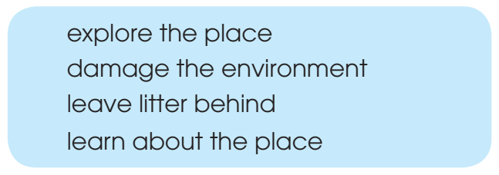
Task 3. Put each phrase into the correct column.
Dos | Don’ts
explore the place
damage the environment
learn about the place
leave litter behind

Slide 17
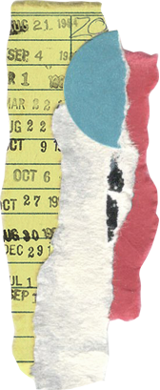
Task 4. Complete these sentences from Task 1.
1. Nam says, “If I ___________ some to my rock collection, it ___________ the best at school!” 2. Ms Hoa says, “If I ___________ you, I ___________ bring too many snacks.”
add
will be
were
wouldn’t

Slide 18
GAME

Slide 19
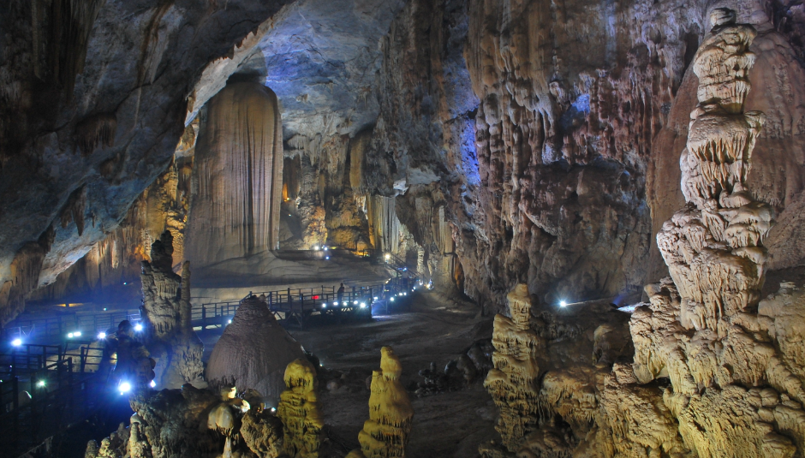
Let find the hidden picture
1
2
3
4
5
6
7
8
9
10
Thien Duong Cave
This is a cave in Phong Nha - Ke Bang National Park
End
Notes:
Bấm vào dòng “This is a cave in Phong Nha – Ke Bang National Park” sẽ hiện đáp án “Thien Duong Cave”

Slide 20
1. Where is Phong Nha cave?
Quang Binh Province
Time up

Slide 21
2. Look at the picture and complete the sentence:
“We can’t take any ________ because it takes hundreds or sometimes thousands of years for them to form.”
stalactites
Time up

Slide 22
3. What should we do in an eco-friendly fieldtrip?
A. Damage the environment
B. Explore and learn about the place
C. Leave litter behind
B. Explore and learn about the place
Time up

Slide 23
4. Look at the picture and complete the sentence:
“Mai will bring snacks with less______ on the trip in order not to damage the environment.”
packaging
Time up

Slide 24
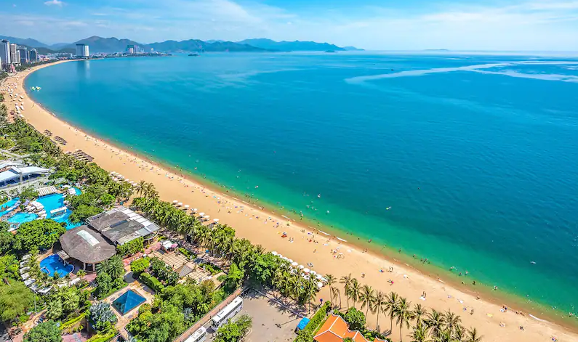
5. Name an activity that we should not do when we visit Nha Trang Beach
Time up

Slide 25
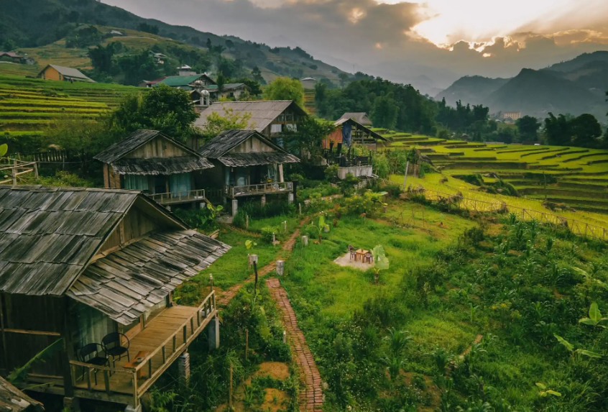
6. Name an eco-friendly activity when we visit Sa Pa
Time up

Slide 26
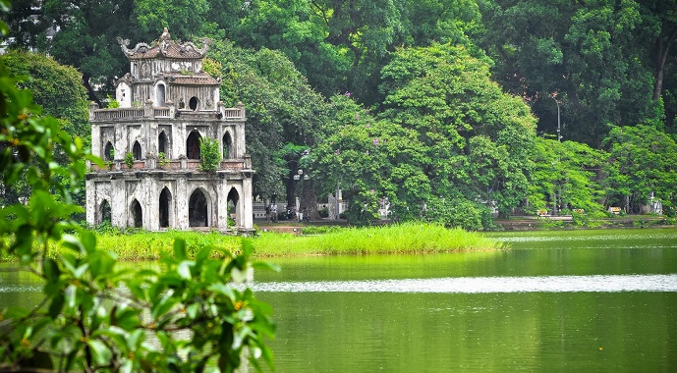
7. Name activity that we should not do when we visit Hoan Kiem Lake
Time up

Slide 27
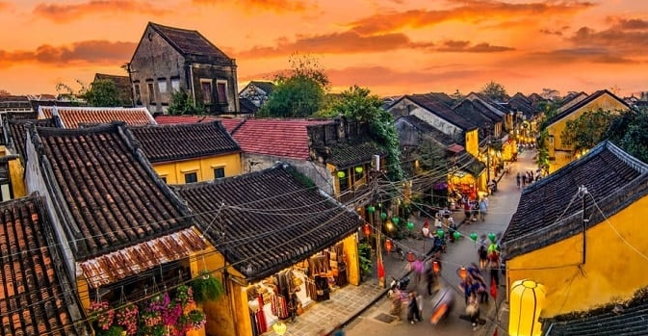
8. Name an eco-friendly activity when we visit Hoi An
Time up

Slide 28
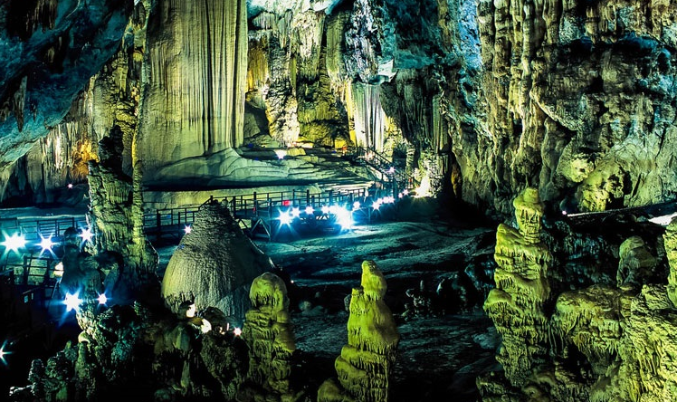
9. If you are going on an eco-friendly fieldtrip to Phong Nha Cave, what should you do to protect the environment?
Time up

Slide 29
10. Name an activity that we should not do when we visit Phong Nha Cave.
Time up

Slide 30
Thank you for your attetion!

