Slide 2
LOOKING BACK AND PROJECT
Unit
9
SOCIAL ISSUES
Unit
FAMILY LIFE
Period 79
11TH GRADE
Lesson 8

Slide 3
UP OR DOWN ?
Do you like oranges?
Would you like a cup of tea?
We have Math and English on Thursday.
Why don’t you answer your phone?
What are you looking for?
Put your rubbish in the bin!

Slide 4
PRONUNCIATION
Mark the intonation in these questions.
1. Should we report bullying to teachers or speak to our parents first?
2. Is this social awareness campaign about poverty or crime?
3. Have you ever experienced any physical, verbal, or social bullying?
4. Do you worry about peer pressure, body shaming, or bullying?

Slide 5
https://wordwall.net/play/70393/398/926
VOCABULARY
poverty
offensive
campaign
cyberbullying
alcohol
violent

Slide 6
VOCABULARY
poverty
offensive
campaign
cyberbullying
alcohol
violent
Many people live in ____________, which means they do not have enough money to buy food, clothes, housing and education
____________ is unhealthy for people’s health. Moreover, it affects people’s behaviour negatively.
___________ behaviour, like hitting and threatening others, is never be okay and can cause serious harm.
___________ is a growing concern because technology becomes more common in students’ lives.
She always speaks kindly to others; by contrast, he often says ____________ things that hurt people's feelings.
The ____________ has raised awareness about bullying; therefore, students are more supportive.

Slide 7
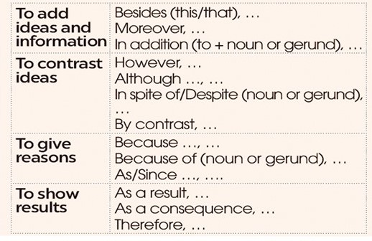
GRAMMAR
LINKING WORDS
OR PHRASE

Slide 8
GRAMMAR
Choose the correct answer to complete each sentence below.
We started a campaign against bullying in our school. However / In addition, we organised classes for teens to try new things and become more confident.
2. Sharing someone’s personal information online is illegal. Therefore / Moreover, you should be very careful about what you post online.

Slide 9
GRAMMAR
Choose the correct answer to complete each sentence below.
3. Because / Because of our health campaign was successful, more teenagers now eat healthy food and exercise regularly.
4. Although / In spite of all our efforts, we were not able to solve the problem.

Slide 10
FURTHER PRACTISE

Slide 11
Question 1: He was feeling unwell but he still went to the party.
a) He went to the party; however, he was feeling unwell.
b) He went to the party because he was feeling unwell.
c) He went to the party; therefore, he was feeling unwell.
d) He went to the party although he was feeling unwell.

Slide 12
Question 2: "He missed the bus because he woke up late."
a) He woke up late; however, he missed the bus.
b) He missed the bus because of waking up late.
c) He missed the bus; therefore, he woke up late.
d) He woke up late because he missed the bus.

Slide 13
Question 3: "She enjoys cooking; however, she denied to become a chef."
a) She enjoys cooking; moreover, she denied to become a chef.
b) She denied to become a chef because she enjoys cooking.
c) She enjoys cooking; therefore, she denied to become a chef.
d) She denied to become a chef although she enjoys cooking.

Slide 14
Question 4: "Because it rained, the picnic was cancelled."
a) Because the rain, the picnic was cancelled.
b) Since the rain, the picnic was cancelled.
c) Because of the rain, the picnic was cancelled.
d) Although the rain, the picnic was cancelled.

Slide 15
PROJECT

Slide 16
CONSOLIDATION
Review the vocabulary and grammar of Unit 9.
Give an oral presentation about a social issue in your community.
Plan activities for a campaign to raise people's awareness about a social issue and give a group presentation about it.

Slide 17
CONSOLIDATION
Do exercises in the workbook.
Prepare for Unit 10.

Slide 18
Website: hoclieu.vn
Fanpage: facebook.com/www.tienganhglobalsuccess.vn/

