Slide 2
Unit
6
1
Unit
FAMILY LIFE
GENDER EQUALITY
PERIOD 55
LESSON 8
LOOKING BACK AND PROJECT
Date of preparation: 29/1/2023 Date of teaching:02/2/2023

Slide 3
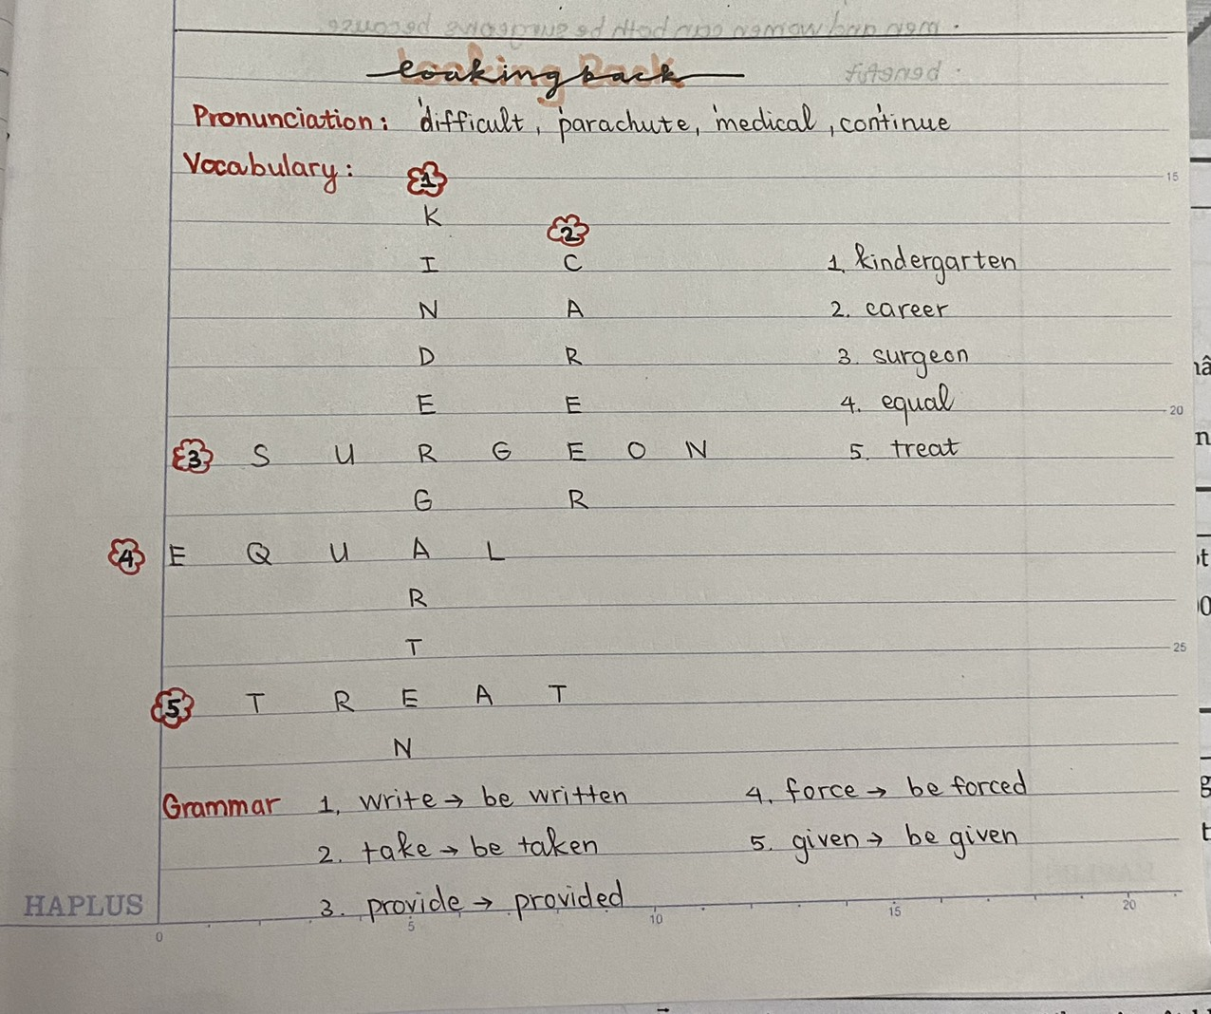
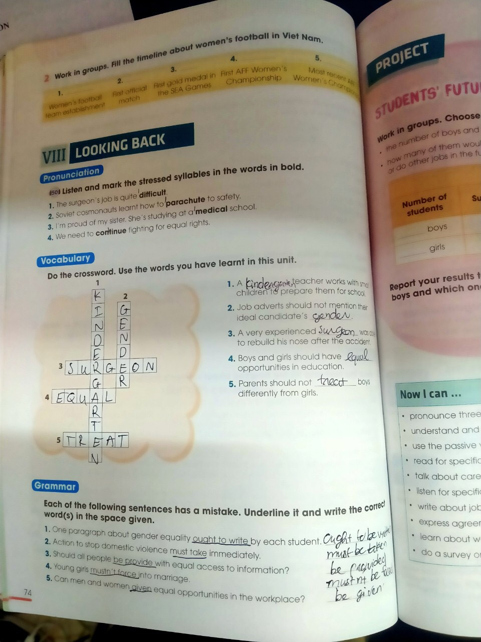

Slide 4
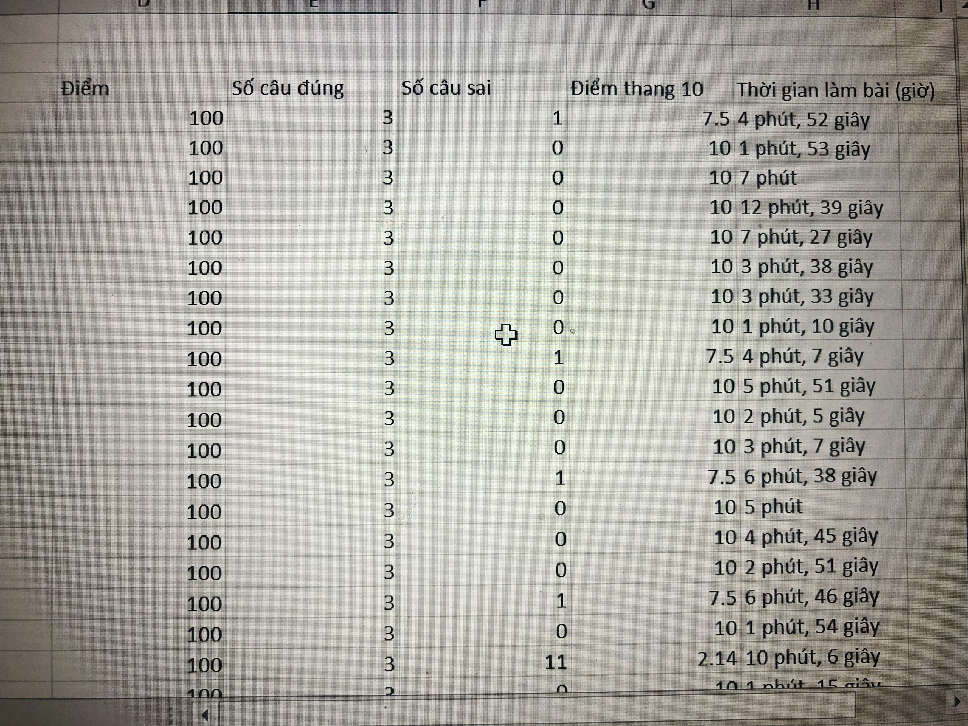
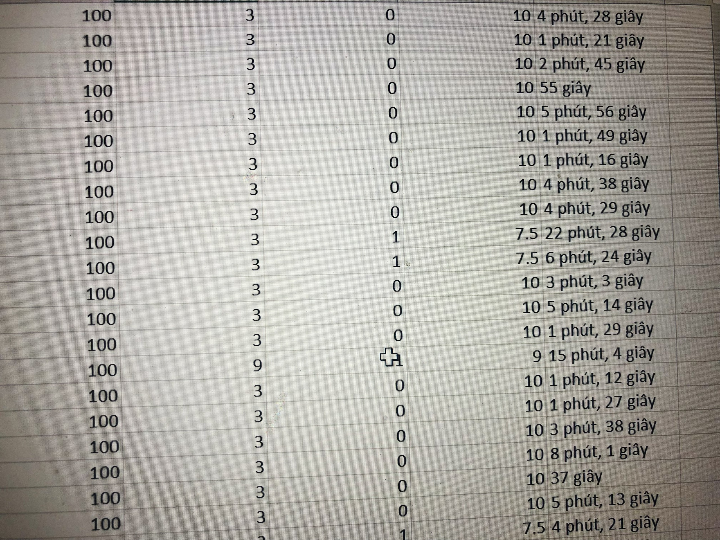

Slide 5
Excellent:77.78% (35/45) Good: 20% (9/45) Below average: 2.22% (1/45)

Slide 6
LESSON 8
LOOKING BACK AND PROJECT
WARM-UP
Game: Last man standing
Pronunciation: Listen and mark the stressed syllables.
Vocabulary: Do the crossword.
Grammar: Underline the mistakes and write the correct word(s).
LOOKING BACK

Slide 7
A/ PRONUNCIATION.
I/ Put the following verbs and adjectives in the correct columns.
difficult continue different educate | popular discover important fantastic physical | celebrate impossible organize expensive

Slide 8
physical difficult different popular educate celebrate organize | fantastic impossible expensive important discover continue

Slide 9
I/ Put the following verbs and adjectives in the correct columns.
Three-syllable adjectives | Three-syllable verbs
physical difficult fantastic different impossible popular expensive important | educate celebrate organize discover continue

Slide 10
II/ Choose the word which has a different stress pattern from the others.
QUESTION 1.
A. opposite B. practical
C. national D. discover

Slide 11
Choose the word which has a different stress pattern from the others.
QUESTION 2.
A. expensive B. fantastic
C. popular D. develop

Slide 12
Choose the word which has a different stress pattern from the others.
QUESTION 3.
A. organise B. important C. benefit D. celebrate

Slide 13
Choose the word which has a different stress pattern from the others.
QUESTION 4.
A. difficult B. continue
C. physical D. parachute

Slide 14
Choose the word which has a different stress pattern from the others.
QUESTION 5.
A. encourage B. educate C. medical D. dangerous

Slide 15
I/ Match the words with their meanings.
1. equality | A.The male or female sex, or the state of being either male or female.
2. opportunity | B. having little or no formal education at school
3. domestic violence | C. a time when a particular situation makes it possible to do or achieve something
4. gender | the fact of being equal in rights, status or advantages
5. uneducated | E. violent behavior that is intended to hurt someone you live with.

Slide 16
II/ Circle the best word.
A good surgeon must have physical and mental (strong/strength).
Unfortunately, in many parts of the world men and women have an (equal/unequal) status.
3. What can (education/educated) girls do for their children and families?
4. My father can work well (above/under) pressure and he doesn’t mind working long hours.
5. Doctors usually make important decision about patients’ health and (safe/safety).
physical
mental
an
status
girls
pressure
health
and

Slide 17
1
E | Q | U | A | L | I | T | Y
2
V | I | O | L | E | N | C | E
3
C | A | R | E | E | R | S
4
C | H | I | L | D
5
C | O | S | M | O | N | A | U | T
6
T | R | E | A | T | M | E | N | T

Slide 20
Choose the best option A, B, C, or D to indicate the word(s) CLOSEST in meaning to the underlined word(s) in each of the following questions.
Women tend to become nurses, secretaries, or shop assistants, which are low-paying jobs.
A. works B. careers
C. laptops D. opportunities

Slide 21
Mark the letter A, B, C, or D to indicate the underlined part that needs correction in each of the following questions.
In many places, parents may see
A
children marriage as a way to protect
B C
their daughters from violence.
D

Slide 23
Complete the following sentence with a suitable word.
Women have to face daily violence and and unequal ……………… both at home and at work.
treatment

Slide 24
I: Choose the best sentence that is closest in meaning to the sentence given.
1. People should send their complaints to the head office.
A. Complaints should sent to the head office.
B. Complaints should be sent to the head office by people.
C. Their complaints should be sent to the head office.
D. Their complaints to the head office should be sent.
2. They had to postpone the meeting because of illness.
A. The meeting had to be postponed because of illness.
B. The meeting because of illness be postponed.
C . The meeting had to postponed by them because of illness.
D. The meeting because of illness had to be postponed.

Slide 25
II: Choose the best sentence that is closest in meaning to the sentence given.
3. They are going to hold next year's congress in San Francisco
A. Congress is going to be held next year in San Francisco
B. Congress in San Francisco is going to be held next year.
C. Next year's congress is going to be held in San Francisco.
D. Next year's congress is going to hold in San Francisco.
4. They will ask you a lot of questions at the interview.
A. You will be ask a lot of questions at the interview.
B. You will asked a lot of questions at the interview.
C. A lot of questions will be ask at the interview.
D. A lot of questions will be asked you at the interview.

Slide 26
II: Choose the best sentence that is closest in meaning to the sentence given.
5. Nobody told me that Tim was ill.
A. I was told that Tim wasn't ill. B. I wasn't told that Tim was ill.
C. Tim wasn't told to be ill. D. Tim was told not to be ill.
6. We will send you the results as soon as they are ready.
A. You will be sent the results as soon as they are ready.
B. You will send the results as soon as they are ready.
C. The results will be send you as soon as they are ready.
D. The results will be sent to as soon as they are ready.

Slide 27
II/ Rewrite the following sentences, using the passive voice.
1. Each student must write an essay on gender equality.
=> An essay ___________________________________________
2. They should give men and women equal pay for equal work. => Men ______________________________________________
3. The Vietnamese government will make more progress in gender equality. => More progress ______________________________________
4. They can open this exit door in case of emergency. => This exit door ________________________________________

Slide 28
II/ Rewrite the following sentences, using the passive voice.
1. Each student must write an essay on gender equality.
=> An essay on gender equality must be written.
2. They should give men and women equal pay for equal work. => Men and women should be given equal pay for equal work.
3. The Vietnamese government will make more progress in gender equality. => More progress will be made by the Vietnamese government in gender equality.
4. They can open this exit door in case of emergency. => This exit door can be opened in case of emergency.

Slide 30
LESSON 8
LOOKING BACK AND PROJECT
WARM-UP
Game: Last man standing
Pronunciation: Listen and mark the stressed syllables.
Vocabulary: Do the crossword.
Grammar: Underline the mistakes and write the correct word(s).
LOOKING BACK
PROJECT
Students’ future jobs

Slide 31
PROJECT
Work in groups. Choose any class in your school and do a survey to find out:
• the number of boys and girls.
• how many of them would like to work as surgeons, airline pilots, nurses and shop assistants, or do other jobs in the future.
Class:
Number of students | Surgeons | Airline pilots | Nurses | Shop assistants | Others
_______ boys
_______ girls

Slide 32
PROJECT
Report your results to the class.
Which of the jobs is the least popular among the boys and which one the least popular among the girls? Give possible reasons.

Slide 33
LESSON 8
LOOKING BACK AND PROJECT
WARM-UP
Game: Last man standing
Pronunciation: Listen and mark the stressed syllables.
Vocabulary: Do the crossword.
Grammar: Underline the mistakes and write the correct word(s).
LOOKING BACK
PROJECT
Students’ future jobs
CONSOLIDATION
Wrap-up
Homework

Slide 34
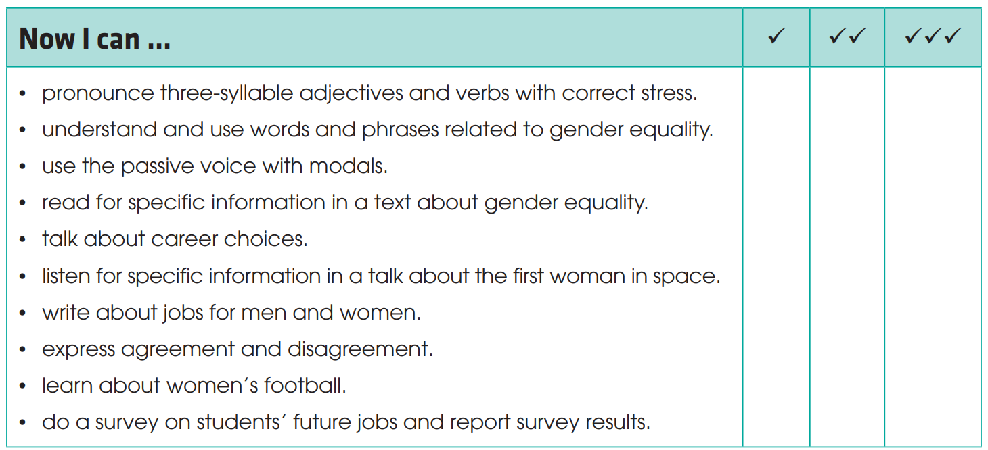
CONSOLIDATION
1
Wrap-up
Check what you have been able to do after this unit!

Slide 35
CONSOLIDATION
2
Homework
Do exercises in the workbook.
Prepare for the next lesson: Unit 7.

