Slide 1
WELCOME TO OUR CLASS

Slide 2
Watch a video clip and answer the questions

Slide 4
1. Have you ever been in the same situation as Nobita?
2. If yes, what skill do you lack?
→ Time management skill
3. What should you do to have this skill?

Slide 5
Unit 3. Becoming Independent
Lesson 3: READING
Time–management skills

Slide 7
Strive /straɪv/ (v) +for:
Cố gắng

Slide 8
Approach /əˈproʊtʃ/ (v):
Đến gần, tiếp cận

Slide 9
Self-esteem
/ˌself.ɪˈstiːm/ (n)
Sự tự tôn, tự trọng

Slide 10
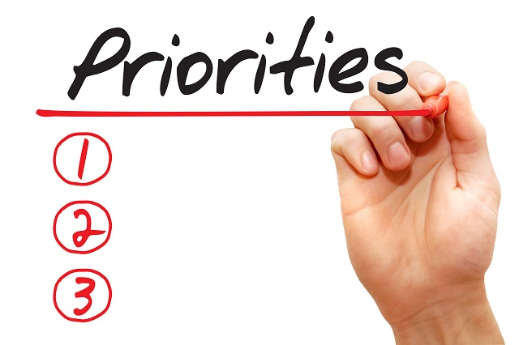
Prioritise /praɪˈɒr.ə.taɪz/ (v):
Dành ưu tiên

Slide 11
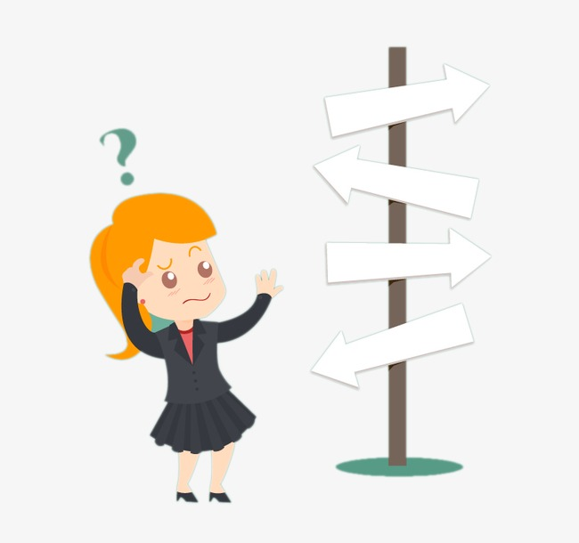
Be at a loss
/bɪ ət ə lɒs/
Lúng túng, bối rối

Slide 12
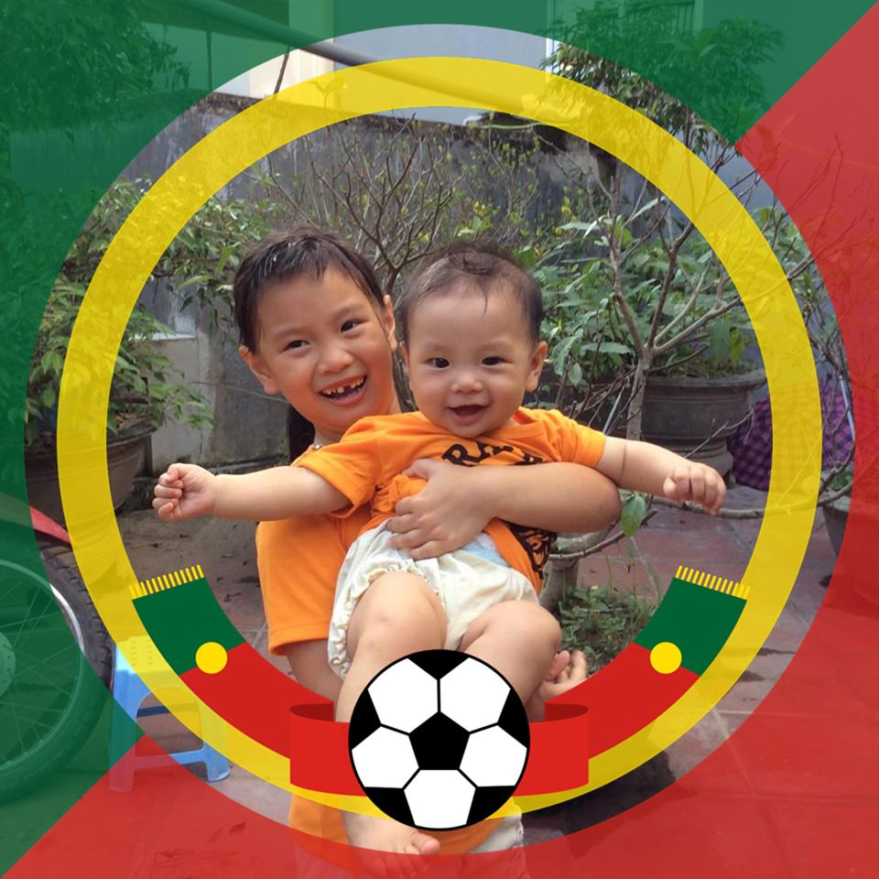
Sibling (n) ['sibliη]:
Anh chị em ruột

Slide 13
Vocabulary
- Strive /straɪv/ + for:
Cố gắng đạt được
- Approach /əˈproʊtʃ/ (v):
Tiến đến, lại gần
- Self-esteem /ˌself.ɪˈstiːm/ (n)
Lòng tự trọng tự tôn
- Prioritise /praɪˈɒr.ə.taɪz/ (v):
Ưu tiên
- Be at a loss /bɪ ət ə lɒs/:
Lúng túng, bối rối
- Sibling (n) ['sibliη]:
Anh chị em ruột

Slide 14
Task 1. Read the text again and select the statement that expresses its main idea.
A. You need important life skills to become independent.
B. Good time-management skills help you to build your confidence and self-esteem.
C. Time-management skills are not difficult to develop.
D. Mastering time-management skills has many benefits and there are three steps to develop them.

Slide 15
Task 2. Read through text again. Decide whether the sentences are true (T), false (F), or not given (NG).
 |  | T | F | NG
1 | Elderly people don’t strive for being independent.
2
3
4 | When teenagers are able to complete their daily tasks and duties at school and at home, they have more confidence and self-esteem.
5 | Having good time- management skills means you can use your time wisely.
✓
The ability to be independent comes naturally to a person when he/ she grow up.
The ability not to be independent comes naturally to a person when he/ she grow up.
✓
Teenagers only need time- management skills to be independent.
Teenagers need a number of life skills to be independent.
✓
✓
✓

Slide 16
Task 3. Answer the following questions.
1. What are the benefits of having good time-management skills?
→ With good time-management skills, you don't feel very stressed when exam dates are approaching; you can act more independently and responsibly, get better grades at school and have more time for family and friends.
2. How can you make plans for the things you need to do?
→ Write the things you will have to do on a planner or an app on your mobile device, and put time limits on them.
3. Why should you schedule the things you need to do?
→ So you can check them later.
4. How can you prioritise your activities?
→ Decide what is important to you and give it the most of your time or add it to the top of your list.
5. Why should you develop routines?
→ Once routines are developed, they take less time to do.

Slide 17
Task 4. Work in groups. Discuss the questions.
Which of the time-management skills mentioned in the text do you have?

Slide 18
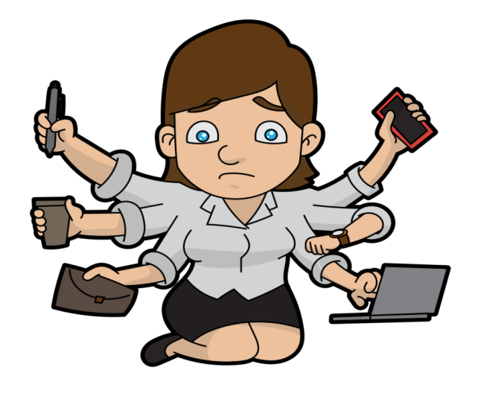
@ HOMEWORK
- Learn new words you learned from the reading
- Name at least two more time-management skills which you have besides making plans, prioritise activities and developing routines.
- Prepare for section 4– Speaking

