Slide 1
Unit 1
Life stories we admire
PERIOD 7
LESSON 6
WRITING
A biography of Walt Disney
Date of preparation:19/9/2024
Date of teaching:24/9/2024

Slide 2
LESSON 6
WRITING
WARM-UP
Look at the pictures and answer the question.
PRE-WRITING
Task 1: Answer the questions.
Task 2: Read some facts about Walt Disney. Answer the questions.
WHILE-WRITING
Task 3: Write a biography of Walt Disney.
POST-WRITING
Peer review
CONSOLIDATION
Wrap-up
Homework

Slide 3
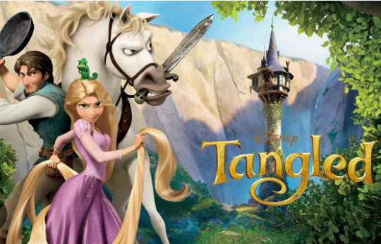
WARM-UP
Who do you think about when seeing the following pictures?

Slide 4
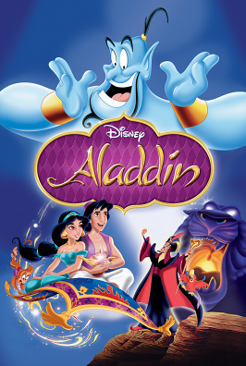
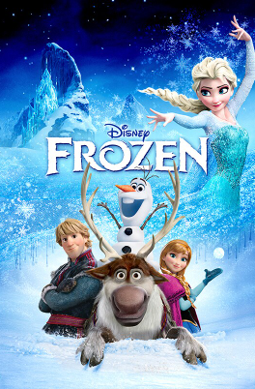
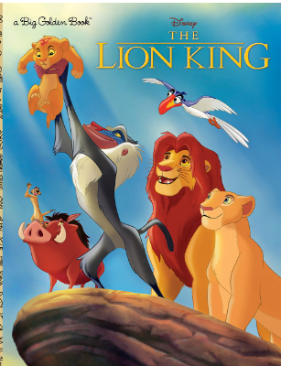
WARM-UP: Who do you think about when seeing the following pictures?

Slide 5
WARM-UP: Who do you think about when seeing the following pictures?
=> Walt Disney

Slide 6
PRE-WRITING
1
Work individually: Answer these questions.
1. When and where was Walt Disney born?
2. What schools did he attend?
3. What talent did he have?
4. What were his most impressive achievements in film-making?
5. What were his other achievements?
6. Was he married and how many children did he have?
7. When did he die?

Slide 7
PRE-WRITING
Work in pairs: Exchange your answer with your partner and correct the mistakes.
1
1. When and where was Walt Disney born?
2. What schools did he attend?
3. What talent did he have?
4. What were his most impressive achievements in film-making?
5. What were his other achievements?
6. Was he married and how many children did he have?
7. When did he die?

Slide 8
PRE-WRITING
Work in pairs: Exchange your answer with your partner and correct the mistakes.
1
1. When and where was Walt Disney born?
2. What schools did he attend?
3. What talent did he have?
4. What were his most impressive achievements in film-making?
5. What were his other achievements?
6. Was he married and how many children did he have?
7. When did he die?

Slide 9
PRE-WRITING
2
Suggested answers:
1. When and where was Walt Disney born?
2. What schools did he attend?
3. What talent did he have?
He was born in Chicago in 1901.
He attended Brenton Grammar School, but dropped out at the age of 16.
He had talent for drawing and painting.

Slide 10
PRE-WRITING
4. What were his most impressive achievements in film-making?
5. What were his other achievements?
6. Was he married and how many children did he have?
7. When did he die?
He created Mickey Mouse, and produced successful animated films such as Snow White and the Seven Dwarfs. He also won 26 Oscars.
He created the Disneyland theme park.
Yes, he was married and had two children.
He died in 1966.

Slide 11
WHILE-WRITING
3
Work individually: Write a biography (180 words) of Walt Disney.

Slide 12
WHILE-WRITING
3
Work in pairs: Swap their drafts with a partner and comment on each other’s ideas, vocabulary, and grammar.

Slide 13
WHILE-WRITING
3
Work individually: Ss make revisions based on peer feedback before they produce a final draft.

Slide 14
POST-WRITING
Suggested answer
WALT DISNEY – THE FATHER OF MICKEY MOUSE
Walt Disney is famous around the world for making a lot of successful films, which are loved by children and adults of many generations.
Childhood and education
Walt Disney was born in Chicago in 1901. During his childhood, he loved drawing and painting. He attended Brenton Grammar School, but he left school when he was 16.
Achievements
Disney was a very successful film maker, who created Mickey Mouse and produced successful animated films such as Snow White and the Seven Dwarfs. Throughout his career, Disney won or received 26 Oscars, three Golden Globe Awards, one Emmy Award – a record in history.
He is also famous for building the first theme park in the world, called Disneyland. Now many more Disney parks have been built and have become popular worldwide.

Slide 15
WHILE-WRITING
Family
Walt Disney had three older brothers and a younger sister. He married Lillian Bounds, and they were together for 41 years. They had one biological daughter and one adopted daughter.
Death and the continued success of the Walt Disney Studios
Disney died from cancer in 1966, but the Walt Disney Studios continued to make live-action and animated films. These films inspire people of all ages to follow their dreams.

Slide 16
CONSOLIDATION
1
Wrap-up
What have you learnt today?
Synthesise and summarise information in order to write a biography about the life of Walt Disney

Slide 17
CONSOLIDATION
2
Homework
Do exercises in the workbook.
Prepare for Lesson 7 – Communication & Culture.

