Slide 1
Unit
3
1
Unit
FAMILY LIFE
MUSIC
LESSON 1
GETTING STARTED
A talented artist

Slide 2
Unit
1
1
FAMILY LIFE
Family Life
Unit
OBJECTIVES
Gain an overview about the vocabulary related to the topic Music and main grammatical points taught in this unit;
Memorise vocabulary to talk about musical idols.

Slide 3
LESSON 1
GETTING STARTED
Unit
GETTING STARTED
Guess the name of the songs
WARM-UP

Slide 4
WARM-UP
Guess the name of the songs
SONG 1
Love yourself
SONG 2
Sorry
SONG 3
What do you mean?
SONG 4
Where are you now
SONG 5
Stuck in moment

Slide 5
WARM-UP
Guess the name of the songs
Love yourself
Whose songs are they?
They are Justin Bieber’s.
Is he a talented singer?
Yes, he is considered the Prince of Pop.
Sorry
What do you mean?
Where are you now
Stuck in moment

Slide 6
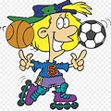
PRESENTATION
talented (adj)
/ˈtæləntɪd/
having a natural ability to do something well

Slide 7
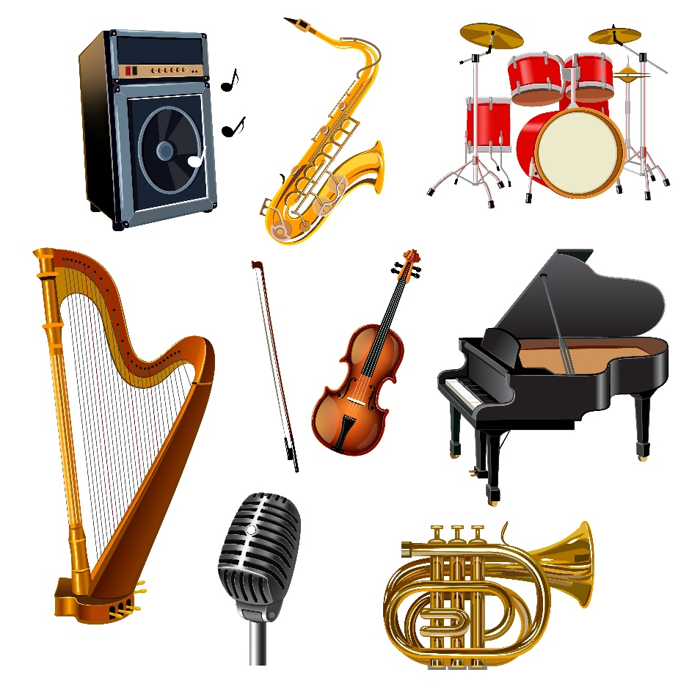
PRESENTATION
musical instrument (n)
/ˌmjuːzɪkl ˈɪnstrəmənt/
an object used for producing musical sounds, for example a piano or a drum

Slide 8
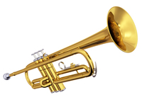
PRESENTATION
trumpet (n)
/ˈtrʌmpɪt/
a brass musical instrument made of a curved metal tube that you blow into, with three valves for changing the note

Slide 9
PRESENTATION
perform (v)
/pəˈfɔːm/
entertain an audience by playing a piece of music, acting in a play, etc.

Slide 10
PRESENTATION
New words | Pronunciation | Meaning
talented (adj) | /ˈtæləntɪd/ | having a natural ability to do something well
musical instrument (n) | /ˌmjuːzɪkl ˈɪnstrəmənt/ | an object used for producing musical sounds, for example a piano or a drum
trumpet (n) | /ˈtrʌmpɪt/ | a brass musical instrument made of a curved metal tube that you blow into, with three valves for changing the note
perform (v) | /pəˈfɔːm/ | entertain an audience by playing a piece of music, acting in a play, etc.

Slide 11
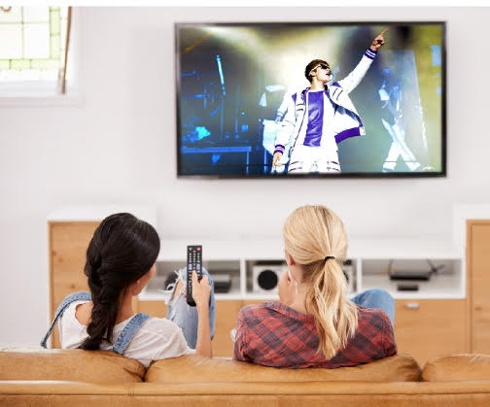
PRACTICE
1
Listen and read.
A talented artist

Slide 12
PRACTICE
1
Listen and read.
A talented artist
Mai: That pop singer looks great, Ann!
Ann: Yeah. He’s a popular teen idol around the world now.
Mai: Really? You must be a fan of his!
Ann: Yep, I really love his music. He’s a talented artist who can write music and play many musical instruments. He has received several awards such as the Grammy, Billboard Music and Teen Choice Awards.
Mai: Wow! Did he go to a music school?

Slide 13
PRACTICE
1
Listen and read.
A talented artist
Ann: No, he didn’t, but he learnt to play the piano, drums, guitar, and trumpet by himself. When he was a teenager, he performed at the local theatre in his home town during the tourist season.
Mai: How did he become famous?
Ann: Well, when he was 12, his mother started to upload his cover song videos on social media, and the videos made him an online star within a couple of months.
Mai: Sounds amazing!
Ann: And his videos have reached more than two billion total views. Many fans say that his beautiful songs have helped bring more love into their lives.

Slide 14
PRACTICE
PRACTICE
2
Read the conversation again and answer the following questions.
Who are Ann and Mai talking about?
What is he good at?
What made him popular?
They are talking about a young pop singer.
(Mai 1: That pop singer looks great.)
He is good at writing music and playing many
musical instruments.
(Ann 2: He’s a talented artist who can write music and play many musical instruments.
His cover song videos made him popular.
(Ann 4: Well, when he was 12, his mother started to upload his cover song videos on social
media, and the videos made him an online star within a couple of months.)

Slide 15
PRACTICE
3
Find words or phrases in the conversation which refer to:
a type of music
music awards
musical instruments
ways of sharing information and videos
pop
Grammy, Billboard Music and Teen Choice Awards
piano, drums, guitar, and trumpet
social media

Slide 16
PRACTICE
4
Match the two parts to make complete sentences.
1. This artist didn’t go to a music school,
a. and he has received several awards.
2. His beautiful songs have helped
b. to upload his cover song videos on social media.
3. His mother started
c. bring more love to people’s lives.
4. He is a talented artist,
d. but he learnt to play musical instruments by himself.

Slide 17
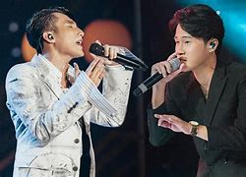
PRODUCTION
5
Talk about your favourite singer or musical band. You should mention who she/he is, what she/he is good at, what makes her/ him famous.

Slide 18
CONSOLIDATION
1
Wrap-up
Gain an overview about the topic Music
Memorise vocabulary to talk about music idols

Slide 19
CONSOLIDATION
2
Homework
Do exercises in the workbook
Project preparation

Slide 20
CONSOLIDATION
2
Homework
Project preparation
+ do research on a form of traditional music in Viet Nam or another country
+ include information related to the points stated on the Project page or prepare a poster (drawing, pictures) presenting the research results.
+ give an oral presentation of the research results in the last lesson of the unit.
(You can search for ideas on the Internet, in the newspaper, etc. or talk to experts for reference and you should use photos/pictures to illustrate your ideas.)

