Slide 1
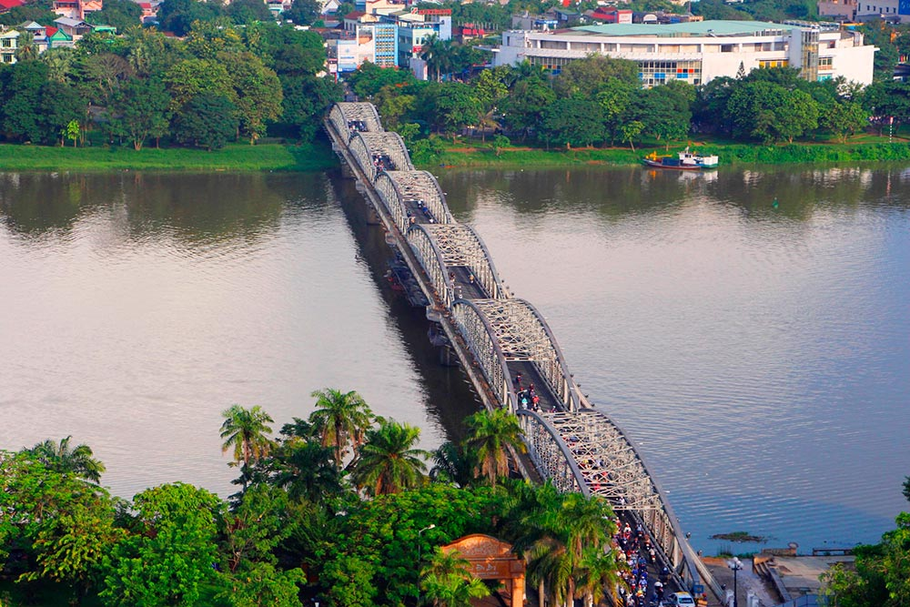
teacher
adorable
focus
marriage
prepare
international
domestic
necessary
violence
gender
education
career
surgeon
equal
continue
difficult
parachute
medical

Slide 2
Unit 7: Viet Nam and international organisations
Lesson 1: Getting started

Slide 3
VOCABULARY
A | B
1. peace | a. mục tiêu
2. poverty | b. hình thành
3. form | c. hỗ trợ kỹ thuật
4. aim | d. tham gia
5. technical support | e. gặp nhiều khó khăn/ thiệt thòi
6. economic | f. hòa bình
7. investor | g. chuyên gia/ chuyên môn
8. participate in | h. sự nghèo đói
9. disadvantaged | i. kinh tế
10. expert | j. nhà đầu tư
f
h
b
a
c
i
j
d
e
g

Slide 4
VOCABULARY
A | B
1. peace | hòa bình
2. poverty | sự nghèo đói
3. form | hình thành
4. aim | mục tiêu
5. technical support | hỗ trợ kỹ thuật
6. economic | kinh tế
7. investor | nhà đầu tư
8. participate in | tham gia
9. disadvantaged | gặp nhiều khó khăn/ thiệt thòi
10. expert | chuyên gia/ chuyên môn

Slide 5
VOCABULARY
A | B
1. peace
2. poverty
3. form
4. aim
5. technical support
6. economic
7. investor
8. participate in
9. disadvantaged
10. expert
hòa bình
sự nghèo đói
hình thành
mục tiêu
hỗ trợ kỹ thuật
kinh tế
nhà đầu tư
tham gia
gặp nhiều khó khăn/ thiệt thòi
chuyên gia/ chuyên môn

Slide 6
Listen and fill in the gaps with the missing words
1945
A. The United Nations (UN) was created in ……………... It is an organisation of most of the world's countries. Its main goal is world ………………. It also works to reduce poverty and improve people's lives in other ways. Viet Nam joined the organisation in …………….. Since then, our country has become more active and has participated in many UN activities including peacekeeping.
B. UNICEF was formed in ………………. It works in over 190 countries to help improve health and education of children. It particularly aims to support the most disadvantaged children all over the world. UNICEF's aim in Viet Nam is to protect children and make sure they are …………….., educated and safe from harm.
C. UNDP was formed in ……………… as part of the UN. It provides technical support, expert advice and training to help people in developing countries have a better life. In Viet Nam, UNDP works closely with the government to reduce ……………….. and improve people's lives.
D. The WTO was formed in ………………. It is the world’s largest international economic organisation. Viet Nam became a WTO …………........... in 2007 Since then, our economy has achieved a high growth level. Viet Nam has also become more attractive to foreign investors.
peace
1977
1946
healthy
1965
poverty
1995
member

Slide 7
Listen and fill in the gabs with the missing words
1. 1945 6. 1965
2. peace 7. poverty
3. 1977 8. 1995
4. 1946 9. member
5. healthy

Slide 8
UNICEF works in nearly 190 countries. (True / False)

Slide 9
What is the aim of UNICEF in Viet Nam?
…………………………………………………………..

Slide 10
What is the aim of the UN?
………………………………………………….

Slide 11
Viet Nam joined WTO in ...................
A. 1995 B. 1965 C. 2007 D. 1946

Slide 12
Viet Nam joined the UN in ..............
A. 1945 B. 1946
C. 1965 D. 1977

Slide 13
The WTO was formed in ...................
A. 1995 B. 1977
C. 2007 D. 1965

Slide 14
UNDP was formed in...............
A. 1995 B. 1977
C. 2007 D. 1965

Slide 15
UNICEF was formed in .....................
A. 1945 B. 1977
C. 1946 D. 1995

Slide 16
The United Nations (UN) was created in ………
A. 1995 B. 1977
C. 2007 D. 1945

Slide 17
Which of the following organization particularly aims to promote economy?
A. The UN B. UNICEF
C. UNDP D. WTO

Slide 18
A. The United Nations (UN) was created in 1945. It is an organisation of most of the world's countries. Its main goal is world peace. It also works to reduce poverty and improve people's lives in other ways. Viet Nam joined the organisation in 1977. Since then, our country has become more active and has participated in many UN activities including peacekeeping.

Slide 19
B. UNICEF was formed in 1946. It works in over 190 countries to help improve health and education of children. It particularly aims to support the most disadvantaged children all over the world. UNICEF's aim in Viet Nam is to protect children and make sure they are healthy, educated and safe from harm.

Slide 20
C. UNDP was formed in 1965 as part of the UN. It provides technical support, expert advice and training to help people in developing countries have a better life. In Viet Nam, UNDP works closely with the government to reduce poverty and improve people's lives.

Slide 21
D. The WTO was formed in 1995. It is the world’s largest international economic organisation. Viet Nam became a WTO member in 2007. Since then, our economy has achieved a high growth level. Viet Nam has also become more attractive to foreign investors.

Slide 22
teacher | marriage | domestic | gender
surgeon | difficult | parachute | equal
education | necessary | prepare | adorable
focus | international | violence | career
continue | medical | organisation | people

Slide 23
