Slide 1
UNIT 4 – PLACES IN VIỆT NAM
Lesson 5a – Vocabulary and Grammar 1

Slide 3
travelling
by plane

Slide 4
going on foot

Slide 5
taking a taxi

Slide 6
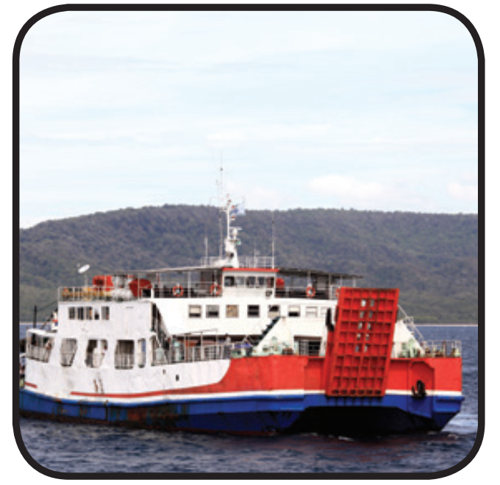
going by
ferry

Slide 7
driving a car

Slide 8
taking a coach

Slide 10
Answer
c
t_king _ coa_h
a
a

Slide 11
Answer
g
f
y
_oing by _err_

Slide 12
Answer
a
x
tak_ng a t_ _i
i

Slide 13
Answer
o
n
t
g_ing o_ foo_

Slide 14
Answer
r
dr_v_ng a ca_
i
i

Slide 15
Answer
v
l
a
tra_el_ing by pl_ne

Slide 16
How do you go to Ba Bể Lake?
I go to Ba Bể Lake by car.

Slide 17
How does your mom travel to Hội An Old Town?
She travels to Hội An Old Town by plane.

Slide 18
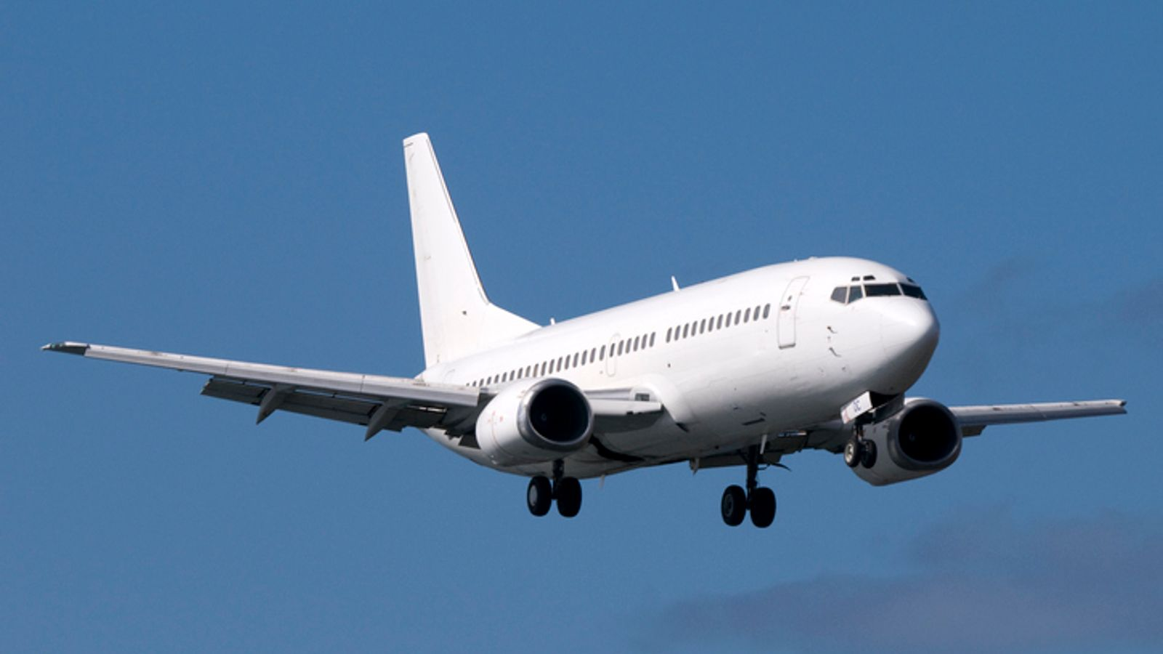
How do you travel to Đà Nẵng City?
Answer
Next
I travel to Đà Nẵng City by plane.

Slide 19
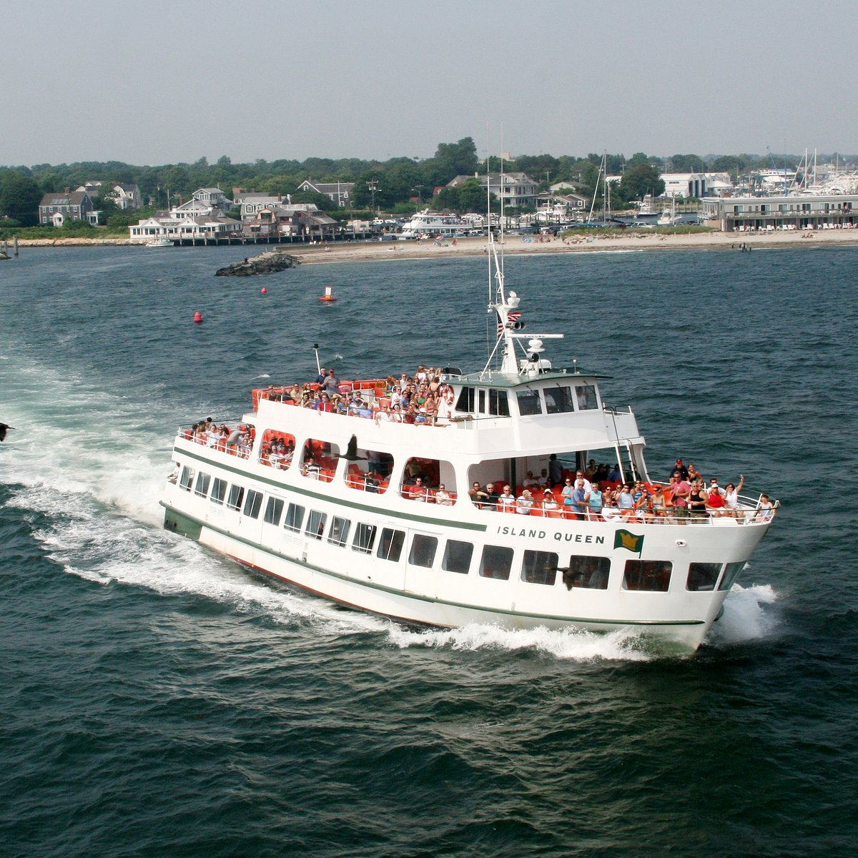
How does Linh go to Lý Sơn Island?
Answer
Next
She goes to Lý Sơn Island by ferry.

Slide 20
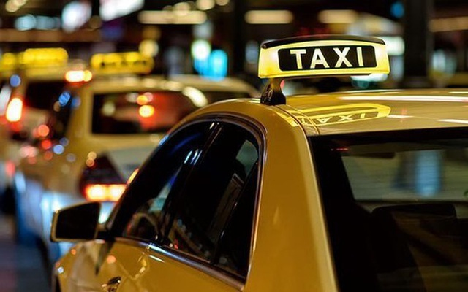
How do your friends go to
Hoàn Kiếm Lake?
Answer
Next
They go to Hoàn Kiếm Lake by a taxi.

Slide 21
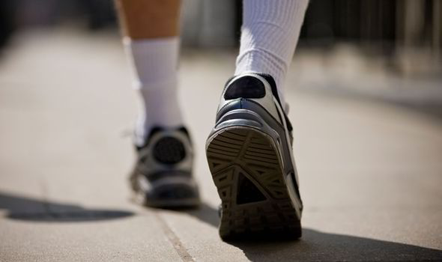
How does your uncle travel to Phan Xi Făng Mountain?
Answer
Next
He goes to Phan Xi Făng Mountain on foot.

Slide 22
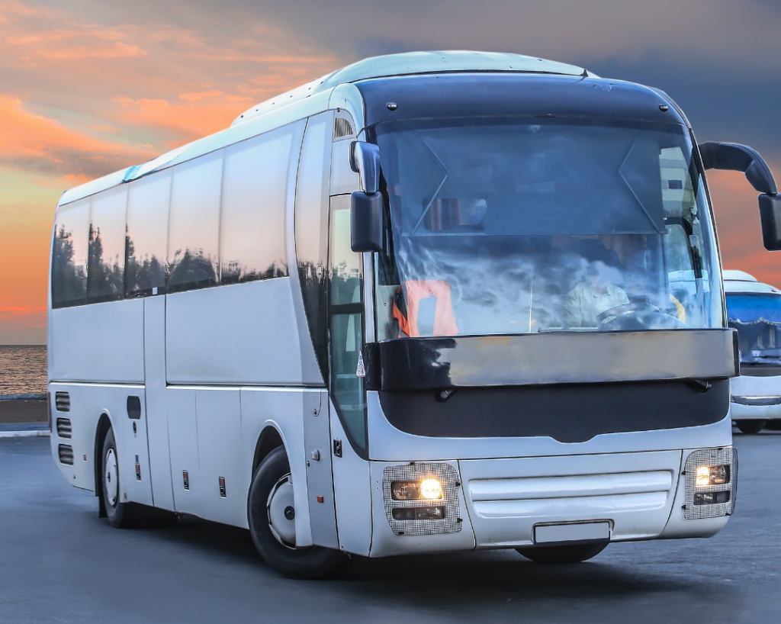
How does your family travel to
Sa Pa Town?
Answer
Next
My family travel to Sa Pa Town by coach.

Slide 23
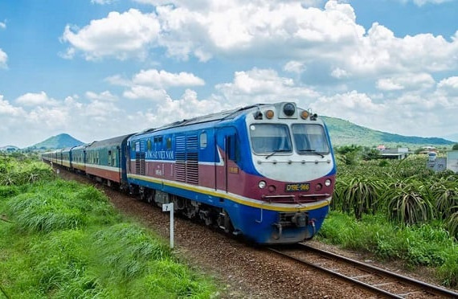
How does Nam go to Thủy Tiên Waterfall?
Answer
Next
He goes to Thủy Tiên Waterfall by train.

Slide 24
Welldone!
End

Slide 26
HOMEWORK
HOMEWORK
Review Vocabulary and Grammar.
Do exercises in the Activity book (page 40).
Check answers in the Teacher’s book (page 88) or Active Teach.

