Slide 1
UNIT 3: WHERE’S MY PEN?
Lesson 4 – Phonics

Slide 2
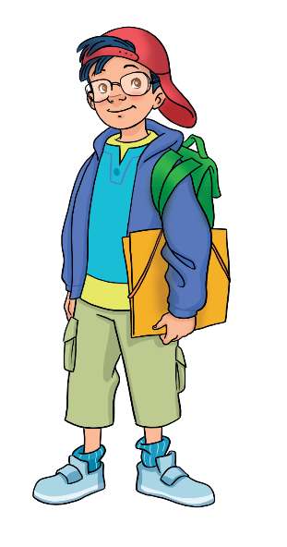
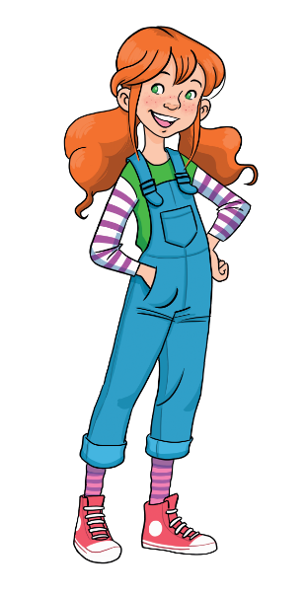
GAME: JUMP AND SAY
Play in team. Click on an apple. Look and jump left or right.
Say the sound a /eɪ/ or oy /ɔɪ/ and the word.
baby
toy
name
joy
lake
soy
/eɪ/, day
/ɔɪ/, boy
a
ROUND 1
oy
Click on Sam & Marie to try.

Slide 3
Song: The Short Vowel Song
WARM-UP
Stand up.
Listen to the song.
Clap your hands and sing along.

Slide 4
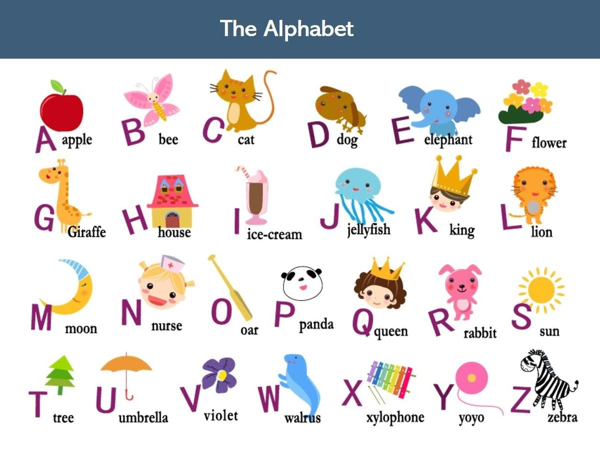
LEAD-IN
This is the Alphabet.
How many letters?
26 letters
Look.
Say the letters.
A
E
I
3
CHECK
Click on “1, 2” to show and hide the circle.

Slide 5
LEAD-IN
LET’S LEARN THE SOUNDS
a e i
/a/ /e/ /i/

Slide 6
Sound /a/
Say the words.
Letter
Sound
a | a
a
What letter is it?
/a/
What is the sound?
a
b g
Notes:
Show the letter, ask “What letter is it?” and have Ss answer “Letter A”
Show the sound, “What is the sound?” and have Ss answer “Sound /a/”
Show the sound in red, say aloud and have Ss repeat the sounds 3 time after each “Click”
Show the word, say aloud and have Ss repeat
Show the picture and have Ss say “a, a, bag”
Have Ss say aloud one more time in rhythm “Letter a, Sound /eɪ/, a… a… a… bag”

Slide 7
Sound /e/
Say the words.
Letter
Sound
e | e
e
What letter is it?
/e/
What is the sound?
e
p n
Notes:
Show the letter, ask “What letter is it?” and have Ss answer “Letter E”
Show the sound, “What is the sound?” and have Ss answer “Sound e/”
Show the sound in red, say aloud and have Ss repeat the sounds 3 time after each “Click”
Show the word, say aloud and have Ss repeat
Show the picture and have Ss say “e, e, pen”
Have Ss say aloud one more time in rhythm “Letter a, Sound /e/, e… e… e… pen”

Slide 8
Sound /e/
Say the words.
Letter
Sound
i | i
i
What letter is it?
/i/
What is the sound?
s x
i
Notes:
Show the letter, ask “What letter is it?” and have Ss answer “Letter I”
Show the sound, “What is the sound?” and have Ss answer “Sound /i/”
Show the sound in red, say aloud and have Ss repeat the sounds 3 time after each “Click”
Show the word, say aloud and have Ss repeat
Show the picture and have Ss say “i, i, six”
Have Ss say aloud one more time in rhythm “Letter a, Sound /i/, i… i… i… six”

Slide 9
Sounds /a/, /e/ & /i/
Letter
Sound
Letter
Sound
Letter
Sound
a
e
i
/a/
/e/
/i/
bag
pen
six

Slide 10
THE LAST PIECE
RULES
There is 1 missing piece in each puzzle
Choose the correct letter “a” or “e” or “i” to complete the word
All students say aloud the sound of the letter and the word
1 correct answer = 1 point
Note:
- Click Next to start the activity
- Click on the question mark “?” to show the letters
- Click on the correct letter to complete the word

Slide 11
i
e
a
s
?
i
x

Slide 12
i
e
a
b
?
a
g

Slide 13
i
e
a
p
?
e
n

Slide 14
i
e
a
c
?
a
t

Slide 15
i
e
a
r
?
e
d

Slide 16
i
e
a
s
?
i
t

Slide 17
Pupil’s Book (p.36)

Slide 18
Pupil’s Book (p.36)
Answers
red
Ben
big
Sam
teddy
ten
this
Click on the icons 3.11 & 3.12 to play the audios
Click on “Answers” to show the answers

Slide 19
Pupil’s Book (p.36)

Slide 20
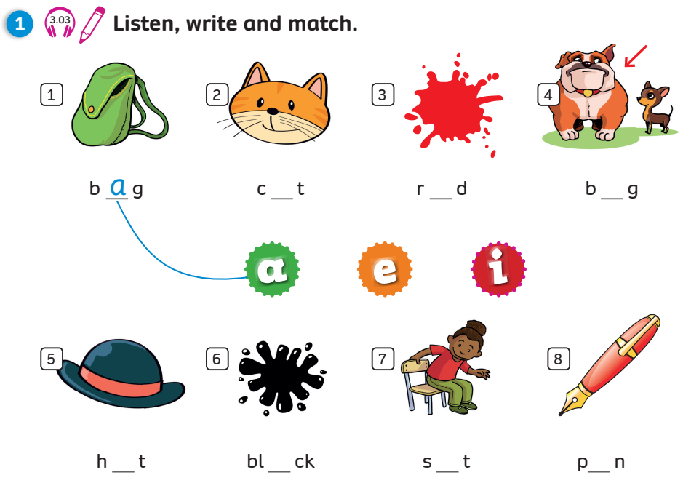
Activity Book (p.32)
Write
Match
a
e
i
a
a
i
e
Click on “Write, Match” to show the answers

Slide 21
Activity Book (p.32)
Match
Click on “Match” to show the answers

Slide 22
FURTHER PRACTICE
SORTING SOUNDS
rat
pin
can
zip
jet
Say aloud the words in the bowl.
Sort the sounds in the correct clouds below.
1 correct answer = 1 point.
hen
hot
van
ten
wig
a /a/
i /i/
e /e/
Click on the words to sort them
Notes:
Show the words in the bowl
Have Ss listen and say aloud the words
Invite 1 student to choose and sort a word, then say it
1 correct answer = 1 point

Slide 23
WRAP-UP
Letter
Sound
Letter
Sound
Letter
Sound
a
e
i
/a/
/e/
/i/
bag
pen
six

