Slide 1
Teacher: Tran Thi To Nga
Tran Nguyen Han secondary school

Slide 2
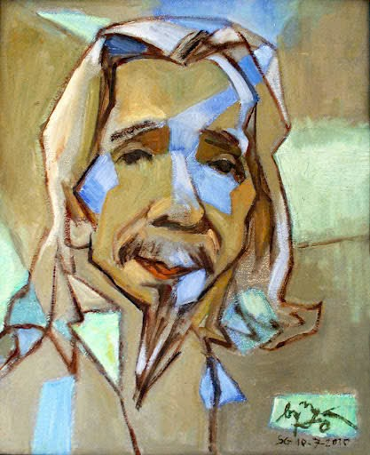
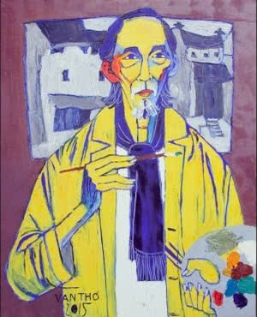
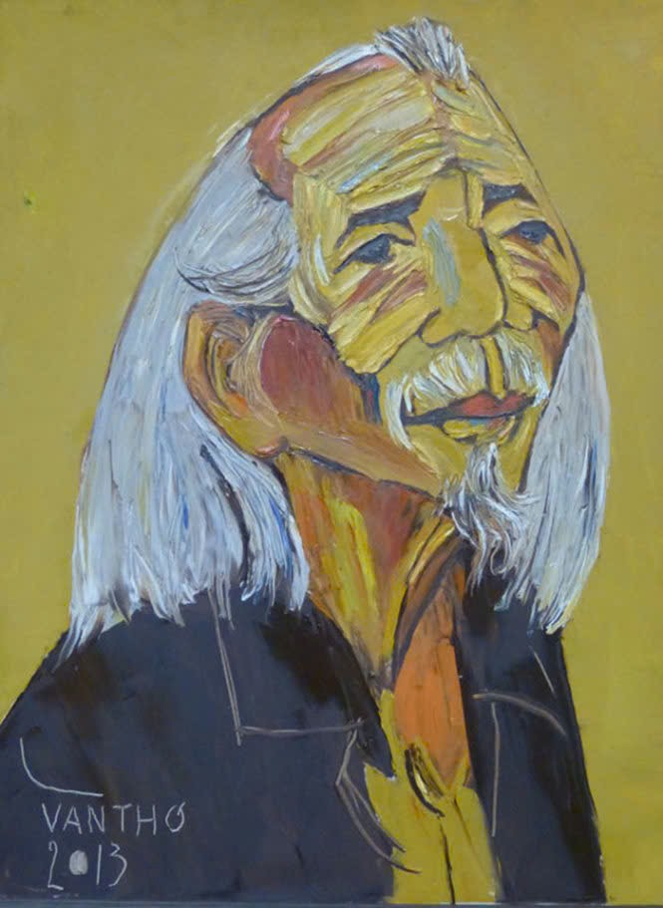
Composer VAN CAO
“Tiến quân ca”- The national song/ anthem of Viet Nam

Slide 3
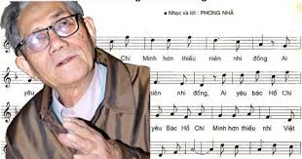
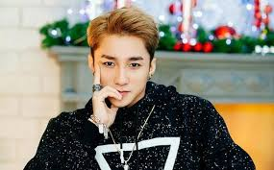
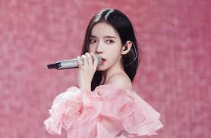
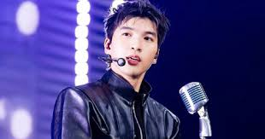

Slide 4
Period 25: UNIT 4: MUSIC AND ARTS
Lesson 1: GETTING STARTED

Slide 5
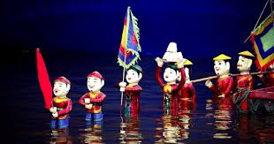
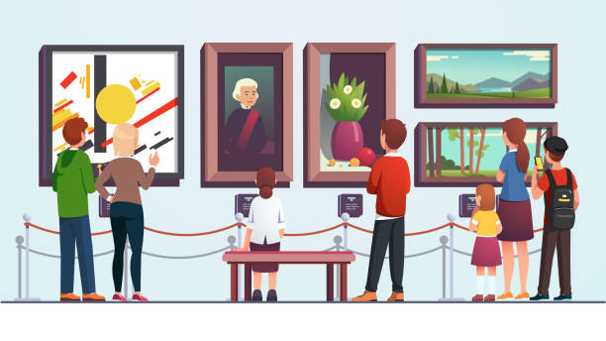
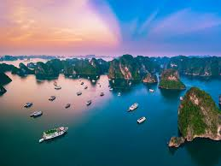
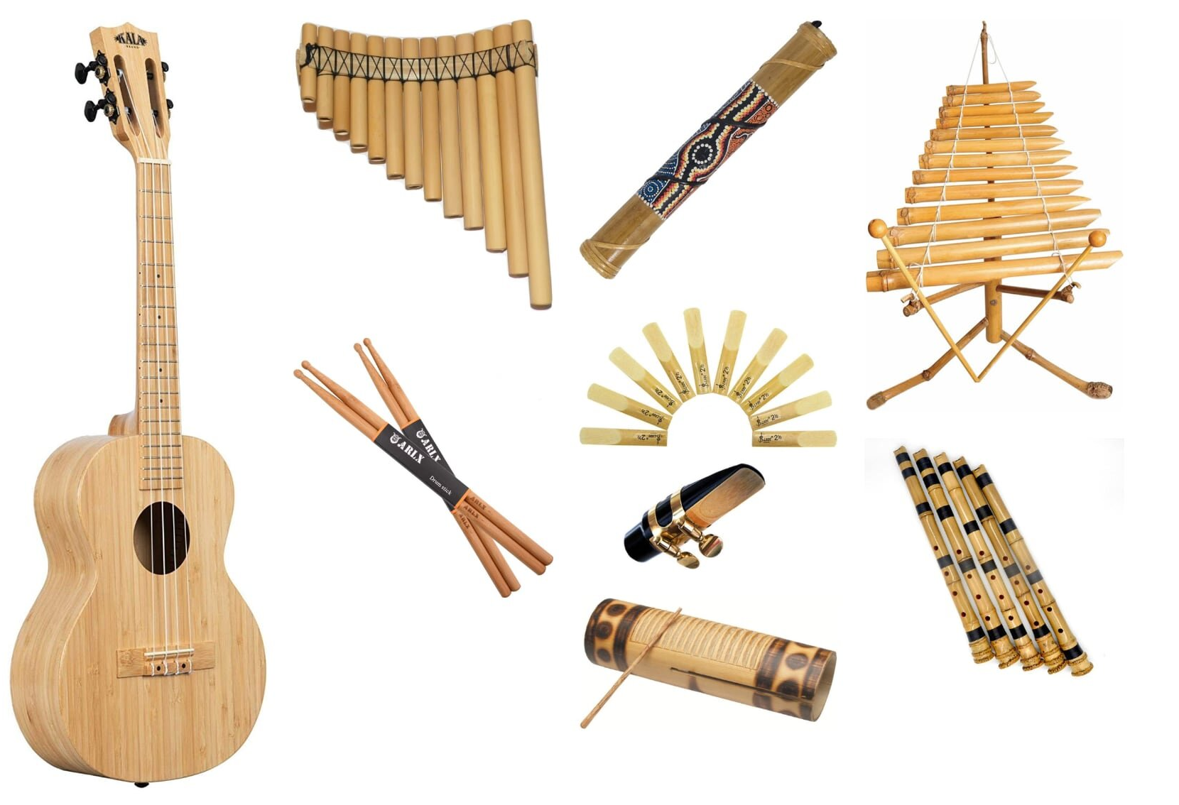
I. Vocabulary
- classical (adj):
cổ điển
- spare time (n):
thời gian rảnh rỗi
- musical instruments (n):
nhạc cụ
modern
- landscape (n):
phong cảnh
- art gallery (n):
phòng trưng bày nghệ thuật
- water puppetry show (n):
buổi biểu diễn múa rối nước

Slide 6
I. Vocabulary
- classical (adj):
nhạc cụ
- spare time (n):
cổ điển
- musical instruments (n):
thời gian rảnh rỗi
- landscape (n):
phòng trưng bày nghệ thuật
- art gallery (n):
buổi biểu diễn múa rối nước
- Water puppetry show (n):
phong cảnh

Slide 7
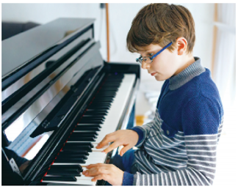
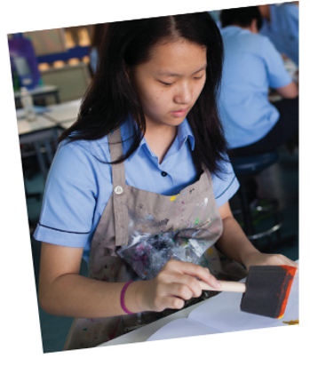
What are Trang and Nick talking about? A. Playing the piano. B. Drawing and painting. C. Music and arts.
Nick
Trang

Slide 8
II. Listen and read
Trang: Hi Nick. What are you listening to?
Nick: I’m listening to music. I like classical music, and I often play
the piano in my spare time.
Trang: Wow. I can’t play any instruments.
Nick: And what about you? What’s your hobby?
Trang: I like painting and taking photos.
Nick: Taking photo? I’ve never tried it. Is it fun?
Trang: Yeah, it is, but not as fun as painting.
Nick: Right. They seem quite different from each other.
What do you normally paint?
Trang: Landscapes and animals, just for pleasure, you know.
I sometimes share them with my friends.
Nick: Really? Um, maybe we should go to an art gallery next weekend?
Trang: Sounds good, but I’d prefer to go to the music festival at my
school.
Nick: Well … OK. That’s fine.
What are Trang and Nick talking about? A. Playing the piano. B. Drawing and painting. C. Music and arts.

Slide 9
Complete each of the sentences with a suitable word or phrase from the box.
photos like different from art gallery musical instruments
Nick wants to go to a(n) _____________ next week.
You can use your smartphone to take ________.
This photo is very bright. It is _____________ that dark one.
Nick and Trang agree that taking photos is not ______painting.
My friend David is very talented. He plays three _________________.
art gallery
photos
different from
like
musical instruments

Slide 10
Good luck!
15
LUCKY WHEEL
0
10
https://hoclieu.vn/skill/46a8b2cf-1a25-4056-b384-10c6ff1ce353?lessonId=08dc3939-3161-41f6-8b73-6d944e6a96d6
5
50
20
30
QUAY

Slide 11
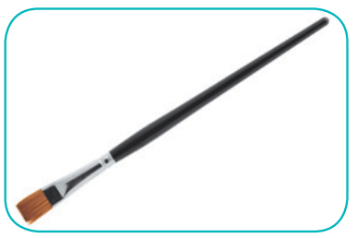
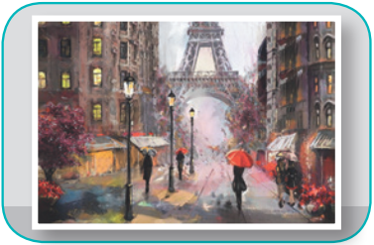
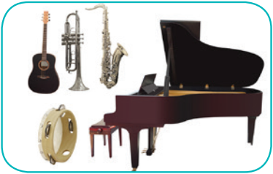
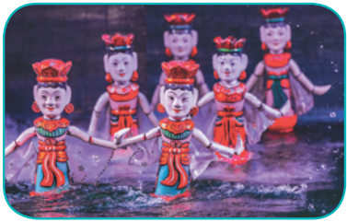
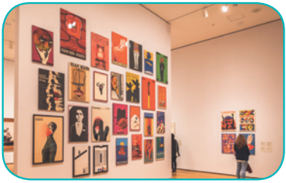
https://www.online-stopwatch.com/emoji-race-timer/?countdown=00:00:10
camera water puppet show
art gallery painting
paintbrush musical instruments
https://hoclieu.vn/skill/1bce1561-fedc-42c2-a1ca-08cc7f1b4712?lessonId=08dc3939-3161-41f6-8b73-6d944e6a96d6
1. ______________
2. ____________
3. ____________
4. __________________________
5. _________________________
6. ____________

Slide 12
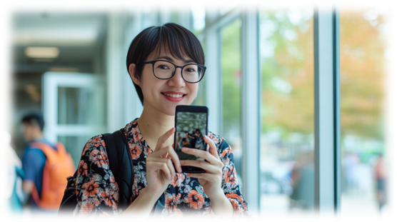
𝓐𝓶 𝓘 𝓪𝓻𝓽𝓲𝓼𝓽𝓲𝓬?
𝓦𝓱𝓪𝓽 𝓪𝓫𝓸𝓾𝓽 𝔂𝓸𝓾?

Slide 13
HOMEWORK
Prepare the vocabulary for the next lesson: A closer look 1.
Prepare for the Project lesson.

Slide 14
Thanks for listening!
Goodbye. See you again

Slide 15
