Slide 1

UNIT 2: LOOK AT MY TOYS!
Lesson 9 – Review

Slide 2
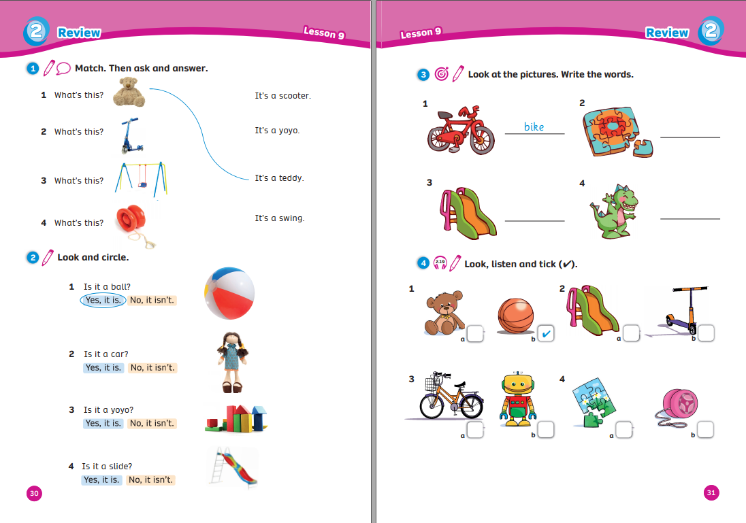
UNIT 2: LOOK AT MY TOYS!
We’re reviewing…
- toys
- how to ask and answer about toys
- SB p.30 – 31
- AB p.26 – 27

Slide 3


WARM-UP
Song: Mystery Box
Listen to the song.
Clap your hands and sing along.
Say aloud the toys.

Slide 4

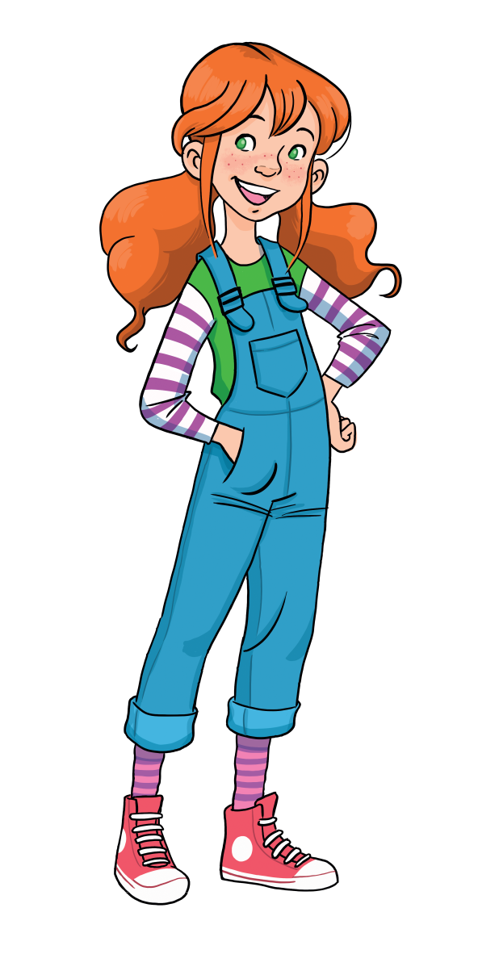
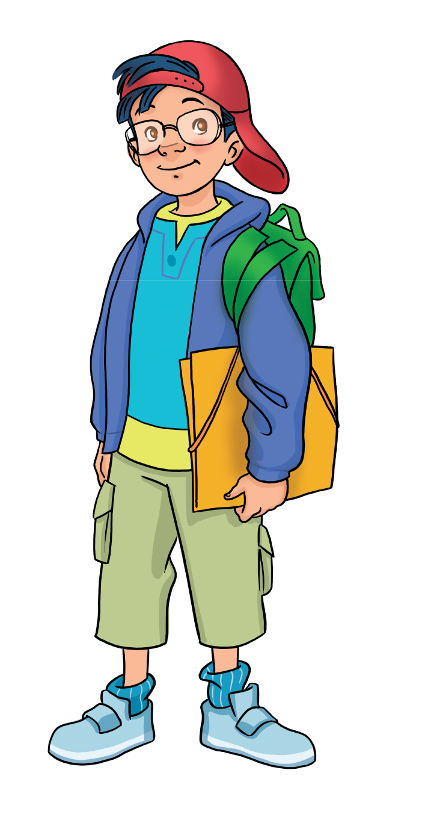
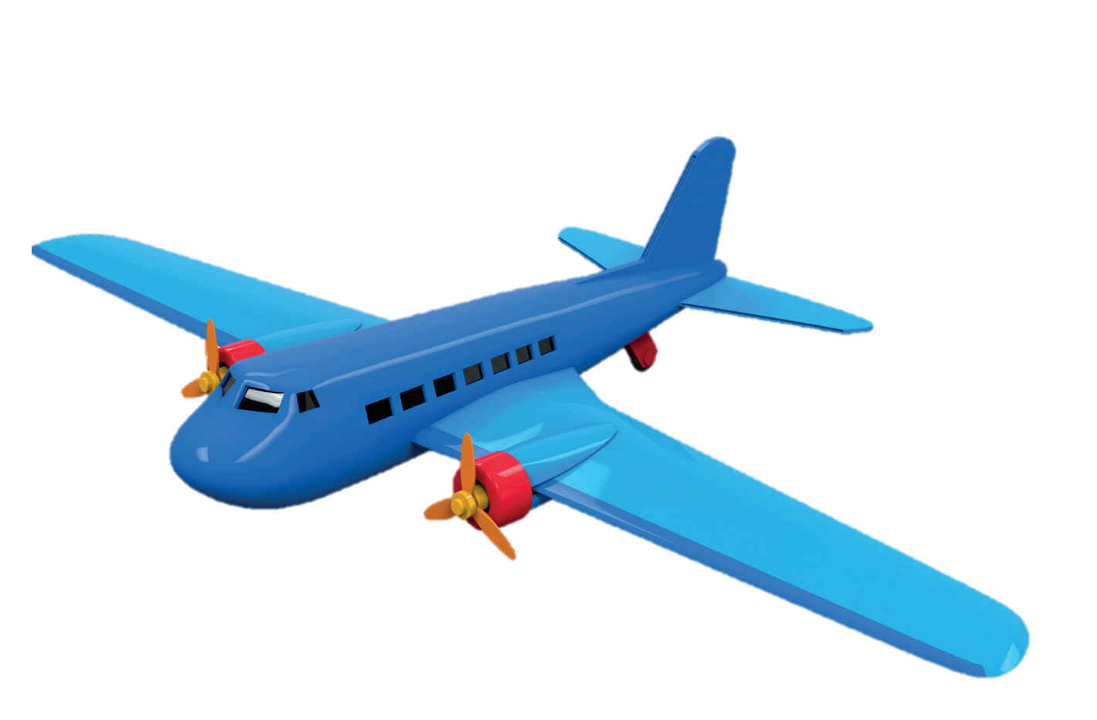
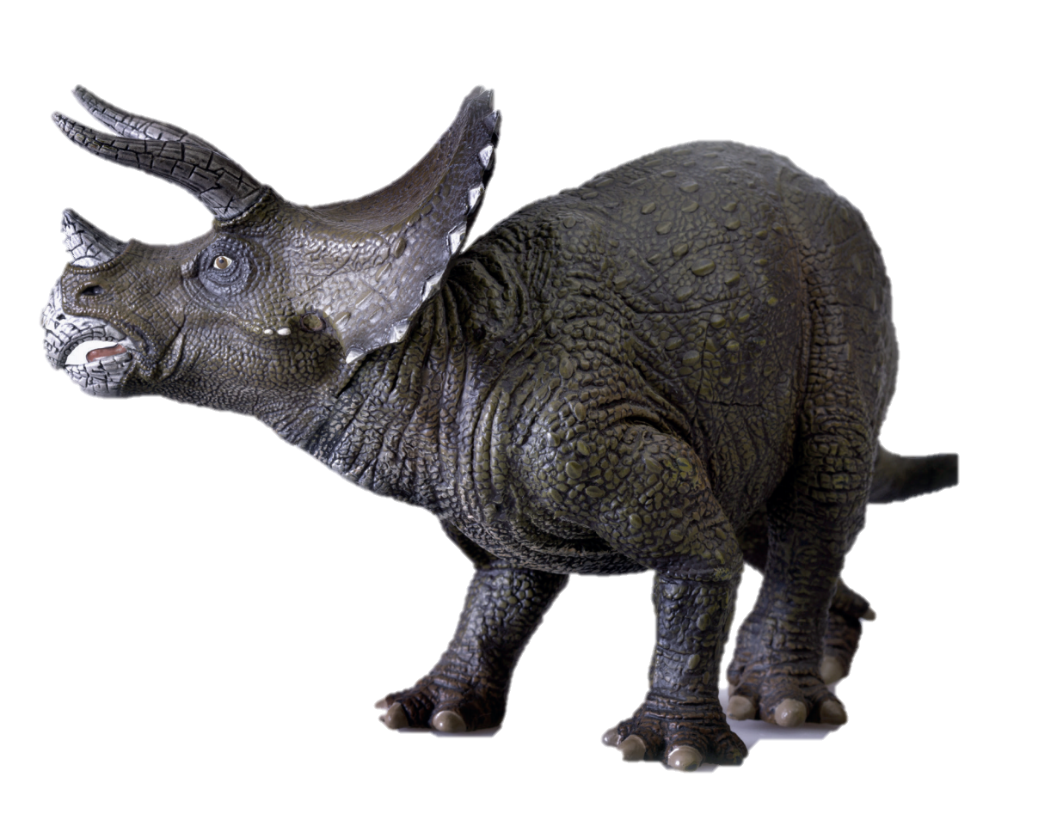
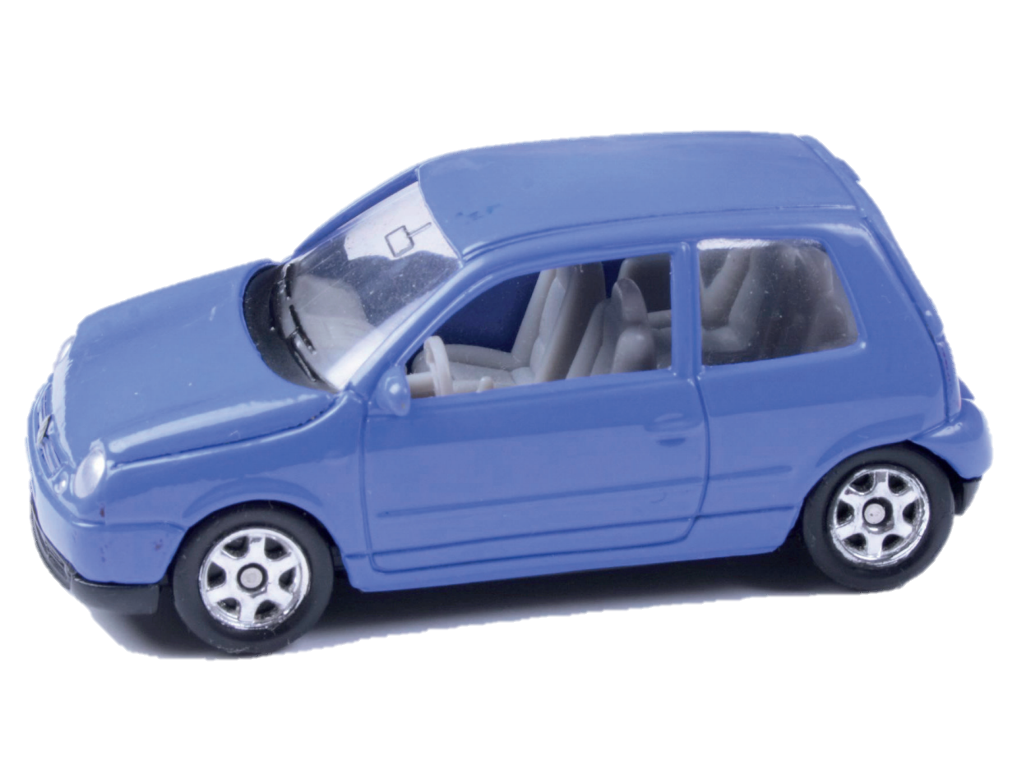

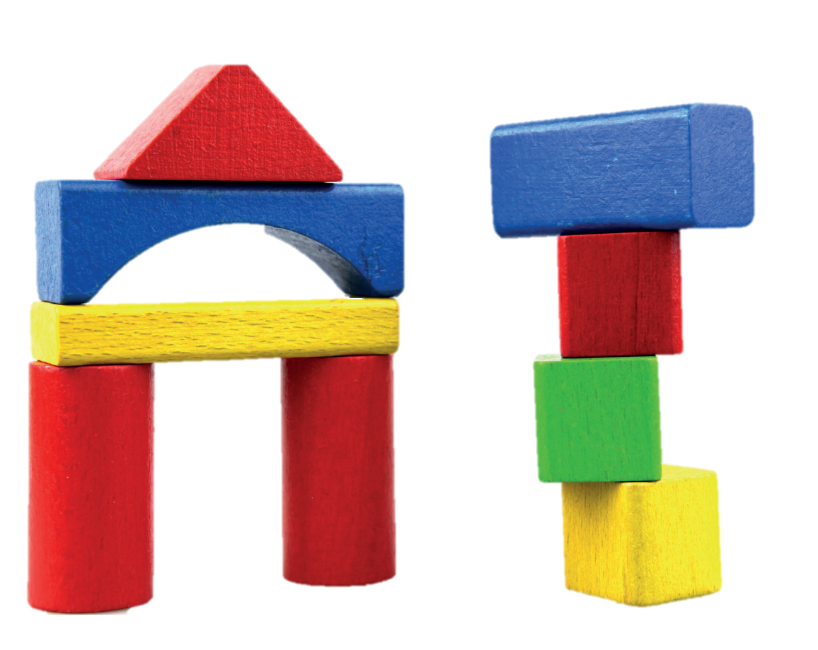
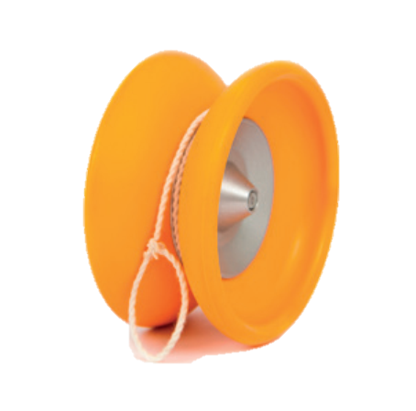
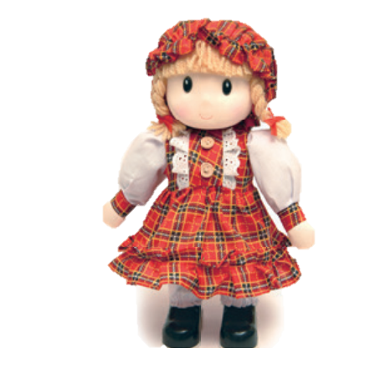

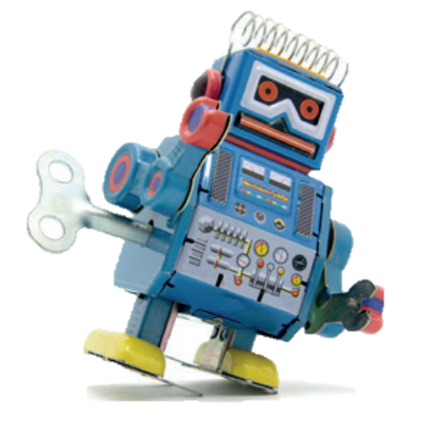
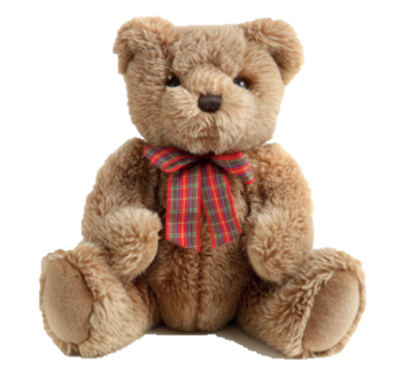
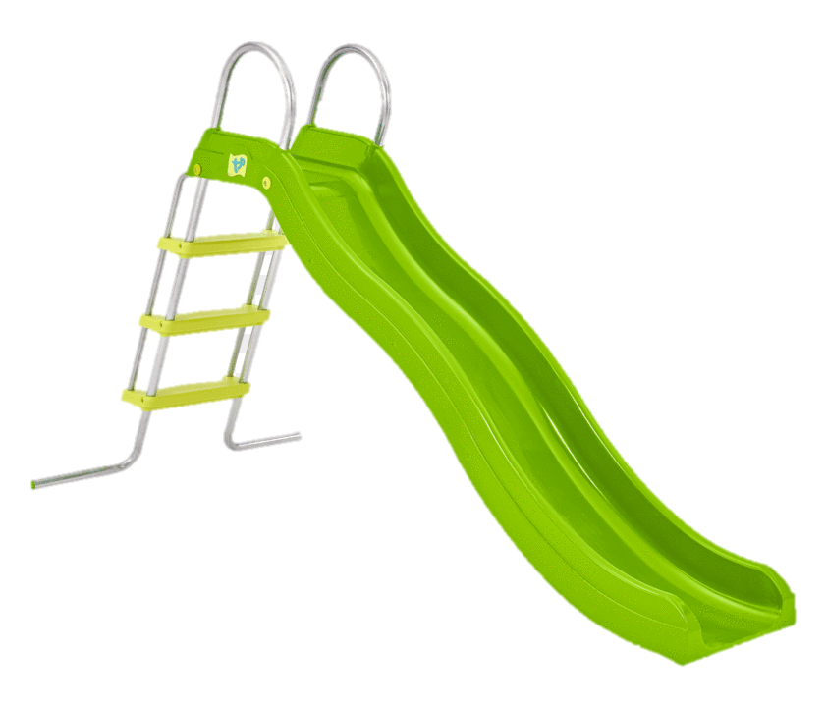
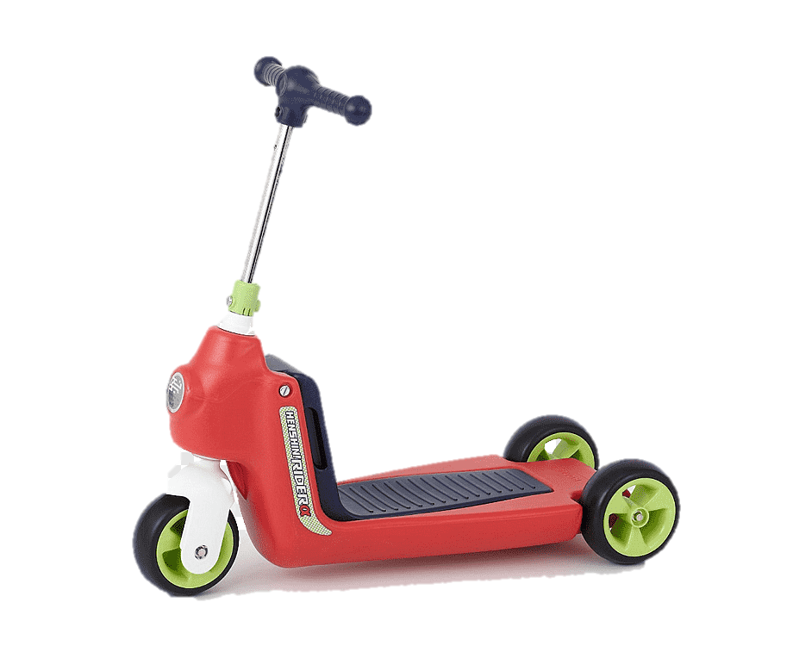

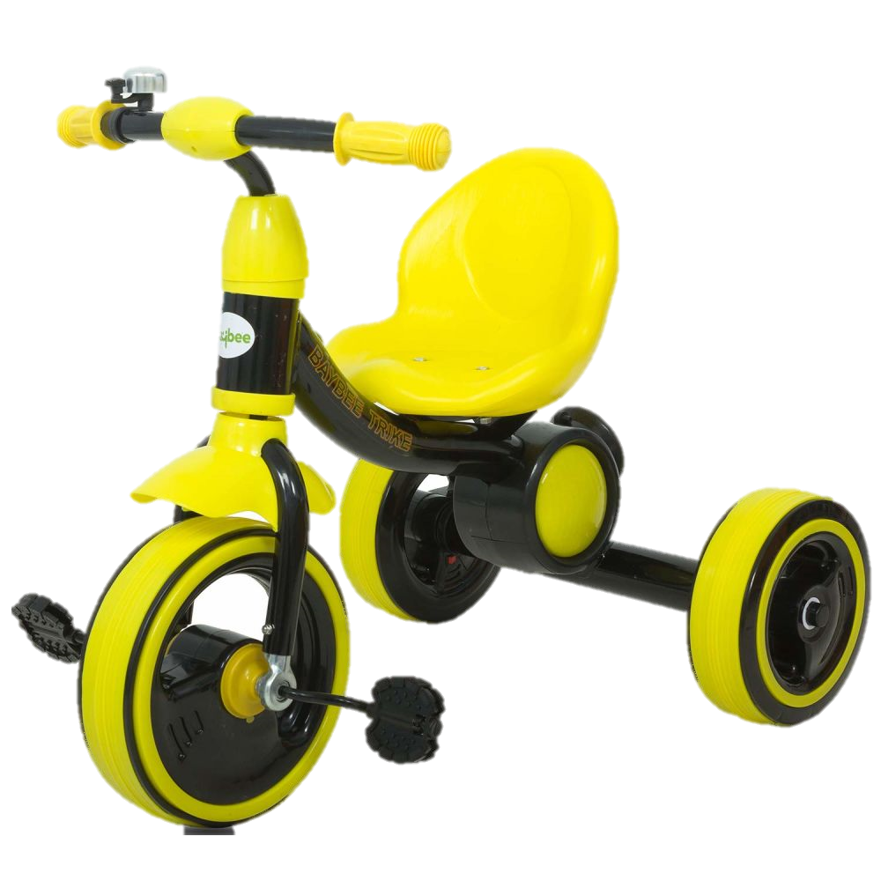
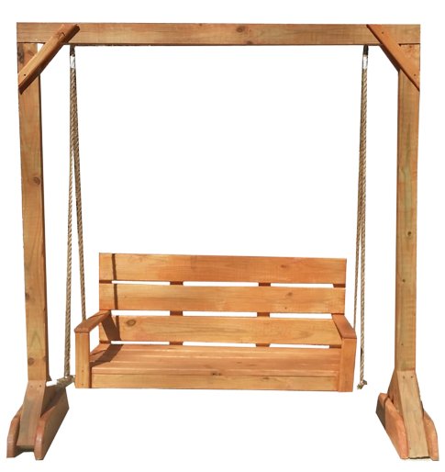
What’s this?
It’s a …
REVIEW: Toys
car
plane
puzzle
building set
dinosaur
yoyo
doll
ball
robot
teddy
slide
scooter
kite
bike
swing
Notes:
Ask the question
Show the pictures and have students say aloud the answer

Slide 5



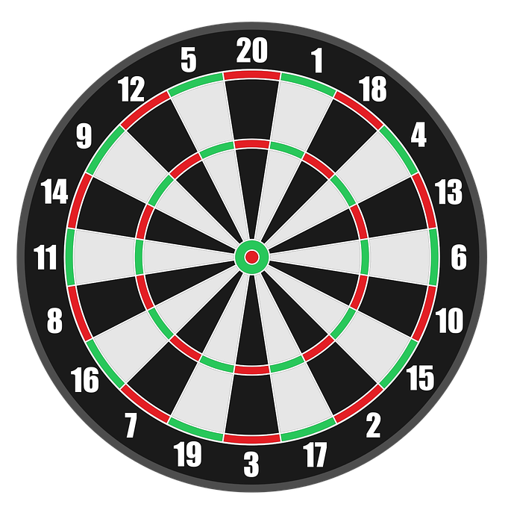


Read the question.
Choose the correct answer A, B or C.
Get points.
PLAY

Slide 6
What’s this?
+ 9
It’s a robot.
It’s a puzzle.
It’s a ball.
It’s a doll.
Next
Abc.xyz789

Slide 7
What’s this?
+14
It’s a teddy.
It’s a yoyo.
It’s a doll.
It’s a plane.
Next
Abc.xyz789

Slide 8
What’s this?
+ 20
It’s a ball.
It’s ball.
It a ball.
Its a ball.
Next
Abc.xyz789

Slide 9
What’s this?
+15
It’s ball.
It’s doll.
It’s a ball.
It’s a doll.
Next
Abc.xyz789

Slide 10
What’s this?
It’s teddy.
It a teddy.
+10
It’s a teddy.
Its a teddy.
Next
Abc.xyz789

Slide 11
What’s this?
+ 6
It’s a
building set.
Is a
building set.
It’s
building set.
It a
building set.
Next
Abc.xyz789

Slide 12
WELL DONE!

Slide 13





REVIEW: Grammar
Is it a
__________?
Is this a…?
- Yes, it is.
- No, it isn’t.
ball
Yes, it is.
No, it isn’t.
Notes:
Ask Ss to recall how Lucy guesses Marie’s new toy
Show the structures, say aloud and have Ss repeat

Slide 14
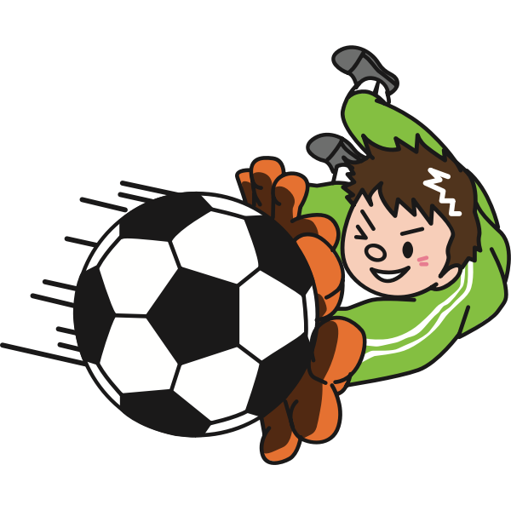
REVIEW: Grammar
DEFEAT THE GOALKEEPER
Read the questions carefully.
Choose the answer A or B
to defeat the goalkeeper.
1 correct answer = 1 point

Slide 15
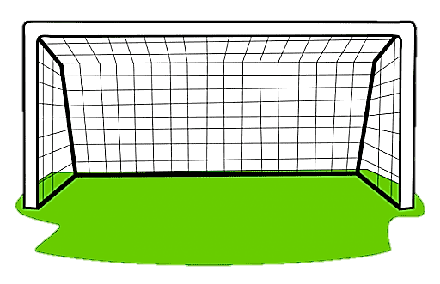
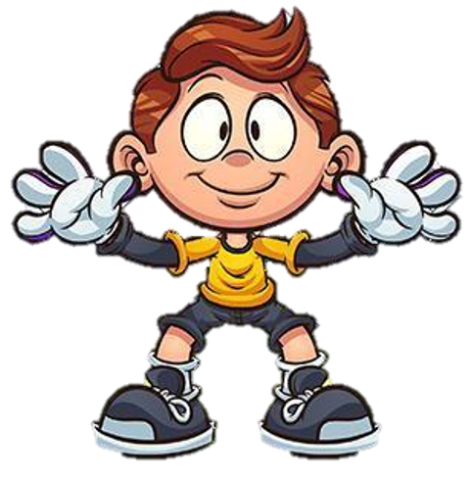
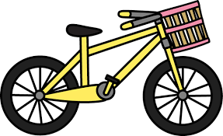

REVIEW: Grammar
QUESTION 1
Is it a red bike?
A. Yes, it is.
B. No, it isn’t.

Slide 16

REVIEW: Grammar
QUESTION 2
Is it a white plane?
A. Yes, it is.
B. No, it isn’t.

Slide 17

REVIEW: Grammar
QUESTION 3
Is it a blue robot?
A. Yes, it is.
B. No, it isn’t.

Slide 18
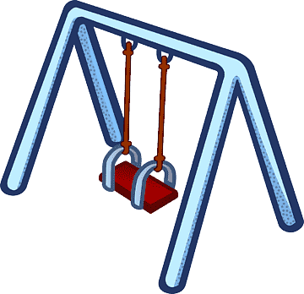
REVIEW: Grammar
QUESTION 4
Is it a purple swing?
A. Yes, it is.
B. No, it isn’t.

Slide 19
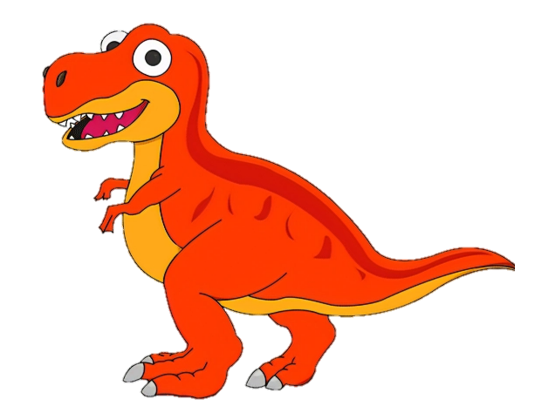
REVIEW: Grammar
QUESTION 5
Is it an orange dinosaur?
A. Yes, it is.
B. No, it isn’t.

Slide 20
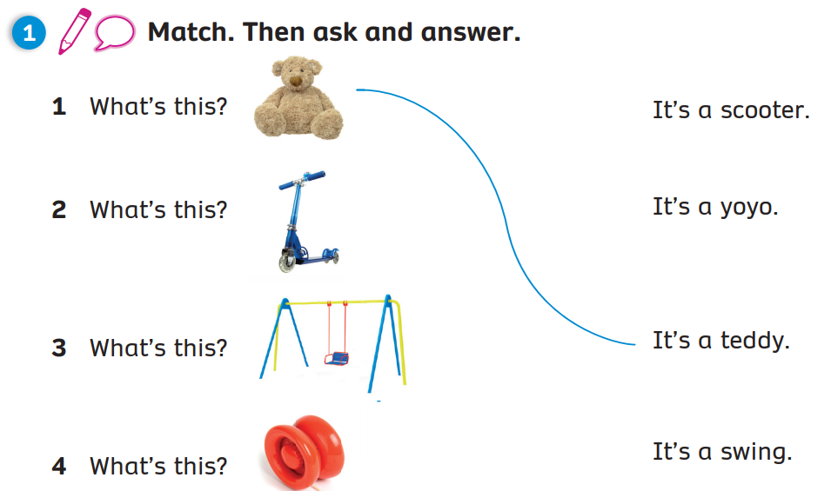
Pupils’ Book (p.30)
Match
Ask & Answer
Click on “Match” to show the answers
Click “Ask & answer” for students to practice

Slide 21
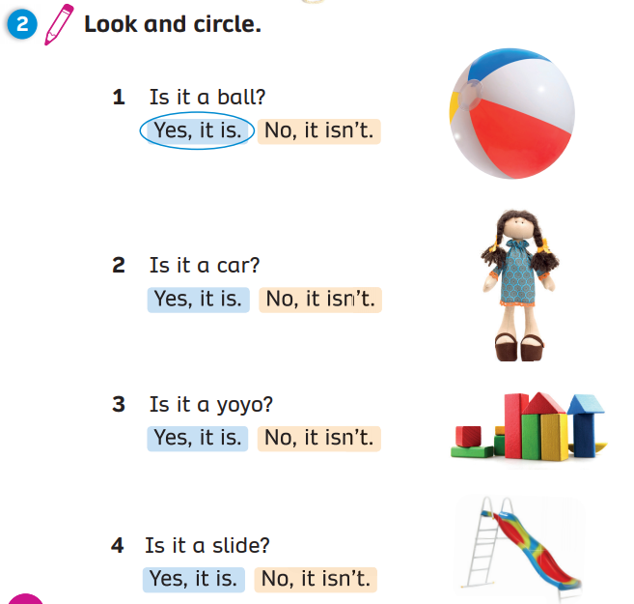
Pupils’ Book (p.30)
Circle
Click on “Circle” to show the answers

Slide 22
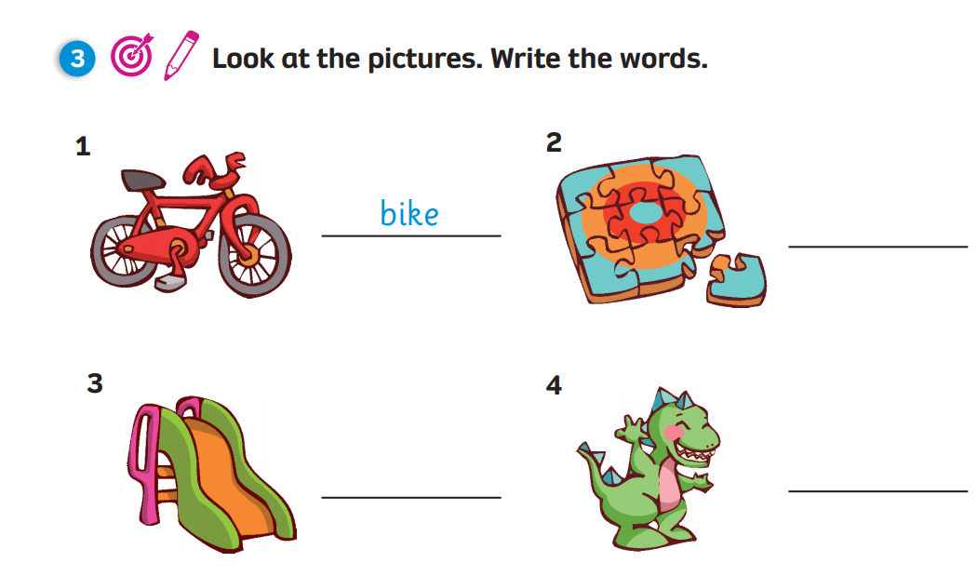
Pupils’ Book (p.31)
Write
puzzle
slide
dinosaur
Click on “Write” to show the answers

Slide 23
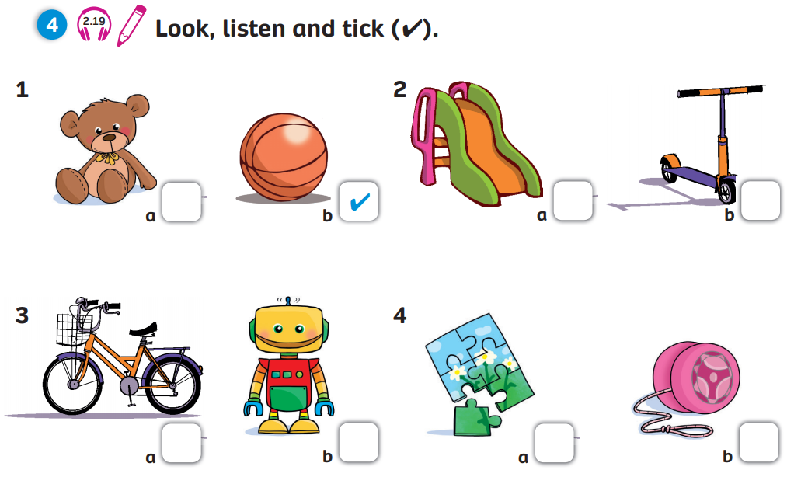


Pupils’ Book (p.31)
Answers
Click on “Answers” to show the answers

Slide 24
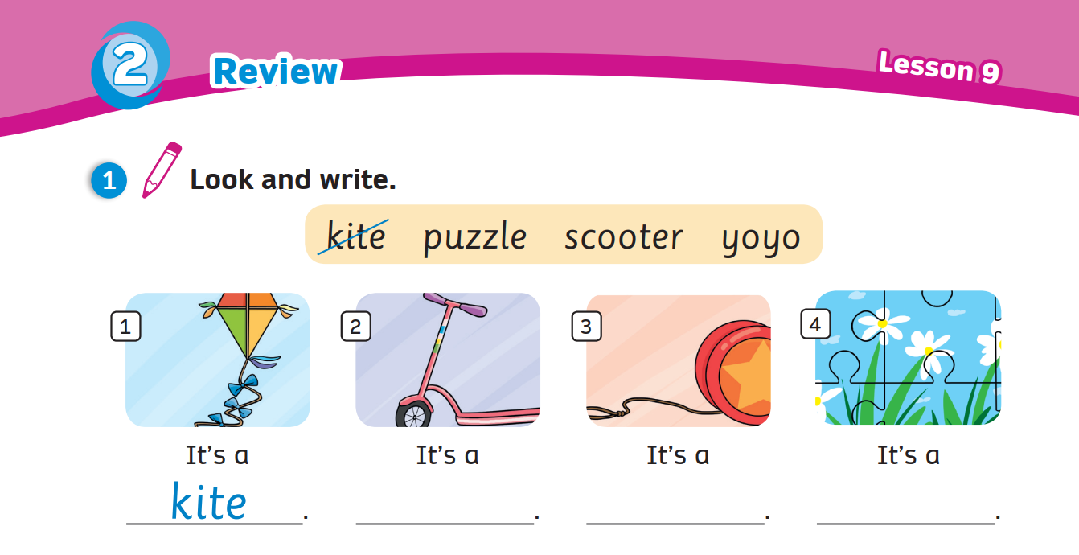
Activity Book (p.26)
Write
scooter
yoyo
puzzle
Click on “Write” to show the answers

Slide 25
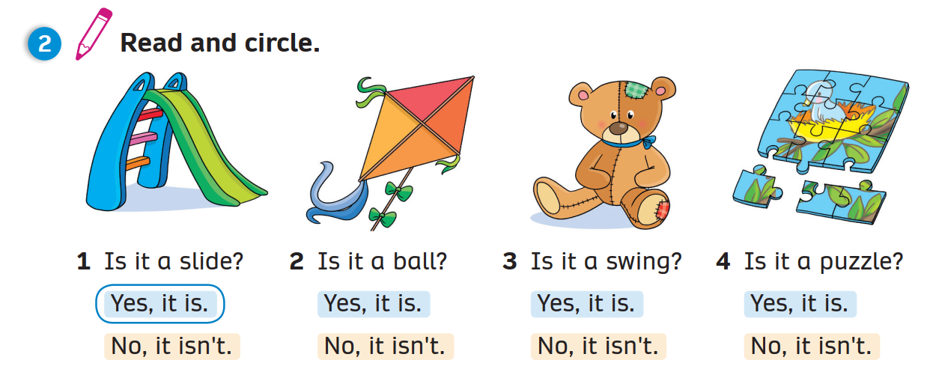
Activity Book (p.26)
Circle
Click on “Circle” to show the answers

Slide 26
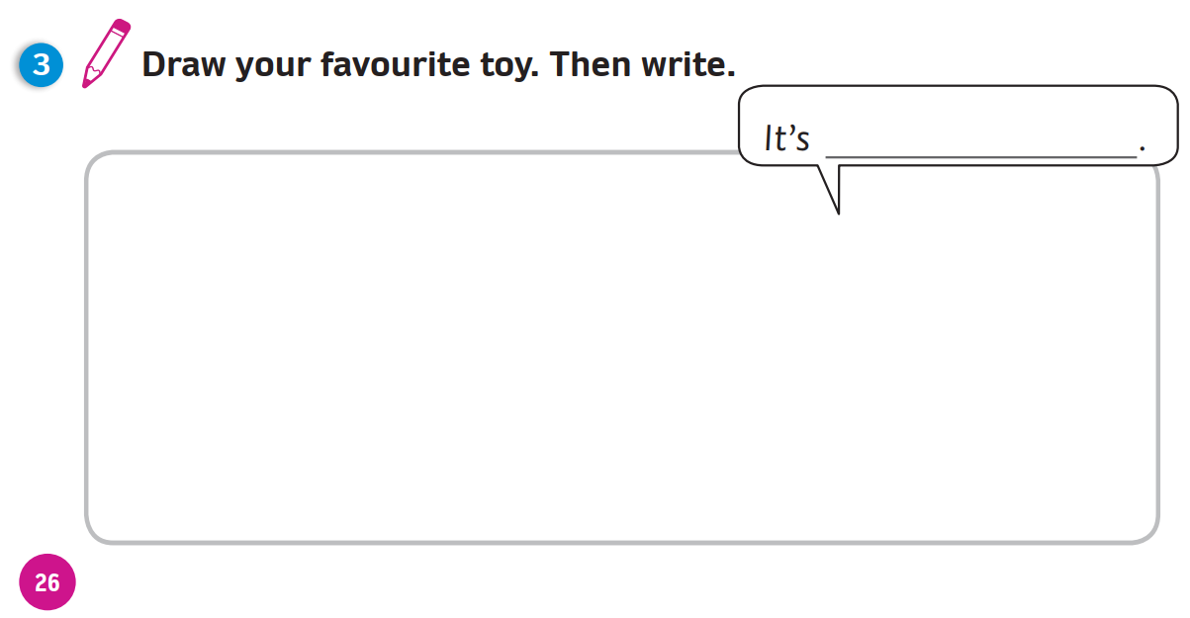
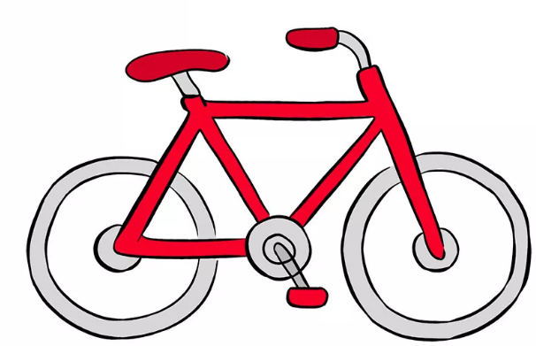
Activity Book (p.26)
a bike. It’s red
Example
Click on “Example” to show the example

Slide 27
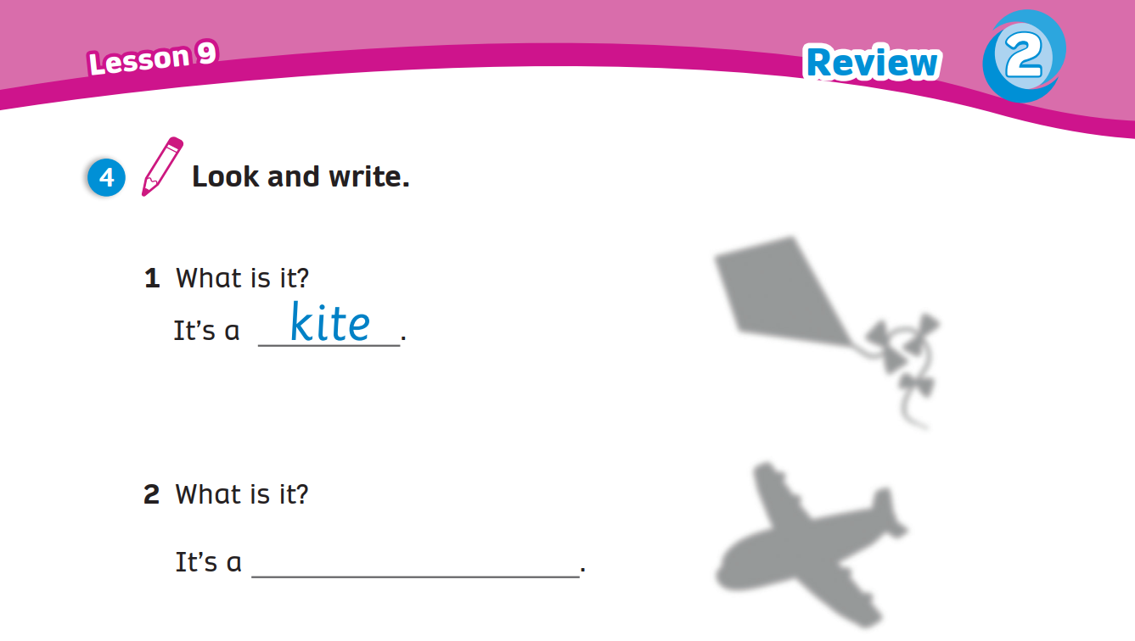
Activity Book (p.27)
Write
plane
Click on “Write” to show the answers

Slide 28
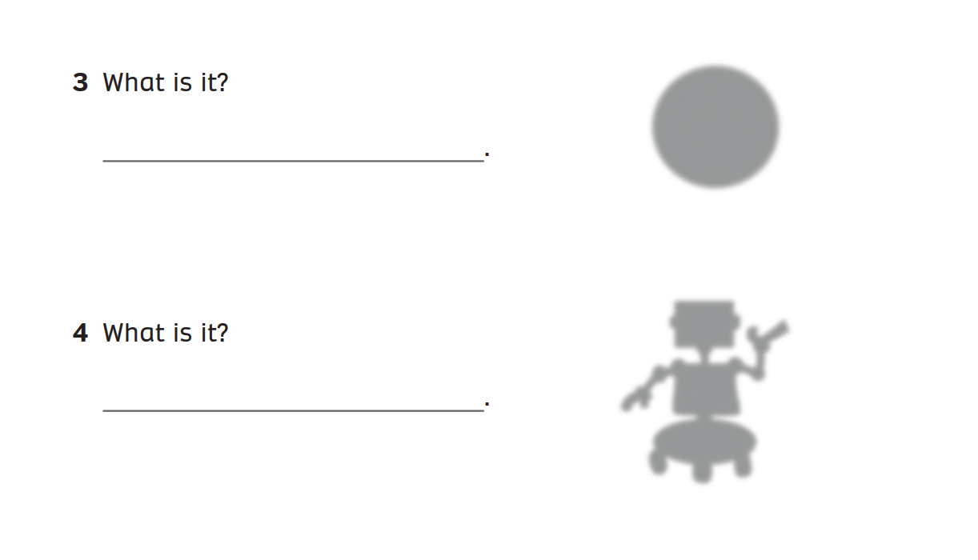
Activity Book (p.27)
Write
It’s a ball.
It’s a robot.
Click on “Write” to show the answers

Slide 29
What’s this?
It’s a …
WRAP-UP
car
plane
puzzle
building set
dinosaur
yoyo
doll
ball
robot
teddy
slide
scooter
kite
bike
swing
Notes:
Ask the question
Show the pictures and have students say aloud the answer

Slide 30
WRAP-UP
Is it a
__________?
Is this a…?
- Yes, it is.
- No, it isn’t.
ball
Yes, it is.
No, it isn’t.

Slide 31
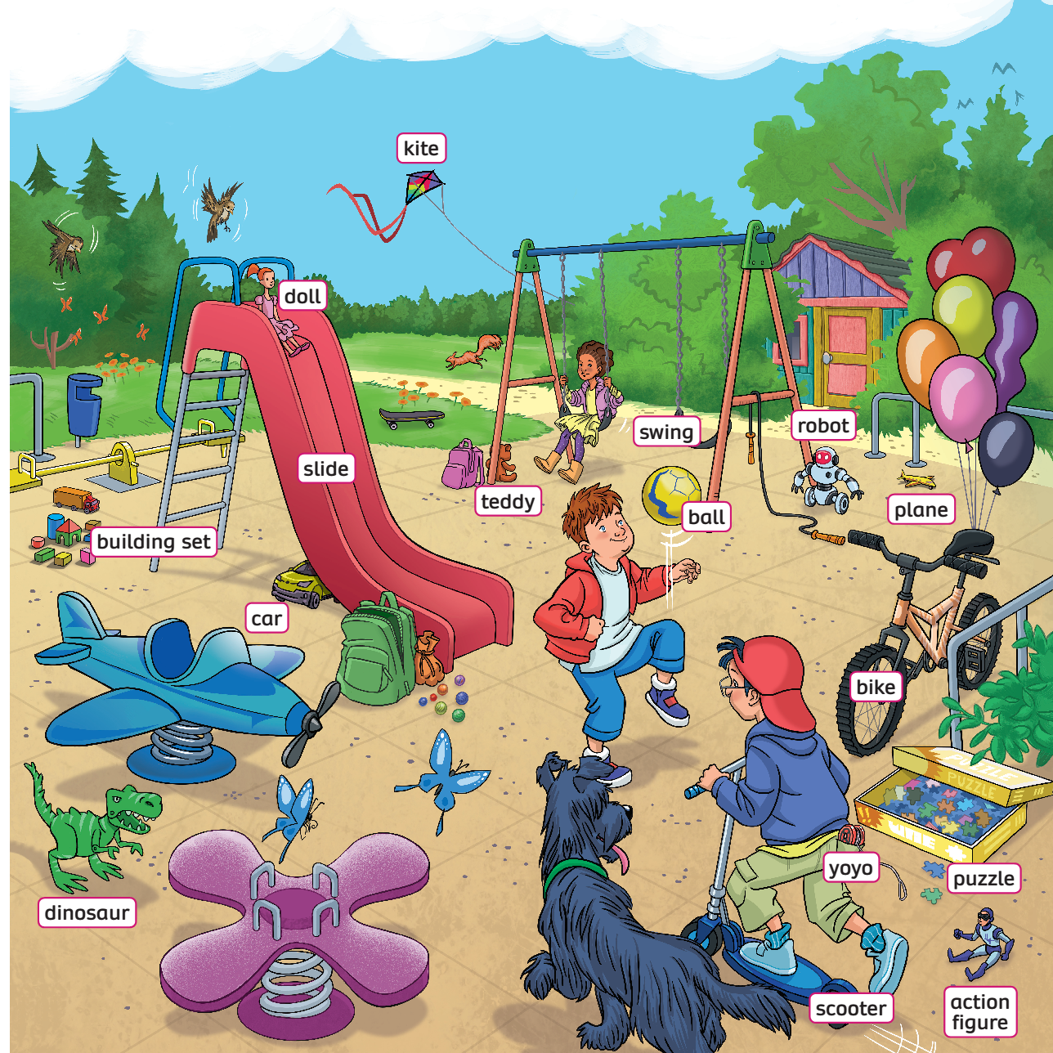
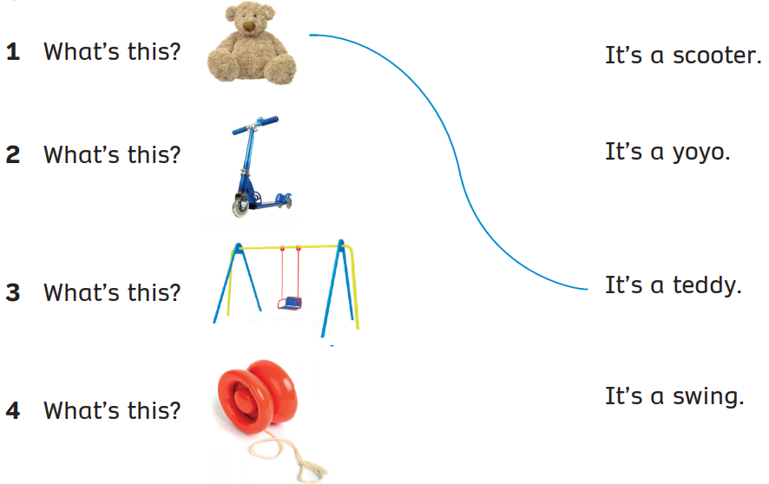

UNIT 2: Lesson 9
We’ve reviewed…

