Slide 1

UNIT 2: LOOK AT MY TOYS!
Lesson 5A – Vocabulary & Grammar 3

Slide 2
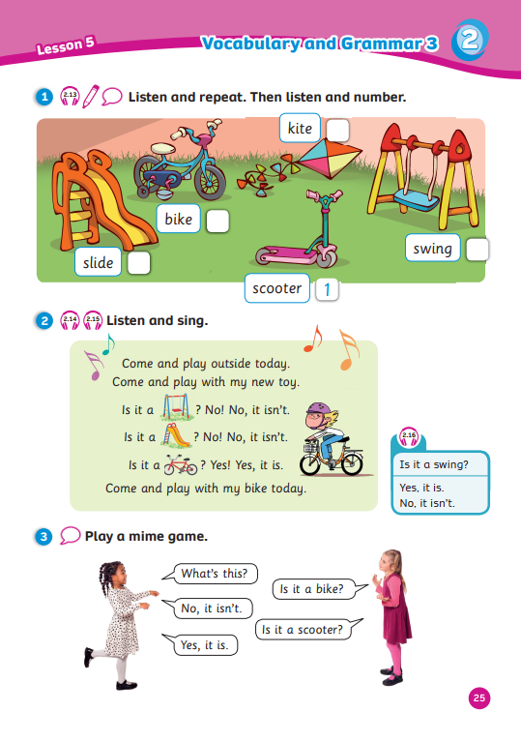
UNIT 2: LOOK AT MY TOYS!
We’re learning…
- toys
- to ask and answer about toys
- SB p.25
- AB p.22

Slide 3


WARM-UP
Song: Don’t Stop Baby Bot Dance
All students stand up.
Listen to the song.
Dance along.

Slide 4



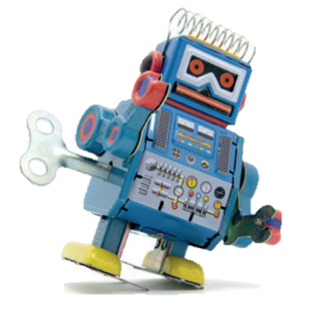
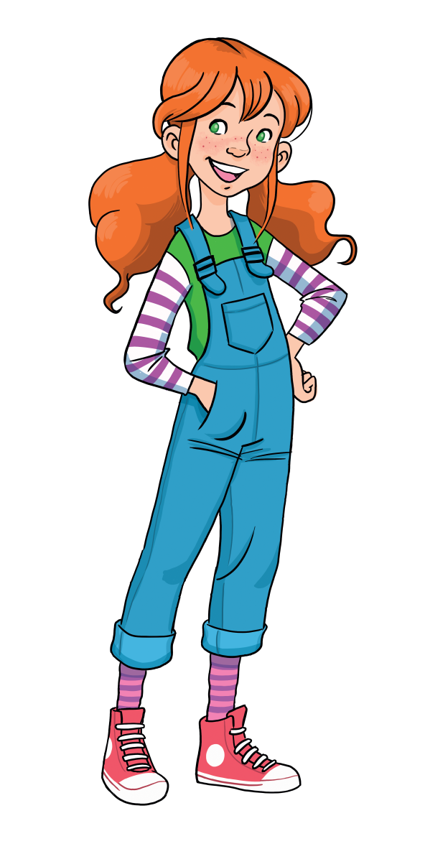
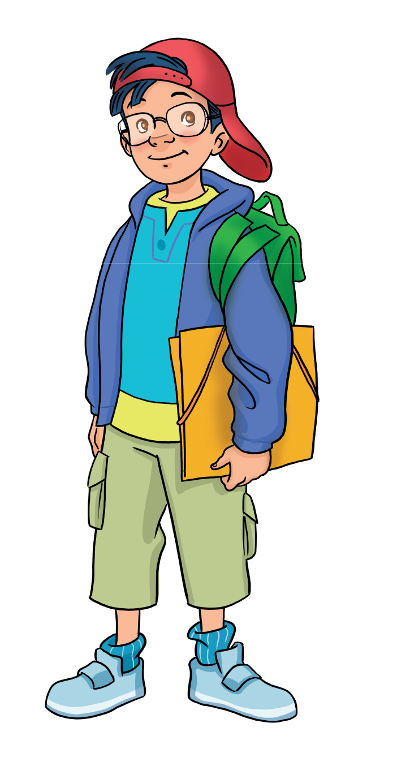
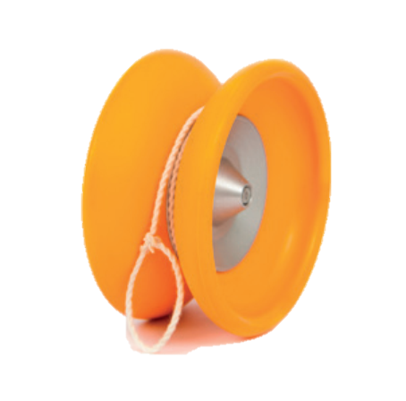



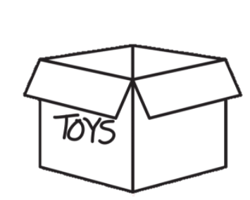
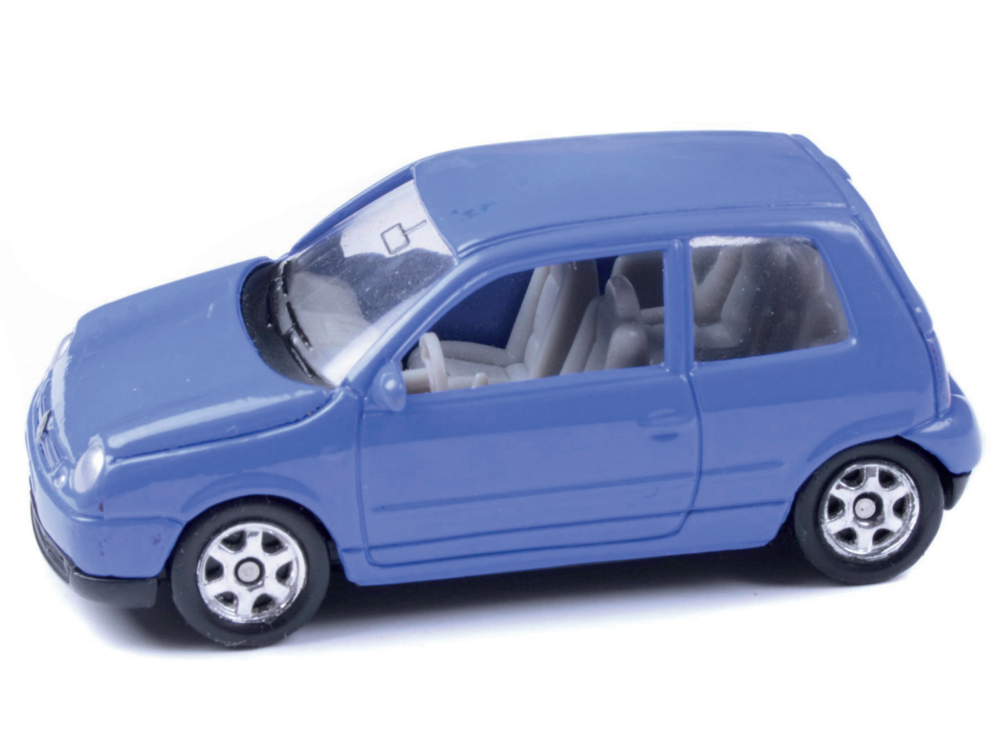
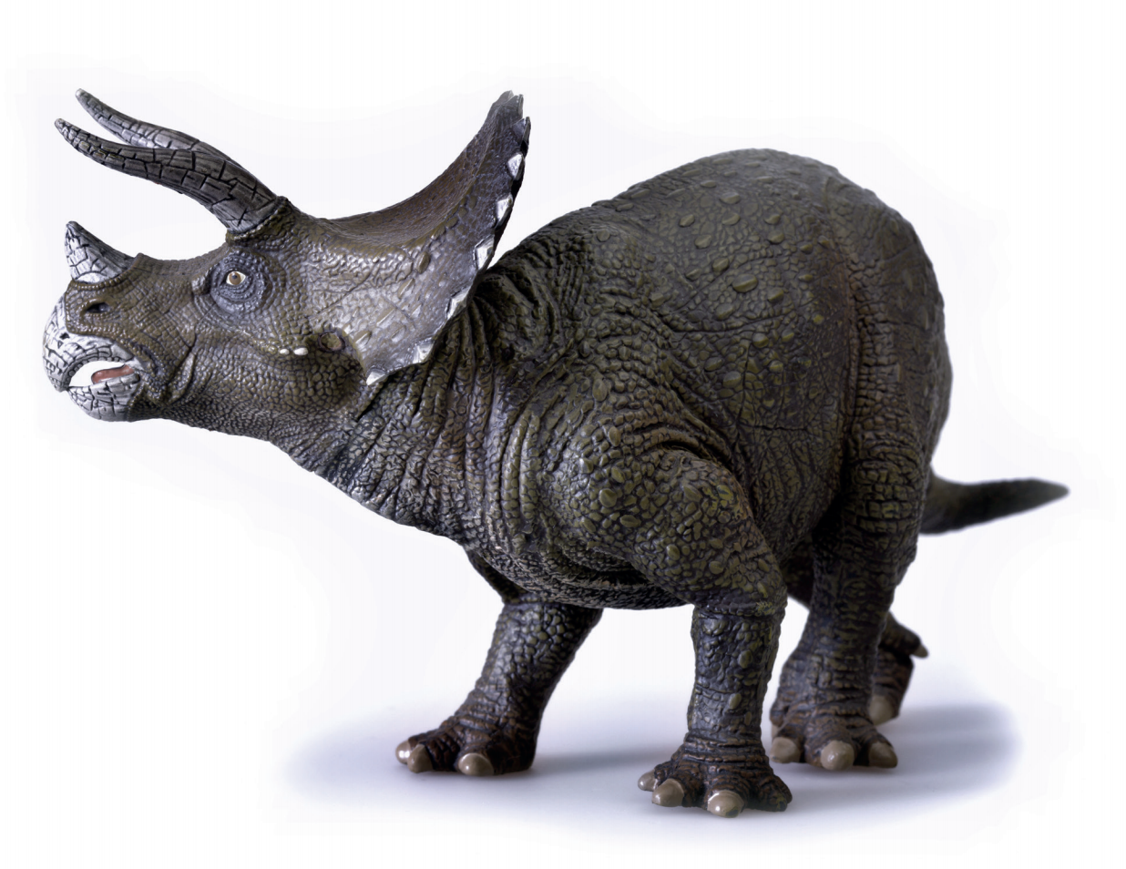
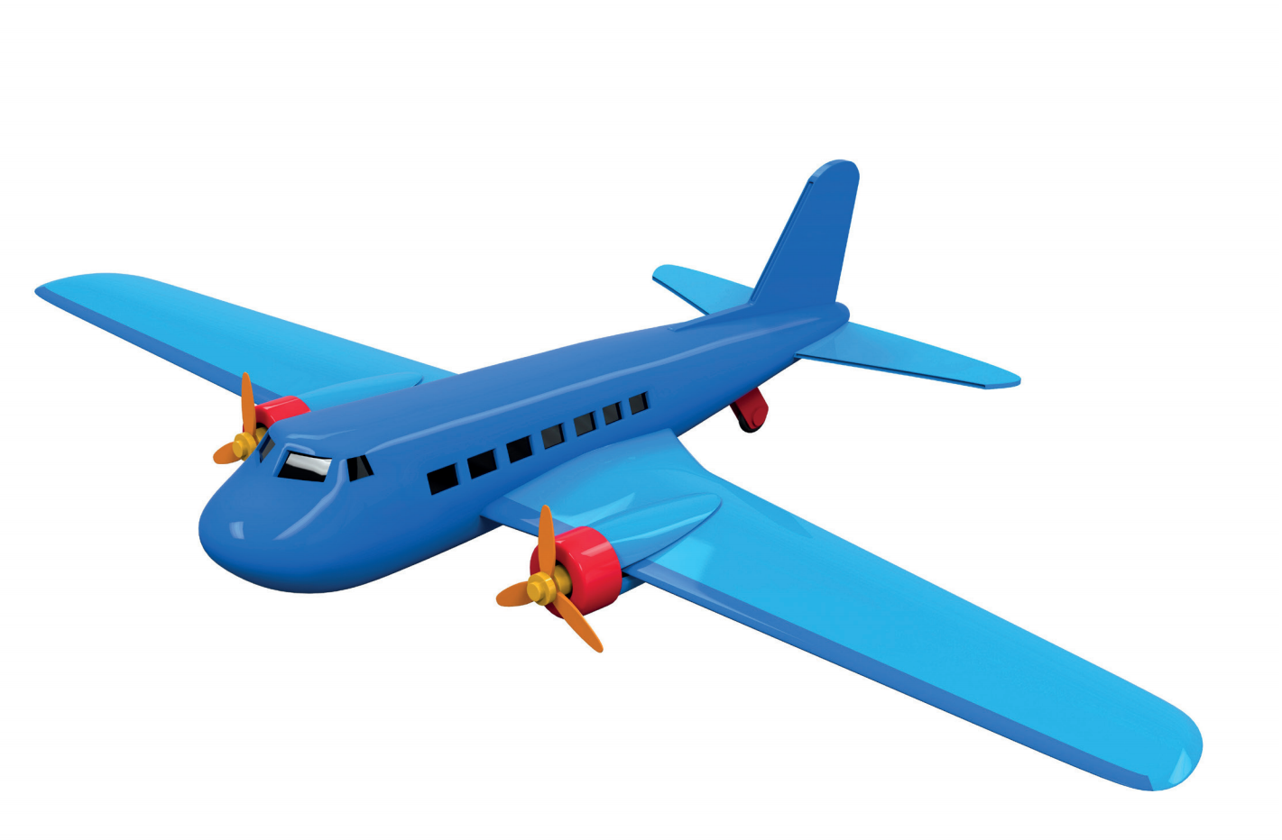
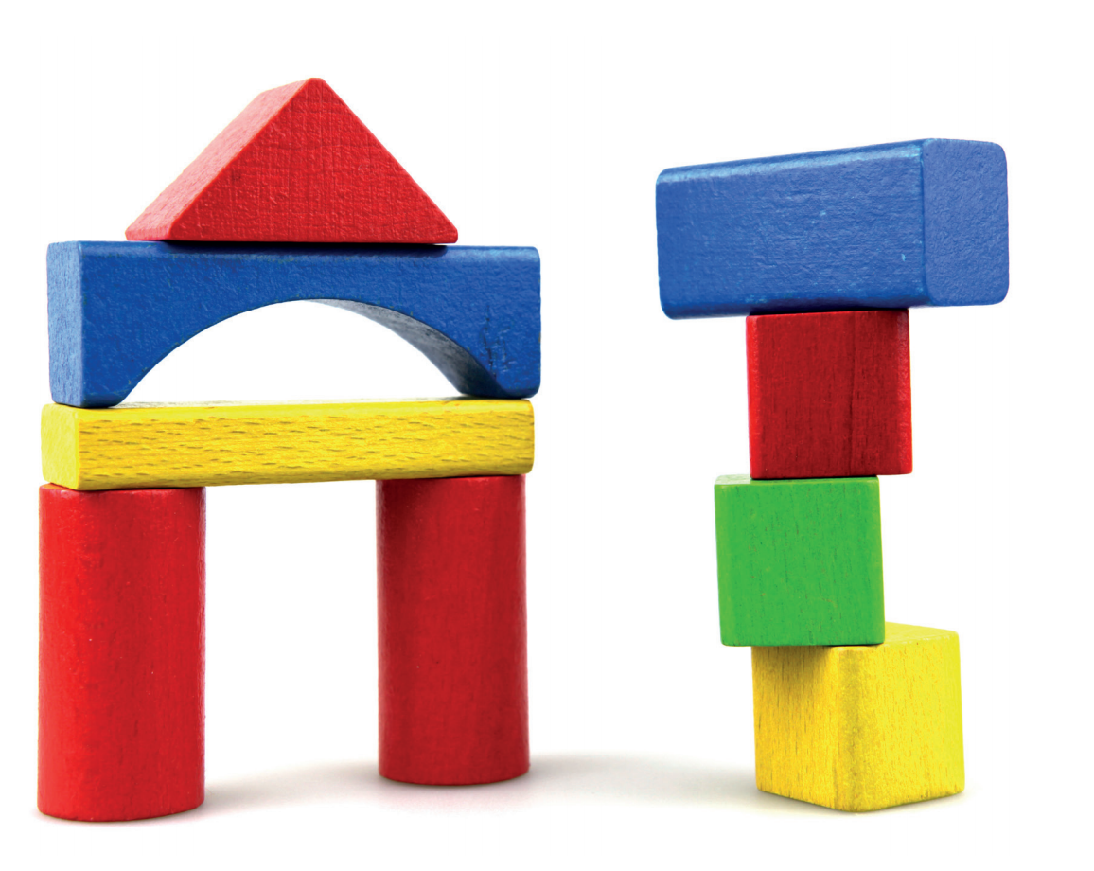

REVIEW: Toys
What’s this?
-> It’s a…
ball
doll
robot
yoyo
teddy
car
dinosaur
plane
building set
puzzle
Notes:
Review all the toy words with Ss
Show the structures then the toy box
Show the first letter(s) of each word for Ss to guess what toy it is
Check their guess by showing the picture and the full words

Slide 5
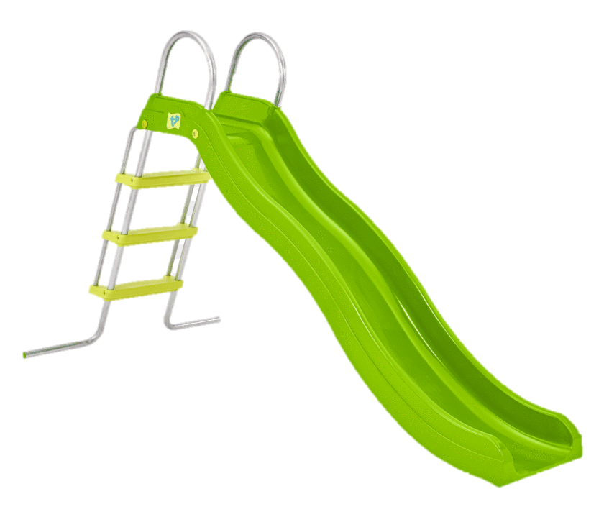

VOCABURALY: Toys
What’s this?
It’s a …
slide
Let’s spell!
s
l
i
d
e

Slide 6
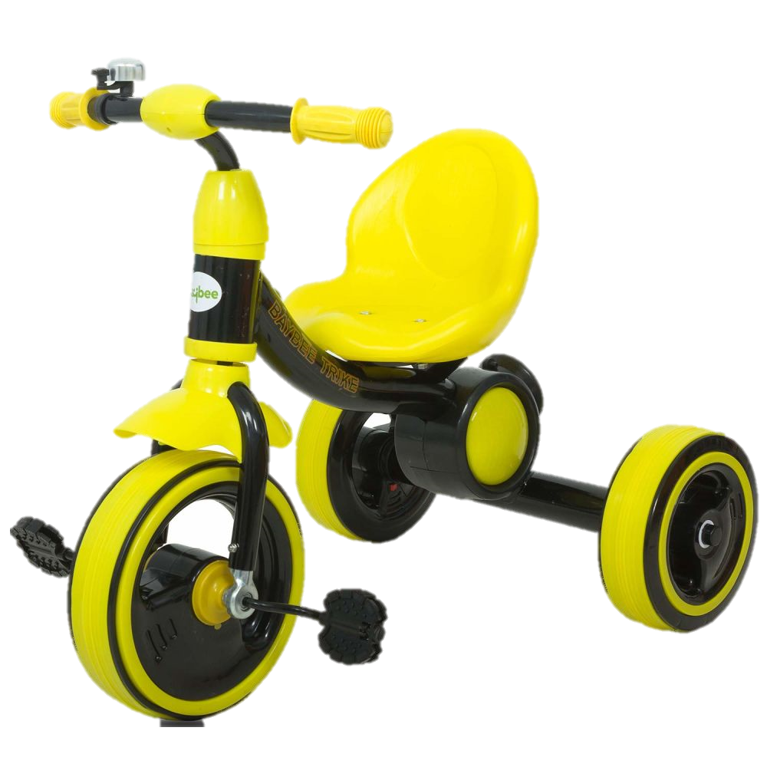
VOCABURALY: Toys
What’s this?
It’s a …
bike
Let’s spell!
b
i
k
e

Slide 7
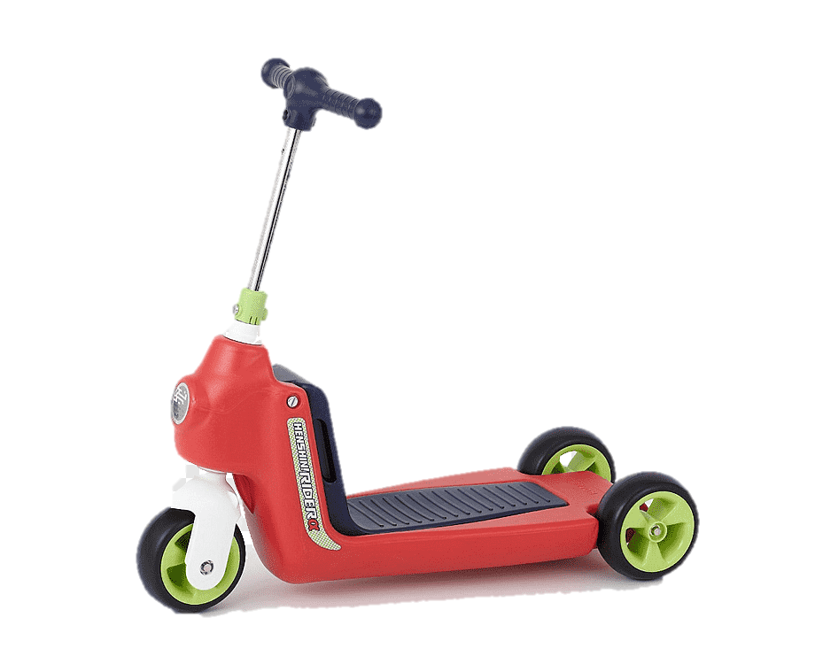
VOCABURALY: Toys
What’s this?
It’s a …
scooter
Let’s spell!
s
c
o
o
t
e
r

Slide 8

VOCABURALY: Toys
What’s this?
It’s a …
kite
Let’s spell!
k
i
t
e

Slide 9
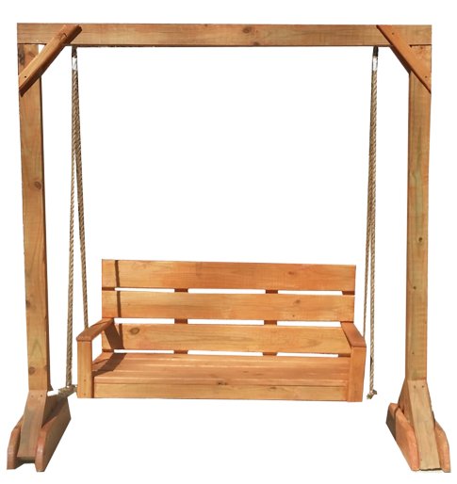
VOCABURALY: Toys
What’s this?
It’s a …
swing
Let’s spell!
s
w
i
n
g

Slide 10

VOCABURALY: Toys
kite
scooter
bike
slide
swing

Slide 11

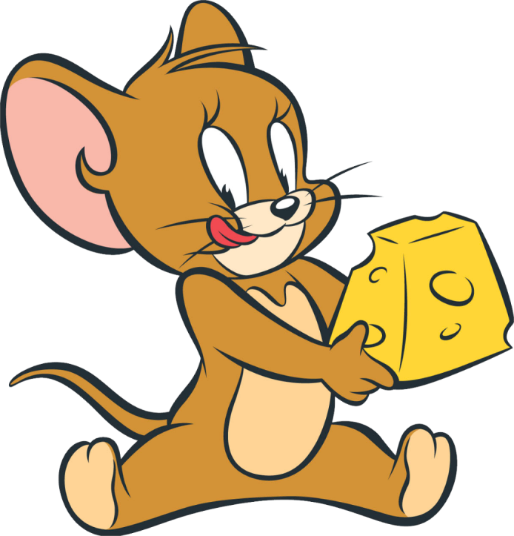
JERRY’S DOOR
RULES
2 students play in one turn.
Students guess the toys behind the doors then ask and answer the questions.
Students get 1 point for each correct answer.
The whole class repeats questions and answers.
START

Slide 12


CHECK
KITE
What’s this?
It’s a …
Notes:
Click on “CHECK” to reveal the answers
Click on the arrow on the top right corner to move to the next slide

Slide 13
CHECK
BIKE
What’s this?
It’s a …
Notes:
Click on “CHECK” to reveal the answers
Click on the arrow on the top right corner to move to the next slide

Slide 14
CHECK
SWING
What’s this?
It’s a …
Notes:
Click on “CHECK” to reveal the answers
Click on the arrow on the top right corner to move to the next slide

Slide 15
CHECK
SCOOTER
What’s this?
It’s a …
Notes:
Click on “CHECK” to reveal the answers
Click on the arrow on the top right corner to move to the next slide

Slide 16
CHECK
SWING
What’s this?
It’s a …
Notes:
Click on “CHECK” to reveal the answers
Click on the arrow on the top right corner to move to the next slide

Slide 17

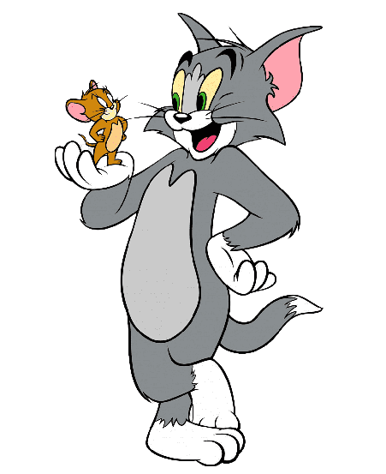
Notes:
- Compliment Ss on their great performance

Slide 18



GRAMMAR: Is it a…? – Yes, it is. / No, it isn’t.
Come and play with my new toy, Lucy!
No, it isn’t.
Yes, it is.
No, it isn’t.
That sounds great!
Is it a slide?
Is it a swing?
Look!
What’s this?
Is it a bike?
Marie
Lucy
Notes:
Set the scene
Remind Ss of Marie and Lucy. Tell Ss that Marie has a new toy and she invite Lucy to come and play with her.
Marie tells Lucy to guess what her new toy is.
And Lucy makes her guesses using the structure “Is it a…?” while Marie responds with either “Yes, it is.” or No, it isn’t?”

Slide 19




GRAMMAR: Is it a…? – Yes, it is. / No, it isn’t.
Is it a
__________?
scooter
Yes, it is.
No, it isn’t.
Notes:
Ask Ss to recall how Lucy guesses Marie’s new toy
Show the structures, say aloud and have Ss repeat

Slide 20



Slide 21

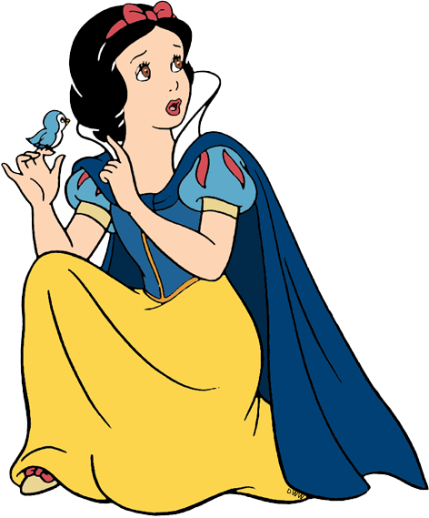


Rescue SNOW WHITE
RULES
All the students ask the question.
1 student answers by choosing 1 apple A or B.
The whole class repeats the questions and answers.
A
B
PLAY

Slide 22

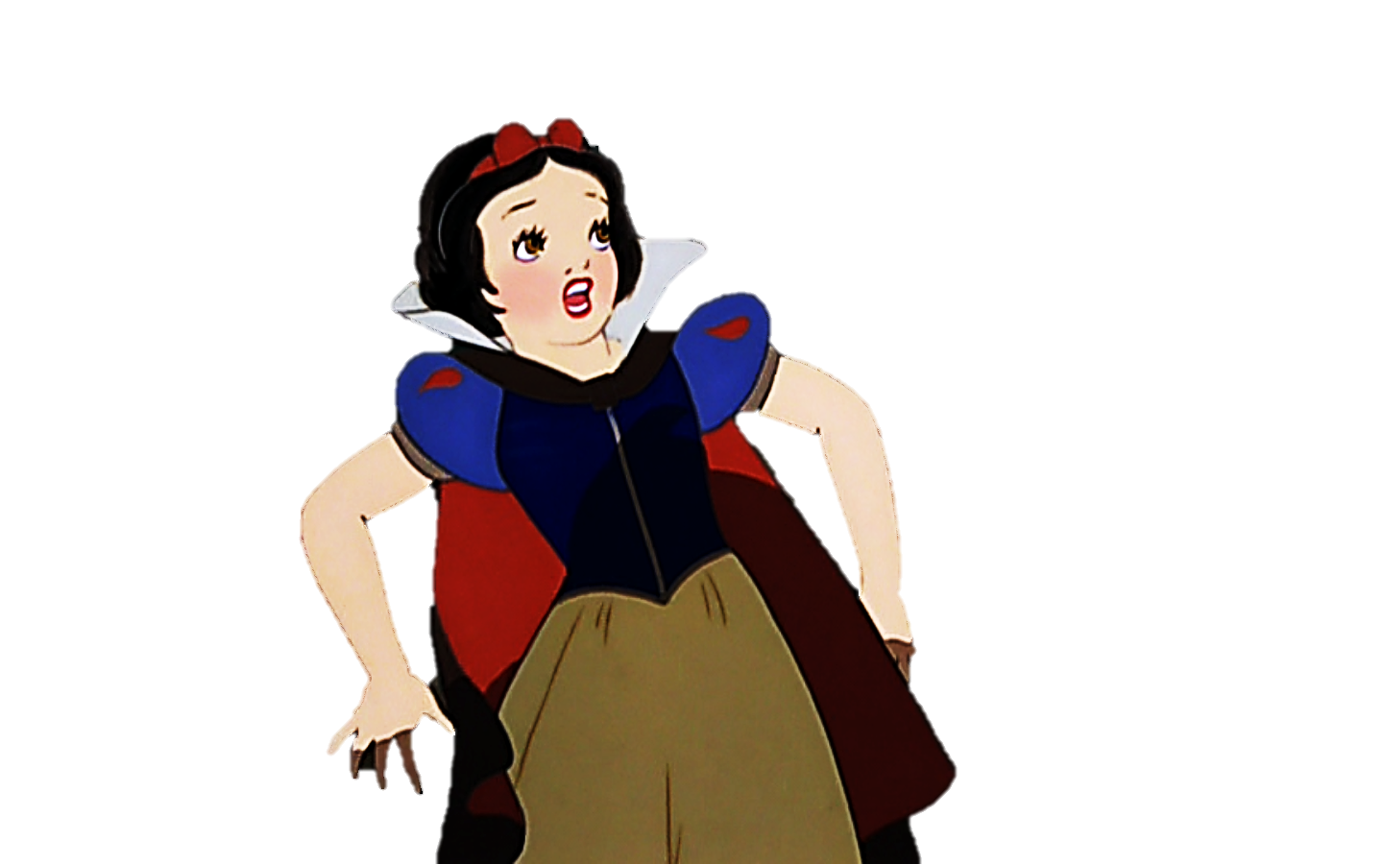
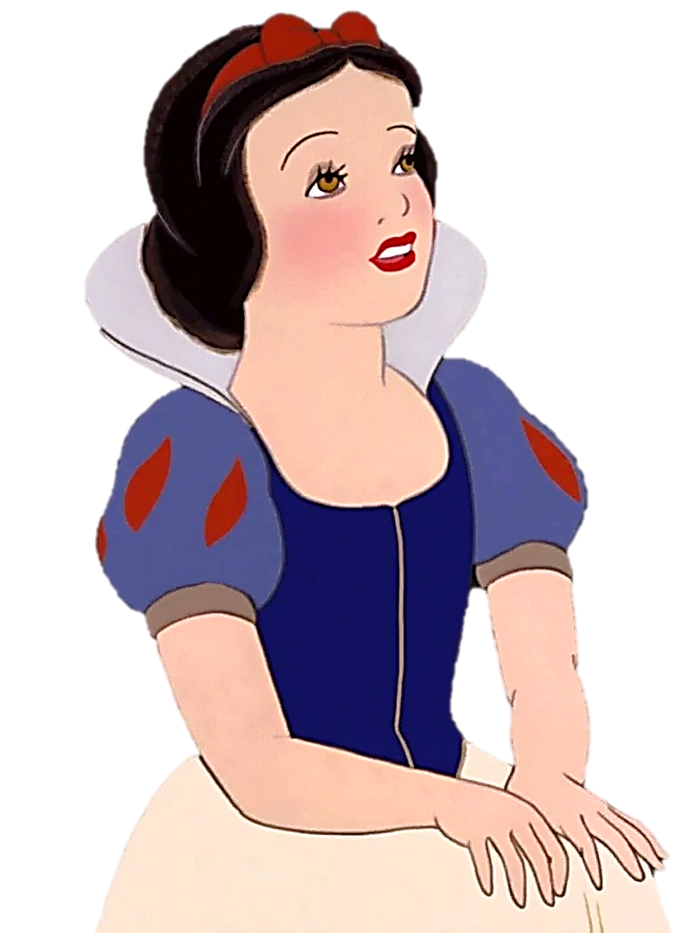
1. Is this a slide?
A. Yes, it is.
B. No, it isn’t.
A
B

Slide 23
2. Is this a swing?
A. Yes, it is.
B. No, it isn’t.
A
B

Slide 24
3. Is this a scooter?
A. Yes, it is.
B. No, it isn’t.
A
B

Slide 25
4. Is this a bike?
A. Yes, it is.
B. No, it isn’t.
A
B

Slide 26
5. Is this a bike?
A. Yes, it is.
B. No, it isn’t.
A
B

Slide 27
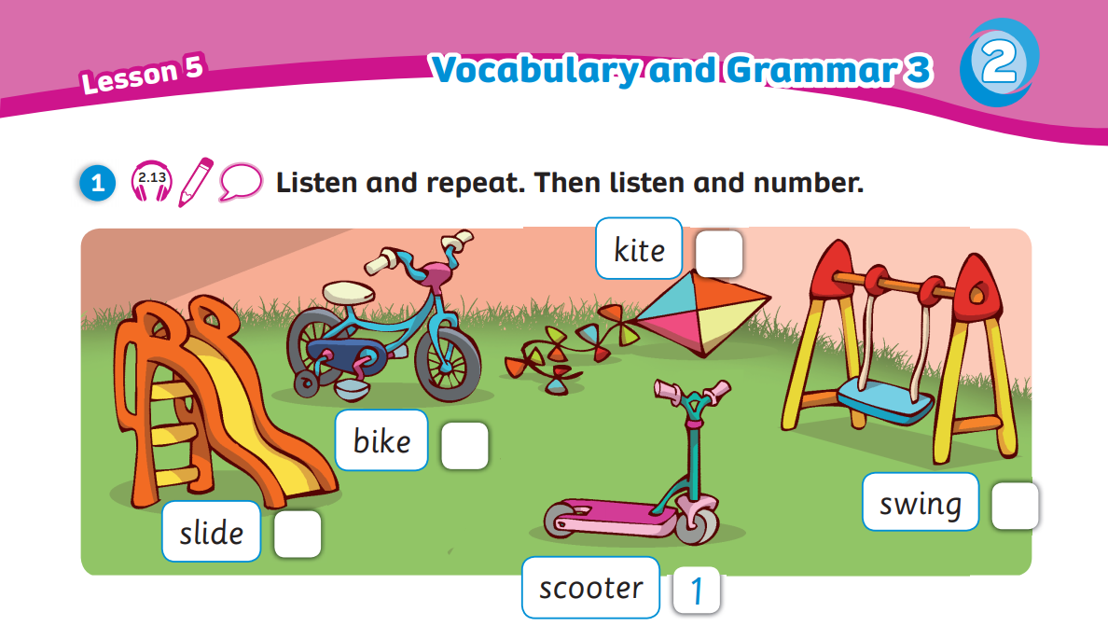
Pupils’ Book (p.25)
Answers
4
5
3
2
Click on “Answers” to show the answers

Slide 28
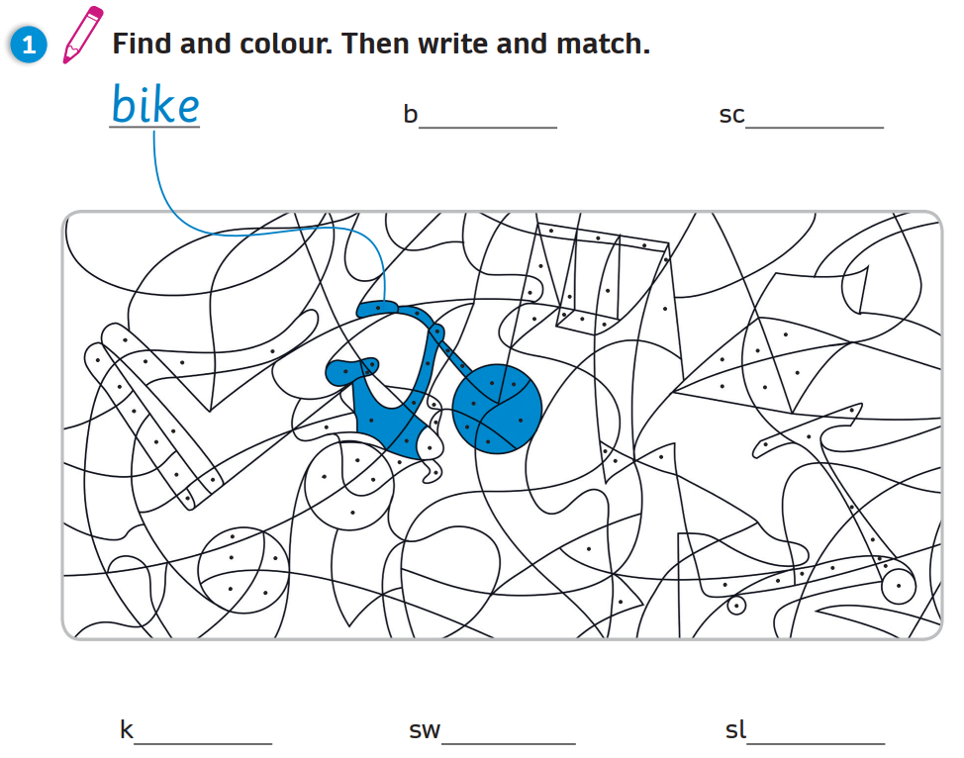
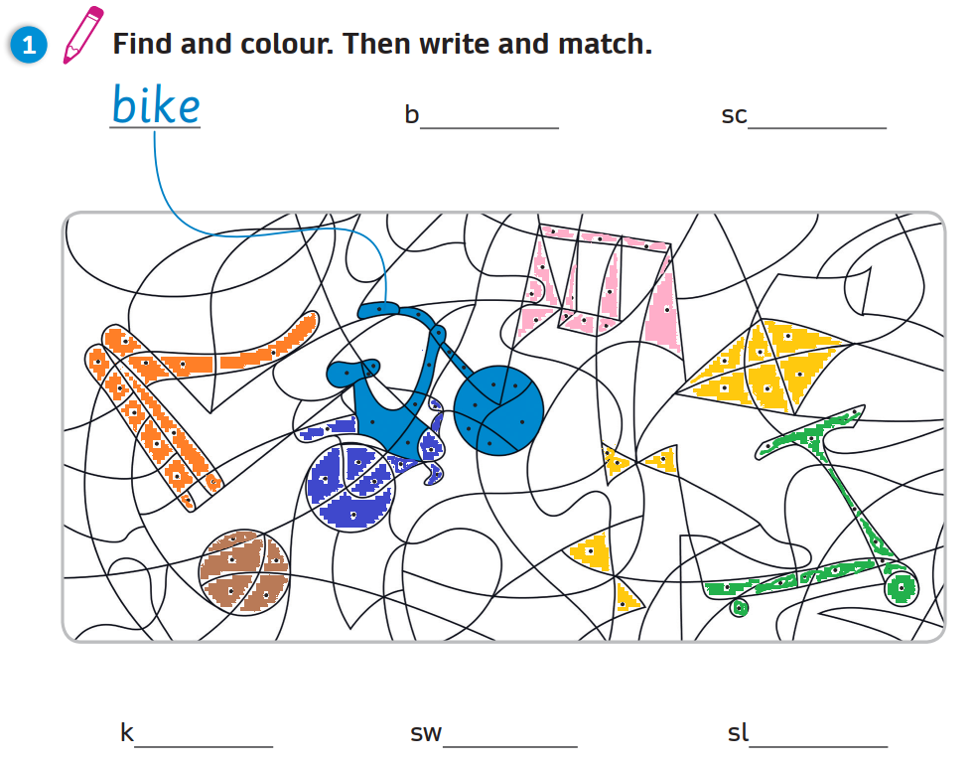
Activity Book (p.22)
Write
all
ooter
ite
ing
ide
Click on “Write” to show the answers
Notes:
- Click on Write to reveal the coloured picture

Slide 29
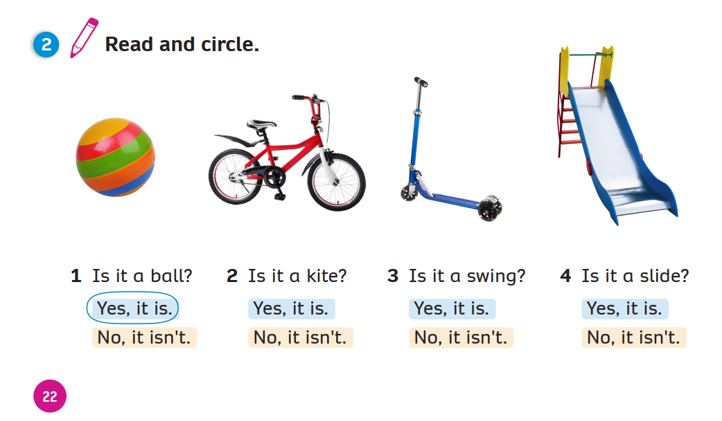
Activity Book (p.22)
Circle
Click on “Circle” to show the answers

Slide 30

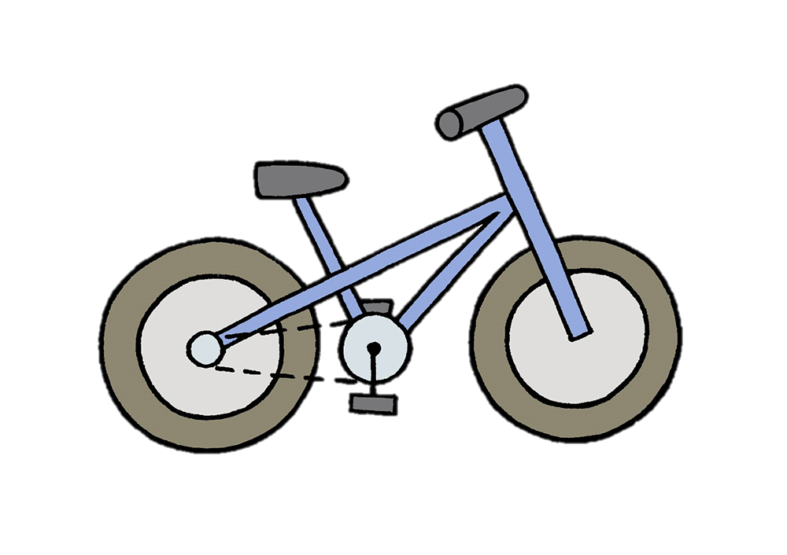

PRODUCTION
Draw a toy. Is it a bike?
Write “Yes, it is.” or “No, it isn’t.”
Is it a bike?
-> __________
Is it a bike?
-> __________
Yes, it is.
No, it isn’t.
Notes:
Have Ss take out notebook or give them paper.
Ask them to draw a toy, then write down the question “Is it a bike?” and the answer “Yes, it is.” or “No, it isn’t.” depending on the drawing.
Show 2 examples for Ss to follow.
Ask Ss to keep their drawing for the next lesson.

Slide 31
WRAP-UP
What’s this?
-> It’s a…
kite
scooter
bike
slide
swing

Slide 32
WRAP-UP
Is this a
__________?
Is this a…?
- Yes, it is.
- No, it isn’t.
scooter
Yes, it is.
No, it isn’t.

Slide 33
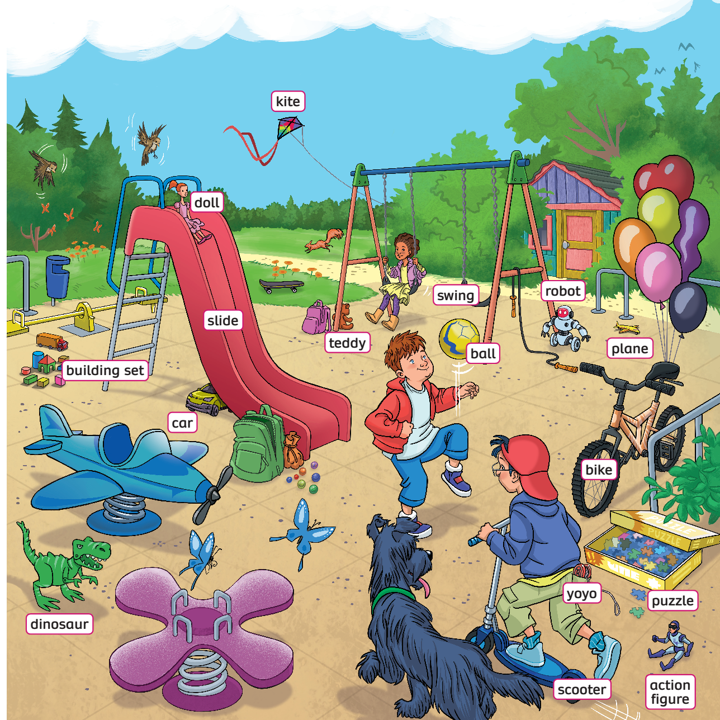
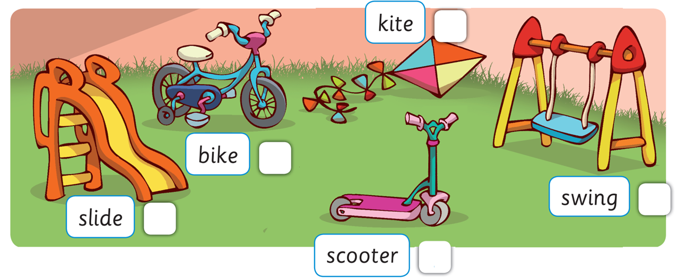

UNIT 2: Lesson 5A
We’ve learnt…

