Slide 1
UNIT 2: LOOK AT MY TOYS!
Lesson 4 – Phonics

Slide 2
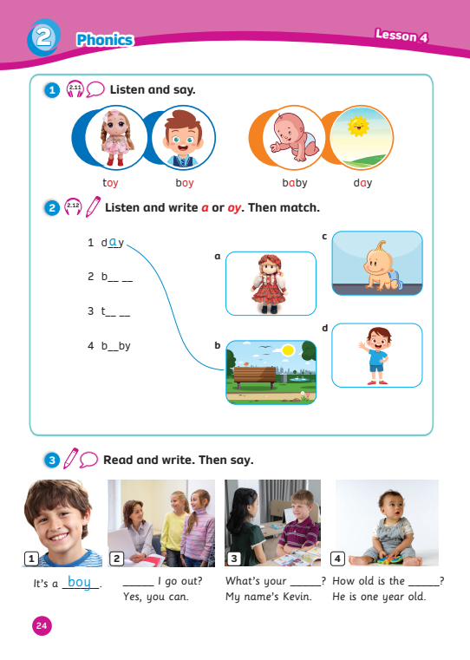
UNIT 2: LOOK AT MY TOYS!
We’re learning…
- sounds /eɪ/ & /ɔɪ/
- words containing sounds /eɪ/ & /ɔɪ/
- SB p.24
- AB p.21

Slide 3
LEAD-IN
Song: Phonics Song
Stand up.
Listen to the song.
Clap your hands and sing along.

Slide 4
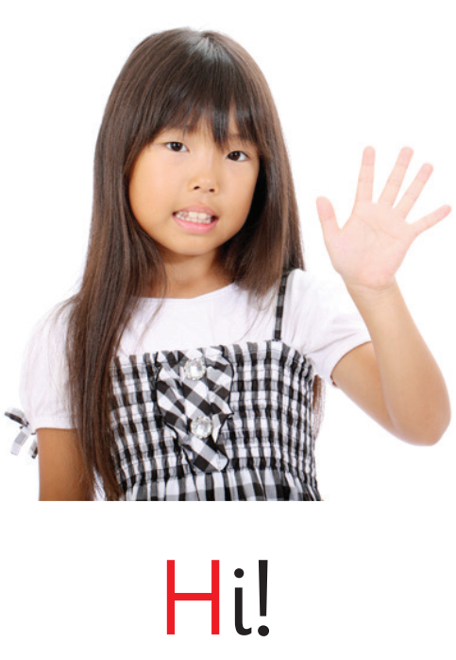
REVIEW: Sounds /h/ & /s/
Letter
Sound
h | h
Letter
Sound
s | s
H h
S s
/h/
/s/

Slide 5
SORTING SOUNDS
Hi
Hello
seven
sea
say
Say aloud the words in the bowl.
Sort the sounds in the correct clouds below.
1 correct answer = 1 point.
sun
hot
hat
six
hen
Sound h /h/
Sound s /s/
Click on the words to sort them
Notes:
Show the words in the bowl
Have Ss listen and say aloud the words
Invite 1 student to choose and sort a word, then say it
1 correct answer = 1 point

Slide 6
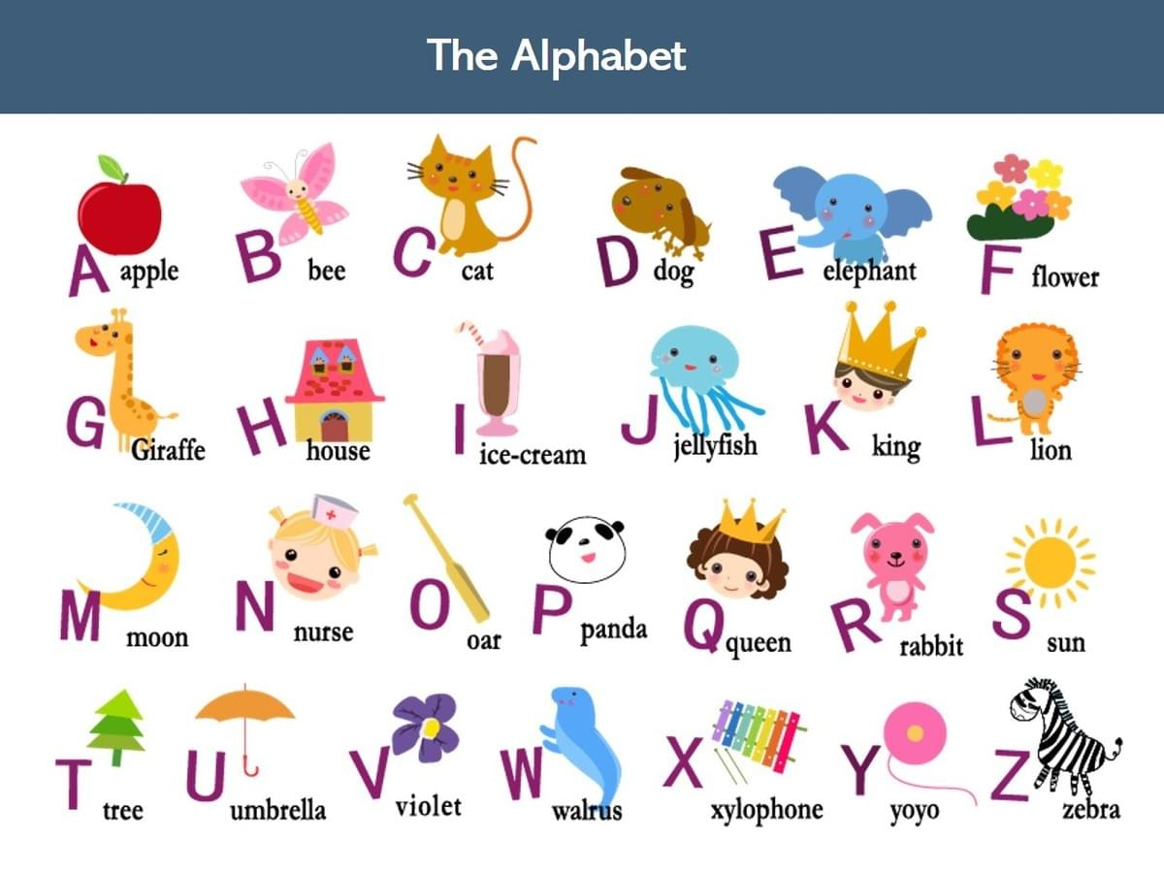
LEAD-IN
This is the Alphabet.
How many letters?
26 letters
Look.
Say the letters.
A
CHECK
Click on “1, 2” to show and hide the circle.

Slide 7
LEAD-IN
This is the Alphabet.
How many letters?
26 letters
Look.
Say the letters.
O
Y
CHECK
Click on “1, 2” to show and hide the circle.

Slide 8
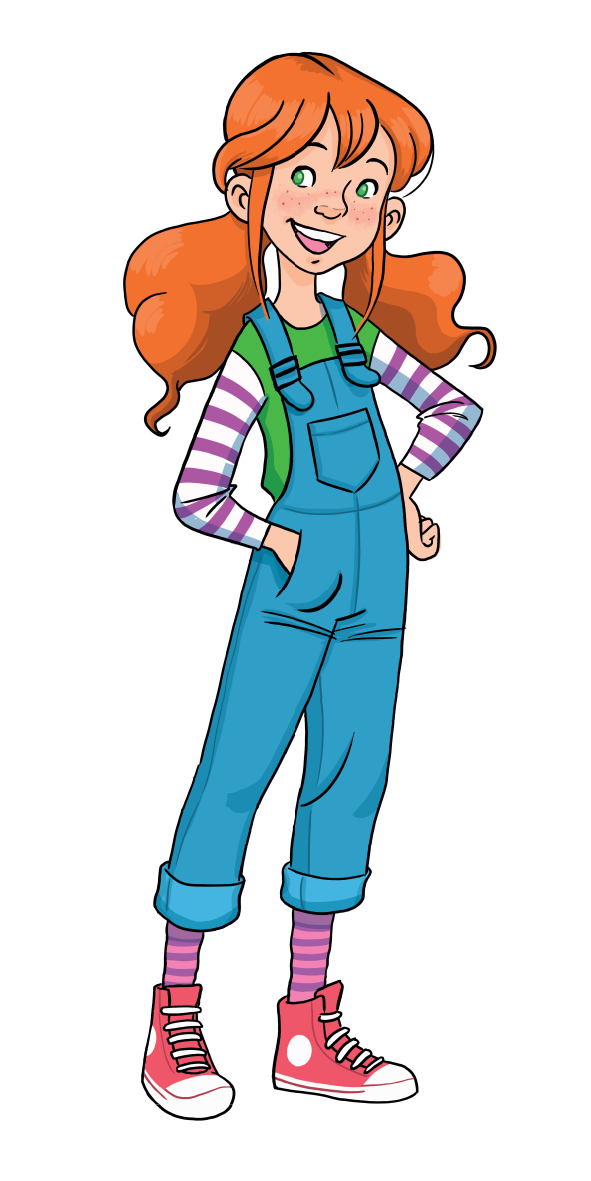
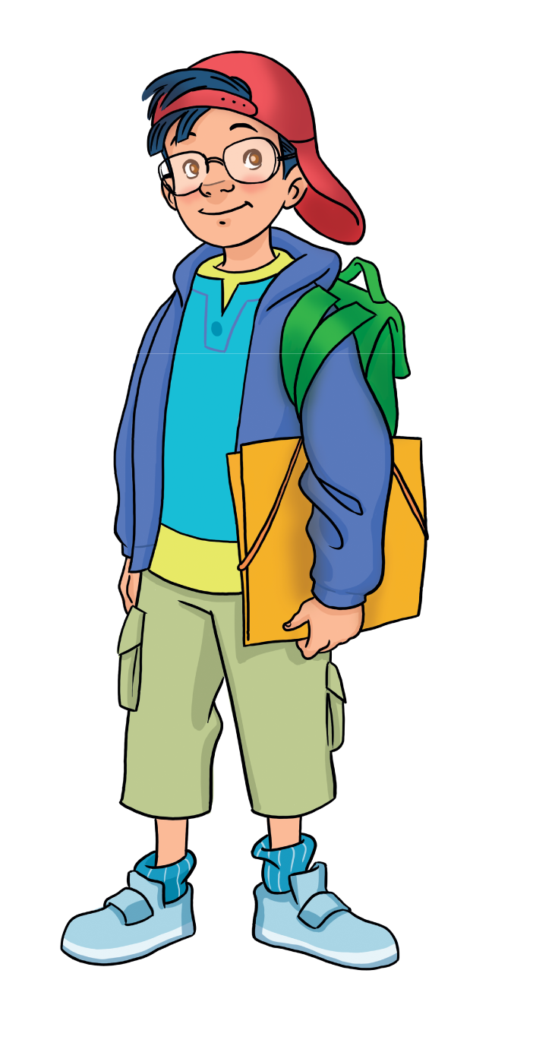
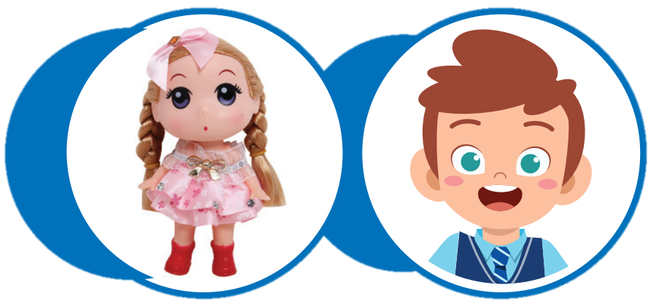
LEAD-IN
LET’S LEARN THE SOUNDS
a oy
/eɪ/ & /ɔɪ/

Slide 9
Sound /eɪ/
Say the words.
Letter
Sound
a | a
a
What letter is it?
/eɪ/
What is the sound?
a
b by
a
d y
Notes:
Show the letter, ask “What letter is it?” and have Ss answer “Letter A”
Show the sound, “What is the sound?” and have Ss answer “Sound /eɪ/”
Show the sound in red, say aloud and have Ss repeat the sounds 3 time after each “Click”
Show the word, say aloud and have Ss repeat
Show the picture and have Ss say “a, a, baby”
Have Ss say aloud one more time in rhythm “Letter a, Sound /eɪ/, a… a… a… baby”
Repeat the steps above with “day”

Slide 10
Sound /ɔɪ/
Say the words.
Letters
Sound
oy | oy
o
y
What letter is it?
/ɔɪ/
What is the sound?
t
oy
oy
b
Notes:
Show the letter, ask “What letter is it?” and have Ss answer “Letter o & letter y”
Show the sound, “What is the sound?” and have Ss answer “Sound /ɔɪ/”
Show the sound in red, say aloud and have Ss repeat the sounds 3 time after each “Click”
Show the word, say aloud and have Ss repeat
Show the picture and have Ss say “oy, oy, toy”
Have Ss say aloud one more time in rhythm“ Letter Hh, Sound /ɔɪ/, oy… oy… oy… toy”
Repeat the steps above with “boy”

Slide 11
Sounds /eɪ/ & /ɔɪ/
Letter
Sound
a | a
Letters
Sound
oy | oy
a
o
y
baby
toy
/eɪ/
/ɔɪ/
day
boy

Slide 12
MATCHING
PAIRS
1
2
3
4
toy
hi
six
a
RULES
Students choose a pair of numbers.
Say aloud the sounds and words.
If the pair has the same colour, students have 2 points.
If not, click on the square one more time to cover it.
5
6
7
8
day
hello
/eɪ/
boy
9
seven
baby
/ɔɪ/
oy
10
11
12

Slide 13
Pupils’ Book (p.24)

Slide 14
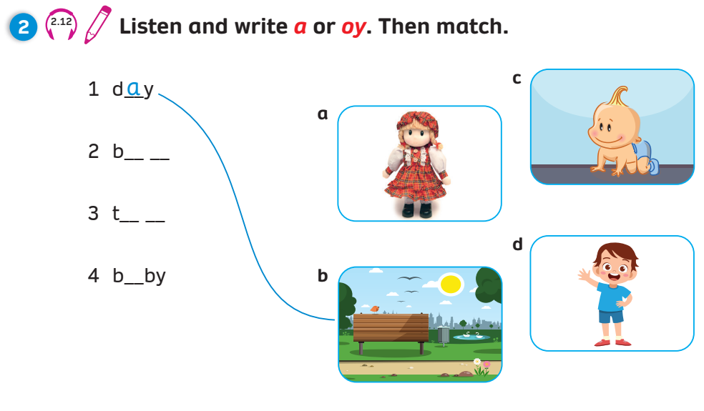
Pupil’s Book (p.24)
Write
Match
o y
o y
a
Click on “Write, Match” to show the answers

Slide 15
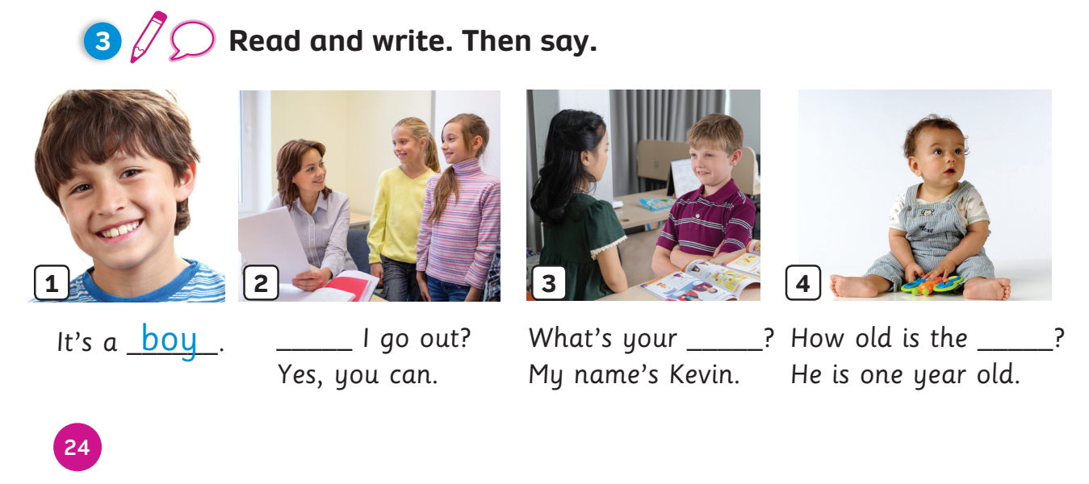
Pupils’ Book (p.24)
Write
Say
May
name
baby
Click on “Write” to show the answers
Click on “Say” for students to say the sentences

Slide 16
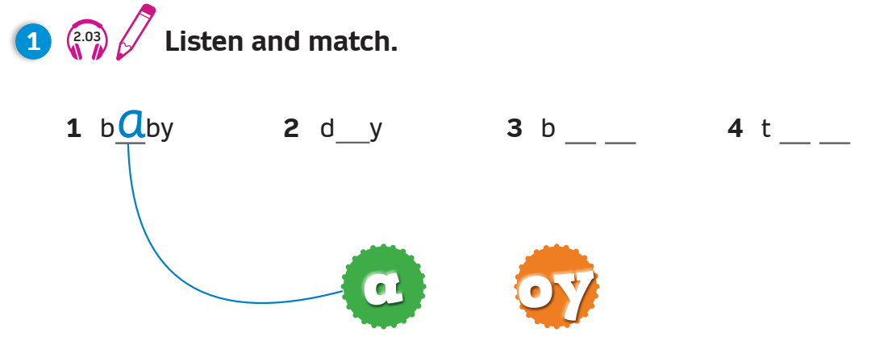
Activity Book (p.21)
Match
a
o y
o y
Click on “Match” to show the answers

Slide 17
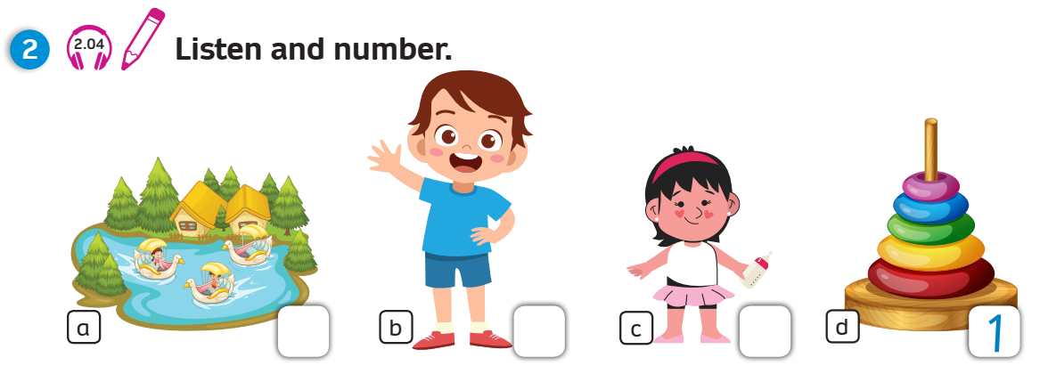
Activity Book (p.21)
Number
4
3
2
Click on “Number” to show the answers

Slide 18
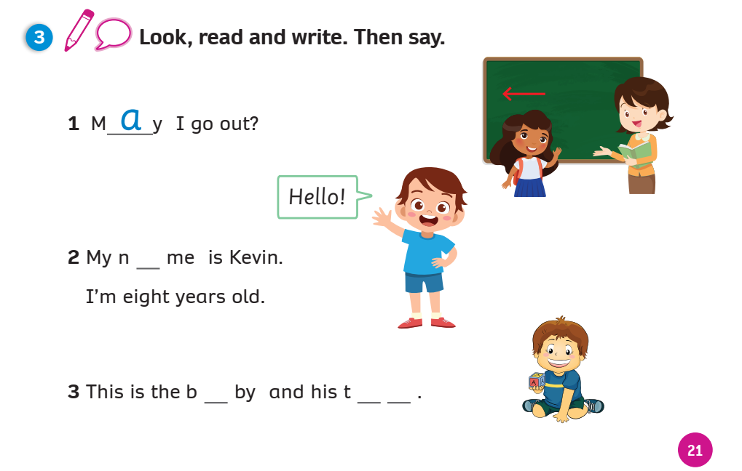
Activity Book (p.21)
Write
Say
a
a
o y
Click on “Write” to show the answers

Slide 19
CHALLENGE YOURSELF
Click on an apple. Look and raise 1 finger if the word has a /eɪ/ sound, 2 fingers if the word has oy /ɔɪ/ sound.
Say the sound and the word. Click on the word and listen.
3
4
may
coy
5
2
joy
pay
6
1
soy
ray
/eɪ/, baby
/ɔɪ/, toy
a
oy
Notes:
Challenge Ss to say the words that have sounds /eɪ/ and /ɔɪ/.

Slide 20
WRAP-UP
Letter
Sound
a | a
Letters
Sound
oy | oy
a
o
y
baby
toy
/eɪ/
/ɔɪ/
day
boy

Slide 21
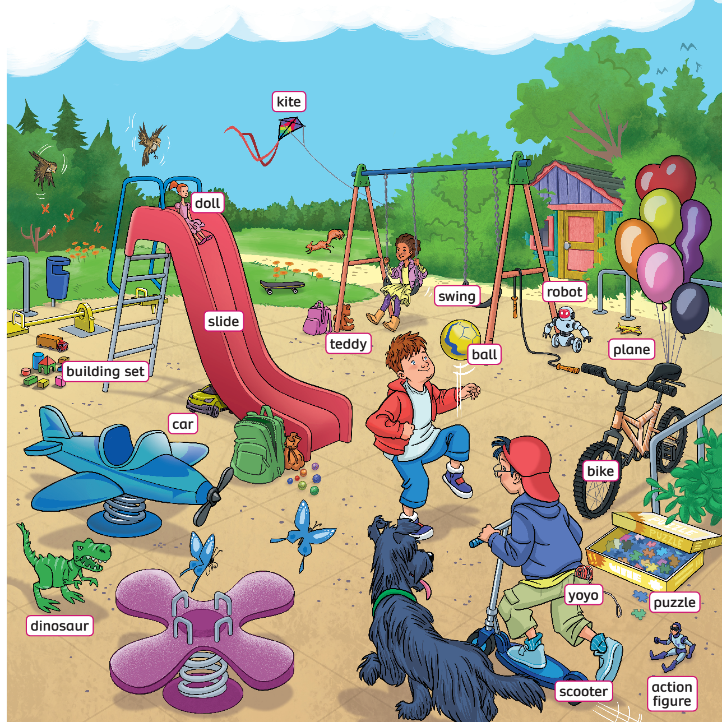
UNIT 2: Lesson 4
We’ve learnt…

