Slide 1
UNIT 2: LOOK AT MY TOYS!
Lesson 3B – Vocabulary & Grammar 2

Slide 2
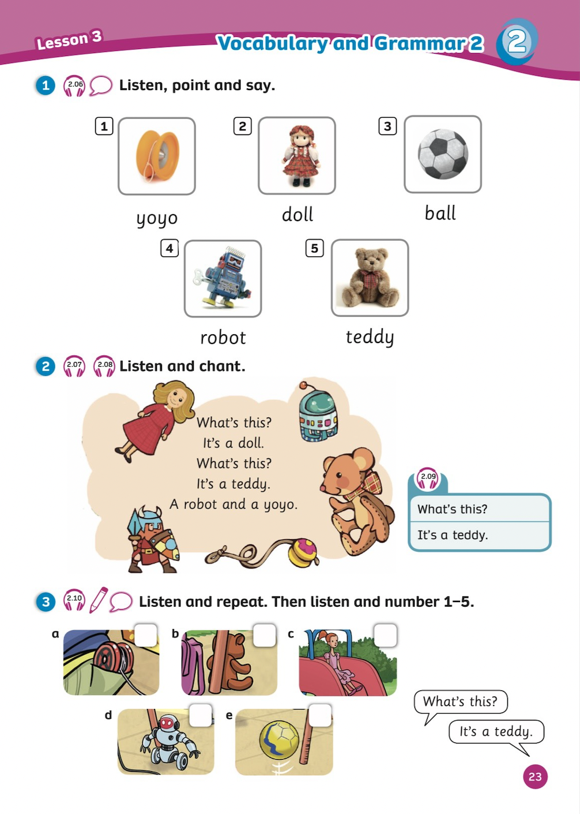
UNIT 2: LOOK AT MY TOYS!
We’re reviewing…
- toys
- how to ask and answer about toys
- SB p.23

Slide 3
WARM-UP
Song: Don’t Stop Baby Bot Dance
All students stand up.
Listen to the song.
Dance along.

Slide 4
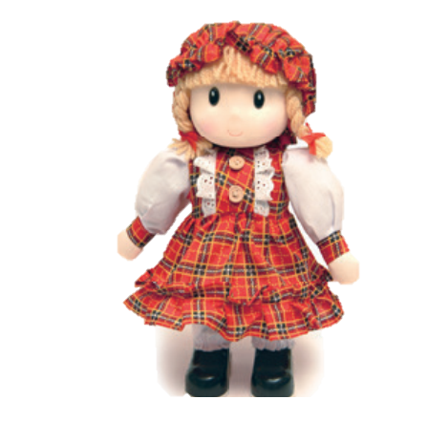
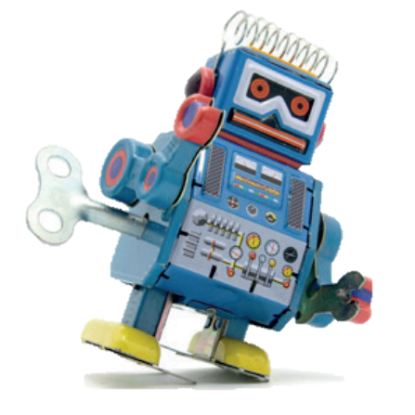
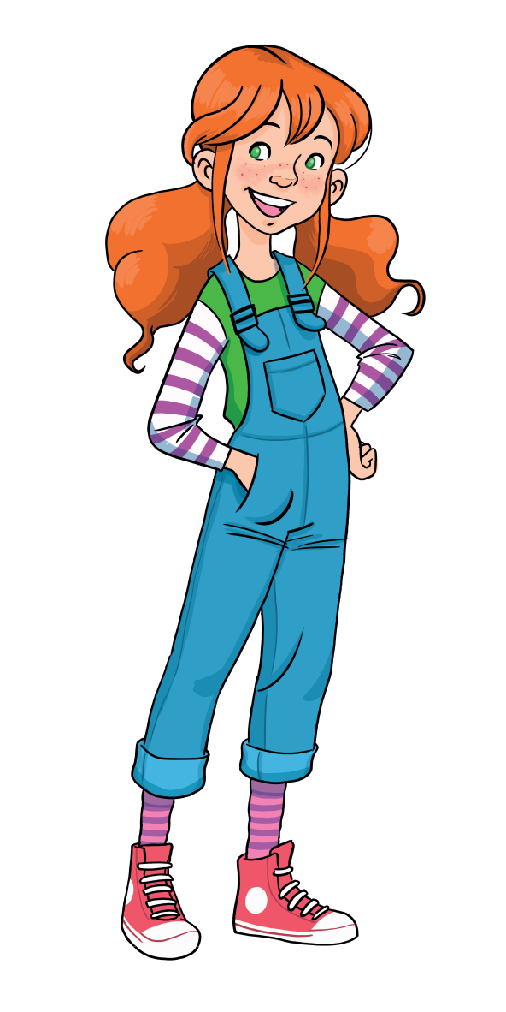
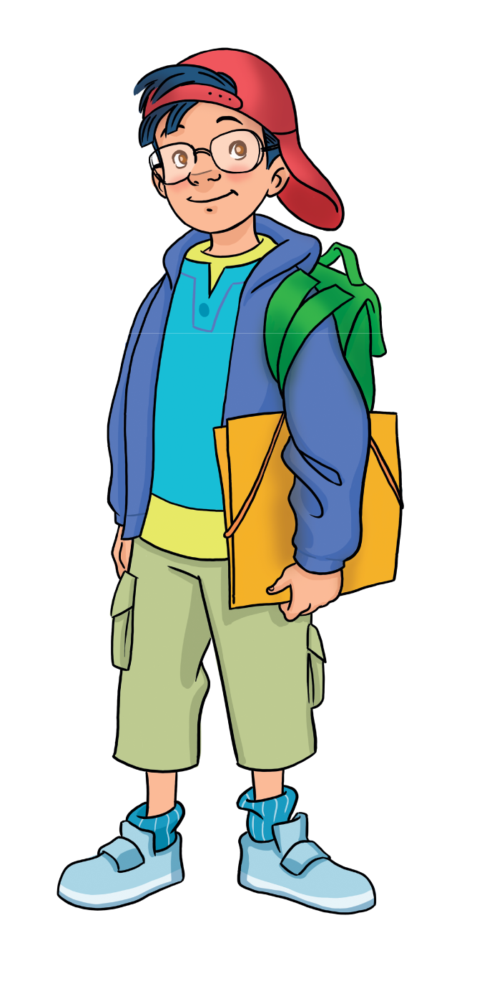
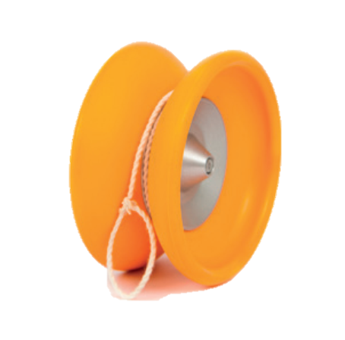
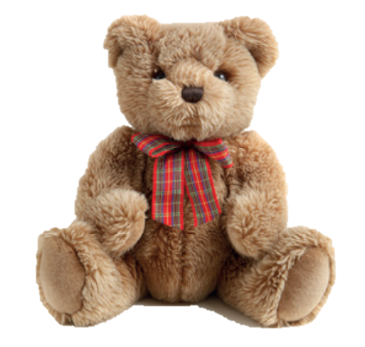
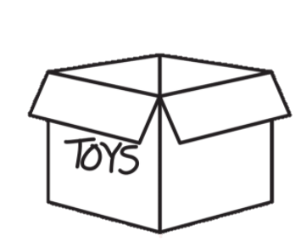
REVIEW: Toys
What’s this?
-> It’s a…
ball
doll
robot
yoyo
teddy

Slide 5
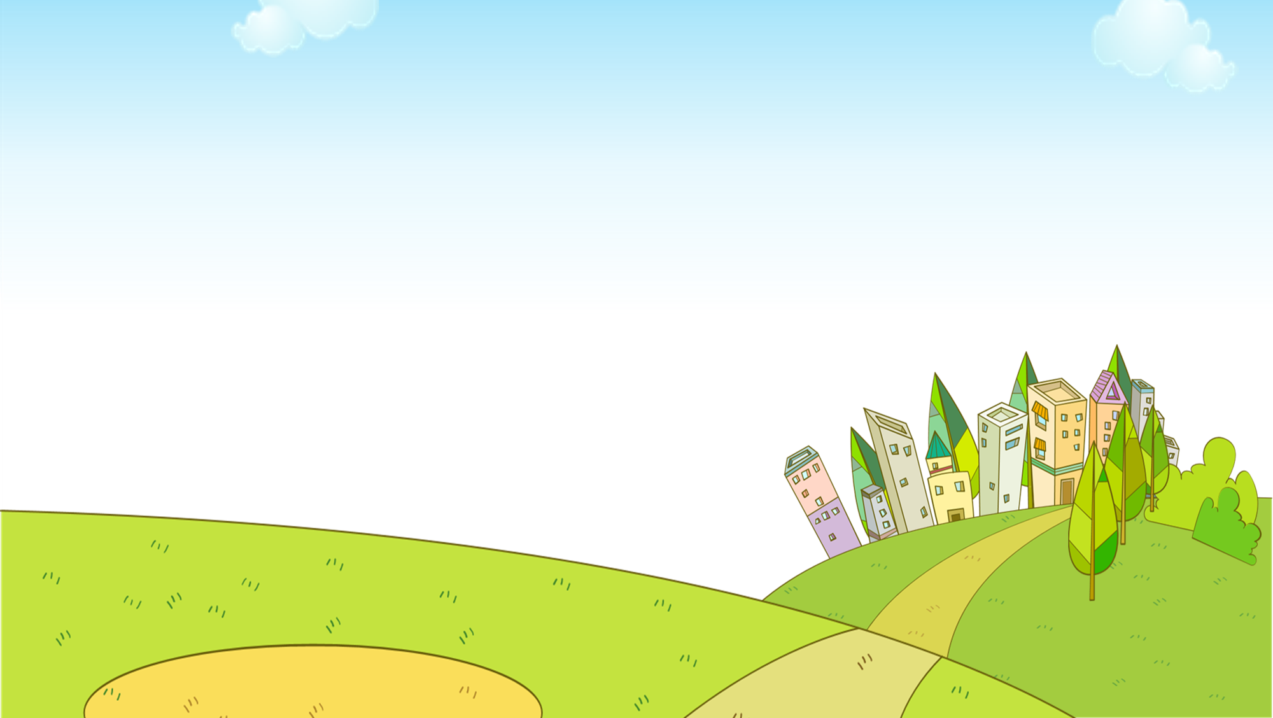

Slide 6
There are 5 questions.
Students choose the correct spelling of the words by showing fingers.
1 student says aloud the answer.
1 correct answer = 1 point.
The whole class then says aloud the correct sentence.

Slide 7
It’s a __________.
teddy
teddy
tedyd

Slide 8
It’s a__________.
robot
rotbo
robot

Slide 9
It’s a__________.
ball
blal
ball

Slide 10
It’s a__________.
yoyo
yoyo
yooy

Slide 11
It’s a__________.
doll
lold
doll

Slide 12
EXIT

Slide 13
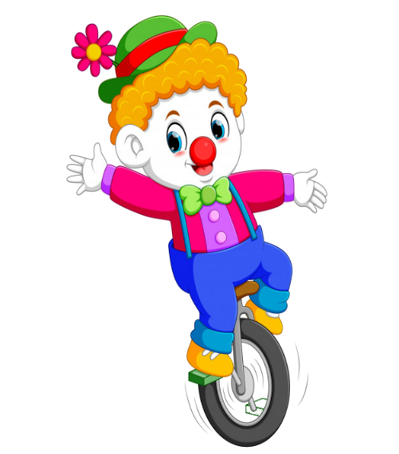
RULES
Students read the sentences.
Say True or False.
1 correct answer = 2 points.

Slide 14
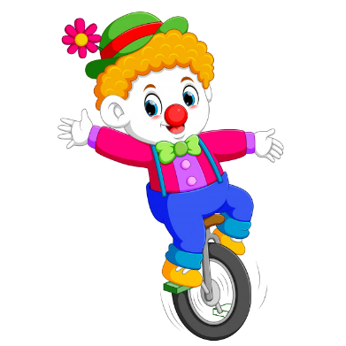
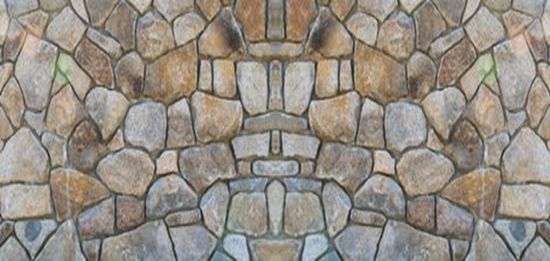
1. It’s a teddy.
True
False

Slide 15
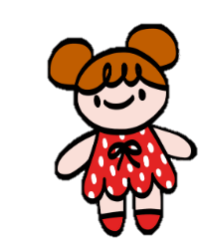
2. It’s a ball.
It’s a doll.
True
False

Slide 16
3. It’s yoyo.
It’s a yoyo.
True
False

Slide 17
4. It’s a ball.
True
False

Slide 18
5. Its a robot.
It’s a robot.
True
False

Slide 19
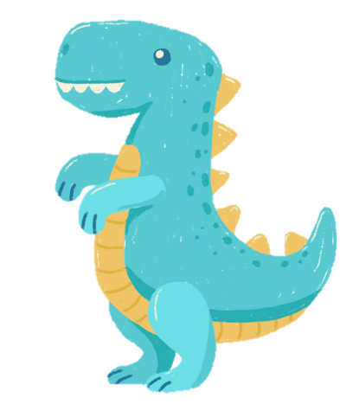
6. Its’ a dinosaur.
It’s a dinosaur.
True
False

Slide 21
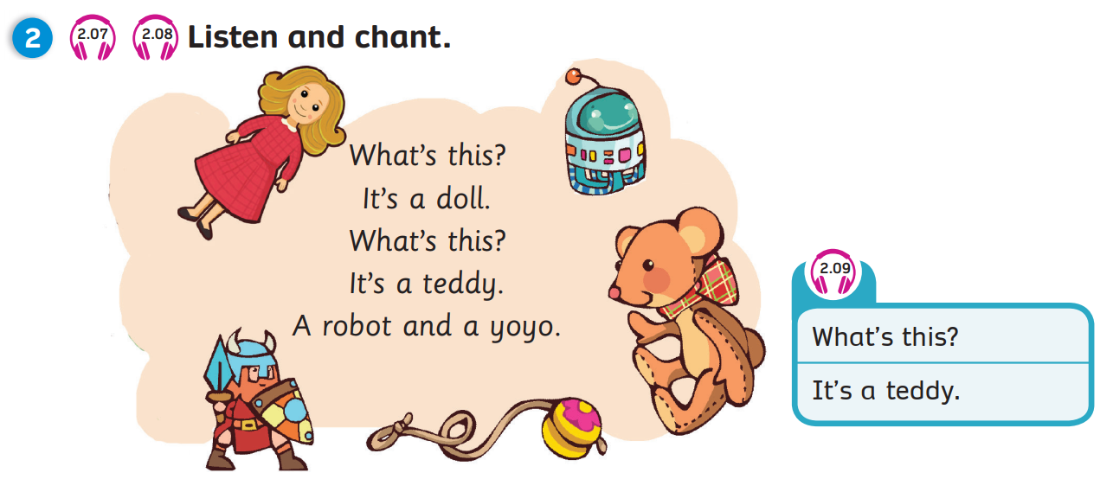
Pupils’ Book (p.23)
Click on the icons 2.07, 2.08, 2.09 to play the audios
Notes:
Play the chant, have Ss listen and whenever they hear a toy, they have to clap their hands
Play the chant again, pause at each sentence, ask Ss to read along with what they hear

Slide 22
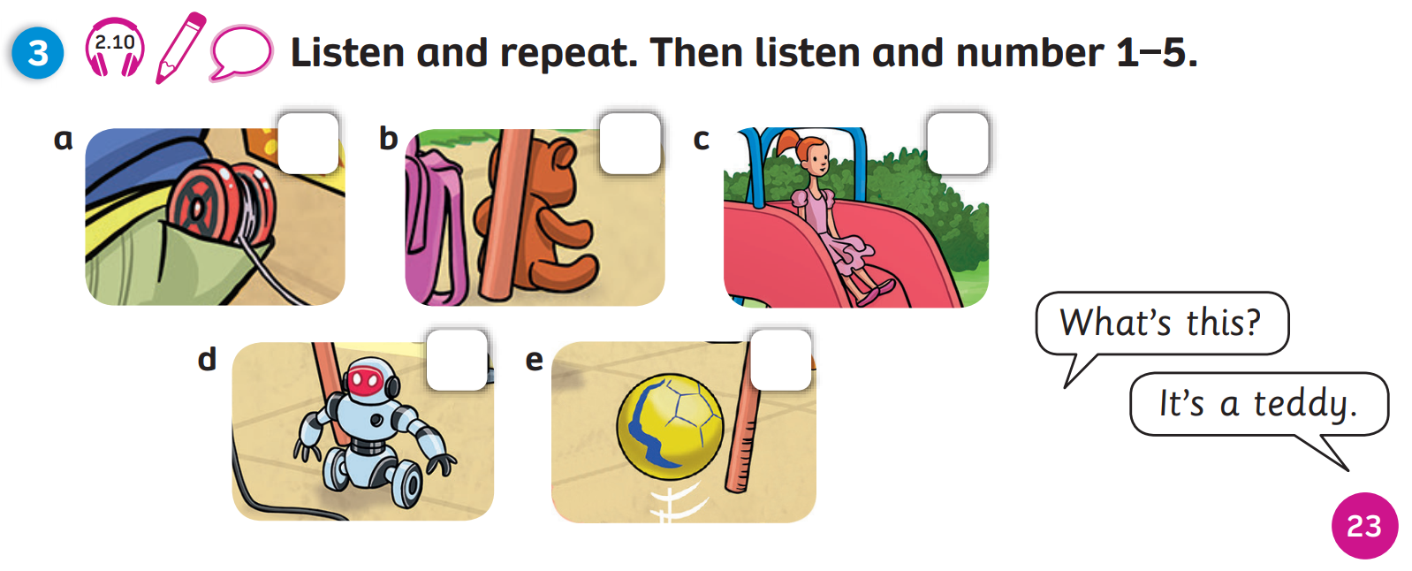
Pupils’ Book (p.23)
Answers
4
1
2
3
5
Click on “Answers” to show the answers
Notes:
Ss listen and repeat after the audio. Then, Ss listen and write number 1-5
After that, Ss work in pairs, point at each pictures, ask and answer each other

Slide 23
PRODUCTION
Show your drawing in the last lesson.
Move around the class. Talk with 3-5 friends about the toy.
It’s a robot.
It’s pink, yellow, green and black.
Notes:
Have Ss take out the drawing they have made in previous lesson
Instruct Ss to move around the class and talk with 3 to 5 friends about it using the given structures in the next slide

Slide 24
PRODUCTION: Example
1
2
What’s this?
It’s a robot.
4
3
It’s pink, yellow, green and black.
What colour is it?
Notes:
Draw Ss’ attention to the 2 questions they have to ask their friends about the drawing
Model by inviting 1 student to come to the front and have the conversation with the teacher

Slide 25
WRAP-UP
What’s this?
-> It’s a…
ball
doll
robot
yoyo
teddy

Slide 26
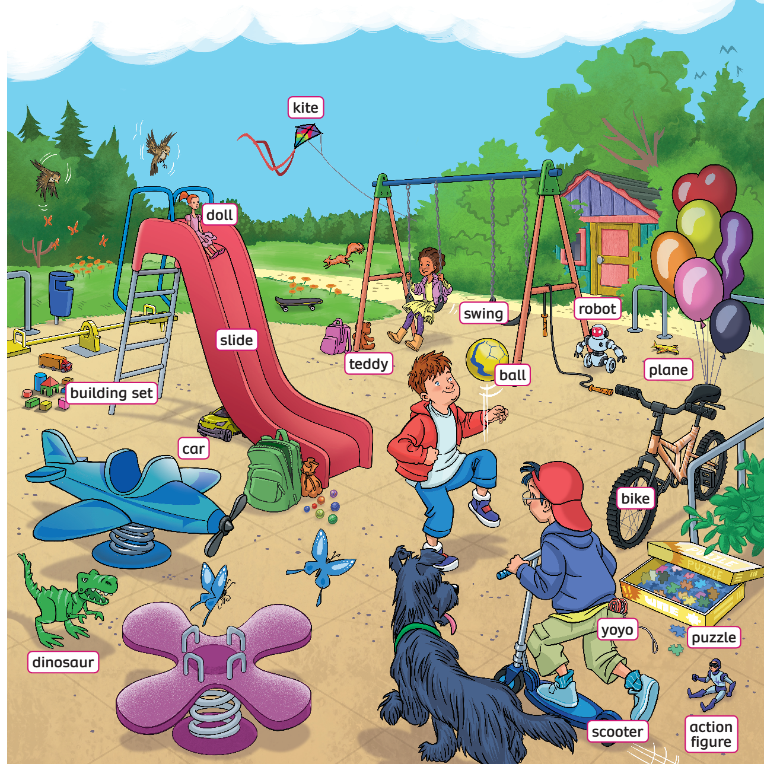
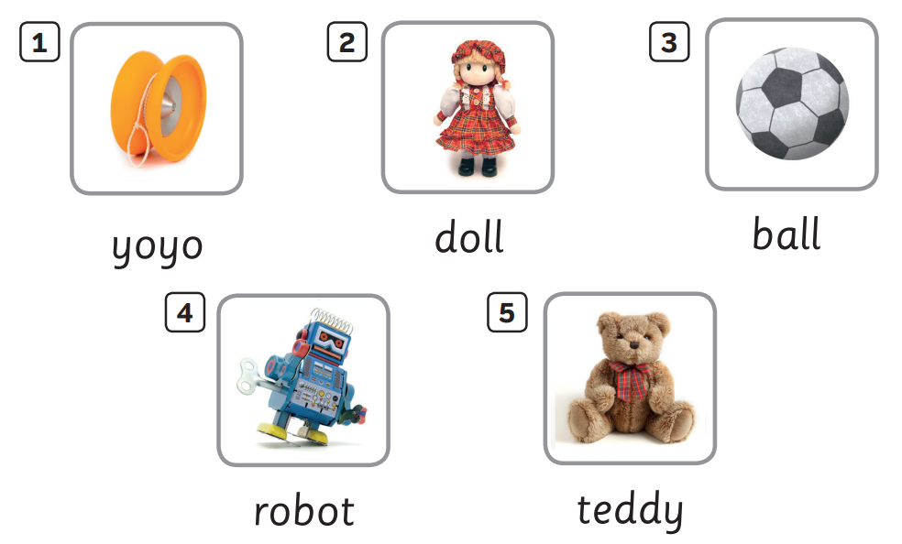
UNIT 2: Lesson 3B
We’ve reviewed…

