Slide 1
UNIT 2: LOOK AT MY TOYS!
Lesson 1B – Vocabulary and Grammar 1

Slide 2
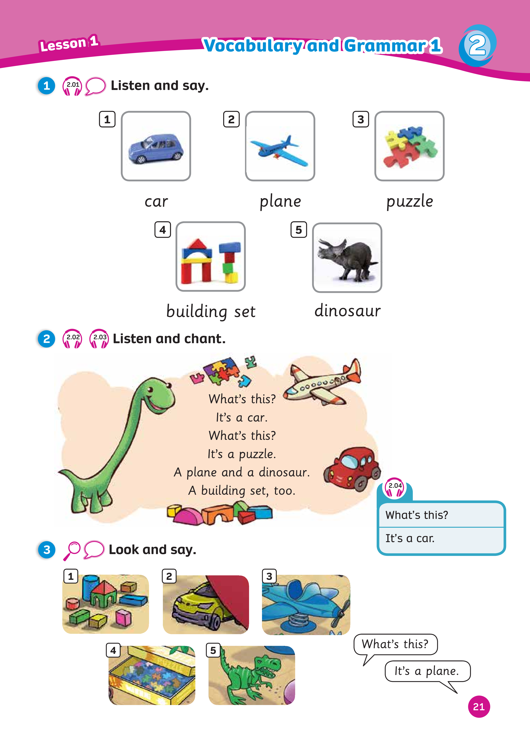
UNIT 2: LOOK AT MY TOYS!
We’re reviewing…
- toys
- how to ask and answer about toys
SB p.21
AB p.18

Slide 3
Song: Teddy Bear, Teddy Bear, Turn Around
WARM-UP
All students stand up.
Listen to the song.
Dance along.

Slide 4
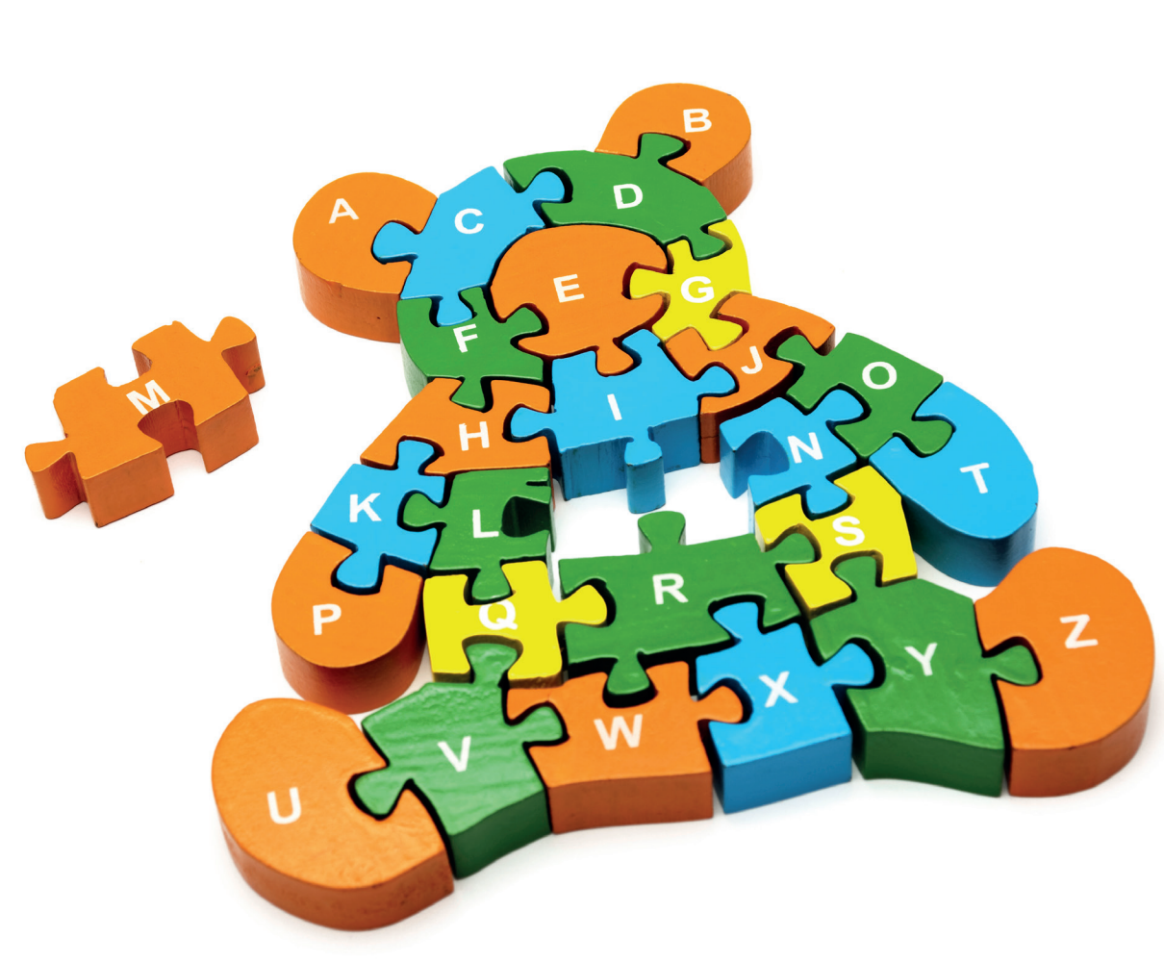
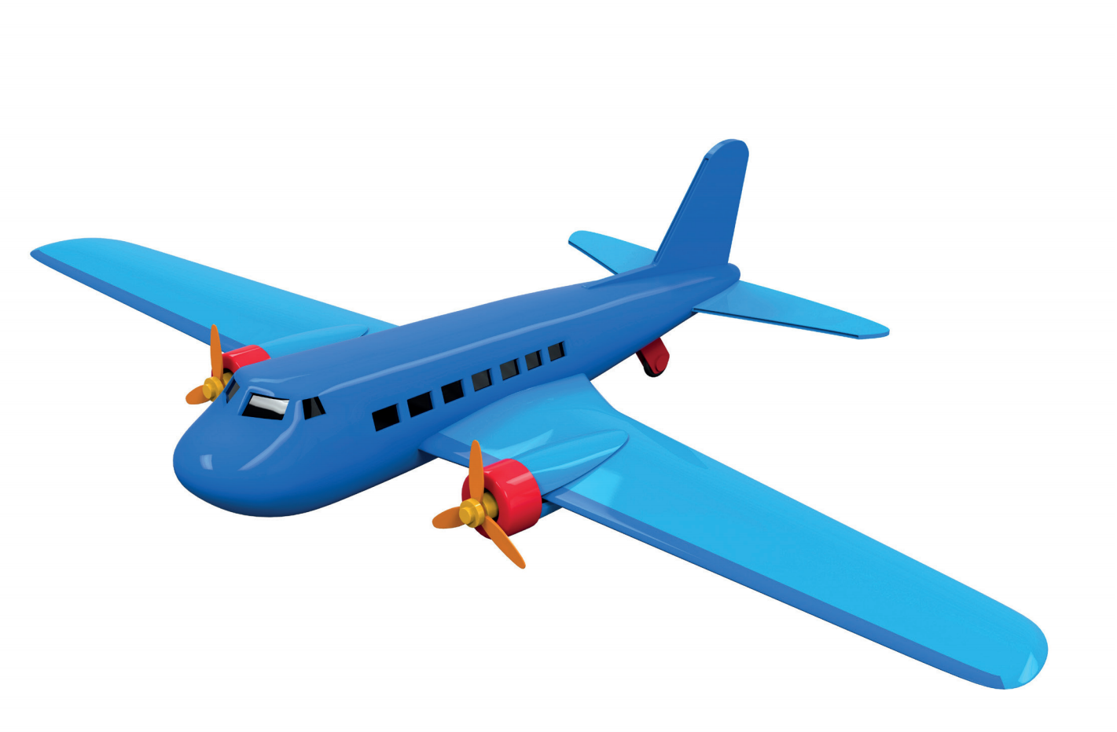
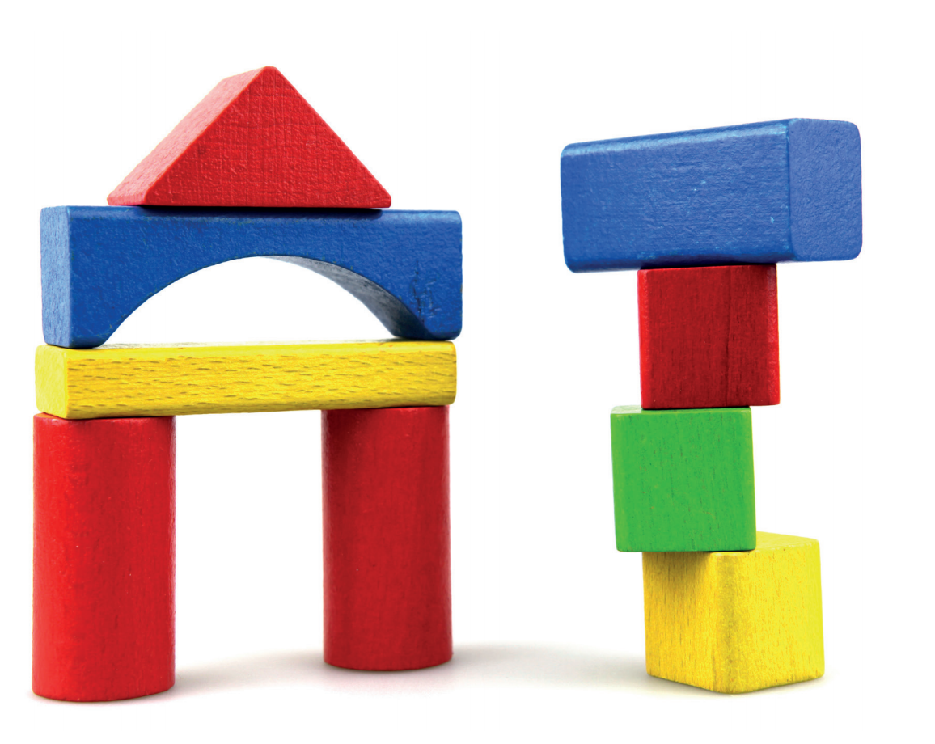
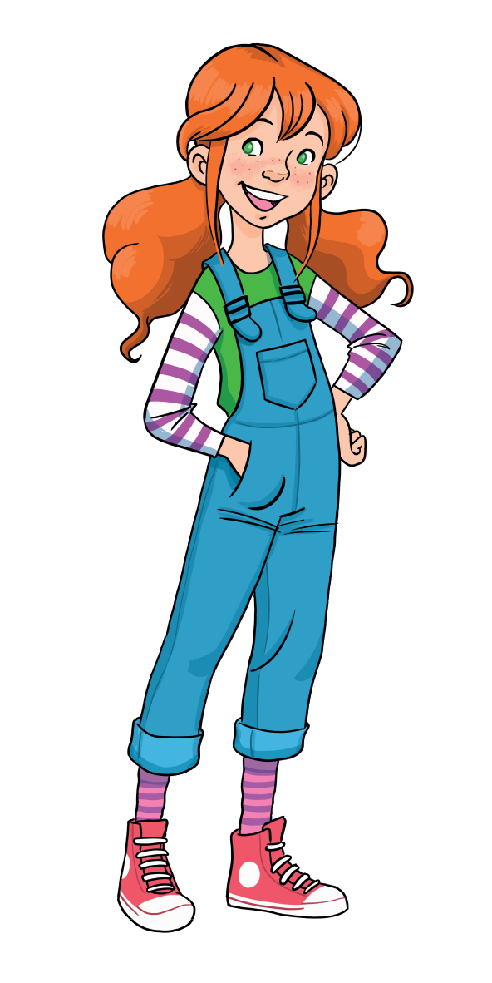
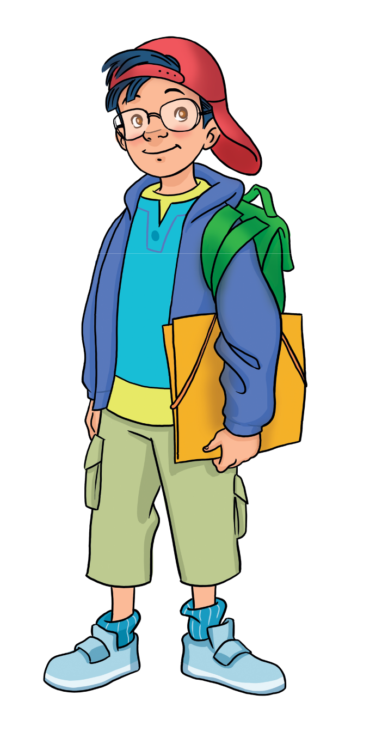
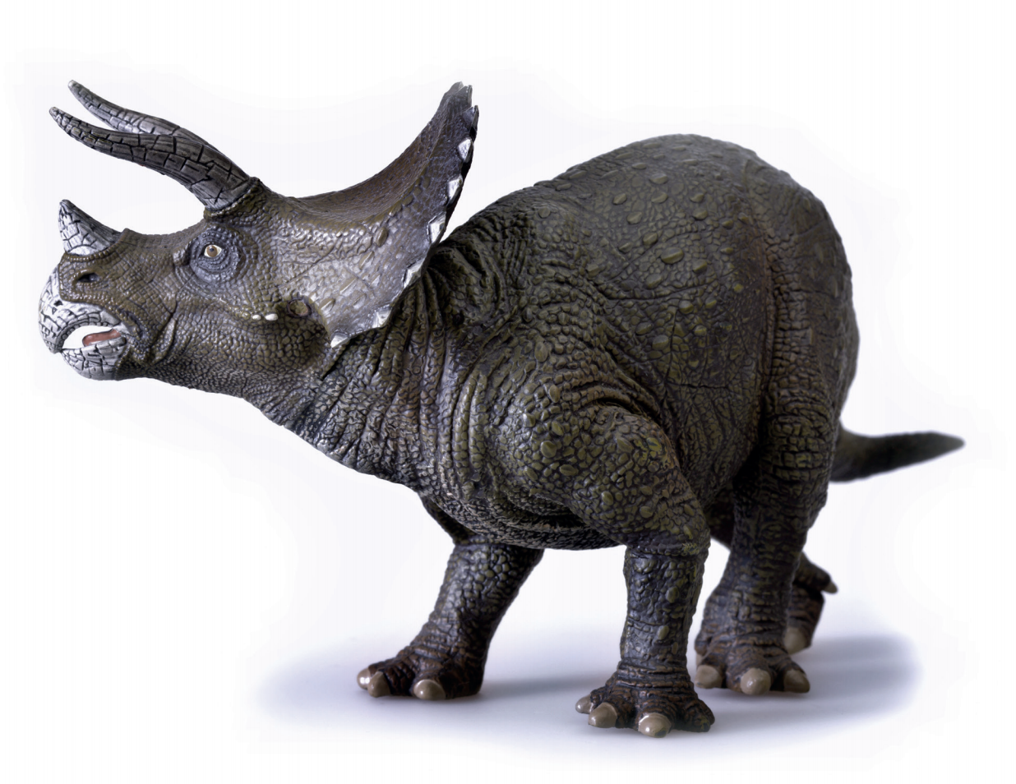
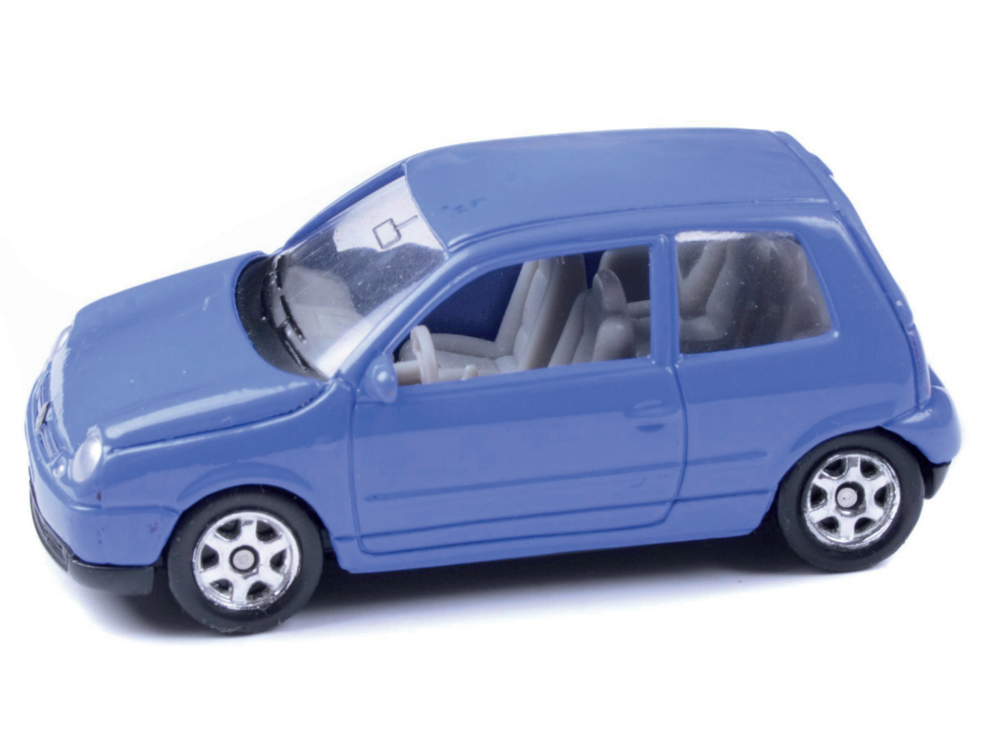
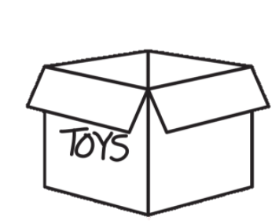
REVIEW: Toys
What’s this?
-> It’s a…
puzzle
plane
building set
car
dinosaur

Slide 5
W
R
O
D
U
Z
E
P
Z
L
Reorder the letters to make correct words.
2 students say the correct word and spell.
The whole class repeats the word.
1 correct word = 2 stars.
Notes:
- Introduce the activity Word Puzzle - Instruct Ss how to play

Slide 6
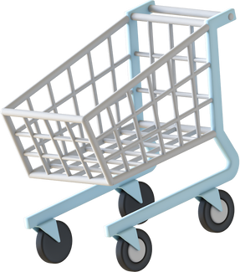
R
O
A
E
Y
U
E
Y
R
A
D
?

Slide 7
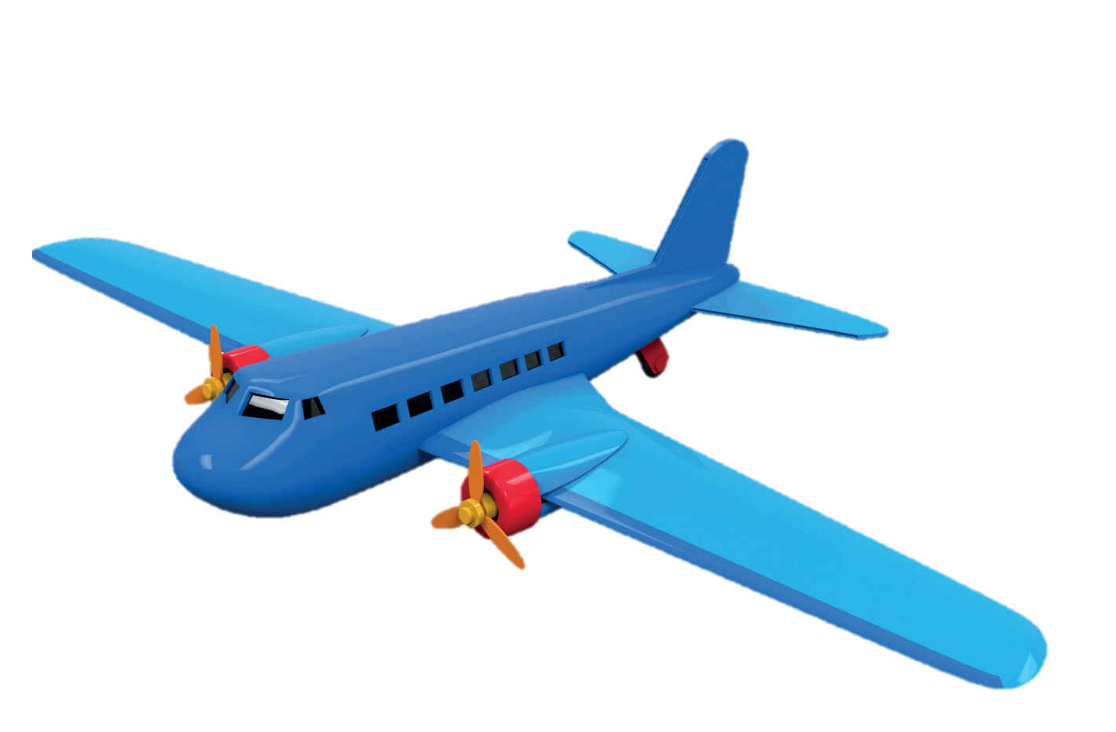
L
A
P
N
E
PLANE
Click on the lightbulb to show the answer

Slide 8
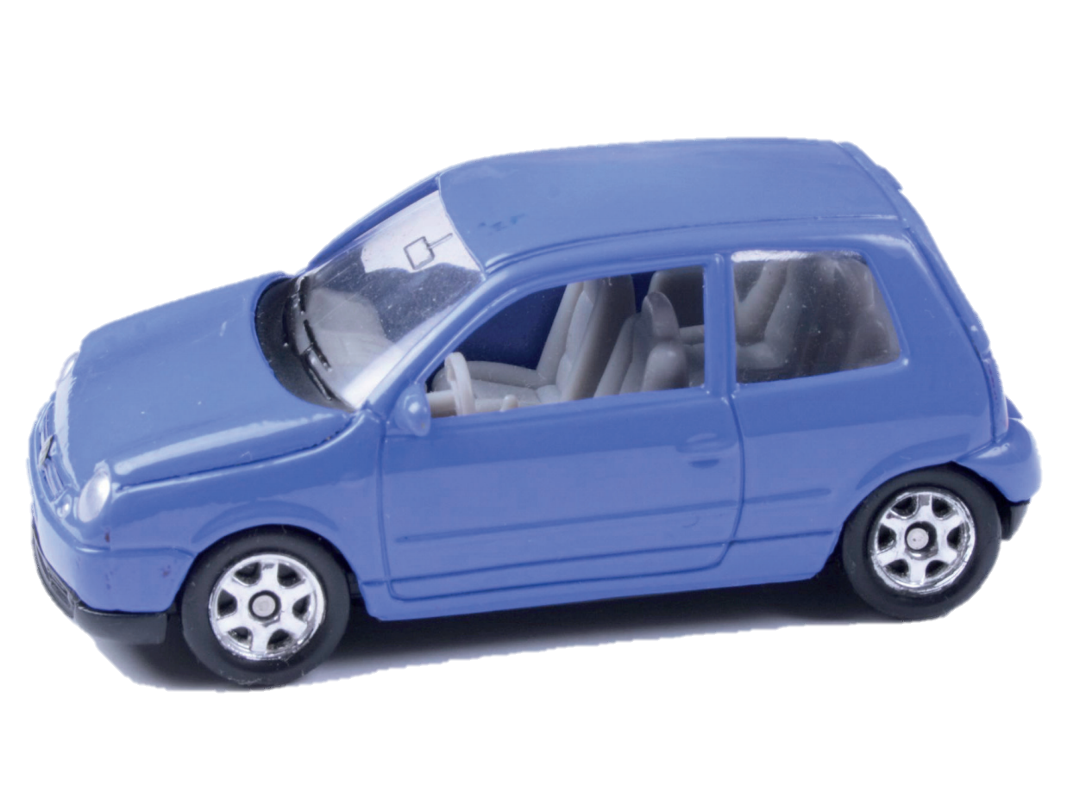
C
R
A
CAR
Click on the lightbulb to show the answer

Slide 9
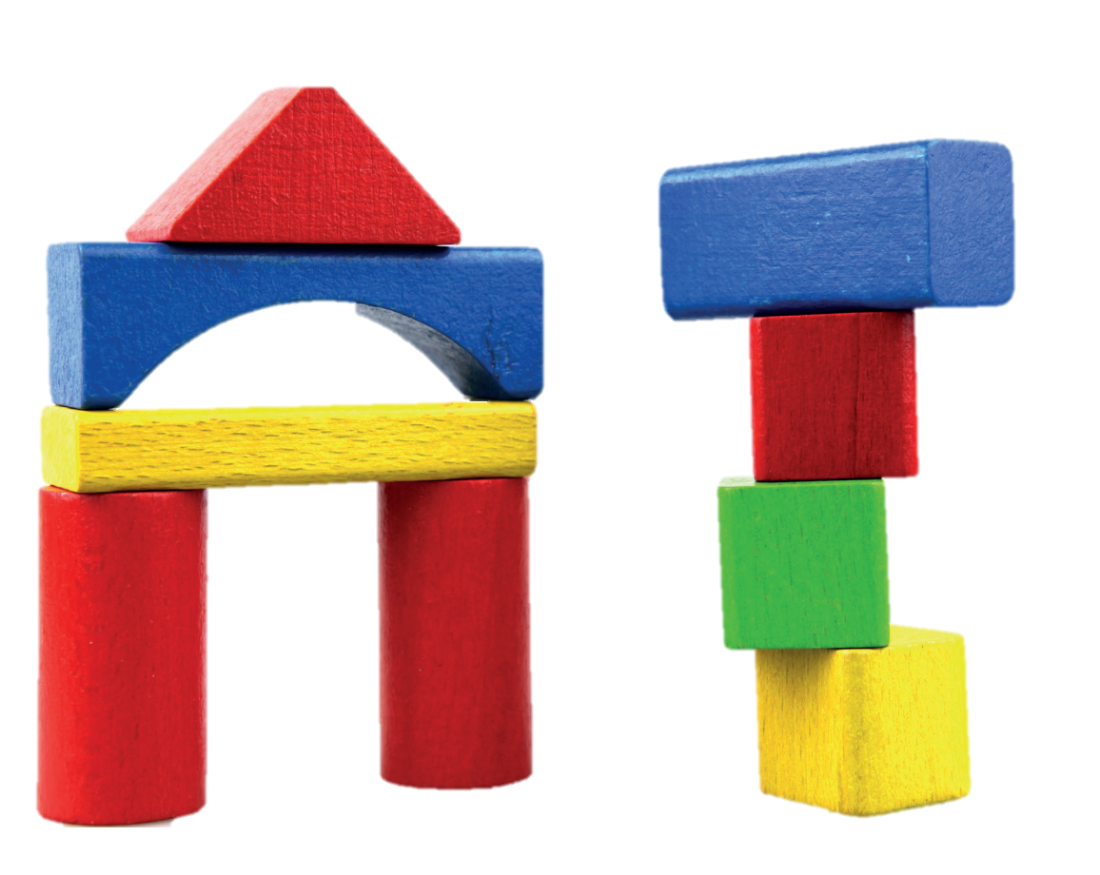
G
D
I
N
U
I
B
L
E
S
T
BUILDING SET
Click on the lightbulb to show the answer

Slide 10
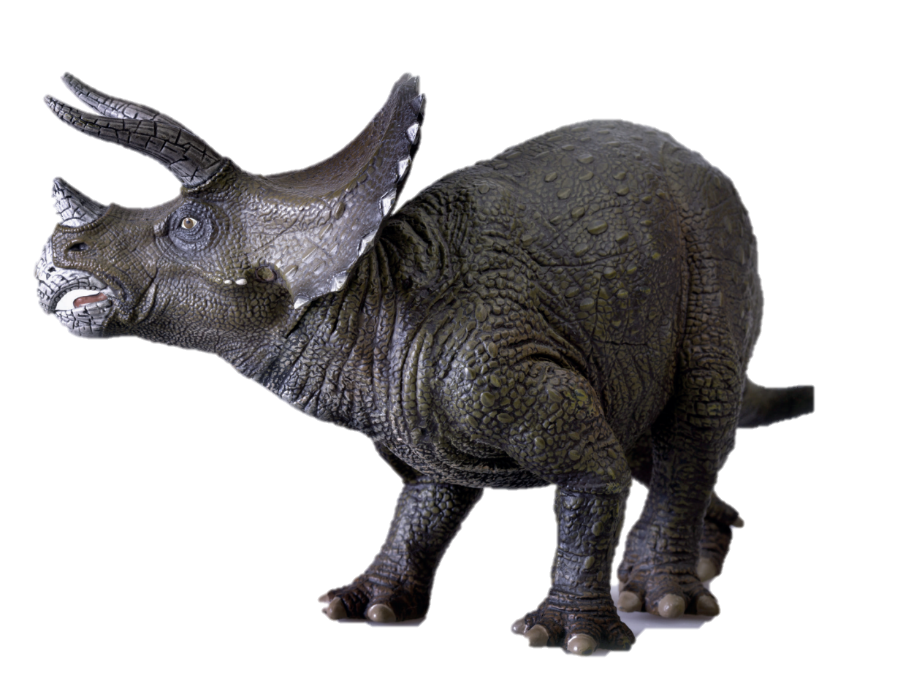
A
I
N
R
U
S
D
O
DINOSAUR
Click on the lightbulb to show the answer

Slide 11
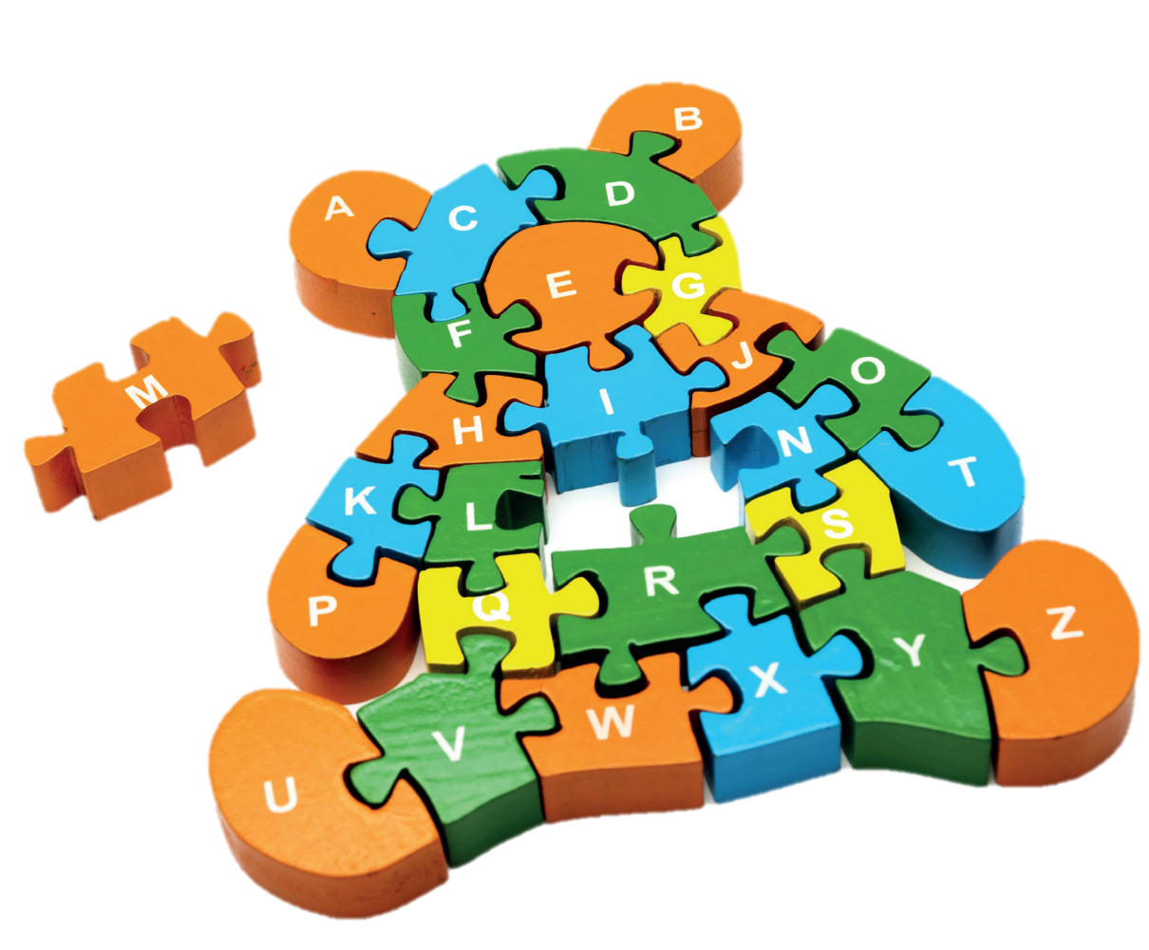
E
Z
U
Z
P
L
PUZZLE
Click on the lightbulb to show the answer

Slide 12
The shadows
RULES
All students raise their fingers to choose the correct shadow.
The teacher invite 2 students to take turns to ask and answer each other.
Students get 1 point for each correct answer.
The whole class repeats the question and answer.
1
2
Notes:
Introduce the activity The Shadows
Instruct Ss how to play

Slide 13
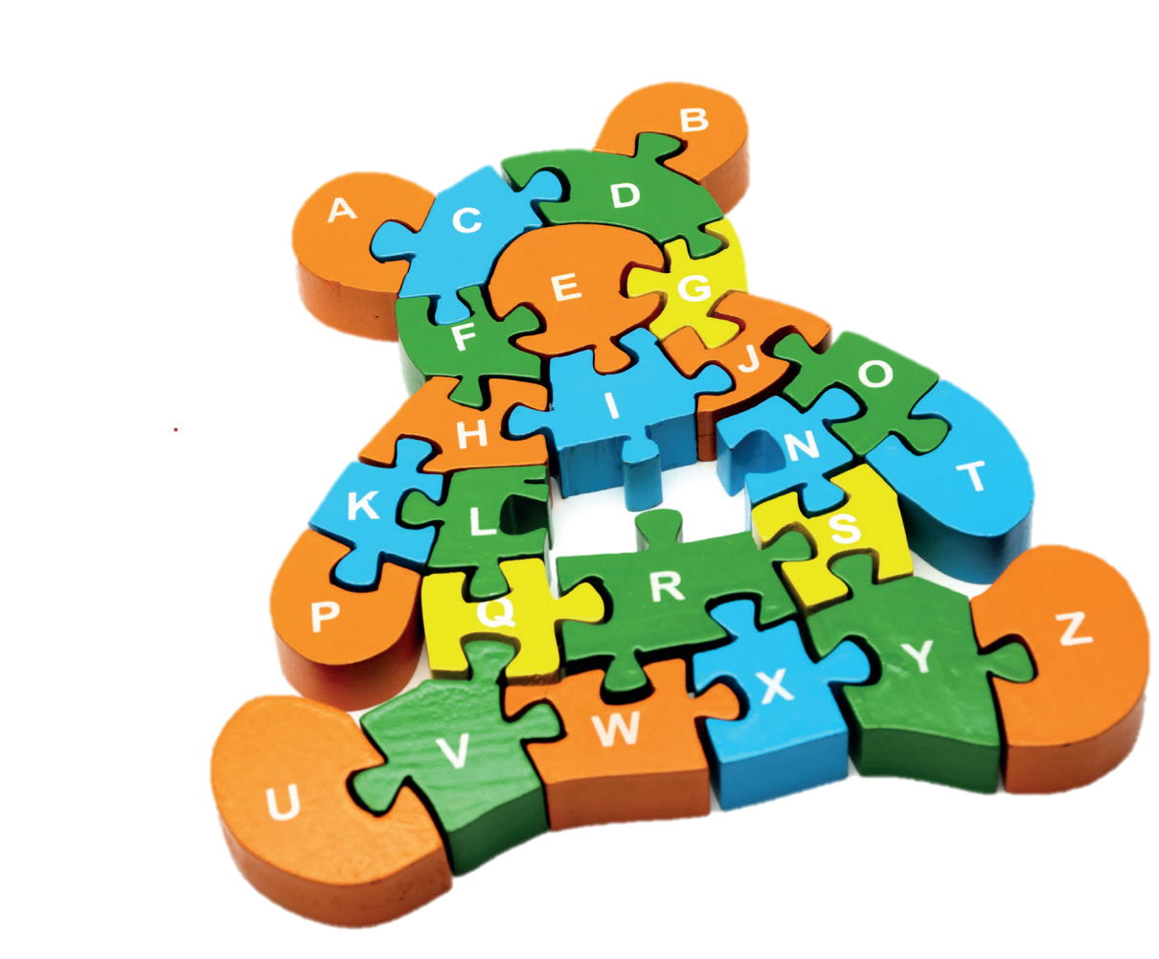
Find the correct shadow.
What’s this?
It’s a …
puzzle
1
2
Click on the picture to show the answer

Slide 14
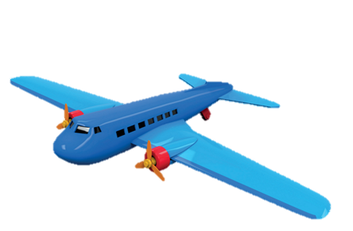
Find the correct shadow.
What’s this?
It’s a …
plane
1
2
Click on the picture to show the answer

Slide 15
Find the correct shadow.
What’s this?
It’s a …
car
1
2
Click on the picture to show the answer

Slide 16
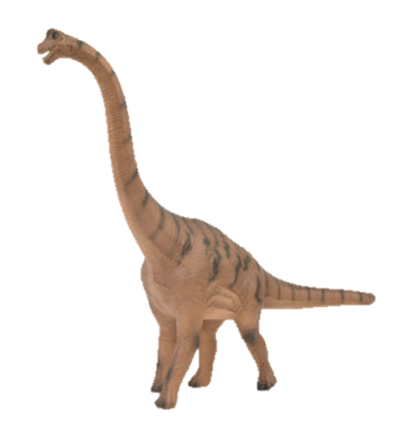
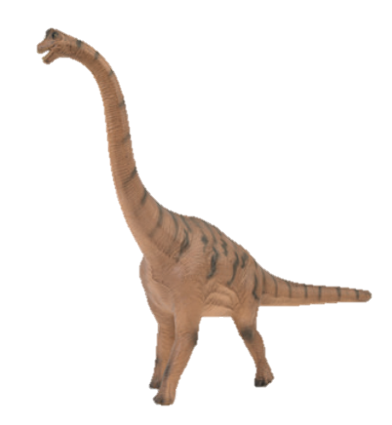
Find the correct shadow.
What’s this?
It’s a …
dinosaur
1
2
Click on the picture to show the answer

Slide 17
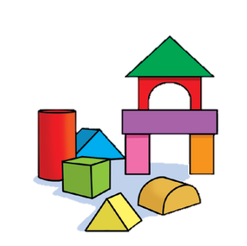
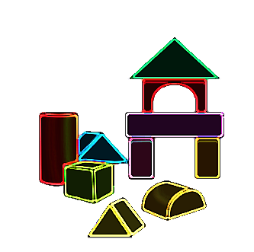
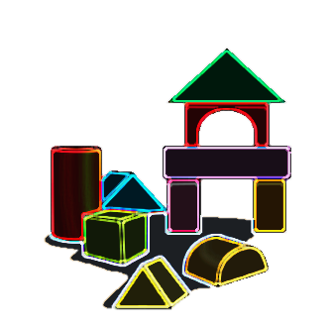
Find the correct shadow.
What’s this?
It’s a …
building set
1
2
Click on the picture to show the answer

Slide 18
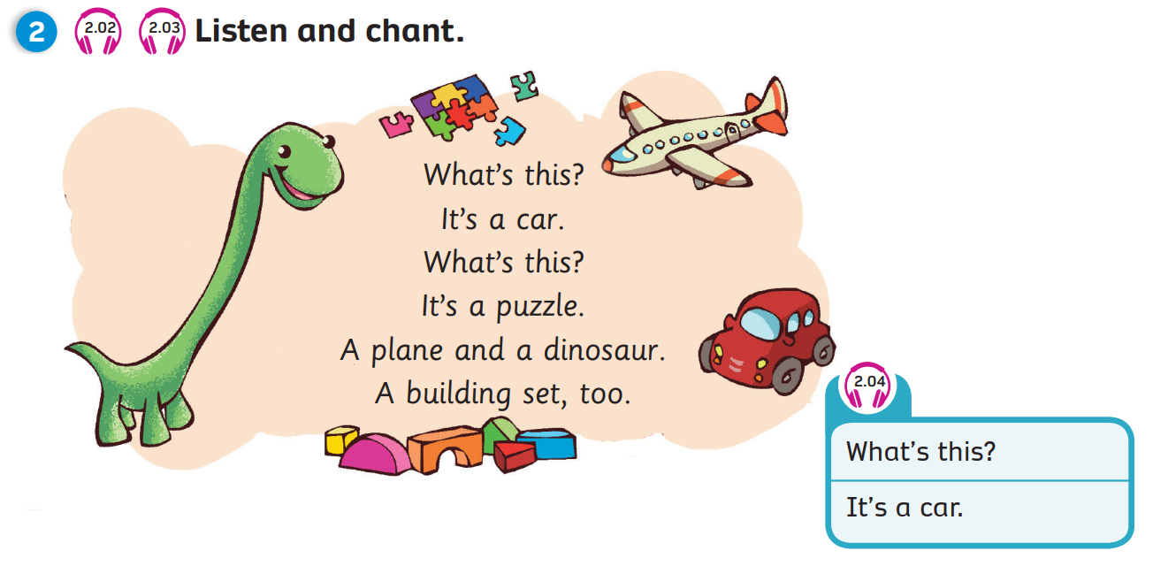
Pupils’ Book (p.21)
Click on the icons 2.02, 2.03, 2.04 to play the audios
Notes:
Play the chant, have Ss listen and whenever they hear a toy, they have to clap their hands
Play the chant again, pause at each sentence, ask Ss to read along with what they hear

Slide 19
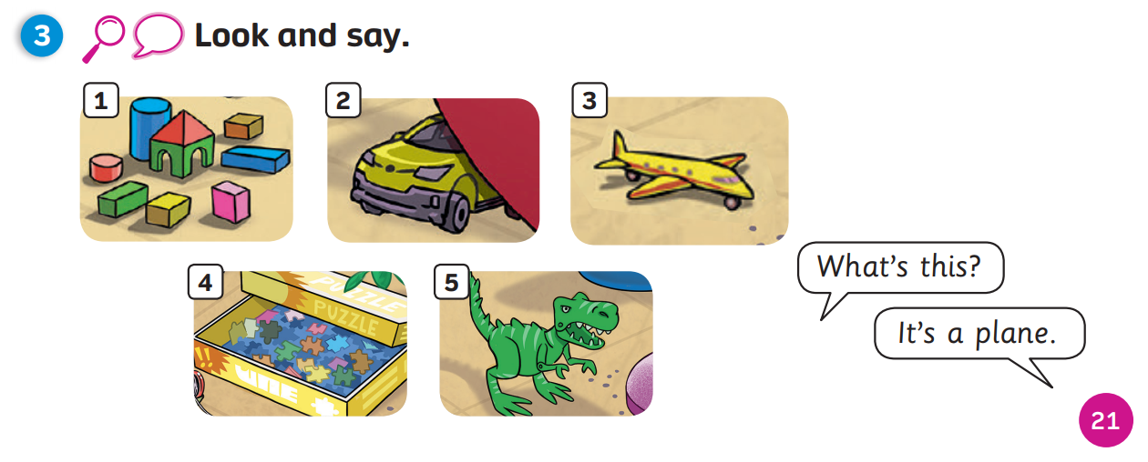
Pupils’ Book (p.21)
Notes:
Ss work in pairs
Point at each pictures
Ask and answer each other

Slide 20
Activity Book (p.21)
Circle
Click on “Circle” to show the answers

Slide 21
Activity Book (p.21)
Write
Match
inosaur
uilding et
lane
ar
Click on “Write, Match” to show the answers

Slide 22
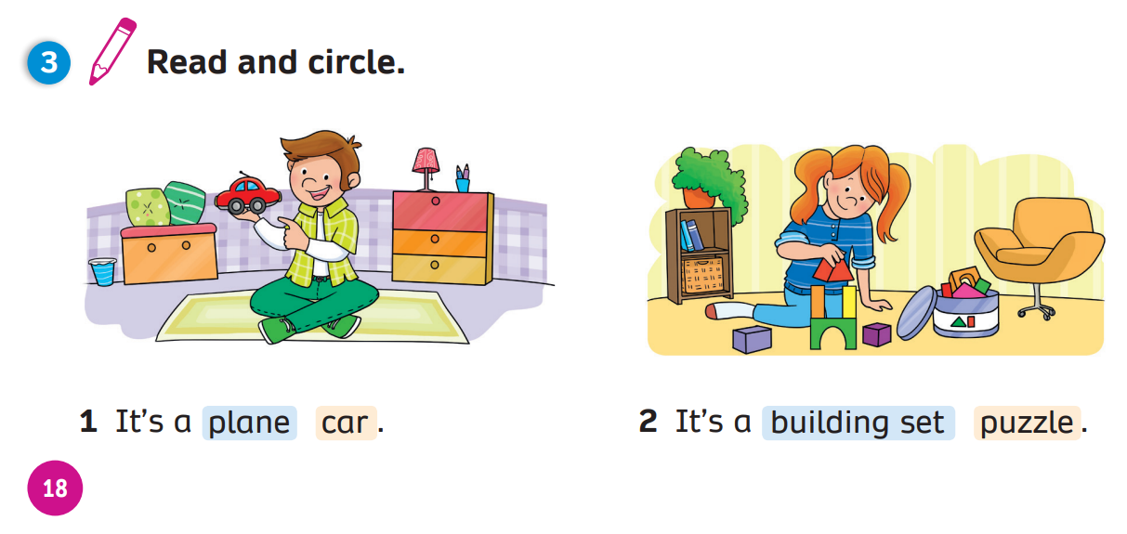
Activity Book (p.21)
Circle
Click on “Circle” to show the answers

Slide 23
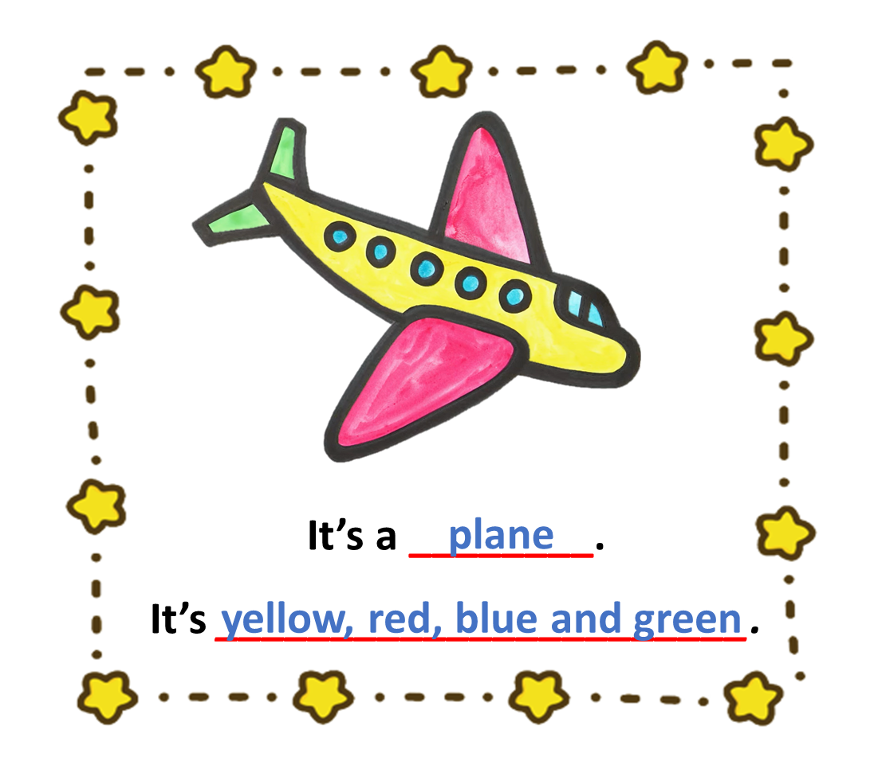
PRODUCTION
Show your drawing in the last lesson.
Move around the class. Talk with 3-5 friends about the toy.
Notes:
Have Ss take out the drawing they have made in previous lesson
Instruct Ss to move around the class and talk with 3 to 5 friends about it using the given structures in the next slide

Slide 24
PRODUCTION: Example
1
2
What’s this?
It’s a plane.
4
3
It’s yellow, red, blue and green..
What colour is it?
Notes:
Draw Ss’ attention to the 2 questions they have to ask their friends about the drawing
Model by inviting 1 student to come to the front and have the conversation with the teacher

Slide 25
WRAP-UP
What’s this?
-> It’s a…
puzzle
plane
building set
car
dinosaur

Slide 26
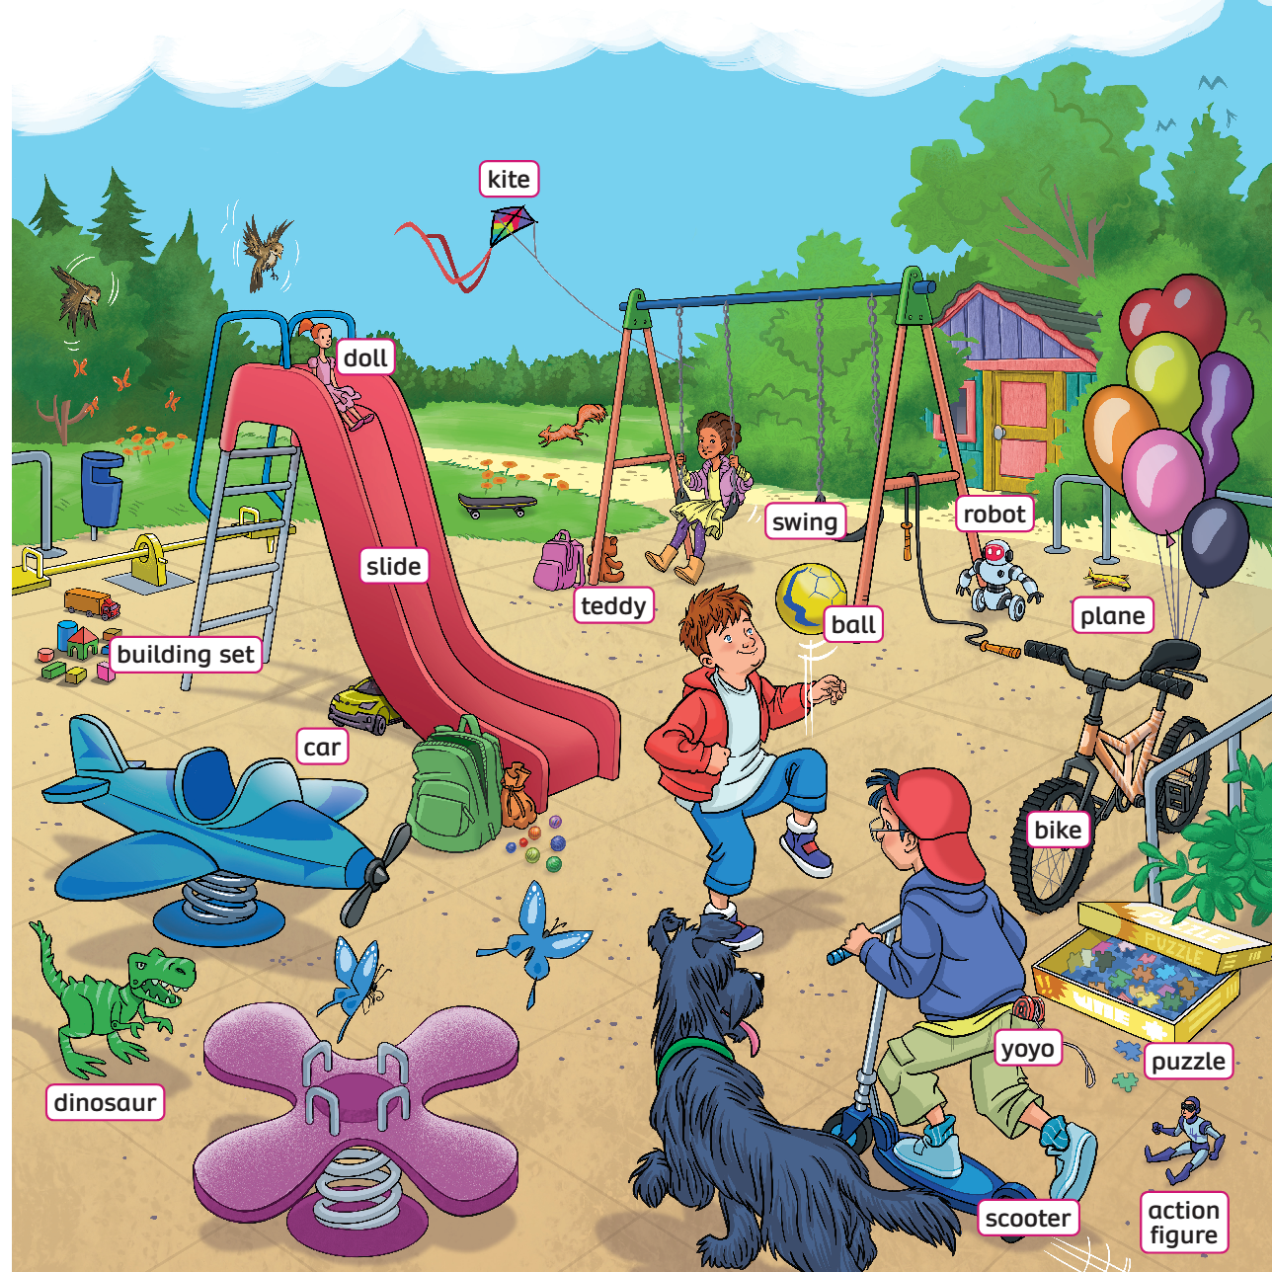
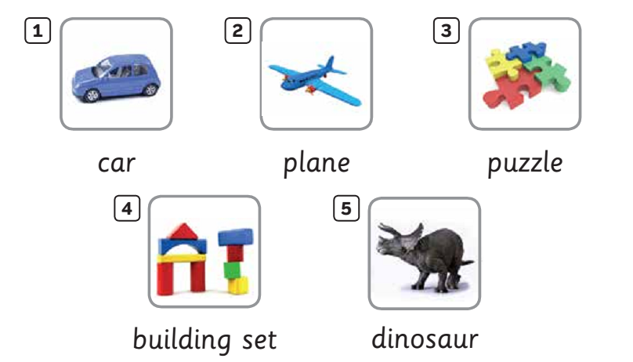
UNIT 2: Lesson 1B
We’ve reviewed…

