Slide 1

UNIT 2: LOOK AT MY TOYS
Lesson 1A – Vocabulary and Grammar 1

Slide 2
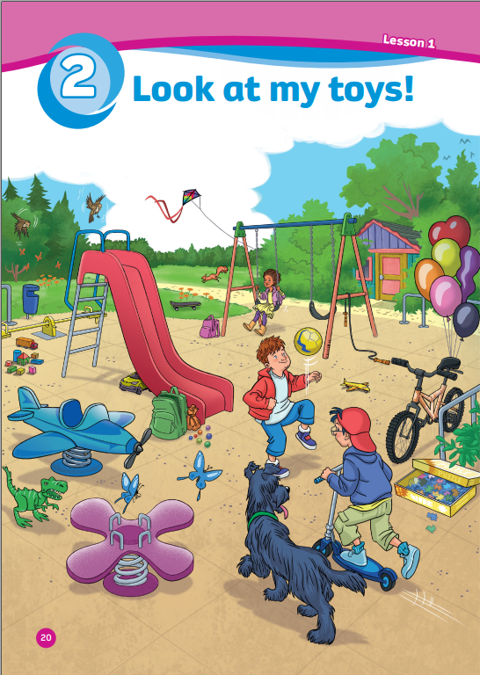
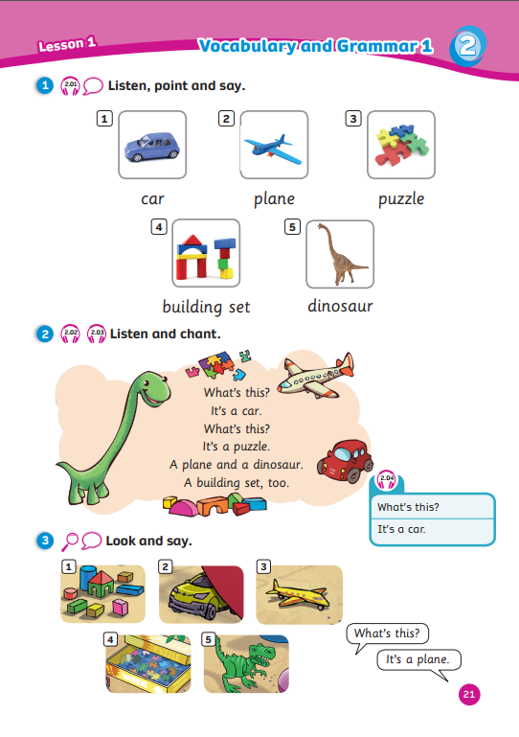
UNIT 2: LOOK AT MY TOYS
We’re learning…
- toys
- to ask and answer about toys
- SB p.20 – 21

Slide 3


Song: Teddy Bear, Teddy Bear, Turn Around
WARM-UP
All students stand up.
Listen to the song.
Dance along.

Slide 4
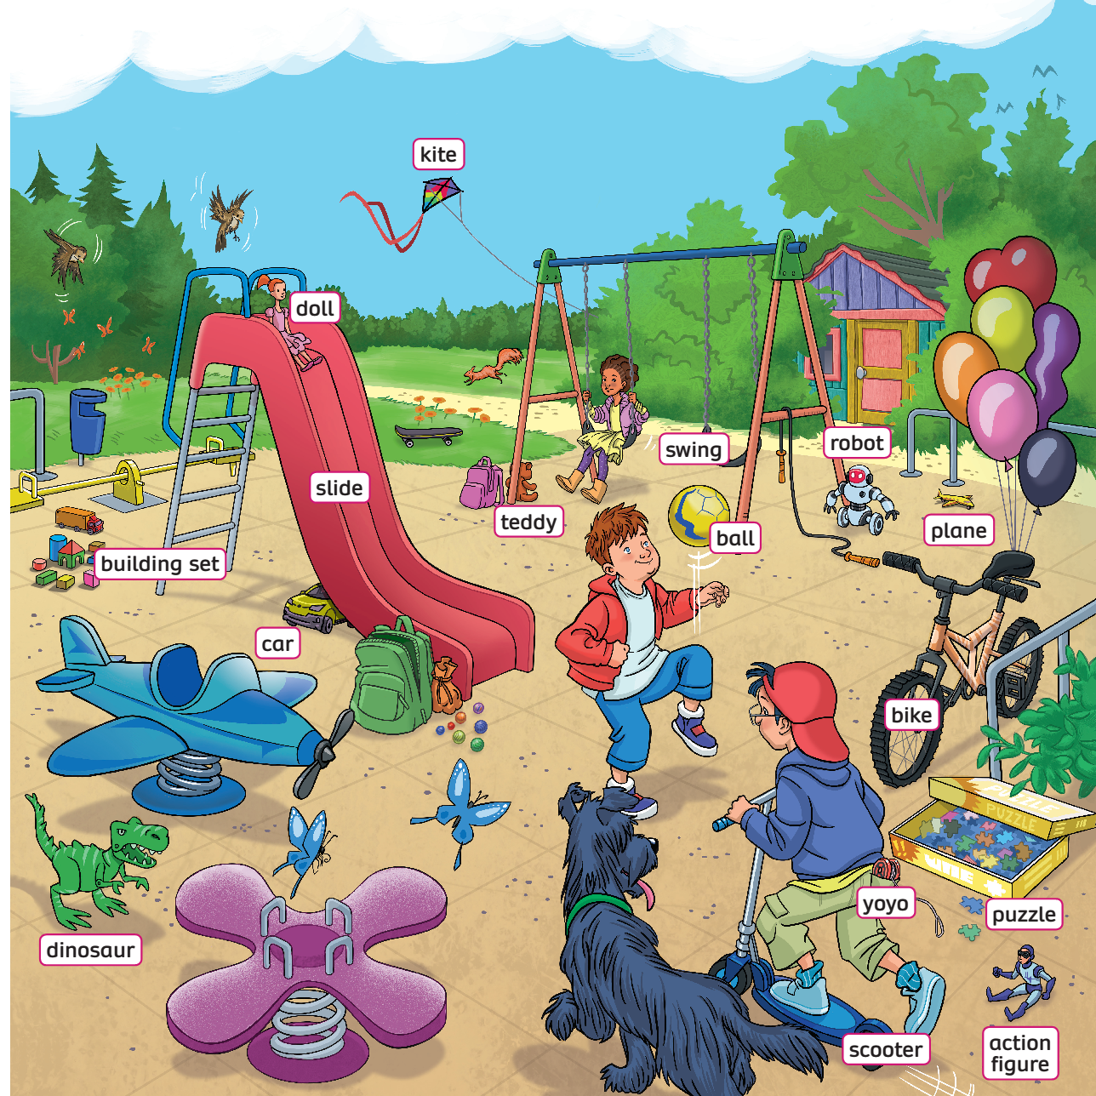
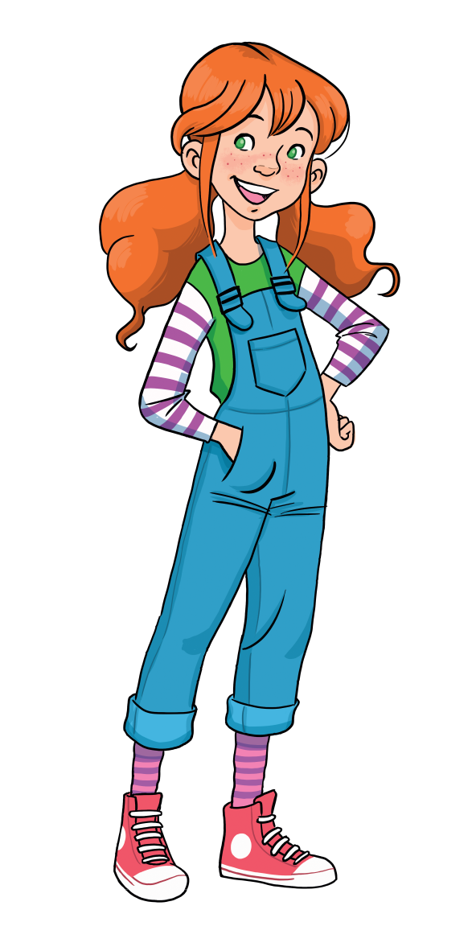
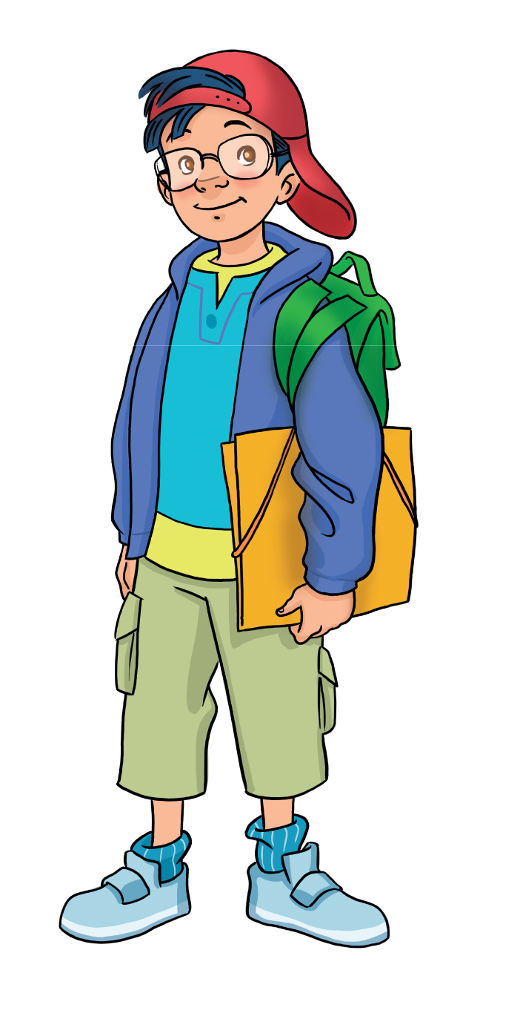
LEAD-IN
Wow! Toys!
Name the toys you can see!

Slide 5
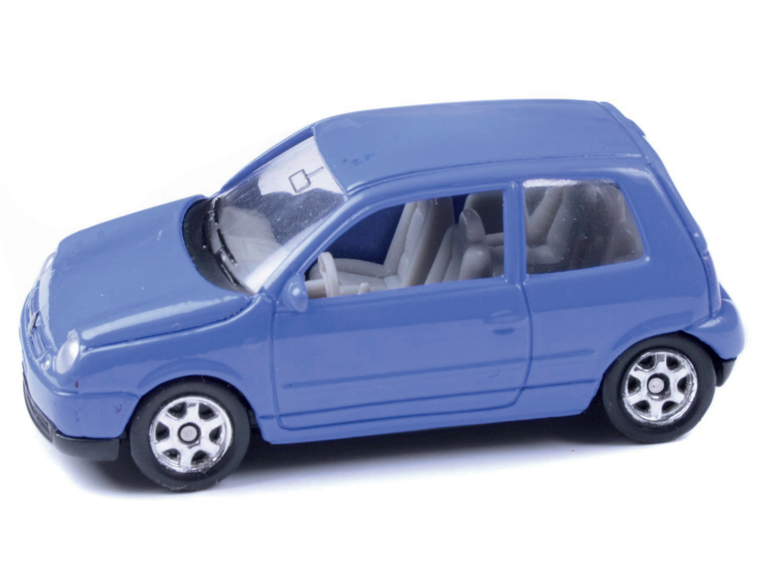

VOCABURALY: Toys
What’s this?
It’s a …
car
Let’s spell!
c
a
r

Slide 6
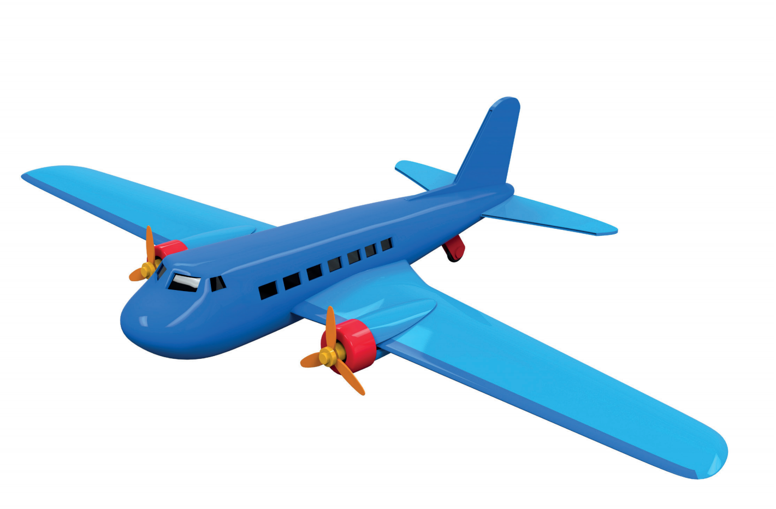
VOCABURALY: Toys
What’s this?
It’s a …
plane
Let’s spell!
p
l
a
n
e

Slide 7

VOCABURALY: Toys
What’s this?
It’s a …
puzzle
Let’s spell!
p
u
z
z
l
e

Slide 8
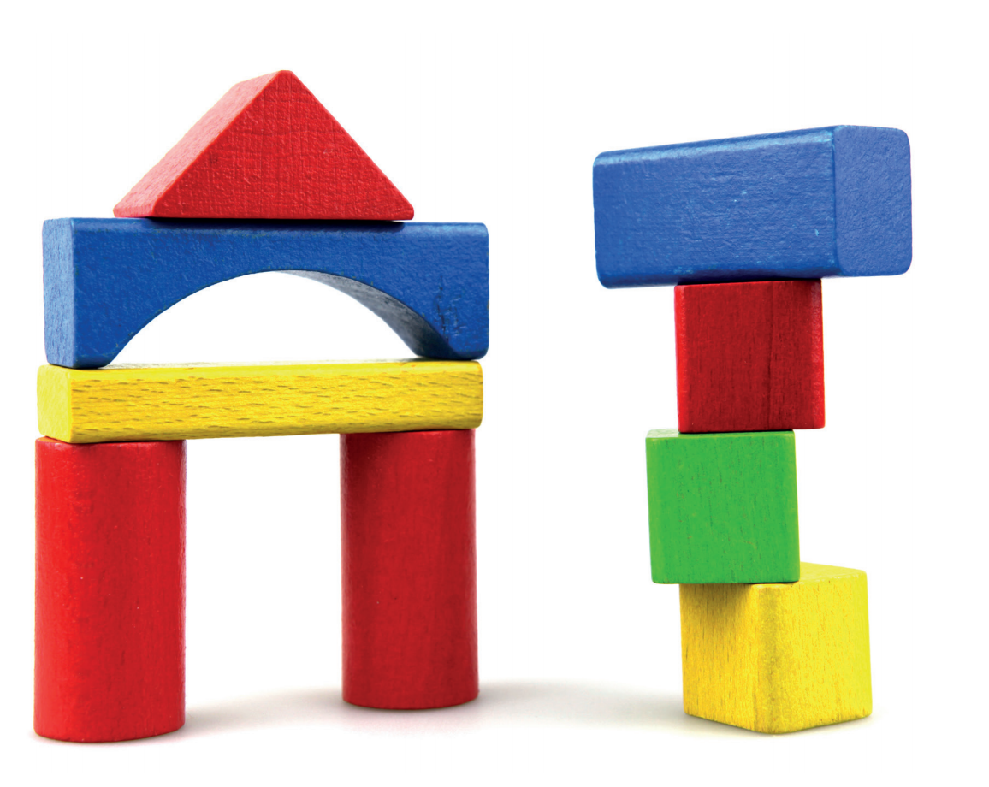
VOCABURALY: Toys
What’s this?
It’s a …
building set
Let’s spell!
b
u
i
l
d
i
n
g
s
e
t

Slide 9
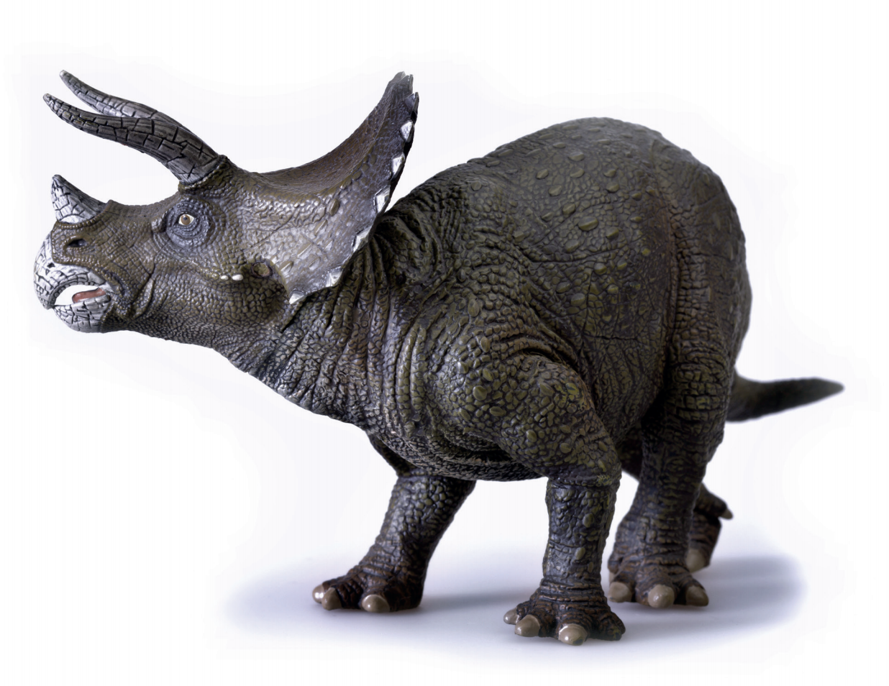
VOCABURALY: Toys
What’s this?
It’s a …
dinosaur
Let’s spell!
d
i
n
o
s
a
u
r

Slide 10


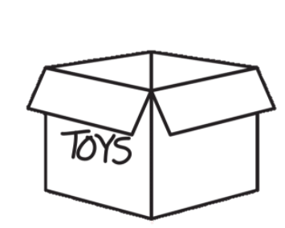
VOCABURALY: Toys
puzzle
plane
building set
car
dinosaur

Slide 11

What’s behind the wall?
RULES
RULES
There is 1 hidden toy behind each brick wall
Students from each team try to guess the toy
Students say “Bricks down” to drop the bricks
Students say “Bingo” to gain the right to answer
1 correct answer = 2 points
Note:
Click on the bricks to drop them down
Click “Check” to drop all the bricks down
Click “Next” to move to the next slide
BRICKS DOWN
START
TOYS

Slide 12
dinosaur
NEXT
Click on the bricks
CHECK

Slide 13
puzzle
NEXT
Click on the bricks
CHECK

Slide 14
plane
NEXT
Click on the bricks
CHECK

Slide 15
car
NEXT
Click on the bricks
CHECK

Slide 16
building set
NEXT
Click on the bricks
CHECK

Slide 17



GRAMMAR
It’s a dinosaur.
Happy birthday, Sam!
Thank you, Marie!
What’s this?
Marie
Sam
Notes:
Set the scene
Remind Ss of Marie and Sam. Today is Sam’s birthday and Marie gives Sam a present.
Show the speech bubbles and have Ss say aloud
Ask Ss to guess how Marie would reply to Sam’s question “What’s this?”

Slide 18









Lucky gifts
Choose a gift by saying its colour/shape.
Click on the gift box to see the question.
Answer the question and check.
See your score.
Back to the main page to play more.
Continue

Slide 19


Get back
What’s this?
CHECK
It’s a car.
1
See your points.

Slide 20
What’s this?
Get back
CHECK
It’s a plane.
2
See your points.

Slide 21
Get back
What’s this?
CHECK
It’s a puzzle.
4
See your points.

Slide 22
Get back
What’s this?
CHECK
It’s a building set.
3
See your points.

Slide 23
LUCKY YOU!
Get back
7

Slide 24
LUCKY YOU!
Get back
4

Slide 25
What’s this?
Get back
CHECK
It’s a dinosaur.
2
See your points.

Slide 26
LUCKY YOU!
Get back
5

Slide 27
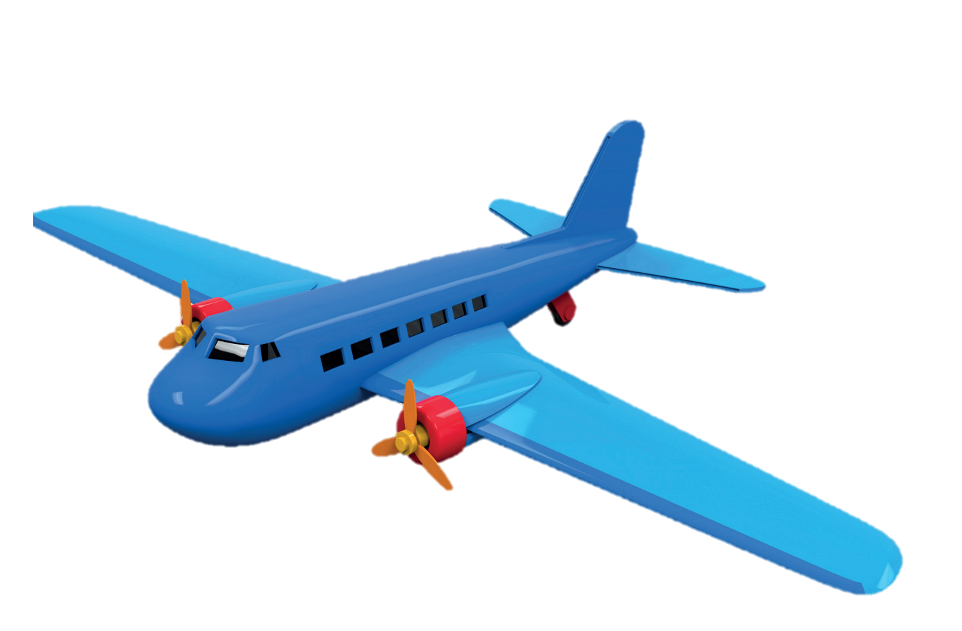
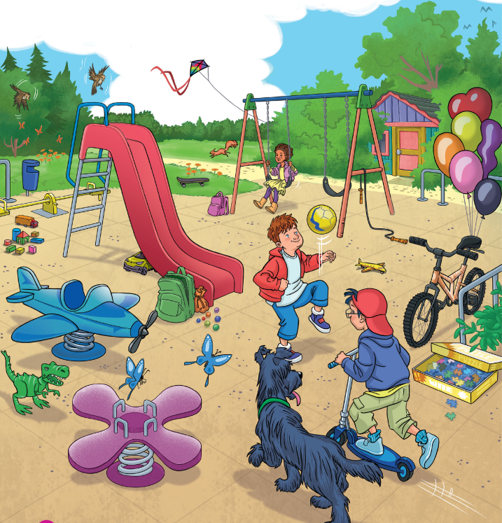
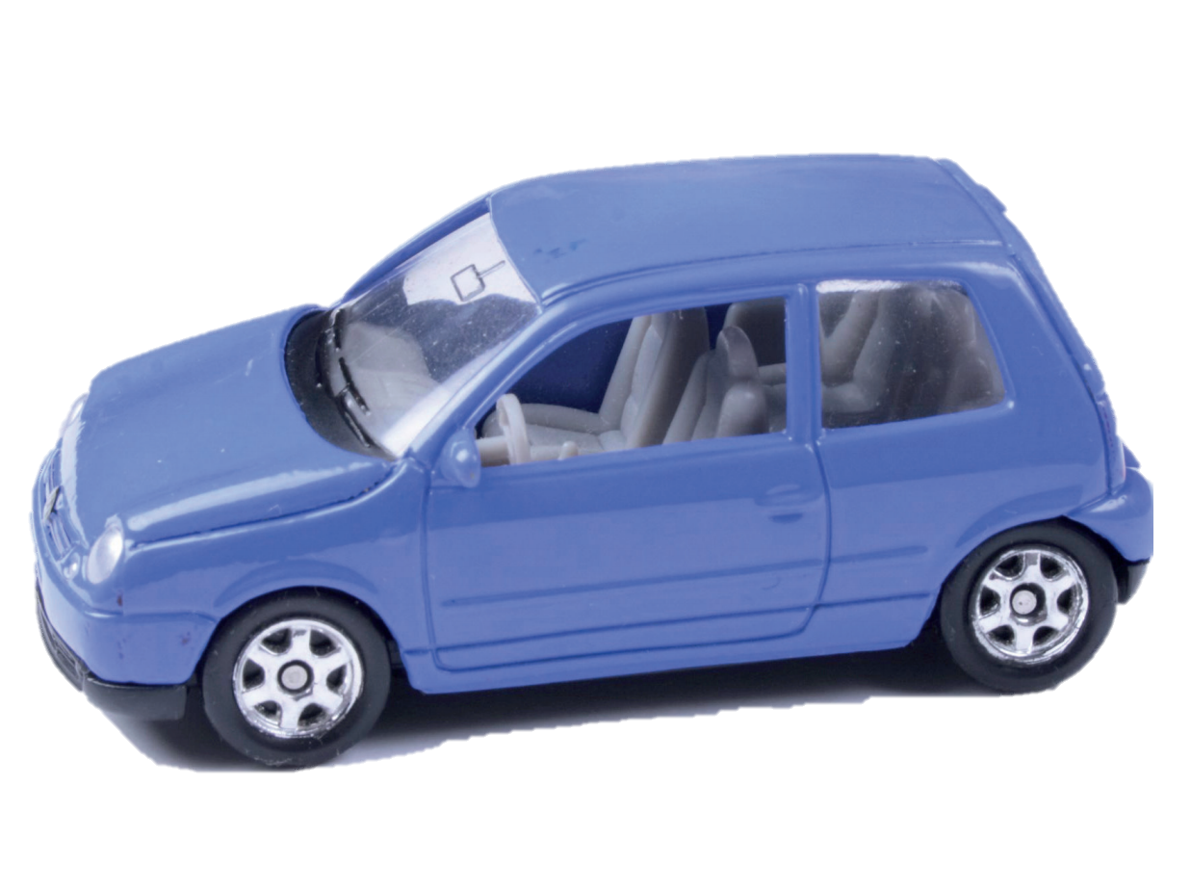

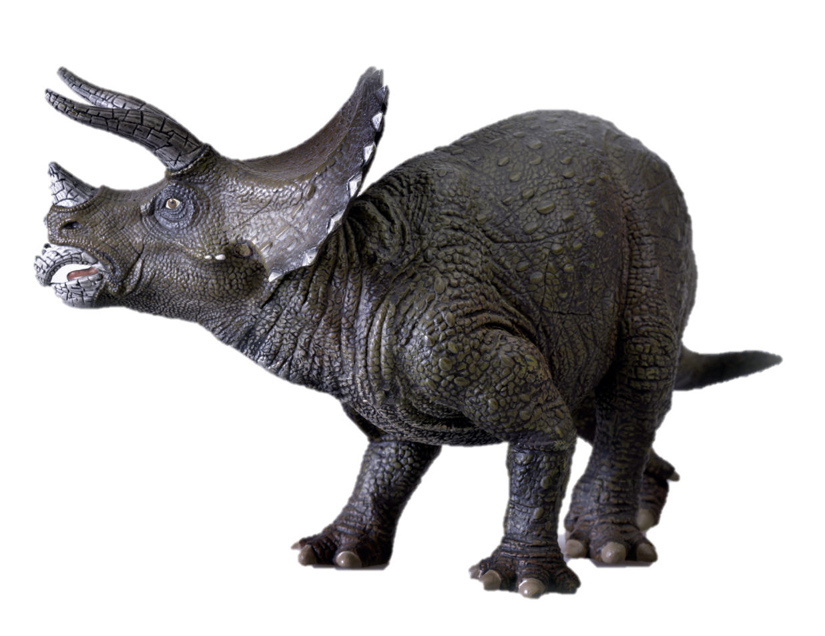
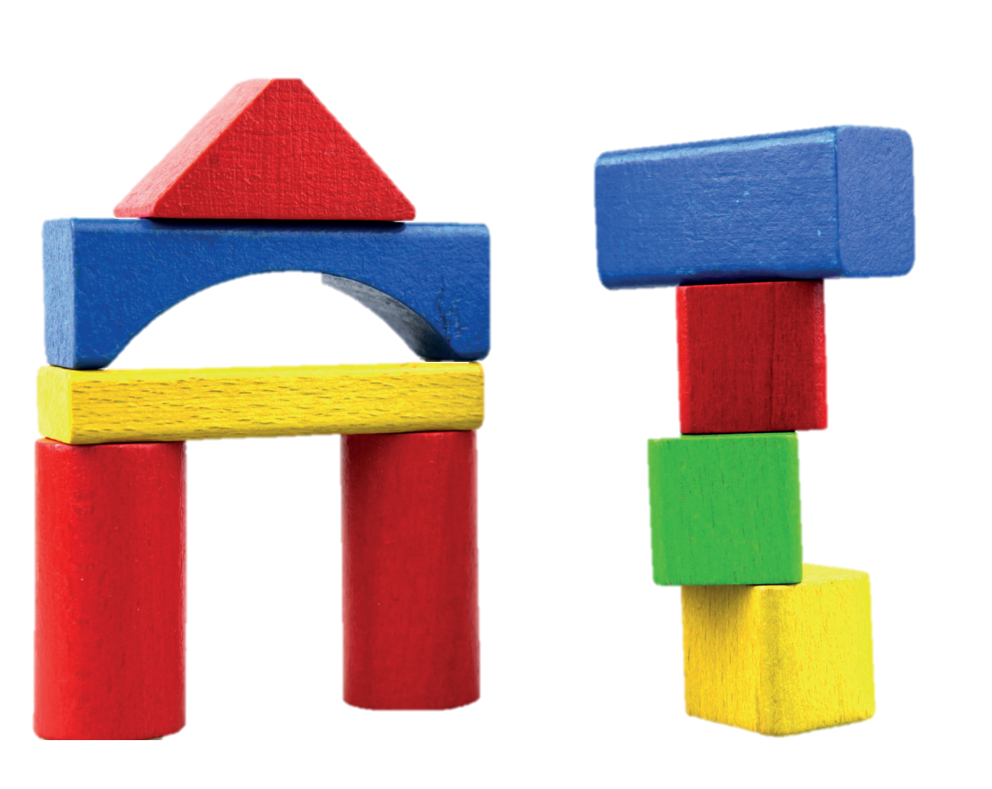
Pupils’ Book (p.20)
Can you see a…?
plane
car
puzzle
dinosaur
building set
Notes:
Ask Ss to look at the poster, show the toys and ask them to find similar images in the poster
Circle the toys in the poster.
Point to the toys in the poster and say the words aloud.

Slide 28
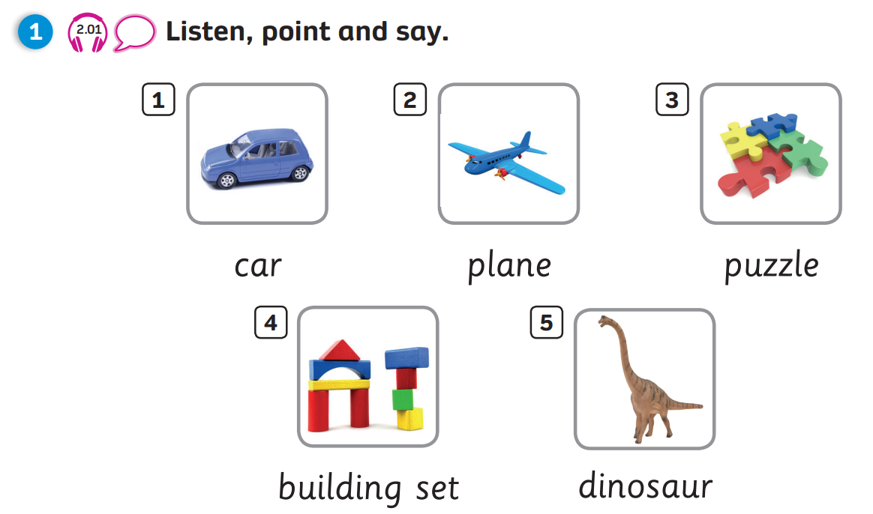
Pupils’ Book (p.21)

Slide 29



PRODUCTION
Draw a toy.
Colour and write.
It’s a ________.
It’s _______________________.
plane
yellow, red, blue and green
Notes:
Have Ss take out notebook or give them paper.
Ask them to draw a toy, colour then write about it.
Show an example for Ss to follow.
Ask Ss to keep their drawing for the next lesson.

Slide 30

WRAP-UP
What’s this?
-> It’s a…
puzzle
plane
building set
car
dinosaur

Slide 31
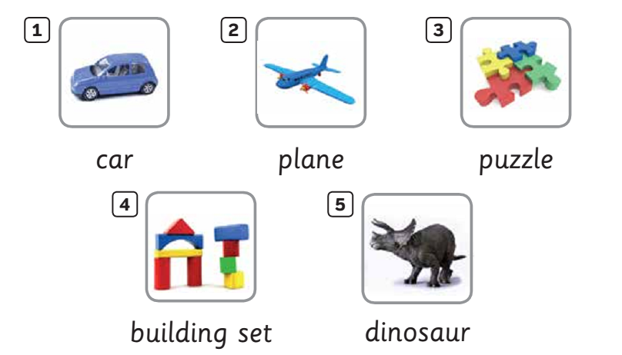

UNIT 2: Lesson 1A
We’ve learnt…

