Slide 1
UNIT 1: HELLO
Lesson 7 – Story

Slide 2
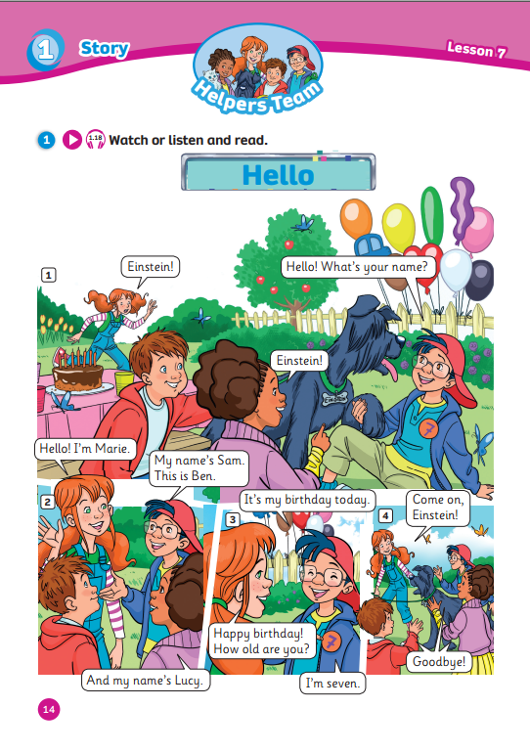
UNIT 1: HELLO
We’re learning…
- Story: Hello
SB p.14 – 15
AB p.14 – 15

Slide 3
Song: Hello, Hello! Can You Clap Your Hands?
WARM-UP
All students stand up.
Listen to the song.
Dance along.

Slide 4
GREETINGS (G) or NUMBERS (N)?
REVIEW: Greetings & Numbers
G
G
N
Nice to meet you!
My name’s Ben.
I’m eight.
N
I’m seven years old.
G
N
Hello! I’m Mai.
What number is it?
G
N
What’s your name?
Number five.
N
How old are you?
Click on the speech bubbles to review the answers
Notes:
Ask Ss to classify which speech bubbles are about greetings and which ones are about numbers

Slide 5
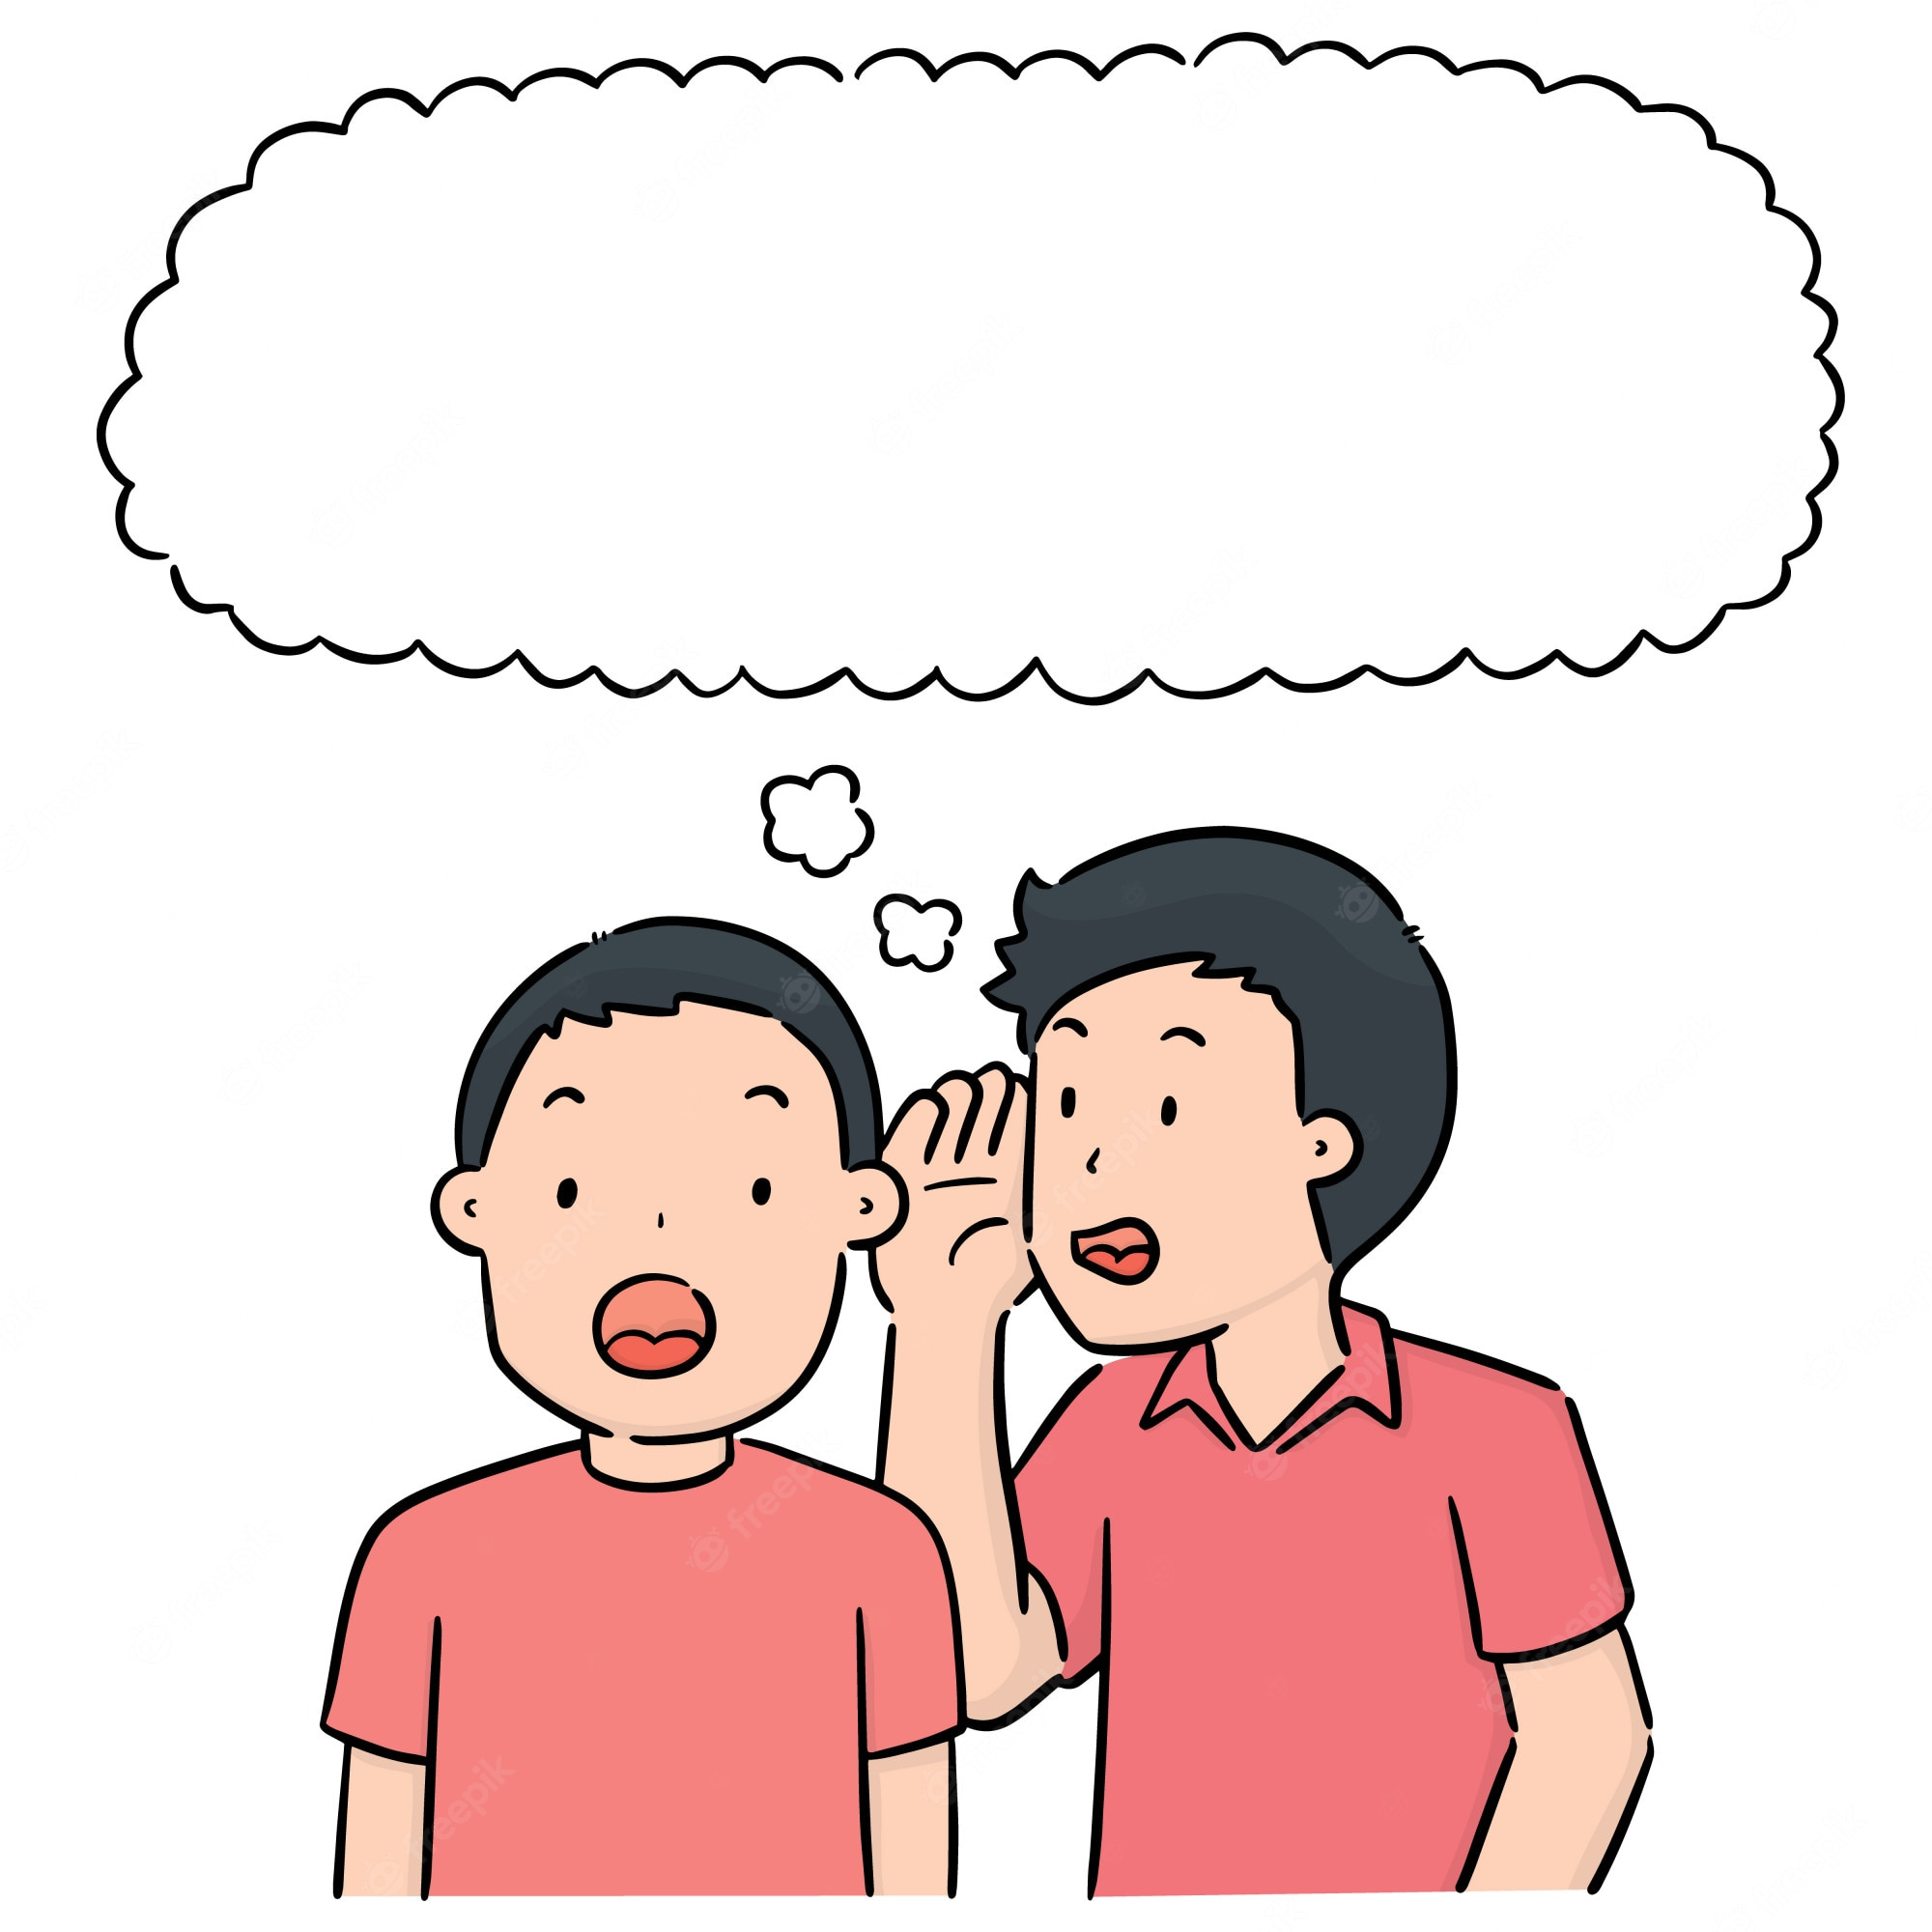
REVIEW: Greetings & Numbers
WHISPER CHALLENGE
RULES
Students line up in teams (4-5 students each line) with their back facing the screen
The first students of each line will turn back and look at the sentence(s)
Students whisper the sentence(s) to the next person
The last student of each team shout out the sentence(s)
The fastest team with the correct answer gets 1 point.
Notes:
Ask Ss to classify which speech bubbles are about greetings and which ones are about numbers

Slide 6
REVIEW: Greetings & Numbers
What’s your name?
WHISPER CHALLENGE
Round 1
Click “Whisper Challenge” to reveal the sentence(s)
Click the grey triangle to move to the next slide

Slide 7
REVIEW: Greetings & Numbers
How old are you?
WHISPER CHALLENGE
Round 2
Click “Whisper Challenge” to reveal the sentence(s)
Click the grey triangle to move to the next slide

Slide 8
REVIEW: Greetings & Numbers
Nice to meet you.
WHISPER CHALLENGE
Round 3
Click “Whisper Challenge” to reveal the sentence(s)
Click the grey triangle to move to the next slide

Slide 9
REVIEW: Greetings & Numbers
My name’s Ben.
I’m eight.
WHISPER CHALLENGE
Round 4
Click “Whisper Challenge” to reveal the sentence(s)
Click the grey triangle to move to the next slide

Slide 10
REVIEW: Greetings & Numbers
Hello! I’m Mai.
I’m seven years old.
WHISPER CHALLENGE
Round 5
Click “Whisper Challenge” to reveal the sentence(s)
Click the grey triangle to move to the next slide

Slide 11
REVIEW: Greetings & Numbers
WELL DONE!
Click the grey triangle to move to the next slide

Slide 12
STORY: Watch the story

Slide 13
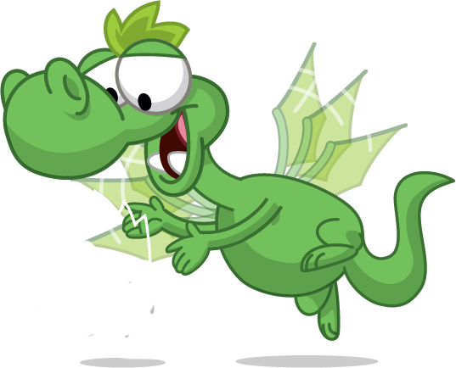
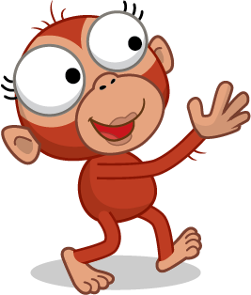
STORY: Vocabulary
Come on, Waldo!
Let’s go to the birthday party.
I’m coming!
birthday
Come on!

Slide 14
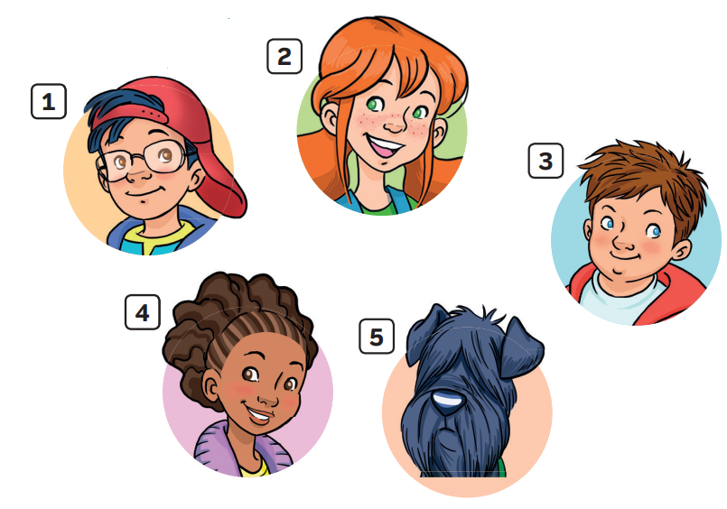
STORY: Introduction
1. What’s the story title?
->
2. How many story frames?
->
3. How many characters?
->
Hello
4 story frames
5 characters
Notes:
Introduce the story to Ss by asking 3 questions
Show the picture of 5 characters and lead in the lesson “Who are these friends? What are their names? Let’s find out!”

Slide 15
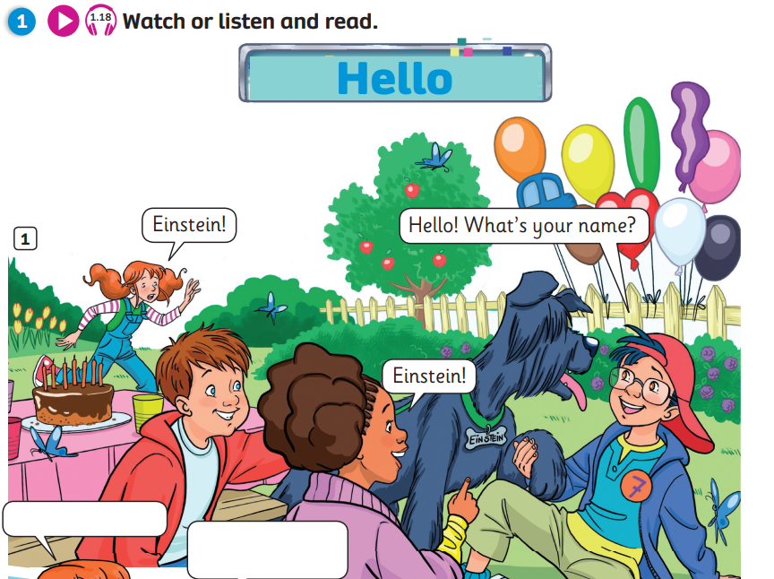
STORY: Gist task
Whose birthday is it today?
Notes:
- Ask Ss to look at the picture and ask questions (e.g. How many friends are there? Where are they? How many balloons are there? What colour are they?) - Tell Ss to listen to the story and answer the question: “Whose birthday is it today?”

Slide 16
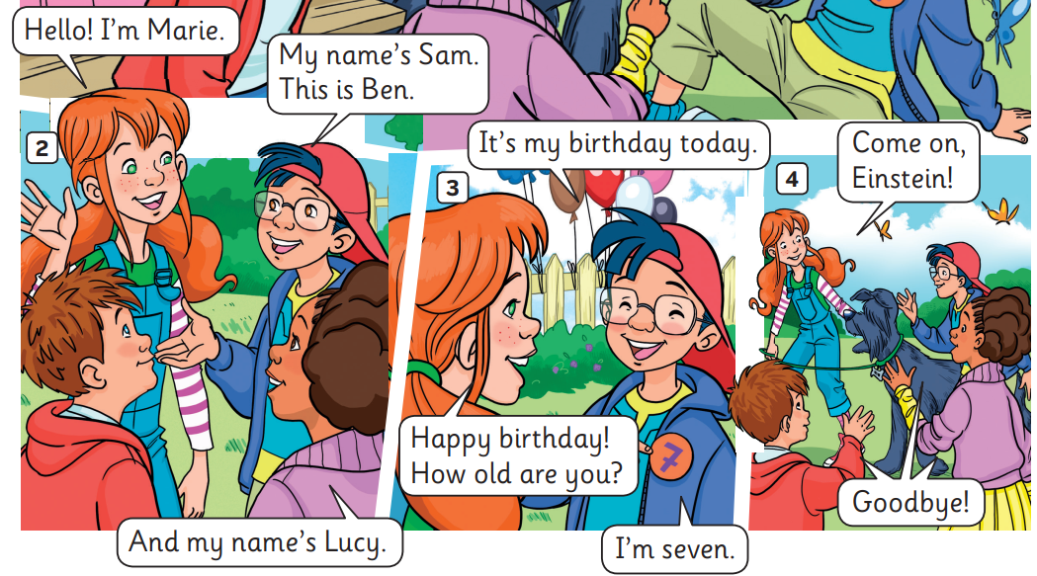
STORY: Gist task
Whose birthday is it today?
Click on Waldo to reveal the answers
Notes:
- Ask Ss to answer the question by raising their finger.

Slide 17
STORY: Comprehension task
Listen and read aloud. Circle the names.
Click on Waldo to reveal the answers
Notes:
Ask Ss to listen one more time. Pause at each line for Ss to read aloud.

Slide 18
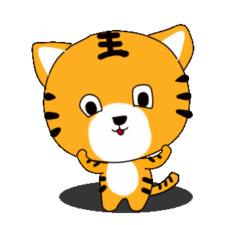
Find The Tiger
Read the questions carefully.
Raise your finger 1, 2 or 3 to answer.
First correct answer = 2 points
Other teams with correct answer = 1 point
Notes:
Tell Ss they are going to help the monkey find the tiger by answering questions.

Slide 19
Question 1: What is his name?
His name’s Sam.
1. Sam
2. Ben
3. Einstein

Slide 20
Question 2: What is her name?
Her name’s Marie.
1. Marie
2. Lucy
3. Einstein

Slide 21
Question 3: What is his name?
His name’s Ben.
1. Sam
2. Einstein
3. Ben

Slide 22
Question 4: What is her name?
Her name’s Lucy.
1. Sam
2. Marie
3. Lucy

Slide 23
Question 5: What is its name?
Its name’s Einstein.
1. Einstein
2. Ben
3. Marie

Slide 24
Question 6: How old is Sam?
6
He’s seven.
1. seven
2. six
3. eight

Slide 25
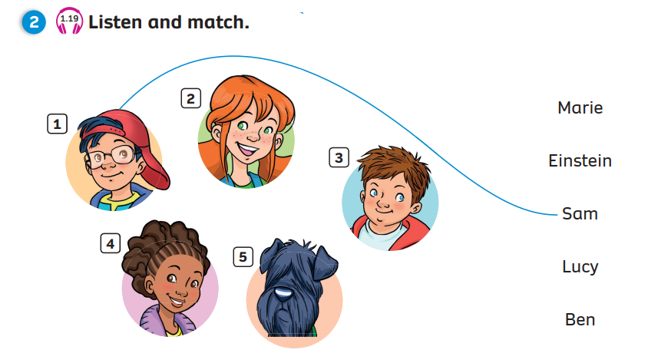
Pupils’ Book (p.15)
Match
Click on “Match” to reveal the answers

Slide 26
Pupils’ Book (p.15)
1
2
Click on the numbers “1, 2” to reveal the answers

Slide 27
Pupils’ Book (p.15)
INSTRUCTIONS
Students work in groups of 5
Each student play a character in the story
Sam
Marie
Ben
Lucy
Einstein
Listen to EACH SECTION OF the story and practice DUBBING the story in groups
Volunteer to dub the story in front of the class WITHOUT THE AUDIO

Slide 28
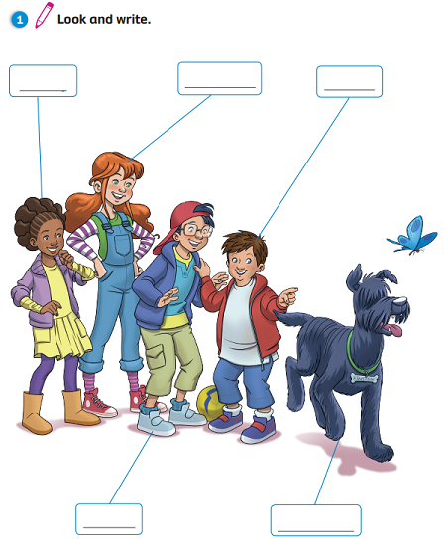
Activity Book (p.14)
Write
Lucy
Marie
Ben
Sam
Einstein
Click on “Write” to reveal the answers

Slide 29
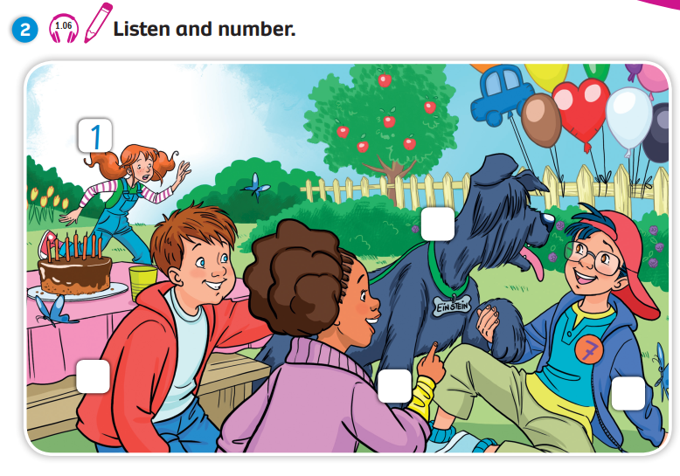
Activity Book (p.14)
5
3
4
2

Slide 30
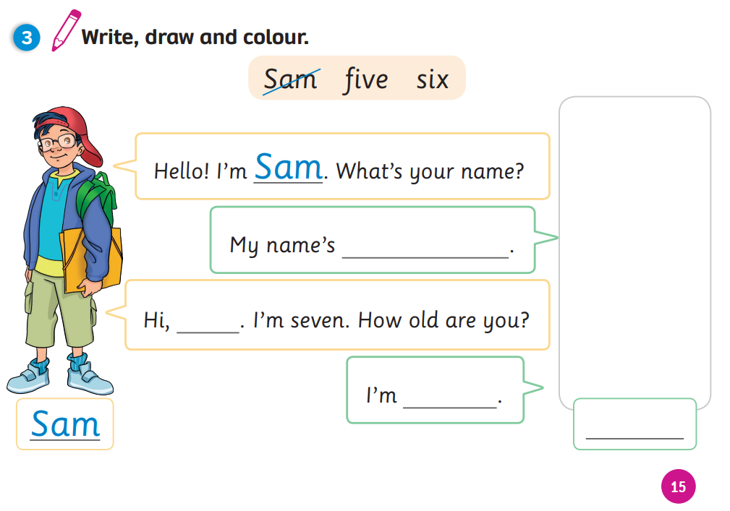
Activity Book (p.14)
Write
Ola
Ola
eight
Ola

Slide 31
WRAP-UP
Story: Hello
5 characters: Sam, Marie, Ben, Lucy, Einstein
Today is Sam’s birthday. He’s seven.
Notes:
Introduce the story to Ss by asking 3 questions
Show the picture of 5 characters and lead in the lesson “Who are these friends? What are their names? Let’s find out!”

Slide 32
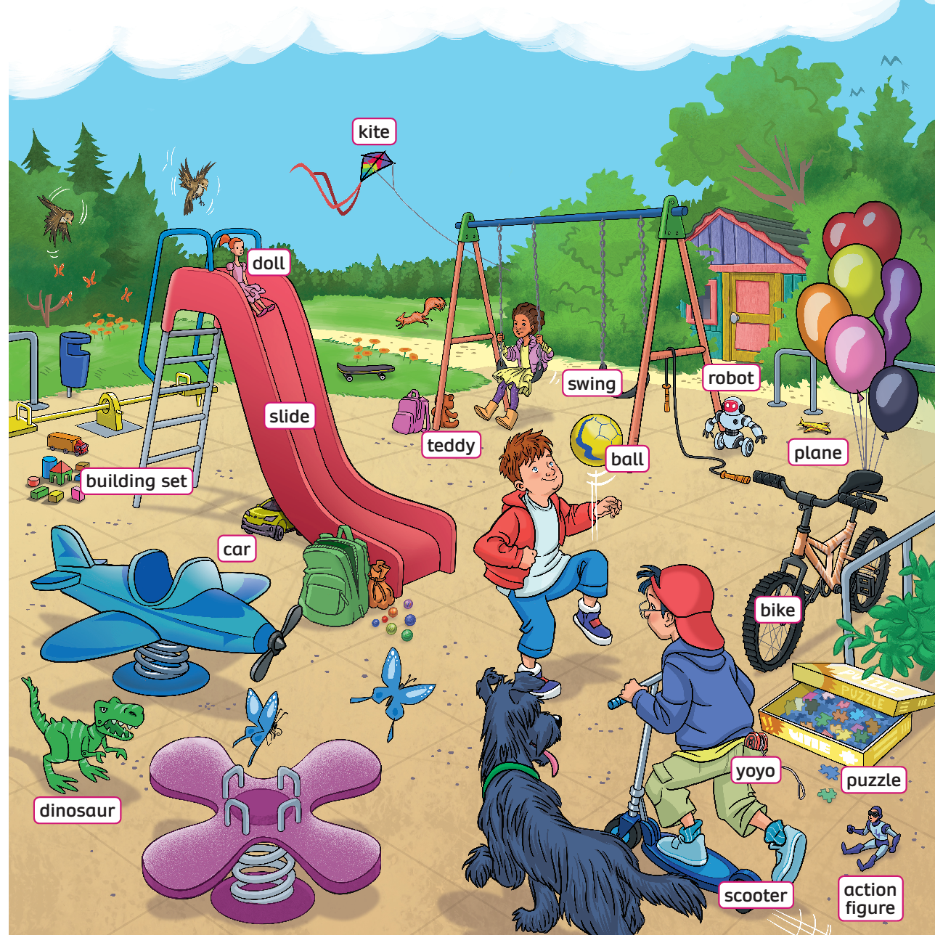
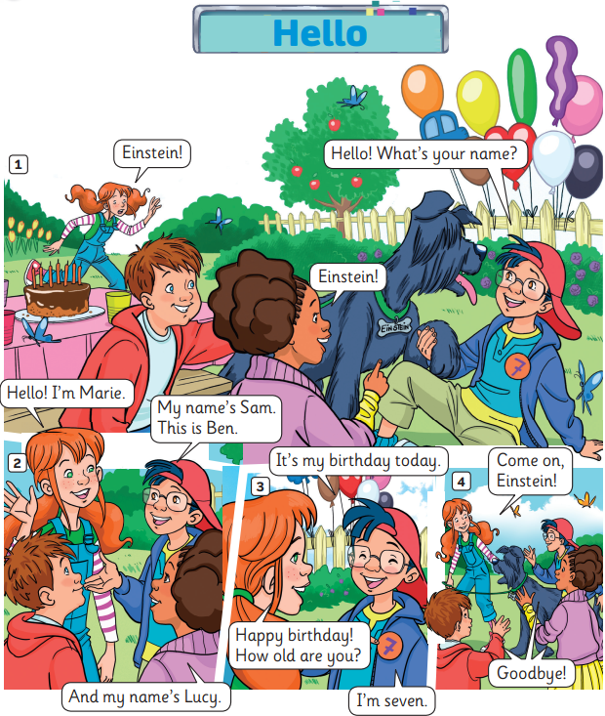
UNIT 2: Lesson 1
We’ve learnt…

