Slide 1

UNIT 1: HELLO
Lesson 6 – Review

Slide 2
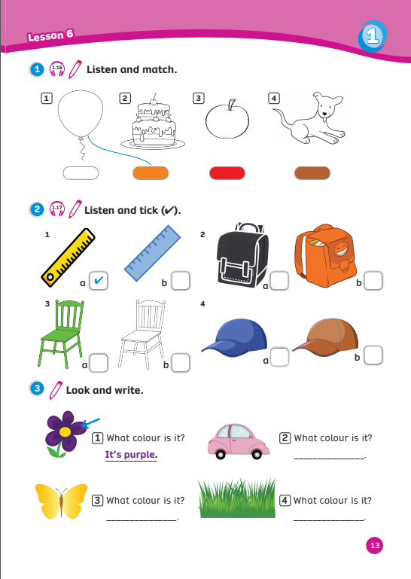
UNIT 1: HELLO
We’re reviewing…
- colours
- to ask and answer about colours
SB p.13
AB p.13

Slide 3


Song: Colorful fruits
WARM-UP
All students stand up.
Listen to the song.
Dance along.

Slide 4
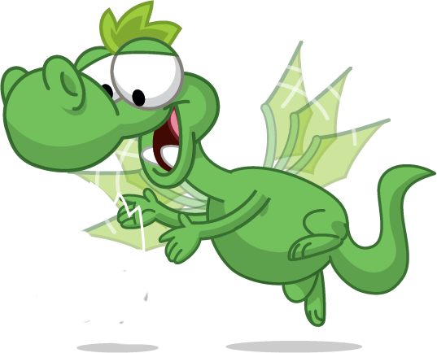
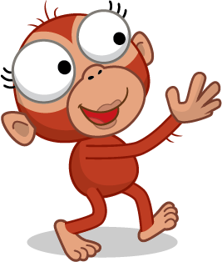
REVIEW: Colours
What colour is it?
It’s …
red
yellow
green
orange
white
Notes:
Show the picture and ask “What colour is it?”
Show the word and have students answer “It’s …”

Slide 5



Find The Tiger
RULES
Choose the correct answer of the colour.
Raise your finger 1, 2 or 3 to answer.
First correct answer = 2 points
Notes:
Tell Ss they are going to help the monkey find the tiger by answering questions.

Slide 6





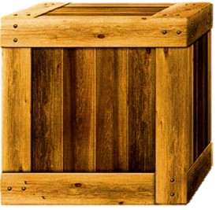
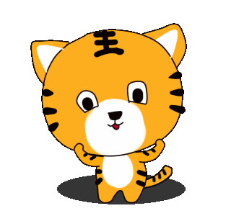

1. What colour is it?
It’s yellow.
1. yellow
2. green
3. red

Slide 7
2. What colour is it?
It’s green.
1.
orange
2.
white
3.
green

Slide 8
3. What colour is it?
It’s red.
1. red
2. white
3. green

Slide 9
4. What colour is it?
It’s orange
1.
orange
2.
white
3.
red

Slide 10
5. What colour is it?
It’s white.
1.
green
2.
red
3.
white

Slide 11
WELL DONE
Notes:
Tell Ss they are going to help the monkey find the tiger by answering questions.

Slide 12

REVIEW: Grammar
What is it?
It’s a balloon.
What colour is it?
It’s red.
Notes:
Have Ss recall the conversation between Ola & Waldo
Get some of the Ss to role play the conversation.

Slide 13
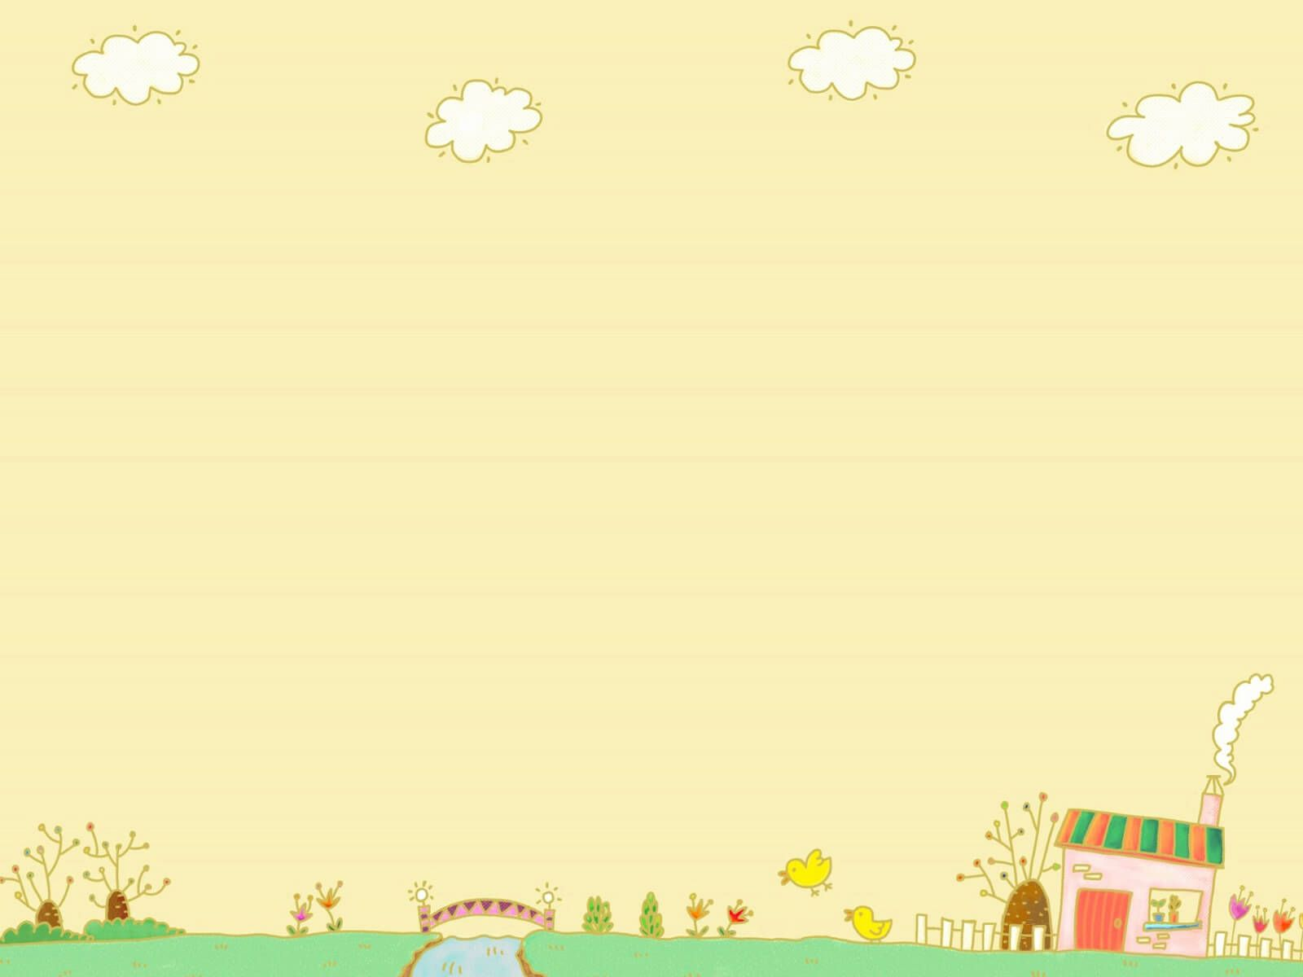

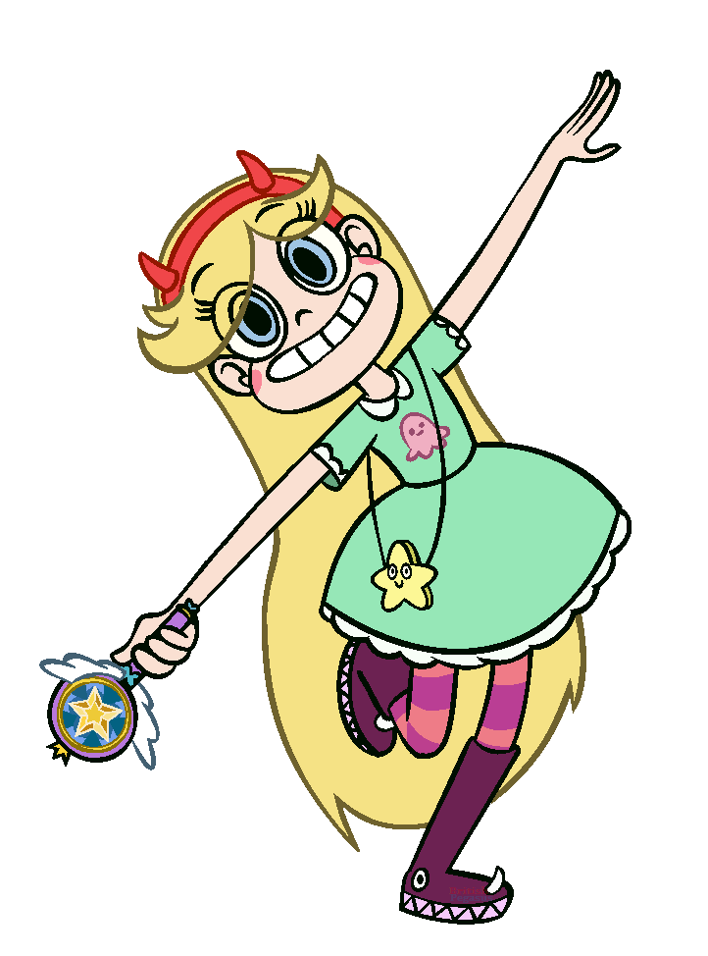
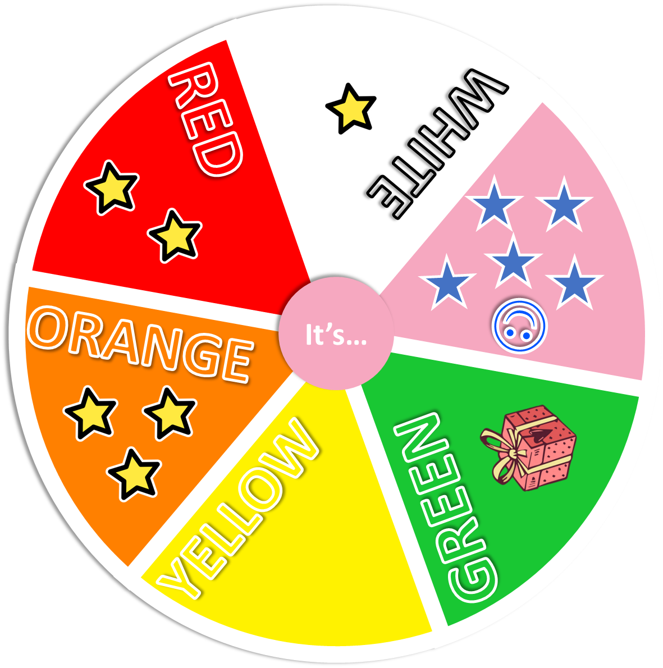

RULES
2 students take turn to spin and stop the wheel
Ask and answer about the colours on the wheel
Get points on the wheel with each correct answer
Note:
- Click the pink circle in the middle to run and stop the wheel
- A present =
give other team 1 point
Colour Wheel
What colour is it?
Notes:
Game: The Colour Wheel
Introduce the colour wheel
Have Ss say aloud all the colours on it
Ask the question, spin the wheel then stop and have Ss answer the colour at which the hand point (spell the words if necessary)
Invite some students to be the teacher, ask the class and spin the wheel

Slide 14


qa
Colour Wheel
RED
WHITE
What colour is it?
It’s…
☺
ORANGE
YELLOW
GREEN
Click the pink circle “It’s…” to spin and stop the wheel
Notes:
Game: The Colour Wheel
Introduce the colour wheel
Have Ss say aloud all the colours on it
Ask the question, spin the wheel then stop and have Ss answer the colour at which the hand point (spell the words if necessary)
Invite some students to be the teacher, ask the class and spin the wheel

Slide 15
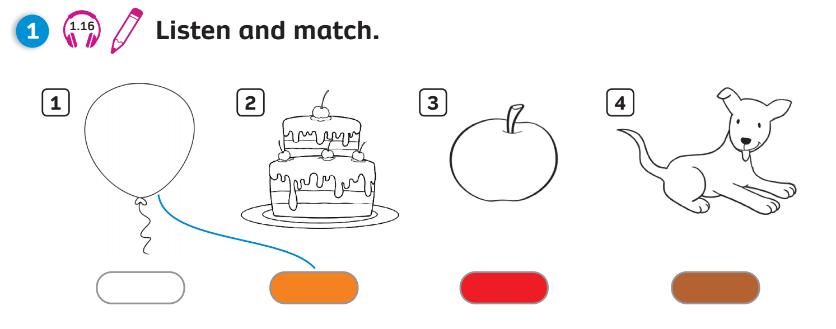



Pupils’ Book (p.13)
1
2
3
4
Click on the numbers “1, 2, 3, 4” to reveal the answers

Slide 16
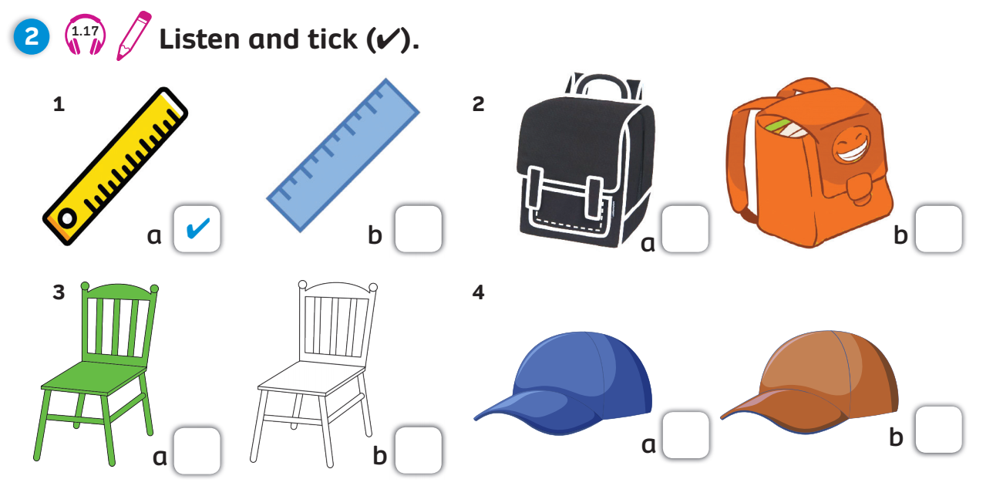

Pupils’ Book (p.13)
1
2
3
4
Click on the numbers “1, 2, 3, 4” to reveal the answers

Slide 17
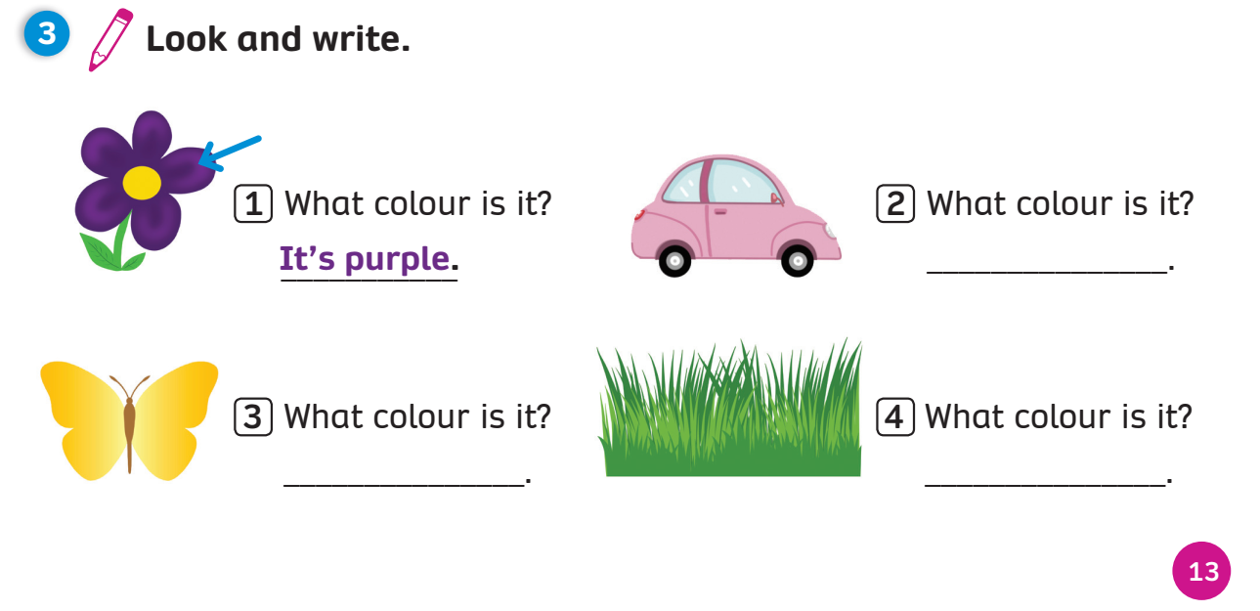
Pupils’ Book (p.13)
1
2
It’s pink
3
4
It’s yellow
It’s green
Click on the numbers “1, 2, 3, 4” to reveal the answers

Slide 18
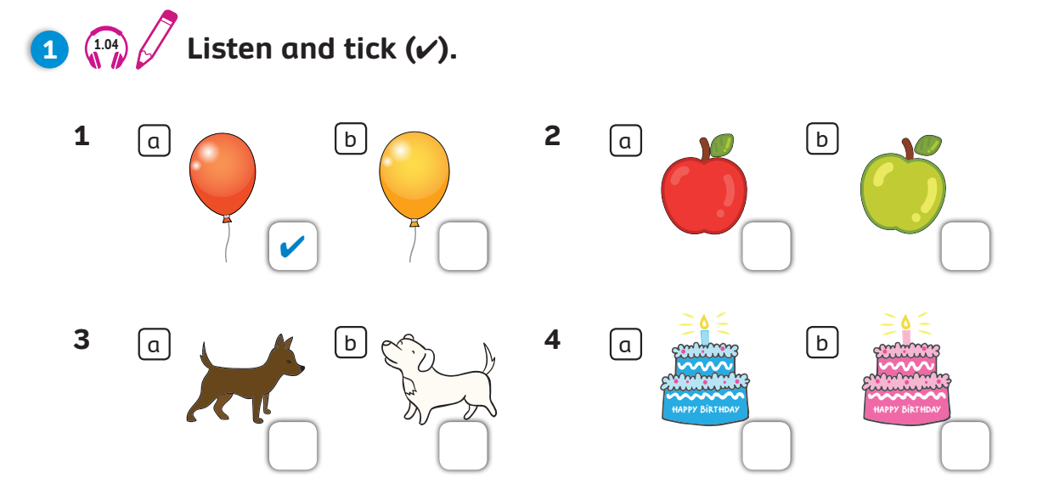

1
2
3
4

Slide 19
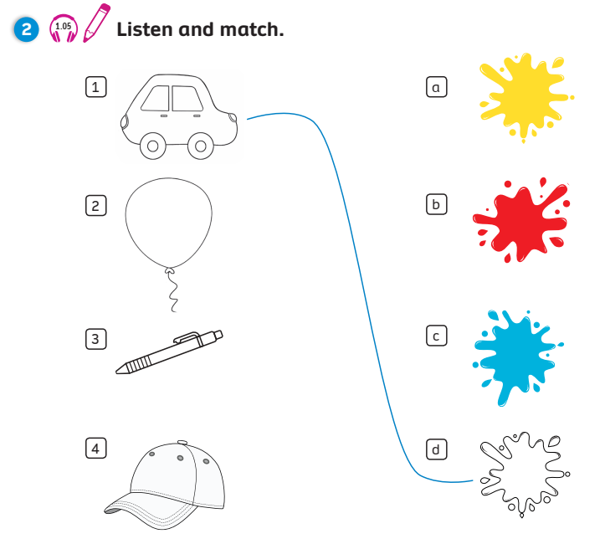
Activity Book (p.13)
1
2
3
4

Slide 20
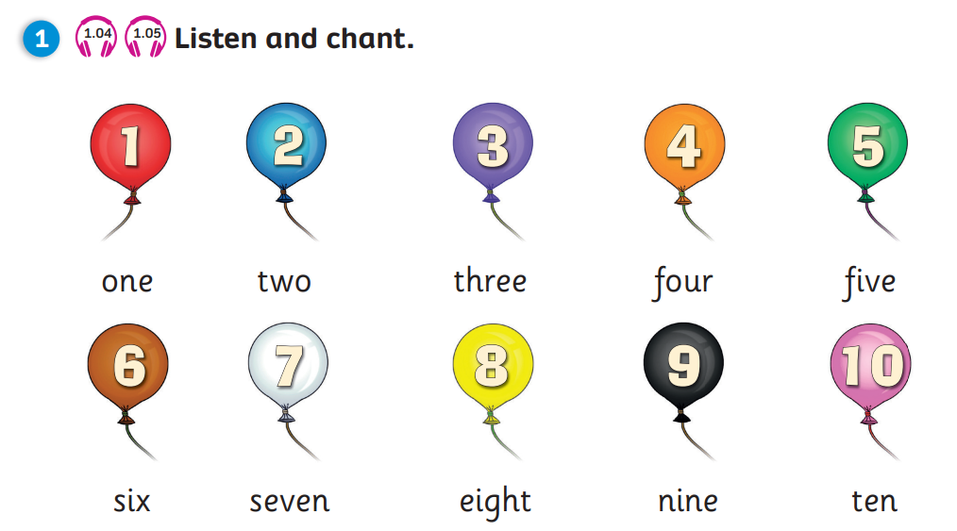


WRAP-UP
How old are you?
-> I’m … years old.
Notes:
Ask the question
Show the pictures and have students say aloud the answer

Slide 21
WRAP-UP
What colour is it?
- It’s …
red
yellow
green
white
orange

Slide 22
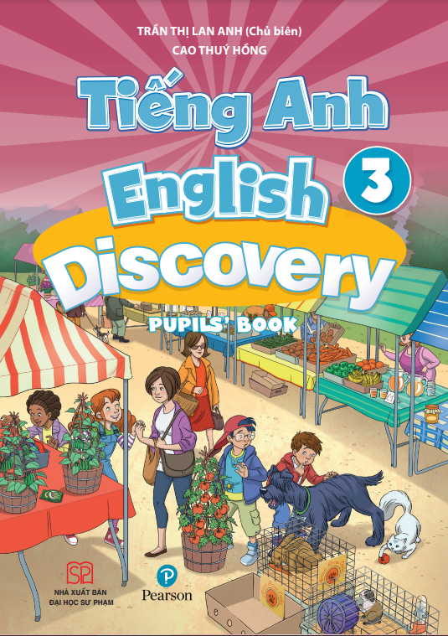
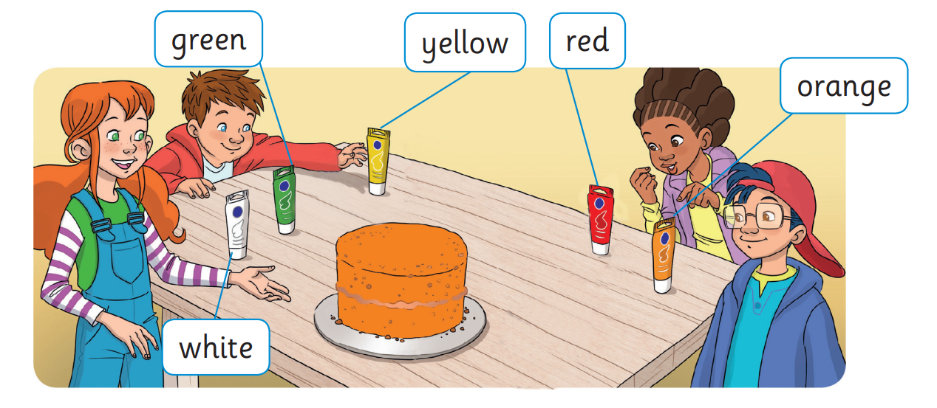

UNIT 1: Lesson 6
We’ve reviewed…

