Slide 1
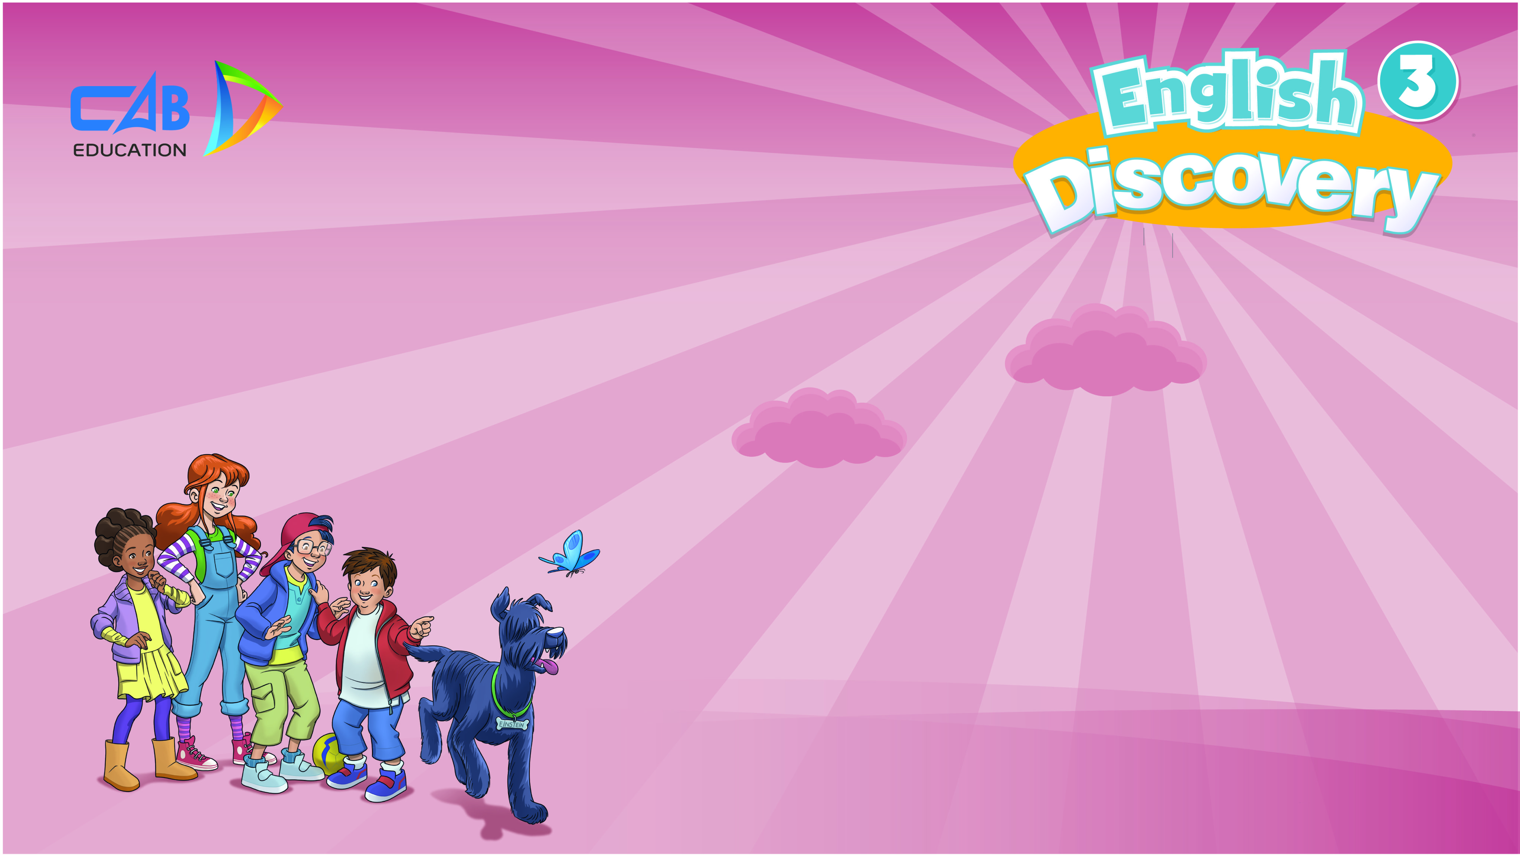
UNIT 1: HELLO
Lesson 5 – Vocabulary

Slide 2
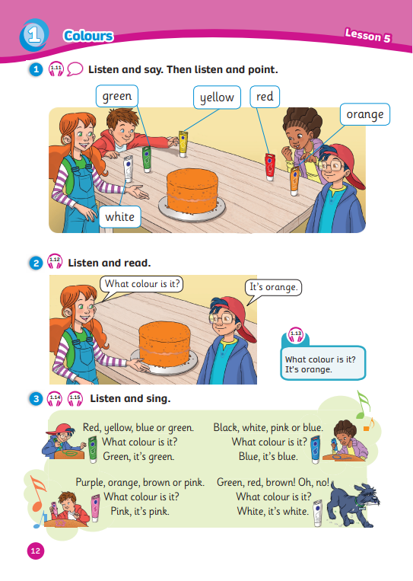
UNIT 1: HELLO
We’re learning…
- colours
- to ask and answer about colours
SB p.12
AB p.12

Slide 3


Song: Colorful fruits
WARM-UP
All students stand up.
Listen to the song.
Dance along.

Slide 4
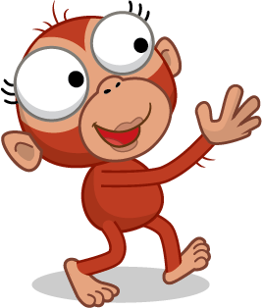

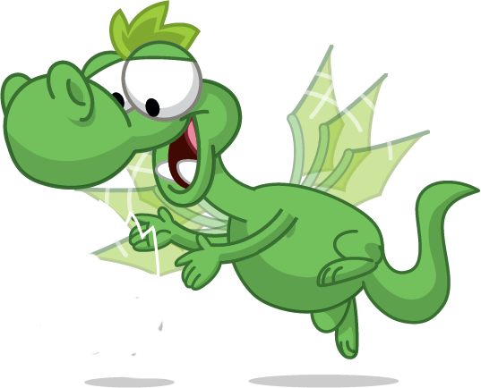
VOCABURALY: Colours
What colour is it?
It’s …
red

Slide 5
VOCABURALY: Colours
What colour is it?
It’s …
yellow

Slide 6
VOCABURALY: Colours
What colour is it?
It’s …
green

Slide 7
VOCABURALY: Colours
What colour is it?
It’s …
orange

Slide 8
VOCABURALY: Colours
What colour is it?
It’s …
white

Slide 9
VOCABURALY: Colours
What colour is it?
It’s …
red
yellow
green
orange
white
Notes:
Show the picture and ask “What colour is it?”
Show the word and have students answer “It’s …”

Slide 10

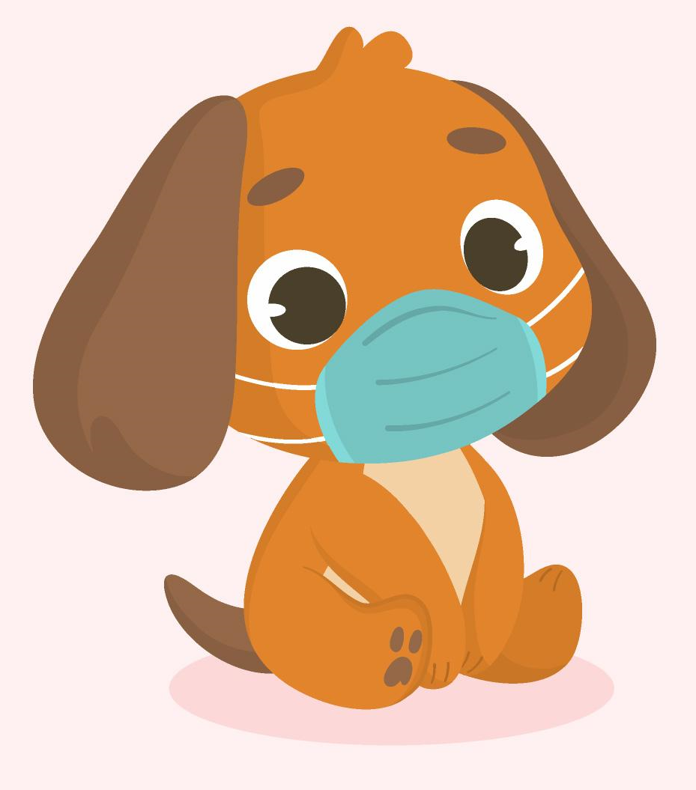
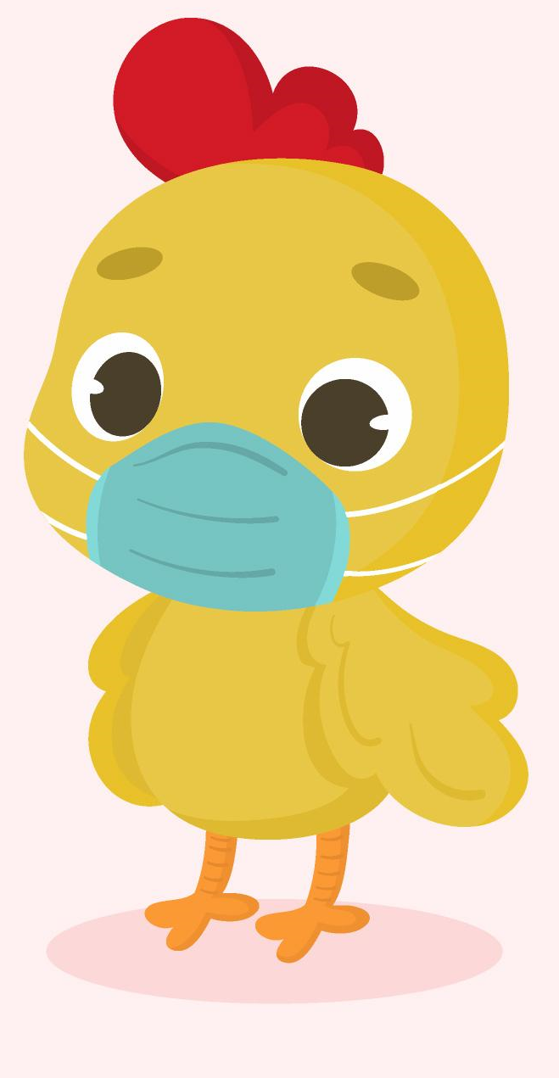
RULES
All students read pictures in sequence.
1 student finds the missing pictures.
Students get stars for each correct answer.
The whole class repeats the vocabulary.
What is
missing?
?
2m
2m
2m
2m
2m

Slide 11

QUESTION 1
?
What is
missing?
orange
Click the chicken TWICE to reveal the answers and points

Slide 12
QUESTION 2
?
What is
missing?
white
Click the chicken TWICE to reveal the answers and points

Slide 13
QUESTION 3
?
What is
missing?
green
Click the chicken TWICE to reveal the answers and points

Slide 14
QUESTION 4
?
What is
missing?
yellow
Click the chicken TWICE to reveal the answers and points

Slide 15
QUESTION 5
?
What is
missing?
orange
Click the chicken TWICE to reveal the answers and points

Slide 16
QUESTION 6
?
What is
missing?
red
Click the chicken TWICE to reveal the answers and points

Slide 17

GRAMMAR
What is it?
It’s a balloon.
What colour is it?
It’s red.
Notes:
Set the scene
Introduce Ola and Waldo: Ola walks in with a balloon on her hand, Waldo flies in and gets curious about the thing Ola is holding.
Show the speech bubbles
Ask Ss to guess how Ola would answer Waldo’s questions
Have students tell how to ask and answer about colours

Slide 18


FIND THE TREASURE

Slide 19







Rules
All students say aloud the question.
2 students chooses the answer and say it aloud.
Students raises their fingers to guess where the treasure is.
Each team gets 2 stars if they can find the treasure.
Note:
- Click the mouse or press the arrow keys to mix the stars.
- Click on stars to show the bomb or the treasure

Slide 20

FIND THE TREASURE
What colour is it?
It’s …
red
yellow
orange

Slide 21





Where is the treasure?
1
2
3

Slide 22

FIND THE TREASURE
What colour is it?
It’s …
white
green
black

Slide 23
Where is the treasure?
1
2
3

Slide 24

FIND THE TREASURE
What colour is it?
It’s …
purple
white
blue

Slide 25
Where is the treasure?
1
2
3

Slide 26

FIND THE TREASURE
What colour is it?
It’s …
red
pink
purple

Slide 27
Where is the treasure?
1
2
3

Slide 28

FIND THE TREASURE
What colour is it?
It’s …
brown
orange
yellow

Slide 29
Where is the treasure?
1
2
3

Slide 30

FIND THE TREASURE
What colour is it?
It’s …
red and green
green and white
green and orange

Slide 31

Where is the treasure?
1
2
3

Slide 32
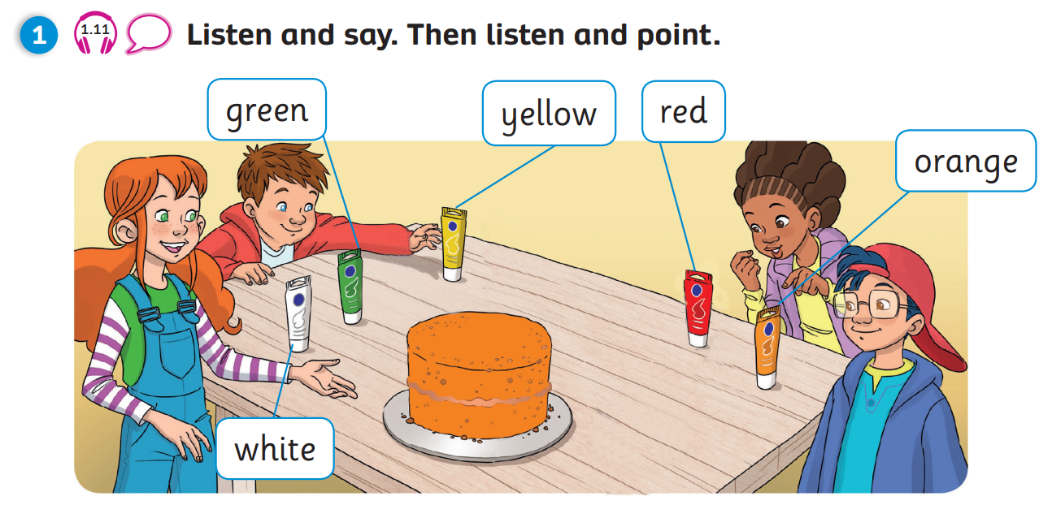
Pupil’s Book (p.12)

Slide 33
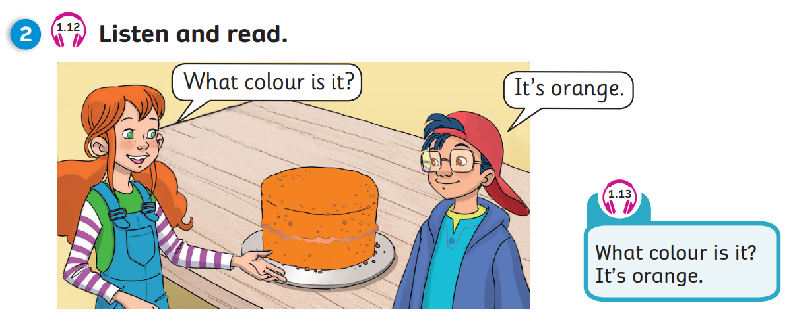
Pupil’s Book (p.12)

Slide 34

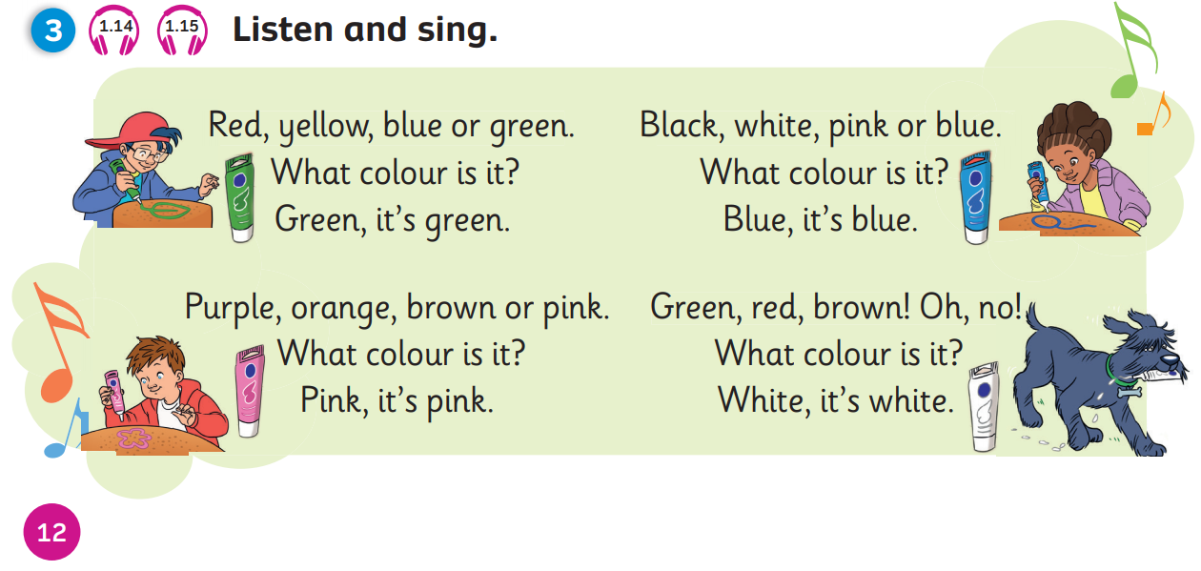
Pupil’s Book (p.12)
Click on the icons 1.14 or 1.15 to play the audios

Slide 35
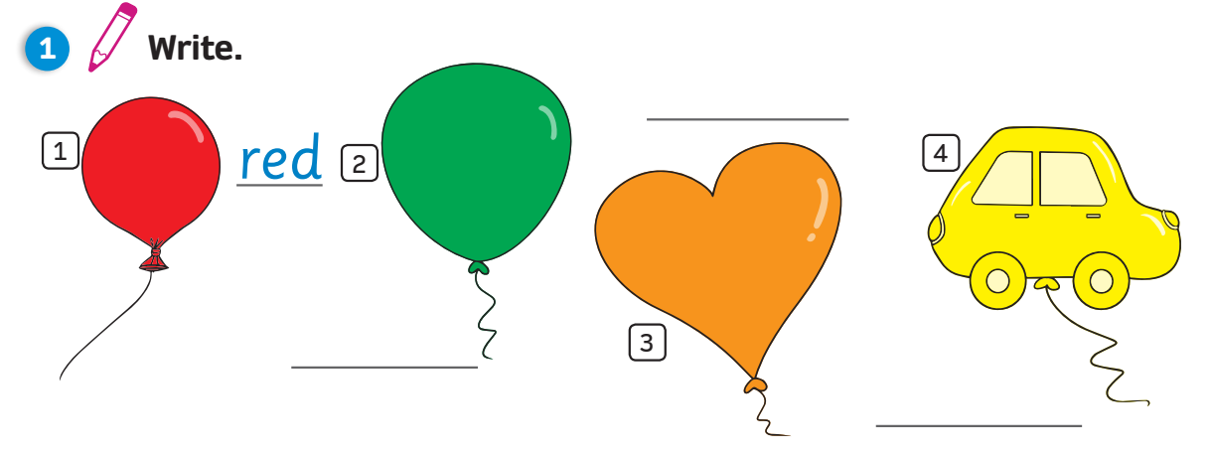
Activity Book (p.12)
orange
1
red
2
4
green
3
yellow
Click on numbers “1, 2, 3, 4” to reveal the answers

Slide 36
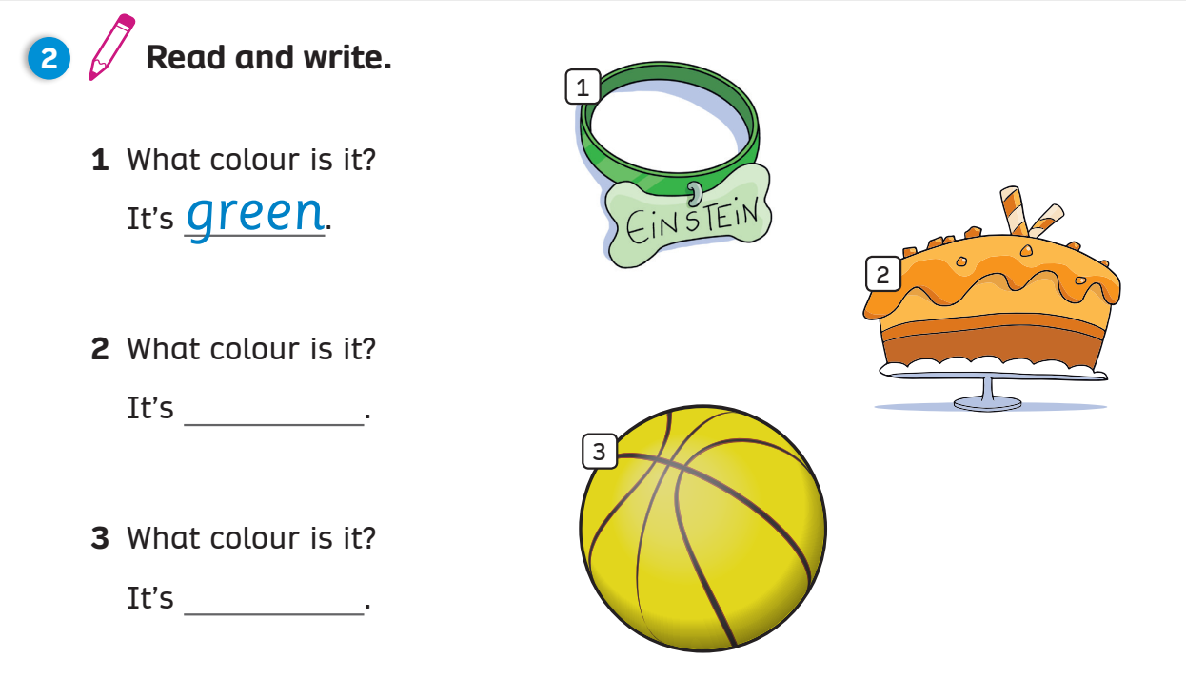

Activity Book (p.12)
1
green
2
orange
3
yellow

Slide 37
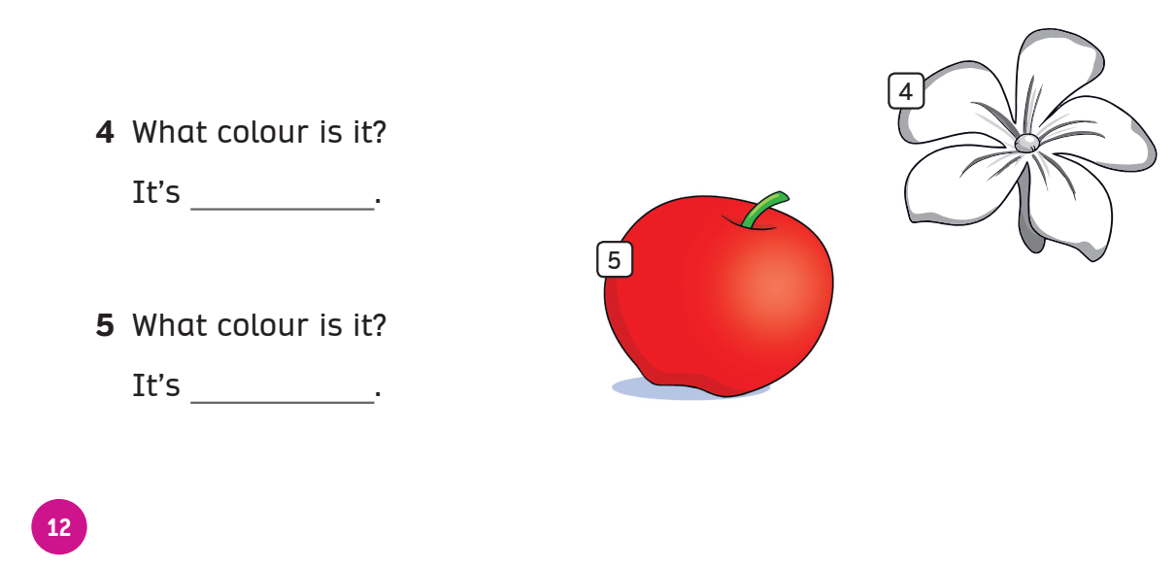
Activity Book (p.12)
4
white
5
red

Slide 38
WRAP-UP
What colour is it?
It’s …
red
yellow
green
orange
white
Notes:
Show the picture and ask “What colour is it?”
Show the word and have students answer “It’s …”

Slide 39
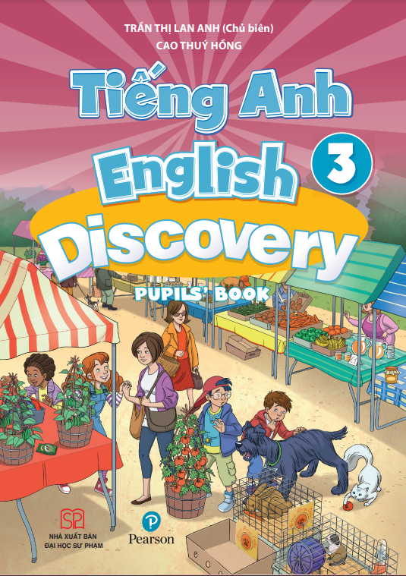
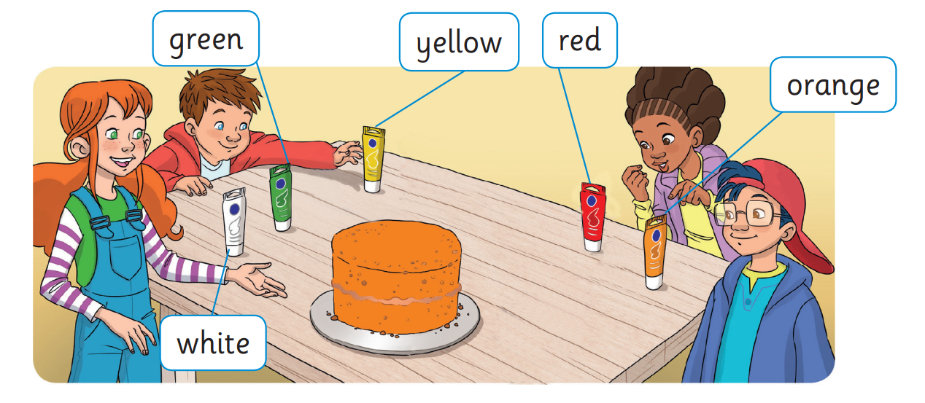

UNIT 1: Lesson 5
We’ve learned…

