Slide 1

UNIT 1: HELLO
Lesson 4 – Phonics

Slide 2
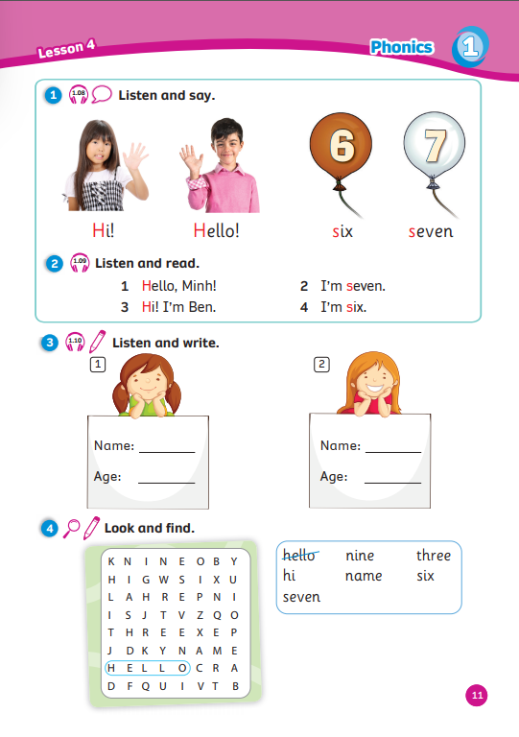
UNIT 1: HELLO
We’re learning…
sounds /h/ & /s/
words starting with /h/ & /s/
SB p.11
AB p.11

Slide 3
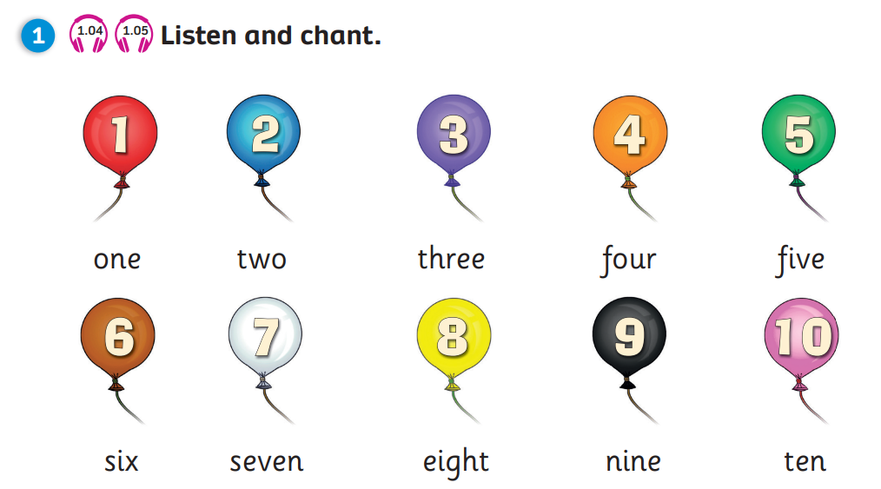


REVIEW: Ages
How old are you?
-> I’m … years old.
Notes:
Ask Ss to recall how to ask and answer about ages
Show the pictures and have students say aloud the answer

Slide 4





RULES
Choose a key and answer a question to open a treasure chest.
If the chest is empty, you get nothing.
If the chest has gold, you get 1 point for a correct answer.
Play

Slide 5







1
2
3
4
5
6
7
8
1
2
3
4
5
6
7
8
1
2
3
4
5
6
7
0
8
1
0
2
3
4
5
6
7
8
0
Exit

Slide 6




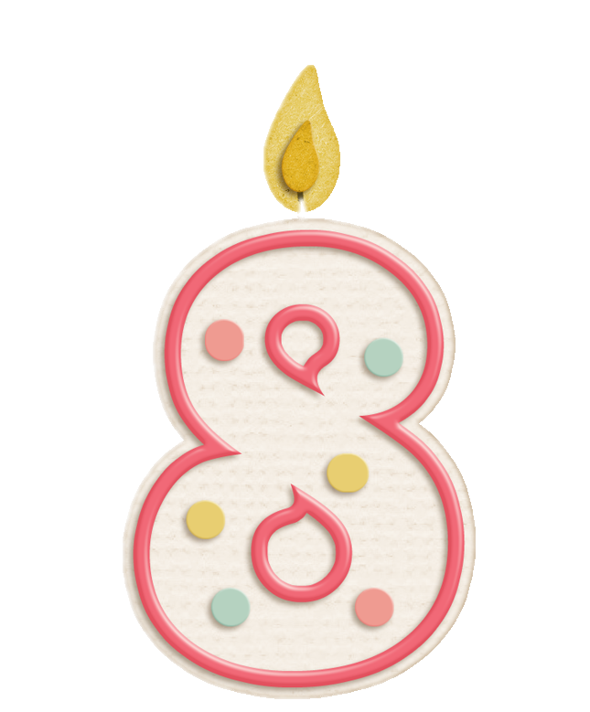
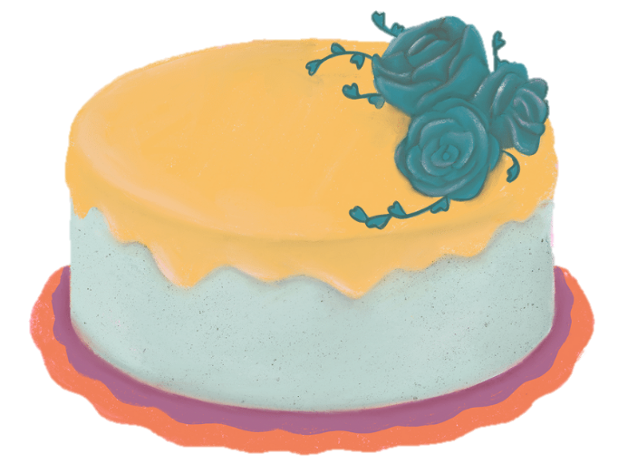
A
I’m eight years old.
How old are you?
B
I’m seven years old.
C
I’m six years old.
Back

Slide 7

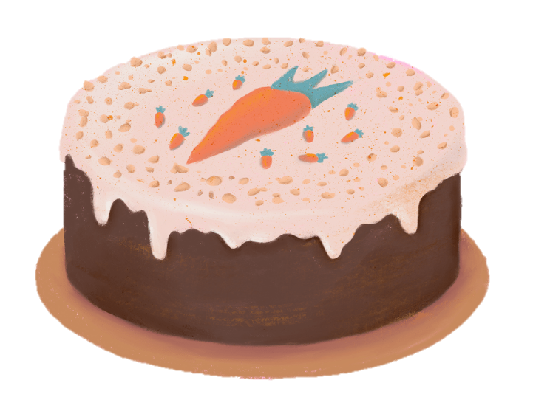
A
I’m three years old.
How old are you?
B
I’m four years old.
C
I’m five years old.
Back

Slide 8

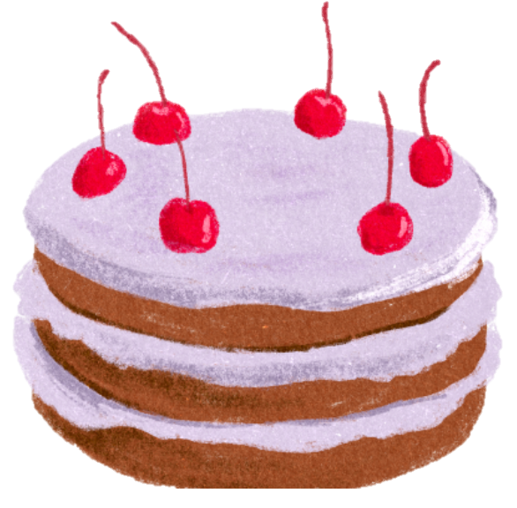
A
I’m three years old.
How old are you?
B
I’m five years old.
C
I’m seven years old.
Back

Slide 9



A
I’m ten.
How old are you?
B
I’m ten years old.
C
A & B are correct.
Back

Slide 10
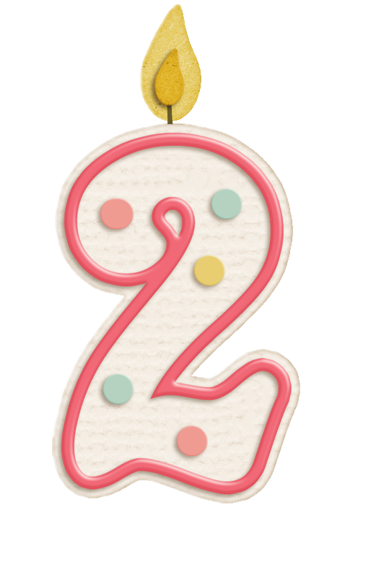
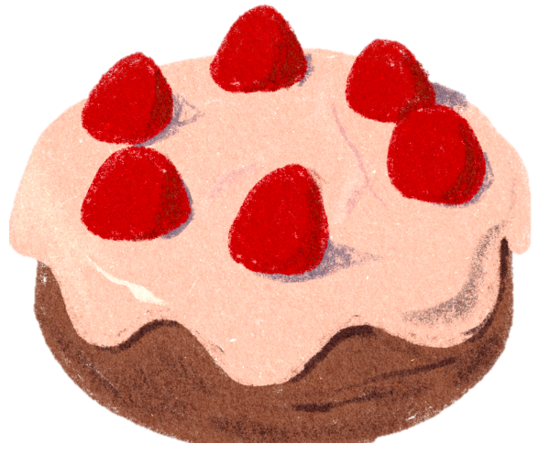
A
I’m two.
How old are you?
B
I’m too.
C
I’m two year old.
Back

Slide 11


A
I’m nine year old.
How old are you?
B
I’m nine years old.
C
I’m nice years old.
Back

Slide 12

A
I’m three.
How old are you?
B
I’m two.
C
I’m one.
Back

Slide 13


LEAD-IN
Song: Phonics Song
Stand up.
Listen to the song.
Clap your hands and sing along.

Slide 14
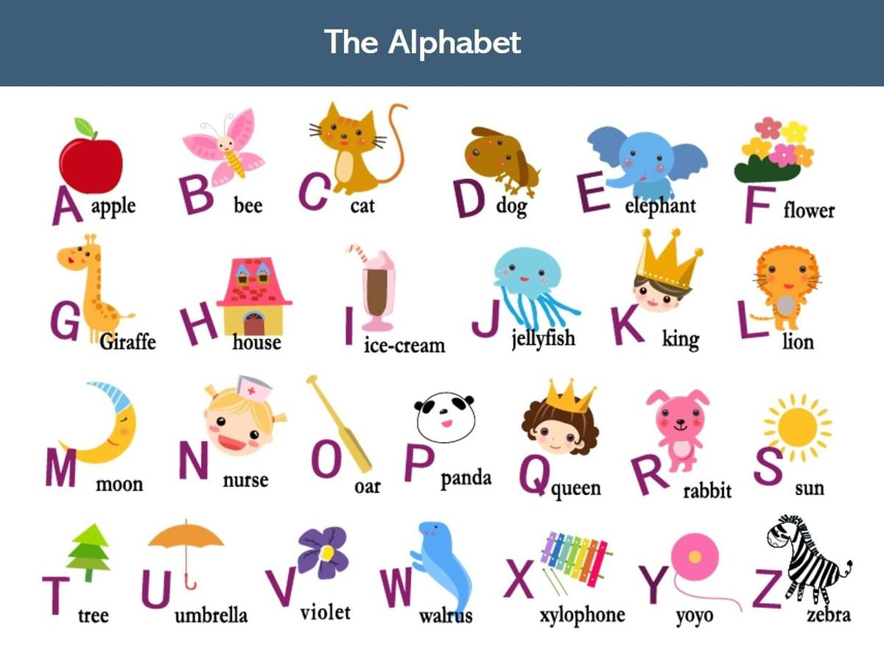



LEAD-IN
This is the Alphabet.
How many letters?
26 letters
Look.
Say the letters.
H
S
CHECK

Slide 15

Sound /h/
Letter
Sound
h | h
H
i!
H h
/h/
Notes:
Show the letter, ask “What letter is it?” and have Ss answer “Letter H”
Show the sound, “What is the sound?” and have Ss answer “Sound /h/”
Show the sound in red, say aloud and have Ss repeat the sounds 3 time after each “Click”
Show the word, say aloud and have Ss repeat
Show the picture and have Ss say “h, h, Hi!”
Have Ss say aloud one more time in rhythm“ Letter Hh, Sound /h/, h… h… h… Hi!”

Slide 16

Sound /h/
Letter
Sound
h | h
H h
H
ello!
/h/
Notes:
Show the letter, ask “What letter is it?” and have Ss answer “Letter H”
Show the sound, “What is the sound?” and have Ss answer “Sound /h/”
Show the sound in red, say aloud and have Ss repeat the sounds 3 time after each “Click”
Show the word, say aloud and have Ss repeat
Show the picture and have Ss say “h, h, Hello!”
Have Ss say aloud one more time in rhythm“ Letter Hh, Sound /h/, h… h… h… Hello!”

Slide 17

Sound /s/
Letter
Sound
s | s
S s
/s/
s
ix
Notes:
Show the letter, ask “What letter is it?” and have Ss answer “Letter S”
Show the sound, “What is the sound?” and have Ss answer “Sound /s/”
Show the sound in red, say aloud and have Ss repeat the sounds 3 time after each “Click”
Show the word, say aloud and have Ss repeat
Show the picture and have Ss say “s, s, six”
Have Ss say aloud one more time in rhythm“ Letter Hh, Sound /s/, s… s… s… six”

Slide 18

Sound /s/
Letter
Sound
s | s
S s
/s/
s
even
Notes:
Show the letter, ask “What letter is it?” and have Ss answer “Letter S”
Show the sound, “What is the sound?” and have Ss answer “Sound /s/”
Show the sound in red, say aloud and have Ss repeat the sounds 3 time after each “Click”
Show the word, say aloud and have Ss repeat
Show the picture and have Ss say “s, s, six”
Have Ss say aloud one more time in rhythm“ Letter Hh, Sound /s/, s… s… s… six”

Slide 19

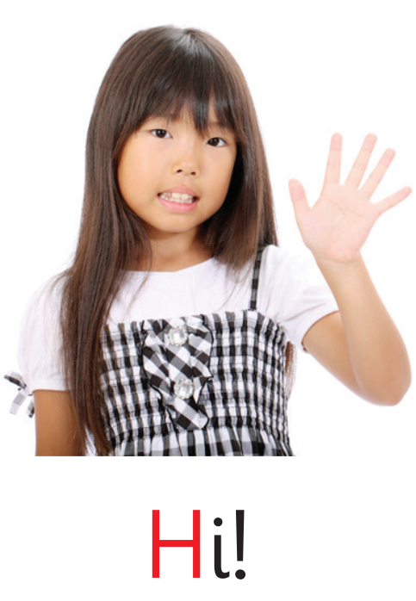


Sounds /h/ & /s/
Letter
Sound
h | h
Letter
Sound
s | s
H h
S s
/h/
/s/
Notes:
Show the letter, ask “What letter is it?” and have Ss answer “Letter S”
Show the sound, “What is the sound?” and have Ss answer “Sound /s/”
Show the sound in red, say aloud and have Ss repeat the sounds 3 time after each “Click”
Show the word, say aloud and have Ss repeat
Show the picture and have Ss say “s, s, six”
Have Ss say aloud one more time in rhythm“ Letter Hh, Sound /s/, s… s… s… six”

Slide 20




Picture Reveal
Sounds /h/ & /s/
In this game, a picture clue is hidden.
Students children to read all of the words in the clouds.
Students choose a number to reveal the picture behind.
Choose the word that match the picture.
1 correct answer = 2 points.
START

Slide 21




What
is this picture?
1
2
3
4
5
6
seven
six
Hi!

Slide 22

What about this one?
1
2
3
4
5
6
seven
Hi!
six

Slide 23

This one is easy.
1
2
3
4
5
6
Hi!
Hello!
six

Slide 24

Look carefully!
1
2
3
4
5
6
seven
Hello!
six

Slide 25

Well done!

Slide 26
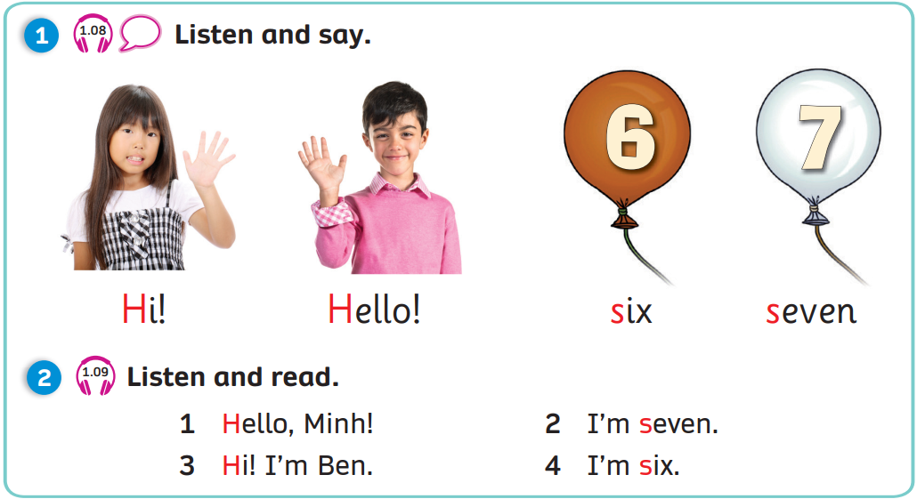
Pupil’s Book (p.11)
1
2
Click on numbers “1, 2” to play the audio tracks

Slide 27
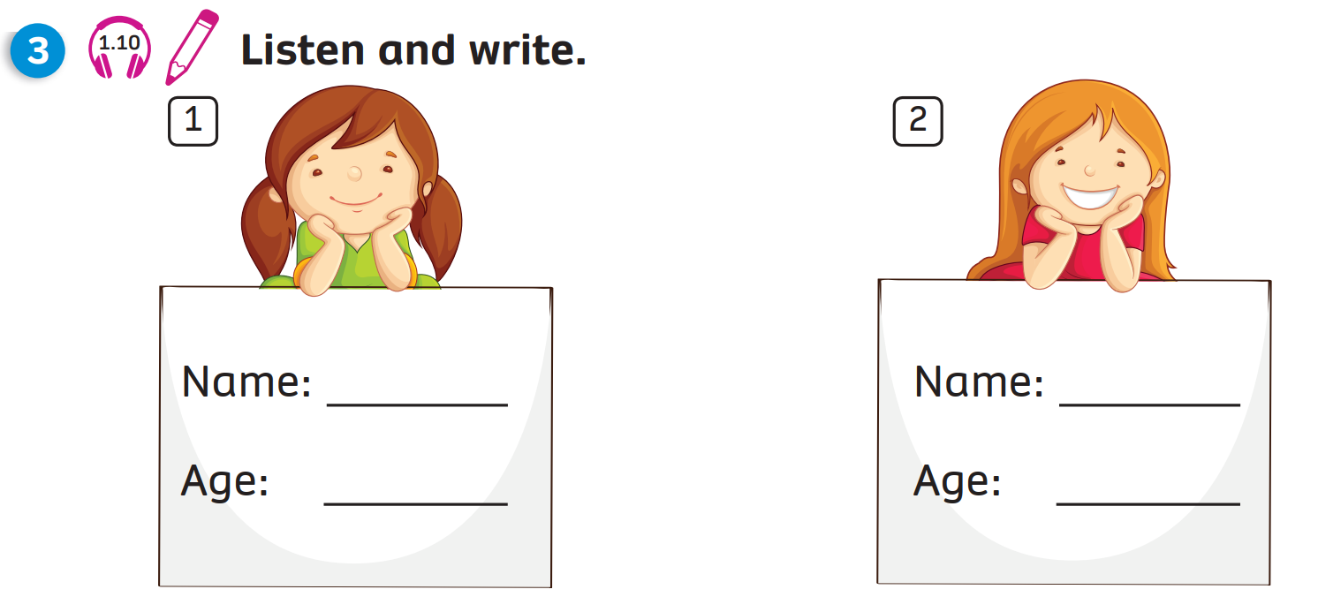
Pupil’s Book (p.11)
1
2
Mai
Mary
seven
eight
Click on numbers “1, 2” to play the audio tracks
and reveal the answers

Slide 28
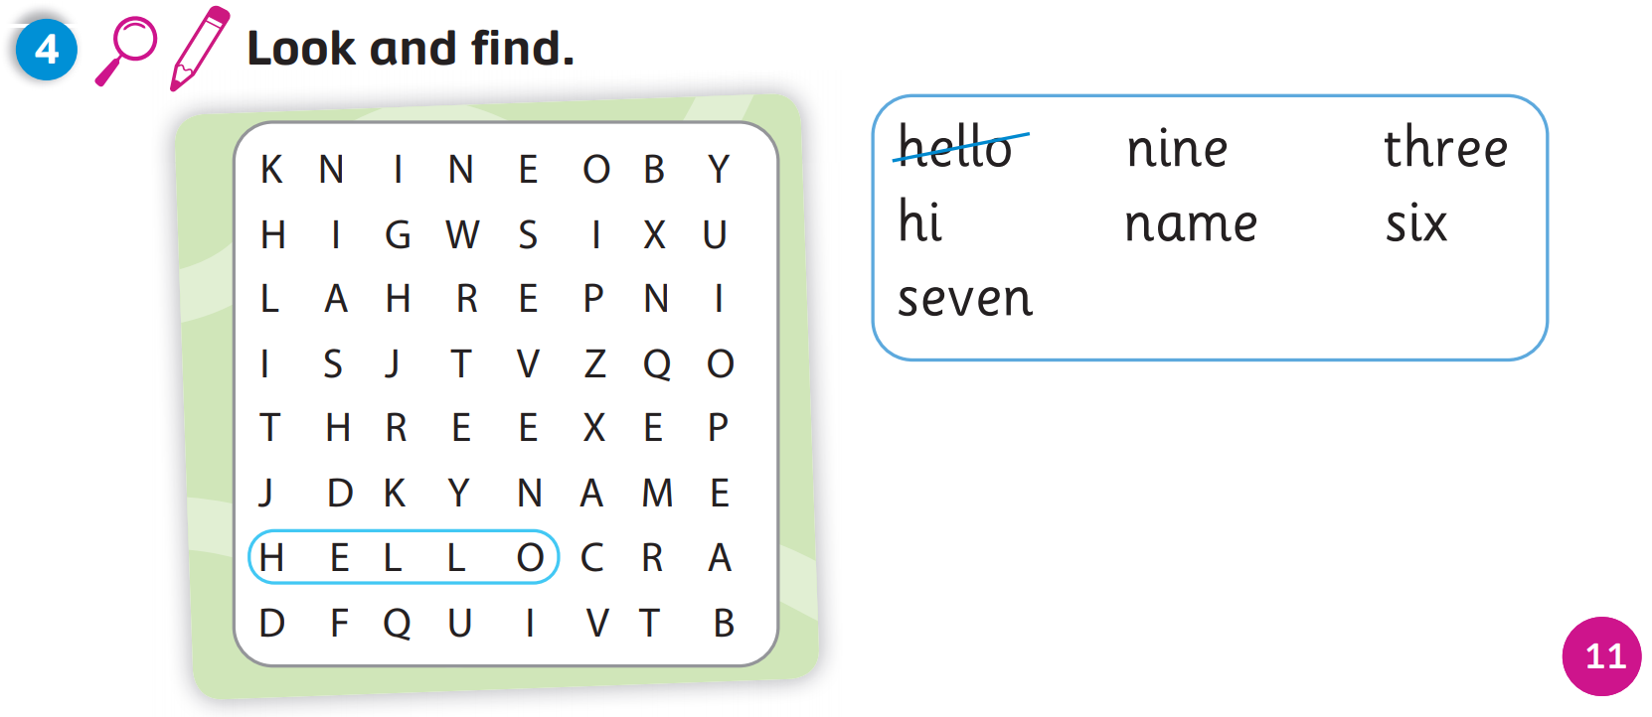
Pupil’s Book (p.11)
Answers
Click on “Answers” to reveal the answers

Slide 29
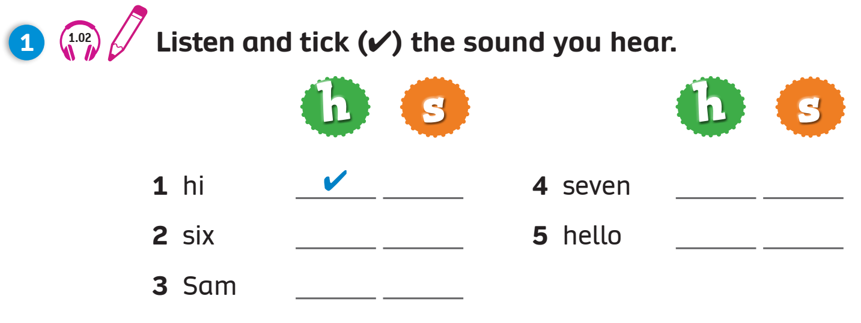
Activity Book (p.11)

Slide 30
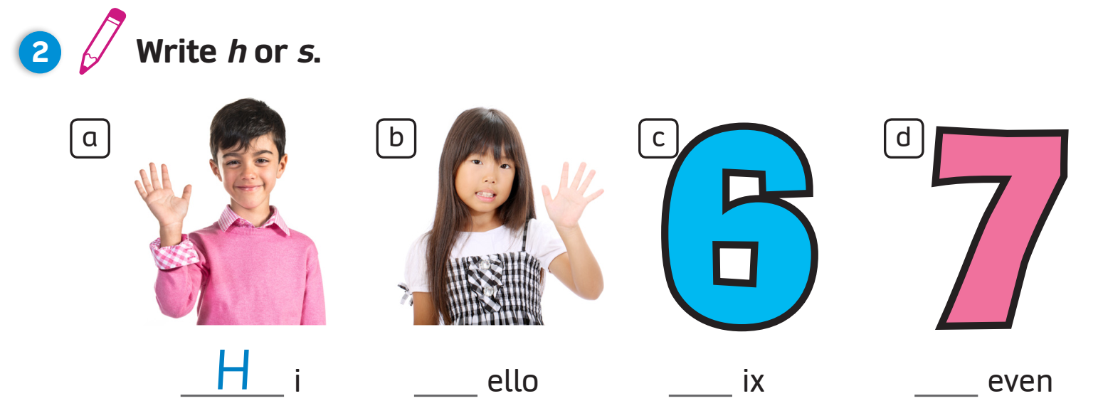
Activity Book (p.11)
1
2
3
4
H
H
s
s

Slide 31
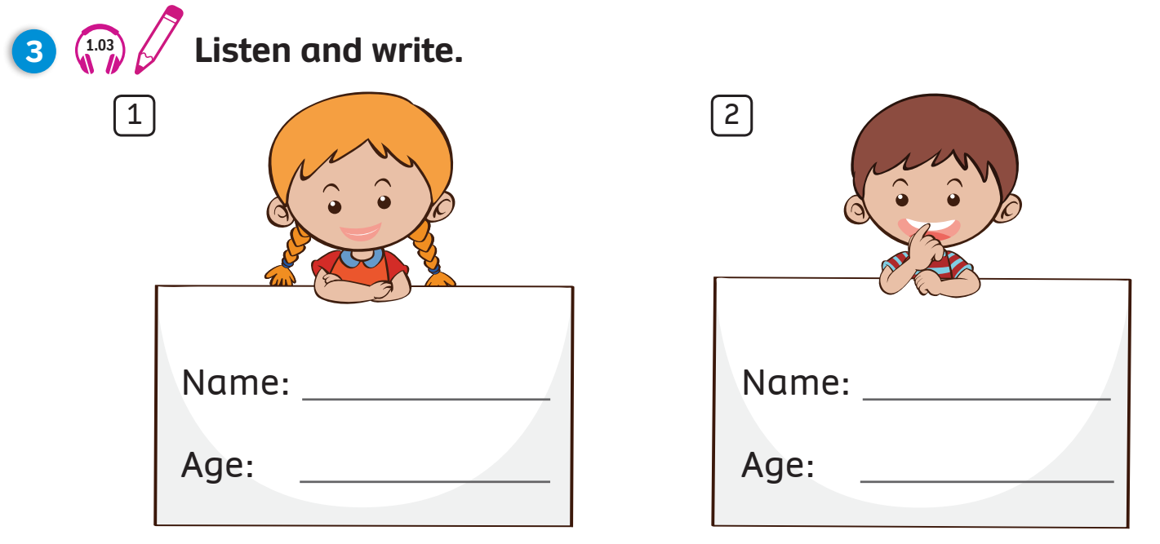
Activity Book (p.11)

Slide 32

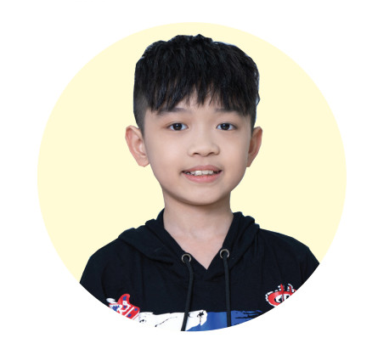
Activity Book (p.11)
Minh
eight (years old)
Example
Click on “Example” to reveal the sample answers

Slide 33
WRAP-UP
Letter
Sound
h | h
Letter
Sound
s | s
H h
S s
/h/
/s/
Notes:
Show the letter, ask “What letter is it?” and have Ss answer “Letter S”
Show the sound, “What is the sound?” and have Ss answer “Sound /s/”
Show the sound in red, say aloud and have Ss repeat the sounds 3 time after each “Click”
Show the word, say aloud and have Ss repeat
Show the picture and have Ss say “s, s, six”
Have Ss say aloud one more time in rhythm“ Letter Hh, Sound /s/, s… s… s… six”

Slide 34

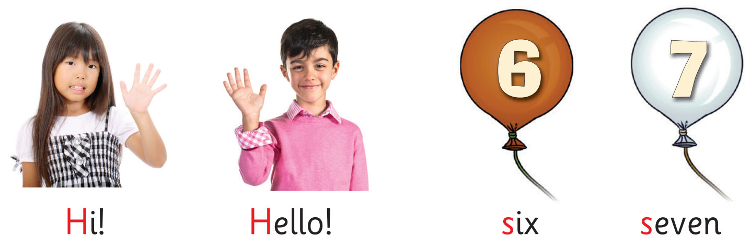

UNIT 1: Lesson 4
We’ve learnt…

