Slide 1

UNIT 1: HELLO
Lesson 2 – Review

Slide 2
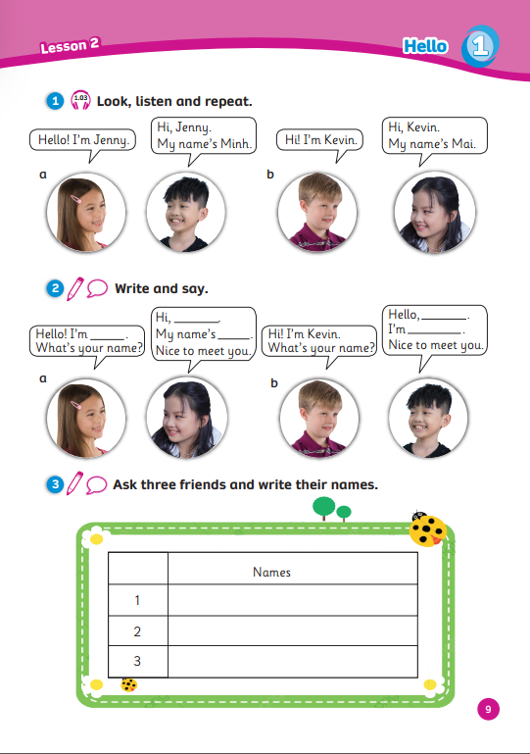
UNIT 1: HELLO
We’re reviewing…
- names
- how to ask and answer about names
SB p.9
AB p.9

Slide 3


Song: Tooty Ta
WARM-UP
All students stand up.
Listen to the song.
Dance along.

Slide 4
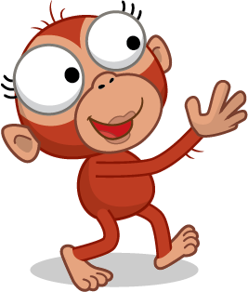
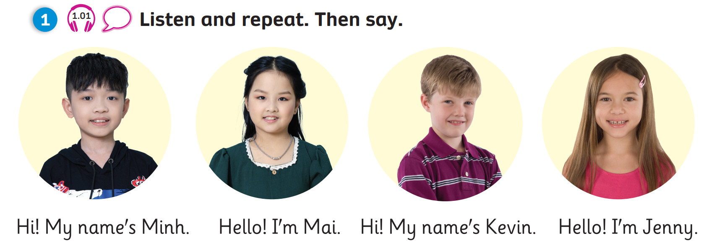
REVIEW: Names
Hello! My name’s …
Hi!
What’s your name?
Minh
Kevin
Mai
Jenny
Notes:
Have recall how to ask for someone’s name
Show the name and have them answer one by one

Slide 5

MEMORY GAME
Let’s Play!

Slide 6

MEMORY GAME
Rules
12 numbers on the slide:
  4 pictures and 4 sentences behind the numbers.
  2 lucky stars with given points & 2 bombs.
Each student chooses 2 numbers and gets 1 point for a match.
1 student asks the question, the whole class answers after each match.
Note:
- Click the card or number to show a picture.
- Click the heart to hide the picture.
Let’s Play!
1

Slide 7

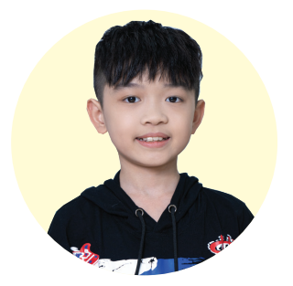



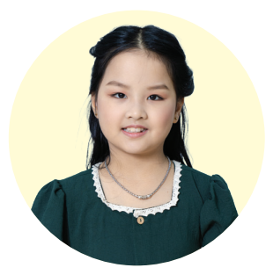
Hi! What’s your name?
Hello! I’m Mai.
Hello! I’m Jenny.
1
2
3
4
+2
Hi! My name’s Kevin.
7
8
5
6
-2
9
Hi! My name’s Minh.
12
10
11
+3
-1
Notes:
- Click the card or number to show a picture.
- Click the heart to hide the picture.

Slide 8
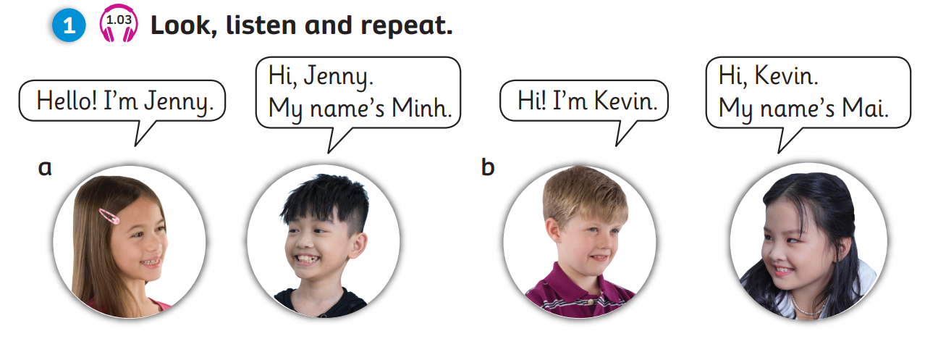
REVIEW: Grammar
1
Hello!
What’s your name?
2
Hi! My name’s Mai.
What’s your name?
3
I’m Kevin.
4
Nice to meet you!
Kevin
Mai
Click on the numbers “1, 2, 3, 4” to reveal the speech bubbles

Slide 9

Smart Sea Animals

Slide 10



Smart Sea Animals
Students choose sea animals to open the questions.
Students choose an answer A, B or C.
The whole class repeats questions and answers.
To go back to the sea animals slide, click
To show the scores, click

Slide 11


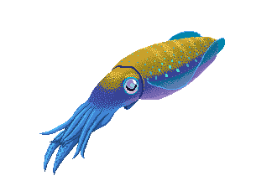






1
2
3
4
5
6
7
Click here to go to BOOKWORK

Slide 12
_____ name’s Jenny.
a. I’m
b. My
c. Hi!
+2
Notes:
- To go back to the sea animals slide, click the whale
- To show the scores, click the pearl.

Slide 13
Hello, I’m Minh.
What’s _____ name?
a. you
b. my
c. your
+1
Notes:
- To go back to the sea animals slide, click the whale
- To show the scores, click the pearl.

Slide 14
_____!
My name’s Kevin.
a. Hello
b. Hi
c. a & b
are correct
+3
Notes:
- To go back to the sea animals slide, click the whale
- To show the scores, click the pearl.

Slide 15
_____ Mai.
a. I’m
b. Hello
c. My name
+4
Notes:
- To go back to the sea animals slide, click the whale
- To show the scores, click the pearl.

Slide 16
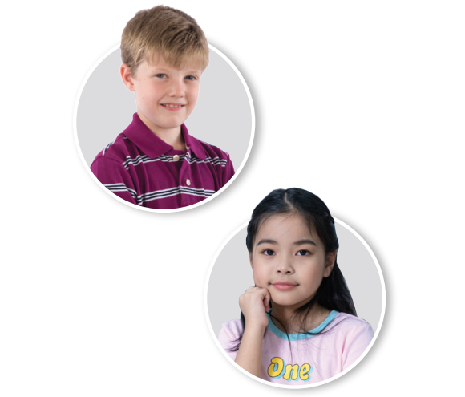
- Kevin: Hi! I’m Kevin.
- Linh: __________.
My name’s Linh.
a. What’s your name
b. Hello, Kevin
c. I’m Jenny
+2
Notes:
- To go back to the sea animals slide, click the whale
- To show the scores, click the pearl.

Slide 17
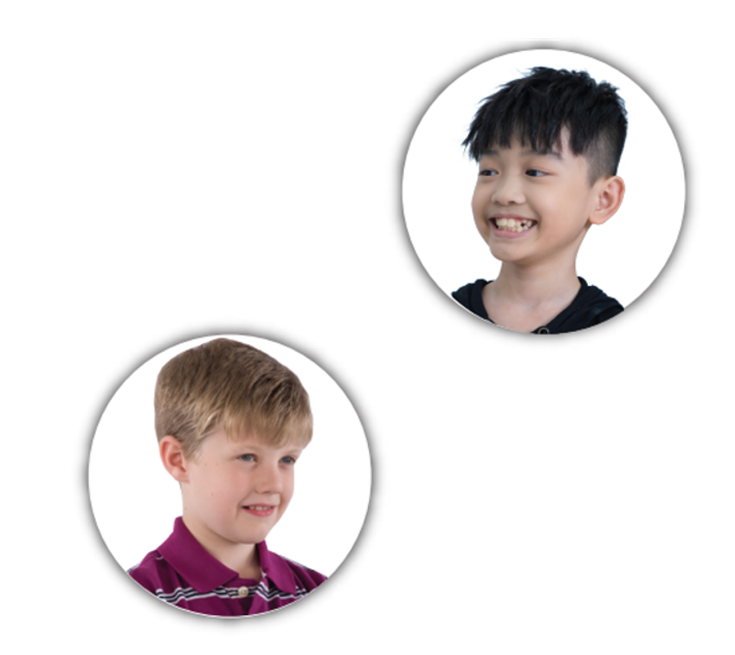
- Minh: __________.
- Kevin: Hi, Minh.
I’m Kevin.
a. Hello, Kevin
b. What’s your name
c. Hello! My name’s Minh
+5
Notes:
- To go back to the sea animals slide, click the whale
- To show the scores, click the pearl.

Slide 18

- Jenny: Hi! I’m Jenny. What’s your name?
- Mai: Hello, Jenny.
I’m Mai. __________.
a. Nice to meet you
b. Nice to greet you
c. Nice to
see you
+3
Notes:
- To go back to the sea animals slide, click the whale
- To show the scores, click the pearl.

Slide 19

Pupil’s Book (p.9)
a
b
Click on the squares “a, b” to play the audio

Slide 20
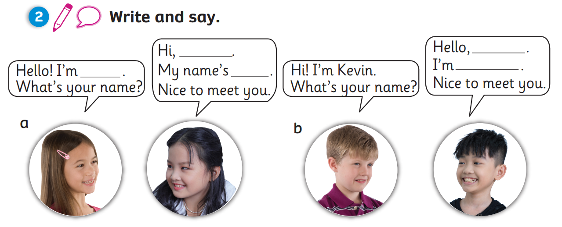
Pupil’s Book (p.9)
Jenny
Kevin
Minh
Jenny
Mai
a
b
Click on the squares “a, b” to reveal the answers

Slide 21
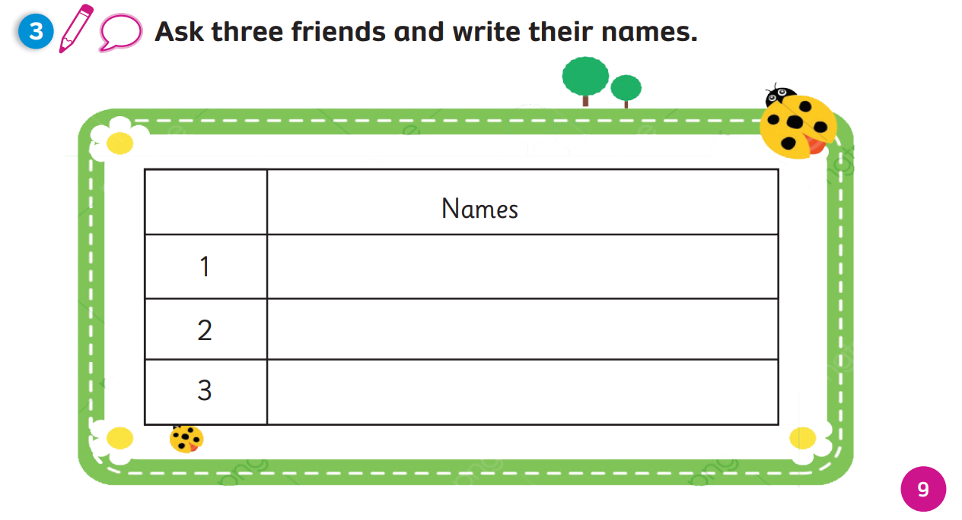
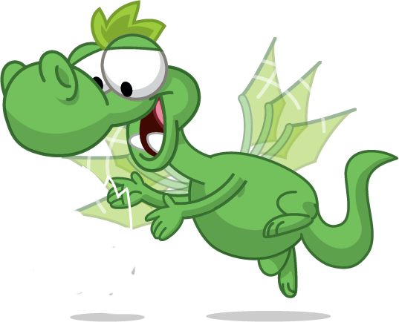



Pupil’s Book (p.9)
Examples
Hello! I’m …
What’s your name?
Minh
Kevin
Mai
Hi, …! I’m …
Nice to meet you!
Click on “Examples” to reveal the answers
Notes:
Review how to ask and answer about names
Instruct students how to do task 3
Click the box “Examples’ to show students how to use the table

Slide 22
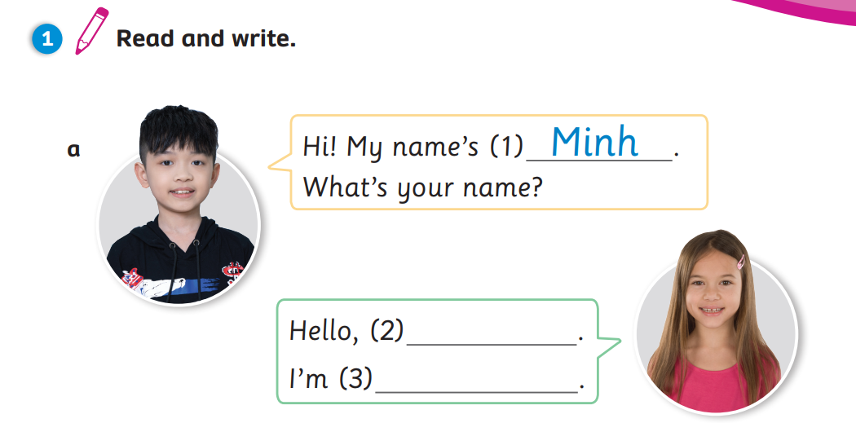
Activity Book (p.9)
a
Minh
Jenny
Click on the squares “a” to reveal the answers
Notes:
Click on the tick to reveal the answers.

Slide 23
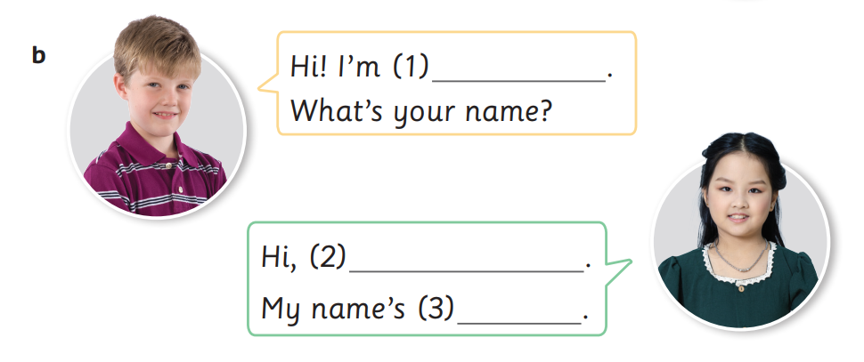
Activity Book (p.9)
b
Kevin
Kevin
Mai
Click on the square “b” to reveal the answers
Notes:
Click on the tick to reveal the answers.

Slide 24
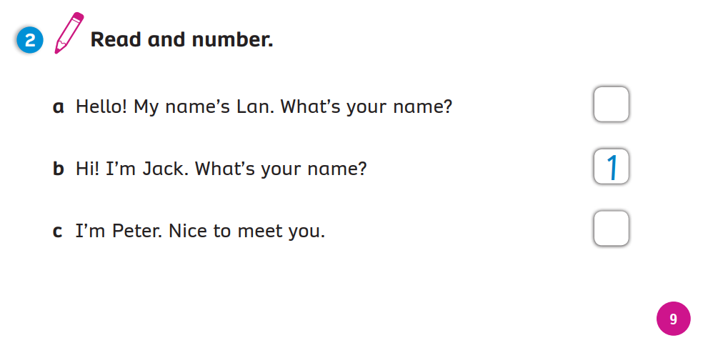
Activity Book (p.9)
a
2
b
1
c
3
Click on the squares “a, b, c” to reveal the answers
Notes:
Click on the tick to reveal the answers.

Slide 25
WRAP-UP
1
Hello!
What’s your name?
2
Hi! My name’s Mai.
What’s your name?
3
I’m Kevin.
4
Nice to meet you!
Kevin
Mai
Click on the numbers “1, 2, 3, 4” to reveal the text
Notes:
Have Ss recall how to ask and answer about names
Click on the number to reveal the text

Slide 26


UNIT 1: Lesson 2
We’ve reviewed…

