Slide 1

UNIT 1: HELLO
Lesson 1 – Vocabulary

Slide 2
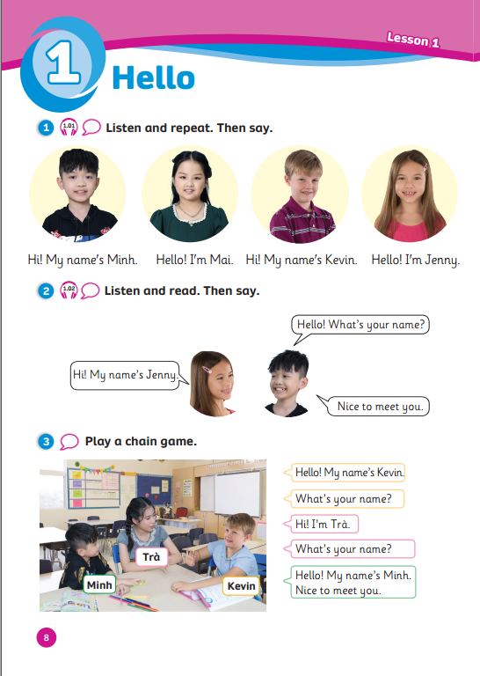
UNIT 1: HELLO
We’re learning…
- names
- to ask and answer about names
SB p.8
AB p.8

Slide 3


Song: What’s your name?
WARM-UP
All students stand up.
Listen to the song.
Dance along.

Slide 4
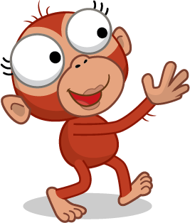
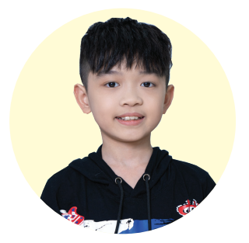


VOCABURALY: Names
Hi!
What’s your name?
Hi! My name’s …
Minh
Notes:
Show the picture, introduce the character as a new friend
Have Ss greet the character and ask about his/her name
Have Ss listen to the audio and say aloud the name
Show the name and have Ss spell & say aloud one more time

Slide 5
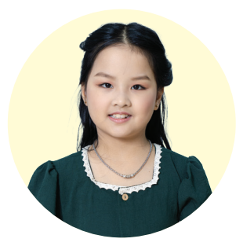
VOCABURALY: Names
Hi!
What’s your name?
Hello! I’m …
Mai
Notes:
Show the picture, introduce the character as a new friend
Have Ss greet the character and ask about his/her name
Have Ss listen to the audio and say aloud the name
Show the name and have Ss spell & say aloud one more time

Slide 6
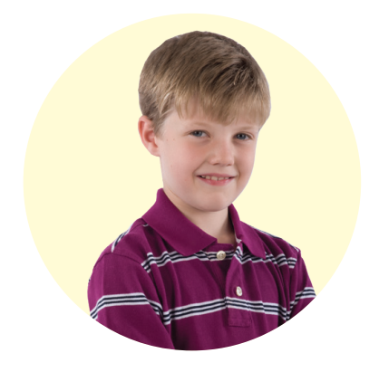
VOCABURALY: Names
Hi!
What’s your name?
Hi! My name’s …
Kevin
Notes:
Show the picture, introduce the character as a new friend
Have Ss greet the character and ask about his/her name
Have Ss listen to the audio and say aloud the name
Show the name and have Ss spell & say aloud one more time

Slide 7

VOCABURALY: Names
Hi!
What’s your name?
Hello! I’m …
Jenny
Notes:
Show the picture, introduce the character as a new friend
Have Ss greet the character and ask about his/her name
Have Ss listen to the audio and say aloud the name
Show the name and have Ss spell & say aloud one more time

Slide 8
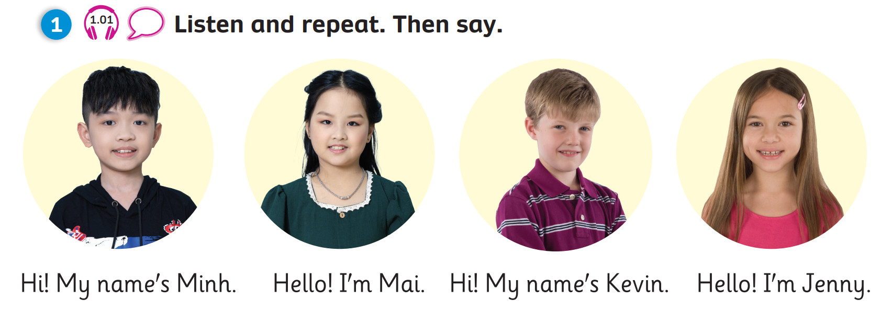
VOCABURALY: Names
Hi!
What’s your name?
Hello! My name’s …
Minh
Kevin
Mai
Jenny

Slide 9

PRACTICE
Behind the squares
1
3✩
2
2✩
3
3✩
Choose a square by saying its number.
Guess the person behind the squares.
Click “Show all” to check the answer.
Get your stars on the square you choose.
4
2✩
5
1✩
6
2✩
7
3✩
8
2✩
9
3✩
Show all

Slide 10
PRACTICE
1
3✩
2
2✩
3
3✩
Show all
Hello! I’m Mai.
4
2✩
5
1✩
6
2✩
Hi!
What’s your name?
7
3✩
8
2✩
9
3✩
Click on the squares to reveal the hidden picture
Click “Show all” to reveal the answer
Notes:
- Ask Ss to open the box to reveal the picture and answer the question.
- The points are on the box.

Slide 11
1
3✩
2
2✩
3
3✩
Show all
Hi! My name’s Kevin.
4
2✩
5
1✩
6
2✩
Hi!
What’s your name?
7
3✩
8
2✩
9
3✩
Click on the squares to reveal the hidden picture
Click “Show all” to reveal the answer
Notes:
- Ask Ss to open the box to reveal the picture and answer the question.
- The points are on the box.

Slide 12
PRACTICE
1
3✩
2
2✩
3
3✩
Show all
Hi! My name’s Minh.
4
2✩
5
1✩
6
2✩
Hi!
What’s your name?
7
3✩
8
2✩
9
3✩
Click on the squares to reveal the hidden picture
Click “Show all” to reveal the answer
Notes:
- Ask Ss to open the box to reveal the picture and answer the question.
- The points are on the box.

Slide 13
PRACTICE
1
3✩
2
2✩
3
3✩
Show all
Hello! I’m Jenny.
4
2✩
5
1✩
6
2✩
Hi!
What’s your name?
7
3✩
8
2✩
9
3✩
Click on the squares to reveal the hidden picture
Click “Show all” to reveal the answer
Notes:
- Ask Ss to open the box to reveal the picture and answer the question.
- The points are on the box.

Slide 14
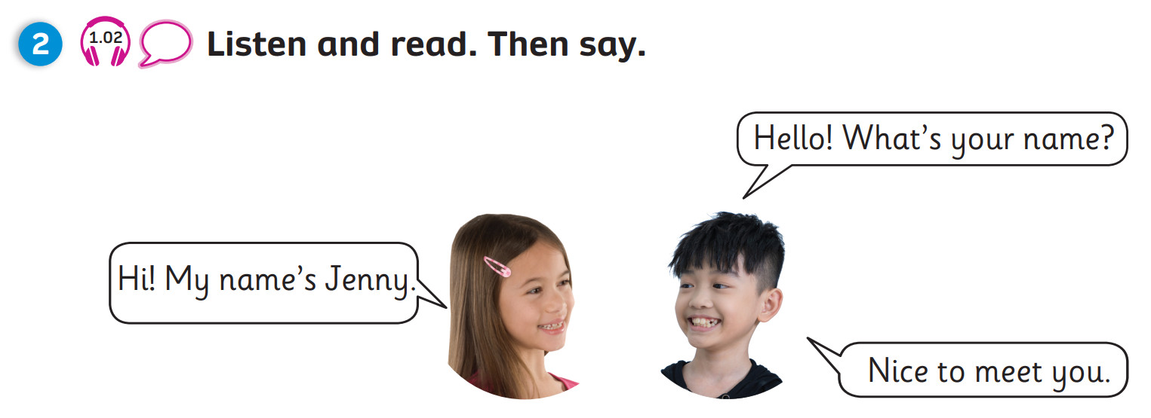
GRAMMAR
1
2
3
Jenny
Minh
Click on the numbers to reveal the text
Notes:
Set the scene
Have students recall the names Jenny and Minh
Tell students Jenny and Minh are asking and answering about their names
Play the audio once and have students recall what Jenny and Minh say
Click on the numbers to reveal the text
Get 2-3 pairs to role play the conversation

Slide 15


PRACTICE
Lucky wheel
+ 10
+ 5
2 students ask and answer each other.
Each student then spin the wheel once to gain points for their team.
Click “Spin” run the wheel.
Click the orange circle to stop the wheel.
+ 1
+ 3
+ 7
- 2
- 1
Spin again
SPIN
Click the orange circle to stop the wheel
Click the grey triangle to move to the next slide

Slide 16
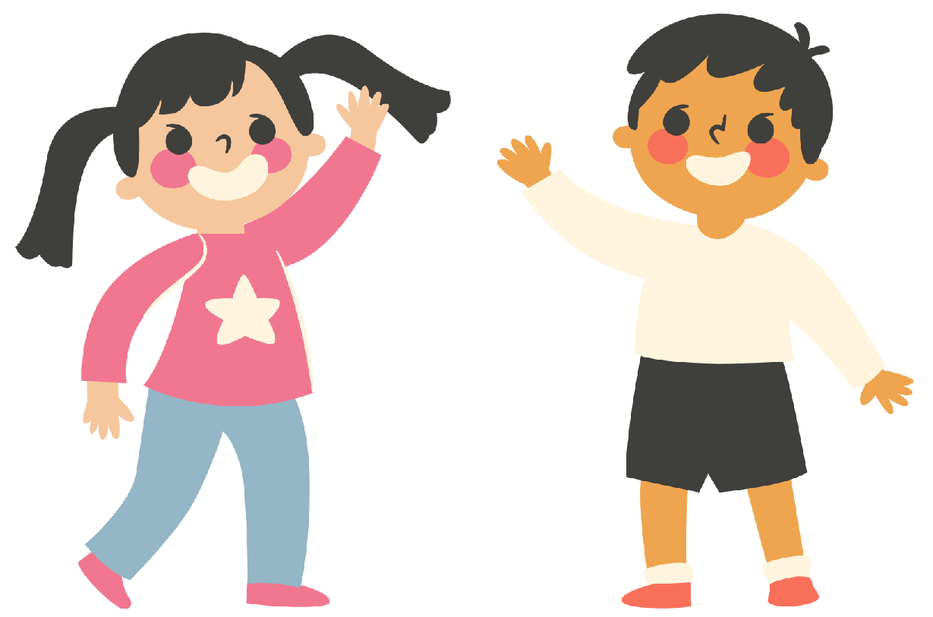
PRACTICE
Lucky wheel
1
2
Hello!
What’s your name?
Hi! My name’s …
What’s your name?
3
4
My name’s …
Nice to meet you!
Notes:
Call out 2 students (each from different team) to ask and answer about their names
Students then take turns to spin the wheel and gain points for their teams
Click the grey triangle to get to the wheel in the next slide

Slide 17


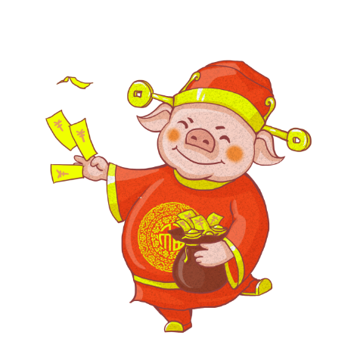
LUCKY WHEEL
Get 10 points
Get 5 points
Get 1 point
Get 3 points
Get 7 points
Lose 2 points
Spin again
Lose 1 point
SPIN
Click the orange circle to stop the wheel
Click the pig to get back to slide ASK & ANSWER
Click the grey triangle to move to the next slide

Slide 18
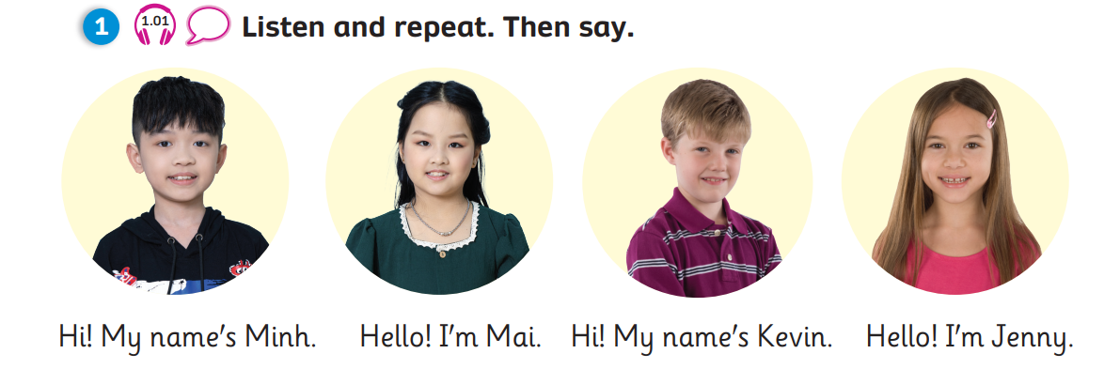
Pupil’s Book (p.8)
Notes:
1st listen: Ss listen and point to the correct friend.
2nd listen: Ss repeat what they hear on the audio.

Slide 19
Pupil’s Book (p.8)
Notes:
Play the audio once for Ss to listen and read.
Role play as a class: boys take on the roles of Minh, girls take on the roles of Jenny -> practice the dialogue
Pair work: Ss practice the dialogue in pairs

Slide 20
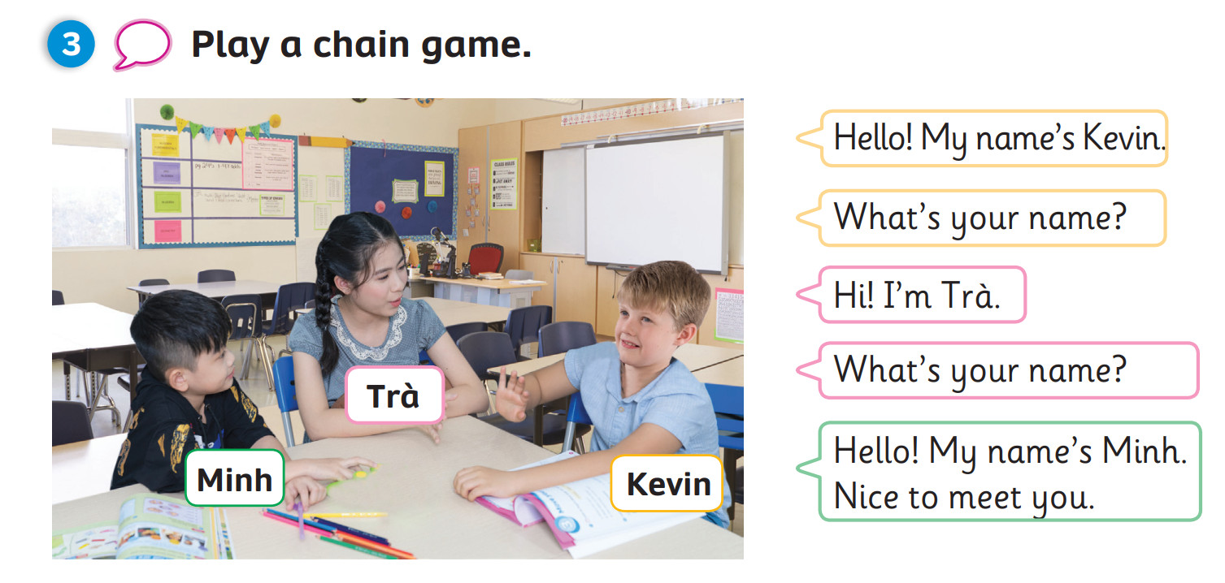
Pupil’s Book (p.8)
Notes:
Ask Ss about the picture: number of people, names, places
Invite 3 students to play the roles of Minh, Trà and Kevin
Explain to Ss how to play the chain game. Have 2 Ss come to the front of the class and play the chain game with them. After Ss understand, have the 3rd student come up to replace the teacher and continue the game.

Slide 21
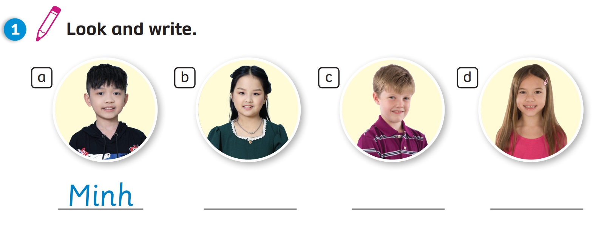
Activity Book (p.8)
a
b
c
d
Minh
Mai
Kevin
Jenny
Click on the squares “a, b, c, d” to reveal the answers

Slide 22
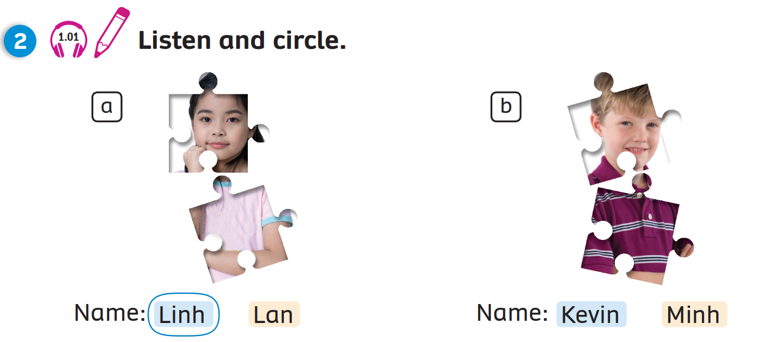
Activity Book (p.8)
a
b
Name: Linh Lan
Name: Kevin Minh
Click on the squares “a, b” to reveal the answers
Notes:
Click on the squares “a, b, c, d” to reveal the answers.

Slide 23
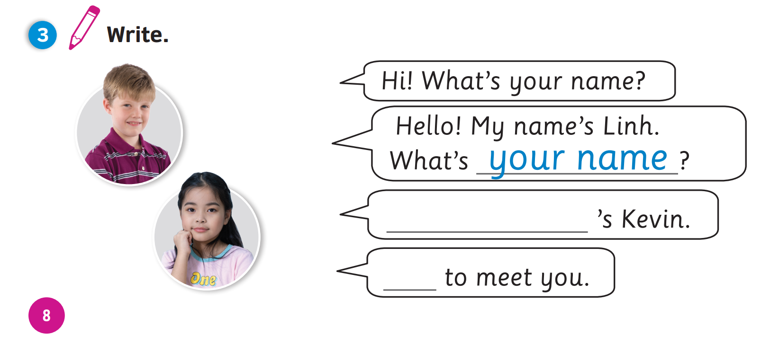

Activity Book (p.8)
1
your name
My name
2
Nice
3
Click on the squares “1, 2, 3” to reveal the answers
Notes:
Click on the tick to reveal the answers.

Slide 24

PRODUCTION
SPEAKING: Move around the class, greet 3-5 friends,
ask and answer about their names.
1
2
Hello!
What’s your name?
Hi! My name’s …
What’s your name?
3
4
My name’s …
Nice to meet you!
Notes:
Call out 2 students and model the structures with them in front of class
Instruct students to leave their seats, move around the class, greet 3-5 friends, ask and answer about their names

Slide 25
WRAP-UP
Hi!
What’s your name?
Hello! My name’s …
Minh
Kevin
Mai
Jenny
Notes:
Have Ss ask the question 1 more time
Show the name and have them answer one by one

Slide 26


UNIT 1: Lesson 1
We’ve learnt…

