Slide 1



UNIT 9 – HOLIDAY TIME!
Lesson 1 – Vocabulary
Teacher: Đoàn Ngọc Hà

Slide 2

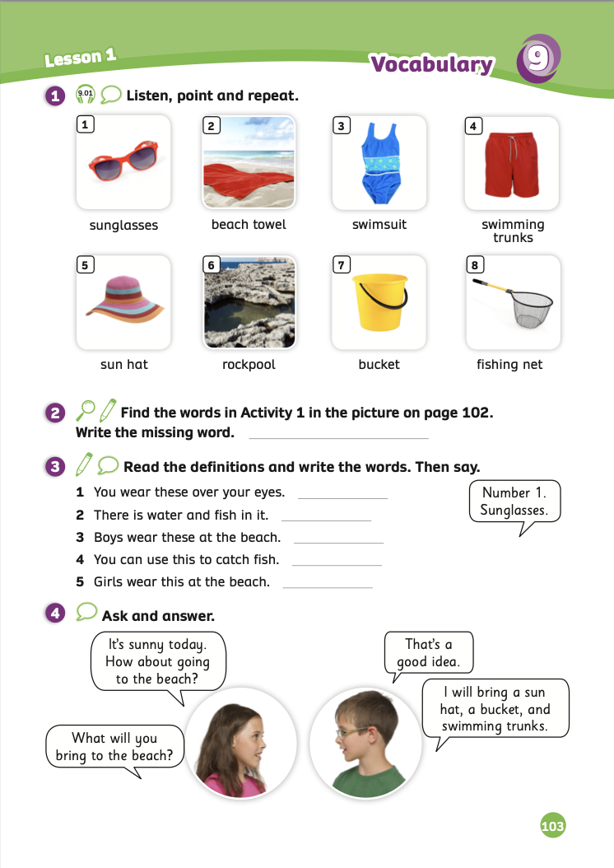
UNIT 9 – Lesson 1
We’re learning…
- To correctly read and pronounce the words related to beach equipment and clothes.
- To use the sentence patterns: What will you bring to the beach?
I will bring a …
- PB p.102,103
- AB p.80

Slide 3


WARM-UP ACTIVITY
Divide the class into two teams. Each team has a character.
Quickly review the space words by showing flashcards from the previous unit.
Each team got five lines between the shark’s mouth and their character.
Students look at the flashcards and randomly spell them when the teacher calls.
If the student is correct, continue with a different student. If that student is wrong, erase a line.
The team that loses all lines first will be out of the game.

Slide 4
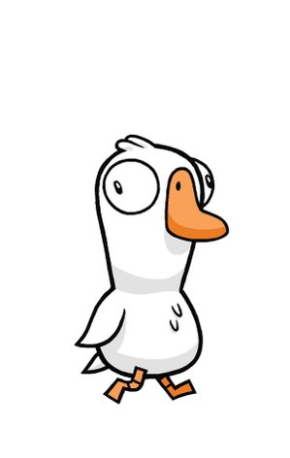



WARM-UP ACTIVITY
☹
☹
The teacher shows the flashcard and asks a random student to spell that word.
Click on “sad face” to erase one line.

Slide 5
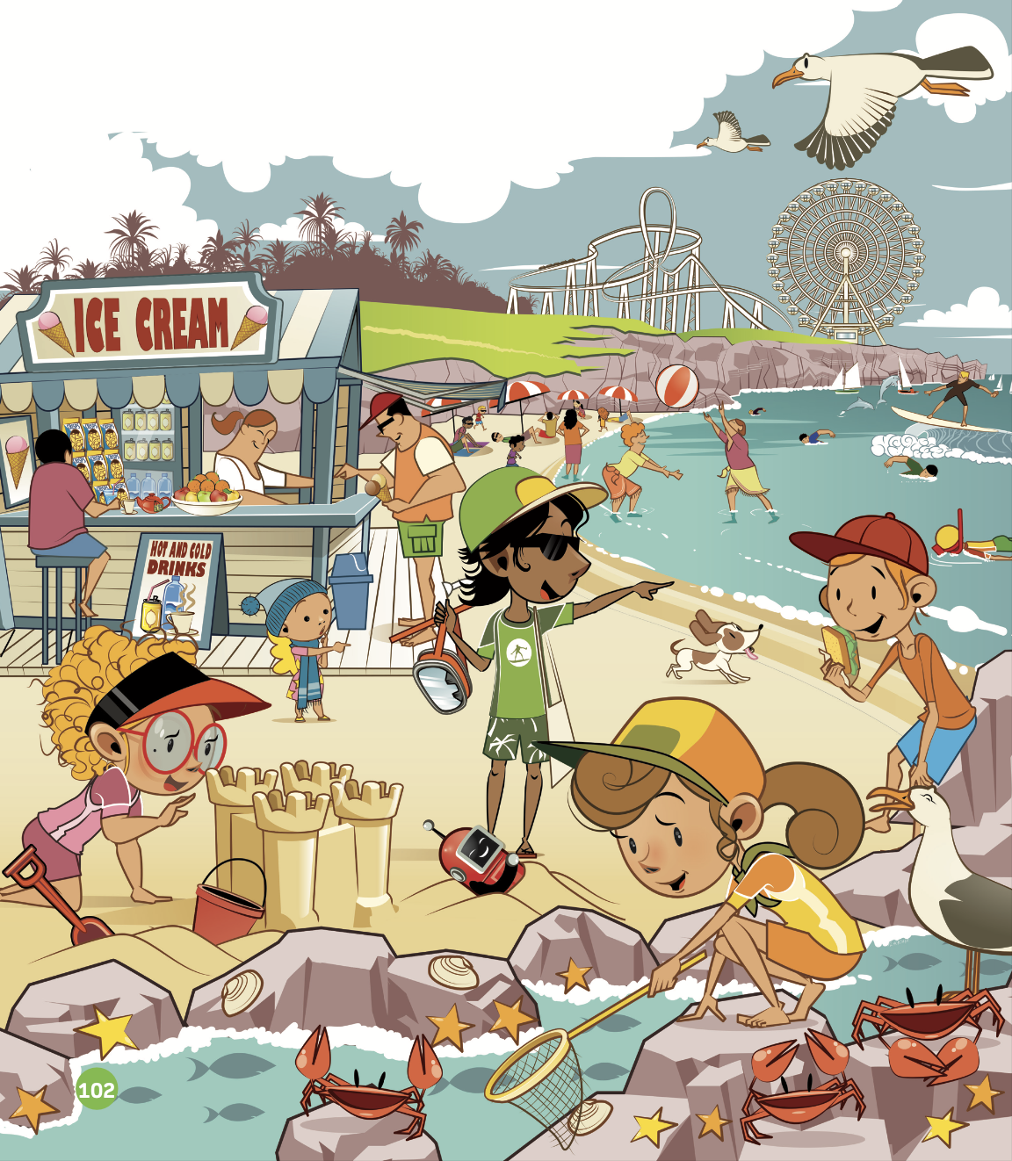
LEAD-IN
sun hat
go swimming
play with ball
bucket
rockpool
crab
Teacher asks students to describe the picture.
Teacher asks students how many beach-related things they see.

Slide 6
LEAD-IN
1. What sea animals do you see?
→ crab, seashell,…
2. What beach activities are they doing?
→ They are playing with ball, going swimming,…
3. What types of beach clothing are they wearing?
→ They are wearing sun hats, swimsuits,...
Put students in pairs. Students have one minute to answer the questions in the box:
1. What sea animals do you see?
2. What beach activities are they doing?
3. What types of beach clothing are they wearing?

Slide 7

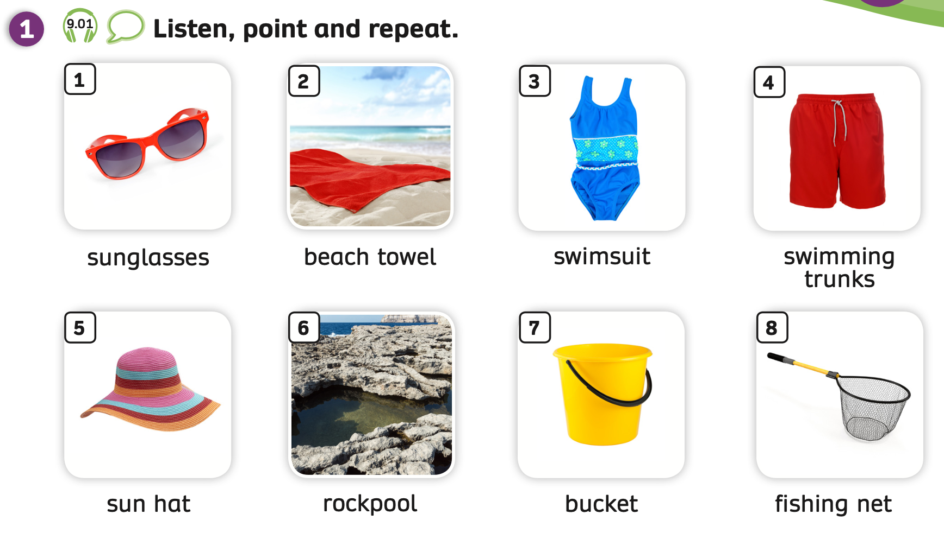
VOCABULARY – Holiday time!
- Play the audio, students listen, point and repeat the words.

Slide 8
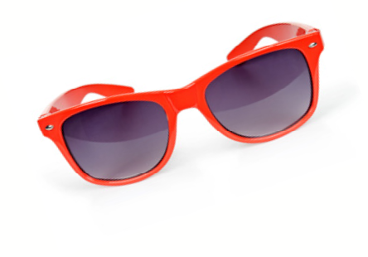

VOCABULARY – Holiday time!
c
Let’s spell!
sunglasses
s
u
n
g
l
a
s
s
e
s
Students listen and repeat the word.

Slide 9
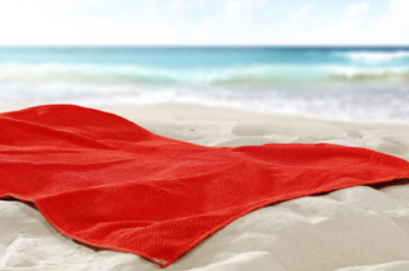
VOCABULARY – Holiday time!
c
Let’s spell!
beach towel
b
e
a
c
h
t
o
w
e
l
Students listen and repeat the word.

Slide 10
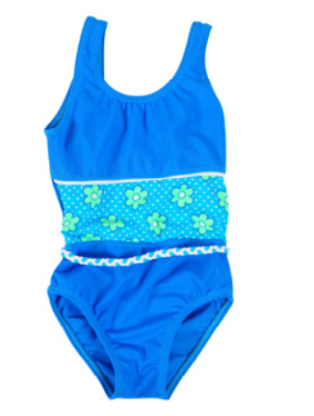
VOCABULARY – Holiday time!
Let’s spell!
c
swimsuit
s
w
i
m
s
u
i
t
Students listen and repeat the word.

Slide 11
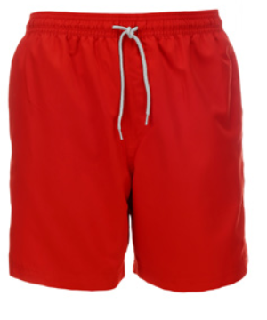
VOCABULARY – Holiday time!
c
Let’s spell!
swimming trunks
s
w
i
m
m
i
n
g
t
r
u
n
k
s
Students listen and repeat the word.

Slide 12
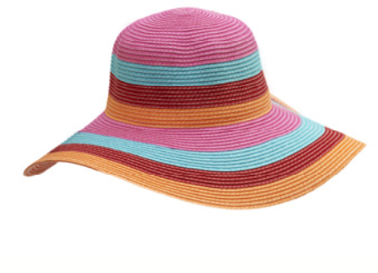
VOCABULARY – Holiday time!
Let’s spell!
c
sun hat
s
u
n
h
a
t
Students listen and repeat the word.

Slide 13
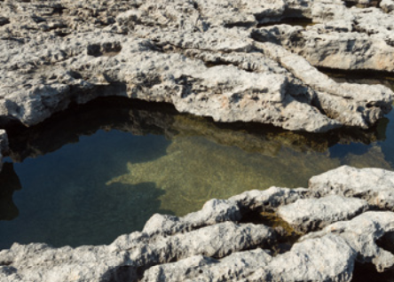
VOCABULARY – Holiday time!
Let’s spell!
c
rockpool
r
o
c
k
p
o
o
l
Students listen and repeat the word.

Slide 14
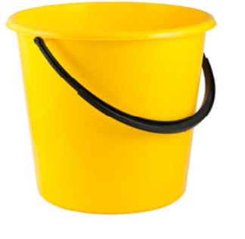
VOCABULARY – Holiday time!
Let’s spell!
c
bucket
b
u
c
k
e
t
Students listen and repeat the word.

Slide 15
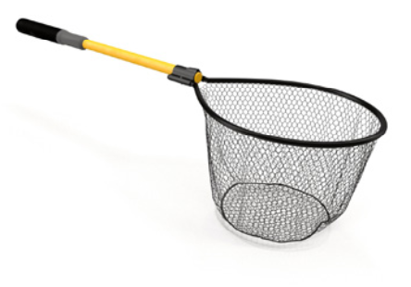
VOCABULARY – Holiday time!
c
Let’s spell!
fishing net
f
i
s
h
i
n
g
n
e
t
Students listen and repeat the word.

Slide 16
VOCABULARY – Holiday time!
REVIEW
1
2
3
4
sunglasses
beach towel
swimsuit
swimming trunks
5
6
7
8
sun hat
rockpool
bucket
fishing net
- Show all the pictures; the teacher says the number, and students say the word.
- Click on each number to show the word, students spell it again.

Slide 17

VOCABULARY – Practice
Ask students to work in groups of 3 or 4.
Students look at the slides and choose the correct answers.
Then, students raise their hands to check the answers.
The fastest group with all the correct answers receives a point.

Slide 18




Slide 19
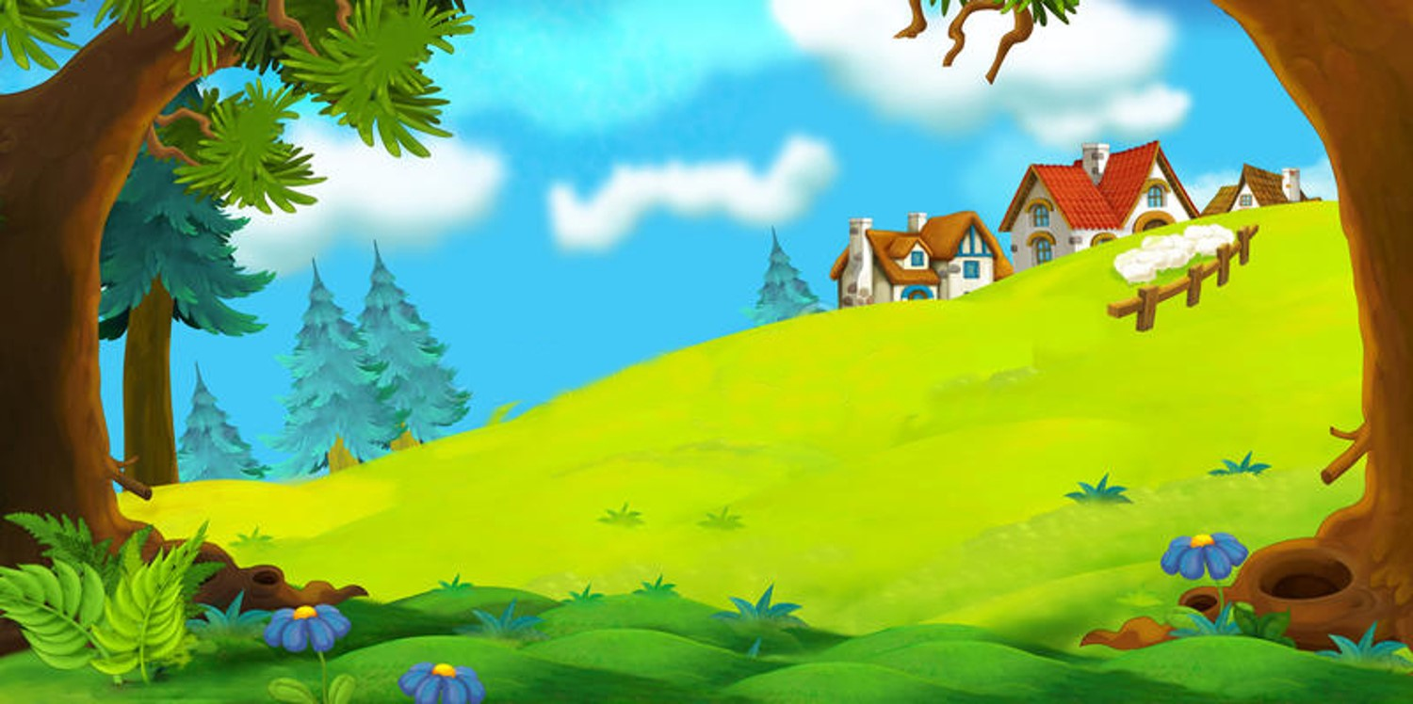

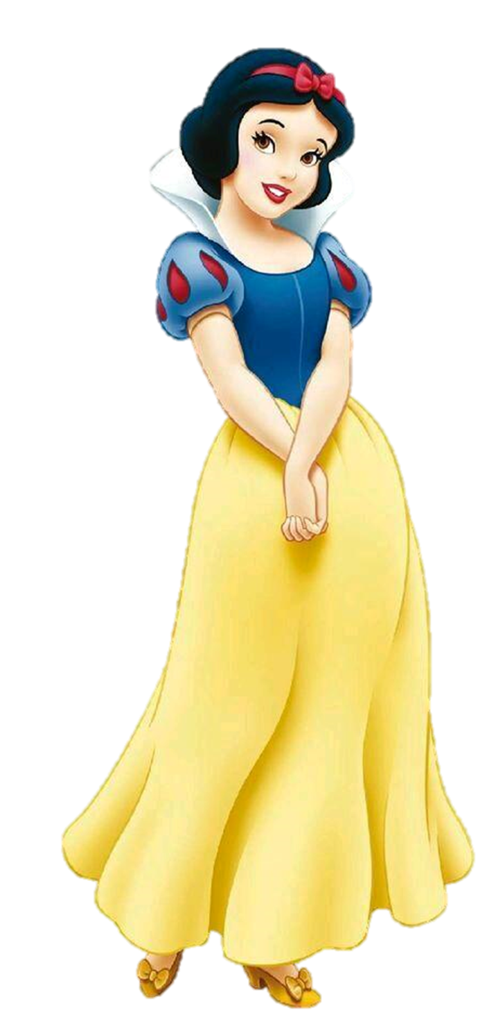
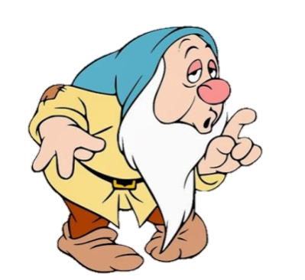
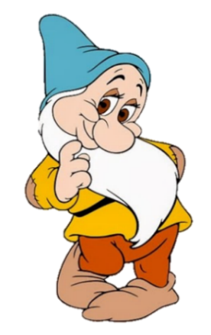
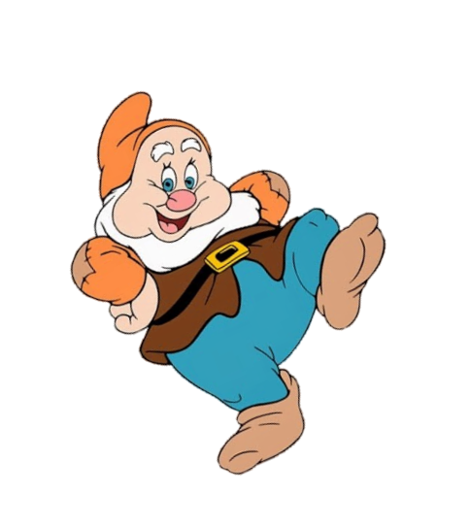
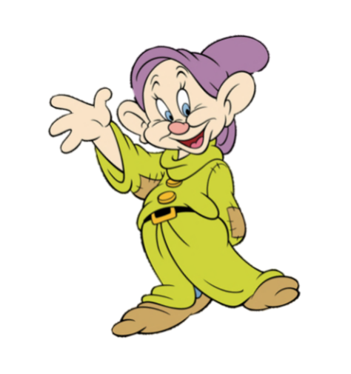
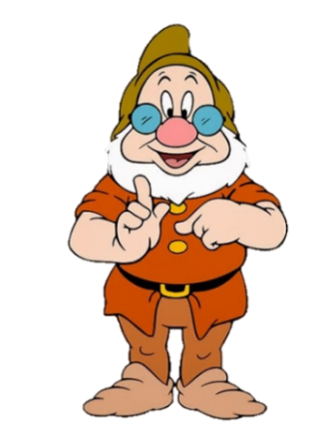
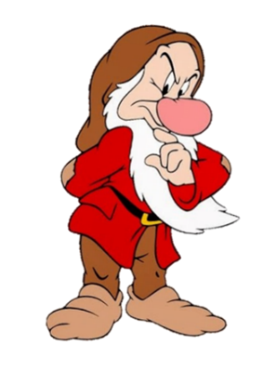
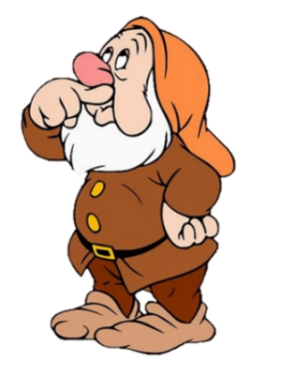

bucket
beach towel
swimsuit
sun hat
next

Slide 20
sunglasses
swimming trunks
sun hat
rockpool
next

Slide 21
fishing net
bucket
beach towel
rockpool
next

Slide 22
sunglasses
rockpool
swimsuit
bucket

Slide 23
sun hat
fishing net
bucket
sunglasses

Slide 24
rockpool
fishing net
sun hat
swimming trunks
next

Slide 25
sunglasses
swimsuit
bucket
fishing net

Slide 26
rockpool
fishing net
bucket
sunglasses
next

Slide 27
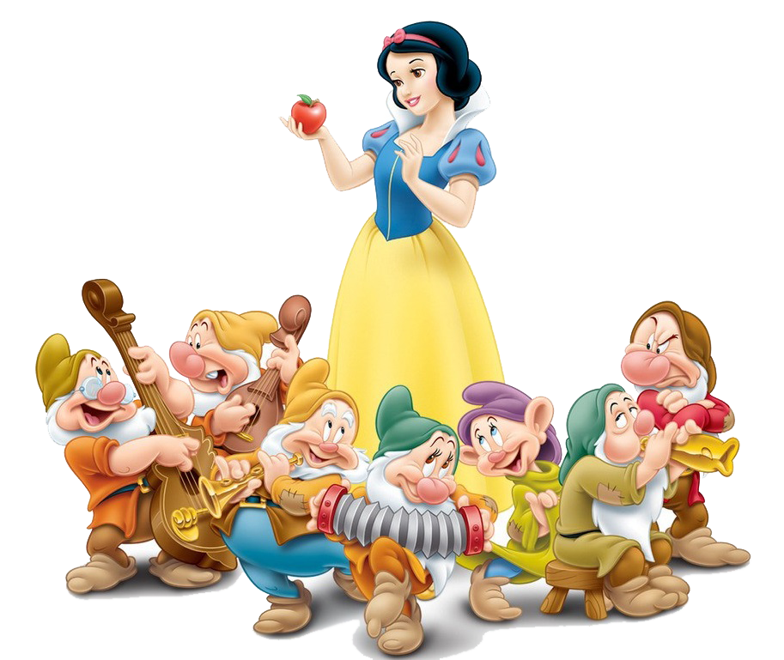

Slide 28


Pupils’ Book (p.103)
sun hat
sunglasses
What’s the missing words?
swimming trunks
swimsuit
It’s beach towel.
bucket
fishing net
rockpool
Have students look at the picture on page 102.
Then, put students in pairs to find the words in Activity 1.
The teacher asks and shows the answer to check with the whole class.

Slide 29
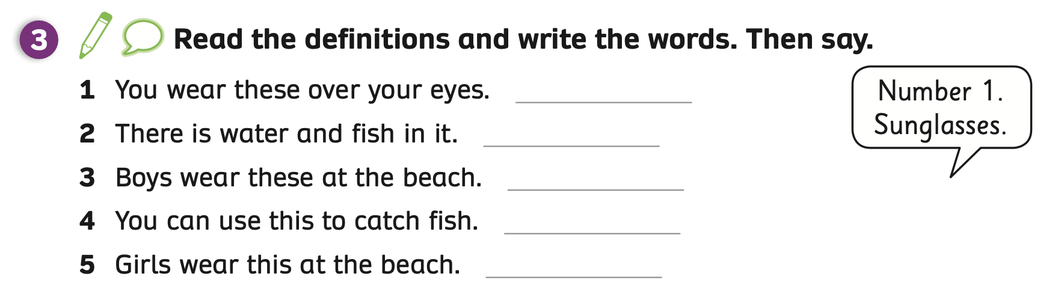
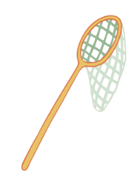
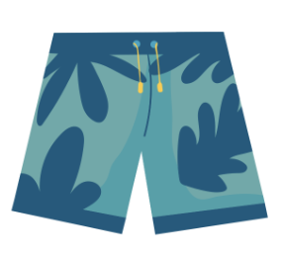

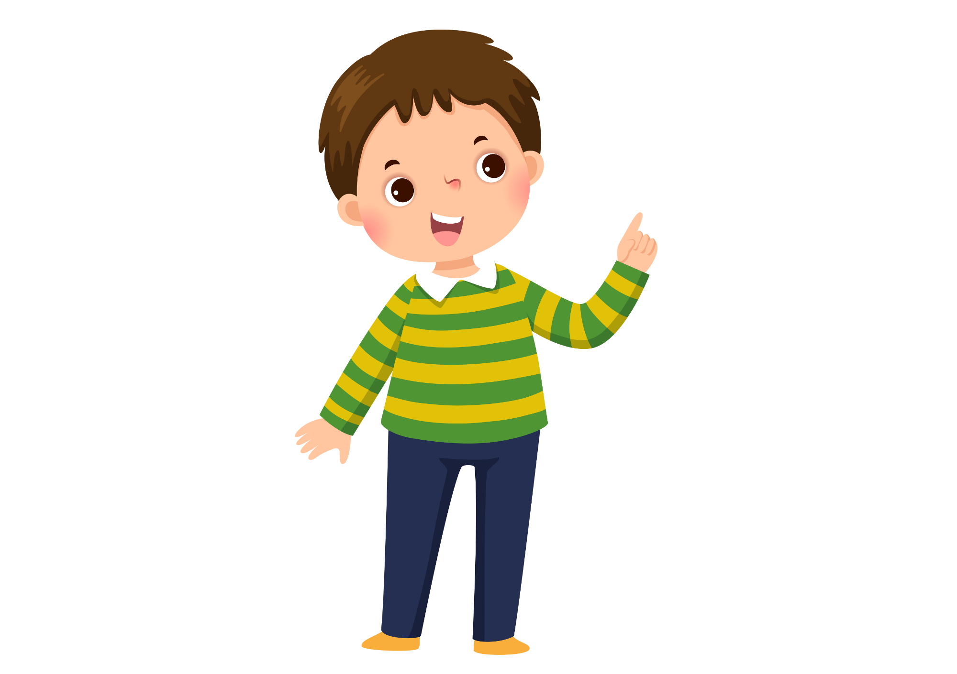

Pupils’ Book (p.103)
sunglasses
rockpool
swimming trunks
fishing net
swimsuit
number 1
sunglasses
Answer
Put students in groups of 3 or 4 to read the definitions and write the words.
After writing, the teacher checks the answers.
Then, put students in pairs, one student says the number “number 1” and one student says the word “sunglasses”. They switch roles to practice.

Slide 30
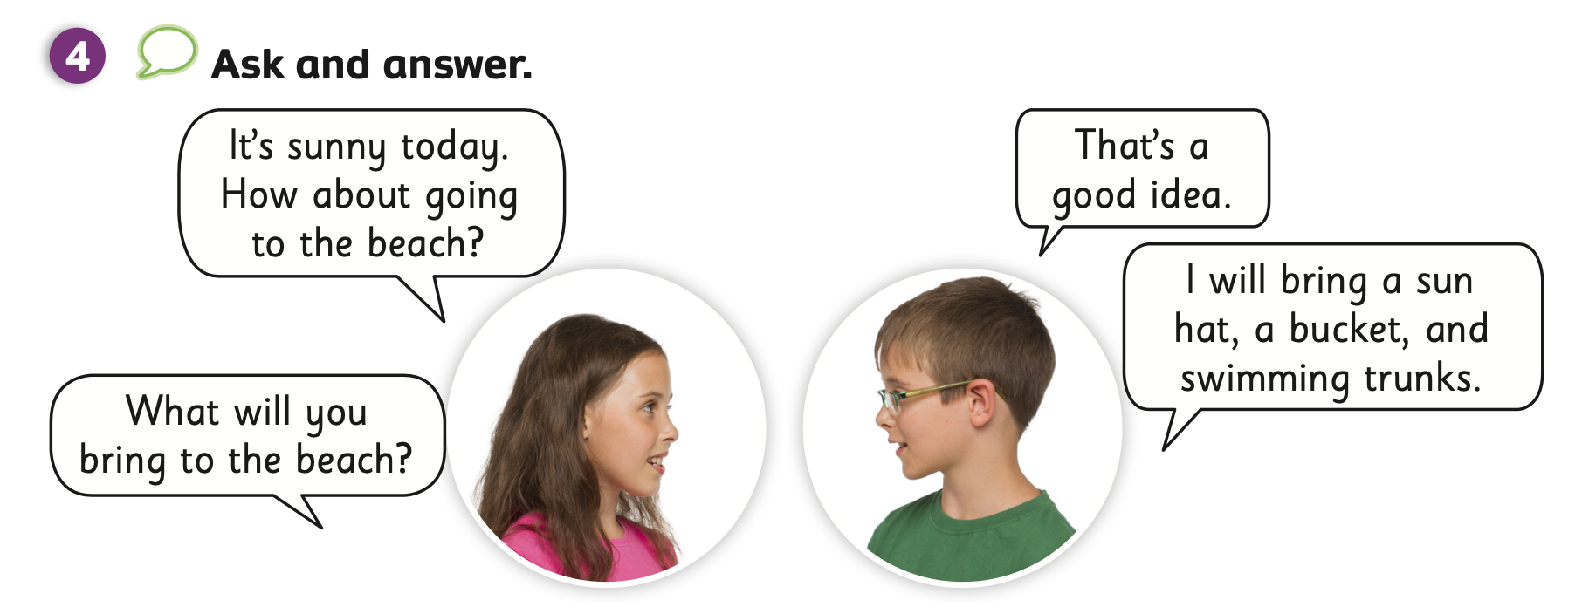
STRUCTURE - Pupils’ Book (p.103)
Have students in pairs look at Activity 4.
Ask students to use the present future with the question: “What will you bring to the beach?” and answer “I will bring a …”
Then, open the bubbles speech to show the example on the next slide.

Slide 31
STRUCTURE - Pupils’ Book (p.103)
It’s sunny today. How about going to the beach?
What will you bring to the beach?
That’s a good idea.
I will bring a sun hat, a bucket, and swimming trunks.
Invite some pairs to present in front of the class. Give points if students perform well.

Slide 32
PRODUCTION
sunglasses
beach towel
swimsuit
swimming trunks
sun hat
rockpool
bucket
fishing net
- Show all the pictures, students look and say the words aloud.

Slide 33

HOMEWORK
Review vocabulary and grammar.
Do exercises in the Activity Book (page 80).
Check the answers in the Teacher’s Book (page 177) or Active Teach.

Slide 34
UNIT 9 – Lesson 1
We’ve learned…
- To correctly read and pronounce the words related to beach equipment and clothes.
- To use the sentence patterns: What will you bring to the beach?
I will bring a …
- PB p.102,103
- AB p.80

