Slide 1

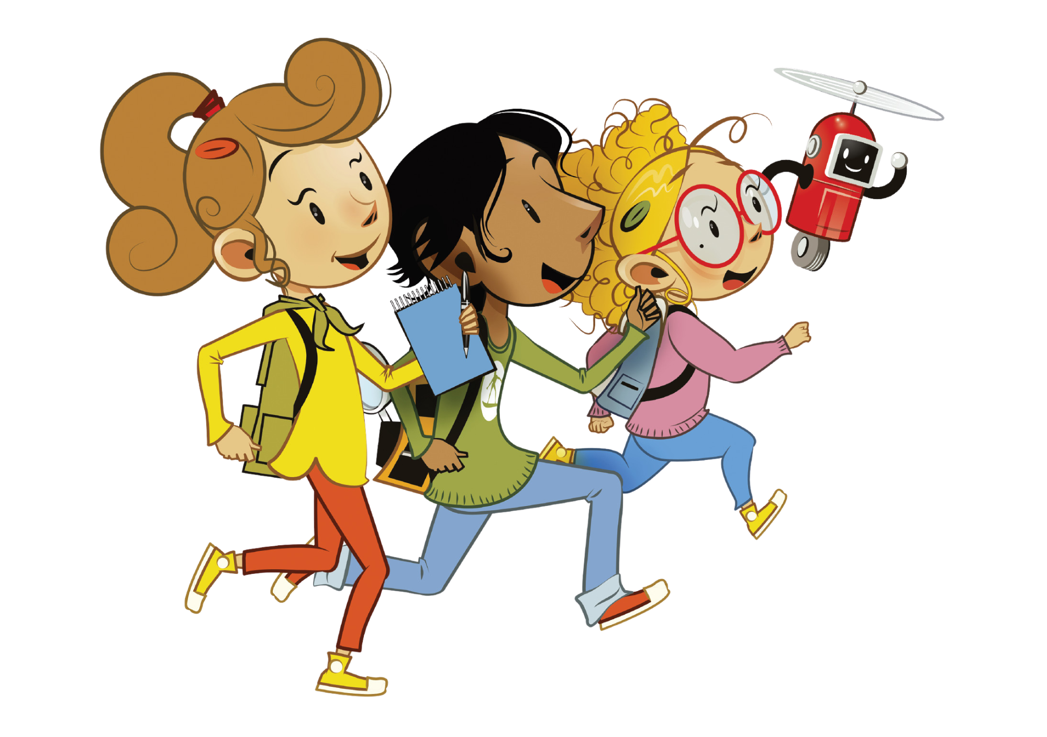

UNIT 7 – MY PARTY
Lesson 1 – Vocabulary
Teacher: Đoàn Ngọc Hà

Slide 2
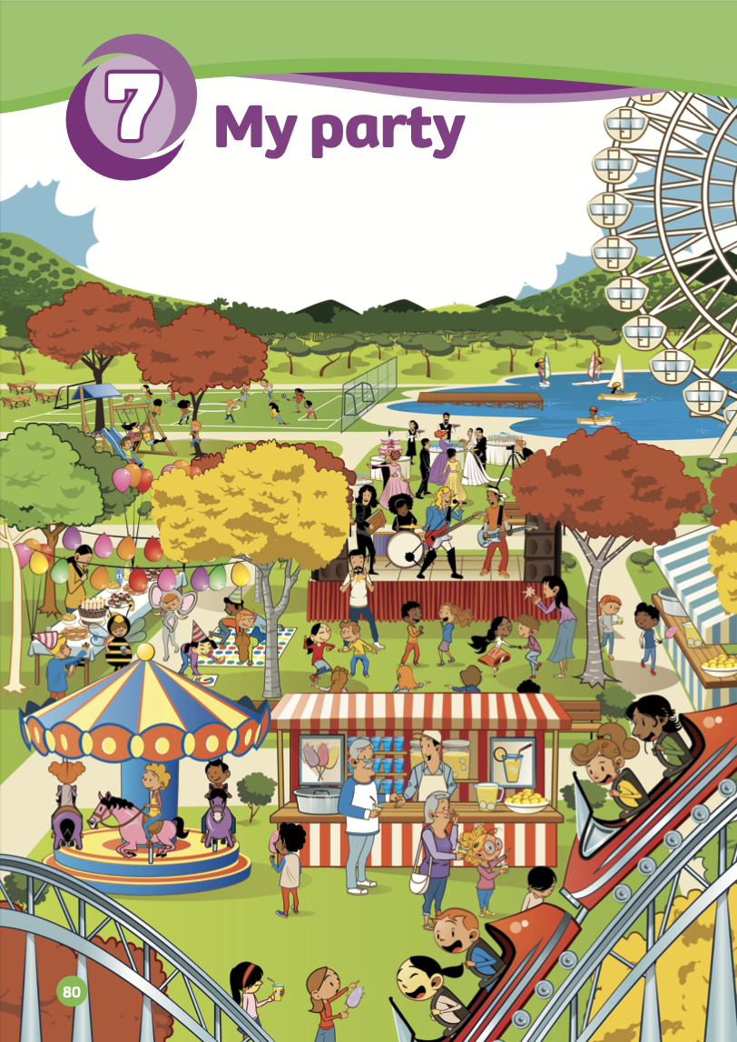
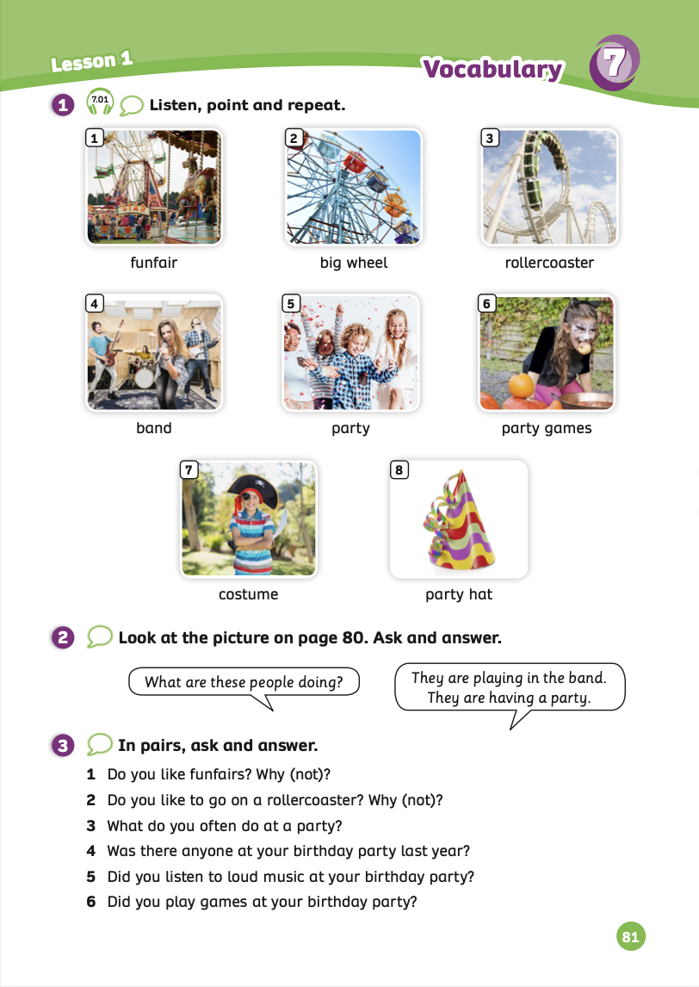
UNIT 7 – Lesson 1
We’re learning…
- To correctly read and pronounce words related to parties.
- To use the structures: What are these people doing? They are...
- PB p.80, 81.
- AB p.62

Slide 3


WARM-UP ACTIVITY
- Divide the class into groups of 4 to 5 students.
- Each group takes out a mini-board or a sheet of paper.
- Write the topic “party” on the board and count 3, 2, 1.
- Students start to write words that relate to the topic.
Ex: birthday cakes, games, party hats, fireworks,…
- Set a limit of 2 minutes for students.
- Then, each group says out loud their words.
- The group with the most correct words receives 2 points.

Slide 4


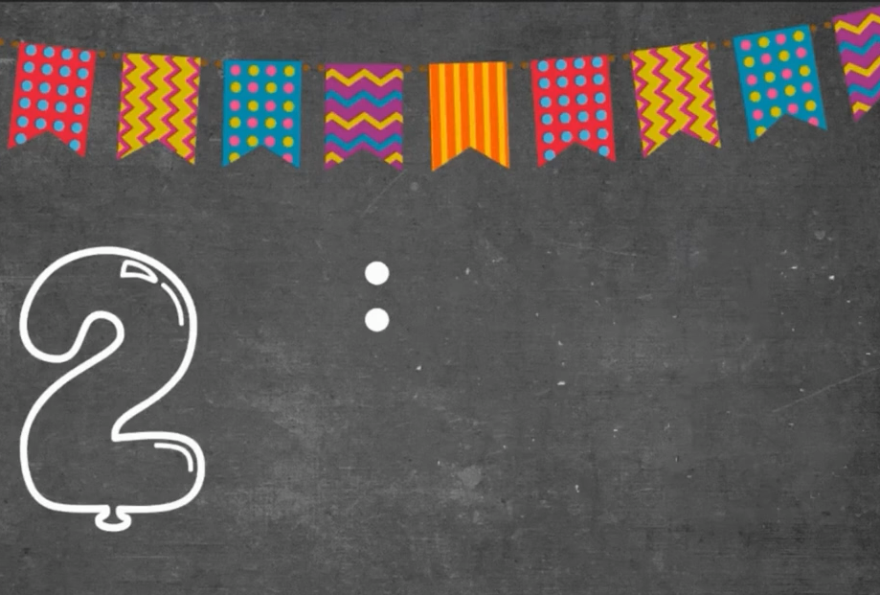

WARM-UP ACTIVITY
PARTY

Slide 5
LEAD-IN
go sailing
play football
rollercoaster
funfair
dance
dress up
big wheel
- Have students look at page 80 or the poster and work individually to circle as many words as they know in English.
- Work in pairs to share answers. Then, answer these questions:
1. Which activities have you done?
2. Which activities do you normally see at a party?

Slide 6
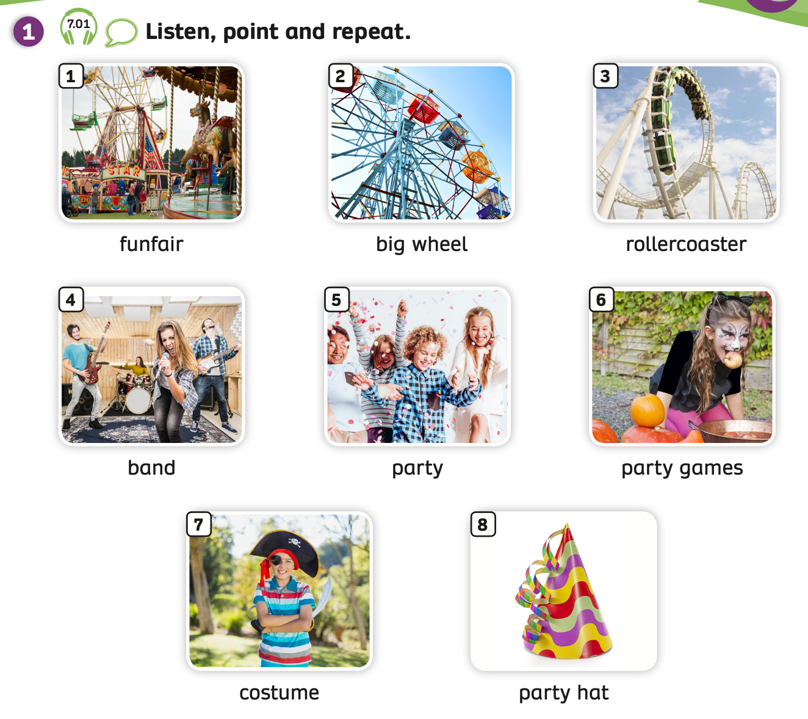

VOCABULARY – My party
Play the audio, students listen and repeat the words.

Slide 7
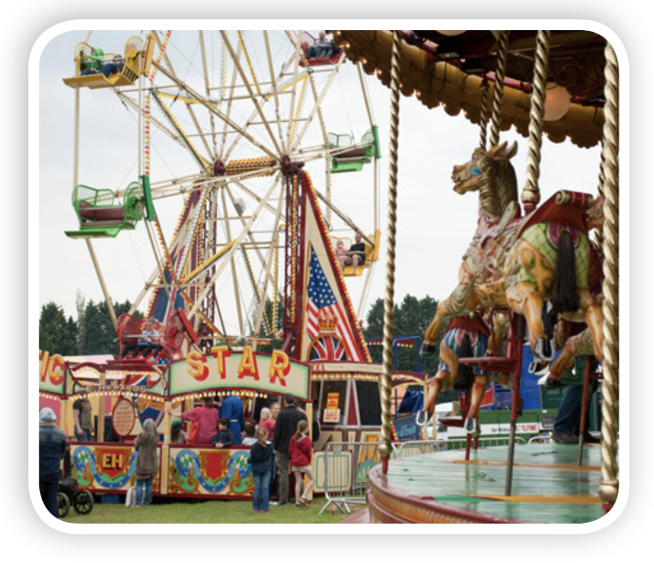
VOCABULARY – My party
c
Let’s spell!
funfair
f
u
n
f
a
i
r
Students listen and repeat the word.

Slide 8
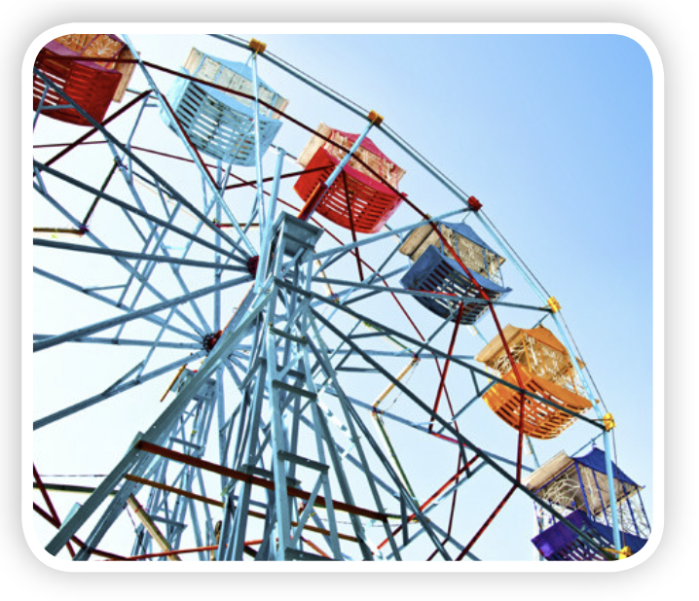
VOCABULARY – My party
c
Let’s spell!
big wheel
b
i
g
w
h
e
e
l
Students listen and repeat the word.

Slide 9
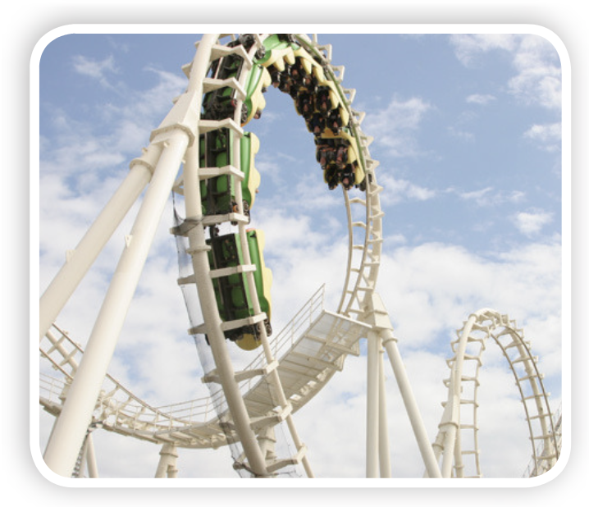
VOCABULARY – My party
c
Let’s spell!
rollercoaster
r
o
l
l
e
r
c
o
a
s
t
e
r
Students listen and repeat the word.

Slide 10
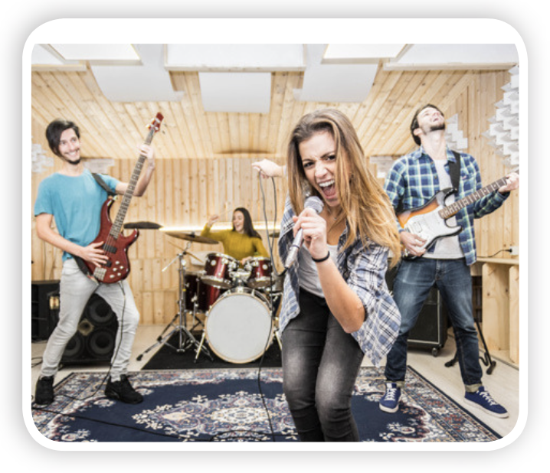
VOCABULARY – My party
Let’s spell!
c
band
b
a
n
d

Slide 11
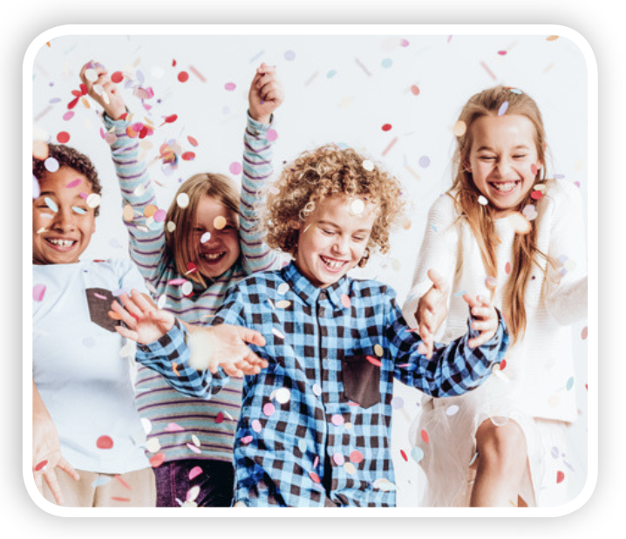
VOCABULARY – My party
Let’s spell!
c
party
p
a
r
t
y

Slide 12
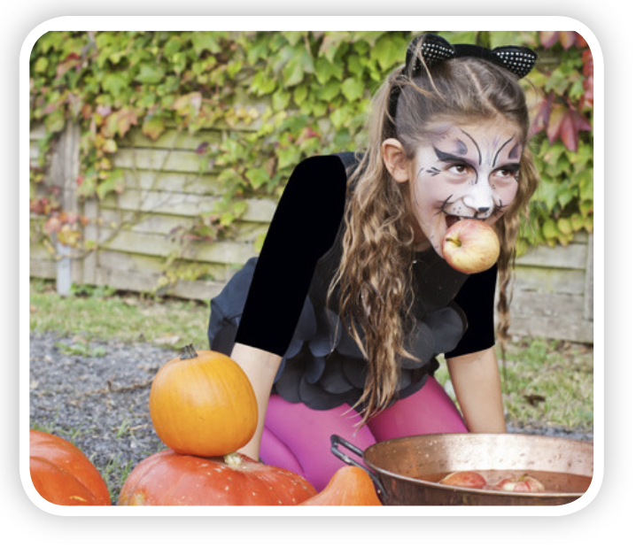
VOCABULARY – My party
c
Let’s spell!
party games
p
a
r
t
y
g
a
m
e
s
Students listen and repeat the word.

Slide 13
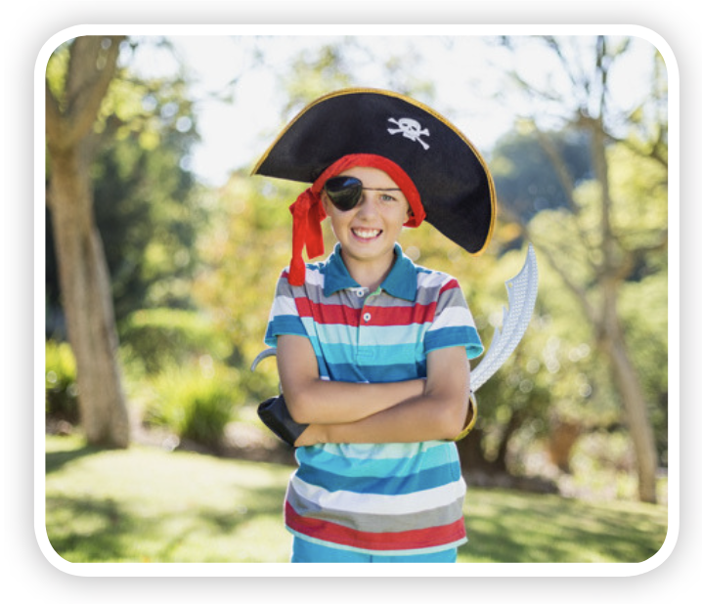
VOCABULARY – My party
c
Let’s spell!
costume
c
o
s
t
u
m
e
Students listen and repeat the word.

Slide 14
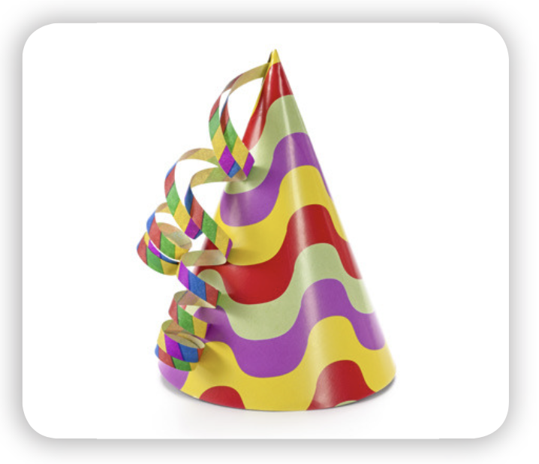
VOCABULARY – My party
c
Let’s spell!
party hat
p
a
r
t
y
h
a
t
Students listen and repeat the word.

Slide 15

VOCABULARY - REVIEW
c
c
c
c
funfair
big wheel
rollercoaster
band
c
c
c
c
party
party games
costume
party hat
Show each picture, students look at and say the word.

Slide 16

VOCABULARY – Practice
Divide the class into two teams: team A and team B.
Each student takes out a mini-board.
Students look at the slides and write down the answers corresponding numbers 1, 2, and 3 for each picture.
If all students in the team write the correct picture, that team will receive 2 points. But if the team has 2 or 3 students write the wrong picture, they won’t receive points.
The team with the highest points wins the game.

Slide 17



Slide 18










party hat

Slide 19
party games

Slide 20
party

Slide 21
funfair

Slide 22
big wheel

Slide 23
band

Slide 24
rollercoaster

Slide 25
costume

Slide 26
STRUCTURE – Pupils’ Book (p.81)
Activity: SPEAKING TIME
- Ask students to work in pairs and look at the picture on page 80.
Ask students to use the present continuous tense and practice the question: “What are these people doing?” and answer with: “They are…”
Invite some pairs to present in front of the class. Give points if they perform successfully.

Slide 27
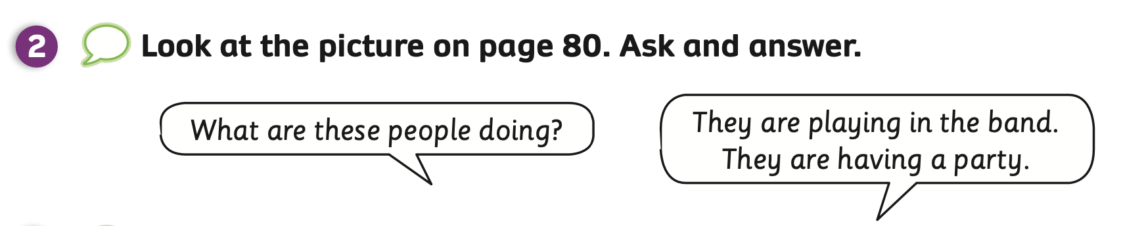
STRUCTURE – Pupils’ Book (p.81)

Slide 28

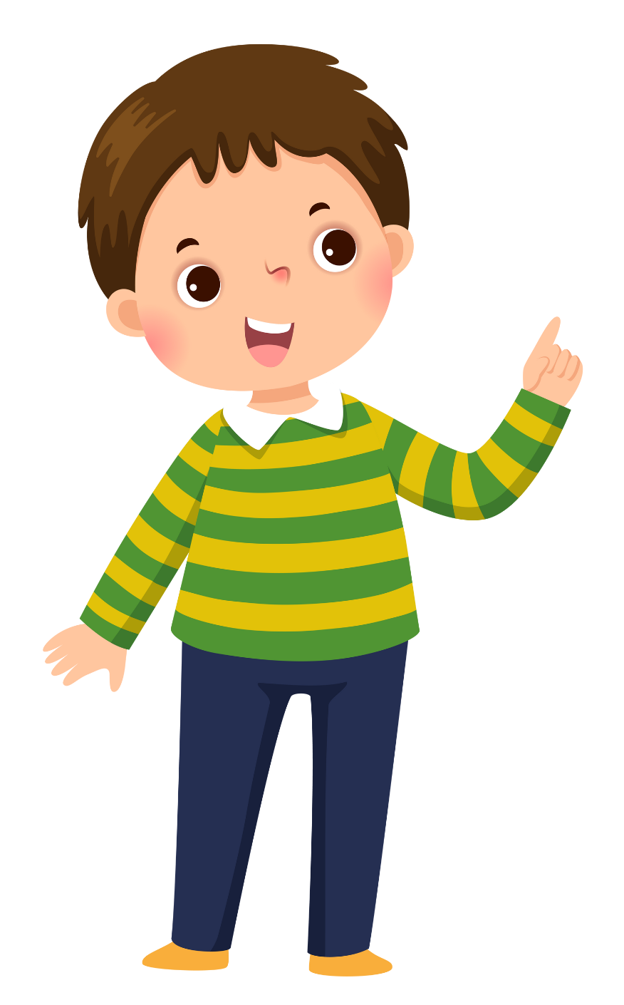

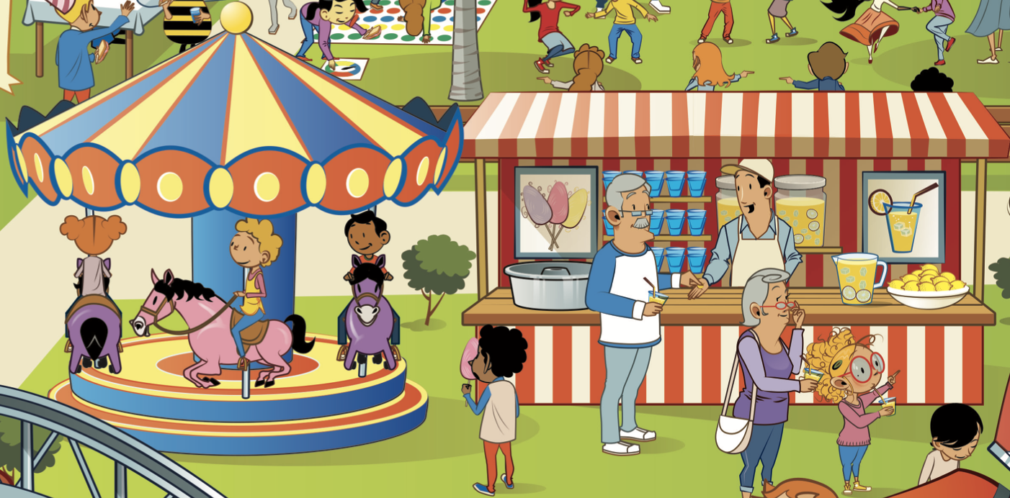
STRUCTURE – Pupils’ Book (p.81)
What are these people doing?
They are playing in the funfair.
Invite some pairs to present in front of the class. Give points if they perform successfully.

Slide 29
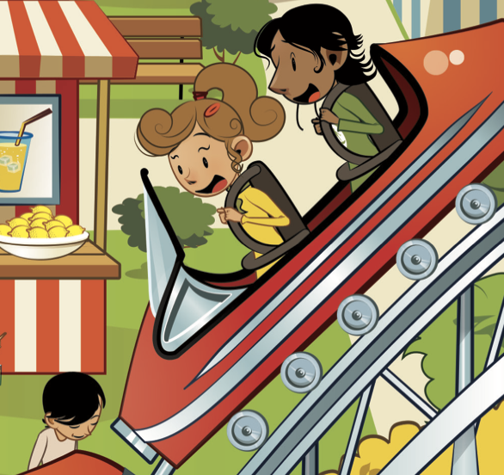
STRUCTURE – Pupils’ Book (p.81)
What are these people doing?
They are playing
rollercoaster.
Invite some pairs to present in front of the class. Give points if they perform successfully.

Slide 30
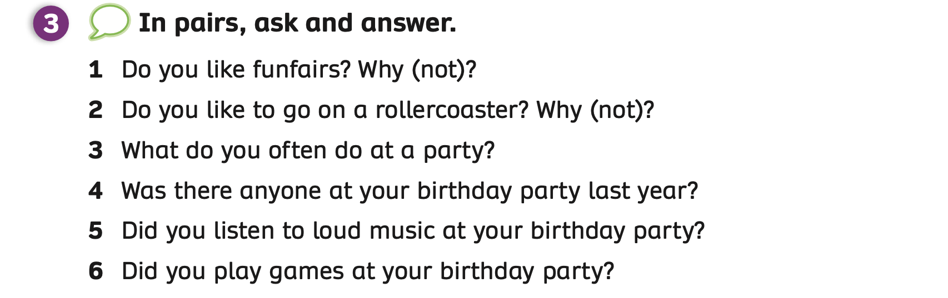
STRUCTURE – Pupils’ Book (p.81)
- Show the questions and introduce the activity.

Slide 31

STRUCTURE – Pupils’ Book (p.81)
Divide the class into groups of 5 to 6 students.
Give each student a piece of paper with 6 columns on it.
Students choose a member in the group, ask 6 questions in Activity 3 and write the information on the paper.
After finishing 3 names on the paper, students say Bingo.
The teacher goes around, checks and helps students if needed.
The 5 fastest students who finish all columns on the paper receive 2 points.

Slide 32
STRUCTURE – Pupils’ Book (p.81)
Name | Funfairs | Rollercoaster | Do at a party | Anyone at party | Listen to loud music | Play games
1
2
3
Teacher shows this table.
Teacher can print out this table or ask students to draw the table on the piece of paper.

Slide 33

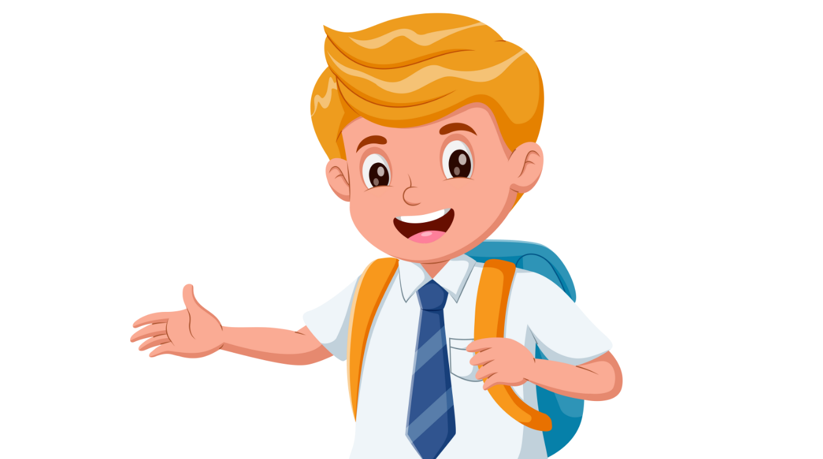
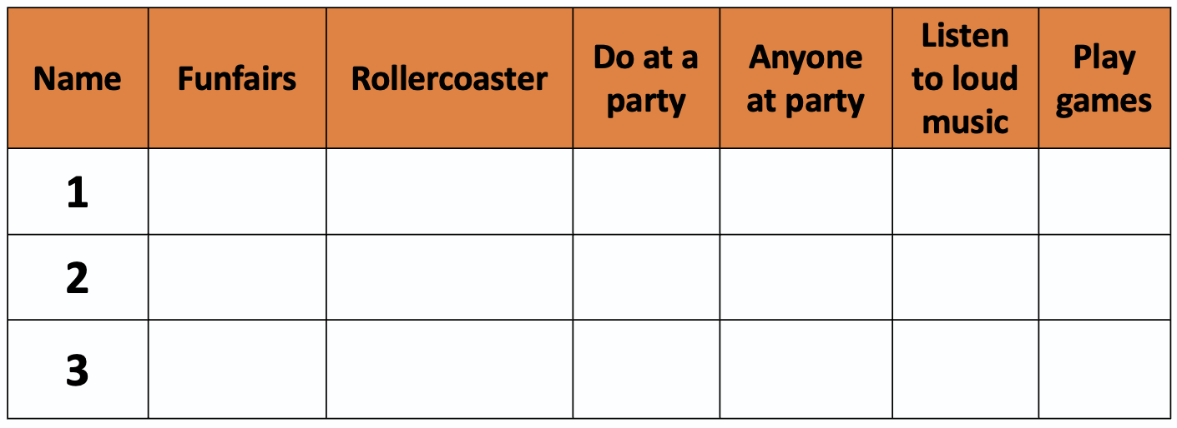
STRUCTURE – Pupils’ Book (p.81)
Do you like to go on
a rollercoaster?
What do you often do at a party?
Yes, I do.
No, I don’t.
Do you like funfairs?
I play games.
Minh
games
Liên
Minh
Students look at the example conversation.
Then, switch roles to practice.

Slide 34
STRUCTURE – Pupils’ Book (p.81)
Was there anyone at your birthday party last year?
Did you listen to loud music at your birthday party?
Yes, there was.
Yes, I did.
Minh
games
Liên
Minh
Students look at the example conversation.
Then, switch roles to practice.

Slide 35
PRODUCTION
c
c
c
c
funfair
big wheel
rollercoaster
band
c
c
c
c
party
party games
costume
party hat
Show each picture, students look at and say the word.

Slide 36
HOMEWORK
Review vocabulary.
Do exercises in the Activity Book (page 62).
Check answers in the Teacher’s Book (page 139) or Active Teach.

Slide 37
UNIT 7 – Lesson 1
We’ve learned…
- To correctly read and pronounce words related to parties.
- To use the structures: What are these people doing? They are...
- PB p.80, 81.
- AB p.62

