Slide 1

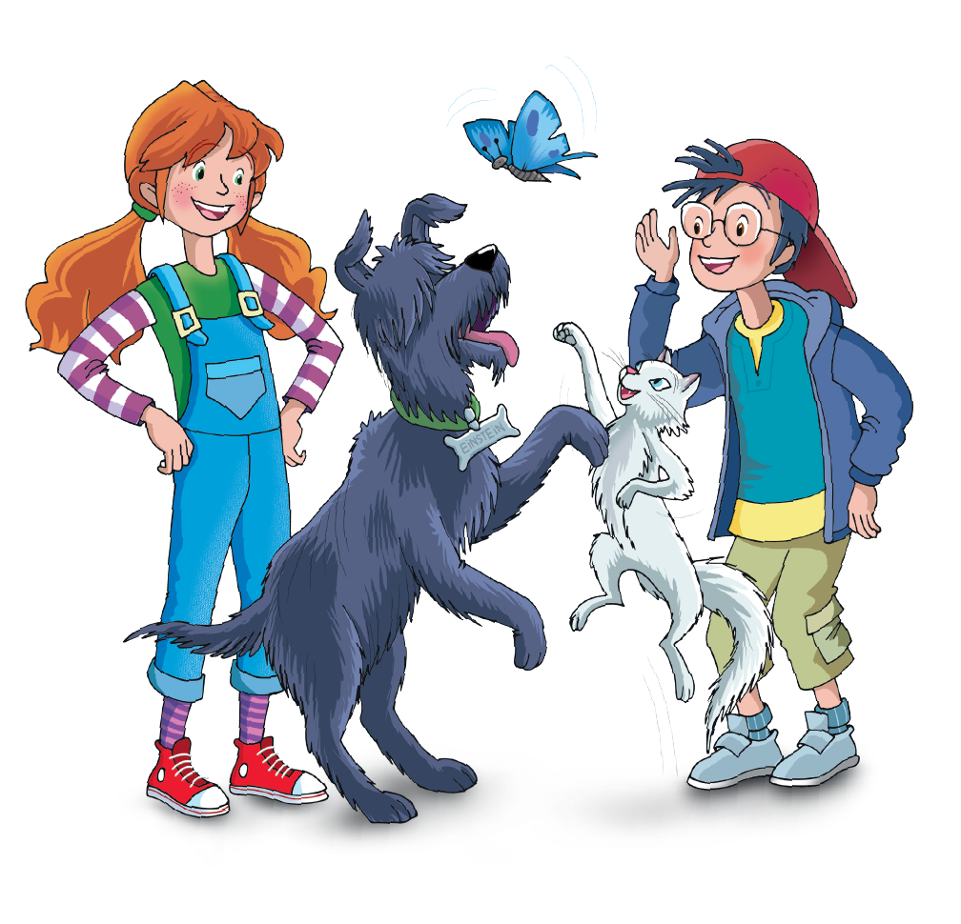

UNIT 6 – A CAMPING TRIP
Lesson 1 – Vocabulary & Grammar 1
Teacher: Đoàn Ngọc Hà

Slide 2

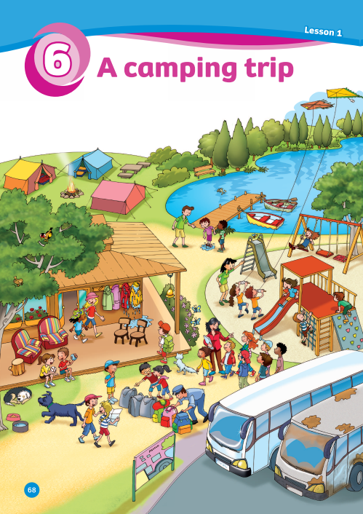
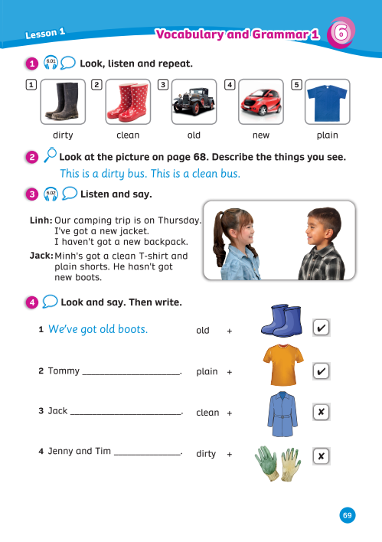
UNIT 6: A CAMPING TRIP
We’re learning…
Adjectives
To describe things using adjectives
PB pp.68,69
AB p.56

Slide 3



WARM - UP
Song: The Warm-up Song!
Listen to the song.
Stand up and dance along.
Notes:
Link video: https://www.youtube.com/watch?v=dCW5P_iDRBY

Slide 4
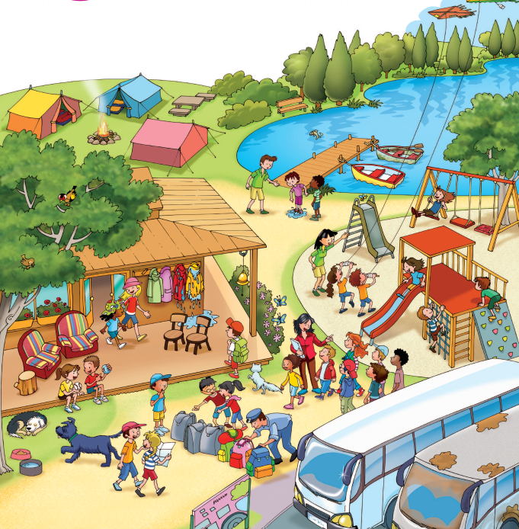
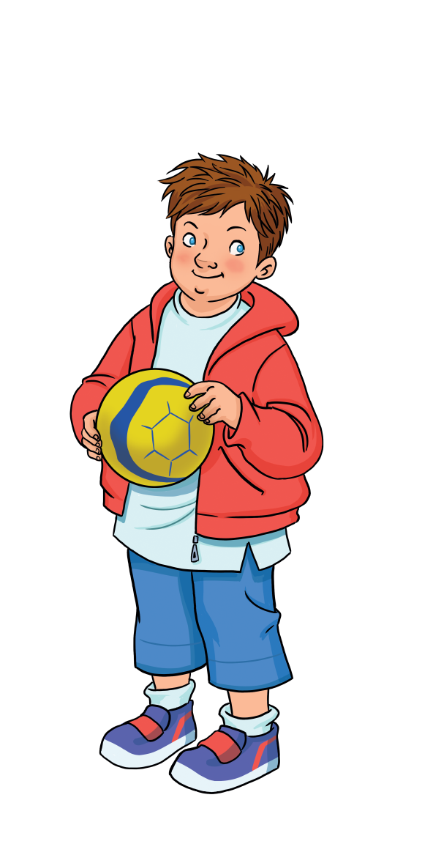

LEAD-IN
How many buses do you see?
I see…

Slide 5
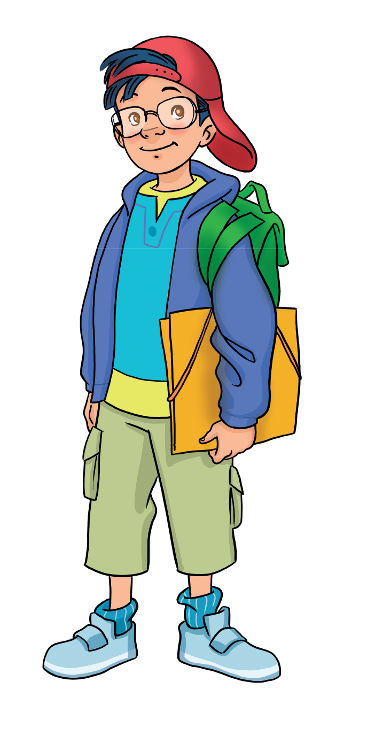
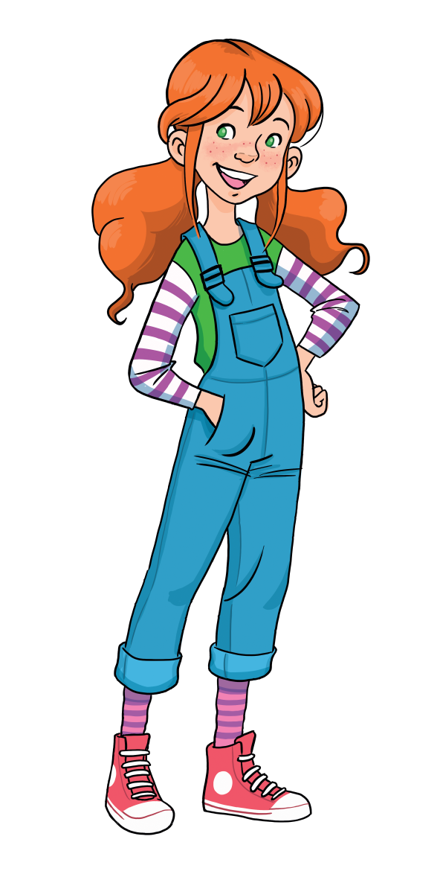
LEAD-IN
Where are they?
They’re in a park.

Slide 6
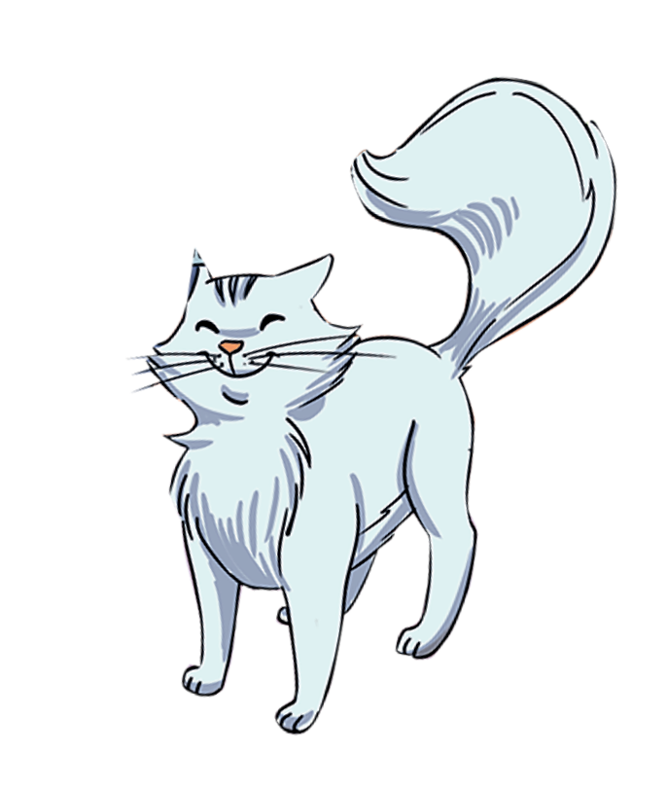
LEAD-IN
They can …
What activities can they do?

Slide 7

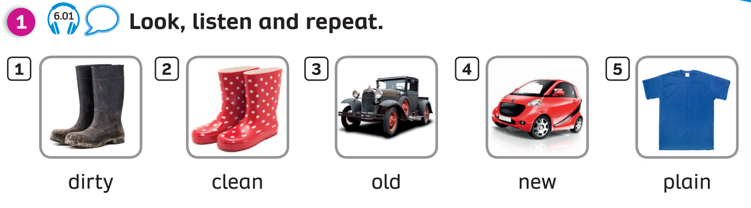
PUPILS’ BOOK (p.69)

Slide 8

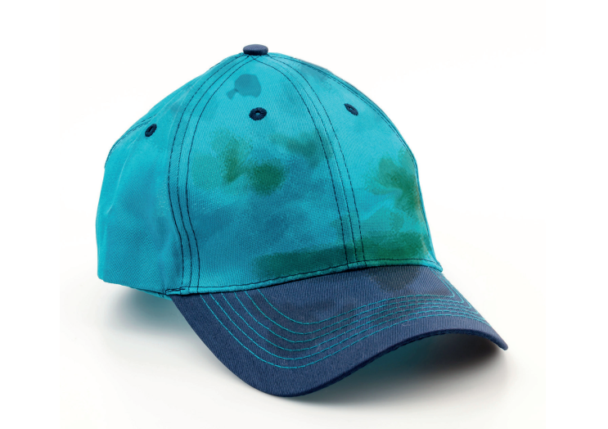

VOCABULARY: Adjectives
Let’s spell!
c
dirty
d
i
r
t
y

Slide 9

VOCABULARY: Adjectives
Let’s spell!
c
clean
c
l
e
a
n

Slide 10
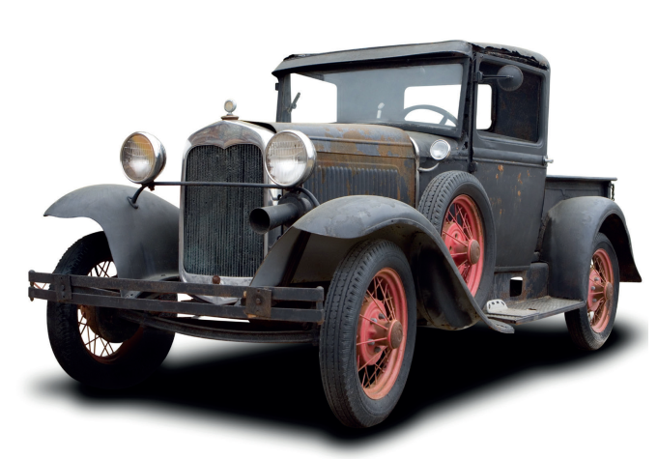
VOCABULARY: Adjectives
Let’s spell!
c
old
o
l
d

Slide 11
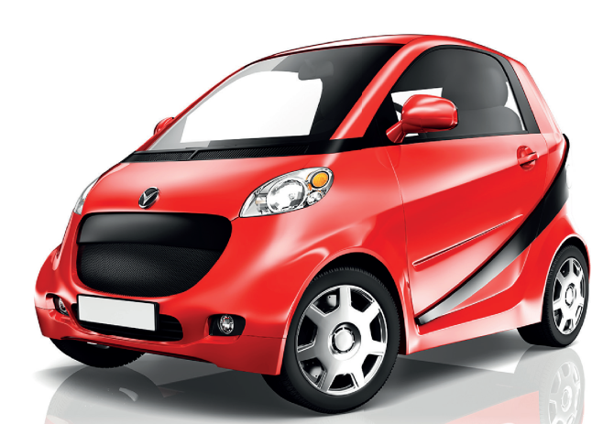
VOCABULARY: Adjectives
Let’s spell!
c
new
n
e
w

Slide 12
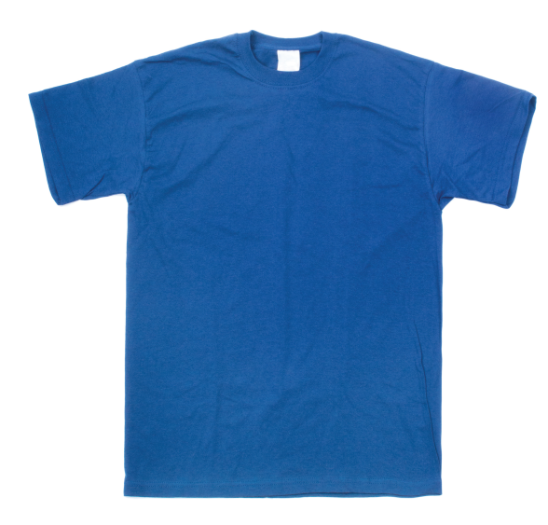
VOCABULARY: Adjectives
Let’s spell!
c
plain
p
l
a
i
n

Slide 13


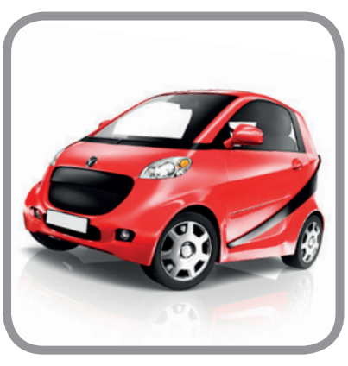

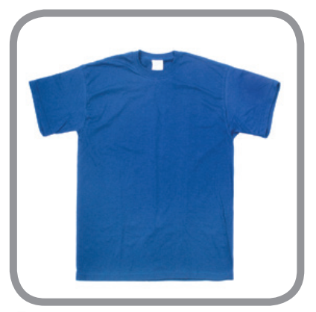
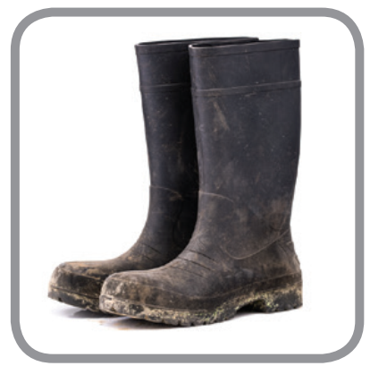
VOCABULARY: Adjectives
old
clean
new
ADJECTIVES
dirty
plain
Look at the pictures and say.

Slide 14




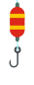

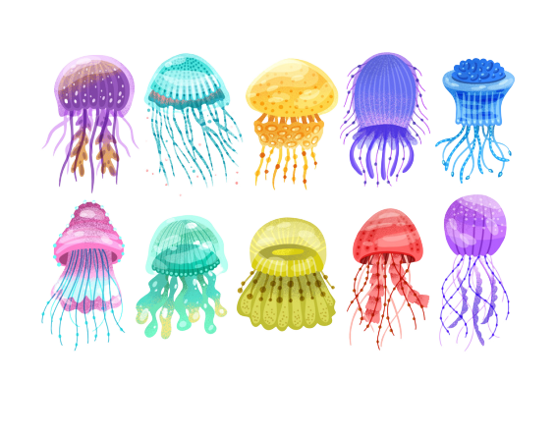




GO FISHING
Game
PLAY
RULES

Slide 15
How to play:
Divide the class into groups of four.
Look at the sentence and the answer, choose the correct answer and raise their fingers to choose the answer (A is 1 finger and B is 2 fingers )
Say aloud the answer.
The first 5 groups get points.
PLAY

Slide 16



Choose the best answer.
A
clean
B
dirty
D
STOVE
Look and choose the right answer. Then write it on the board.
Click on the letters to check.

Slide 17
Choose the best answer.
A
plain
B
new
D
May
Look and choose the right answer. Then write it on the board.
Click on the letters to check.

Slide 18
Choose the best answer.
A
old
B
new
D
Climb
Look and choose the right answer. Then write it on the board.
Click on the letters to check.

Slide 19
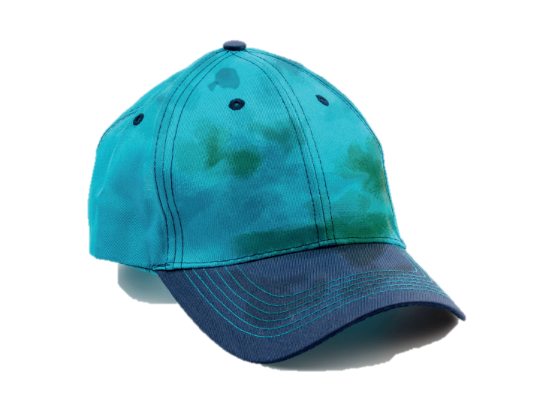
Choose the best answer.
A
clean
B
dirty
D
Watch
Look and choose the right answer. Then write it on the board.
Click on the letters to check.

Slide 20
Choose the best answer.
B
new
C
old
D
Next to
Look and choose the right answer. Then write it on the board.
Click on the letters to check.

Slide 21

EXIT

Slide 22

PUPILS’ BOOK (p.69)
Example
This is a dirty bus.
This is a clean bus.
Click on “Example” to show the example. In pairs, complete the activity. Invite some pairs to describe the things they see.

Slide 23
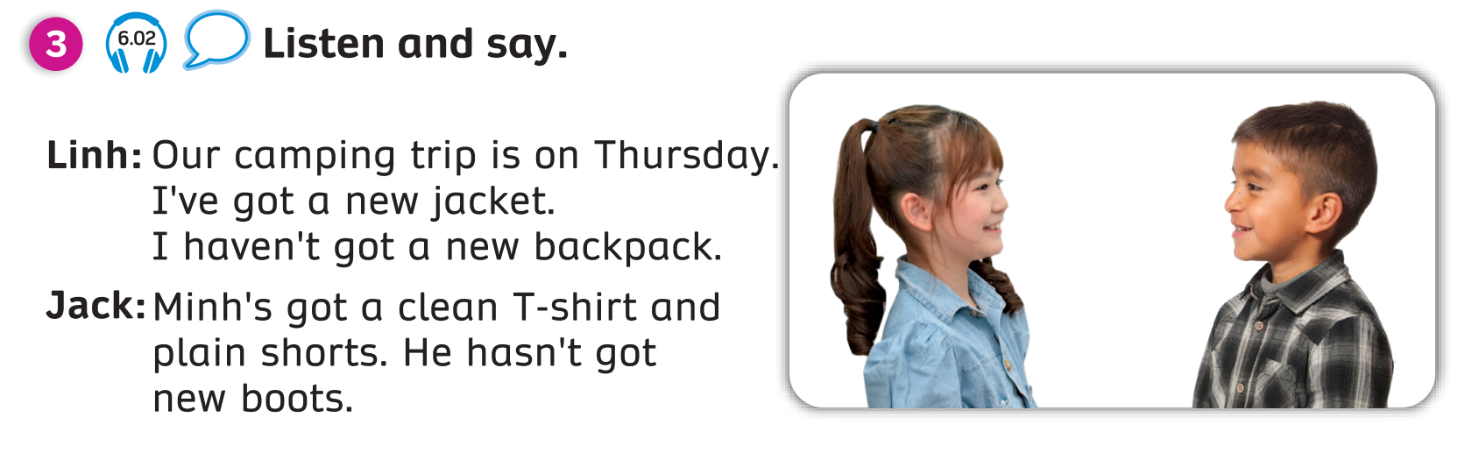
PUPILS’ BOOK (p.69)
Listen and read. In pairs, practice the conversation together.
Notes:
Post - listening

Slide 24


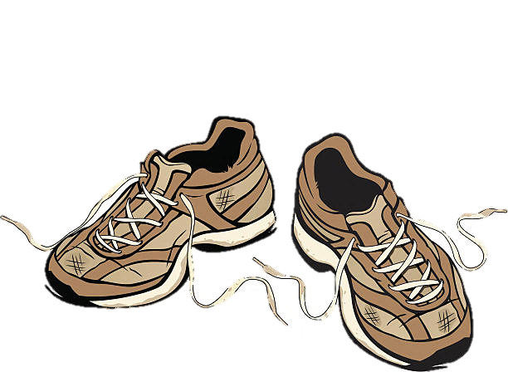
GRAMMAR
I’ve got a new dress.
I haven’t got new shoes.

Slide 25
GRAMMAR
I’ve got a new jacket.
I haven’t got a new backpack.
I/You/We/They’ve got + …..
I/You/We/They haven’t got + …..
Show the structures, students look and read again.
Put students in pairs, say the sentences.
Notes:
Post - listening

Slide 26



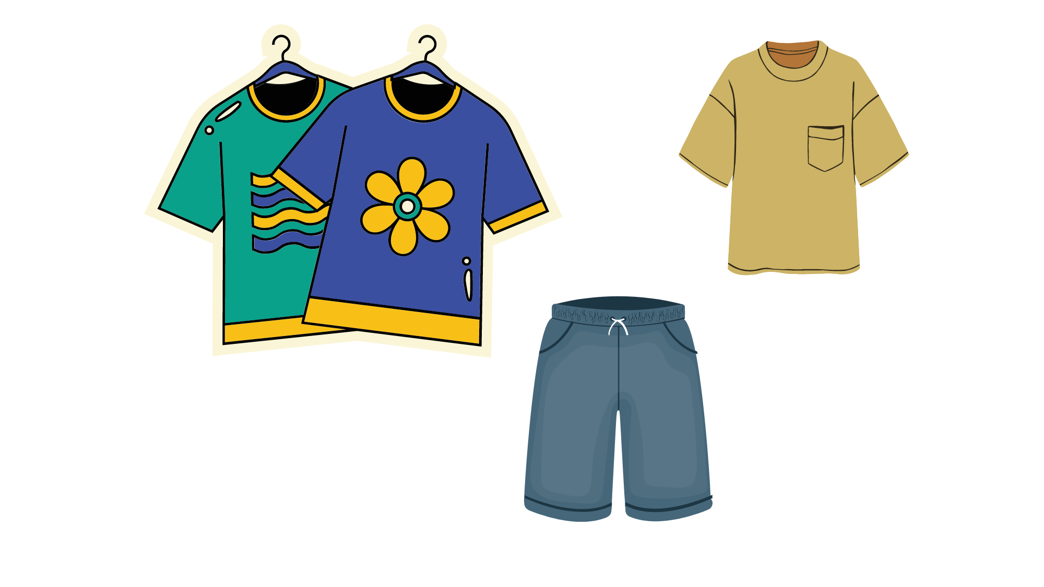
GRAMMAR
Sam’s got a clean T-shirt and plain shorts.
He hasn’t got a new cap.

Slide 27
GRAMMAR
Minh’s got a clean T-shirt and plain shorts.
He hasn’t got new boots.
He/She/It’s got + …..
He/She/It hasn’t got + …..
Show the structures, students look and read again.
Put students in pairs, say the sentences.
Notes:
Post - listening

Slide 28
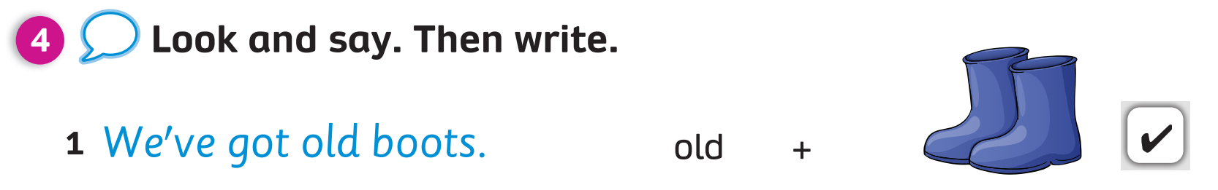

PUPILS’ BOOK (p.69)
1. We __________________.
We have got old boots.

Slide 29
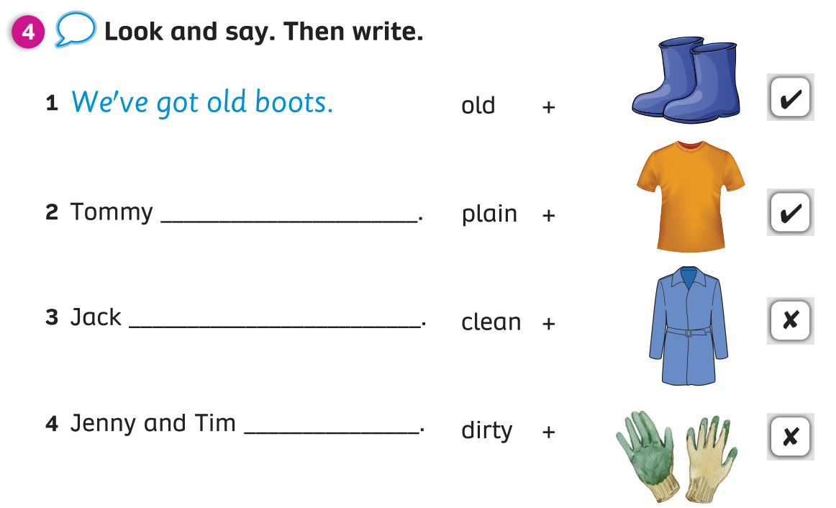
PUPILS’ BOOK (p.69)
Students open their books and complete the activity.

Slide 30
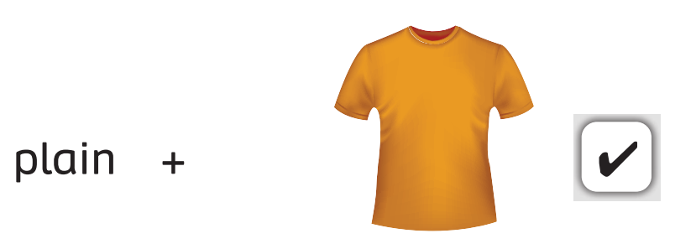
PUPILS’ BOOK (p.69)
2. Tommy____________________
has got a plain T-shirt.
Answer
Click on the “answer” to check.
Then say the sentence.

Slide 31
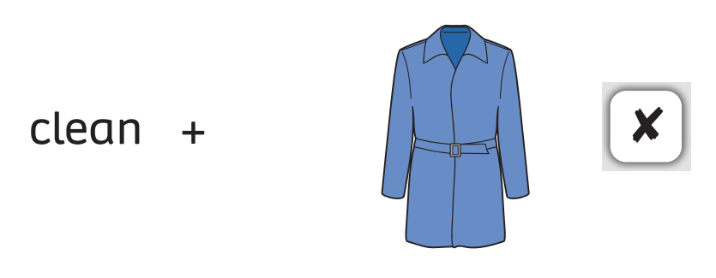
PUPILS’ BOOK (p.69)
3. Jack ____________________
hasn’t got a clean jacket.
Answer
Click on the “answer” to check.
Then say the sentence.

Slide 32

PUPILS’ BOOK (p.69)
3. Jenny and Tim ____________________.
have got dirty gloves.
Answer
Click on the “answer” to check.
Then say the sentence.

Slide 33
PRODUCTION
I’ve got new shoes.
I’ve got a clean dress.
I haven’t got new socks.
I haven’t got
a new backpack.
Look at the conversation between Marie and Lucy.
Practice in pairs to describe their things using the structure
“I’ve got ….”; “I haven’t got ….”

Slide 34
WRAP - UP
old
clean
new
ADJECTIVES
dirty
plain

Slide 35

HOMEWORK
Review vocabulary and grammar.
Do exercises in the Activity book (page 56).
Check answers in the Teacher’s book (page 130) or Active Teach.

Slide 36

UNIT 6: A CAMPING TRIP
We’re learning…

