Slide 1

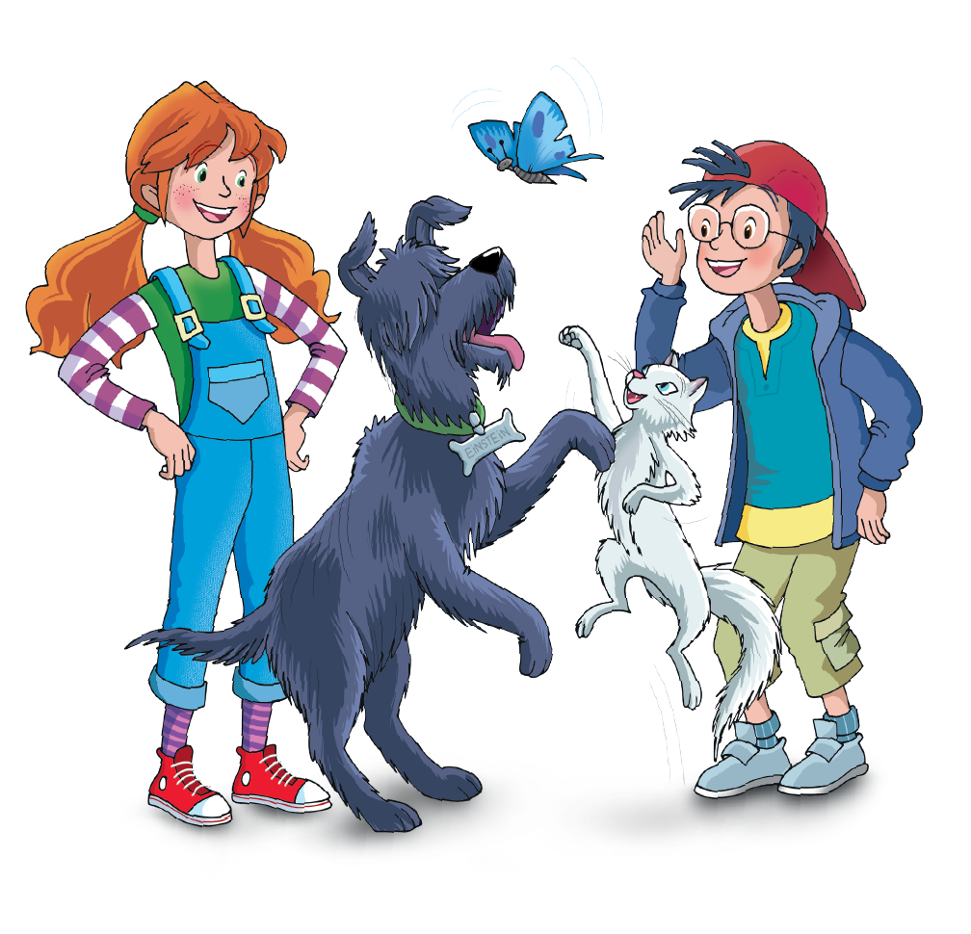

UNIT 5 – I WANT TO BE A COOK!
Lesson 3A – Vocabulary and Grammar 2
Teacher: Đoàn Ngọc Hà

Slide 2

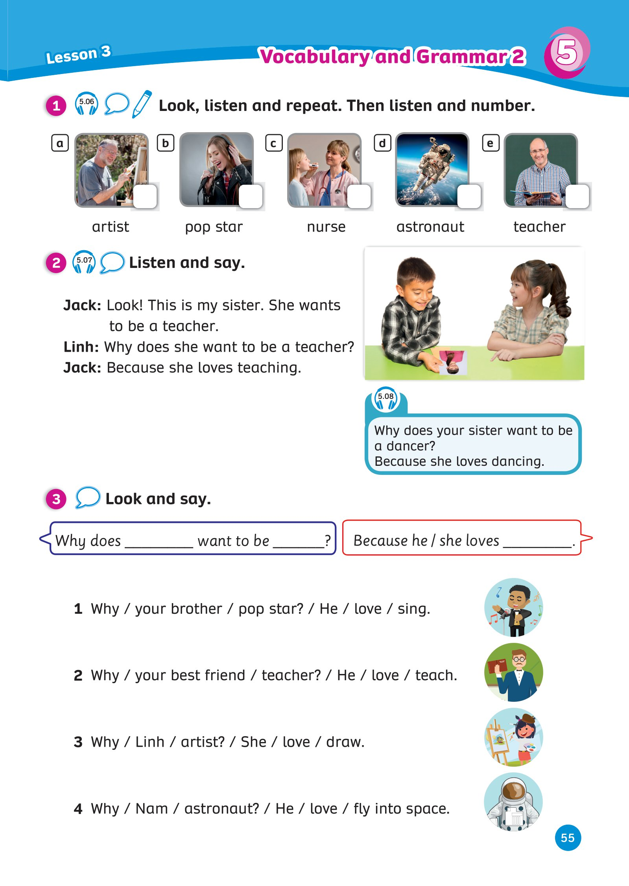
UNIT 5: I WANT TO BE A COOK!
We’re learning…
talk about jobs
PB p.55
AB p.48

Slide 3


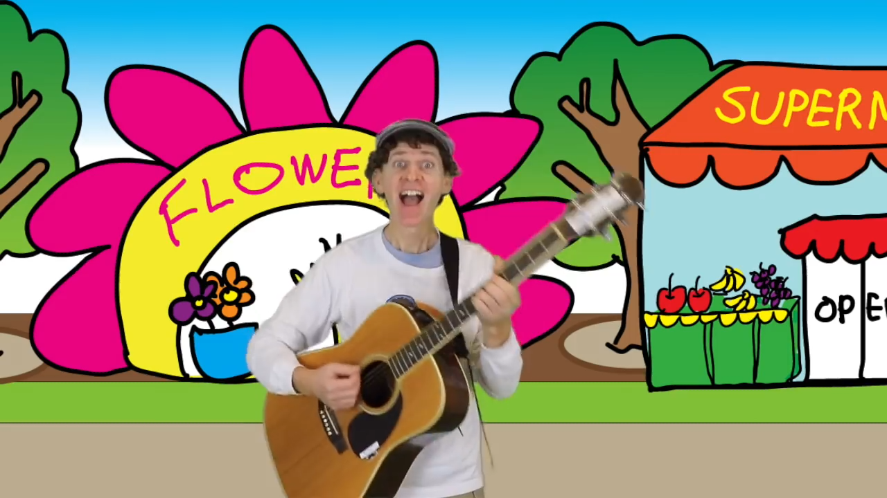
WARM-UP
Song: Who do you see?
Stand up.
Listen to the song.
Sing along.
Notes:
Link Youtube: https://www.youtube.com/watch?v=2nesqKP9-5c

Slide 4

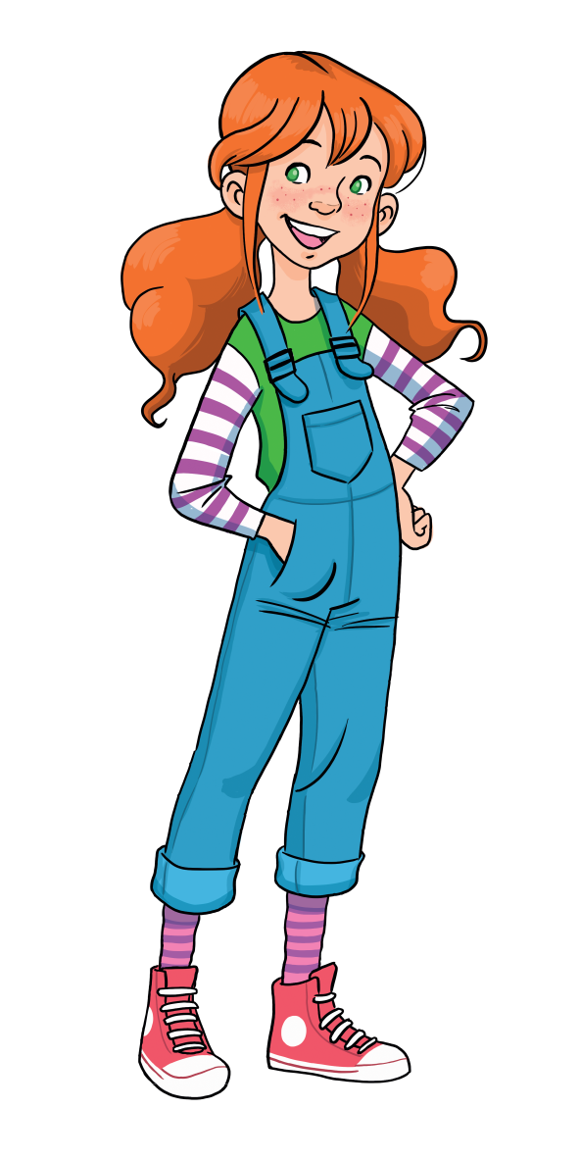
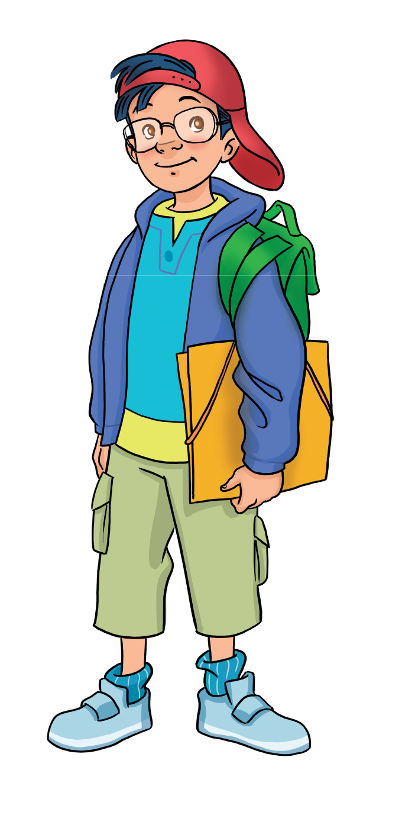
WARM-UP ACTIVITY
Let’s play!
Put students into pairs.
Say a sentence: I like building houses. I want to be a_____
Students listen and write a correct word on the mini-board.
1 correct answer = 1 point.
All students repeat the answers.

Slide 5

WARM-UP ACTIVITY
SENTENCES
pilot
1. I like flying in the sky. I want to be a ______.
cook
2. I like cooking meals. I want to be a _______.
dancer
3. I like dancing. I want to be a ________.
nurse
4. I like helping people. I want to be a _______.
5. I like building houses. I want to be a ______.
builder

Slide 6

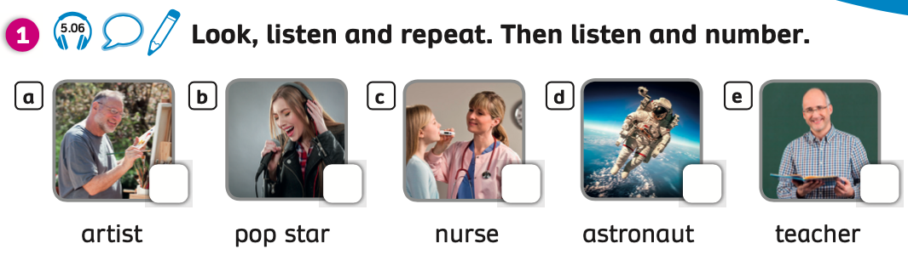
VOCABULARY: Jobs

Slide 7
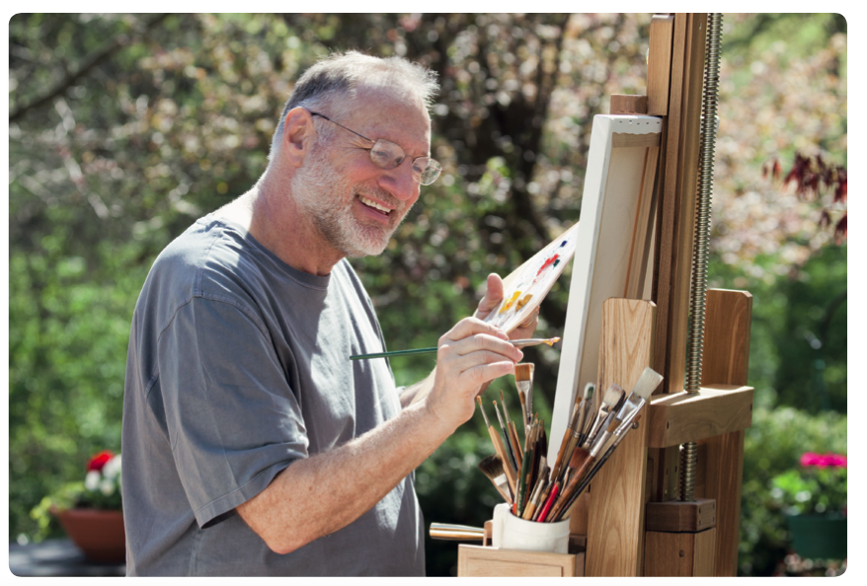

VOCABULARY: Jobs
Let’s spell!
c
artist
a
r
t
i
s
t

Slide 8
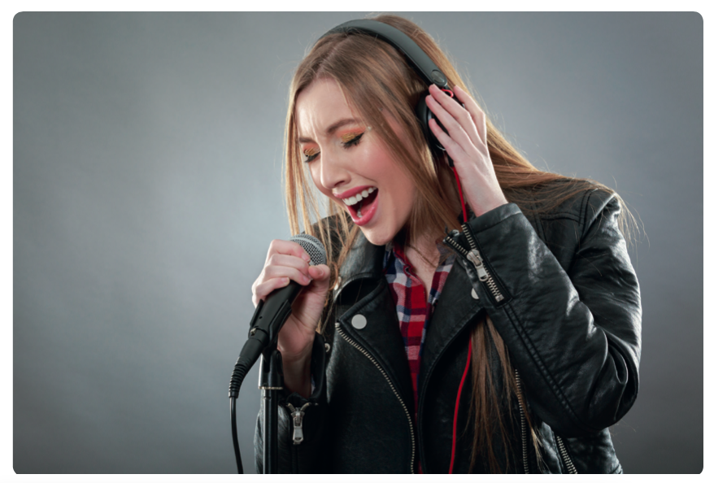
VOCABULARY: Jobs
Let’s spell!
c
pop star
p
o
p
s
t
a
r

Slide 9
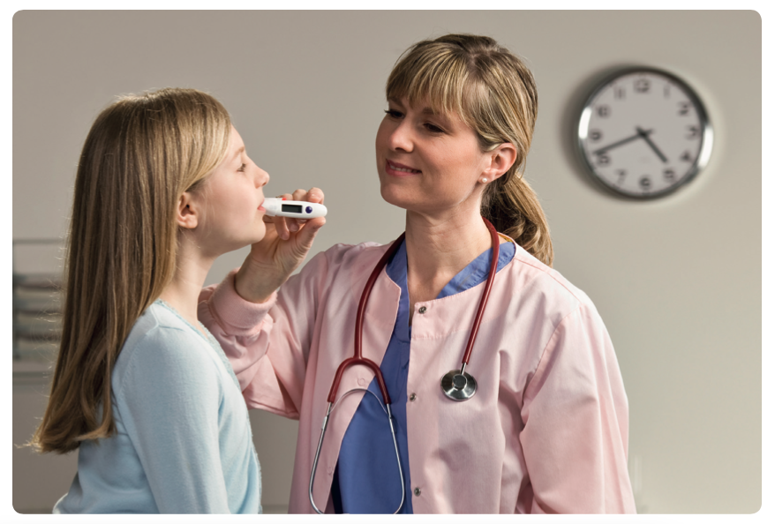
VOCABULARY: Jobs
Let’s spell!
c
nurse
n
u
r
s
e

Slide 10
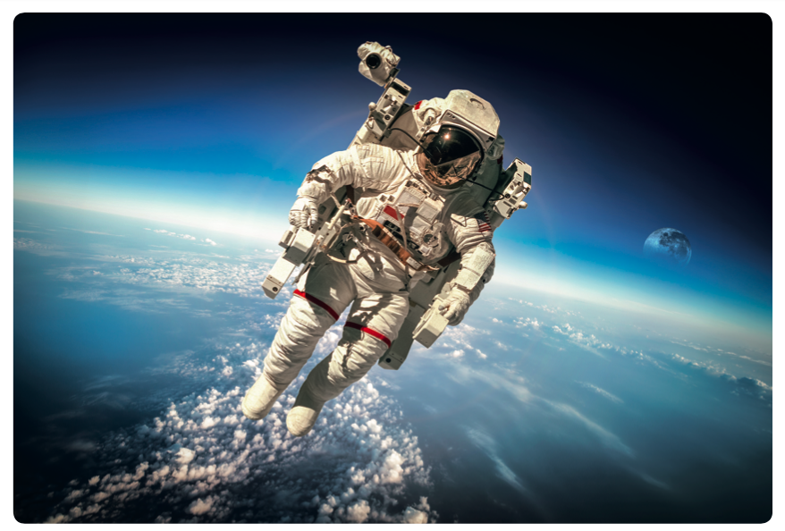
VOCABULARY: Jobs
Let’s spell!
c
astronaut
a
s
t
r
o
n
a
u
t

Slide 11

VOCABULARY: Jobs
Let’s spell!
c
teacher
t
e
a
c
h
e
r

Slide 12

REVIEW
nurse
pop star
astronaut
artist
teacher
- Point to each picture, students look and spell words.

Slide 13
PRACTICE
Let’s play!
Put students into two or three groups.
Each team takes turns playing. Students look at the picture, say a correct word aloud then spell the word.
1 correct answer = 1 point.
All students repeat the answers.

Slide 14









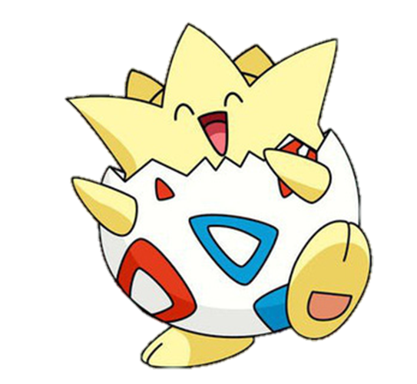

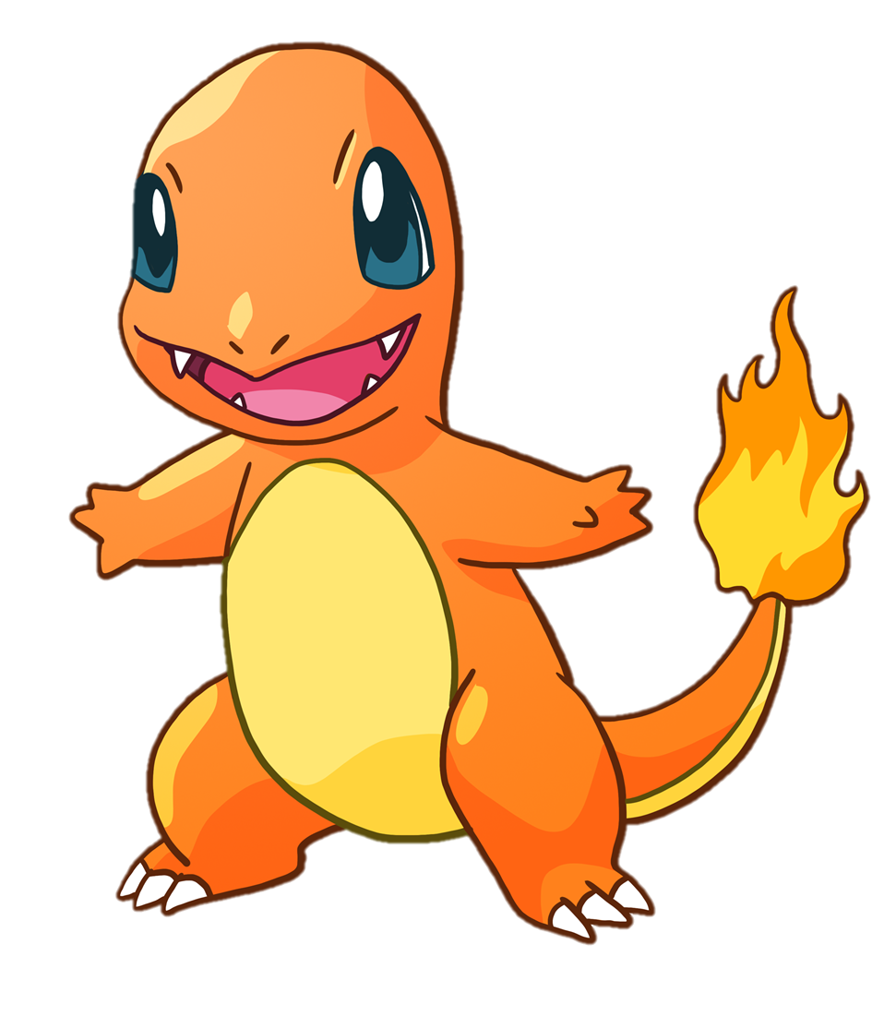


MsPham-0936082789
MsPham-0936082789
MsPham-0936082789
MsPham-0936082789

Slide 15
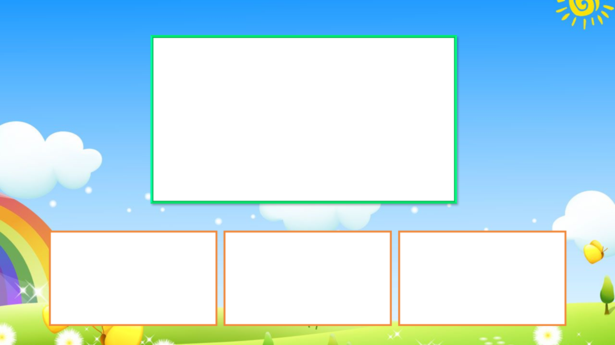



teacher
pop star
artist

Slide 16

astronaut
nurse
teacher

Slide 17
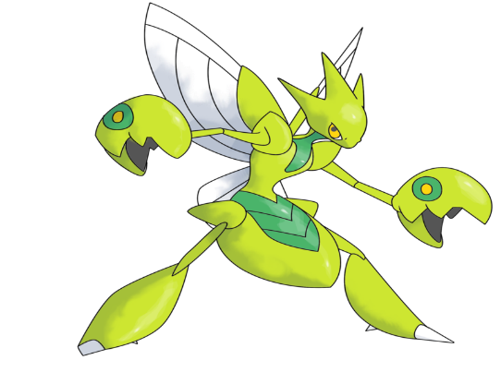
artist
teacher
pop star

Slide 18

artist
astronaut
nurse

Slide 19

teacher
pop star
nurse

Slide 20


Well done!

Slide 21
PUPILS’ BOOK p.55
ANSWER
Listen and number
5
3
2
4
1
Have students open their books, look at these pictures and say the words aloud.
Play the audio, students listen and write a number in each box.
Play the audio again, students listen and check their answers.

Slide 22
GRAMMAR
I want to be a pop star.
Show the speech bubble with the sound, students listen and repeat.

Slide 23
GRAMMAR
He wants to be a teacher.
Show the speech bubble with the sound, students listen and repeat.

Slide 24

GRAMMAR
She wants to be a nurse.
Show the speech bubble with the sound, students listen and repeat.

Slide 25
GRAMMAR
Structure:
I
want
+
He
wants
+
She

Slide 26

PRODUCTION
Put students in groups of four.
Each member of the team takes turns spelling a word. Other students listen and say the word aloud.
The fastest person with the correct word receives 1 point.

Slide 27


WRAP-UP
What have you learnt today?
nurse
teacher
Students call out all the jobs they have learnt today.

Slide 28
WRAP UP
nurse
pop star
astronaut
artist
teacher
Point to each picture, students look and make a sentence.
He wants to be a/an_____. She wants to be a/an___.

Slide 29
HOMEWORK
Review vocabulary and grammar.
Do exercise 1 in the Activity book (page 48).
Check answers in the Teacher’s book (page 112) or Active Teach.

Slide 30

UNIT 5: I WANT TO BE A COOK
We’re learned…

