Slide 1

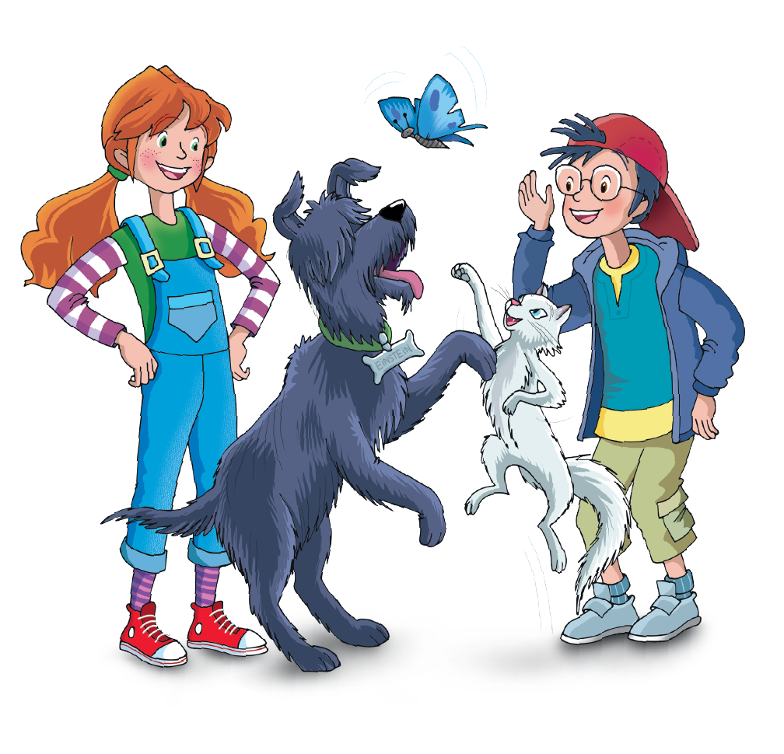

UNIT 5 – I WANT TO BE A COOK!
Lesson 1 – Vocabulary & Grammar 1
Teacher: Đoàn Ngọc Hà

Slide 2

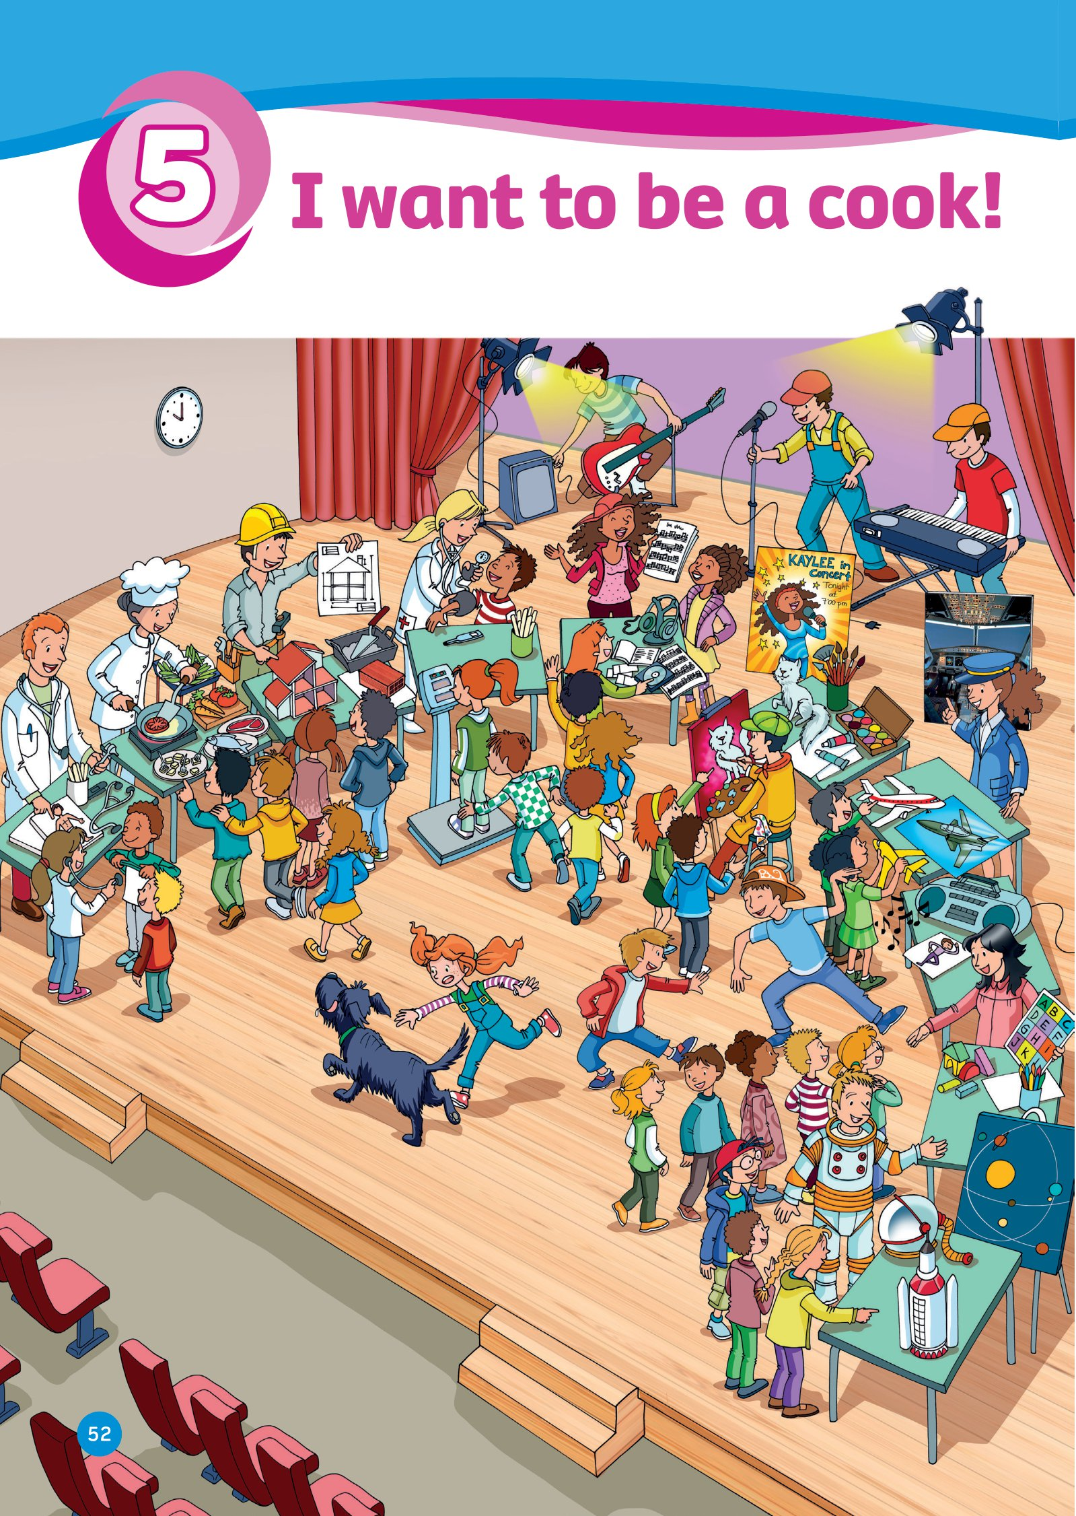
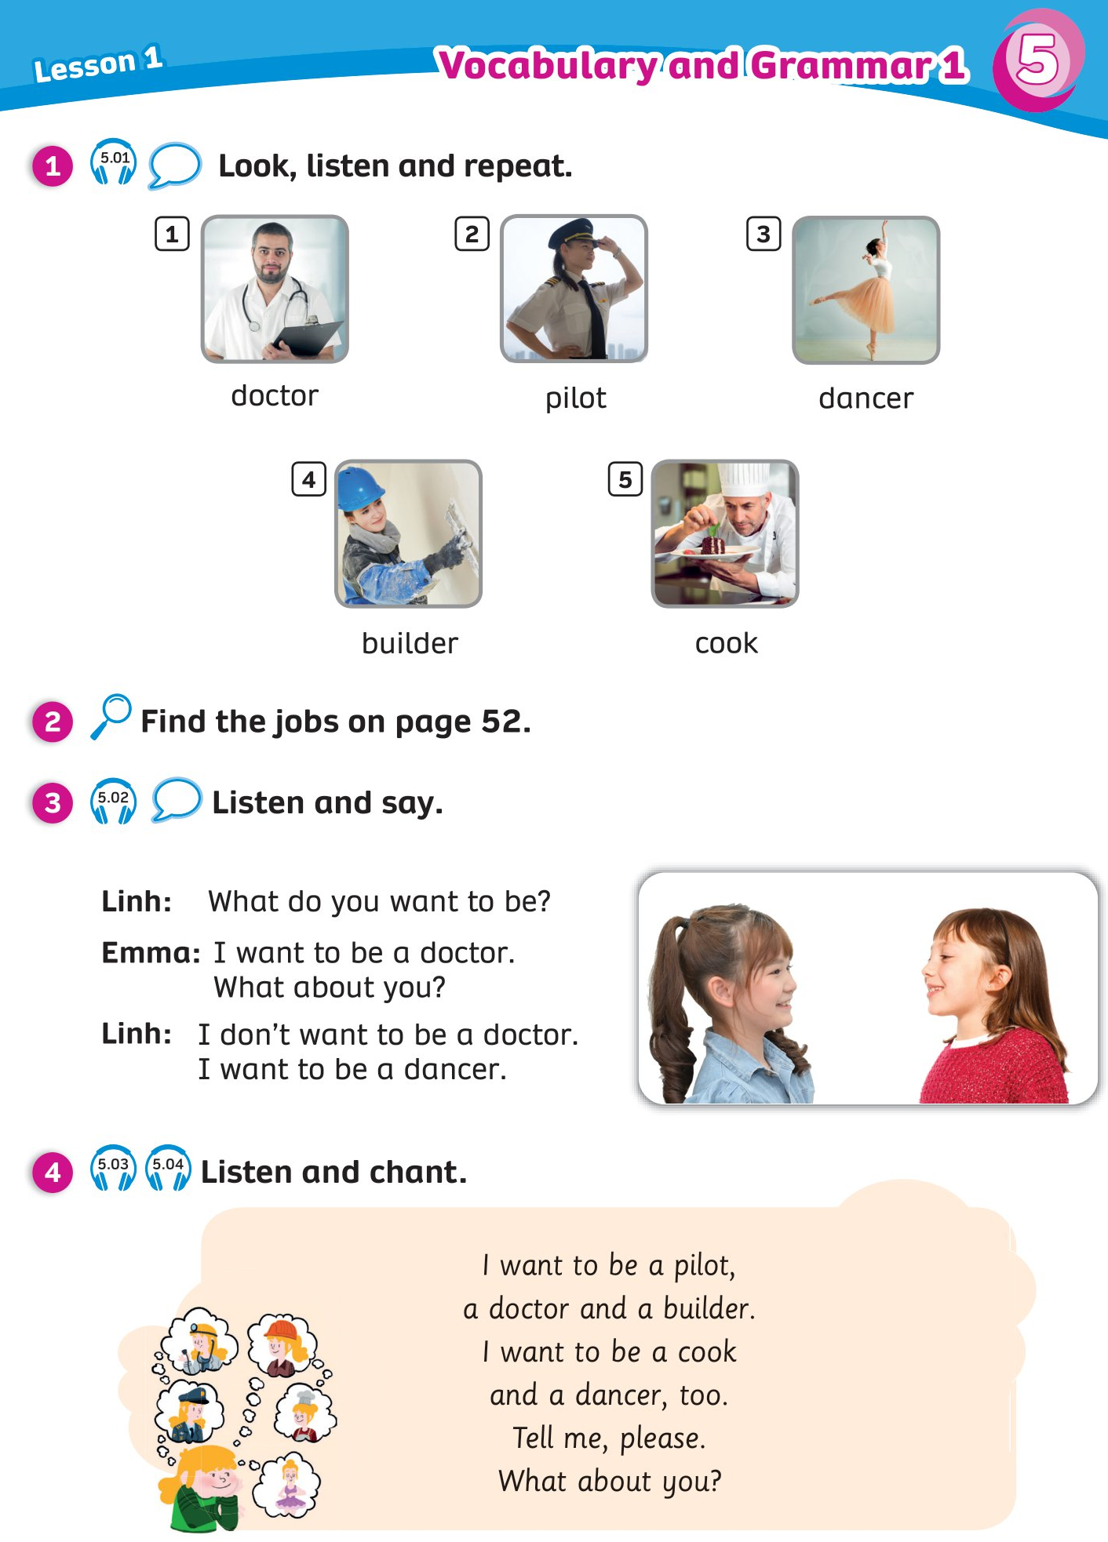
UNIT 5: I WANT TO BE A COOK!
We’re learning…
Jobs
To ask and answer about jobs.
PB pp. 52 - 53
AB p. 46

Slide 3


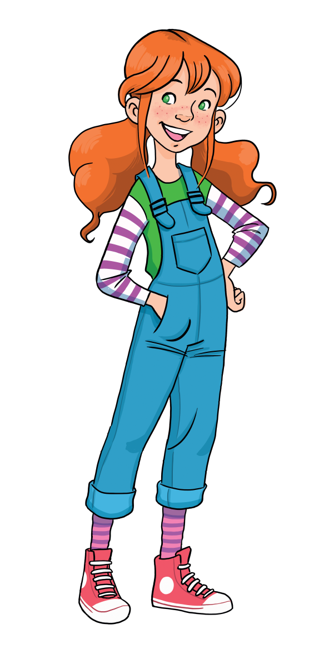
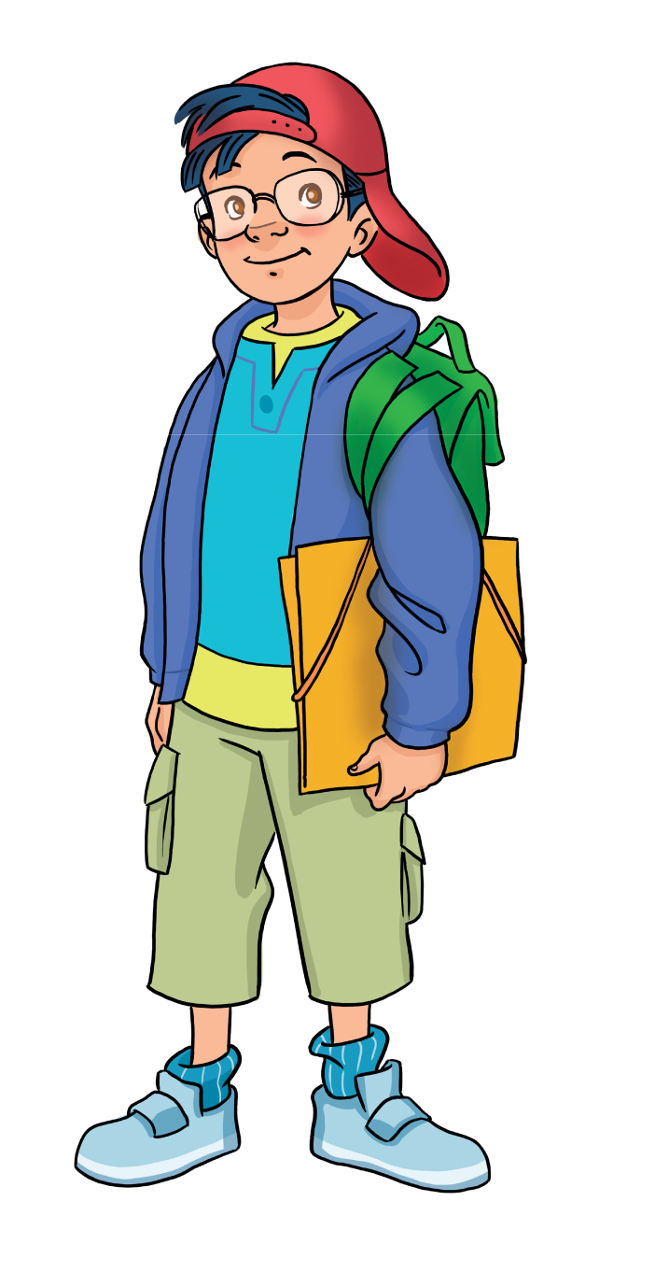
WARM-UP
Let’s play!
Put students into two or three teams.
The teacher places all flashcards of wild animals (Unit 4).
Invite one or two members from each team to come to play.
The teacher says a word aloud. Students listen, run to the board and point to it.
The fast student who can point to the correct picture receives 2 points for the team.

Slide 4

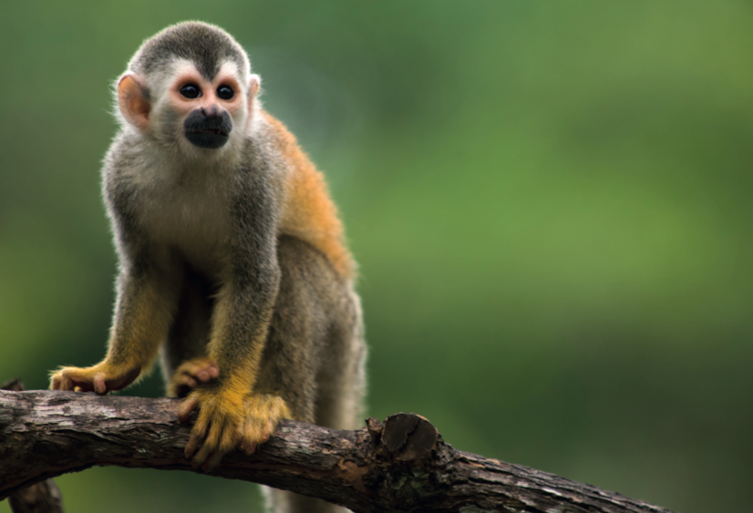
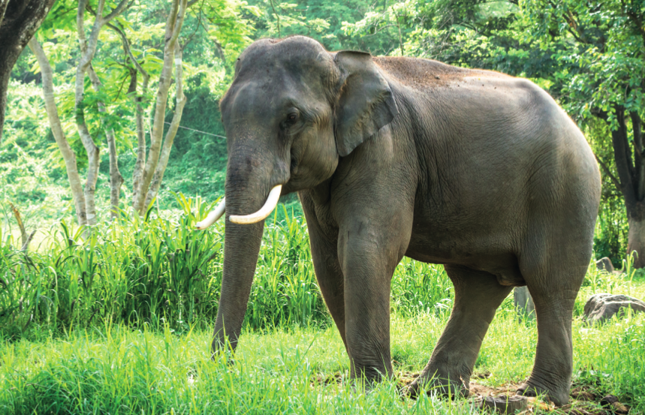
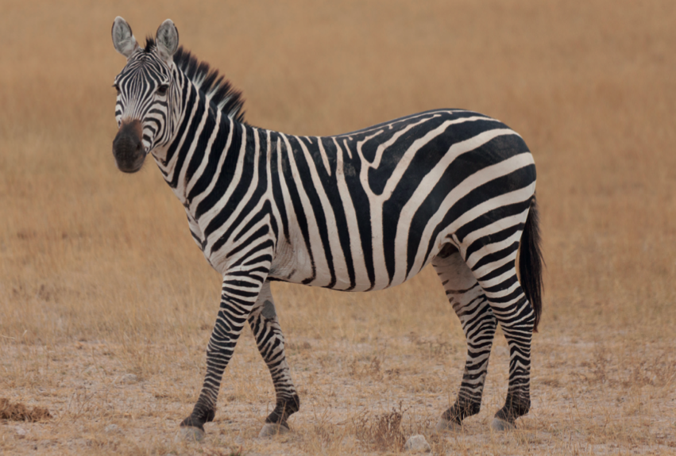

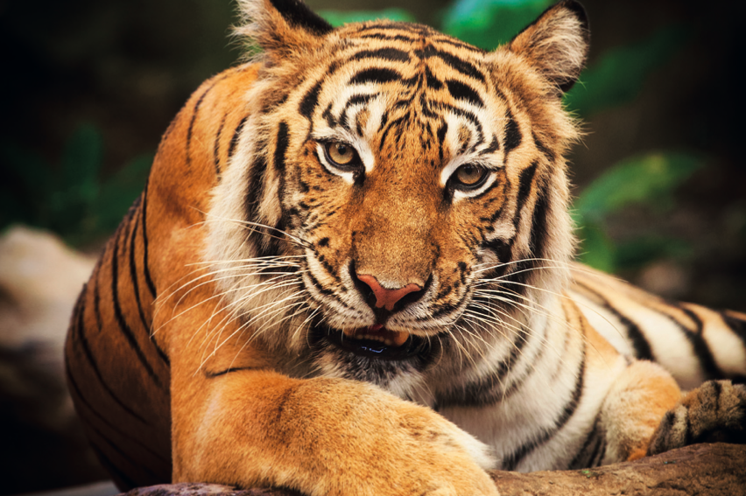
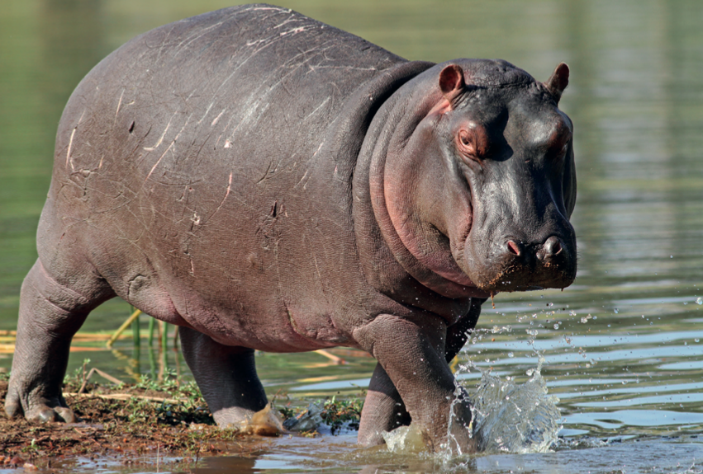
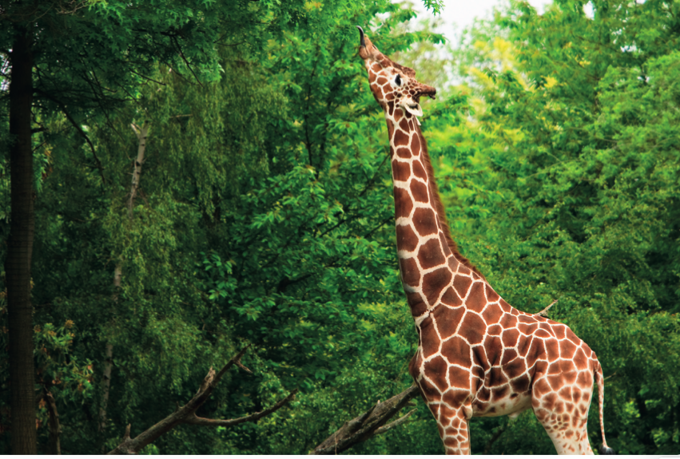

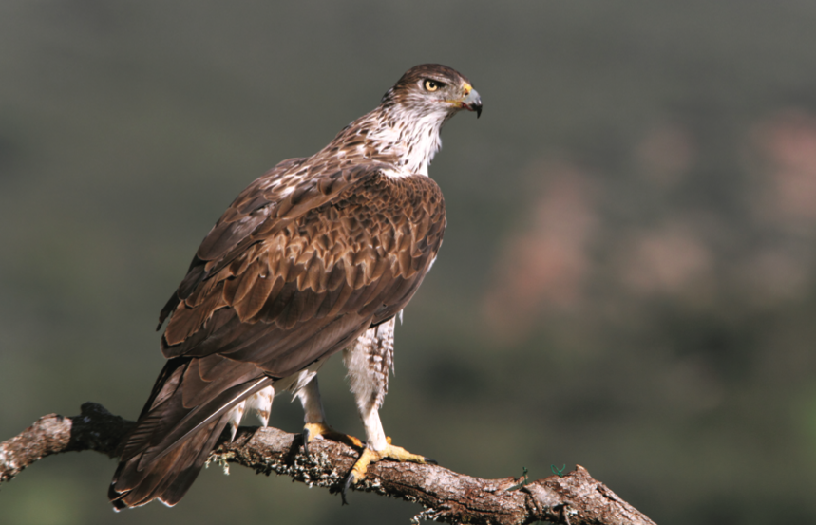

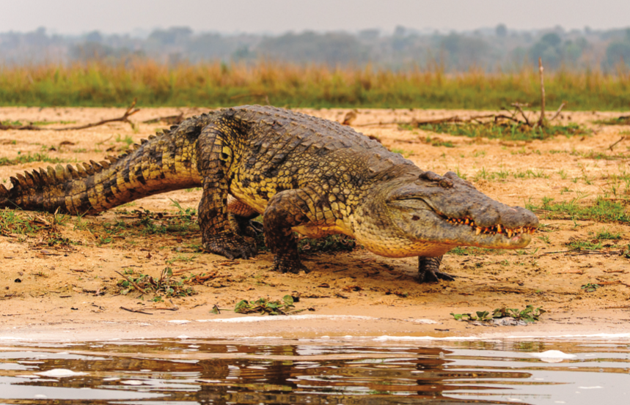

WARM-UP
It’s a hippo!

Slide 5

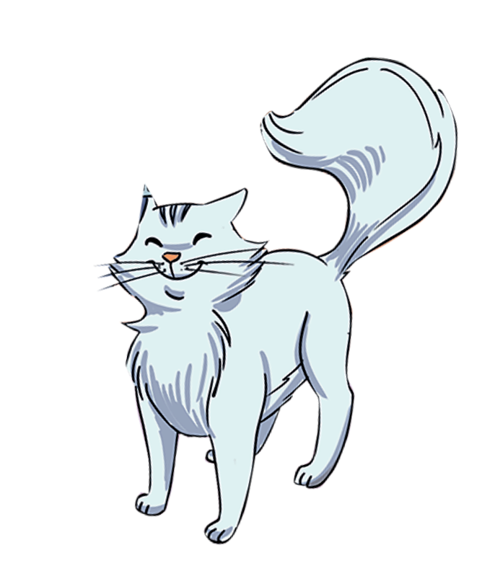
LEAD -IN
Who is painting?
c
He is painting.

Slide 6
LEAD -IN
What food can you see?
Meat
Fish
Tomatoes
Peas
….

Slide 7

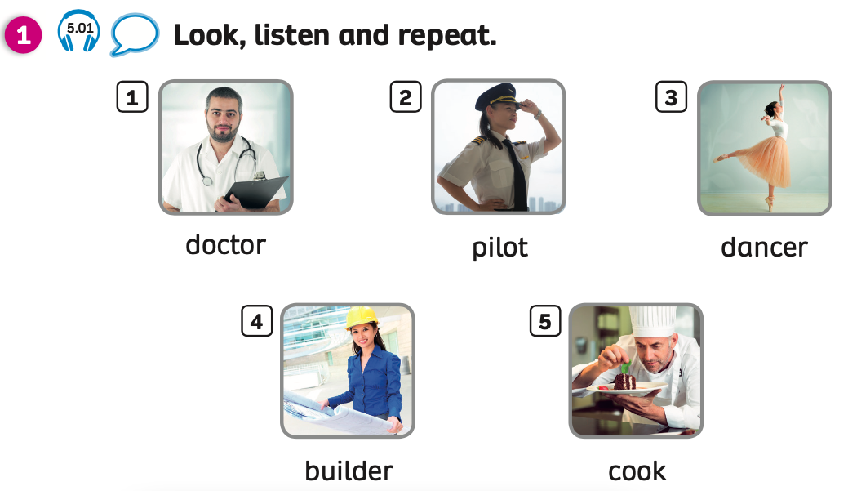
VOCABULARY: Jobs
Notes:
Have students look at the picture.
Play the audio, students listen and repeat.

Slide 8


VOCABULARY: Jobs
Let’s spell!
c
doctor
d
o
c
t
o
r

Slide 9
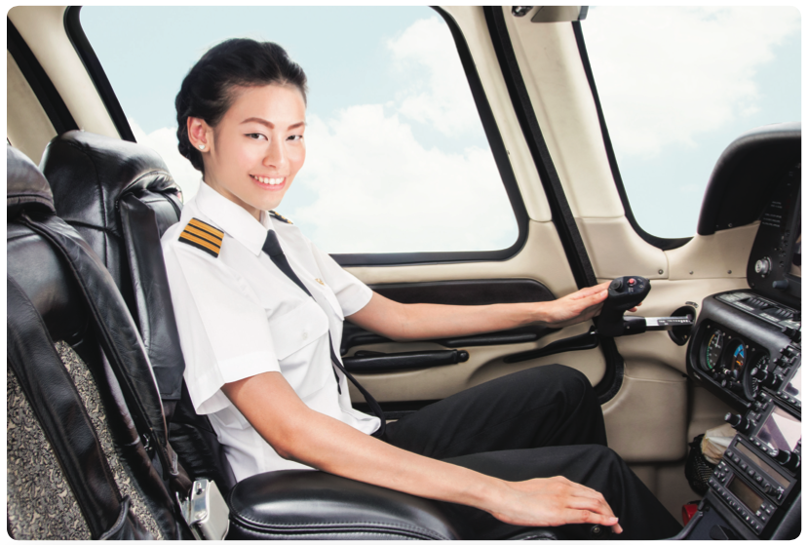
VOCABULARY: Jobs
Let’s spell!
c
pilot
p
i
l
o
t

Slide 10

VOCABULARY: Jobs
Let’s spell!
c
dancer
d
a
n
c
e
r

Slide 11
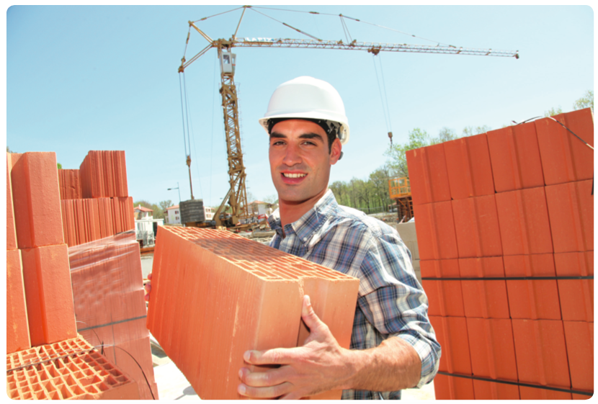
VOCABULARY: Jobs
Let’s spell!
c
builder
b
u
i
l
d
e
r

Slide 12
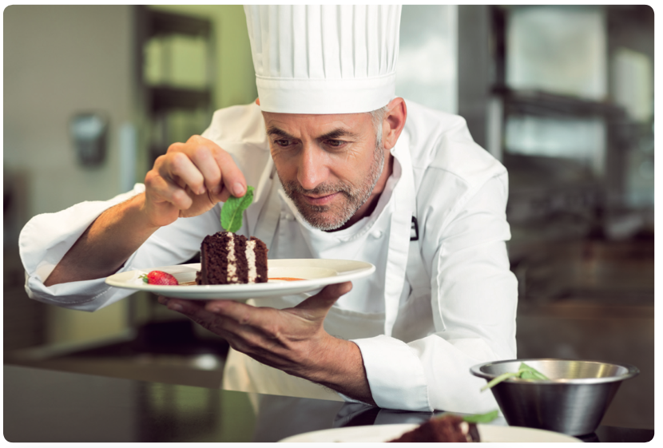
VOCABULARY: Jobs
Let’s spell!
c
cook
c
o
o
k

Slide 13

VOCABULARY: Jobs
dancer
pilot
builder
doctor
cook

Slide 14
PRACTICE
Let’s play!
Put students into two or three groups.
Each team takes turns playing. Students look at the picture, say a correct word aloud then spell the word.
1 correct answer = 1 point.
All students repeat the answers.

Slide 15

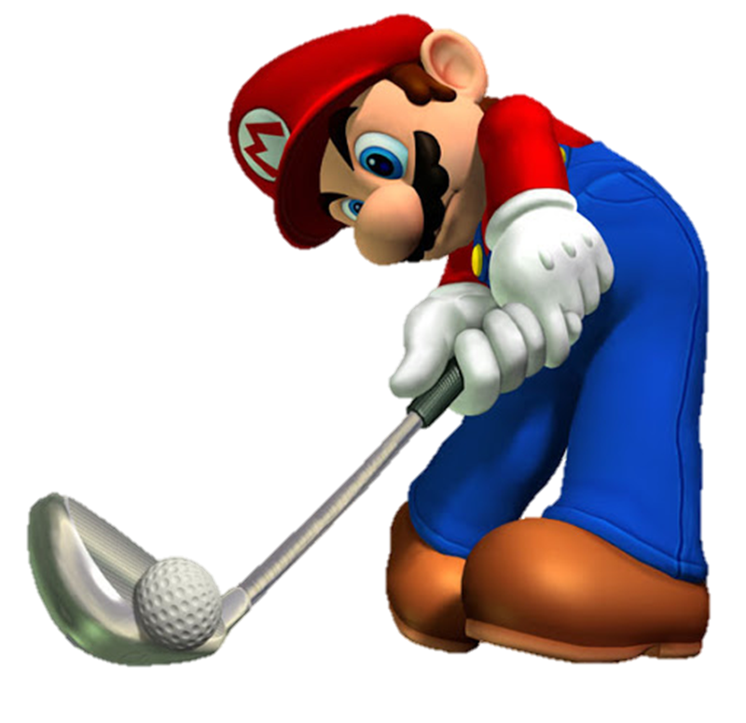





Slide 16






doctor
cook
builder

Slide 17
pilot
doctor
dancer

Slide 18
doctor
dancer
cook

Slide 19
dancer
builder
pilot

Slide 20
END
dancer
cook
pilot

Slide 21
VOCABULARY – Pupils’ book (pp. 52 – 53)
Let’s play!
Put students in pairs. Have students open their books to page 52.
Give them a minute to find and circle 5 jobs they have learnt.
Check the answers with the whole class.
The pair who has all the correct answers receives 2 points.
All students repeat the answers.

Slide 22

VOCABULARY – Pupils’ book (pp 52 – 53)
Let’s find 5 jobs!

Slide 23
VOCABULARY – Pupils’ book (pp 52 – 53)
ANSWER
doctor
cook
builder
pilot
dancer

Slide 24
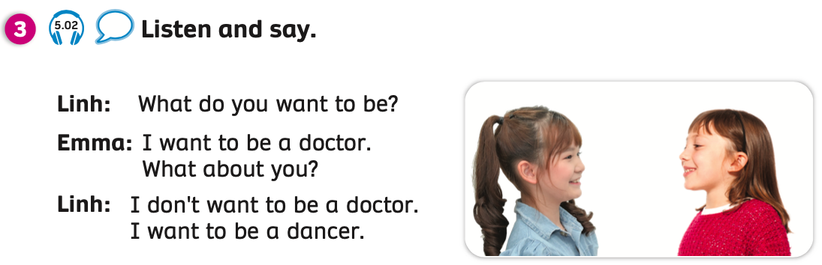
GRAMMAR

Slide 25


GRAMMAR
What do you want to be?
c
c
I don’t want to be a doctor.
I want to be a dancer.

Slide 26
GRAMMAR
What do you want to be?
c
c
I don’t want to be a cook.
I want to be a pilot.

Slide 27
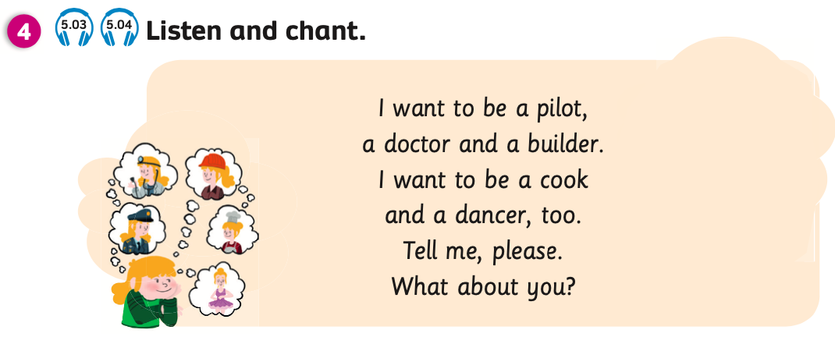
PUPILS’ BOOK (p.53)
Have students look at the lyric of the chant, circle the jobs and read along.
Play the chant and pause after each sentence, students listen and repeat.
Play the chant, students listen and chant.

Slide 28
PRODUCTION (Optional)
Chant along
Play audio 5.04, students listen and chant again.

Slide 29


WRAP-UP
What have you learnt today?
dancer
doctor
Students call out all the jobs they have learnt today.

Slide 30
WRAP-UP
dancer
pilot
builder
doctor
cook
- Point to each picture, students look and spell words.

Slide 31

HOMEWORK
Review vocabulary and grammar.
Do exercises in the Activity book (page 46).
Check answers in the Teacher’s book (page 108) or Active Teach.

Slide 32
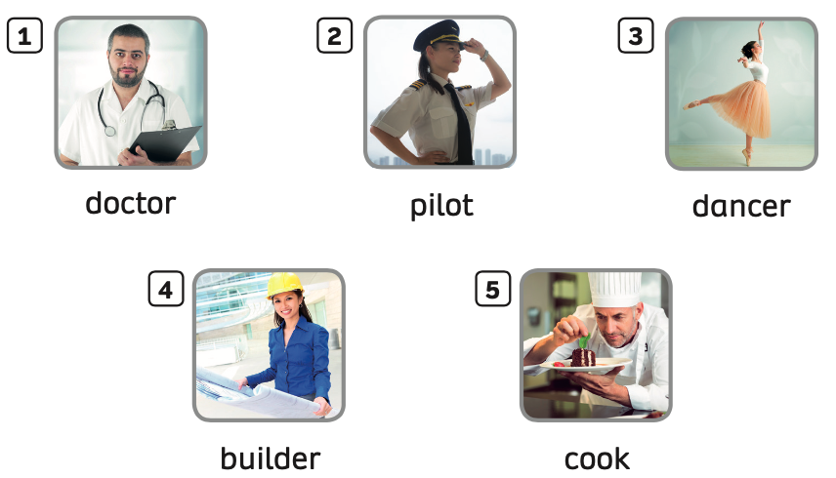

UNIT 5: I WANT TO BE A COOK
We’re learned…

