Slide 1

UNIT 2: LOOK AT MY TOYS!
Lesson 3A – Vocabulary & Grammar 2
Teacher: Đoàn Ngọc Hà

Slide 2
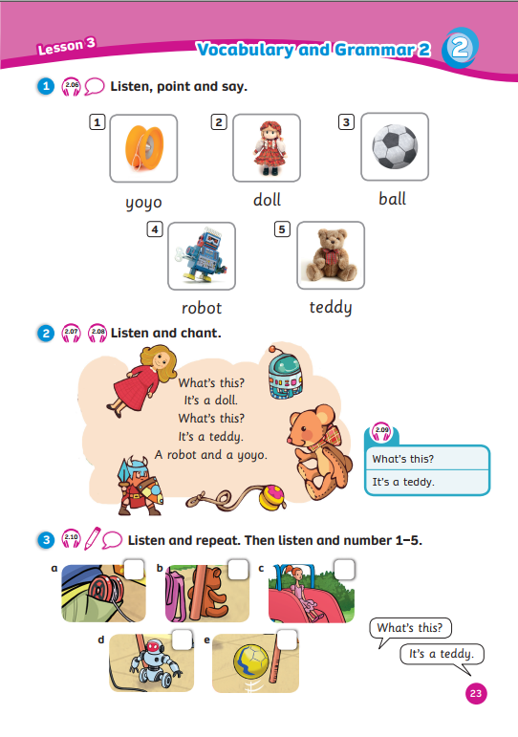
UNIT 2: LOOK AT MY TOYS!
We’re learning…
- toys
- to ask and answer about toys
- SB p.23
- AB p.20

Slide 3


Song: Don’t Stop Baby Bot Dance
WARM-UP
All students stand up.
Listen to the song.
Dance along.

Slide 4
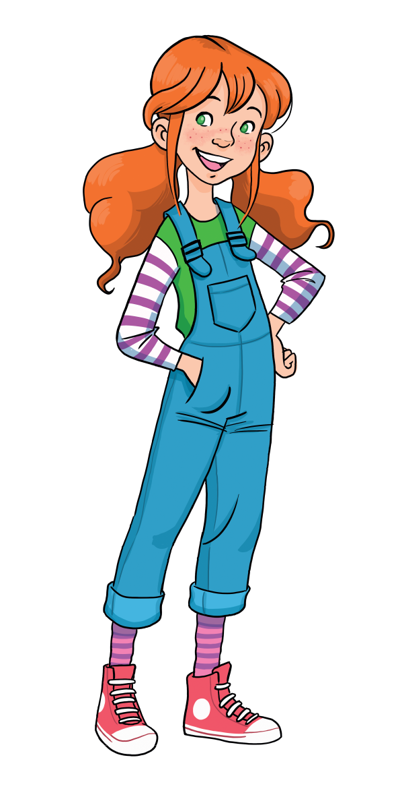

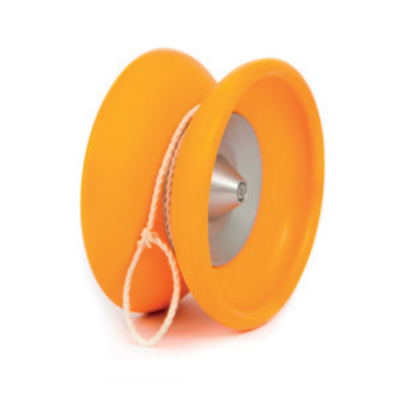

VOCABURALY: Toys
What’s this?
It’s a …
yoyo
Let’s spell!
y
o
y
o

Slide 5
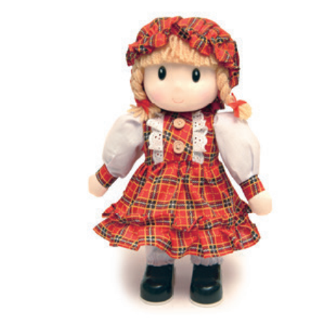
VOCABURALY: Toys
What’s this?
It’s a …
doll
Let’s spell!
d
o
l
l

Slide 6

VOCABURALY: Toys
What’s this?
It’s a …
ball
Let’s spell!
b
a
l
l

Slide 7
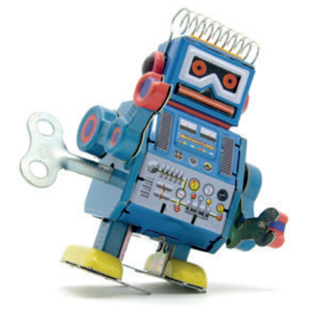
VOCABURALY: Toys
What’s this?
It’s a …
robot
Let’s spell!
r
o
b
o
t

Slide 8

VOCABURALY: Toys
What’s this?
It’s a …
teddy
Let’s spell!
t
e
d
d
y

Slide 9

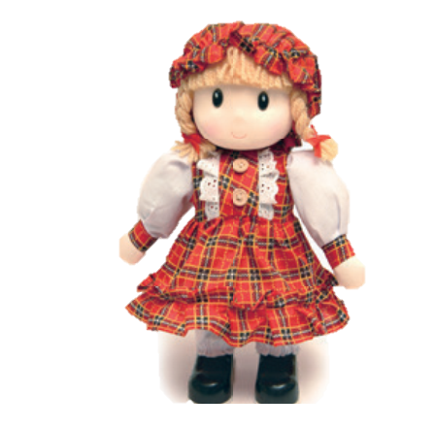
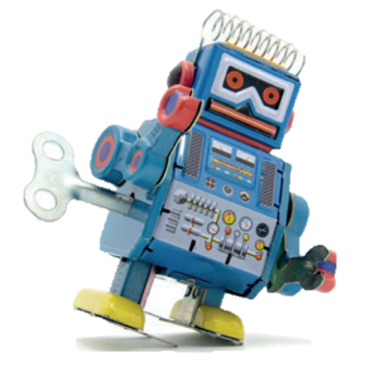


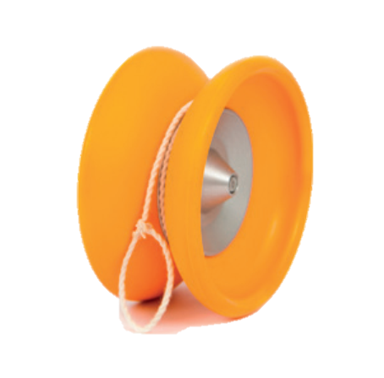

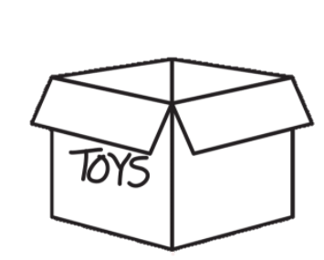
VOCABURALY: Toys
ball
doll
robot
yoyo
teddy

Slide 10

MEMORY GAME
Let’s Play!

Slide 11

MEMORY GAME
Rules
12 numbers on the slide:
  5 pictures and 5 words behind the numbers.
  2 lucky stars with given points.
Each student chooses 2 numbers and gets 1 point for a match.
1 student asks the question, the whole class answers after each match.
Note:
- Click the card or number to show a picture.
- Click the heart to hide the picture.
Let’s Play!
1

Slide 12

What is this? – It’s a …
robot
yoyo
1
2
3
4
+1
teddy
7
8
5
6
+2
ball
doll
9
10
11
12
Notes:
- Click the card or number to show a picture.
- Click the heart to hide the picture.

Slide 13
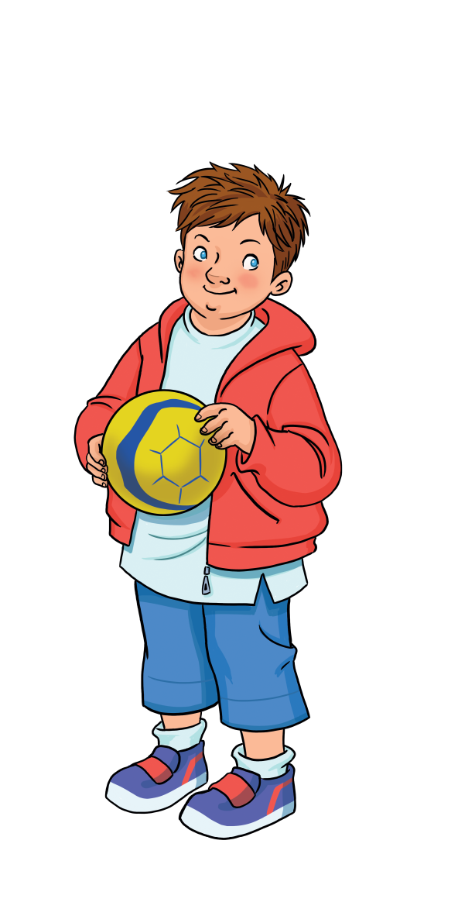




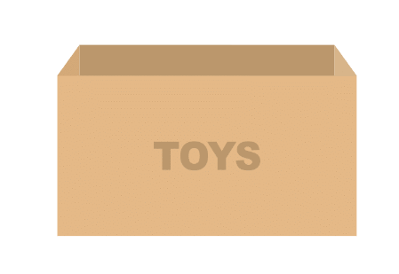
GRAMMAR
It’s a doll.
It’s a teddy.
It’s a robot.
It’s a yoyo.
Look at my toys!
What’s this?
Marie
Ben
Notes:
Set the scene
Remind Ss of Marie and Ben. Marie shows Ben her toys. Ben asks her “What’s this?” and she answers.
Show the speech bubbles and have Ss say aloud.
Ask Ss to guess how Marie would reply to Ben’s question “What’s this?”

Slide 14

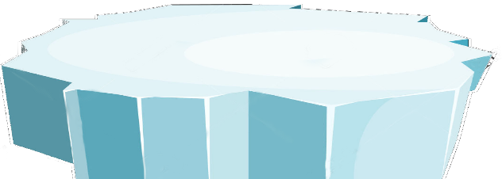



The little penguins
RULES
Students ask “What is this?”
Look at the picture and answer
1 correct answer = 2 points
PLAY

Slide 15
What’s this?
SURFING
NEXT
STOP
It’s a robot.

Slide 16
What’s this?
SURFING
NEXT
STOP
It’s a ball.

Slide 17
What’s this?
SURFING
NEXT
STOP
It’s a yoyo.

Slide 18
What’s this?
SURFING
NEXT
STOP
It’s a doll.

Slide 19
What’s this?
SURFING
NEXT
STOP
It’s a teddy.

Slide 20
Game over!
EXIT

Slide 21
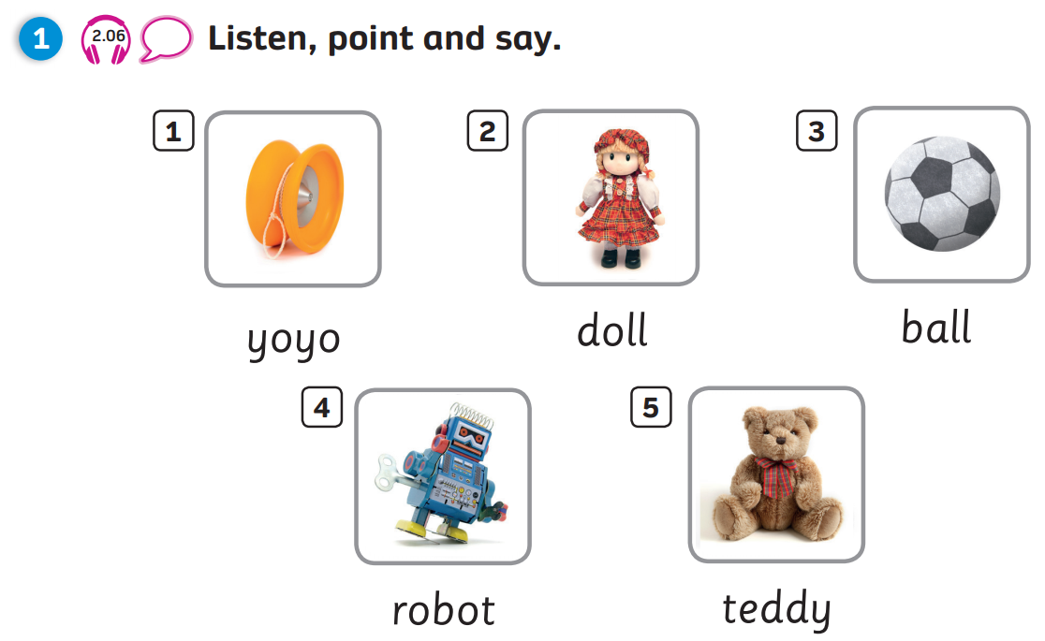
Pupils’ Book (p.23)

Slide 22
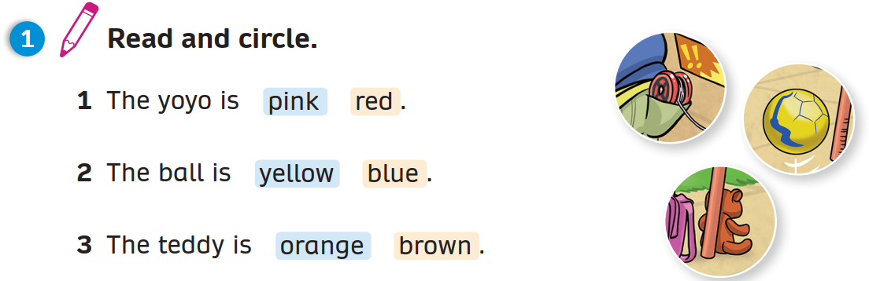
Activity Book (p.20)
Circle
Click on “Circle” to show the answers

Slide 23
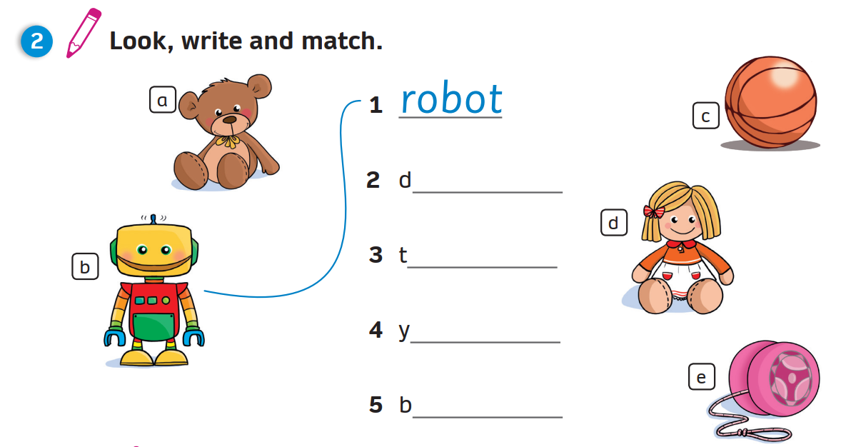
Activity Book (p.20)
Write
Match
oll
eddy
oyo
all
Click on “Write, Match” to show the answers

Slide 24
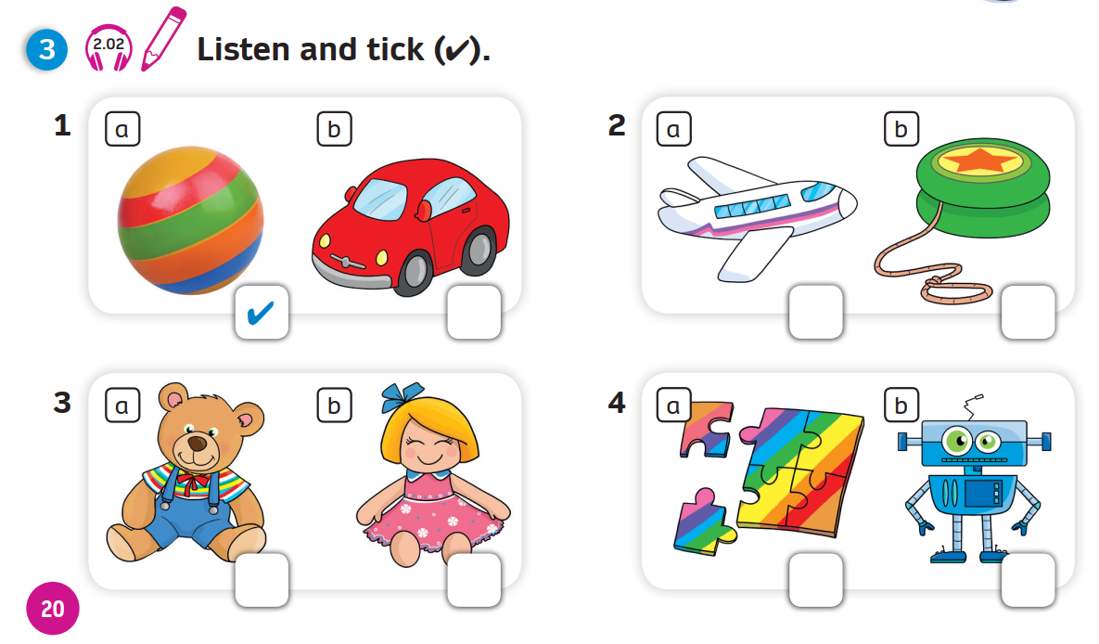
Activity Book (p.20)
Answers
Click on “Answers” to show the answers

Slide 25


PRODUCTION
Draw a toy.
Colour and write.
It’s a ________.
It’s ________________.
robot
pink, yellow, green and black.
Notes:
Have Ss take out notebook or give them paper.
Ask them to draw a toy, colour then write about it.
Show an example for Ss to follow.
Ask Ss to keep their drawing for the next lesson.

Slide 26

WRAP-UP
What’s this?
-> It’s a…
ball
doll
robot
yoyo
teddy

Slide 27
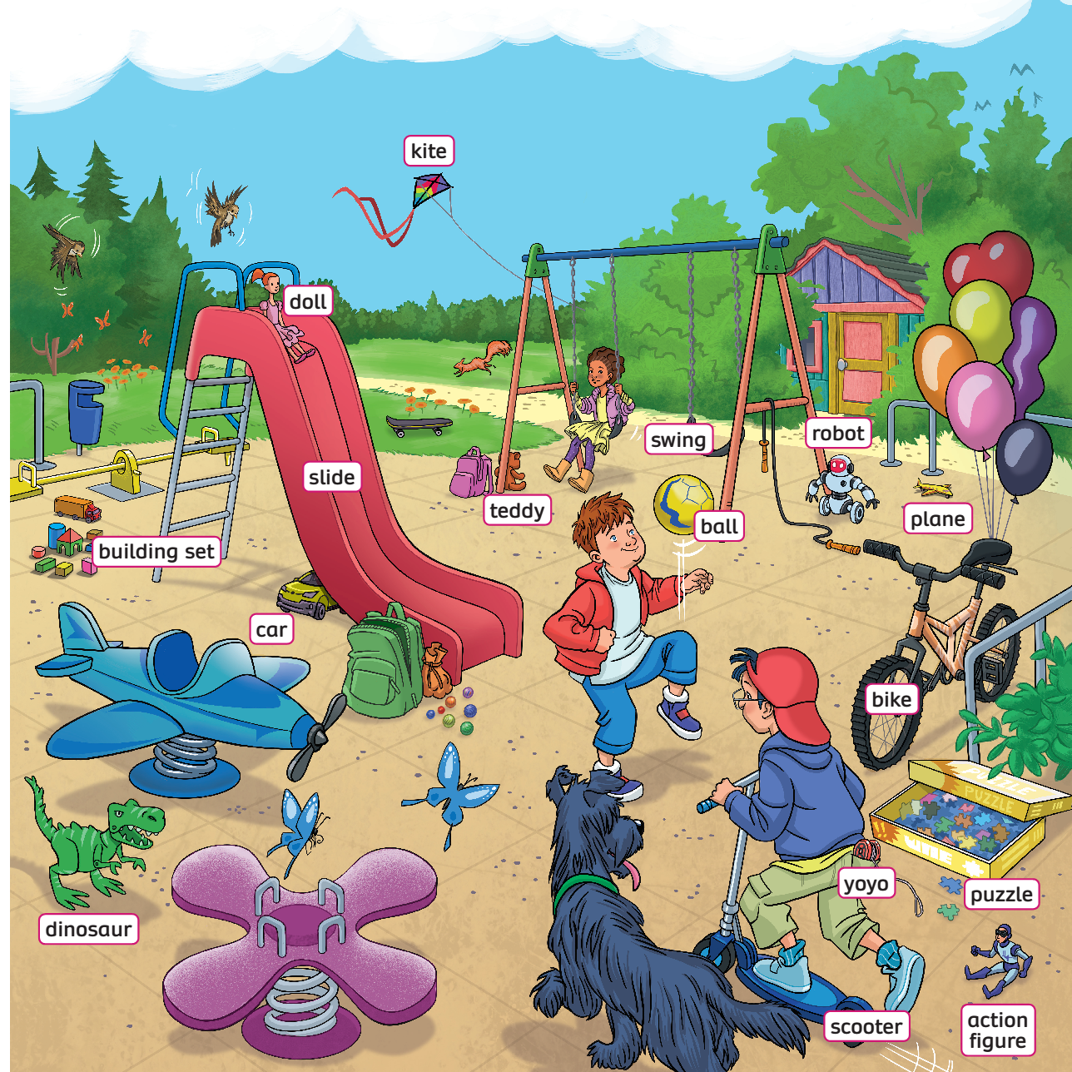
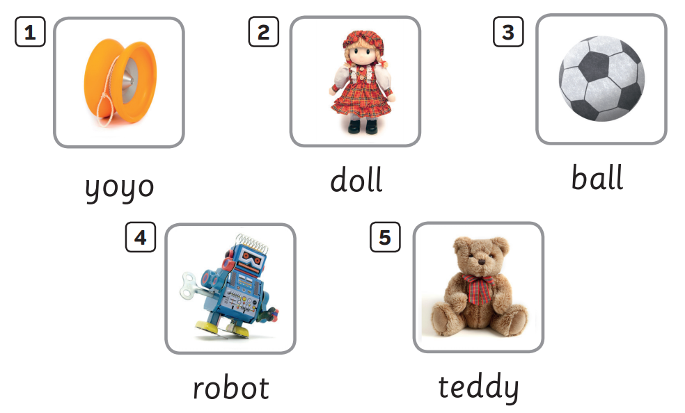

UNIT 2: Lesson 3A
We’ve learnt…

