Slide 1

Song Ve secondary school.
Good morning class!!!
Mrs Thu Ba

Slide 2

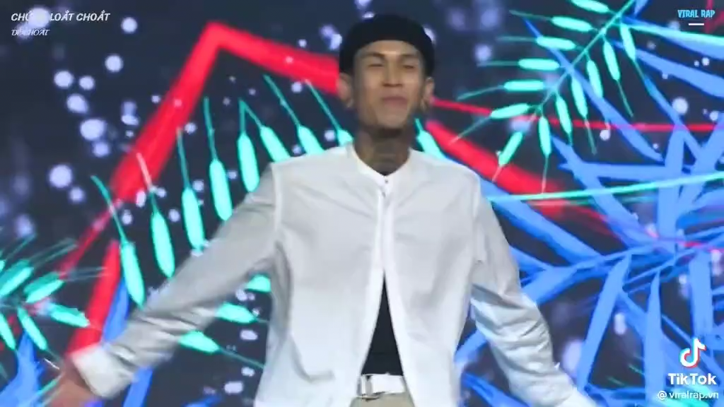
WARM-UP:
Listen a song and answer some questions

Slide 3



CHATTING
- Do you like the piece of music you have listened?
- Do you know what kind of music it is?
- When do you listen to music?
- How do you feel when you listen to music?
- Is music important to our life?

Slide 4




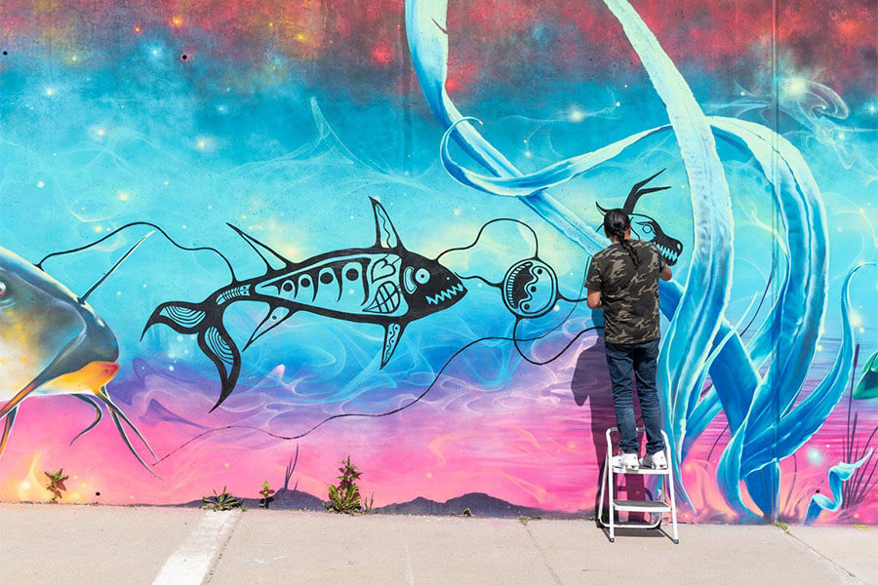

Unit
4
MUSIC AND ARTS
LESSON 1: GETTING STARTED
A talk at the school gate
Unit
HOBBIES

Slide 5
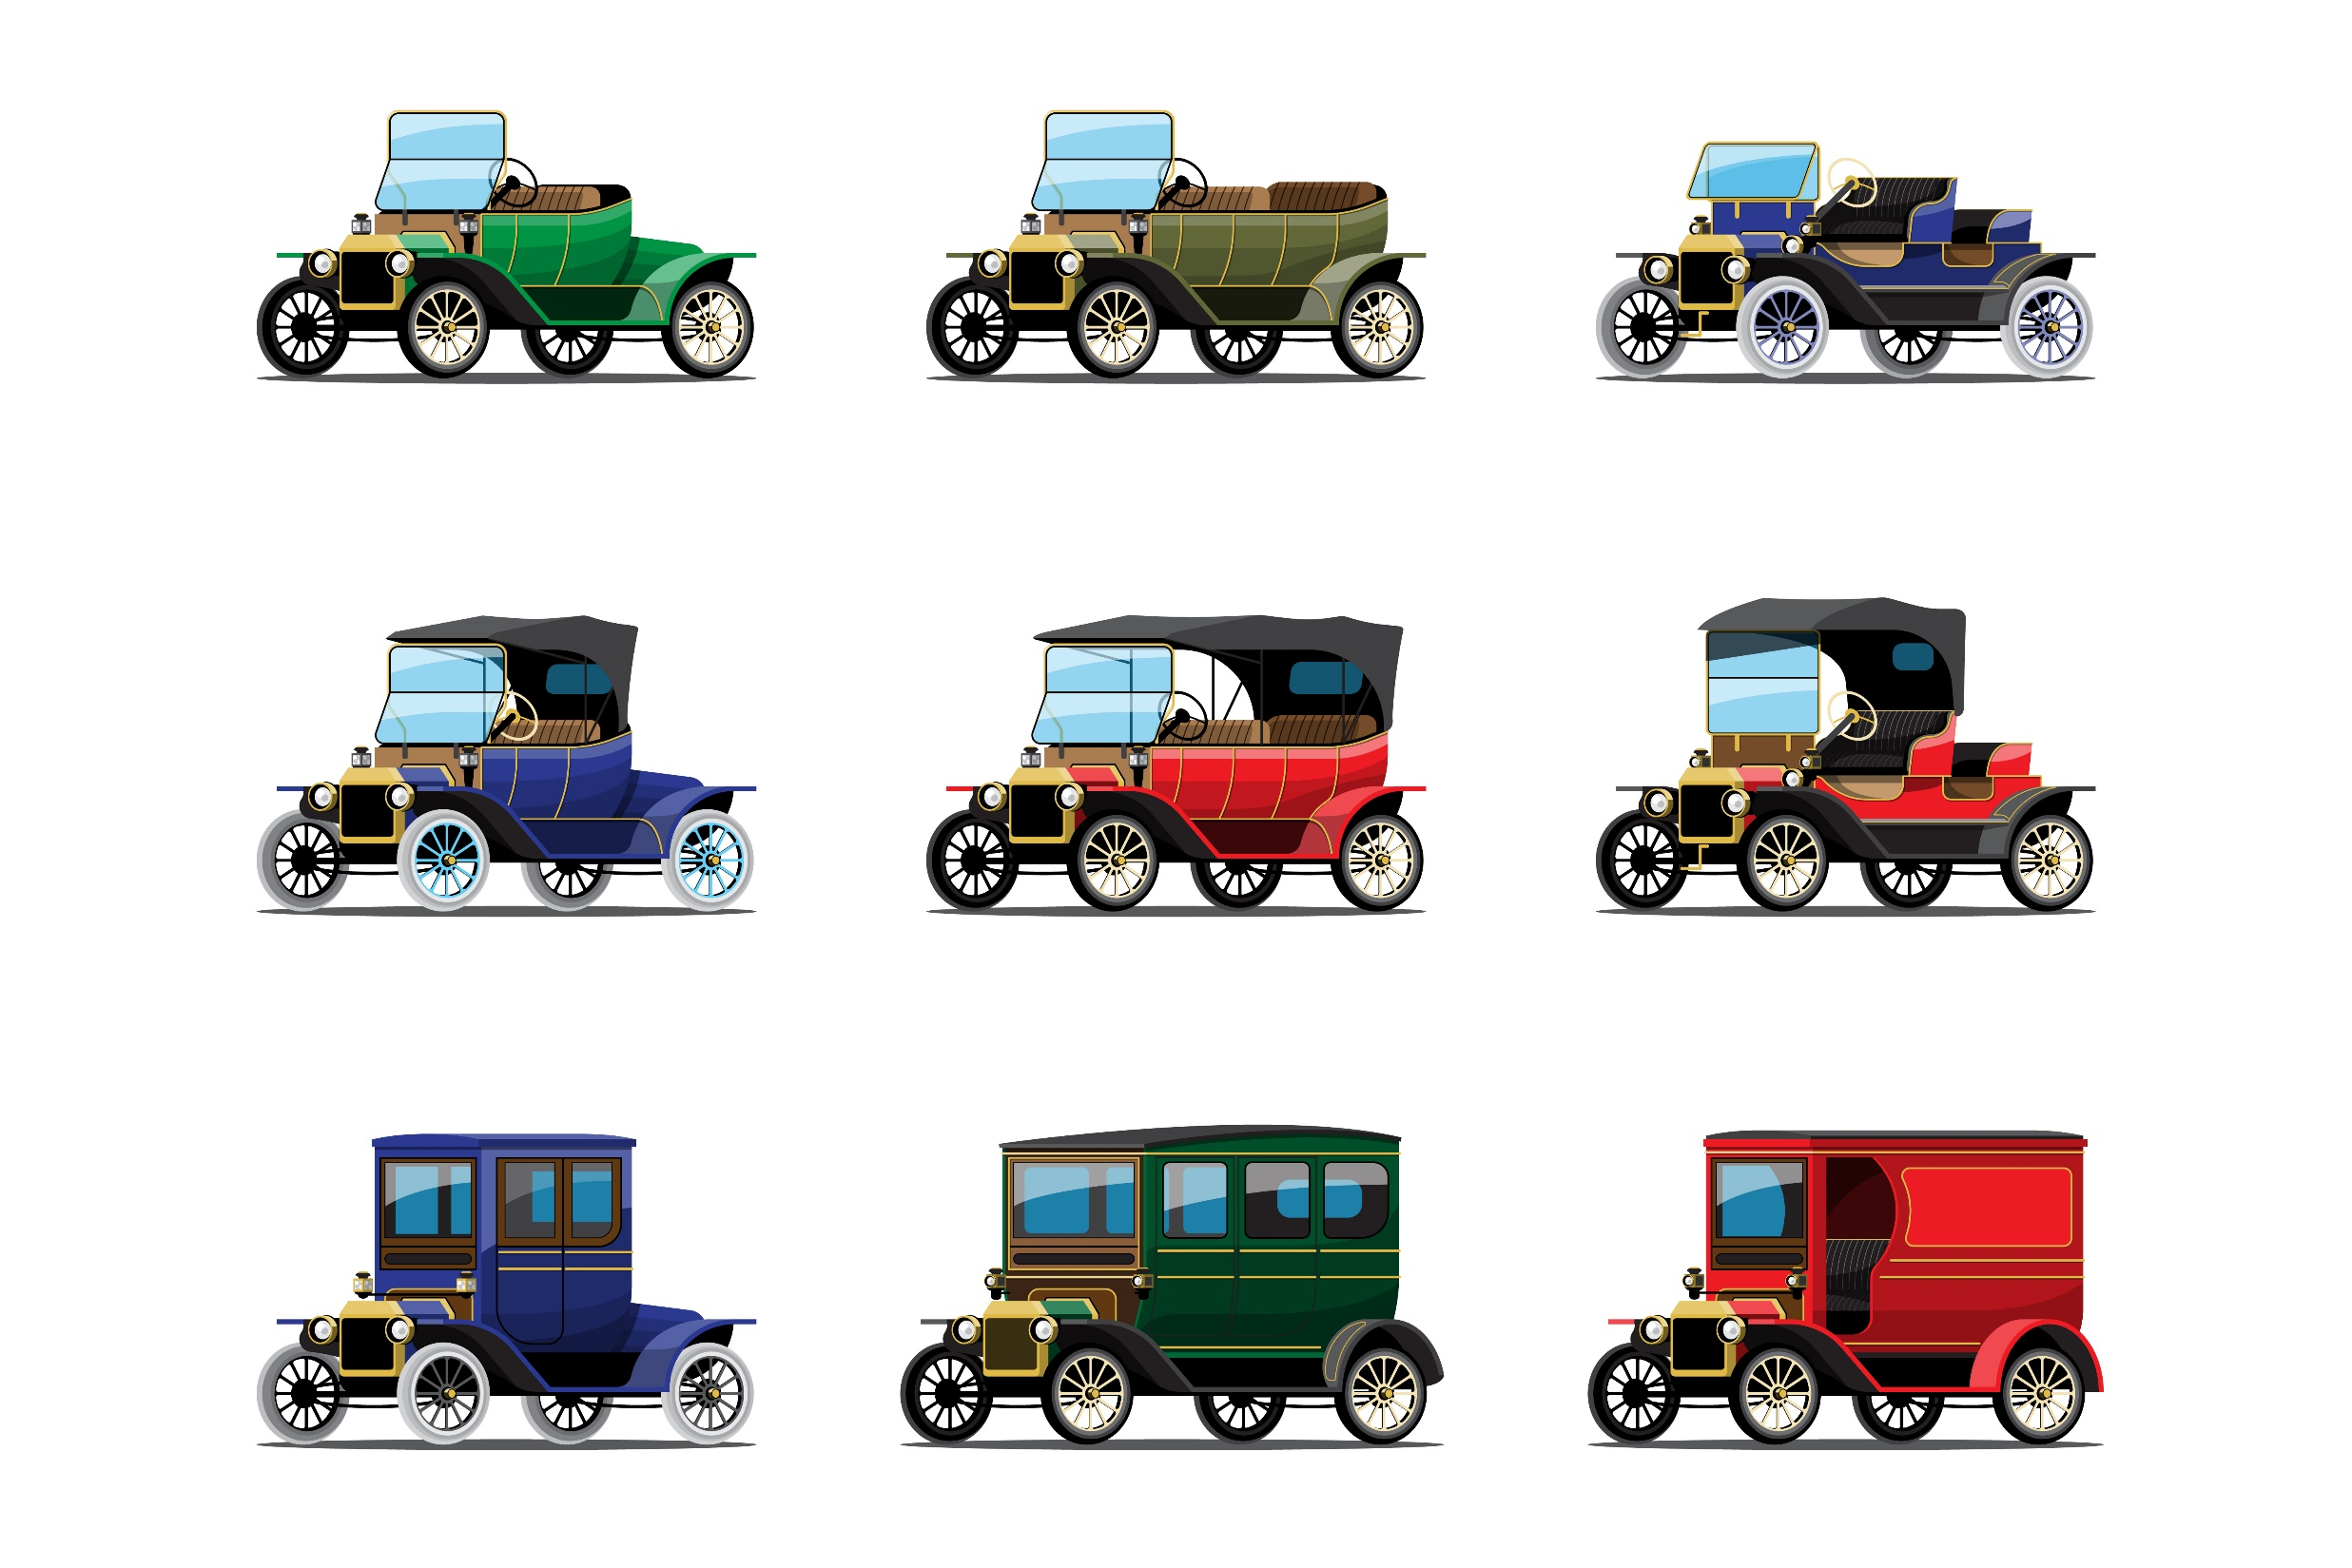
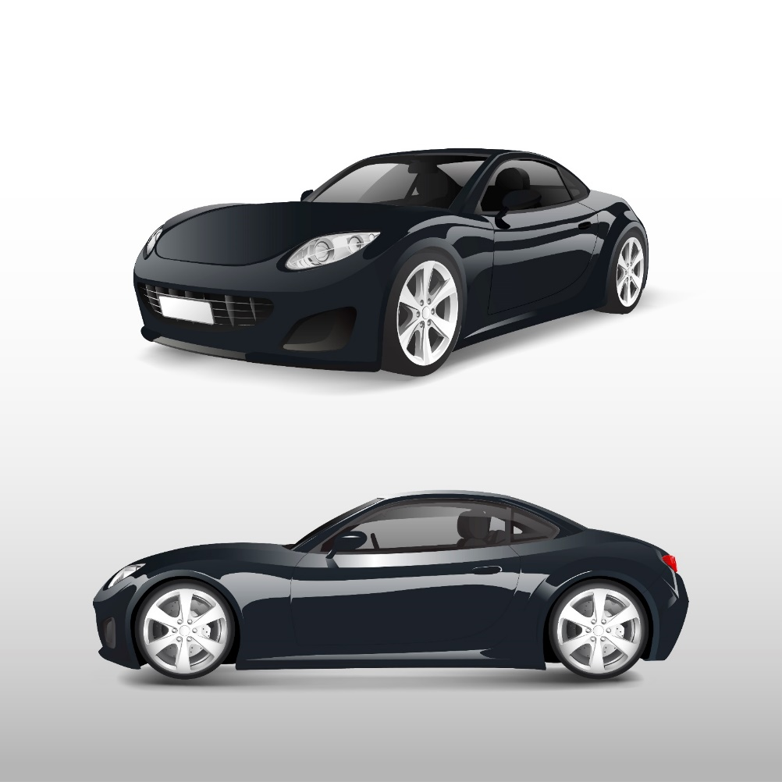
* VOCABULARY
- classical (adj):
cổ điển
/ˈklæsɪkəl/
modern

Slide 6




- spare time (n):
/speər taɪm/
thời gian rảnh rỗi

Slide 7
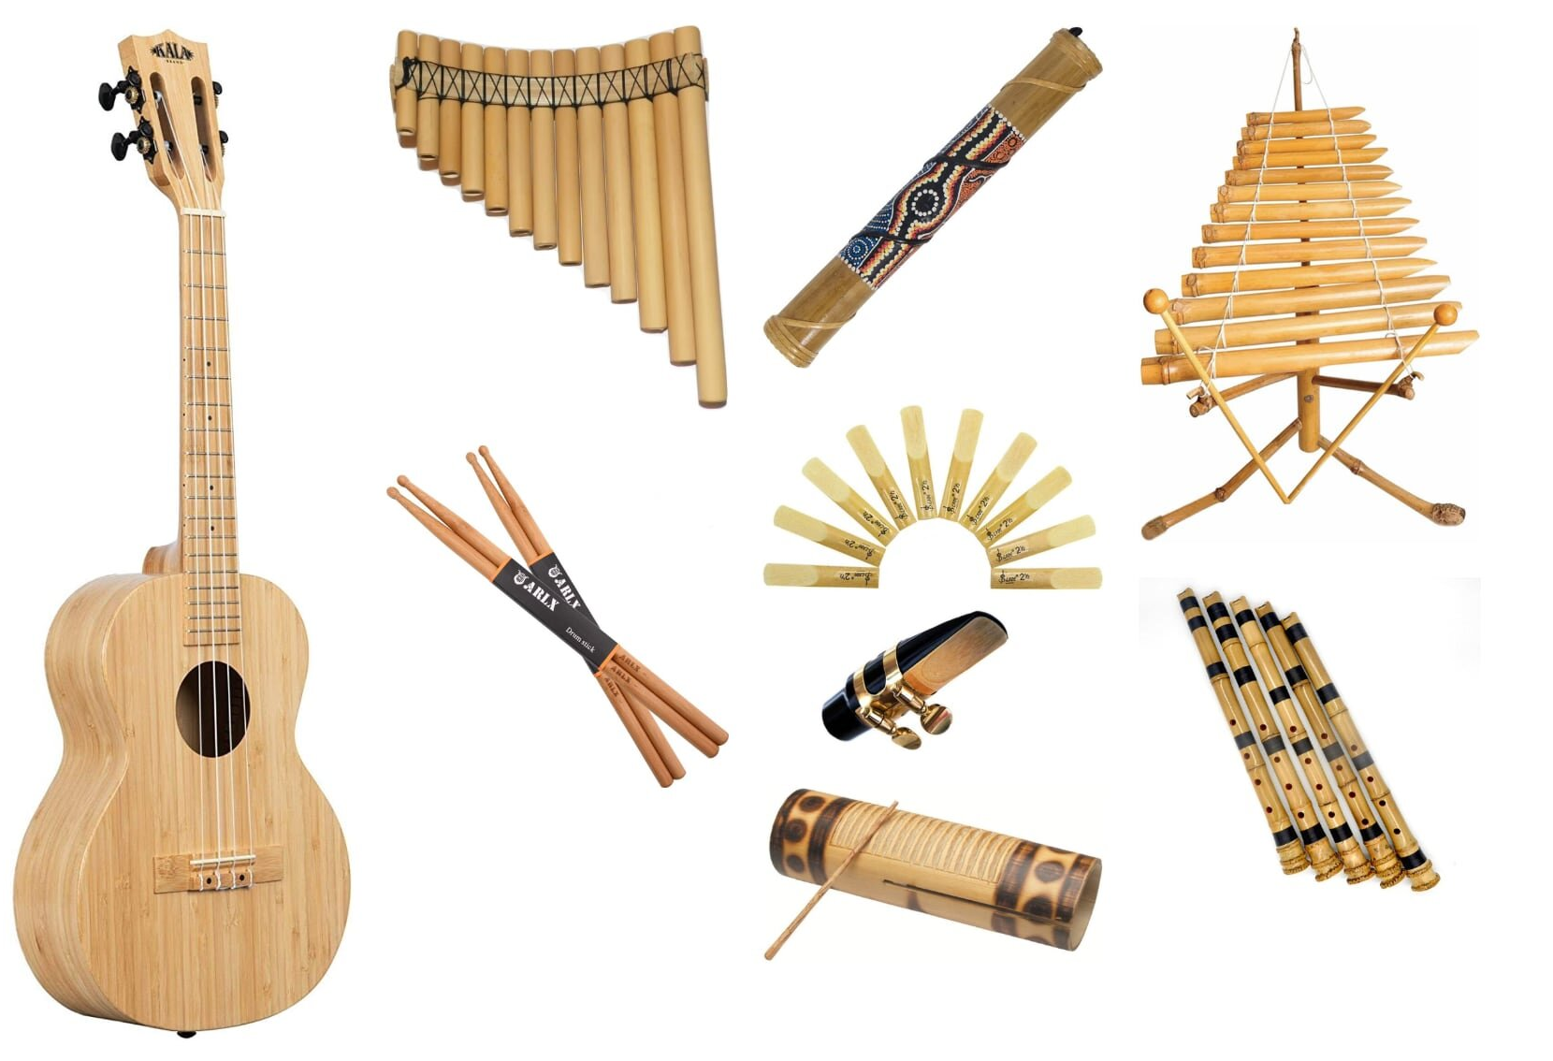
- musical instruments (n):
/ˈmjuːzɪkəl ˈɪnstrəmənts/
nhạc cụ

Slide 8

- landscape (n):
/ˈlændskeɪp/
cảnh quan

Slide 9
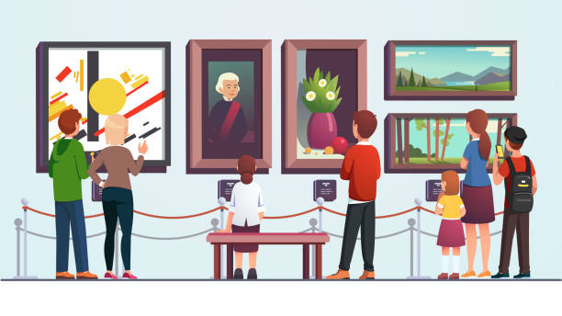
- art gallery (n):
/ˈɑːt ˌɡæləri/
phòng trưng bày nghệ thuật

Slide 10
* VOCABULARY
New words | Pronunciation | Meaning
classical (adj) | /ˈklæsɪkəl/ | cổ điển
spare time (n) | /speər taɪm/ | thời gian rảnh rỗi
musical instruments (n) | /ˈmjuːzɪkəl ˈɪnstrəmənts/ | nhạc cụ
landscape (n) | /ˈlændskeɪp/ | cảnh quan
art gallery (n) | /ˈɑːt ˌɡæləri/ | phòng trưng bày nghệ thuật

Slide 11
* Checking vocab
say words in English
musical instruments
Nhạc cổ điển
Nhạc cụ
Classical
music
Thời gian
Rãnh rỗi
spare time
Phong cảnh
landscape
Phòng trưng bày nghệ thuật
art gallery

Slide 12
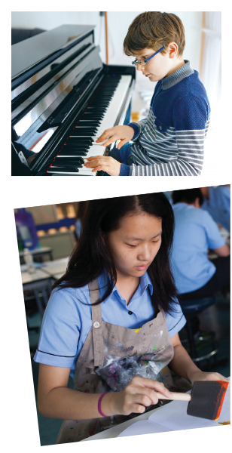
1
Listen and read
Who are they?
→
2. What are they doing?
→
3. What are you going to learn in this lesson today?
→
They are Trang and Nick / students.
Nick is playing the piano and Trang is drawing.
We are going to learn about music and art.

Slide 13

1. Listen and read
Trang: Hi Nick. What are you listening to?
Nick: I’m listening to music. I like classical music, and I often play
the piano in my spare time.
Trang: Wow. I can’t play any instruments.
Nick: And what about you? What’s your hobby?
Trang: I like painting and taking photos.
Nick: Taking photo? I’ve never tried it. Is it fun?
Trang: Yeah, it is, but not as fun as painting.
Nick: Right. They seem quite different from each other. What do
you normally paint?
Trang: Landscapes and animals, just for pleasure, you know. I
sometimes share them with my friends.
Nick: Really? Um, maybe we should go to an art gallery next
weekend?
Trang: Sounds good, but I’d prefer to go to the music festival at my
school.
Nick: Well … OK. That’s fine.

Slide 14
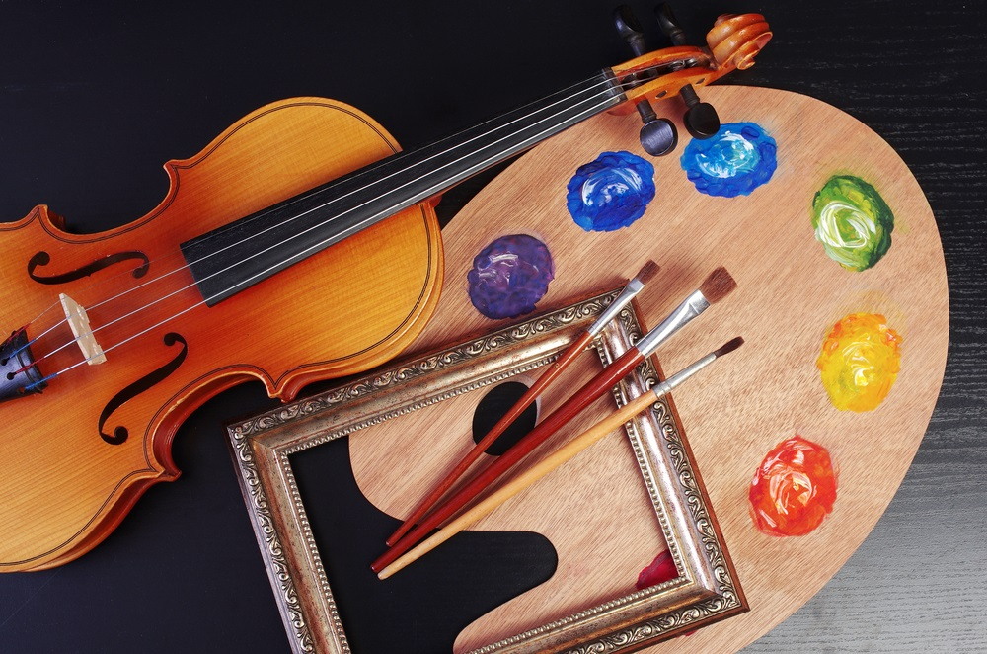
* PRACTICE
2
Tick the correct answer.
1. What are Trang and Nick talking about?
A. Playing the piano.
B. Drawing and painting.
C. Music and arts.
Trang: Hi Nick. What are you listening to?
Nick: I’m listening to music. I like classical music, and I often play the piano in my spare time.

Slide 15
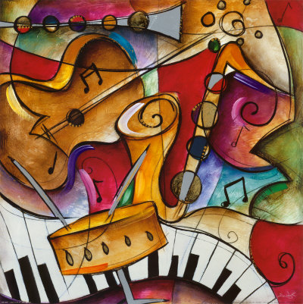
3
Complete each of the sentences with a suitable word or phrase from the box.
photos like different from art gallery musical instruments
Nick wants to go to a(n) _____________ next week.
You can use your smartphone to take ________.
This photo is very bright. It is _____________ that dark one.
Nick and Trang agree that taking photos is not _____________ painting.
My friend David is very talented. He plays three _______________________.
art gallery
photos
different from
like
musical instruments

Slide 16
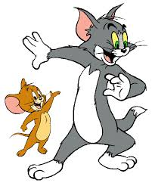
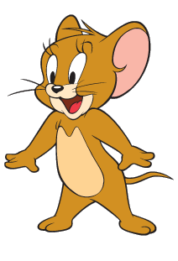
Questions: Lucky numbers
1
2
3
4
5
6

Slide 17
3
Complete each of the sentences with a suitable word or phrase from the box.
photos like different from art gallery musical instruments
art gallery
Nick wants to go to a(n) ____________next week.

Slide 18
3
Complete each of the sentences with a suitable word or phrase from the box.
photos like different from art gallery musical instruments
2. You can use your smartphone to take ________.
photos

Slide 19
3
Complete each of the sentences with a suitable word or phrase from the box.
photos like different from art gallery musical instruments
3. This photo is very bright. It is _____________ that dark one.
different from

Slide 20
3
Complete each of the sentences with a suitable word or phrase from the box.
photos like different from art gallery musical instruments
4. Nick and Trang agree that taking photos is not ____________painting.
like

Slide 21
3
Complete each of the sentences with a suitable word or phrase from the box.
photos like different from art gallery musical instruments
5. My friend David is very talented. He plays three _____________________.
musical instruments

Slide 22



Slide 23
3
Complete each of the sentences with a suitable word or phrase from the box.
photos like different from art gallery musical instruments
Nick wants to go to a(n) _____________ next week.
You can use your smartphone to take ________.
This photo is very bright. It is _____________ that dark one.
Nick and Trang agree that taking photos is not _____________ painting.
My friend David is very talented. He plays three _______________________.
art gallery
photos
different from
like
musical instruments

Slide 24
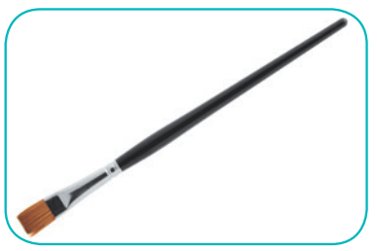

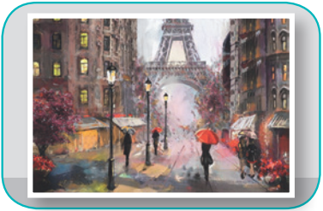
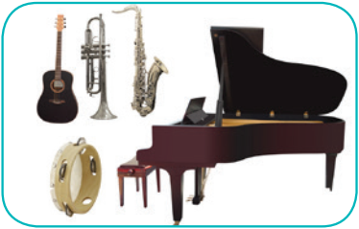
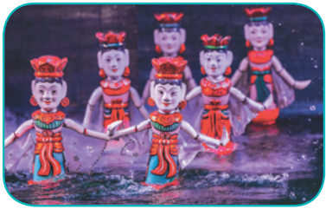
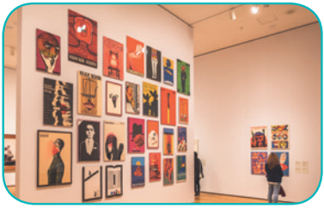
3
Write the correct word or phrase under each picture. Then listen and repeat.
camera water puppet show art gallery
painting paintbrush musical instruments
paintbrush
camera
painting
1. ______________
2. ____________
3. ____________
musical instruments
water puppet show
4. __________________________
5. _________________________
art gallery
6. ____________

Slide 25


5
Quiz “How artistic are you?”.

Slide 26


5
Quiz “How artistic are you?”.
For each question, you get two points if your answer is A, zero if your answer is B. Add up your five answers and decide how artistic you are on a scale from 1-10.
Not very (1-4)
Somewhat (5-7)
Very (8-10)

Slide 27
5
Quiz “How artistic are you?” Take the quiz to find out.
1. Your hobby is __________.
A. playing an instrument
B. playing computer games
2. Do you like listening to music or playing sports?
A. Listening to music.
B. Playing sports.
3. Which of these do you prefer doing?
A. Going to an art gallery.
B. Going to a book fair.

Slide 28
5
Quiz “How artistic are you?” Take the quiz to find out.
4. You describe yourself as ________.
A. creative
B. hard-working
5. What do you want to be when you grow up?
A. A musician.
B. An engineer.

Slide 29

* CONSOLIDATION
1
WRAP-UP
MUSIC AND ARTS
ABOUT MUSIC
ABOUT ARTS
Topic of the unit
Vocabulary

Slide 30


homework
Prepare the vocabulary for the next lesson: A closer look 1.
Prepare for the Project lesson.

Slide 31




Slide 32
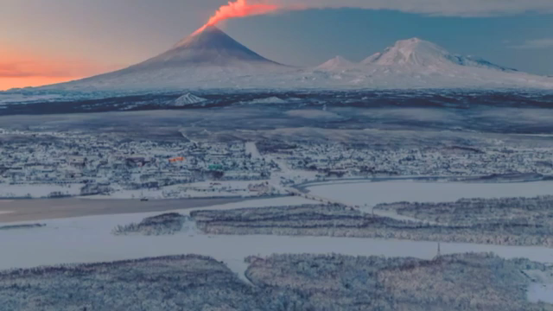

WARM-UP: CHATTING

Slide 33

LESSON 1: GETTING STARTED
WARM-UP
Chatting
Aims of the stage:
to create an active atmosphere in the class before the lesson
to introduce the topic

