Slide 1


Slide 2
WARM UP
hair
eye
cheek
words for body parts
nose
mouth
shoulder
arm
hand
foot
leg

Slide 3
WARM UP
blonde
curly
long
black
words to describe parts of the body
short
straight
small
slim
big
beautiful

Slide 4

UNIT 3: MY FRIENDS

Slide 5


UNIT 3: MY FRIENDS
LESSON 2
Vocabulary
Personality adjectives

Slide 6
Match the word with it’s meaning
active
Cẩn thận
Carefull
Tự tin
Picnic
năng động
Confident
Chuyến dã ngoại
Creative
Nhút nhát
Shy
Thông minh
Clever
Sáng tạo
funny
Vui nhộn
Caring
Làm việc chăm chỉ
hard-working
Quan tâm

Slide 7
Match the word with it’s meaning
active
năng động
Carefull
Cẩn thận
Picnic
Chuyến dã ngoại
Confident
Tự tin
Creative
Sáng tạo
Shy
Nhút nhát
Clever
Thông minh
funny
Vui nhộn
Caring
Quan tâm
hard-working
Làm việc chăm chỉ

Slide 8

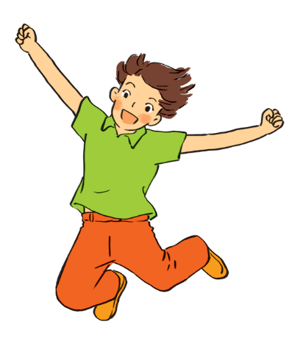
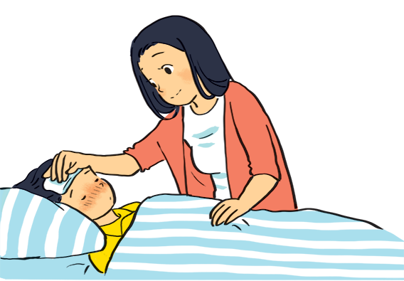
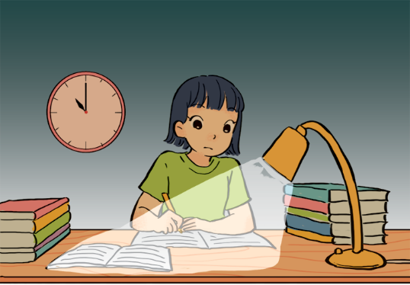
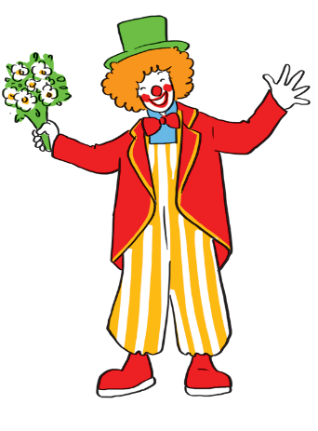
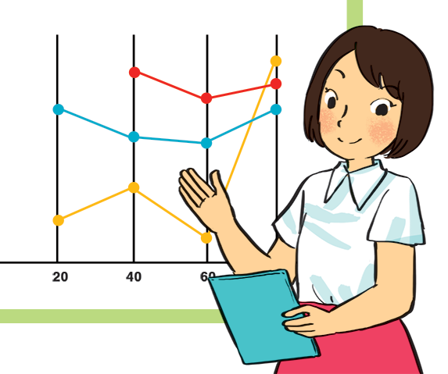
Match the adjectives to the pictures.
a
a
1. hard - working
b
b
2. confident
4. caring
3. funny
4. caring
4. caring
5. active
5. active
5. active
c
d
e
1. hard - working
3. funny
2. confident

Slide 9

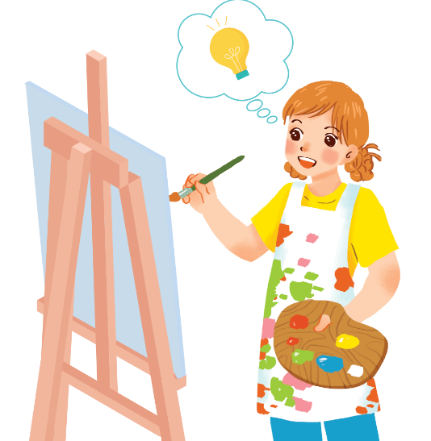
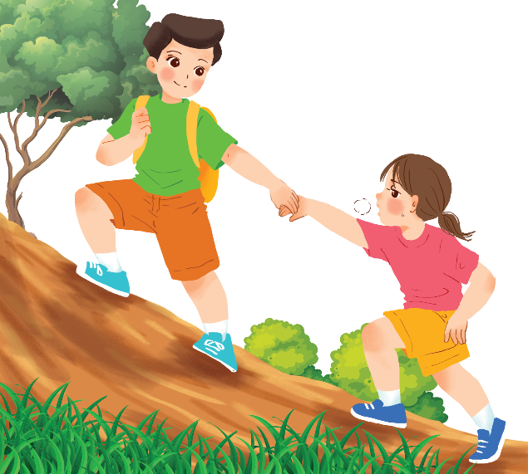
Use the adjectives in the box to complete the sentences.
Pay attention to the highlighted words / phrases.
carefull
clever
shy
kind
creative
friendly
1.
Mina is very . She likes drawing pictures. She always has lots of new ideas.
creative
Nam is .
He likes helping his friends.
2.
kind

Slide 10
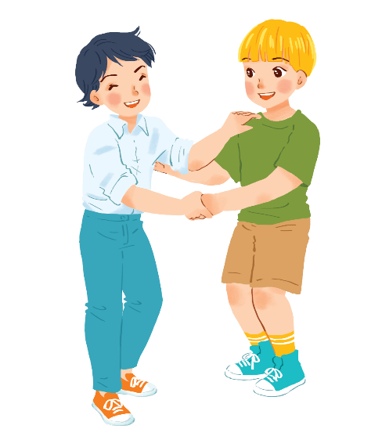
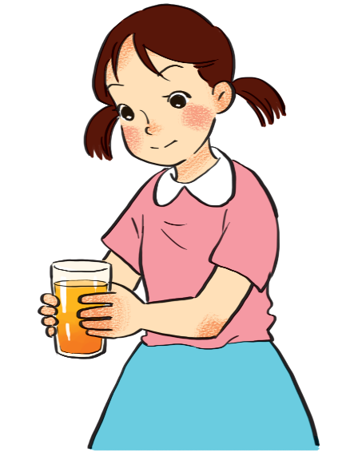
Use the adjectives in the box to complete the sentences.
Pay attention to the highlighted words / phrases.
carefull
clever
shy
kind
creative
friendly
Minh Duc is
He likes meeting new people.
3.
friendly.
.
Kim is very .
She pays attention to what she’s doing.
4.
carefull

Slide 11
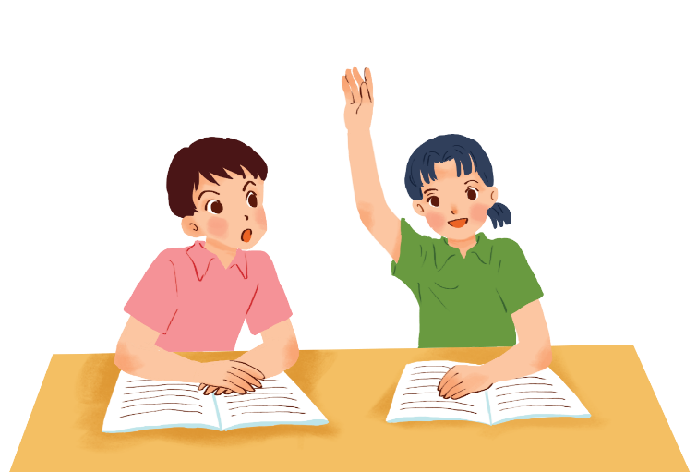
Use the adjectives in the box to complete the sentences.
Pay attention to the highlighted words / phrases.
carefull
clever
shy
kind
creative
friendly
5.
Mai is .
She learns things quickly and easily.
clever

Slide 12
Game: Why do I love my friends?
* Work in groups.
I love … because he/she is …, … and …
* Suggested answer:
1. I love Trang because she is kind, creative and funny.
2. I love Minh because he is smart, caring and friendly.
3. …

Slide 13



Friendship ﬂower.
Work in groups. Write two personality adjectives for each group member.
Minh: kind funny

Slide 14


* Pronunciation
/b/ and /p/
Listen and circle the words you hear. Then repeat.
 | /b/ | /p/
1. | big | pig
2. | bear | pear
3. | buy | pie
4. | robe | rope

Slide 15


Listen. Then practise the chant. Notice the rhyme.
We’re having a picnic
We’re having a picnic
Fun! Fun! Fun!
We’re bringing some biscuits
We’re bringing some biscuits
Yum! Yum! Yum!
We’re playing together
We’re playing together
Hurrah! Hurrah! Hurrah!

Slide 16
* CONSOLIDATION
Complete the table with the words in the box. Some words may belong to more than one column.
has |  | is
Describing parts of the body | Parts of the body | Describing the person
big | arms | big
arms big legs long shoulders small
hands eyes fast short cute strong sporty
weak smart feet ears tall hair head

Slide 17
Homework
-Learn by heart new words.
Do exercises in the workbook
Prepare: A closer look 2.

Slide 18
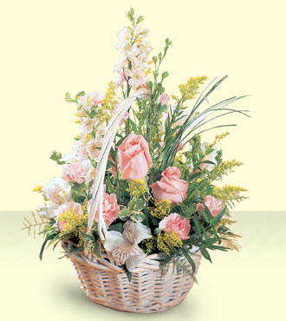
Thank you very much.

